Slide 1

FUNDAMENTALS OF PHYSICS
( 10th edition )- HALLIDAY & RESNICK

Slide 2

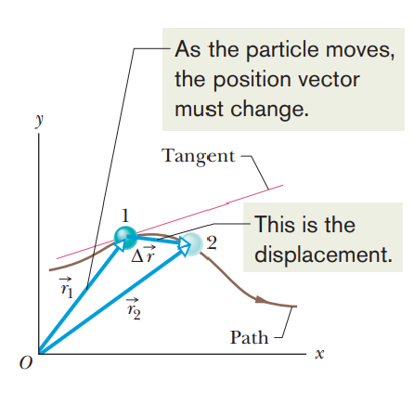






Slide 3
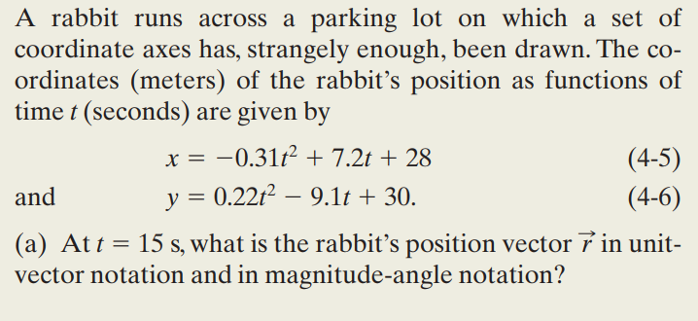


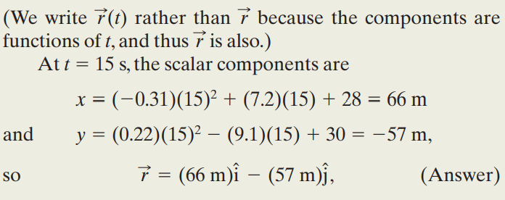
Example 1
The Answer

Slide 4
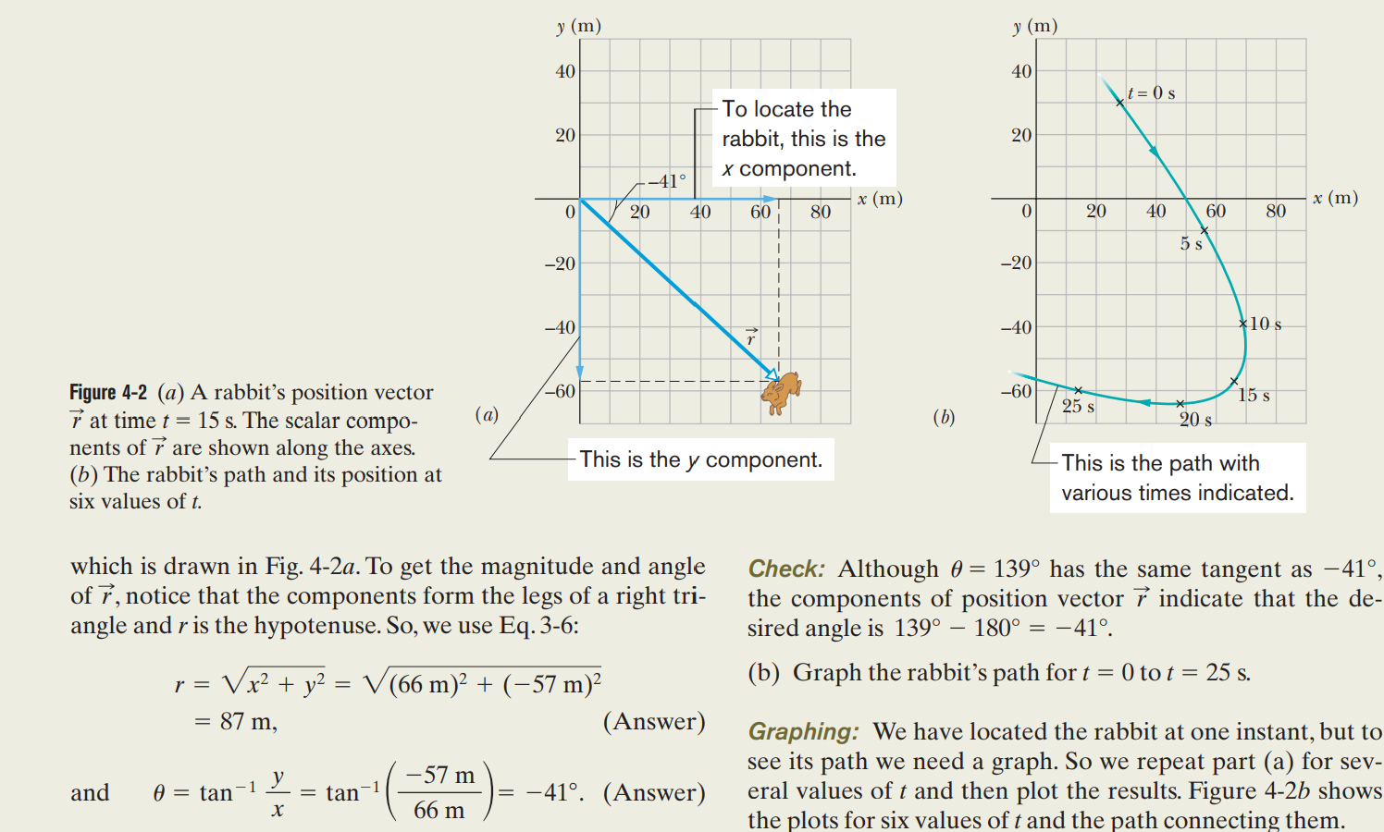

Slide 5
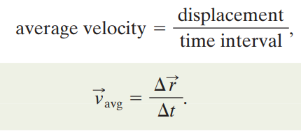


Example 2

Slide 6



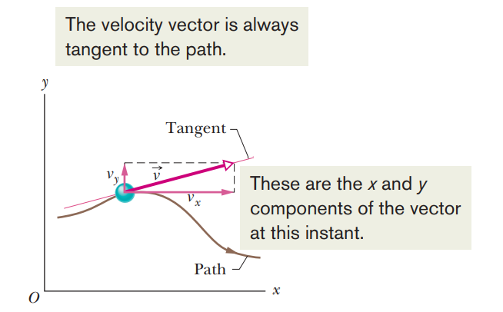

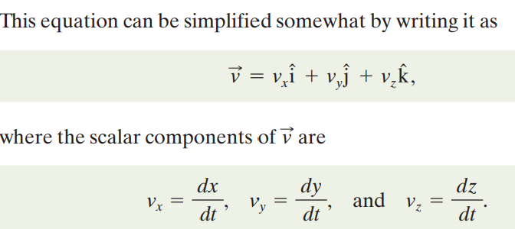

Slide 7
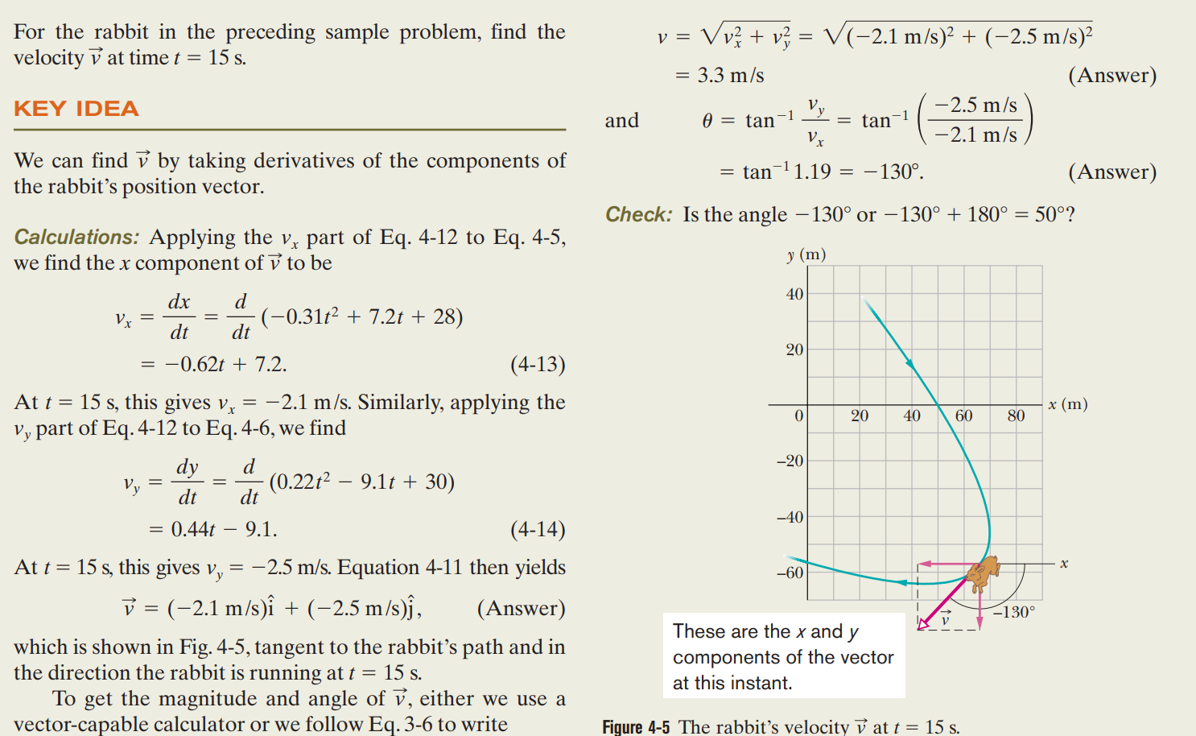
Example 3

Slide 8
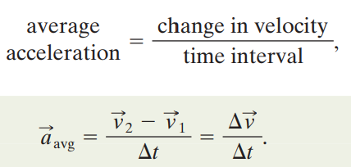
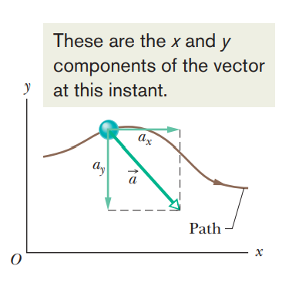
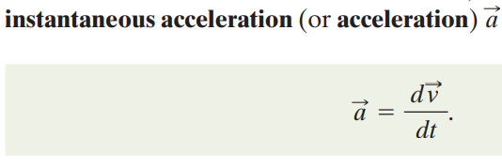
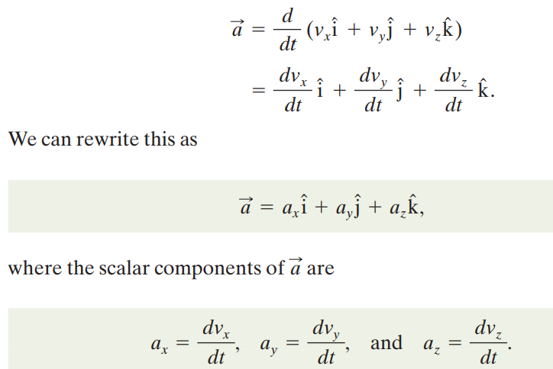


Slide 9

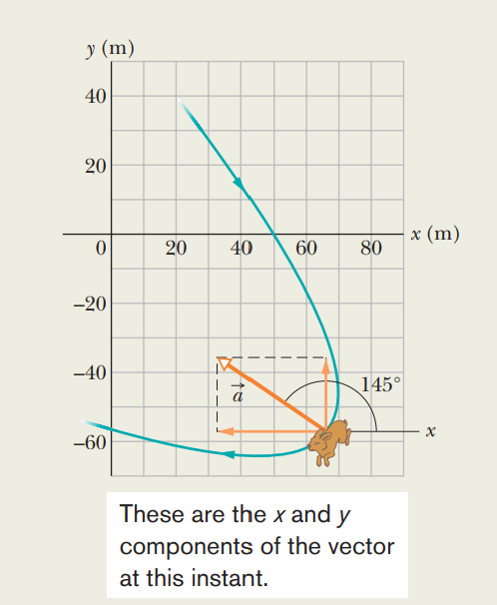





Example 4
The Answer

Slide 10

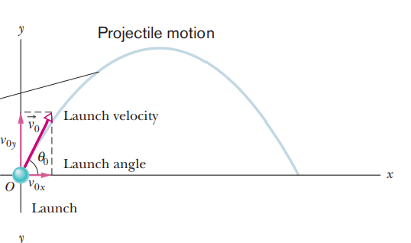
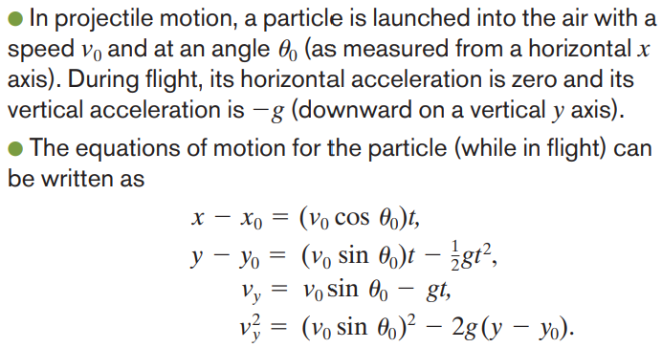
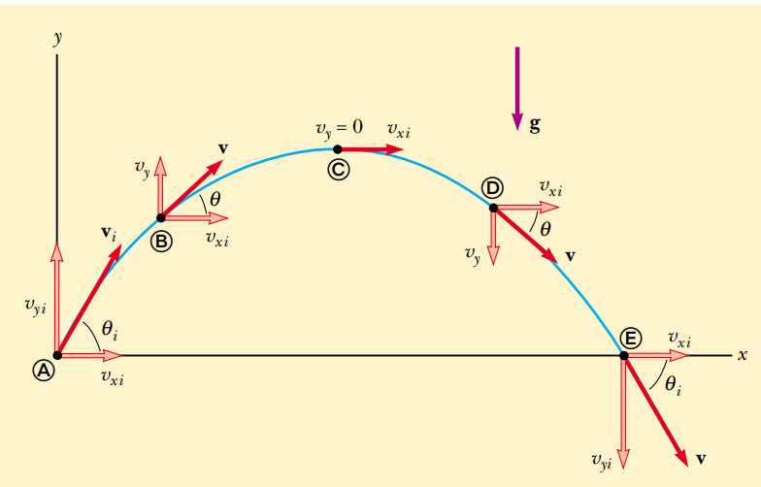

Slide 11

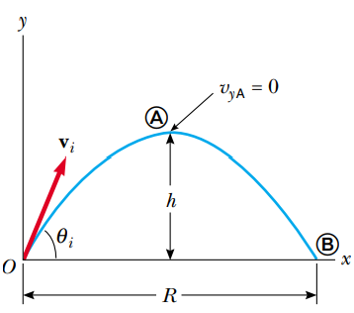



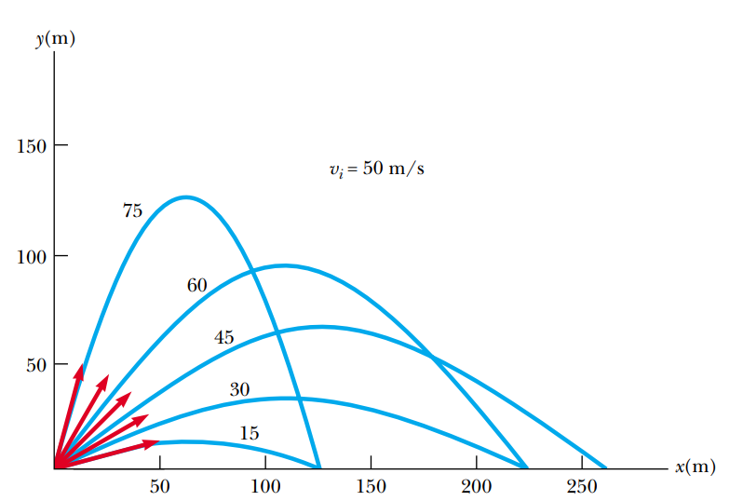
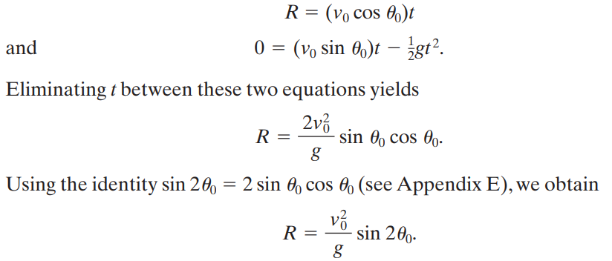
t between these two equations:
we obtain:

Slide 12

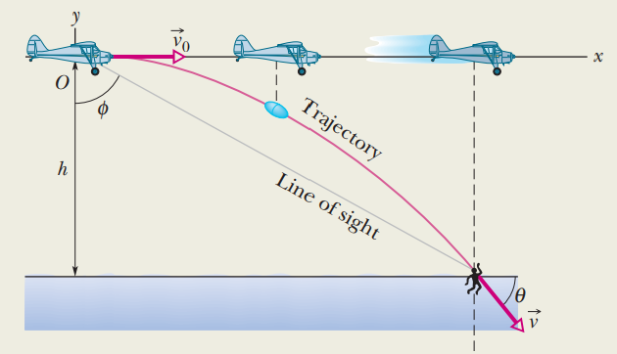
Example
The Answer

Slide 13
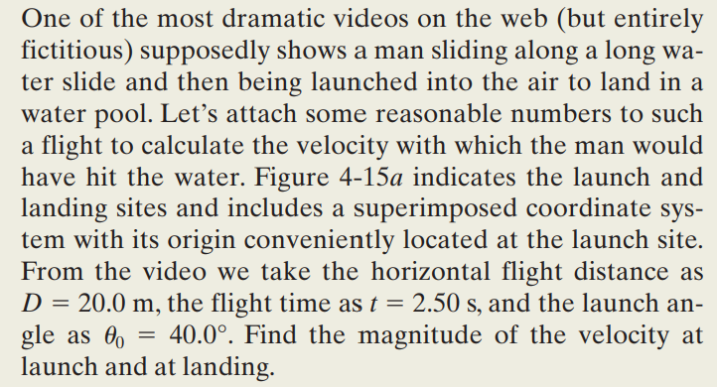
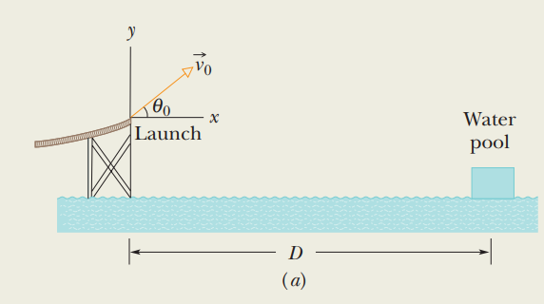
Example

Slide 14
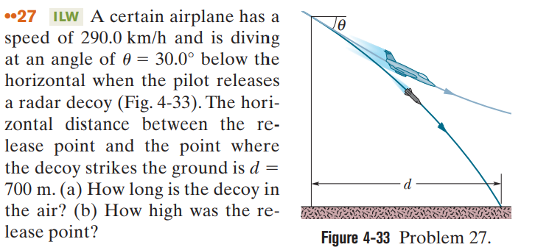
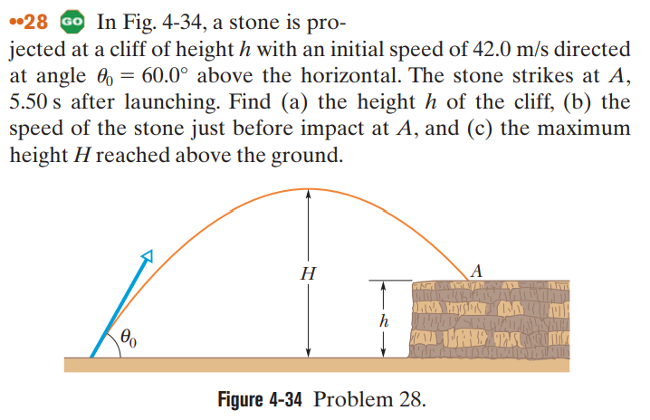

Slide 15
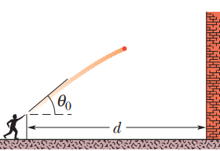
A ball was thrown toward a wall at speed 30 m/s and at angle 60.0° above the horizontal as shown in the figure1. The wall is distance d=22.0 m from the release point of the ball. (a) How far above the release point does the ball hit the wall? (b) What is the magnitude and the direction of its velocity as it hits the wall? (c) When it hits, has it passed the highest point on its trajectory? (d) find the maximum height reached above the ground.

Slide 16

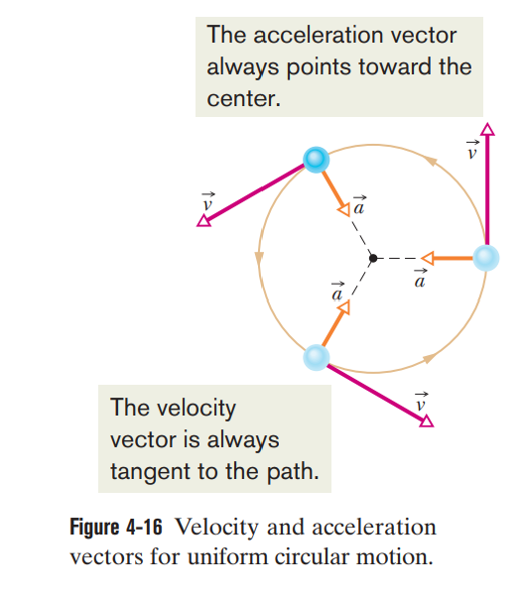



Slide 17

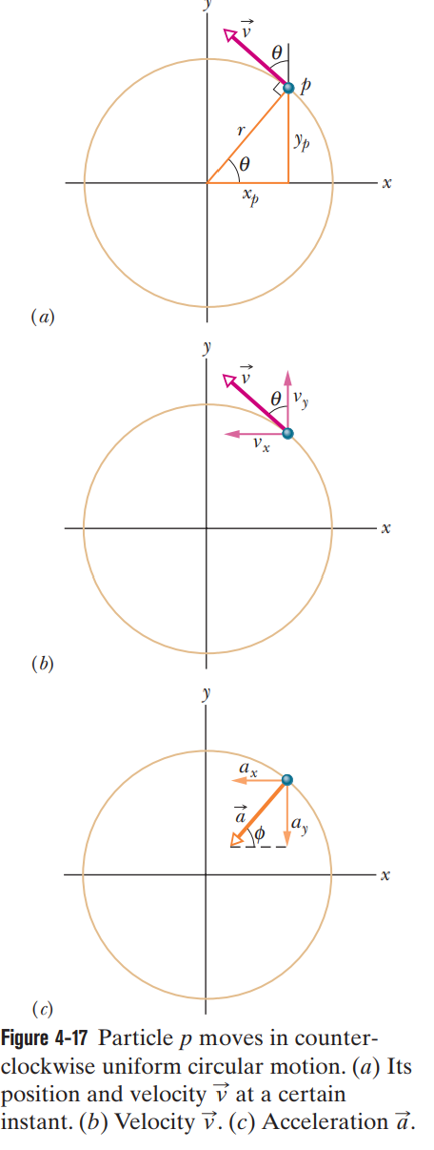
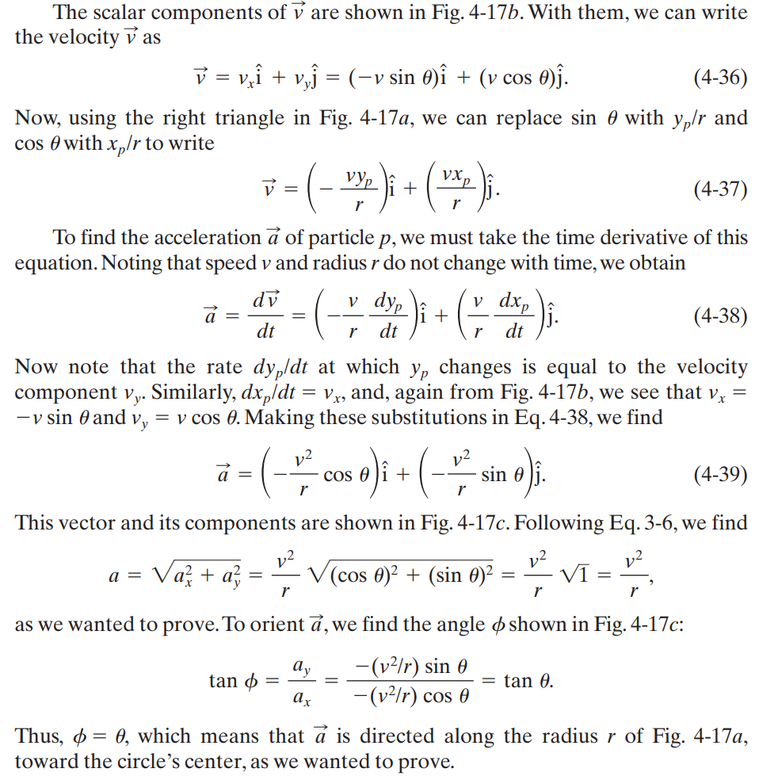

Slide 18


Example
The Answer

Slide 19

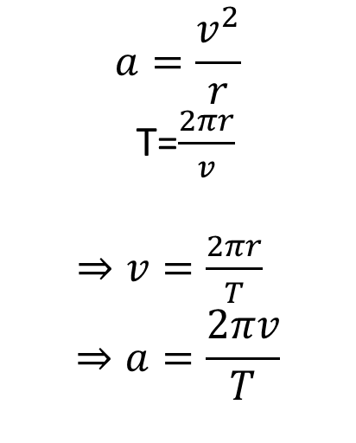
$$a=\frac{v^{2}}{r}$$
T=$\frac{2πr}{v}$
$⇒v=\frac{2πr}{T}$
$$⇒a=\frac{2πv}{T}$$

Slide 20

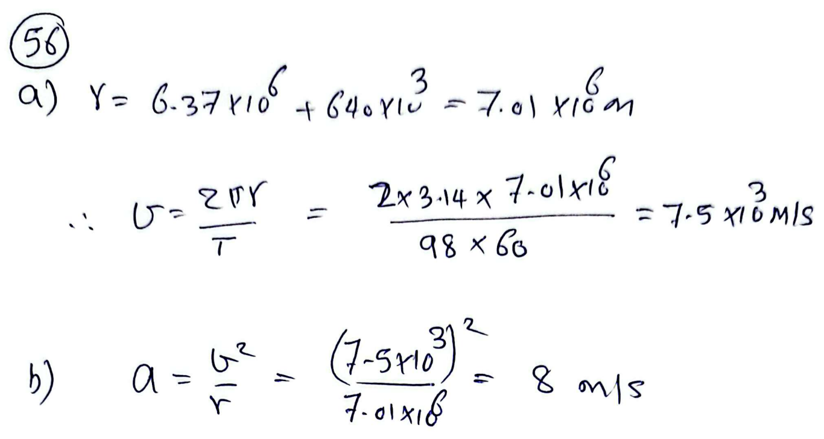

Slide 21


Slide 22
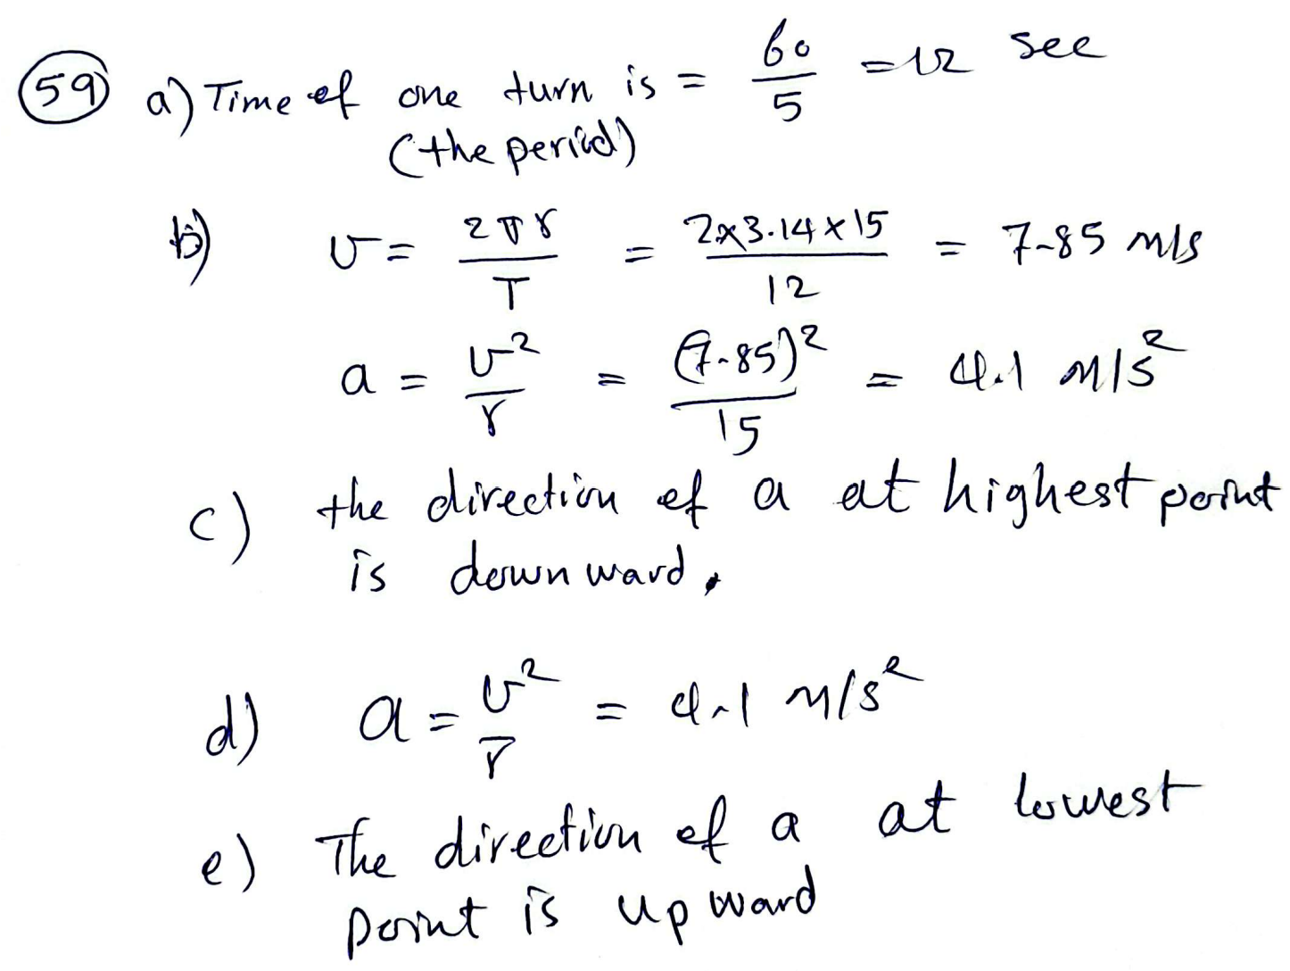

Slide 23



Slide 24
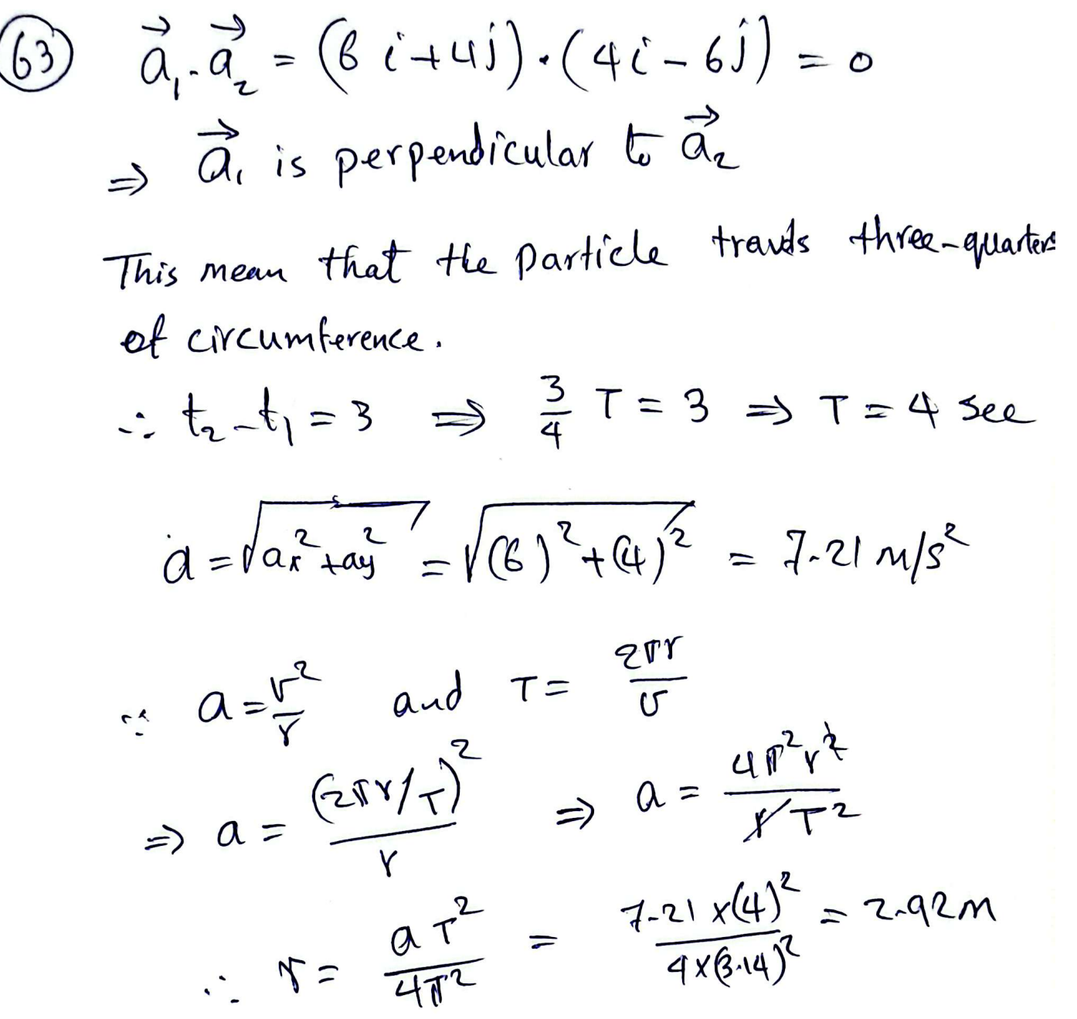

Slide 25

