Slide 1
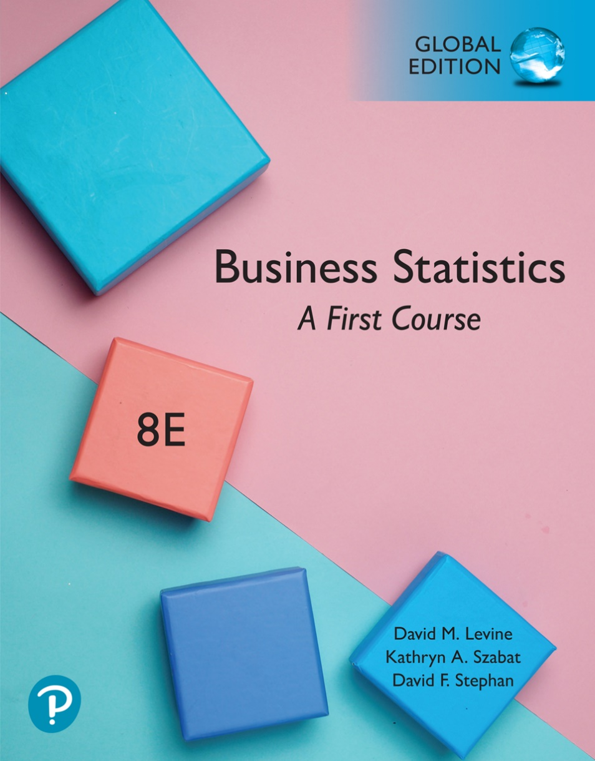
Chapter 4
Basic Probability

Slide 2
Objectives
The objectives for this chapter are:
To understand basic probability concepts.
To understand conditional probability.
Use Bayes’ theorem to revise probabilities.
Apply counting rules.

Slide 3
The Sample Space Is The Collection Of All Possible Outcomes Of A Variable
e.g. All 6 faces of a die:
e.g. All 52 cards of a bridge deck

Slide 4
Each Possible Outcome Of A Variable Is An Event
Simple event:
  An event described by a single characteristic.
  e.g., A day in January from all days in 2019.
Joint event:
  An event described by two or more characteristics.
  e.g. A day in January that is also a Wednesday from all days in 2019.
Complement of an event A (denoted A’):
  All events that are not part of event A.
  e.g., All days from 2019 that are not in January.

Slide 5
Basic Probability Concepts
Probability – the numerical value representing the chance, likelihood, or possibility that a certain event will occur (always between 0 and 1).
Impossible Event – an event that has no chance of occurring (probability = 0).
Certain Event – an event that is sure to occur (probability = 1).

Slide 6
Mutually Exclusive Events
Mutually exclusive events:
  Events that cannot occur simultaneously.
Example: Randomly choosing a day from 2019
  A = day in January; B = day in February
  Events A and B are mutually exclusive.

Slide 7
Collectively Exhaustive Events
Collectively exhaustive events:
  One of the events must occur.
  The set of events covers the entire sample space.
Example: Randomly choose a day from 2019.
A = Weekday; B = Weekend;
C = January; D = Spring;
  Events A, B, C and D are collectively exhaustive (but not mutually exclusive – a weekday can be in January or in Spring).
  Events A and B are collectively exhaustive and also mutually exclusive.

Slide 8
Three Approaches To Assessing Probability Of An Event
1. a priori -- based on prior knowledge of the process
2. empirical probability -- based on observed data
3. subjective probability
probability of occurrence
Assuming all outcomes are equally likely
probability of occurrence
based on a combination of an individual’s past experience, personal opinion, and analysis of a particular situation.

Slide 9
Example of a priori probability
When randomly selecting a day from the year 2019 what is the probability the day is in January?

Slide 10
Example of empirical probability
Find the probability of selecting a male taking statistics from the population described in the following table:
 | Taking Stats | Not Taking Stats | Total
Male | 84 | 145 | 229
Female | 76 | 134 | 210
Total | 160 | 279 | 439
Probability of male taking stats

Slide 11
Subjective Probability Differs From Person To Person
What is the probability a new ad campaign is successful?
  A media development team assigns a 60% probability of success to its new ad campaign.
  The chief media officer of the company is less optimistic and assigns a 40% of success to the same campaign.
The assignment of a subjective probability is based on a person’s experiences, opinions, and analysis of a particular situation.
Subjective probability is useful in situations when an empirical or a priori probability cannot be computed.

Slide 12
Summarizing Sample Spaces
Contingency Table -- M&R Survey Results.
Actually Purchased TV
Planned To Purchase TV Yes No Total
Yes 200 50 250
No 100 650 750
Total 300 700 1,000
Total Number
Of Sample
Space Outcomes.

Slide 13
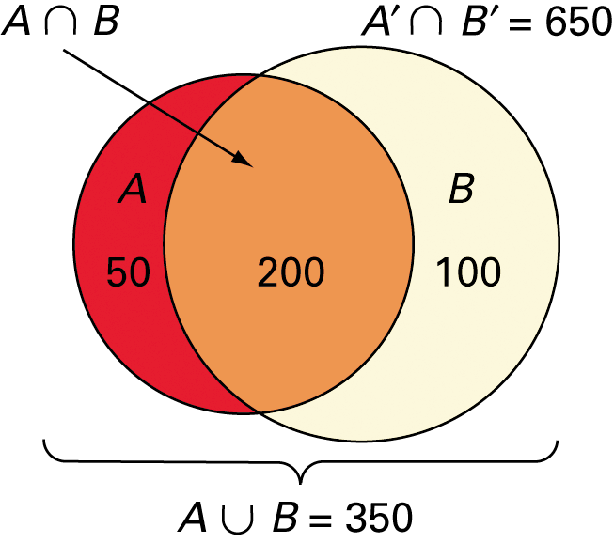
Summarizing Sample Spaces
Venn Diagram -- M&R Survey Results.
A = Planned to Purchase
A’ = Did not Plan To Purchase
B = Actually Purchased
B’ = Did not Purchase
Actually Purchased TV
Planned To Purchase TV Yes No Total
Yes 200 50 250
No 100 650 750
Total 300 700 1,000

Slide 14
Simple Probability: Definition & Computing
Simple Probability refers to the probability of a simple event.
  P(Planned to purchase)
  P(Actually purchased)
P(Purchase) = 250 / 1000
Actually Purchased TV
Planned To Purchase TV Yes No Total
Yes 200 50 250
No 100 650 750
Total 300 700 1,000
P(Actually Purchased) = 300 / 1000

Slide 15
Joint Probability: Definition & Computing
Joint Probability refers to the probability of an occurrence of two or more events (joint event).
  ex. P(Plan to Purchase and Purchase).
  ex. P(No Plan and Purchase).
P(Plan to Purchase and Purchase) = 200 / 1000
Actually Purchased TV
Planned To Purchase TV Yes No Total
Yes 200 50 250
No 100 650 750
Total 300 700 1,000
P(No Plan and Purchase) = 50 / 1000

Slide 16
Computing A Marginal Probability Via Joint Probabilities
Computing a marginal (or simple) probability:
    Where B₁, B₂, …, B_{k} are k mutually exclusive and collectively exhaustive events.
P(Planned) = P(Yes and Yes) + P(Yes and No) =
200 / 1000 + 50 / 1000 = 250 / 1000
Actually Purchased TV
Planned To Purchase TV Yes No Total
Yes 200 50 250
No 100 650 750
Total 300 700 1,000

Slide 17
Marginal & Joint Probabilities In A Contingency Table
Event
Event
B₁
B₂
Total
A₁
P(A₁ and B₁)
P(A₁ and B₂)
P(A₁)
A₂
P(A₂ and B₁)
P(A₂ and B₂)
P(A₂)
Total
P(B₁)
P(B₂)
1
Joint Probabilities
Marginal (Simple) Probabilities

Slide 18
Probability Summary So Far
Probability is the numerical measure of the likelihood that an event will occur.
The probability of any event must be between 0 and 1, inclusively.
The sum of the probabilities of all mutually exclusive and collectively exhaustive events is 1.
1
Certain
0 ≤ P(A) ≤ 1 For any event A
0.5
0
Impossible
If A, B, and C are mutually exclusive and collectively exhaustive

Slide 19
General Addition Rule
General Addition Rule:
P(A or B) = P(A) + P(B) - P(A and B)
If A and B are mutually exclusive, then
P(A and B) = 0, so the rule can be simplified:
P(A or B) = P(A) + P(B)
For mutually exclusive events A and B

Slide 20
General Addition Rule Example
P(Planned or Purchased) =
P(Planned) + P(Purchased) – P(Planned and Purchased) =
250 / 1,000 + 300 / 1,000 – 200 / 1,000 = 350 / 1,000
Actually Purchased TV
Planned To Purchase TV Yes No Total
Yes 200 50 250
No 100 650 750
Total 300 700 1,000

Slide 21
Computing Conditional Probabilities
A conditional probability is the probability of one event, given that another event has occurred:
The conditional probability of A given that B has occurred.
The conditional probability of B given that A has occurred.
Where P(A and B) = joint probability of A and B
P(A) = marginal or simple probability of A
P(B) = marginal or simple probability of B

Slide 22
Conditional Probability Example
P(Purchased | Planned) = P(Purchased and Planned) / P(Planned) =
(200 / 1000) / (250 / 1000) = 200 / 250
Actually Purchased TV
Planned To Purchase TV Yes No Total
Yes 200 50 250
No 100 650 750
Total 300 700 1,000
Since Planned is given we only need to consider the top row of the table.

Slide 23
Independent Events
Two events are independent if and only if:
Events A and B are independent when the probability of one event is not affected by the fact that the other event has occurred.

Slide 24
Are The Events Planned and Purchased Independent?
Does P(Purchased | Planned) = P(Purchased)?
P(Purchased | Planned) = 200 / 250 = 0.8.
P(Purchased) = 700 / 1000 = 0.7.
Since these two probabilities are not equal, these two events are dependent.
Actually Purchased TV
Planned To Purchase TV Yes No Total
Yes 200 50 250
No 100 650 750
Total 300 700 1,000

Slide 25
Multiplication Rules For Two Events
The General Multiplication Rule
Solving for P(A and B)
Note: If A and B are independent, then
and the multiplication rule simplifies to:

Slide 26
Marginal Probability Using The General Multiplication Rule
Marginal probability for event A:
  Where B₁, B₂, …, B_{k} are k mutually exclusive and collectively exhaustive events.
Let A = Planned, B₁ = Purchase, & B₂ = No Purchase
P(A) = P(A|B₁)P(B₁) + P(A|B₂)P(B₂) =
(200/300)(300/1000) + (50/700)(700/1000) = 0.25
Actually Purchased TV
Planned To Purchase TV Yes No Total
Yes 200 50 250
No 100 650 750
Total 300 700 1,000

Slide 27
Bayes’ Theorem
Bayes’ Theorem is used to revise previously calculated probabilities based on new information.
Developed by Thomas Bayes in the 18th Century.
It is an extension of conditional probability.

Slide 28
Bayes’ Theorem
where:
B_{i} = i^{th} event of k mutually exclusive and collectively
exhaustive events
A = new event that might impact P(B_{i})

Slide 29
Bayes’ Theorem Example
A drilling company has estimated a 40% chance of striking oil for their new well.
A detailed test has been scheduled for more information. Historically, 60% of successful wells have had detailed tests, and 20% of unsuccessful wells have had detailed tests.
Given that this well has been scheduled for a detailed test, what is the probability
that the well will be successful?

Slide 30
Bayes’ Theorem Example
(continued)
Let S = successful well
U = unsuccessful well
P(S) = 0.4 , P(U) = 0.6 (prior probabilities)
Define the detailed test event as D
Conditional probabilities:
    P(D|S) = 0.6 P(D|U) = 0.2
Goal is to find P(S|D)

Slide 31
Bayes’ Theorem Example
(continued)
Apply Bayes’ Theorem:
So the revised probability of success, given that this well has been scheduled for a detailed test, is 0.667

Slide 32
Bayes’ Theorem Example
(continued)
Given the detailed test, the revised probability of a successful well has risen to 0.667 from the original estimate of 0.4
Event | Prior Prob. | Conditional Prob. | Joint Prob. | Revised Prob.
S (successful) | 0.4 | 0.6 | (0.4)(0.6) = 0.24 | 0.24/0.36 = 0.667
U (unsuccessful) | 0.6 | 0.2 | (0.6)(0.2) = 0.12 | 0.12/0.36 = 0.333
Sum = 0.36

Slide 33
Counting Rules Are Often Useful In Computing Probabilities
In many cases, there are a large number of possible outcomes.
Counting rules can be used in these cases to help compute probabilities.

Slide 34
Counting Rules
Rules for counting the number of possible outcomes
Counting Rule 1:
  If any one of k different mutually exclusive and collectively exhaustive events can occur on each of n trials, the number of possible outcomes is equal to
  Example
    If you roll a fair die 3 times then there are 6³ = 216 possible outcomes
k^{n}

Slide 35
Counting Rules
(continued)
Counting Rule 2:
  If there are k₁ events on the first trial, k₂ events on the second trial, … and k_{n} events on the n^{th} trial, the number of possible outcomes is
  Example:
    You want to go to a park, eat at a restaurant, and see a movie. There are 3 parks, 4 restaurants, and 6 movie choices. How many different possible combinations are there?
    Answer: (3)(4)(6) = 72 different possibilities
(k₁)(k₂)…(k_{n})

Slide 36
Counting Rules
(continued)
Counting Rule 3:
  The number of ways that n items can be arranged in order is
  Example:
    You have five books to put on a bookshelf. How many different ways can these books be placed on the shelf?
    Answer: 5! = (5)(4)(3)(2)(1) = 120 different possibilities.
n! = (n)(n – 1)…(1)

Slide 37
Counting Rules
(continued)
Counting Rule 4:
  Permutations: The number of ways of arranging X objects selected from n objects in order is
  Example:
    You have five books and are going to put three on a bookshelf. How many different ways can the books be ordered on the bookshelf?
    Answer: different possibilities.

Slide 38
Counting Rules
(continued)
Counting Rule 5:
  Combinations: The number of ways of selecting X objects from n objects, irrespective of order, is
  Example:
    You have five books and are going to select three are to read. How many different combinations are there, ignoring the order in which they are selected?
    Answer: different possibilities

Slide 39
Chapter Summary
In this chapter we covered:
Using basic probability concepts.
Using conditional probability.
Using Bayes’ theorem to revise probabilities.
Using counting rules.

