Slide 1
Chapter 4-c
FUNDAMENTALS OF PHYSICS ( 10th edition )- HALLIDAY & RESNICK

Slide 2
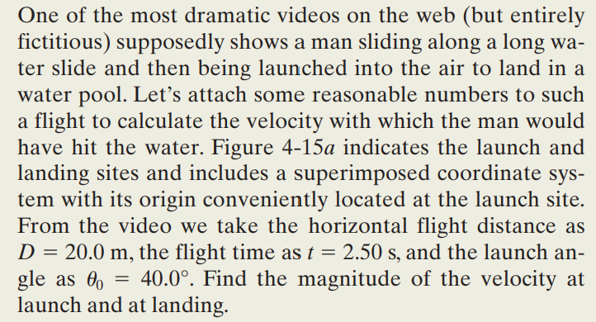
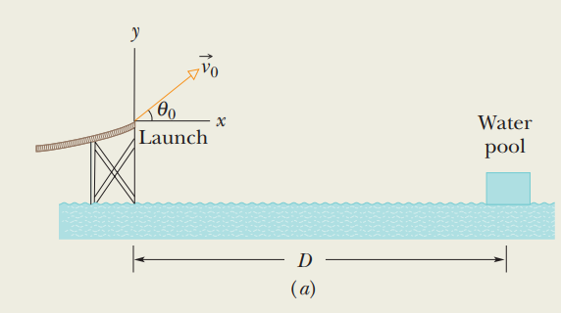
Example

Slide 3
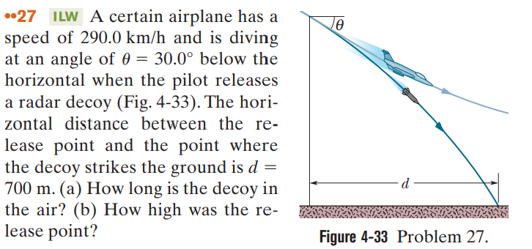
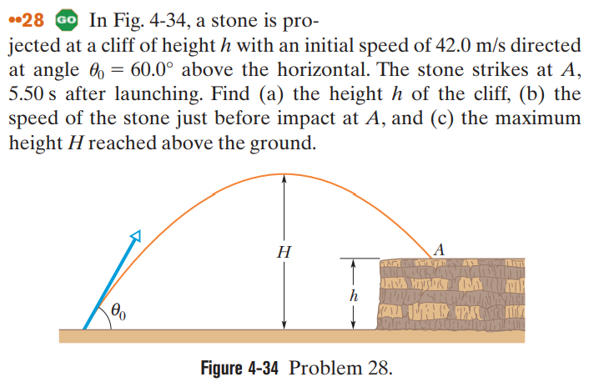

Slide 4
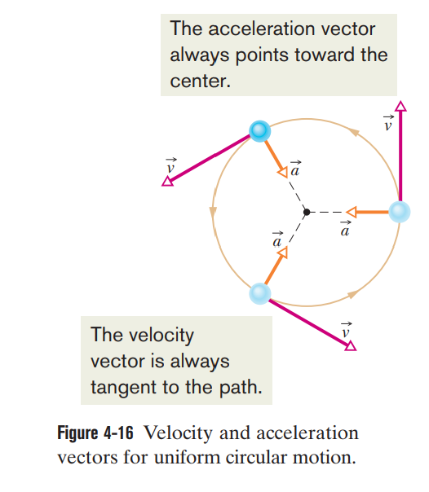

Slide 5
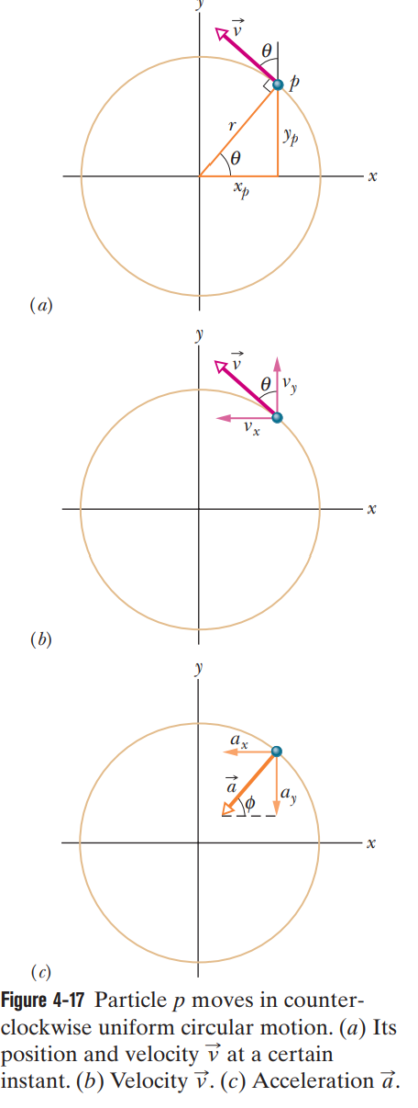
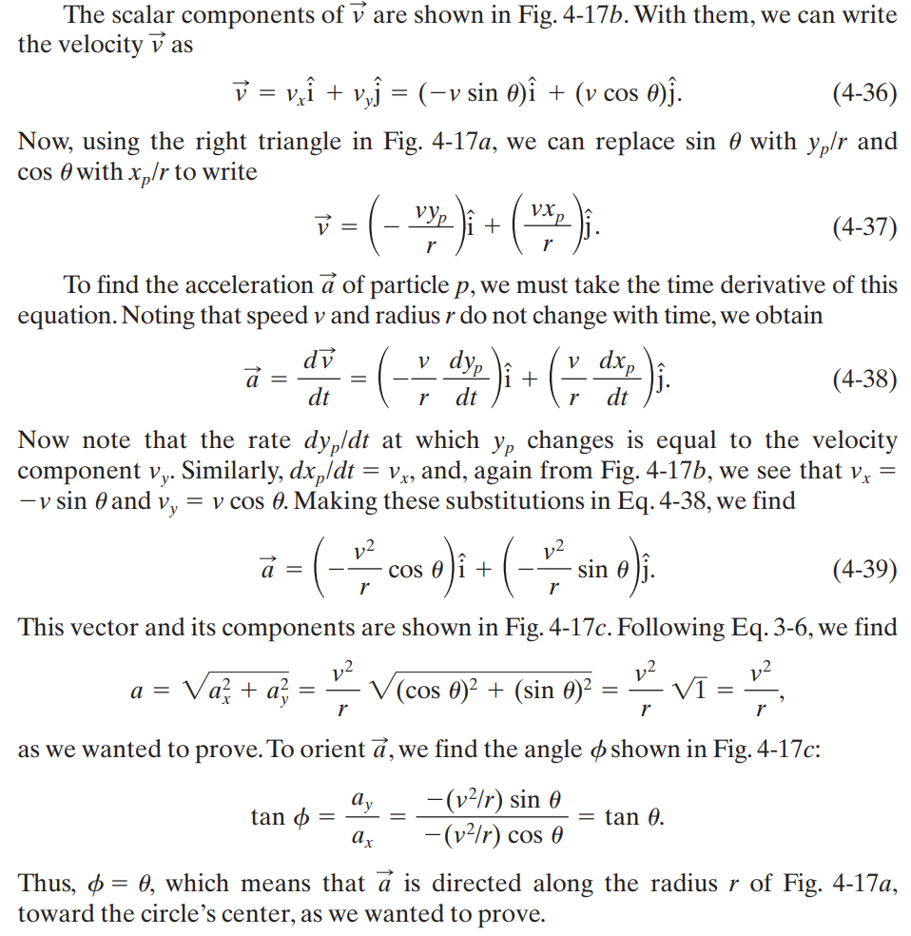

Slide 6
Example
The Answer

Slide 7
$$a=\frac{v^{2}}{r}$$
T=$\frac{2πr}{v}$
$⇒v=\frac{2πr}{T}$
$$⇒a=\frac{2πv}{T}$$

