Slide 1
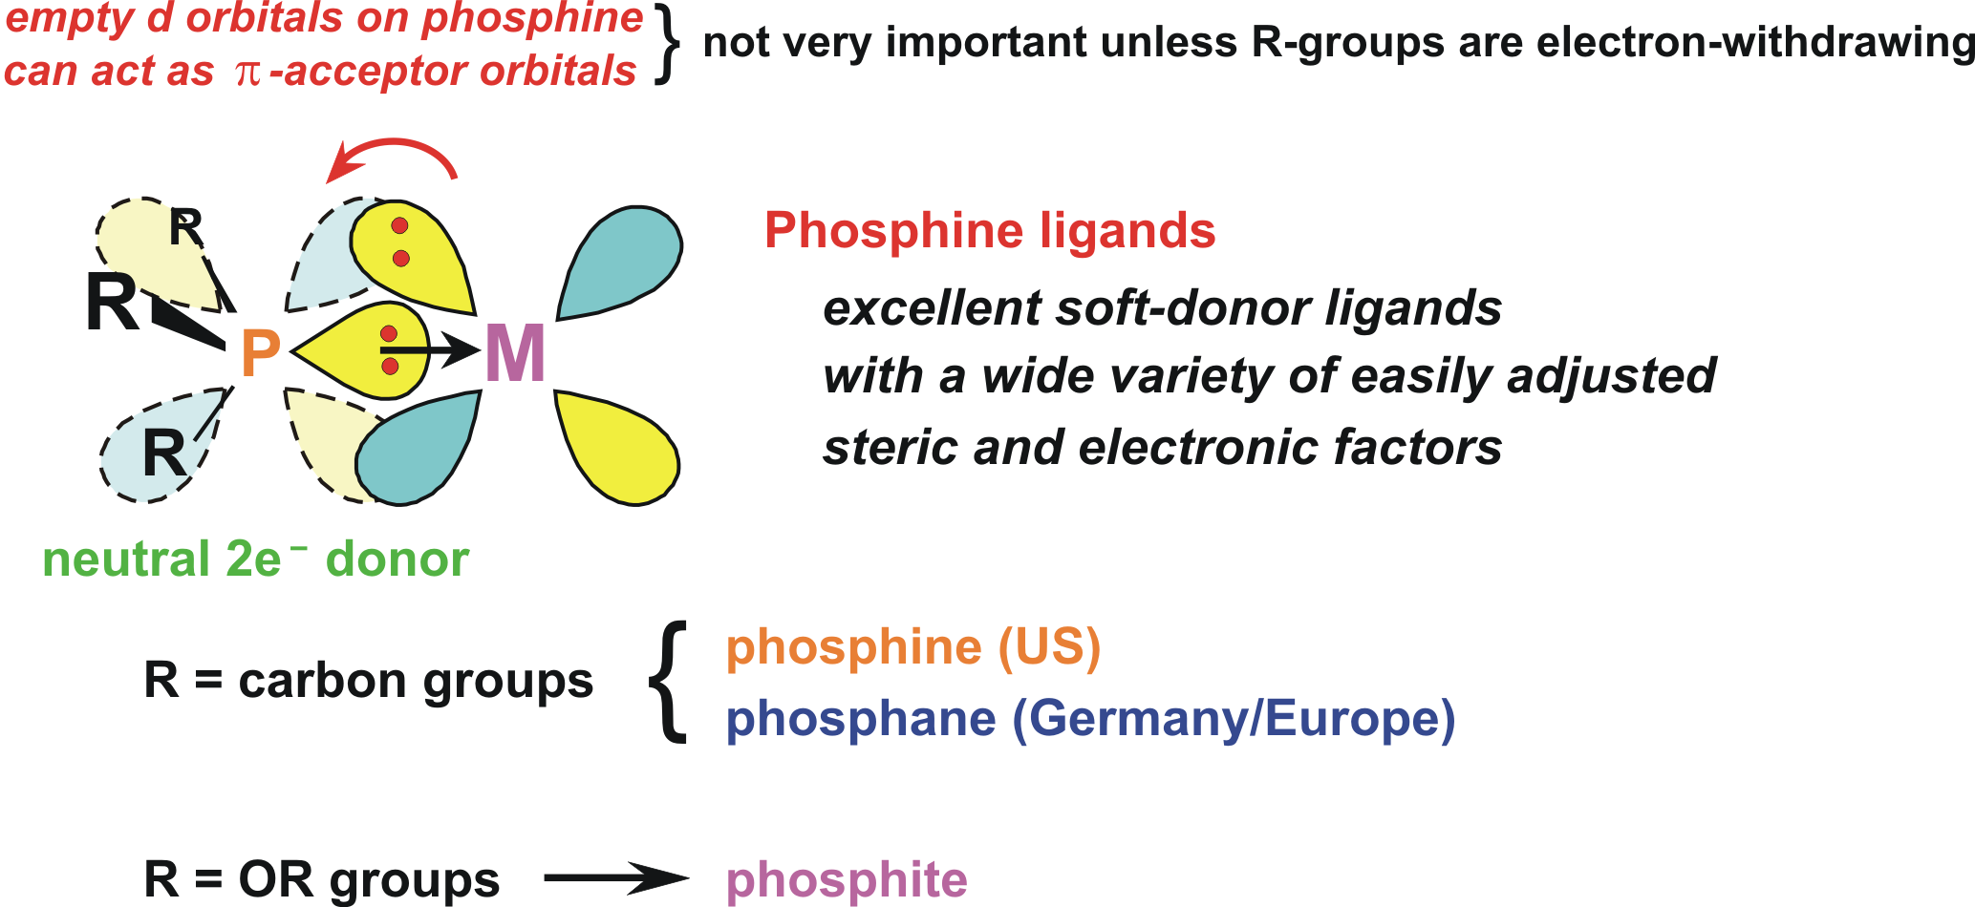
Phosphine Ligands – PR₃

Slide 2
large changes in the donor/acceptor properties of the phosphine (from excellent donor/poor π-acceptor to poor donor/excellent π-acceptor)
large changes in the steric profile of the phosphine (from fairly small to enormous)
generation of a large number of polydentate polyphosphines (bis-, tris-, tetra-, penta-, and hexaphosphine ligands are all known) that can adopt specific coordination geometries (cis-enforcing, facial tridentate, bridging, bridging and chelating, etc.)

Slide 3
Tolman’s Cone Angle and Electronic Parameter
The electron-donating ability of a phosphine ligand was determined by measuring the ν_{CO} of a Ni(CO)₃(PR₃) complex:
The size or steric bulk of a phosphine ligand was determined from simple 3-D space-filling models of the phosphine ligand coordinated to a Ni atom:

Slide 4
Tolman’s Electronic Parameter ν (most donating to least)
PR₃ |  | mixed | P(OR)₃ |  | PX₃ | ν, cm⁻¹
P(t-Bu)₃ |  |  |  |  |  | 2056.1
PCy₃ |  |  |  |  |  | 2056.4
P(o-OMe-C₆H₄)₃ |  |  |  |  |  | 2058.3
P(i-Pr)₃ |  |  |  |  |  | 2059.2
PBu₃ |  |  |  |  |  | 2060.3
PEt₃ |  |  |  |  |  | 2061.7
 |  | PEt₂Ph |  |  |  | 2063.7
PMe₃ |  |  |  |  |  | 2064.1
 |  | PMe₂Ph |  |  |  | 2065.3
P(p-OMe-C₆H₄)₃ |  | PPh₂(o-OMe-C₆H₄) |  |  |  | 2066.1
PBz₃ |  |  |  |  |  | 2066.4
P(o-Tol)₃ |  |  |  |  |  | 2066.6
P(p-Tol)₃ |  | PEtPh₂ |  |  |  | 2066.7
 |  | PMePh₂ |  |  |  | 2067.0
P(m-Tol)₃ |  |  |  |  |  | 2067.2
 |  | PPh₂(NMe₂) |  |  |  | 2067.3
 | PPh₂(2,4,6-Me-C₆H₂) |  |  |  |  | 2067.4
 |  | PPhBz₂ |  |  |  | 2067.6
 |  | PPh₂(p-OMe-C₆H₄) |  |  |  | 2068.2
 |  | PPh₂Bz |  |  |  | 2068.4
PPh₃ |  |  |  |  |  | 2068.9

Slide 5
P(CH=CH₂)₃ | PPh₂(p-F-C₆H₄) |  |  |  |  | 2069.5
 | PPh(p-F-C₆H₄)₂ |  |  |  |  | 2070.0
P(p-F-C₆H₄)₃ |  |  |  |  |  | 2071.3
 | PPh₂(OEt) |  |  |  |  | 2071.6
 | PPh(O-i-Pr)₂ |  |  |  |  | 2072.2
P(p-Cl-C₆H₄)₃ |  |  |  |  |  | 2072.8
 | PPh₂H |  |  |  |  | 2073.3
 | PPh(OBu)₂ |  |  |  |  | 2073.4
P(m-F-C₆H₄)₃ |  |  |  |  |  | 2074.1
 | PPh(OEt)₂ |  |  |  |  | 2074.2
 | PPh₂(C₆F₅) |  |  |  |  | 2074.8
 |  |  | P(O-i-Pr)₃ |  |  | 2075.9
 |  |  | P(OEt)₃ |  |  | 2076.3
 | PPhH₂ |  |  |  |  | 2077.0
 |  |  | P(OMe)₃ |  |  | 2079.5
 | PPh(OPh)₂ |  |  |  |  | 2079.8
 |  |  | PPh₂Cl |  |  | 2080.7
 |  |  | PMe₂CF₃ |  |  | 2080.9
 |  | P(O-2,4-Me-C₆H₃)₃ |  |  | PH₃ | 2083.2
 |  |  | P(OPh)₃ |  |  | 2085.3
 |  |  | P(OCH₂)₃CR |  |  | 2086.8
 | P(C₆F₅)₃ |  |  |  |  | 2090.9
 |  |  |  | PCl₃ |  | 2097.0
 |  |  |  | PF₃ |  | 2110.8

Slide 6
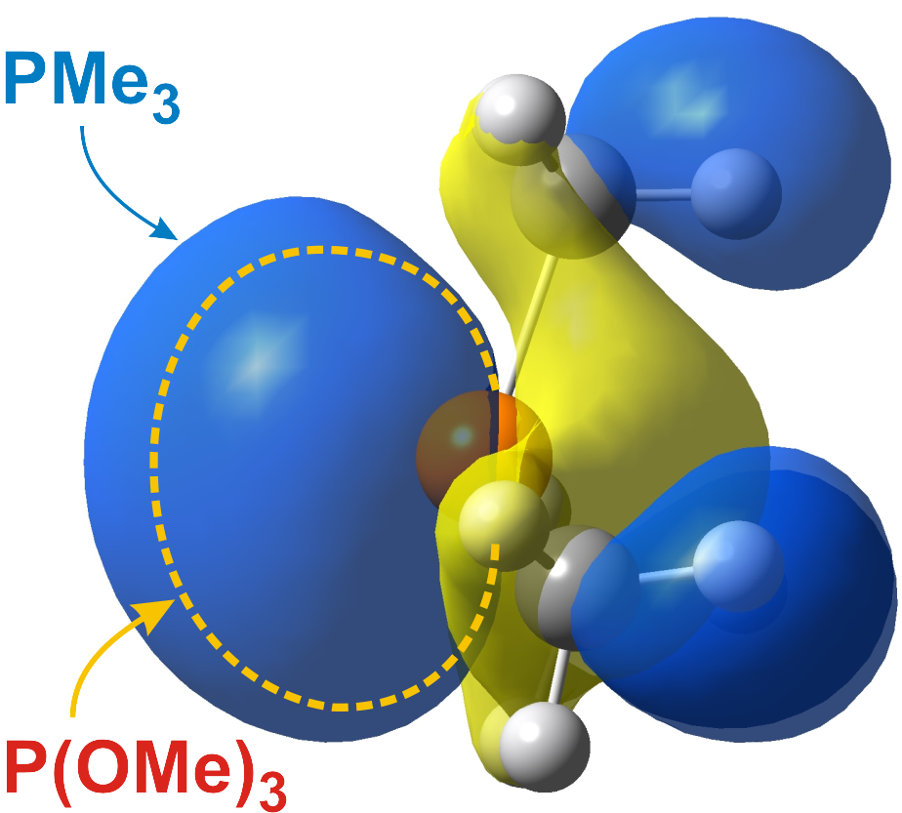
PMe₃ vs. P(OMe)₃: The methyl groups are considered to be electron donating making the P center more electron-rich. The methoxy groups are σ electron-withdrawing due to the electronegative oxygen atoms, making the P center more electron deficient. The results from Density Functional Theory (DFT) calculations on both are shown below. Note the higher energy of the P lone pair (highest occupied molecular orbital, HOMO), greater spatial extent (generally better overlap with metal d-orbitals), and lower positive charge on P for PMe₃ relative to P(OMe)₃.
PMe₃
HOMO = −5.03 eV
Charge on P = +0.22
P(OMe)₃
HOMO = −7.40 eV
Charge on P = +0.75
MO plot of the lone pair orbital (HOMO) for PMe₃. Dashed outline indicates the spatial extent of the lone pair for P(OMe)₃.

Slide 7
Problem: Order the following phosphines from strongest to weakest σ donor:
P(OEt)₃ | PPh₃ | PPr₃ | PCl₃ | PPh(OMe)₂

Slide 8
Tolman’s Cone Angle θ (smallest to largest)
PR₃ |  | mixed | P(OR)₃ | PX₃ | θ (°)
 |  |  |  | PH₃ | 87
 |  | PPhH₂ | P(OCH₂)₃CR |  | 101
 |  |  |  | PF₃ | 104
 | Me₂PCH₂CH₂PMe₂ |  | P(OMe)₃ |  | 107
 |  |  | P(OEt)₃ |  | 109
 |  | P(CH₂O)₃CR |  |  | 114
 |  | Et₂PCH2CH2PEt₂ |  |  | 115
PMe₃ |  |  |  |  | 118
 |  | Ph₂PCH₂PPh₂ |  |  | 121
 |  |  | PMe₂CF₃ | PCl₃ | 124
 |  | Ph₂PCH₂CH₂PPh₂ |  |  | 125
 |  | PPh₂H | P(OPh)₃ |  | 128
 |  |  |  | PBr₃ | 131
PEt₃, PPr₃, PBu₃ |  | PPh2(OMe) |  |  | 132
 |  | PEt₂Ph, PMePh₂ |  |  | 136
 |  | Cy₂PCH₂CH₂PCy₂ |  |  | 142
PPh₃ |  |  |  |  | 145

Slide 9
 | PPh₂(t-Bu) |  |  | 157
 | PPh₂(C₆F₅) |  |  | 158
P(i-Pr)₃ |  |  |  | 160
PBz₃ |  |  |  | 165
PCy₃ | PPh(t-Bu)₂ |  |  | 170
 |  | P(O-t-Bu)₃ |  | 175
P(t-Bu)₃ |  |  |  | 182
 | P(C₆F₅)₃ |  |  | 184
P(o-Tol)₃ |  |  |  | 194
P(mesityl)₃ |  |  |  | 212
Problem: Order the following phosphines from smallest to largest:
Problem: Order the following phosphines from best to worst π-acceptor:
P(OEt)₃ | PPh₃ | PPr₃ | PCl₃ | PPhCy₂
P(OEt)₃ | PPh₃ | PPr₃ | PCl₃ | PPhCy₂

Slide 10
Commonly Used Monodentate Phosphines
PPh₃ (145°, medium donor), triphenylphosphine, tpp “The KING”
air-stable, white crystalline material, no odor to speak of
Increasing σ-Donor Ability:
PMePh₂ (136°), PMe₂Ph (122°), PMe₃ (118°), PEt₃ (132°)
P(Cy)₃ (170°) tricyclohexylphosphine, P(t-Bu)₃ (182°)
the alkyl phosphines are strong σ-donors; low MW ones usually colorless liquids, somewhat to very air-sensitive, horrible smelling (unless very high MW and non-volatile)
Poor σ-Donors, Good π-Acceptors:
Phosphites: P(OMe)₃ (107°), P(OEt)₃ (110°), P(OPh)₃ (128°)
phosphites are relatively poor σ-donors, but can be fairly good π-acceptor ligands (about half as good as CO); low MW ones are usually colorless liquids, higher MW compounds are white solids; usually air-stable but moisture sensitive; sometimes sweet smelling
PF₃ (104°) } v. poor donor; strong π-acceptor, almost as good as CO

Slide 11
Commonly Used Polydentate Phosphines

Slide 12
Some Other Polydentate Phosphines

Slide 14
Some Structural Information
Phosphines have only been characterized as simple 2 e− donating, terminal-only ligands. No true μ-bridging monophosphines are known (although bridging phosphides, PR₂⁻, are very common).
Phosphines generally tend to orient trans to one another in order to minimize steric interactions (especially true for bulky PR₃). Chelating bisphosphine ligands are used to enforce cisoidal coordination geometries when needed.
Some typical first row M-PR₃ average bond distances:
Ti-P | 2.6 Å
V-P | 2.5 Å
Cr-P | 2.4 Å
Ni-P | 2.1 Å
M-P bonds are the strongest for alkylated phosphine ligands bonding to a neutral or monocationic middle to later transition metal center that is electron-deficient. High oxidation state early transition metals are too “hard” to have very effective bonding to most phosphines, although more and more early transition metal phosphine complexes are being characterized and found to be reasonably stable.

Slide 15
Metal centers that are too electron-rich will generally not want to have a strong electron-donating alkylated phosphine coordinated, this leads to weaker M-P bonding and more likely phosphine dissociation.
The asymmetric dimer can be considered to be zwitterionic: one cationic Rh(+1) center that has 3 phosphines coordinated and an anionic Rh(-1) pseudo-tetrahedral center that has 3 π-accepting CO ligands.

Slide 16
Bond Length vs. Bond Strength

Slide 17
PCl₃
PMe₃
HOMO energy = −8.36 eV −6.23 eV

Slide 18
ΔΔE Bond dissociation = (ΔE(bonded-unbonded)PMe₃) - (ΔE(bonded-unbonded)PCl₃)
ΔΔE Bond dissociation = 6.8 Kcals (PMe₃ system having stronger bonding)

Slide 19
Further Test: Examine PCl₃ vs. PMe₃ bonding to a d⁰ metal center: TiCl₄(PCl₃) and TiCl₄(PMe₃).
In this d⁰ system the lack of any π-backbonding and good Ti-Cl bonding favored complete dissociation of the poor σ donating PCl₃ ligand. The far better PMe₃ σ-donor, on the other hand, bonds nicely to the Ti(+4) d⁰ center.
4.63 Å
2.18 Å
2.69 Å
2.24 Å

Slide 20
Problem: For each of the following pairs of metal complexes, which should have the highest average carbonyl IR stretching frequency.
CpFeBr(CO)₂ -or- CpRuCl(CO)(PMe₃)
MnCl(CO)₅ -or- Cr(CO)₆
(η³-allyl)Co(PPh₃)(CO)₂ -or- (η³-allyl)Co(PMe₃)(CO)₂
[Rh(CO)₂(P(OPh)₃)₂]⁺ -or- Rh(CH₃)₃(CO)(dmpe)
Mo(CO)₄(PMe₃)₂ -or- W(CO)₄{P(OMe)₃}₂
f) CpRe(CO)₂{P(OMe)₃} -or- Hf(O)Cl₂(CO)(PEt₃)₂

Slide 21
³¹P NMR Spectroscopy
Ligand | Chemical Shift (ppm) | Ligand | Chemical Shift (ppm)
PCl₃ | 220 | H3PO4 | 0 (reference)
PMeCl₂ | 191 | P(CF₃)₃ | -2
PCy(OBu)₂ | 184 | PPh₃ | -6
P(OMe)₃ | 140 | PEt₃ | -20
P(OPh)₃ | 126 | NaPPh₂ | -24
PEt₂Cl | 119 | PMePh₂ | -28
PPh₂(OMe) | 115 | PPr₃ | -33
PF₃ | 97 | PMe₂Et | -50
PMe₂Cl | 96 | PMe₃ | -62
PMe₂(O-t-Bu) | 91 | P(CN)₃ | -135
O=P(CH₂OH)₃ | 45 | PH₃ | -238
O=PMe₃ | 36 | KPH₂ | -255

Slide 22
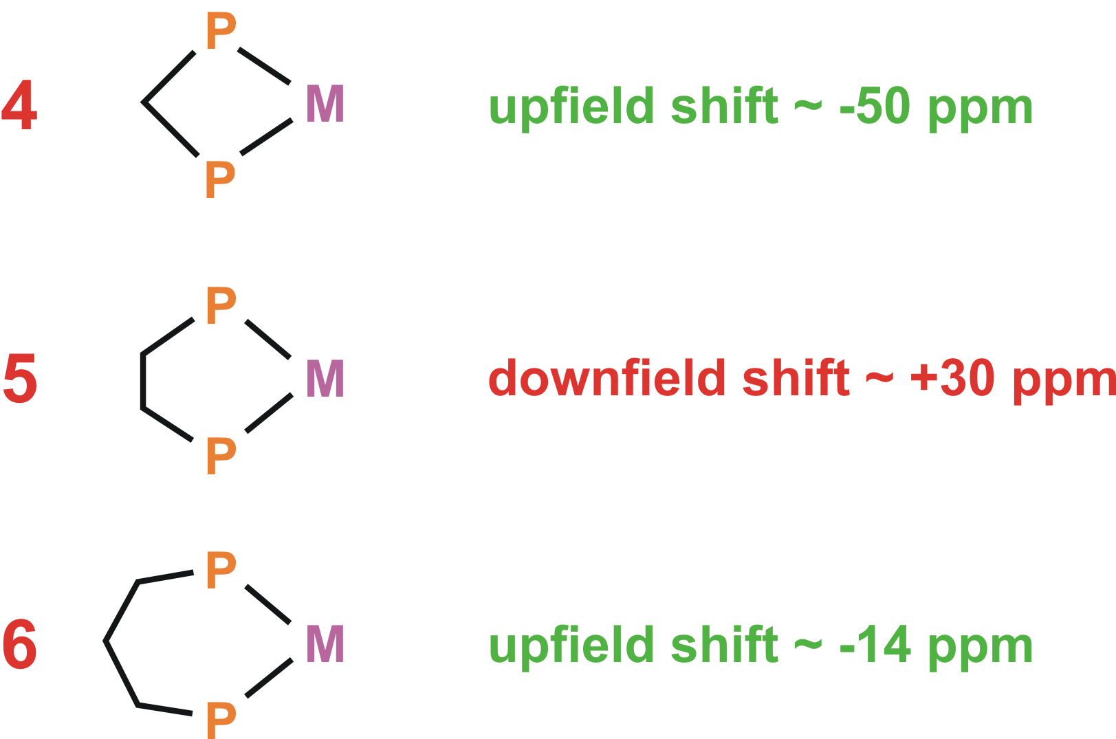
Chelate Ring Effects:
Metal Row Effects:
W(CO)₄(κ²-dppm) | −23.7 ppm
Mo(CO)₄(κ²-dppm) | 0 ppm
Cr(CO)₄(κ²-dppm) | 23.5 ppm

Slide 23
³¹P NMR, as with ¹H and ¹³C methods, can be exceptionally useful in characterizing metal-phosphine complexes and structures:

Slide 24
Problem: Which of the following complexes will have the highest νCO stretching frequency in the IR? Why?
[Mn(CO)₃{P(OPh)₃}₃]⁺
W(CO)₃(PEt₃)₃
[(PF₃)Ag(CO)]⁺
Problem: Which of the following complexes will have the lowest νCO stretching frequency in the IR? Why?
Ni(CO)(PMe₃)₃
Fe(CO)₄(PPh₃)
[Re(CO)₂{P(OMe)₃}₄]⁺

