Slide 1

Chapter 3
Numerical Descriptive Measures

Slide 2
Objectives
In this chapter, you learn to:
Describe the properties of central tendency, variation, and shape in numerical variables.
Construct and interpret a boxplot.
Compute descriptive summary measures for a population.
Calculate the covariance and the coefficient of correlation.

Slide 3
Summary Definitions
DCOVA
The central tendency is the extent to which the values of a numerical variable group around a typical or central value.
The variation is the amount of dispersion or scattering away from a central value that the values of a numerical variable show.
The shape is the pattern of the distribution of values from the lowest value to the highest value.

Slide 4
Measures of Central Tendency:
The Mean
DCOVA
The arithmetic mean (often just called the “mean”) is the most common measure of central tendency.
  For a sample of size n:
The i^{th} value
Pronounced X-bar
Sample size
Observed values

Slide 5
Measures of Central Tendency:
The Mean (con’t)
DCOVA
The most common measure of central tendency.
Mean = sum of values divided by the number of values.
Affected by extreme values (outliers).
11 12 13 14 15 16 17 18 19 20
11 12 13 14 15 16 17 18 19 20
Mean = 13
Mean = 14

Slide 6
Measures of Central Tendency:
The Median
DCOVA
In an ordered array, the median is the “middle” number (50% above, 50% below).
Less sensitive than the mean to extreme values.
11 12 13 14 15 16 17 18 19 20
11 12 13 14 15 16 17 18 19 20
Median = 13
Median = 13

Slide 7
Measures of Central Tendency:
Locating the Median
DCOVA
The location of the median when the values are in numerical order (smallest to largest):
If the number of values is odd, the median is the middle number.
If the number of values is even, the median is the average of the two middle numbers.
Note that is not the value of the median, only the position of
the median in the ranked data.

Slide 8
Measures of Central Tendency:
The Mode
DCOVA
Value that occurs most often.
Not affected by extreme values.
Used for either numerical or categorical data.
There may be no mode.
There may be several modes.
0 1 2 3 4 5 6 7 8 9 10 11 12 13 14
0 1 2 3 4 5 6
Mode = 9
No Mode

Slide 9
Measures of Central Tendency:
Review Example
DCOVA
House Prices:
$2,000,000
$ 500,000
$ 300,000
$ 100,000
$ 100,000
Sum $ 3,000,000
Mean: ($3,000,000/5)
= $600,000
Median: middle value of ranked data
= $300,000
Mode: most frequent value
= $100,000

Slide 10
Measures of Central Tendency:
Which Measure to Choose?
DCOVA
The mean is generally used, unless extreme values (outliers) exist.
The median is often used, since the median is not sensitive to extreme values. For example, median home prices may be reported for a region; it is less sensitive to outliers.
In many situations it makes sense to report both the mean and the median.

Slide 11
Measures of Central Tendency:
Summary
DCOVA
Central Tendency
Arithmetic Mean
Median
Mode
Middle value in the ordered array
Most frequently observed value

Slide 12
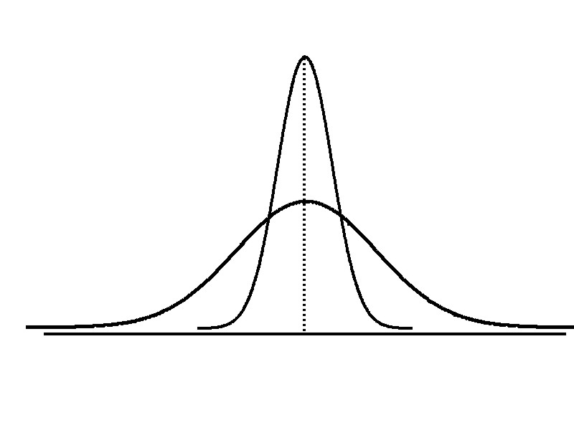
Measures of Variation
DCOVA
Variation
Range
Variance
Standard Deviation
Coefficient of Variation
Measures of variation give information on the spread or variability or dispersion of the data values.
Same center,
different variation

Slide 13
Measures of Variation:
The Range
DCOVA
Simplest measure of variation.
Difference between the largest and the smallest values:
Range = X_{largest} – X_{smallest}
Example:
0 1 2 3 4 5 6 7 8 9 10 11 12 13 14
Range = 13 - 1 = 12

Slide 14
Measures of Variation:
Why The Range Can Be Misleading
DCOVA
Does not account for how the data are distributed.
Sensitive to outliers
7 8 9 10 11 12
7 8 9 10 11 12
Range = 12 - 7 = 5
Range = 12 - 7 = 5
1,1,1,1,1,1,1,1,1,1,1,2,2,2,2,2,2,2,2,3,3,3,3,4,5
Range = 5 - 1 = 4
1,1,1,1,1,1,1,1,1,1,1,2,2,2,2,2,2,2,2,3,3,3,3,4,120
Range = 120 - 1 = 119

Slide 15
Measures of Variation:
The Sample Variance
DCOVA
Where
= arithmetic mean
n = sample size
X_{i} = i^{th} value of the variable X
Average (approximately) of squared deviations of values from the mean.
  Sample variance:

Slide 16
Measures of Variation:
The Sample Standard Deviation
DCOVA
Most commonly used measure of variation.
Shows variation about the mean.
Is the square root of the variance.
Has the same units as the original data.
  Sample standard deviation:

Slide 17
Measures of Variation:
The Sample Standard Deviation
DCOVA
Steps for Computing Standard Deviation:
1. Compute the difference between each value and the mean.
2. Square each difference.
3. Add the squared differences.
4. Divide this total by n-1 to get the sample variance.
5. Take the square root of the sample variance to get the sample standard deviation.

Slide 18
Measures of Variation:
Sample Standard Deviation Calculation Example
DCOVA
Sample
Data (X_{i}) : 10 12 14 15 17 18 18 24
n = 8 Mean = X = 16
A measure of the “average” scatter around the mean.

Slide 19
Measures of Variation:
Comparing Standard Deviations
DCOVA
Data A
Mean = 15.5
S = 3.338
11 12 13 14 15 16 17 18 19 20 21
Data B
Mean = 15.5
S = 0.926
11 12 13 14 15 16 17 18 19 20 21
Data C
Mean = 15.5
S = 4.567
11 12 13 14 15 16 17 18 19 20 21

Slide 20
Measures of Variation:
Comparing Standard Deviations
DCOVA
Smaller standard deviation
Larger standard deviation

Slide 21
Measures of Variation:
Summary Characteristics
DCOVA
The more the data are spread out, the greater the range, variance, and standard deviation.
The more the data are concentrated, the smaller the range, variance, and standard deviation.
If the values are all the same (no variation), all these measures will be zero.
None of these measures are ever negative.

Slide 22
Measures of Variation:
The Coefficient of Variation
DCOVA
Measures relative variation.
Always in percentage (%).
Shows variation relative to mean.
Can be used to compare the variability of two or more sets of data measured in different units.

Slide 23
Measures of Variation:
Comparing Coefficients of Variation
DCOVA
Stock A:
  Mean price last year = $50.
  Standard deviation = $5.
Stock B:
  Mean price last year = $100.
  Standard deviation = $5.
Both stocks have the same standard deviation, but stock B is less variable relative to its mean price.

Slide 24
Measures of Variation:
Comparing Coefficients of Variation (con’t)
Stock A:
  Mean price last year = $50.
  Standard deviation = $5.
Stock C:
  Mean price last year = $8.
  Standard deviation = $2.
DCOVA
Stock C has a much smaller standard deviation but a much higher coefficient of variation

Slide 25
Locating Extreme Outliers:
Z-Score
DCOVA
To compute the Z-score of a data value, subtract the mean and divide by the standard deviation.
The Z-score is the number of standard deviations a data value is from the mean.
A data value is considered an extreme outlier if its Z-score is less than -3.0 or greater than +3.0.
The larger the absolute value of the Z-score, the farther the data value is from the mean.

Slide 26
Locating Extreme Outliers:
Z-Score
DCOVA
where X represents the data value
X is the sample mean
S is the sample standard deviation

Slide 27
Locating Extreme Outliers:
Z-Score
DCOVA
Suppose the mean math SAT score is 490, with a standard deviation of 100.
Compute the Z-score for a test score of 620.
A score of 620 is 1.3 standard deviations above the mean and would not be considered an outlier.

Slide 28
Shape of a Distribution
DCOVA
Describes how data are distributed.
Two useful shape related statistics are:
  Skewness:
    Measures the extent to which data values are not symmetrical.
  Kurtosis:
    Kurtosis measures the peakedness of the curve of the distribution—that is, how sharply the curve rises approaching the center of the distribution.

Slide 29
Shape of a Distribution (Skewness)
DCOVA
Measures the extent to which data is not symmetrical.
Left-Skewed
Symmetric
Right-Skewed
Mean < Median
Mean = Median
Median < Mean
Skewness
Statistic
< 0 0 >0

Slide 30
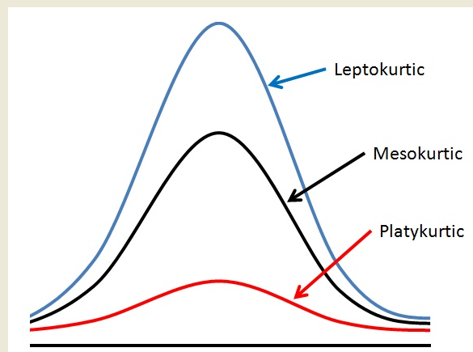
Shape of a Distribution -- Kurtosis measures how sharply the curve rises approaching the center of the distribution
DCOVA
Sharper Peak
Than Bell-Shaped
(Kurtosis > 0)
Bell-Shaped
(Kurtosis = 0)
Flatter Than
Bell-Shaped
(Kurtosis < 0)

Slide 31
Exploring Numerical Data Using Quartiles
DCOVA
Can visualize the distribution of the values for a numerical variable by computing:
  The quartiles.
  The five-number summary.
  Constructing a boxplot.

Slide 32
Quartile Measures
DCOVA
Quartiles split the ranked data into 4 segments with an equal number of values per segment.
25%
25%
25%
25%
Q1
Q2
Q3
The first quartile, Q₁, is the value for which 25% of the values are smaller and 75% are larger.
Q₂ is the same as the median (50% of the values are smaller and 50% are larger).
Only 25% of the values are greater than the third quartile.

Slide 33
Quartile Measures:
Locating Quartiles
DCOVA
Find a quartile by determining the value in the appropriate position in the ranked data, where:
First quartile position: Q₁ = (n+1)/4 ranked value.
Second quartile position: Q₂ = (n+1)/2 ranked value.
Third quartile position: Q₃ = 3(n+1)/4 ranked value.
where n is the number of observed values.

Slide 34
Quartile Measures:
Calculation Rules
DCOVA
When calculating the ranked position use the following rules:
  If the result is a whole number then it is the ranked position to use.
  If the result is a fractional half (e.g. 2.5, 7.5, 8.5, etc.) then average the two corresponding data values.
  If the result is not a whole number or a fractional half then round the result to the nearest integer to find the ranked position.

Slide 35
Quartile Measures
Calculating The Quartiles: Example
DCOVA
Sample Data in Ordered Array: 11 12 13 16 16 17 18 21 22
(n = 9)
Q₁ is in the (9+1)/4 = 2.5 position of the ranked data,
so Q₁ = (12+13)/2 = 12.5.
Q₂ is in the (9+1)/2 = 5th position of the ranked data,
so Q₂ = median = 16.
Q₃ is in the 3(9+1)/4 = 7.5 position of the ranked data,
so Q₃ = (18+21)/2 = 19.5.
Q₁ and Q₃ are measures of non-central location.
Q₂ = median, is a measure of central tendency.

Slide 36
Quartile Measures:
The Interquartile Range (IQR)
DCOVA
The IQR is Q₃ – Q₁ and measures the spread in the middle 50% of the data.
The IQR is also called the midspread because it covers the middle 50% of the data.
The IQR is a measure of variability that is not influenced by outliers or extreme values.
Measures like Q₁, Q₃, and IQR that are not influenced by outliers are called resistant measures.

Slide 37
Calculating The Interquartile Range
DCOVA
Example:
Median
(Q₂)
X
X
Q₁
Q₃
minimum
maximum
25% 25% 25% 25%
12 30 45 57 70
Interquartile range
= 57 – 30 = 27

Slide 38
The Five Number Summary
DCOVA
The five numbers that help describe the center, spread and shape of data are:
  X_{smallest.}
  First Quartile (Q₁).
  Median (Q₂).
  Third Quartile (Q₃).
  X_{largest.}

Slide 39
Five Number Summary and
The Boxplot
DCOVA
The Boxplot: A Graphical display of the data based on the five-number summary:
X_{smallest} -- Q₁ -- Median -- Q₃ -- X_{largest}
Example:
25% of data 25% 25% 25% of data
of data of data
X_{smallest} Q₁ Median Q₃ X_{largest}

Slide 40
Five Number Summary:
Shape of Boxplots
DCOVA
If data are symmetric around the median then the box and central line are centered between the endpoints.
A Boxplot can be shown in either a vertical or horizontal orientation.
X_{smallest} Q₁ Median Q₃ X_{largest}

Slide 41
Numerical Descriptive Measures for a Population
DCOVA
Descriptive statistics discussed previously described a sample, not the population.
Summary measures describing a population, called parameters, are denoted with Greek letters.
Important population parameters are the population mean, variance, and standard deviation.

Slide 42
Numerical Descriptive Measures for a Population: The mean µ
DCOVA
The population mean is the sum of the values in the population divided by the population size, N.
Where
μ = population mean
N = population size
X_{i} = i^{th} value of the variable X

Slide 43
Numerical Descriptive Measures For A Population: The Variance σ²
DCOVA
Where
μ = population mean
N = population size
X_{i} = i^{th} value of the variable X
Average of squared deviations of values from the mean.
  Population variance:

Slide 44
Numerical Descriptive Measures For A Population: The Standard Deviation σ
DCOVA
Most commonly used measure of variation.
Shows variation about the mean.
Is the square root of the population variance.
Has the same units as the original data.
  Population standard deviation:

Slide 45
Sample statistics versus population parameters
DCOVA
Measure | Population Parameter | Sample Statistic
Mean
Variance
Standard Deviation

Slide 46
The Empirical Rule
DCOVA
The empirical rule approximates the variation of data in a symmetric mound-shaped distribution.
Approximately 68% of the data in a symmetric mound shaped distribution is within 1 standard deviation of the mean or µ ± 1σ.
68%
µ
µ ± 1σ

Slide 47
The Empirical Rule
DCOVA
Approximately 95% of the data in a symmetric mound-shaped distribution lies within two standard deviations of the mean, or µ ± 2σ.
Approximately 99.7% of the data in a symmetric mound-shaped distribution lies within three standard deviations of the mean, or µ ± 3σ.
95%
99.7%

Slide 48
Using the Empirical Rule
DCOVA
Suppose that the variable Math SAT scores is bell-shaped with a mean of 500 and a standard deviation of 90. Then:
  Approximately 68% of all test takers scored between 410 and 590, (500 ± 90).
  Approximately 95% of all test takers scored between 320 and 680, (500 ± 180).
  Approximately 99.7% of all test takers scored between 230 and 770, (500 ± 270).

Slide 49
We Discuss Two Measures Of The Relationship Between Two Numerical Variables
Scatter plots allow you to visually examine the relationship between two numerical variables and now we will discuss two quantitative measures of such relationships.
The Covariance.
The Coefficient of Correlation.

Slide 50
The Covariance
DCOVA
The covariance measures the strength of the linear relationship between two numerical variables (X & Y).
The sample covariance:
Only concerned with the strength of the relationship.
No causal effect is implied.

Slide 51
Interpreting Covariance
DCOVA
Covariance between two variables:
cov(X,Y) > 0 X and Y tend to move in the same direction.
cov(X,Y) < 0 X and Y tend to move in opposite directions.
cov(X,Y) = 0 X and Y are independent.
The covariance has a major flaw:
  It is not possible to determine the relative strength of the relationship from the size of the covariance.

Slide 52
Coefficient of Correlation
DCOVA
Measures the relative strength of the linear relationship between two numerical variables.
Sample coefficient of correlation:
Where,

Slide 53
Features of the
Coefficient of Correlation
DCOVA
The population coefficient of correlation is referred as .
The sample coefficient of correlation is referred to as r.
Either ρ or r have the following features:
  Unit free.
  Range between –1 and 1.
  The closer to –1, the stronger the negative linear relationship.
  The closer to 1, the stronger the positive linear relationship.
  The closer to 0, the weaker the linear relationship.

Slide 54
Scatter Plots of Sample Data with Various Coefficients of Correlation
Y
Y
DCOVA
X
X
r = -1
r = -.6
Y
Y
Y
X
X
X
r = +1
r = +.3
r = 0

Slide 55
Chapter Summary
In this chapter we have discussed:
Describing the properties of central tendency, variation, and shape in numerical variables.
Constructing and interpreting a boxplot.
Computing descriptive summary measures for a population.
Calculating the covariance and the coefficient of correlation.

