Slide 1

FUNDAMENTALS OF PHYSICS
( 10th edition )- HALLIDAY & RESNICK

Slide 2
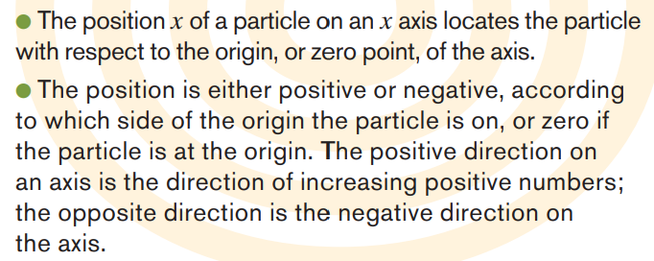
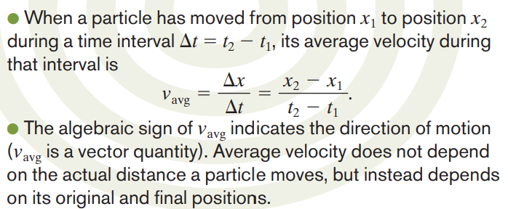
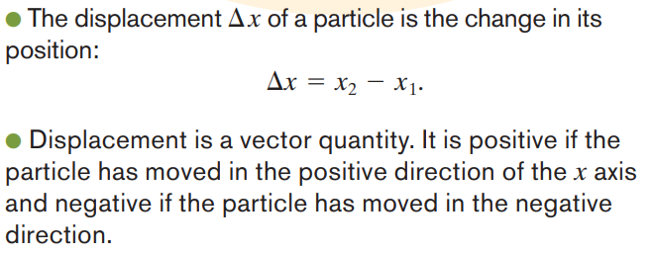


Slide 3
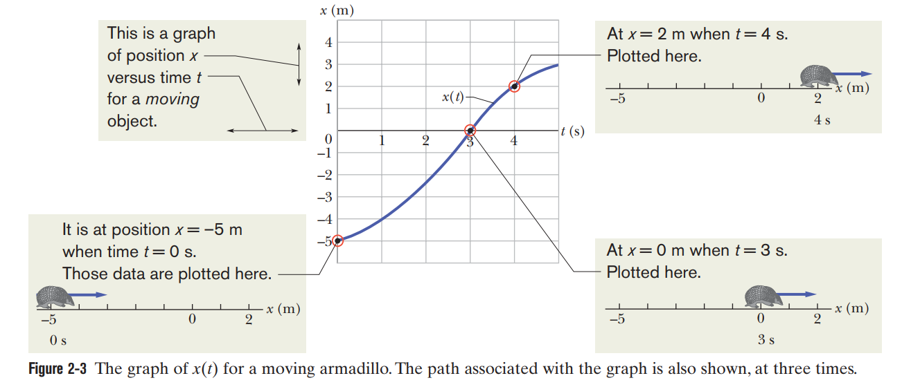

Slide 4
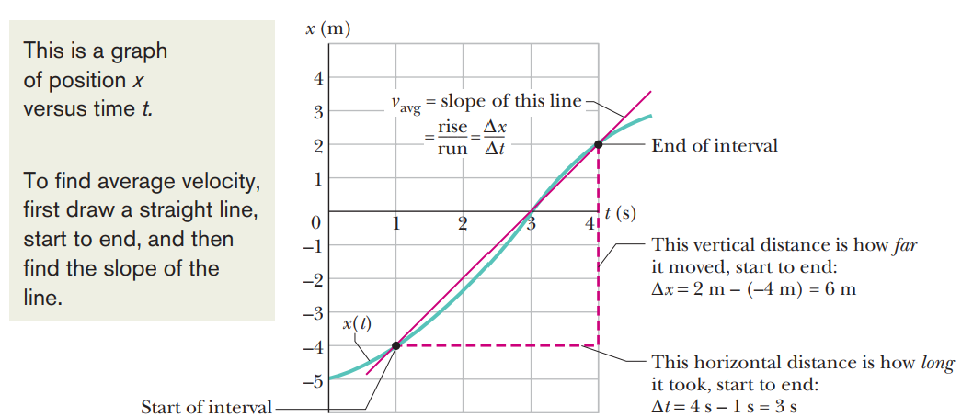
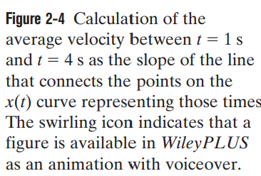

Slide 5




Example 1

Slide 6


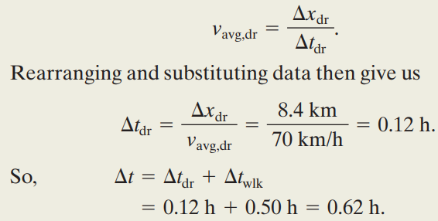
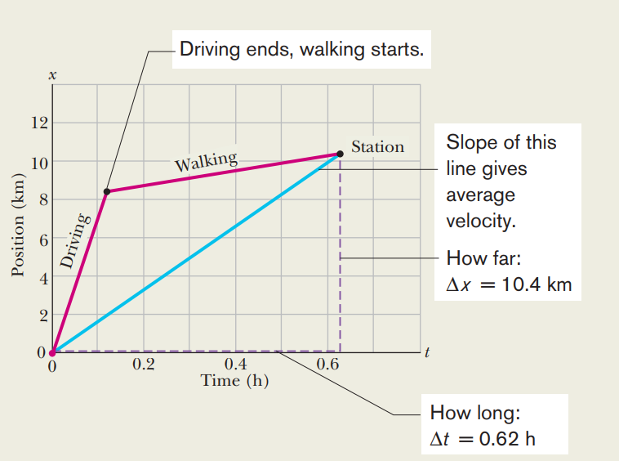
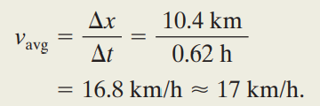

Slide 7

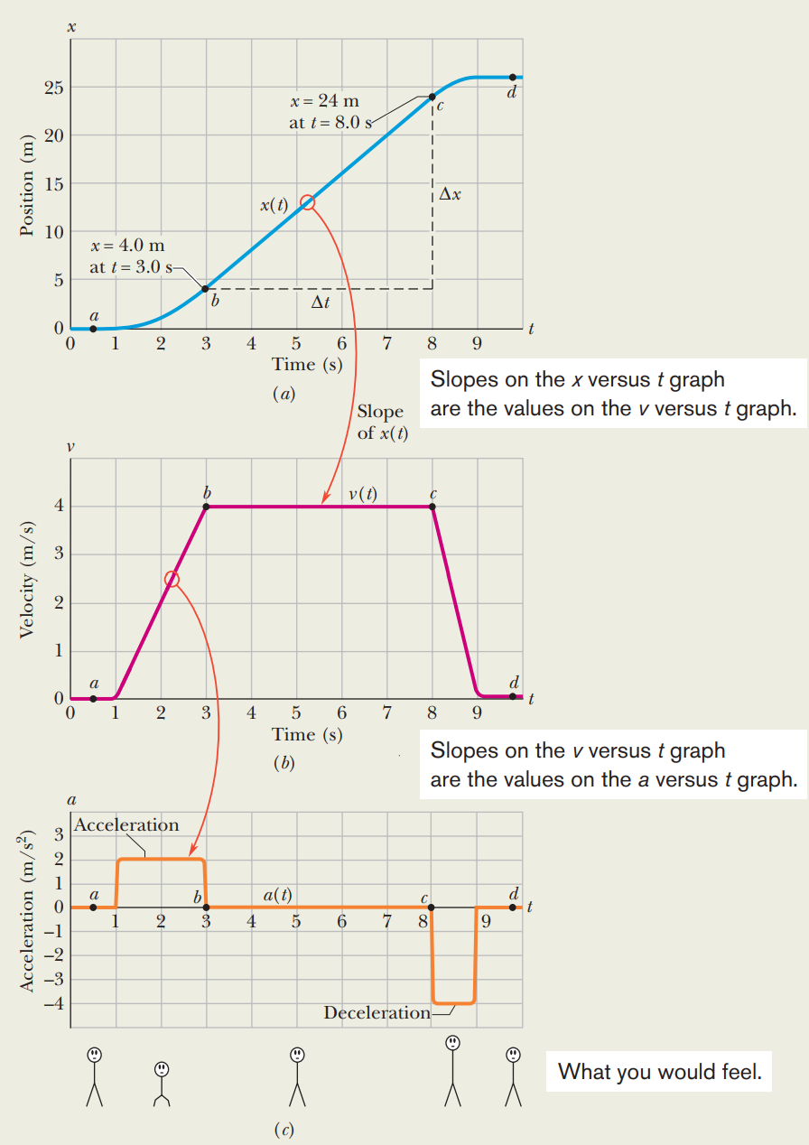



Slide 8


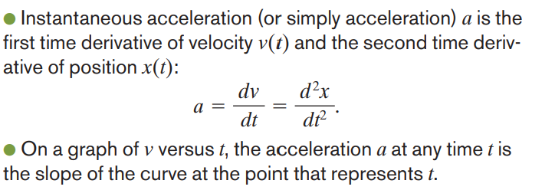

Slide 9
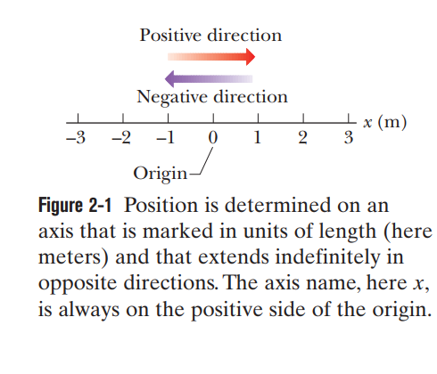
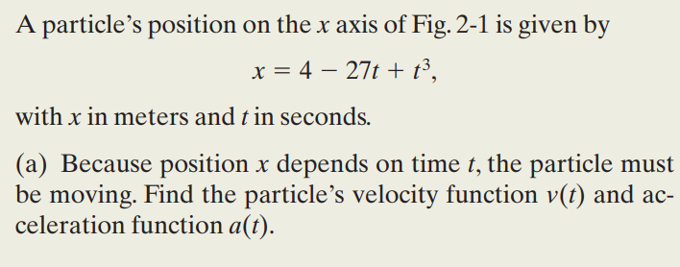
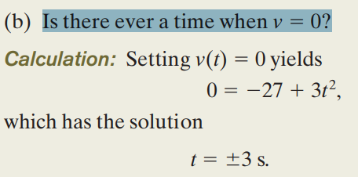






Example 2

Slide 10
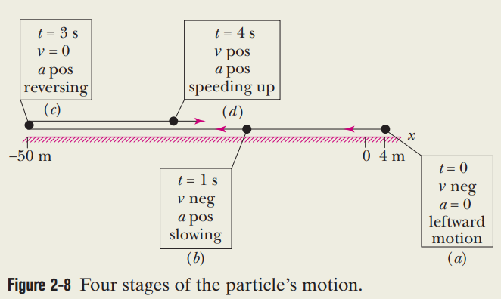

Slide 11

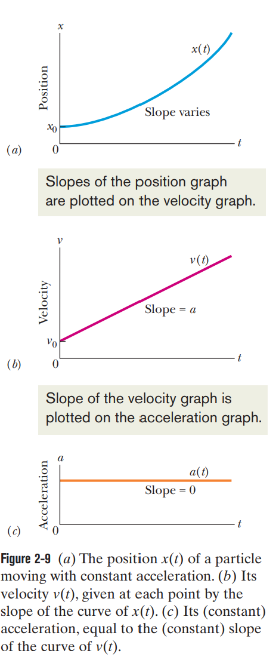


Slide 12



a = - g up ward
a= + g down ward

Slide 13
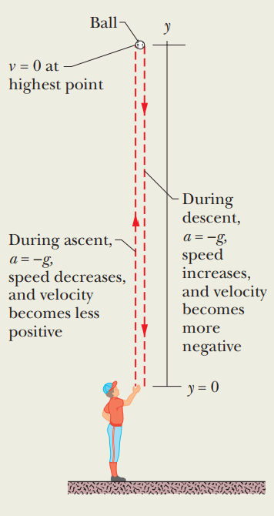

Example 3

Slide 14




Slide 15


Slide 16
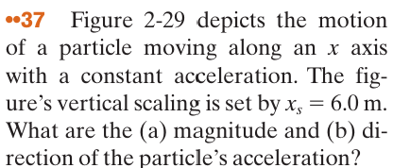
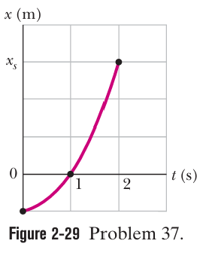





The solution
a) From the figure $x_{ο}=−2m$
$$at t=1 and t=2 we have x−x_{ο}=v_{ο}t+\frac{1}{2}at^{2}$$
$$⇒$$
$$⇒$$
$$v_{ο}=0 and a=4m/s^{2}$$
b) Because the acceleration is positive, its direction is in the direction of the positive x-axis

Slide 17
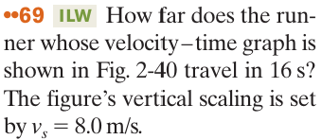
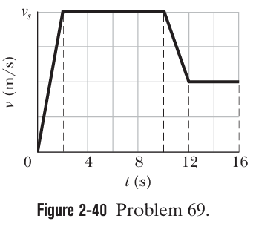
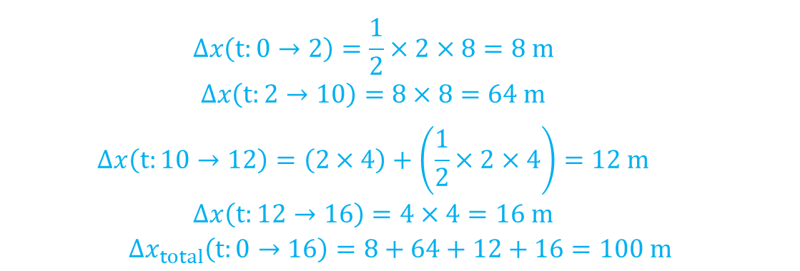
The solution
$$∆x\left(t:0→2\right)=\frac{1}{2}×2×8=8 m$$
$$∆x\left(t:2→10\right)=8×8=64 m$$
$$∆x\left(t:10→12\right)=\left(2×4\right)+\left(\frac{1}{2}×2×4\right)=12 m$$
$$∆x\left(t:12→16\right)=4×4=16 m$$
$${∆x}_{total}\left(t:0→16\right)=8+64+12+16=100 m$$

Slide 18
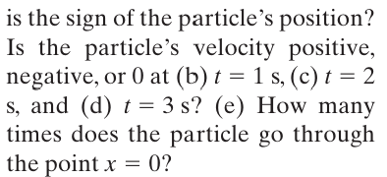
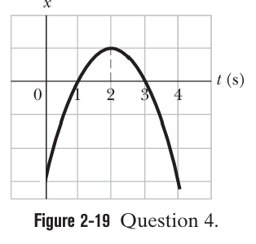
The solution

