Slide 1
The International Monetary System
Chapter Two
© 2021 McGraw Hill. All rights reserved. Authorized only for instructor use in the classroom. No reproduction or further distribution permitted without the prior written consent of McGraw Hill.

Slide 2
Overview
Evolution of the International Monetary System
Bimetallism: Before 18 75
Classical Gold Standard: 18 75 to 19 14
Interwar Period: 19 15 to 19 44
Bretton Woods System: 19 45 to 19 72
Flexible Exchange Rate Regime: 19 73 to Present
Current Exchange Rate Arrangements
Euro and European Monetary Union
Mexican Peso Crisis
Asian Currency Crisis
Argentine Peso Crisis
Rise of Chinese R M B
Fixed versus Flexible Exchange Rate Regimes

Slide 3
Evolution of the International Monetary System
International monetary system went through several distinct stages of evolution, summarized as follows:
  Bimetallism: Before 18 75.
  Classical gold standard: 18 75 to 19 14.
  Interwar period: 19 15 to 19 44.
  Bretton Woods system: 19 45 to 19 72.
  Flexible exchange rate regime: Since 19 73.

Slide 4
Bimetallism: Before 18 75
Bimetallism was a “double standard” in the sense that free coinage was maintained for both gold and silver
Countries on the bimetallic standard often experienced the well-known phenomenon referred to as Gresham’s law
  Gresham’s law dictates that, under the bimetallic standard, the abundant metal was used as money while the scarce metal was driven out of circulation, because the ratio of the two metals was officially fixed.

Slide 5
Classical Gold Standard: 18 75 to 19 14
First full-fledged gold standard, a monetary system in which currencies are defined in terms of their gold content, was established in 18 21 in Great Britain
  Majority of countries moved away from gold in 19 14 when World War I began.
Under the gold standard, the exchange rate between any two currencies will be determined by the gold contents

Slide 6
Classical Gold Standard: An Example
Suppose the pound (£) is pegged to gold at six pounds (£6) per ounce, whereas one ounce of gold is worth
12 francs (₣)
  £6 = 1 oz. gold.
  ₣12 = 1 oz. gold.
Deducing from the information given above, £6 must equal ₣12
  6/12 reduces to 1/2; therefore £1 = ₣2.
Exchange rate between the pound and the franc should then be two francs per pound

Slide 7
Classical Gold Standard: Adjustment Mechanism
Price-specie-flow mechanism was an automatic correction of payment imbalanced between countries operating under the gold standard
  Based on the fact that domestic money stock rises or falls as the country experiences inflows or outflows of gold.
Key shortcomings of the gold standard:
  Supply of newly minted gold is so restricted that the growth of world trade and investment can be seriously hampered for lack of sufficient monetary reserves.
  No mechanism to compel each major country to abide by the rules of the game.
Notes:
Under the gold standard, international imbalances of payment will also be corrected automatically. Consider a situation where Great Britain exported more to France than the former imported from the latter. This kind of trade imbalance will not persist under the gold standard. Net export from Great Britain to France will be accompanied by a net flow of gold in the opposite direction. This international flow of gold from France to Great Britain will lead to a lower price level in France and, at the same time, a higher price level in Great Britain. (Recall that under the gold standard, the domestic money stock is supposed to rise or fall as the country experiences an inflow or outflow of gold.) The resultant change in the relative price level, in turn, will slow exports from Great Britain and encourage exports from France as British (French) goods become more (less) expensive. As a result, the initial net export from Great Britain will eventually disappear. This adjustment mechanism is referred to as the price-specie-flow mechanism, which is attributed to David Hume, a Scottish philosopher. 3

Slide 8
Interwar Period: 19 15 to 19 44
World War I ended the classical gold standard in August 19 14
Major countries followed sterilization of gold policy by matching inflows and outflows of gold respectively with reductions and increases in domestic money and credit.
Countries widely used “predatory” depreciations of their currencies as a means of gaining advantages in the world export market
  Period characterized by economic nationalism, halfhearted attempts and failure to restore the gold standard, economic and political instabilities, bank failures, and panicky flights of capital across borders.
Notes:
World War I ended the classical gold standard in August 1914, as major countries such as Great Britain, France, Germany, and Russia suspended redemption of banknotes in gold and imposed embargoes on gold exports. After the war, many countries, especially Germany, Austria, Hungary, Poland, and Russia, suffered hyperinflation. The German experience provides a classic example of hyperinflation: By the end of 1923, the wholesale price index in Germany was more than 1 trillion (!) times as high as the prewar level. Freed from wartime pegging, exchange rates among currencies were fluctuating in the early 1920s. During this period, countries widely used "predatory" depreciations of their currencies as a means of gaining advantages in the world export market.
As major countries began to recover from the war and stabilize their economies, they attempted to restore the gold standard. The United States, which replaced Great Britain as the dominant financial power, spearheaded efforts to restore the gold standard. With only mild inflation, the United States was able to lift restrictions on gold exports and return to a gold standard in 1919. In Great Britain, Winston Churchill, the chancellor of the Exchequer, played a key role in restoring the gold standard in 1925. Besides Great Britain, such countries as Switzerland, France, and the Scandinavian countries restored the gold standard by 1928.
The international gold standard of the late 1920s, however, was not much more than a facade. Most major countries gave priority
to the stabilization of domestic economies and systematically followed a policy of sterilization of gold by matching inflows and outflows of gold respectively with reductions and increases in domestic money and credit. The Federal Reserve of the United States, for example, kept some gold outside the credit base by circulating it as gold certificates. The Bank of England also followed the policy of keeping the amount of available dom@stic credit stable by neutralizing the effects of gold flows. In a word, countries lacked the political will to abide by the "rules of the game," and so the automatic adjustment mechanism of the gold standard was unable to work.

Slide 9
Bretton Woods System: 19 45 to 19 72
Named for a July 19 44 meeting of 44 nations at Bretton Woods, New Hampshire
  Purpose of meeting was to discuss and design the postwar international monetary system (that is, Bretton Woods system).
  Described as a dollar-based gold-exchange standard.
Triffin paradox explains the collapse of this system in the early 19 70s
  Reserve-currency country should run a balance of payments deficit, but this can decrease confidence in the reserve currency and lead to the downfall of the system.

Slide 10
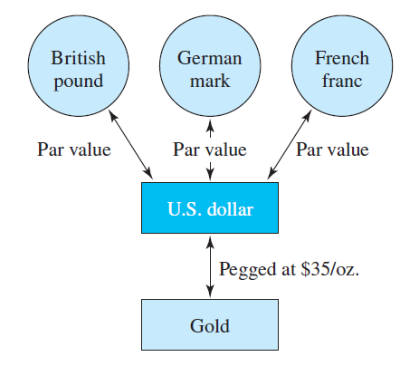
The Design of the Gold-Exchange System
Access the text alternative for slide images.

Slide 11
The Flexible Exchange Rate Regime: 19 73 to Present
Flexible exchange rate regime was ratified in January 19 76 when the IMF members met in Jamaica and agreed to a new set of rules, referred to as the Jamaica Agreement:
  Flexible exchange rates were declared acceptable to the I M F members; central banks could intervene in exchange markets to iron out unwarranted volatilities.
  Gold was officially abandoned (that is, demonetized) as an international reserve asset.
  Non-oil-exporting countries and less-developed countries were given greater access to I M F funds.

Slide 12
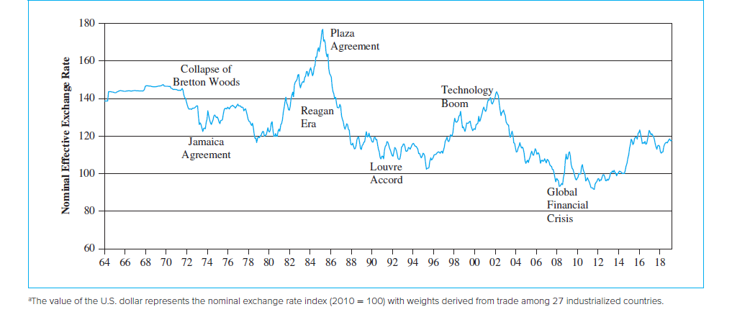
The Trade-Weighted Value of the U.S. Dollar since 19 64
Source: Effective exchange rate indices (monthly), Bank for International Settlements.
Access the text alternative for slide images.

Slide 13
Current Exchange Rate Arrangements 1
As can be seen from the exhibit, the IMF currently classifies exchange rate arrangements into 10 separate regimes:
No separate legal tender:
  Currency of another country circulates as the sole legal tender.(for example, Ecuador, El Salvador, and Panama). (a country uses another one’s currency and thus gives away its capacity of using monetary policies.)
Currency board:
  An extreme form of the fixed exchange rate regime under which local currency is fully backed by the U.S. dollar or another chosen standard currency (for example, Hong Jong, Bulgaria, and Brunei).
Conventional peg:
  Country formally pegs its currency at a fixed rate to another currency or basket of currencies (for example, Jordan, Saudi Arabia, and Morocco).
Stabilized arrangement:
  Entails a spot market exchange rate that remains within a margin of 2% for 6 months or more (for example, Indonesia, Singapore, and Lebanon).
Notes:
IMF currently classifies exchange rate arrangements into 10 separate regimes.

Slide 14
Crawling peg:
  Involves the confirmation of the country authorities’ de jure exchange rate arrangement. The currency is adjusted in small amounts at a fixed rate or in response to changes in selected quantitative indicators, such as past inflation differentials vis-à-vis major trading partners or differentials between the inflation target and expected inflation in major trading partners. (for example, Honduras and Nicaragua).
Crawl-like arrangement:
  Exchange rate must remain within a narrow margin of 2% relative to a statistically identified trend for 6 months or more (for example, Iran, China, and Serbia).
Pegged exchange rate with horizontal bands:
  Value of currency is maintained within certain margins of fluctuation of at least +/− 1% around a fixed central rate, or the margin between the maximum and minimum value of the exchange rate exceeds 2% (for example, Tonga).

Slide 15
Current Exchange Rate Arrangements 3
Other managed arrangement:
  Residual category used when the exchange rate arrangement does not meet the criteria for any of the other categories (for example, Algeria, Cambodia, and Sudan).
Floating:
  Largely market determined, without an ascertainable or predictable path for the rate (for example, Brazil, Korea, Turkey, India, South Africa, and Thailand).
Free floating:
  Intervention occurs only exceptionally and aims to address disorderly market conditions; authorities confirm intervention has been limited to at most 3 instances in the previous 6 months, each lasting no more than 3 business days (for example, Australia, Canada, Mexico, Japan, U.K., U.S., and euro zone).

Slide 16
European Monetary System
The chief goals of the European Monetary System (E M S) are the following:
  To establish a “zone of monetary stability” in Europe.
  To coordinate exchange rate policies vis-à-vis the non-E M S currencies.
  To pave the way for the eventual European monetary union.
Two main instruments of the E M S:
  European Currency Unit (E C U).
  Exchange Rate Mechanism (E R M).
Notes:
The EMS was formally launched in March 1979.

Slide 17
The Euro and the European Monetary Union
11 of 15 E U countries adopted a common currency, the euro, on January 1, 19 99
  European Monetary Union (E M U) created.
Each national currency of the euro-11 countries was irrevocably fixed to the euro at a conversion rate as of January 1, 19 99
Euro notes and coins were introduced to circulation on January 1, 2002, while national bills and coins were being gradually withdrawn
Changeover completed by July 1, 2002

Slide 18
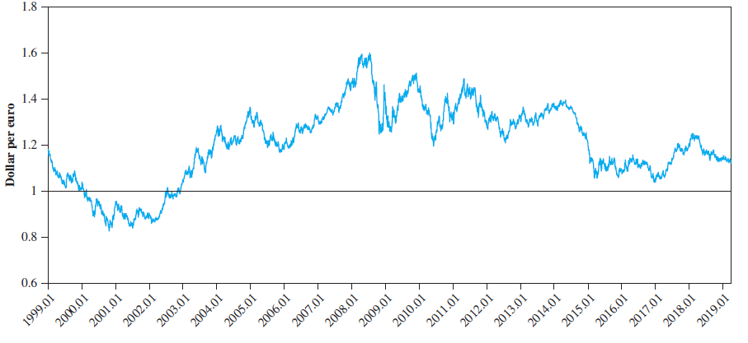
The Dollar-Euro Exchange Rate
Source: Datastream
Access the text alternative for slide images.

Slide 19
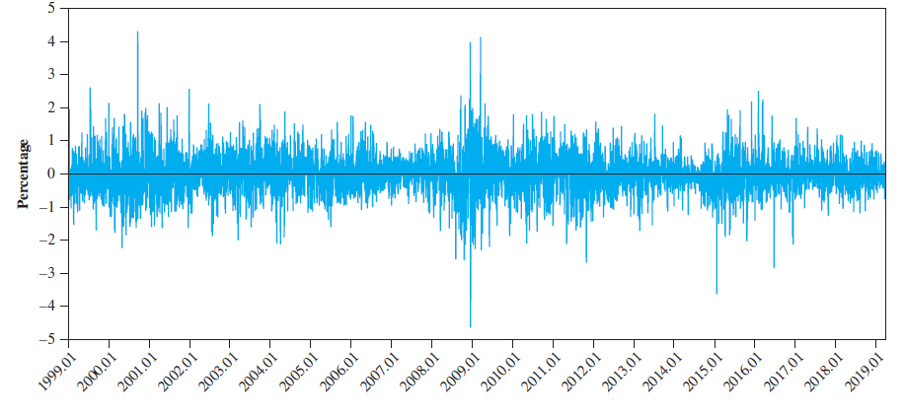
The Dollar-Euro Exchange Rate Changes
Source: Datastream.
Access the text alternative for slide images.

Slide 20
A Brief History of the Euro
Monetary policy for euro zone countries is now conducted by the European Central Bank (E C B)
  Primary objective is to maintain price stability.
  Independence is legally guaranteed.
Eurosystem is made up of E C B and central banks of euro-zone countries; tasks include:
  Defining and implementing common monetary policy of the Union.
  Conducting foreign exchange operations.
  Holding and managing official foreign reserves of euro member states.

Slide 21
Benefits and Costs of Monetary Union
Key benefits
  Reduced transaction costs.
  Elimination of exchange rate uncertainty.
  Enhanced efficiency and competitiveness of the European economy.
  Conditions conducive to the development of continental capital markets with depth and liquidity comparable to those of the U.S.
  Political cooperation and peace in Europe.
Main cost
  Loss of national monetary and exchange rate policy independence.

Slide 22
Currency Crises
Three major currency crises revealed the fragility of the international monetary system (I M S)
  Mexican peso crisis (19 94 to 19 95).
  Asian currency crisis (19 97 to 19 98).
  Argentine peso crisis (2002).

Slide 23
The Mexican Peso Crisis 1
On December 20, 19 94, the Mexican government announced a plan to devalue the peso against the dollar by 14 percent
This decision caused pesos, as well as Mexican stocks and bonds, to be sold rapidly
  By early January 19 95, the peso had fallen against the U.S. dollar by as much as 40 percent, forcing the Mexican government to float the peso.
Peso crisis rapidly spilled over to other Latin American and Asian financial markets

Slide 24
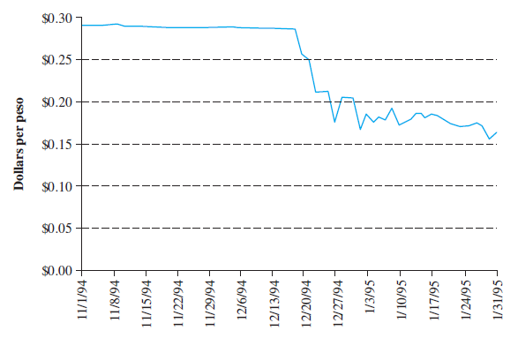
U.S. Dollar versus Mexican Peso Exchange Rate (November 1, 19 94 to January 31, 19 95)
Access the text alternative for slide images.

Slide 25
The Mexican Peso Crisis 2
Mexican Peso crisis is unique in that it represents the first serious international financial crisis touched off by cross-border flight of portfolio capital
Two lessons emerge:
  It is essential to have a multinational safety net in place to safeguard the world financial system from such crises.
  Mexico excessively depended on foreign portfolio capital to finance economic development when a higher priority should have been placed on saving domestically.
Notes:
Mexico excessively depended on foreign portfolio capital to finance its economic development. In hindsight, the country should have saved more domestically and depended more on long-term rather than short-term foreign capital investments. As Professor Robert MacKinnon of Stanford University pointed out, a flood of foreign money had two undesirable effects. It led to an easy credit policy on domestic borrowings, which caused Mexicans to consume more and save less.? Moreign capital influx also caused a higher domestic inflation and an overvalued peso, which hurt Mexico's trade balances.

Slide 26
The Asian Currency Crisis
Far more serious than the crises of the E M S and Mexican peso in terms of the extent of the contagion and the severity of the resultant economic and social costs
  Many firms with foreign currency bonds were forced into bankruptcy.
Led to an unprecedentedly deep, widespread, and long-lasting recession in East Asia, a region that has enjoyed the most rapidly growing economy in the world over the last few decades

Slide 27
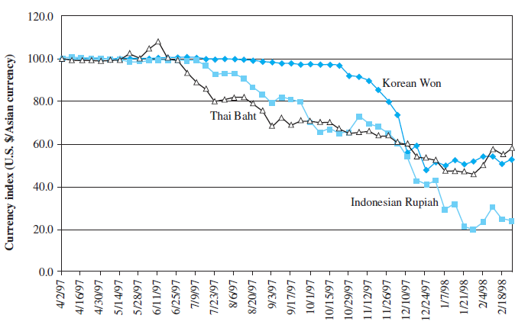
Asian Currency Crisis
Access the text alternative for slide images.

Slide 28
Origins of the Asian Currency Crisis 1
As capital markets were opened, large inflows of private capital resulted in a credit boom in the Asian countries
Fixed or stable exchange rates also encouraged unhedged financial transactions and excessive risk-taking by both borrowers and lenders
The real exchange rate rose, which led to a slowdown in export growth
Also, Japan’s long-lasting recession (and yen depreciation) hurt neighboring countries
Notes:
Several factors are responsible for the onset of the Asian currency crisis: a weak domestic financial system, free international capital flows, the contagion effects of changing market sentiment, and inconsistent economic policies.
Large inflows of private capital resulted in a credit boom in the Asian countries in the early and mid-1990s. The credit boom was often directed to speculations in real estate and stock markets as well as to investments in marginal industrial projects. Fixed or stable exchange rates also encouraged unhedged financial transactions and excessive risk-taking by both lenders and borrowers, who were not much concerned with exchange risk. As asset prices declined (as happened in Thailand prior to the currency crisis) in part due to the government's effort to control the overheated economy, the quality of banks' loan portfolios also declined as the same assets were held as collateral for the loans. Clearly, banks and other financial institutions in the afflicted countries practiced poor risk management and were poorly supervised. In addition, their lending decisions were often influenced by political considerations, likely leading to suboptimal allocation of resources.

Slide 29
Origins of the Asian Currency Crisis 2
If the Asian currencies had been allowed to depreciate in real terms (which was not possible due to the fixed exchange rates), the sudden and catastrophic changes in exchange rates observed in 19 97 might have been avoided
Eventually, something had to give—it was the Thai bhat
  Sudden collapse of the bhat touched off a panicky flight of capital from other Asian countries.

Slide 30
Origins of the Asian Currency Crisis 3
A fixed, but adjustable, exchange rate is problematic in the face of integrated international financial markets
  Invites speculative attack at the time of financial vulnerability.
  Incompatible trinity suggests it is very difficult, if not impossible, to have all three conditions:
    A fixed exchange rate.
    Free international flows of capital.
    Independent monetary policy.

Slide 31
The Argentine Peso Crisis 1
In February 19 91, the Argentine government passed the Convertibility Law, linking the peso to the U.S. dollar at parity
The initial economic effects were positive:
  Argentina’s chronic inflation was curtailed dramatically, and foreign investment began to pour in, leading to an economic boom.
Peso appreciated against most currencies as the U.S. dollar became increasingly stronger in the second half of the 19 90s

Slide 32
The Argentine Peso Crisis 2
A strong peso hurt exports from Argentina and caused a protracted economic downturn that led to the abandonment of peso–dollar parity in January 2002
This change caused severe economic and political distress in the country:
  Unemployment rate rose above 20 percent.
  Inflation rate reached a monthly rate of 20 percent.

Slide 33
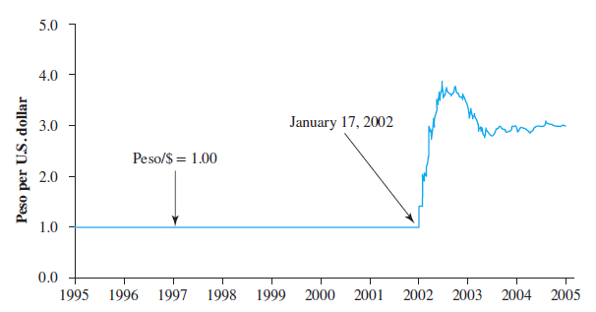
Collapse of the Currency Board Arrangement in Argentina
Source: Bloomberg.
Access the text alternative for slide images.

Slide 34
The Argentine Peso Crisis 3
There are at least three factors that are related to the collapse of the currency board arrangement and the ensuing economic crisis:
  Lack of fiscal discipline.
  Labor market inflexibility.
  Contagion from the financial crises in Brazil and Russia.

Slide 35
Rise of Chinese R M B
China has recently become one of the top trading powers in the world
  G D P is second only to the U.S. among individual countries, but its currency, the renminbi (R M B), has not achieved similar international prominence.
China’s currency has the potential to become a global currency, but China will need to meet a few critical conditions:
  Full convertibility of its currency.
  Open capital markets with depth and liquidity.
  Rule of law and protection of property rights.

Slide 36
Fixed versus Flexible Exchange Rate Regimes 1
Arguments in favor of flexible exchange rates:
  Easier external adjustments.
  National policy autonomy.
Arguments against flexible exchange rates:
  Exchange rate uncertainty may hamper international trade and investment.
  No safeguards to prevent crises.

Slide 37
Fixed versus Flexible Exchange Rate Regimes 2
A “good” (or ideal) international monetary system should provide the following:
  Liquidity.
  Adjustment.
  Confidence.

Slide 38
End of Main Content
© 2021 McGraw Hill. All rights reserved. Authorized only for instructor use in the classroom.
No reproduction or further distribution permitted without the prior written consent of McGraw Hill.

Slide 39
Accessibility Content: Text Alternatives for Images

Slide 40
The Design of the Gold-Exchange System - Text Alternative
Return to parent-slide containing images.
Diagram showing three circles at the top indicating the par value of the British pound, the German mark, and the French franc with two-way arrows pointing to a box marked "U.S. dollar". A two-way arrow is then pointing from the U.S. dollar to a box marked "gold" and the arrow is labeled "pegged at $35 per ounce".
Return to parent-slide containing images.

Slide 41
The Trade-Weighted Value of the U.S. Dollar since 19 64 - Text Alternative
Return to parent-slide containing images.
This graph shows a time line from 19 64 to 2018, which are the dates noted on the x-axis in two-year increments. The y-axis is titled Nominal effective exchange rate and starts at 60 increasing by 20 increments to reach 180. The exchange rate starts at 140 in 19 64 and it decreases from 19 70 through 19 73, which is labeled the Collapse of Bretton Woods. It increases slightly with the Jamaica Agreement in 19 74 and increases during the Reagan era, reaching a peak in 19 85 of 180, which is labeled the Plaza Agreement. It falls again from 19 86 to 19 96 due to the Louvre Accord and increases through 19 96 to 2003 with the Technology boom to 140. It then decreases to a low of 95 in 2008 during the Global Financial Crisis and ending at 120 in 2018.
Return to parent-slide containing images.

Slide 42
The Dollar-Euro Exchange Rate – Text Alternative
Return to parent-slide containing images.
This illustration shows graphs on two panels. The graph on Panel A is labeled the dollar-euro exchange rate and shows the dollar per euro on the y-axis starting at 0.6 and increasing by 2/10s to top out at 1/8. The x-axis shows years from 1999.01 through 2019.01. The rate starts at 1.2 in 1999 and fluctuates to 0.8 in 2001 then increases steadily to a high of 1.7 in 2008. It then fluctuates from 1.2 to 1.4 between 2009 and 2014 before dropping to 1.05 in 2017. In 2018, the rate increases to a high of 1.2 but then begins to decline, dropping to a low of 1.1 in 2019. Panel B shows the dollar to euro exchange rate changes for years 1999.01 through 2019.01, which is depicted on the x-axis. The y-axis indicates percentages starting at negative 5 percent increasing in increments of 1 to positive 5 percent. The rates fluctuate between a negative 1 percent and a positive 1 percent with various spikes during 2000 reaching 3.5%, and oscillating widely in 2009 between a negative 4% and a positive 5%.
Return to parent-slide containing images.

Slide 43
The Dollar-Euro Exchange Rate Changes – Text Alternative
Return to parent-slide containing images.
This illustration shows graphs on two panels. The graph on Panel A is labeled the dollar-euro exchange rate and shows the dollar per euro on the y-axis starting at 0.6 and increasing by 2/10s to top out at 1/8. The x-axis shows years from 1999.01 through 2019.01. The rate starts at 1.2 in 1999 and fluctuates to 0.8 in 2001 then increases steadily to a high of 1.7 in 2008. It then fluctuates from 1.2 to 1.4 between 2009 and 2014 before dropping to 1.05 in 2017. In 2018, the rate increases to a high of 1.2 but then begins to decline, dropping to a low of 1.1 in 2019. Panel B shows the dollar to euro exchange rate changes for years 1999.01 through 2019.01, which is depicted on the x-axis. The y-axis indicates percentages starting at negative 5 percent increasing in increments of 1 to positive 5 percent. The rates fluctuate between a negative 1 percent and a positive 1 percent with various spikes during 2000 reaching 3.5%, and oscillating widely in 2009 between a negative 4% and a positive 5%.
Return to parent-slide containing images.

Slide 44
U.S. Dollar versus Mexican Peso Exchange Rate (November 1, 19 94 to January 31, 19 95) – Text Alternative
Return to parent-slide containing images.
This graph shows dollars per peso on the y-axis starting at 0 and increasing by 5 cents to reach 30 cents. The x-axis shows weekly dates starting November 1, 19 94 and ending January 31, 19 95. The dollars per peso starts at 29 cents and remains steady until it drops to a low of 17 cents on December 27, 19 94, increasing and decreasing until it reaches 16 cents on January 31, 19 95.
Return to parent-slide containing images.

Slide 45
Asian Currency Crisis – Text Alternative
Return to parent-slide containing images.
This graph shows the currency index between the U.S. dollar and Asian currency starting with 0 on the Y-axis and increasing by 20 to reach 120. The x-axis shows bi-weekly dates starting April 2, 19 97 and ending February 18, 19 98. There are three lines for different Asian currencies, the Korean Won, the Thai Baht and the Indonesian Rupiah. All three start out even with the U.S. dollar with the Thai Baht increasing slightly on June 11, 19 97 and then steadily decreasing to reach 60 on February 18, 19 98. The Indonesian Rupiah decreases steadily downward to reach 20 on February 18, 19 98. The Korean Won remains steady until decreasing to 48 on December 24, 19 97 and then finishing at 52 on February 18, 19 98.
Return to parent-slide containing images.

Slide 46
Collapse of the Currency Board Arrangement in Argentina – Text Alternative
Return to parent-slide containing images.
This graph indicates the exchange rate between the Peso and the U.S. dollar between 19 95 and 2005. The y-axis shows the pesos per U.S. dollar, starting at 0 and increasing by 1.0 increments to reach 5.0. The x-axis shows the years from 19 95 to 2005. The peso equaled the U.S. dollar from 19 95 to 2002. It increased to 4.0 on January 17, 2002 and dropped to 3.0 during 2003 and remaining there until 2005.
Return to parent-slide containing images.

