Slide 1
Physics for Scientists and Engineers Storyline
Tenth Edition

Slide 2

Electric Fields
Chapter 22
Notes:
Storyline Taking advantage of a weekend visit to your family home, you have washed and dried your clothing and are removing the clothing from the dryer. You notice that your socks seem to be stuck to your shirts. Even shaking the shirt will not remove the socks. When you pull the socks off the shirt, they peel off with a crackling sound. As you carry your dry clothes into your bedroom, you wonder why those effects occurred. You are still wondering while you comb your hair in the bathroom. You turn on the faucet and unintentionally hold the comb you just used next to the stream of water. The stream of water bends to the side, toward the comb! You move the comb to different positions and notice that the stream of water deviates to the side by different amounts. Your father wanders by while you are doing this and says, "That's exactly the technique we use in designing our high-speed manufacturing printers. Go look at the cans of food in the kitchen. How do you think the expiration dates are printed on the cans? Even more fascinating, how do we print code numbers on eggs?" You never quite understood what your father does for a living, but are now quite intrigued. You know that he designs some kind of industrial printers. You ask him what he means about your bathroom experiment. He tells you to do some online research on continuous inkjet printing.
Connections In our earlier chapters on mechanics, we identified several types of forces: normal forces perpendicular to surfaces, friction forces parallel to surfaces, tension forces along strings, gravitational forces on planets, etc. Among these, the gravitational force, which we studied in detail in Chapter 13, is unique, as it is a fundamental force in nature. It turns out that the other forces in this list are all due to a second type of fundamental force, the electromagnetic force. In this chapter, we will begin our study of one manifestation of this force, the electric force. Our understanding of the gravitational force developed according to a conceptual structure that we built: we learned that the force exists between objects with mass. We then developed a mathematical law, Newton's law of universal gravitation, to describe the magnitude of the force. We then introduced the notion of a gravitational field. From there we discussed gravitational potential energy in a system of two or more massive objects. We will follow a similar conceptual development in our study of the electric force. We will learn that the force exists between objects with electric charge. We will develop a mathematical law, Coulomb's law, to describe the magnitude of the force. We will introduce the notion of an electric field, and we will discuss electric potential energy in a system of two or more charged objects. As we continue to study the electric force in the next few chapters, we will find that we have much more control over this force than we do over gravity. Sources of gravity are restricted to one shape: the spherical shape of planets and stars (with the exception of small asteroids and moons that might deviate slightly from spheres). On the other hand, we can formulate various shapes for electrical situations: spheres, plates, wires, and the like! Objects moving in gravitational fields are huge and massive; we can't control their motion. Objects moving in electric fields can be as small as electrons; we can easily change their motion! We have no control over gravity; it's always there. But we can turn electricity on and off! We can't adjust the strength of the gravitational field of the Earth. But we can easily turn a dial to change the strength of an electric field! Gravity is everywhere, inside and outside of everything. But some materials conduct electricity and others don't! And we can create electric field-free regions of space quite easily! This type of control that we have over electricity makes it the basis of our technological society. Phenomena associated with electrical charges will appear repeatedly in most of the remaining chapters in this book.

Slide 3
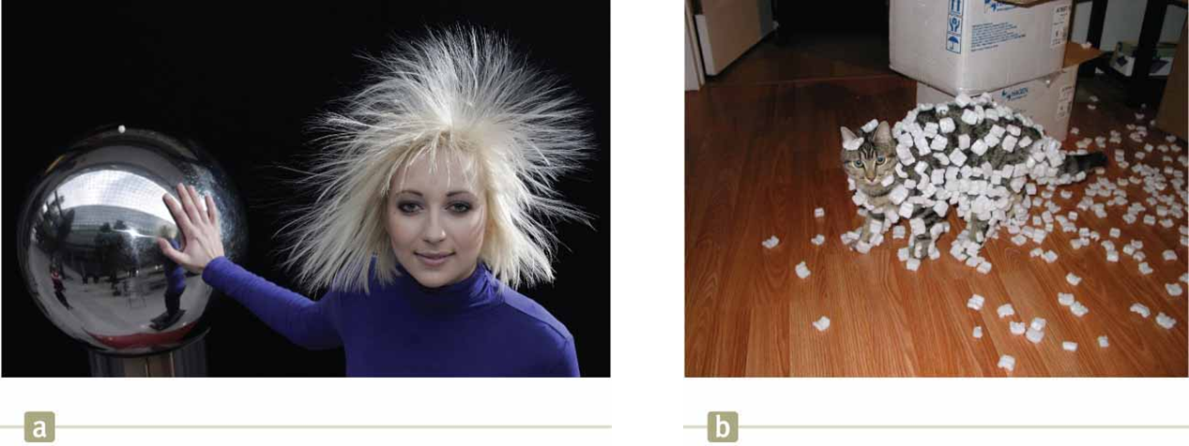
Properties of Electric Charges (1 of 2)
Notes:
Simple experiments show existence of electric force
Example: rubbing balloon on your hair on a dry day → balloon attracts bits of paper
Figure (a): woman’s body becomes charged → repulsive force between hairs on her head
Figure (b): cat rubbed its body against Styrofoam peanuts → attractive force: Styrofoam peanuts stuck to its body
When materials behave in this way: electrified or have become electrically charged
Electric force: force acting between electrically charged objects
Example: electrify your body by vigorously rubbing your shoes on wool rug
Touch friend →
Might see spark
Both feel slight tingle
Best on dry day because excessive moisture in air can cause any charge you build up to “leak” from your body to the Earth

Slide 4
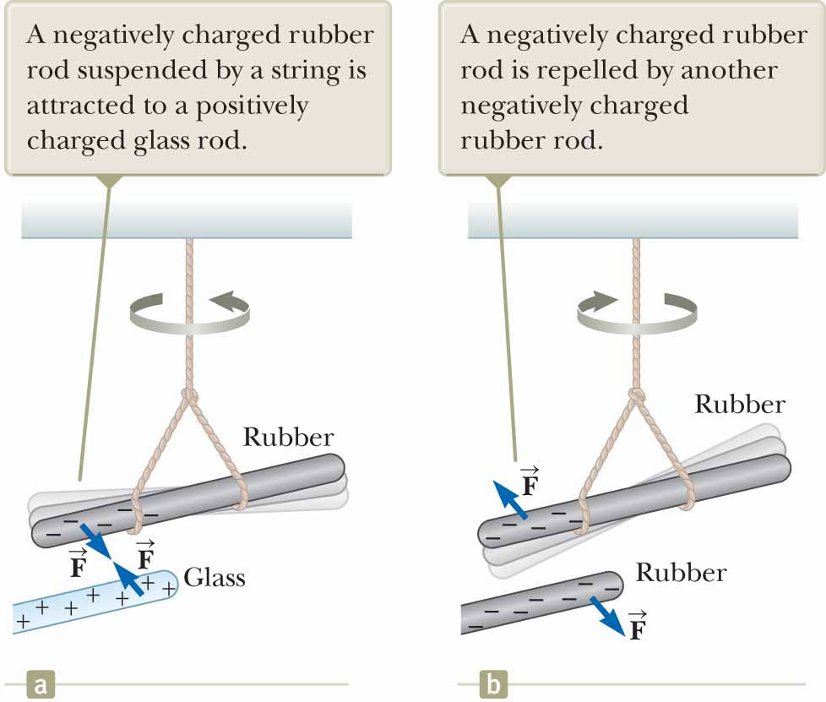
Properties of Electric Charges (2 of 2)
Notes:
Two kinds of electric charge: positive and negative (named by Benjamin Franklin)
Electrons: negative charge
Protons: positive charge
Imagine hard rubber rod that has been rubbed on fur suspended by a string (figure)
When glass rod that has been rubbed on silk brought near rubber rod → rods exhibit attractive force on each other (figure (a))
If two charged rubber rods (or two charged glass rods) brought near each other →
Rods exhibit repulsive force on each other (figure (b))
Experiment shows: rubber and glass have two different types of charge on them
Conclusion: charges of same sign repel one another and charges with opposite signs attract one another
Charge on glass rod: positive
Charge on rubber rod: negative
Any charged object attracted to charged rubber rod (or repelled by charged glass rod) must have positive charge
Any charged object repelled by charged rubber rod (or attracted to charged glass rod) must have negative charge

Slide 5
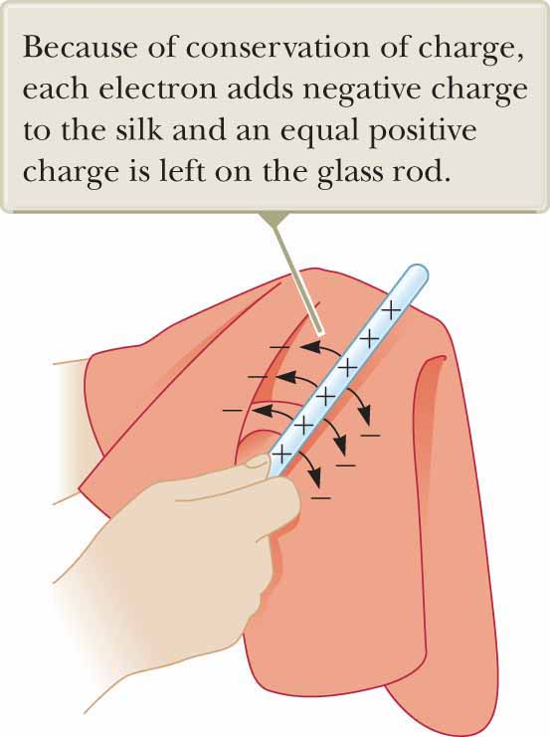
Conservation of Charge
Notes:
Electric charge is always conserved in isolated system
When one object rubbed against another: charge not created in process
Electrified state due to transfer of charge from one object to other
One object gains negative charge
Other gains equal amount of positive charge
Example: when glass rod rubbed on silk (figure) → silk obtains negative charge equal in magnitude to positive charge on glass rod
Electrons are transferred in rubbing process from glass to silk
When rubber rubbed on fur → electrons transferred from fur to rubber:
Rubber: net negative charge
Fur: net positive charge
Note: neutral, uncharged matter contains as many positive charges (protons within atomic nuclei) as negative charges (electrons)
Conservation of electric charge for isolated system → like conservation of:
Energy
Momentum
Angular momentum
No analysis model: not used often enough in mathematical solution to problems

Slide 6
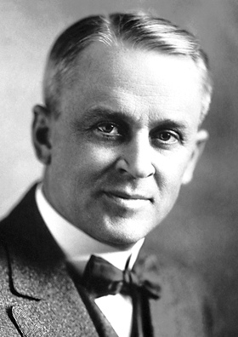
Charge is Quantized
Robert A. Millikan
Notes:
In 1909, Robert Millikan discovered: electric charge always occurs as integral multiples of fundamental amount of charge e
Electric charge q quantized
q = standard symbol used for charge as a variable
Electric charge exists as discrete “packets”
Can write: [click to show equation]
N = integer
Other experiments showed:
Electron has charge −e
Proton has charge of equal magnitude but opposite sign +e
Some particles (i.e., neutron): no charge
Image credit:
https://commons.wikimedia.org/wiki/File%3AMillikan.jpg
By Nobel foundation [Public domain], via Wikimedia Commons

Slide 7
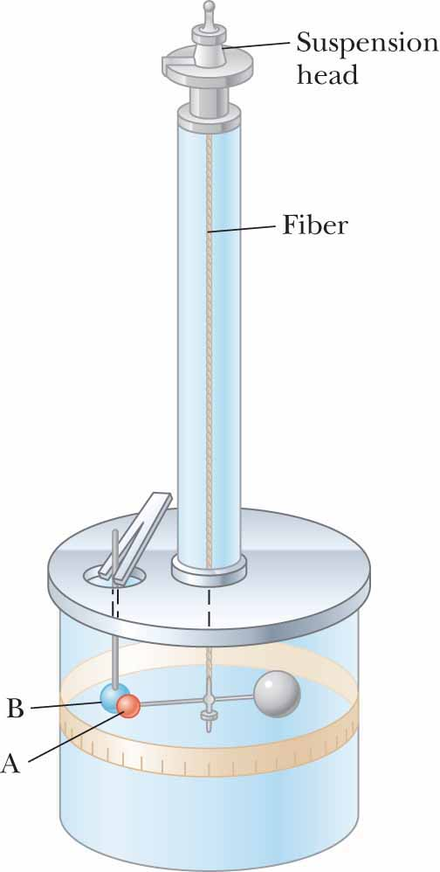
Electric Forces between Charged Objects
Notes:
Charles Coulomb: invented torsion balance (figure) to measure magnitudes of electric forces between charged objects
Electric force between charged spheres A and B causes spheres to either attract or repel each other:
Resulting motion causes suspended fiber to twist
Restoring torque of twisted fiber ∝ angle through which fiber rotates →
Measurement of angle provides quantitative measure of electric force of attraction or repulsion
Once spheres charged by rubbing:
Electric force between them large compared with gravitational attraction →
Gravitational force can be neglected

Slide 8
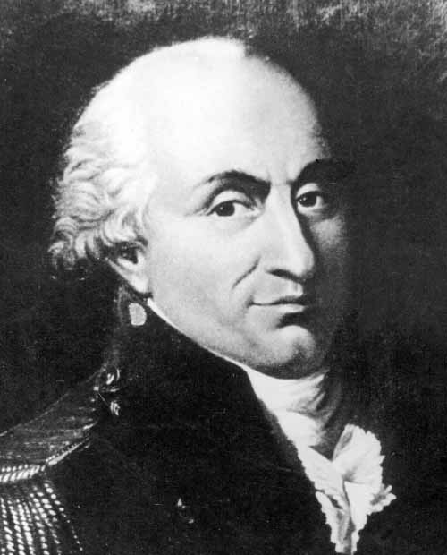
Coulomb’s Law
Charles Coulomb
Notes:
From Coulomb’s experiments → generalize properties of electric force (electrostatic force) between two stationary charged particles
Point charge: charged particle of zero size
Electrical behavior of electrons and protons very well described by modeling them as point charges.
From experimental observations: magnitude of electric force (Coulomb force) between two point charges given by Coulomb’s law: [click to show equation]
k_{e} = Coulomb constant
Coulomb showed: value of exponent of r is 2 to within uncertainty of a few percent
Modern experiments show: exponent is 2 to within uncertainty of a few parts in 10¹⁶
Experiments also show: electric force (like gravitational force) is conservative
Value of Coulomb constant depends on choice of units
SI unit of charge: coulomb (C)
Coulomb constant k_{e} in SI units is: [click to show equation]
Also written as: [click to show equation]
ε₀ = permittivity of free space: [click to show equation]
Smallest unit of free charge e known in nature:
Charge on electron (−e) or proton (+e): [click to show equation]

Slide 9
Coulomb of Charge
Notes:
1 C of charge ≈ charge of 6.24 × 10¹⁸ electrons or protons
Very small when compared with number of free electrons in 1 cm³ of copper:
∼ 10²³
1 C: substantial amount of charge
In typical experiments in which rubber or glass rod charged by friction → net charge ∼ 10⁻⁶ C
Only very small fraction of total available charge transferred between rod and rubbing material

Slide 10
Charges and Masses of Electrons, Protons, and Neutrons
Table 22.1 Charge and Mass of the Electron, Proton, and Neutron
Particle | Charge (C) | Mass (kg)
Electron (e) | −1.602 176 6 × 10⁻¹⁹ | 9.109 4 × 10⁻³¹
Proton (p) | +1.602 176 6 × 10⁻¹⁹ | 1.672 62 × 10⁻²⁷
Neutron (n) | 0 | 1.674 93 × 10⁻²⁷
Notes:
Table: charges and masses of electron, proton, and neutron
Note: electron and proton identical in magnitude of their charge
Vastly different in mass.
Proton and neutron similar in mass
Vastly different in charge

Slide 11
Example 22.1: The Hydrogen Atom (1 of 2)
The electron and proton of a hydrogen atom are separated (on the average) by a distance of approximately 5.3 × 10⁻¹¹ m. Find the magnitudes of the electric force and the gravitational force between the two particles.
Notes:
Conceptualize Think about the two particles separated by the very small distance given in the problem statement. Because the particles have both electric charge and mass, there will be both an electric force and a gravitational force between them.
Categorize The electric and gravitational forces will be evaluated from universal force laws, so we categorize this example as a substitution problem.

Slide 12
Example 22.1: The Hydrogen Atom (2 of 2)
Notes:
Use Coulomb’s law to find the magnitude of the electric force.
Substitute values. [click to show equation]
Use Newton’s law of universal gravitation and the particle masses to find the magnitude of the gravitational force. [click to show equation]
The ratio F_{e}/F_{g} ≈ 2 × 10³⁹. [click to show equation] Therefore, the gravitational force between charged atomic particles is negligible when compared with the electric force. Notice the similar mathematical forms of Newton’s law of universal gravitation and Coulomb’s law of electric forces. Other than the magnitude of the forces between elementary particles, what is a fundamental difference between the two forces?

Slide 13
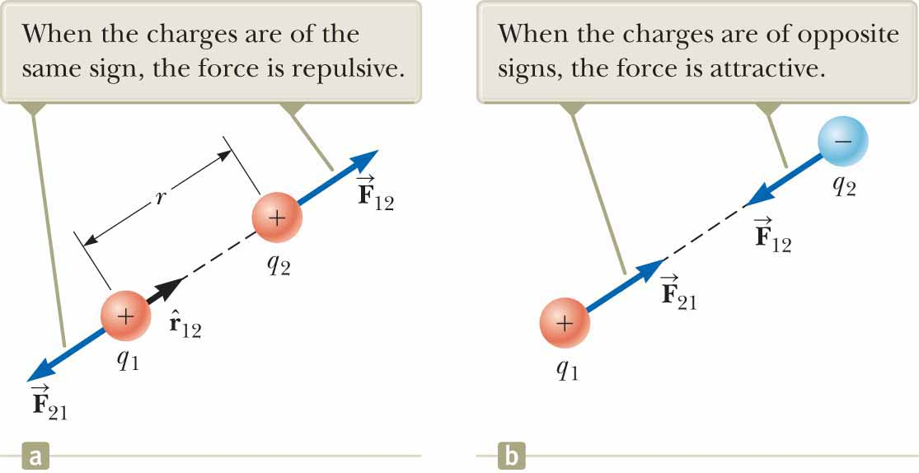
Coulomb’s Law in Vector Form
Notes:
Coulomb’s law in vector form for electric force exerted by charge q₁ on charge q₂: [click to show equation]
r₁₂ = unit vector directed from q₁ toward q₂ (figure (a))
Electric force obeys Newton’s third law →
Electric force exerted by q₂ on q₁ = in magnitude to force exerted by q₁ on q₂ and in opposite direction:
F₂₁ = −F₁₂
If q₁ and q₂ have same sign (figure (a)):
Product q₁q₂ positive
Electric force on one particle directed away from other particle
If q₁ and q₂ opposite sign (figure (b)):
Product q₁q₂ negative
Electric force on one particle directed toward other particle
Signs describe relative direction of force, not absolute direction.
Negative product → attractive force
Positive product → repulsive force
Absolute direction of force on charge depends on location of other charge
Example: if x axis lies along two charges (figure (a)):
Product q₁q₂ positive
F₁₂ points in positive x direction
F₂₁ points in negative x direction
When more than two charges present: force between any pair given by superposition principle
Example: 4 charges: [click to show equation]
Resultant force = vector sum of forces exerted by other individual charges

Slide 14
Quick Quiz 22.3 (1 of 2)
Object A has a charge of +2 μC, and object B has a charge of +6 μ C. Which statement is true about the electric forces on the objects?

Slide 15
Quick Quiz 22.3 (2 of 2)
Object A has a charge of +2 μC, and object B has a charge of +6 μ C. Which statement is true about the electric forces on the objects?
Notes:
From Newton’s third law, the electric force exerted by object B on object A is equal in magnitude to the force exerted by object A on object B and in the opposite direction.

Slide 16
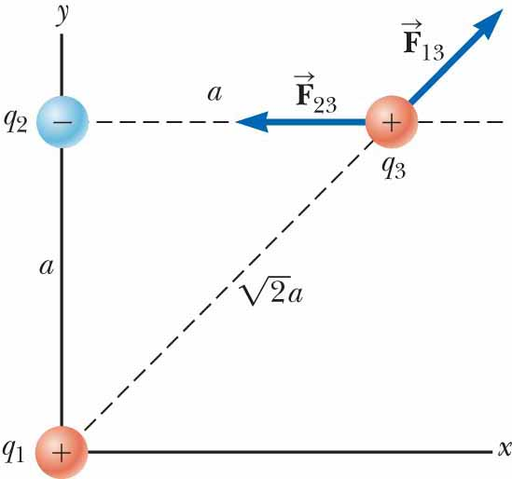
Example 22.2: Find the Resultant Force (1 of 3)
Consider three point charges located at the corners of a right triangle as shown in the figure, where q₁ = q₃ = 5.00 μC, q₂ = −2.00 μC, and a = 0.100 m. Find the resultant force exerted on q₃.
Notes:
Conceptualize Think about the net force on q₃. Because charge q₃ is near two other charges, it will experience two electric forces. These forces are exerted in different directions as shown in the figure. Based on the forces shown in the figure, estimate the direction of the net force vector.
Categorize Because two forces are exerted on charge q₃, we categorize this example as a vector addition problem.

Slide 17
Example 22.2: Find the Resultant Force (2 of 3)
Notes:
Analyze The individual forces exerted by q₁ and q₂ on q₃ have a direction determined by the pairs of charges; the forces are either attractive or repulsive. The vector forces on q₃ are shown in the figure. The force F₂₃ exerted by q₂ on q₃ is attractive because q₂ and q₃ have opposite signs. In the coordinate system shown, the attractive force F₂₃ is to the left (in the negative x direction). The force F₁₃ exerted by q₁ on q₃ is repulsive because both charges are positive. The repulsive force F₁₃ makes an angle of 45.0° with the x axis. The magnitudes of the forces F₁₃ and F₂₃ are determined using the absolute magnitudes of the charges in the equation.
Find the magnitude of F₂₃. [click to show equation]
Find the magnitude of the force F₁₃. [click to show equation]
Find the x and y components of the force F₁₃. [click to show equation]
Find the components of the resultant force acting on q₃. [click to show equation]
Express the resultant force acting on q₃ in unit-vector form. [click to show equation]
Finalize The net force on q₃ is upward and toward the left in the figure. If q₃ moves in response to the net force, the distances between q₃ and the other charges change, so the net force changes. Therefore, if q₃ is free to move, it can be modeled as a particle under a net force as long as it is recognized that the force exerted on q₃ is not constant. As a reminder, we display most numerical values to three significant figures, which leads to operations such as 7.94 N + (28.99 N) = 21.04 N above. If you carry all intermediate results to more significant figures, you will see that this operation is correct.

Slide 18
Example 22.2: Find the Resultant Force (3 of 3)
Notes:
Answer The charge q₃ would still be attracted toward q₂ and repelled from q₁ with forces of the same magnitude.
Therefore, the final result for F₃ would be the same.

Slide 19
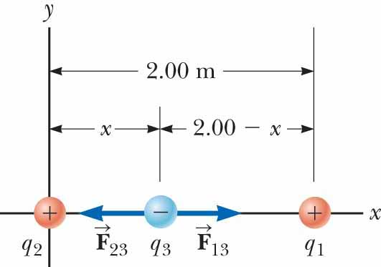
Example 22.3: Where Is the Net Force Zero? (1 of 3)
Three point charges lie along the x axis as shown in the figure. The positive charge q₁ = 15.0 μC is at x = 2.00 m, the positive charge q₂ = 6.00 μC is at the origin, and the net force acting on q₃ is zero. What is the x coordinate of q₃?
Notes:
Conceptualize Because q₃ is near two other charges, it experiences two electric forces. Unlike the preceding example, however, the forces lie along the same line in this problem as indicated in the figure. Because q₃ is negative and q₁ and q₂ are positive, the forces F₁₃ and F₂₃ are both attractive. Because q₂ is the smaller charge, the position of q₃ at which the force is zero should be closer to q₂ than to q₁.
Categorize Because the net force on q₃ is zero, we model the point charge as a particle in equilibrium.

Slide 20
Example 22.3: Where Is the Net Force Zero? (2 of 3)
Notes:
Analyze Write an expression for the net force on charge q₃ when it is in equilibrium. [click to show equation]
Move the second term to the right side of the equation and set the coefficients of the unit vector i equal. [click to show equation]
Eliminate k_{e} and |q₃| and rearrange the equation. [click to show equation]
Take the square root of both sides of the equation. [click to show equation]
Solve for x. [click to show equation]
Substitute numerical values, choosing the plus sign. [click to show equation]
Finalize Notice that the movable charge is indeed closer to q₂ as we predicted in the Conceptualize step. Notice that the result in Equation (1) is independent of both the magnitude and the sign of charge q₃. If q₃ increases, both forces in the figure increase in magnitude but still cancel. If q₃ changes sign, both forces reverse direction but still cancel. The second solution to the equation (if we choose the negative sign) is x = −3.44 m. That is another location where the magnitudes of the forces on q₃ are equal, but both forces are in the same direction, so they do not cancel.

Slide 21
Example 22.3: Where Is the Net Force Zero? (3 of 3)
Suppose q₃ is constrained to move only along the x axis. From its initial position at x = 0.775 m, it is pulled a small distance along the x axis. When released, does it return to equilibrium, or is it pulled farther from equilibrium? That is, is the equilibrium stable or unstable?
Notes:
If q₃ is moved to the right, F₁₃ becomes larger and F₂₃ becomes smaller. The result is a net force to the right, in the same direction as the displacement. Therefore, the charge q₃ would continue to move to the right and the equilibrium is unstable. If q₃ is constrained to stay at a fixed x coordinate but allowed to move up and down in the figure, the equilibrium is stable. In this case, if the charge is pulled upward (or downward) and released, it moves back toward the equilibrium position and oscillates about this point. Is the oscillation simple harmonic?

Slide 22
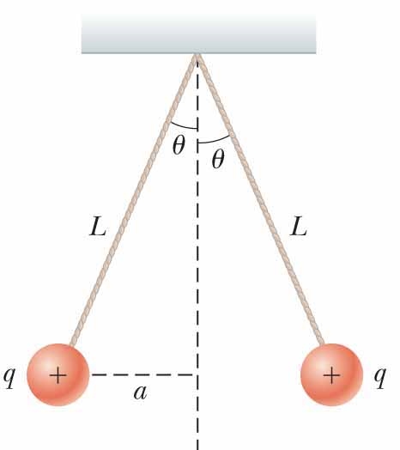
Example 22.4: Find the Charge on the Spheres (1 of 3)
Two identical small charged spheres, each having a mass of 3.00 × 10⁻² kg, hang in equilibrium as shown in the figure. The length L of each string is 0.150 m, and the angle θ is 5.00°. Find the magnitude of the charge on each sphere.
Notes:
Conceptualize The figure helps us conceptualize this example. The two spheres exert repulsive forces on each other. If they are held close to each other and released, they move outward from the center and settle into the configuration in Figure the figure after the oscillations have vanished due to air resistance.
Categorize The key phrase “in equilibrium” helps us model each sphere as a particle in equilibrium.

Slide 23
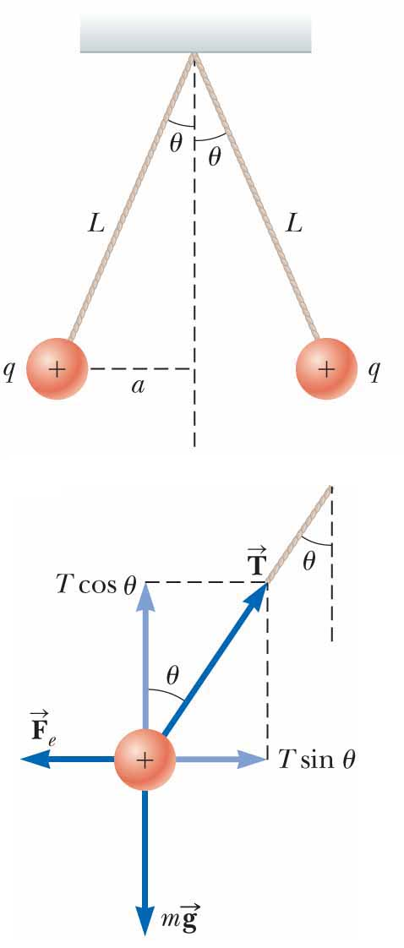
Example 22.4: Find the Charge on the Spheres (2 of 3)
Notes:
Analyze The force diagram for the left-hand sphere is shown in the bottom figure. The sphere is in equilibrium under the application of the force T from the string, the electric force F_{e} from the other sphere, and the gravitational force mg.
From the particle in equilibrium model, set the net force on the left-hand sphere equal to zero for each component. [click to show equation]
Divide the equations to find F_{e} . [click to show equation]
Use the geometry of the right triangle in the bottom figure to find a relationship between a, L, and θ. [click to show equation]
Solve Coulomb’s law for the charge |q| on each sphere and substitute. [click to show equation]
Substitute numerical values. [click to show equation]
Finalize If the sign of the charges were not given in the figure, we could not determine them. In fact, the sign of the charge is not important. The situation is the same whether both spheres are positively charged or negatively charged.

Slide 24
Example 22.4: Find the Charge on the Spheres (3 of 3)
Suppose your roommate proposes solving this problem without the assumption that the charges are of equal magnitude. She claims the symmetry of the problem is destroyed if the charges are not equal, so the strings would make two different angles with the vertical and the problem would be much more complicated. How would you respond?
Notes:
The symmetry is not destroyed and the angles are not different. Newton’s third law requires the magnitudes of the electric forces on the two spheres to be the same, regardless of the equality or nonequality of the charges. The solution to the example remains the same with one change: the value of |q| in the solution is replaced by $\sqrt{q_{1}q_{2}}$ in the new situation, where q₁ and q₂ are the values of the charges on the two spheres. The symmetry of the problem would be destroyed if the masses of the spheres were not the same. In this case, the strings would make different angles with the vertical and the problem would be more complicated.

Slide 25
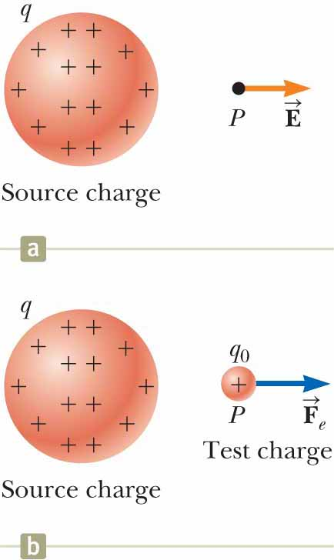
Analysis Model: Particle in a Field (Electric) (1 of 4)
Notes:
Field forces can act through space →
Producing effect even when no physical contact occurs between interacting objects
Model interaction as two-step process:
Source particle establishes field
Charged particle interacts with field and experiences a force
Gravitational field g at point in space due to source particle = gravitational force F_{g} acting on test particle of mass m₀ divided by that mass: [click to show equation]
Force exerted by field on any particle of mass m is: [click to show equation]
Field concept developed by Michael Faraday in context of electric forces
Figure: shows two-step process for electric force
Electric field said to exist in region of space around charged object: source charge
Figure (a): shows source charge and resulting electric field at point P in space external to source charge
Presence of electric field detected by placing test charge in field and noting electric force on it (figure (b))
Define electric field due to source charge at location of charge to be electric force on test charge per unit charge:
Electric field vector E at point in space defined as electric force F_{e} acting on positive test charge q₀ placed at that point divided by test charge: [click to show equation]
Vector E: SI units of newtons per coulomb (N/C)
Direction of E (figure (a)): direction of force positive test charge experiences when placed in field
Note: E = field produced by source charge alone
Presence of test charge not necessary for field to exist
Test charge serves only as detector of electric field:
An electric field exists at a point if test charge at that point experiences electric force
If arbitrary charge q placed in electric field E → experiences electric force given by: [click to show equation]
Equation: mathematical representation of electric version of particle in a field analysis model
If q positive → force in same direction as field
Once magnitude and direction of electric field known at some point:
Electric force exerted on any charged particle placed at that point can be calculated

Slide 26
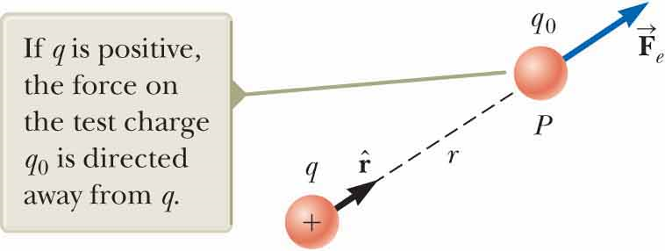
Analysis Model: Particle in a Field (Electric) (2 of 4)
Notes:
To determine vector form of electric field:
Test charge q₀ placed at point P, distance r from source charge (figure)
Coulomb’s law: force exerted by q on test charge is: [click to show equation]
r = unit vector directed from q toward q₀.
Force directed away from source charge q.
Because electric field at P (position of test charge) defined by: [click to show equation]
Electric field at P created by q is: [click to show equation]

Slide 27
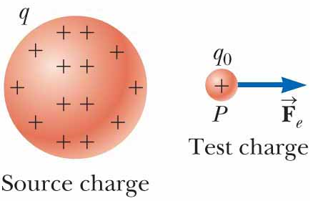
Analysis Model: Particle in a Field (Electric) (3 of 4)
Notes:
Many similarities between electric field and gravitational field
Note difference between notations used:
Gravitational field generally set up by object whose mass is huge compared to that of object placed in field
Use symbol M_{E} for source: [click to show equation]
Use separate symbol m for mass of object placed in field: [click to show equation]
In electric field:
Charge of source of field often similar in magnitude to charge placed in field
Tend to use same symbol q for both
In Figure and equation: [click to show equation]: q represents source charge that sets up electric field
In this equation: [click to show equation]
q represents charge placed in electric field
Whenever possibility of confusion → use subscripts to differentiate charges (i.e, q₁ and q₂)

Slide 28
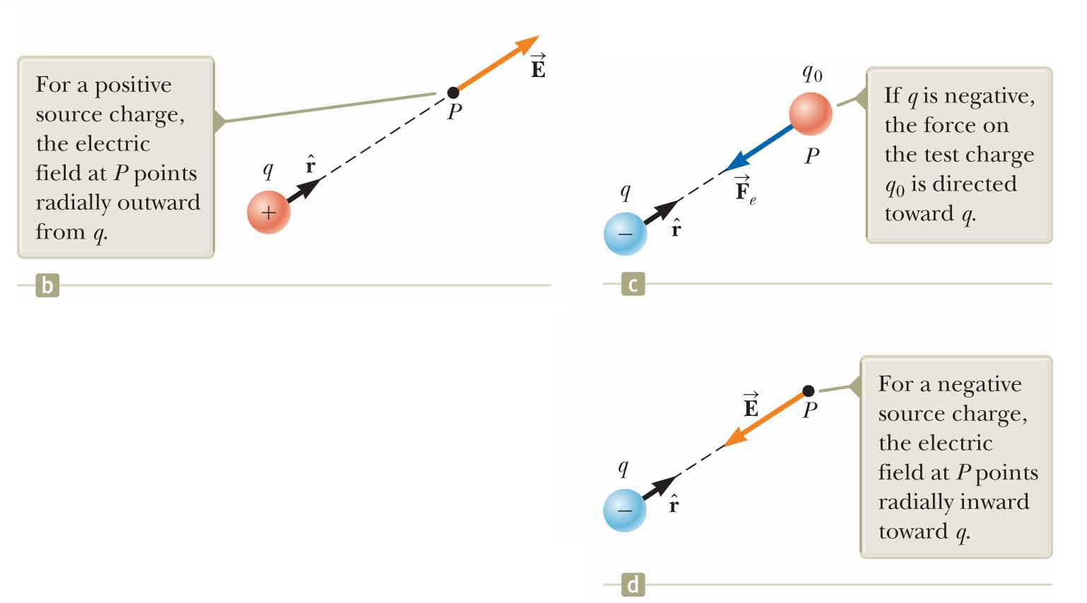
Analysis Model: Particle in a Field (Electric) (4 of 4)
Notes:
If source charge q positive → figure (b) shows situation with test charge removed
Source charge sets up electric field at P, directed away from q
If q negative (figure (c)) → force on positive test charge directed towards q
Electric field at P directed toward source charge (figure (d))
Calculate electric field at point P due to small number of point charges:
First calculate electric field vectors at P individually: [click to show equation]
Add vectorially
At any point P: total electric field due to group of source charges = vector sum of electric fields of all charges
Superposition principle applied to fields follows directly from vector addition of electric forces
Electric field at point P due to group of source charges expressed as vector sum: [click to show equation]
r_{i} = distance from ith source charge q_{i} to point P
r_{i} = unit vector directed from q_{i} toward P

Slide 29

Electric Force
Notes:
Electric force: responsible for all three phenomena mentioned in introductory storyline
As well as that in photo
As your clothing items rub together in rotating dryer → electric charge transferred from one item to another
Items stick together when you take them out of dryer
When you comb your hair →
Rubbing of comb against hair causes comb to become charged
When charged comb placed near stream of water:
Attractive force between comb and ions in water
In inkjet printing: ink drops given charge and then projected downward toward surface to be printed
When ink drops moving toward location to be printed →
Pass freely through field-free region
When ink drops moving toward location not to be printed → electric field turned on
Electric force on ink drops diverts them into trough
Do not contribute to printed image
In photo: child electrically charged from rubbing against plastic slide
Image credit:
https://commons.wikimedia.org/wiki/File%3AStatic_on_the_playground_(48616367).jpg
By Chris Darling from Portland, USA (static on the playground) [CC BY 2.0 (http://creativecommons.org/licenses/by/2.0)], via Wikimedia Commons

Slide 30
Quick Quiz 22.4 (1 of 2)
A test charge of +3 μC is at a point P where an external electric field is directed to the right and has a magnitude of 4 × 10⁶ N/C. If the test charge is replaced with another test charge of −3 μC, what happens to the external electric field at P?
It is unaffected.
It reverses direction.
It changes in a way that cannot be determined.

Slide 31
Quick Quiz 22.4 (2 of 2)
A test charge of +3 μC is at a point P where an external electric field is directed to the right and has a magnitude of 4 × 10⁶ N/C. If the test charge is replaced with another test charge of −3 μC, what happens to the external electric field at P?
It is unaffected.
It reverses direction.
It changes in a way that cannot be determined.
Notes:
There is no effect on the electric field if we assume the source charge producing the field is not disturbed by our actions. Remember that the electric field is created by the source charge(s) (unseen in this case), not the test charge(s).

Slide 32
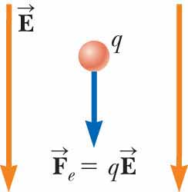
Analysis Model: Particle in a Field (Electric)
Notes:
Imagine an object with charge that we call a source charge. The source charge establishes an electric field E throughout space. Now imagine a particle with charge q is placed in that field. The particle interacts with the electric field so that the particle experiences an electric force given by the equation shown.
Examples:
• An electron moves between the deflection plates of a cathode ray oscilloscope and is deflected from its original path
• Charged ions experience an electric force from the electric field in a velocity selector before entering a mass spectrometer
• An electron moves around the nucleus in the electric field established by the proton in a hydrogen atom as modeled by the Bohr theory
• A hole in a semiconducting material moves in response to the electric field established by applying a voltage to the material

Slide 33
Example 22.5: A Suspended Water Droplet
A water droplet of mass 3.00 × 10⁻¹² kg is located in the air near the ground during a stormy day. An atmospheric electric field of magnitude 6.00 × 10³ N/C points vertically downward in the vicinity of the water droplet. The droplet remains suspended at rest in the air. What is the electric charge on the droplet?
Notes:
Conceptualize Imagine the water droplet hovering at rest in the air. This situation is not what is normally observed, so something must be holding the water droplet up.
Categorize The droplet can be modeled as a particle and is described by two analysis models associated with fields: the particle in a field (gravitational) and the particle in a field (electric). Furthermore, because the droplet is subject to forces but remains at rest, it is also described by the particle in equilibrium model.
Write Newton’s second law from the particle in equilibrium model in the vertical direction. [click to show equation]
Using the two particle in a field models mentioned in the Categorize step, substitute for the forces in this equation, recognizing that the vertical component of the electric field is negative. [click to show equation]
Solve for the charge on the water droplet. [click to show equation]
Substitute numerical values. [click to show equation]
Finalize Noting the smallest unit of free charge, the charge on the water droplet is a large number of these units. Notice that the electric force is upward to balance the downward gravitational force. The problem statement claims that the electric field is in the downward direction. Therefore, the charge found above is negative so that the electric force is in the direction opposite to the electric field.

Slide 34
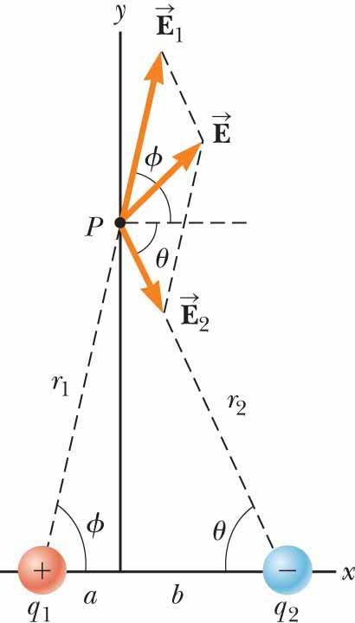
Example 22.6: Electric Field Due to Two Charges (1 of 4)
Charges q₁ and q₂ are located on the x axis, at distances a and b, respectively, from the origin as shown in the figure.
(A) Find the components of the net electric field at the point P, which is at position (0, y).

Slide 35
Example 22.6: Electric Field Due to Two Charges (2 of 4)
Notes:
Analyze Find the magnitude of the electric field at P due to charge q₁. [click to show equation]
Find the magnitude of the electric field at P due to charge q₂. [click to show equation]
Write the components of the net electric field vector. [click to show equation]

Slide 36
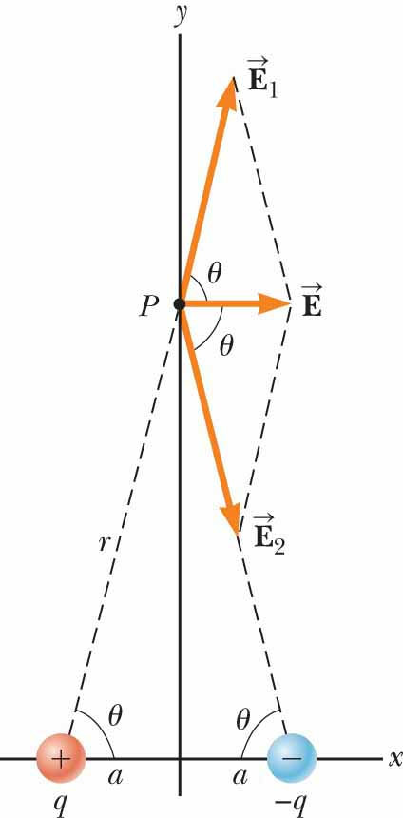
Example 22.6: Electric Field Due to Two Charges (3 of 4)
(B) Evaluate the electric field at point P in the special case that |q₁| = |q₂| and a = b.
Notes:
Conceptualize The figure shows the situation in this special case. Notice the symmetry in the situation and that the charge distribution is now an electric dipole.
Categorize Because the figure is a special case of the general case shown earlier, we can categorize this example as one in which we can take the result of part (A) and substitute the appropriate values of the variables.
Analyze Based on the symmetry in the figure, evaluate the equations from part (A) with a = b, |q₁| = |q₂| = q, and φ = θ. [click to show equation]
From the geometry in the figure, evaluate cos θ. [click to show equation]
Substitute. [click to show equation]
Electric dipole: defined as positive charge q and negative charge −q separated by distance 2a.
Good model of many molecules (i.e., hydrochloric acid (HCl))
Neutral atoms and molecules behave as dipoles when placed in an external electric field.
Many molecules (i.e., HCl): permanent dipoles.

Slide 37
Example 22.6: Electric Field Due to Two Charges (4 of 4)
(C) Find the electric field due to the electric dipole when point P is a distance y >> a from the origin.
Notes:
In the solution to part (B), because y >> a, neglect a² compared with y² and write the expression for E in this case. [click to show equation]
Finalize We see that at points far from a dipole but along the perpendicular bisector of the line joining the two charges, the magnitude of the electric field created by the dipole varies as 1/r³, whereas the more slowly varying field of a point charge varies as 1/r². That is because at distant points, the fields of the two charges of equal magnitude and opposite sign almost cancel each other. The 1/r³ variation in E for the dipole also is obtained for a distant point along the x axis and for any general distant point. In both parts (A) and (B), if a new charge q₁ is placed at point P, the equation can be used to find the electric force on the charge: F = q₁E = q₁E_{x}i + q₁E_{y}j.

Slide 38
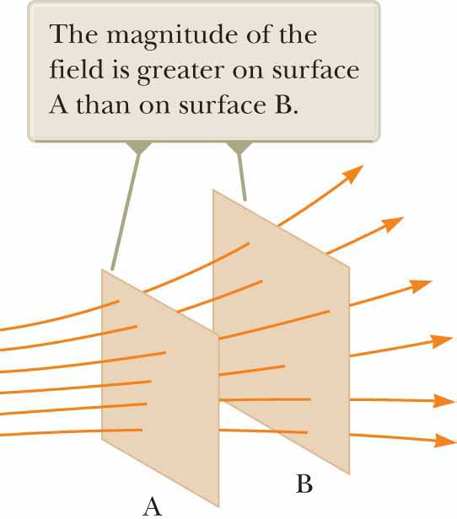
Electric Field Lines (1 of 5)
Notes:
Visualizing electric field in pictorial representation: electric field lines
Related to electric field in region of space: (see figure)
Electric field vector E tangent to electric field line at each point
Line direction (indicated by arrowhead) same as that of electric field vector
Direction of line: that of force on positive charge placed in field according to particle in field model
Number of lines per unit area through surface perpendicular to lines ∝ magnitude of electric field in region
Field lines close together where electric field strong
Far apart where field weak
Density of field lines through surface A > density of lines through surface B →
Magnitude of electric field larger on surface A than on surface B
Because lines at different locations point in different directions:
Field nonuniform
Relationship between strength of electric field and density of field lines consistent with: [click to show equation]
Consider imaginary spherical surface of radius r concentric with point charge
From symmetry → magnitude of electric field same everywhere on surface of sphere
Number of lines N that emerge from charge = number that penetrate spherical surface
Number of lines per unit area on sphere is N/4πr² (surface area of sphere = 4πr²)
E ∝ number of lines per unit area→
E varies as 1/r²

Slide 39
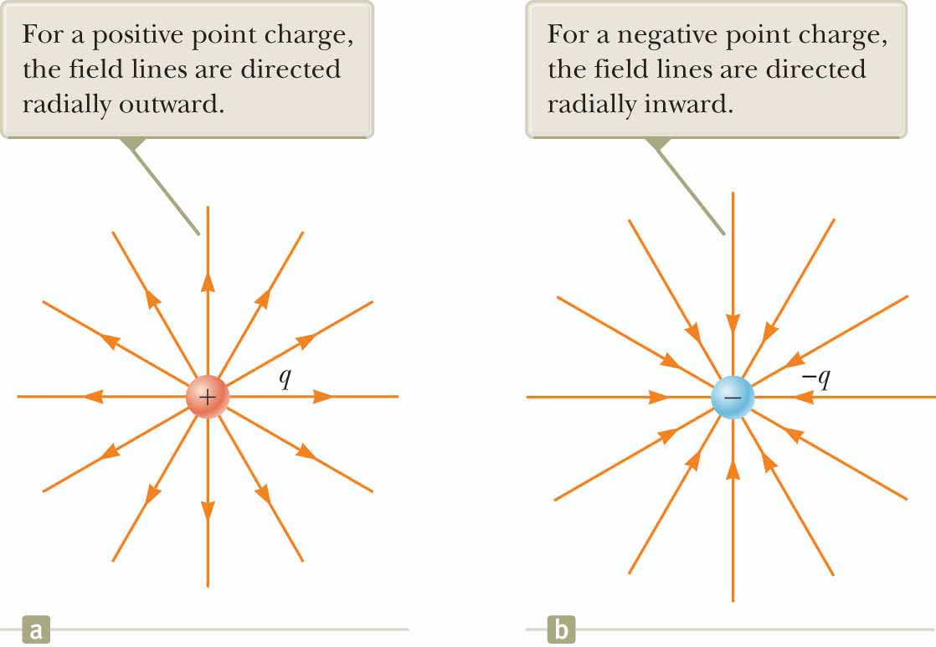
Electric Field Lines (2 of 5)
Notes:
Figure (a): representative electric field lines for field due to single positive point charge
Lines actually directed radially outward from charge in all directions
Picture entire spherical distribution of lines
Because positive charge placed in this field repelled by positive source charge →
Lines directed radially away from source charge
Field lines representing field due to single negative point charge directed toward charge (figure (b))
Both figures:
Lines along radial direction
Extend all the way to infinity
Note: lines become closer together as they approach charge:
Indicating that strength of field increases as we move toward source charge
Rules for drawing electric field lines:
Lines must begin on positive charge and terminate on negative charge
In case of excess of one type of charge → some lines will begin or end infinitely far away
Number of lines drawn leaving positive charge or approaching negative charge ∝ magnitude of charge
No two field lines can cross

Slide 40
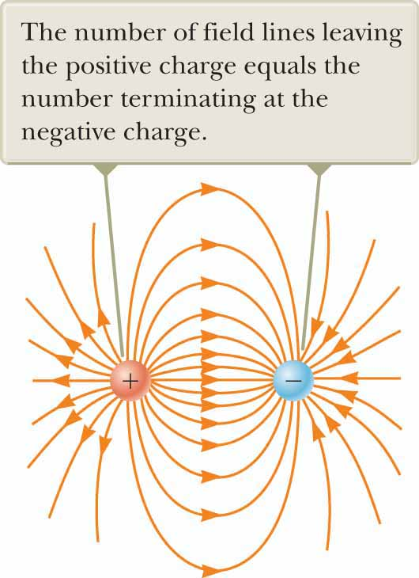
Electric Field Lines (3 of 5)
Notes:
Choose number of field lines starting from any object with positive charge q₊ to be Cq₊
Number of lines ending on any object with negative charge q₋ to be C|q₋|
C = arbitrary proportionality constant
Once C chosen: number of lines fixed.
For example:
In two-charge system: if object 1 has charge Q₁ and object 2 has charge Q₂ →
Ratio of number of lines in contact with charges is: [click to show equation]
Figure: electric field lines for two point charges of equal magnitude but opposite signs (an electric dipole)
Because charges are of equal magnitude →
Number of lines that begin at positive charge must equal number that terminate at negative charge
At points very near charges:
Lines nearly radial, as for single isolated charge
High density of lines between charges indicates region of strong electric field

Slide 41
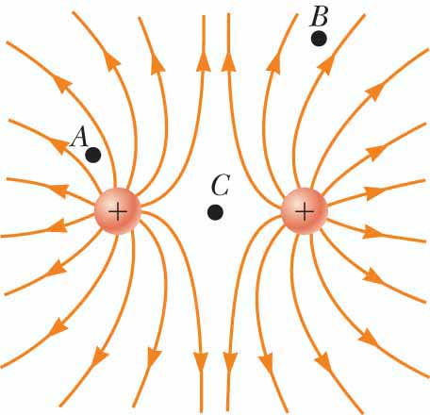
Electric Field Lines (4 of 5)
Notes:
Figure: electric field lines in vicinity of two equal positive point charges
Lines nearly radial at points close to either charge
Same number of lines emerges from each charge because charges are equal in magnitude
No negative charges available: electric field lines end infinitely far away
At great distances from charges:
Field ≈ that of single point charge of magnitude −q

Slide 42
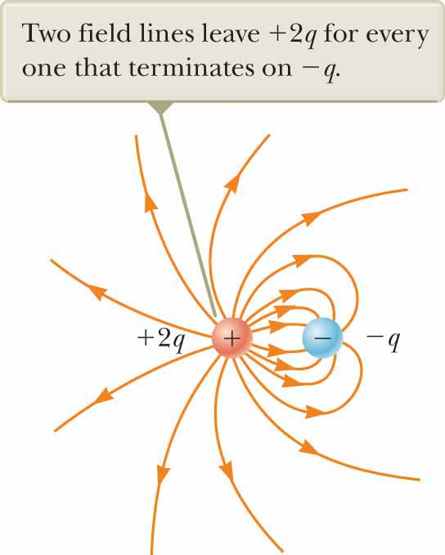
Electric Field Lines (5 of 5)
Notes:
Figure: electric field lines associated with positive charge +2q and negative charge −q
Number of lines leaving +2q twice number terminating at −q
Half lines that leave positive charge reach negative charge
Remaining half terminate on negative charge we assume to be at infinity
At distances much greater than charge separation:
Electric field lines equivalent to those of single charge +q

Slide 43
Quick Quiz 22.5 (1 of 2)
Rank the magnitudes of the electric field at points A, B, and C shown in the figure (greatest magnitude first).

Slide 44
Quick Quiz 22.5 (2 of 2)
Rank the magnitudes of the electric field at points A, B, and C shown in the figure (greatest magnitude first).
A, B, C
Notes:
The field is greatest at point A because that is where the field lines are closest together. The absence of lines near point C indicates that the electric field there is zero.

Slide 45
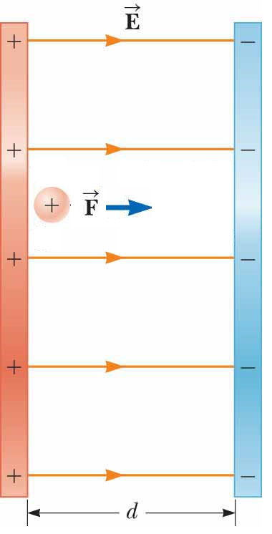
Motion of a Charged Particle in a Uniform Electric Field
Notes:
When particle of charge q and mass m placed in electric field E:
Electric force exerted on charge = qE
If only force exerted on particle:
Must be net force
Causes particle to accelerate according to particle under a net force model.
Therefore: [click to show equation]
Acceleration of particle is: [click to show equation]
If E uniform (i.e., constant in magnitude and direction) and particle free to move:
Electric force on particle constant
Can apply particle under constant acceleration model to motion of particle.
Particle described by three analysis models!
Particle in a field
Particle under a net force
Particle under constant acceleration
If particle has positive charge:
Acceleration in direction of electric field
If particle has negative charge:
Acceleration in direction opposite electric field

Slide 46
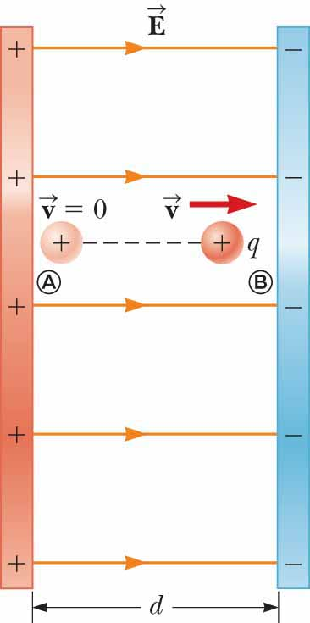
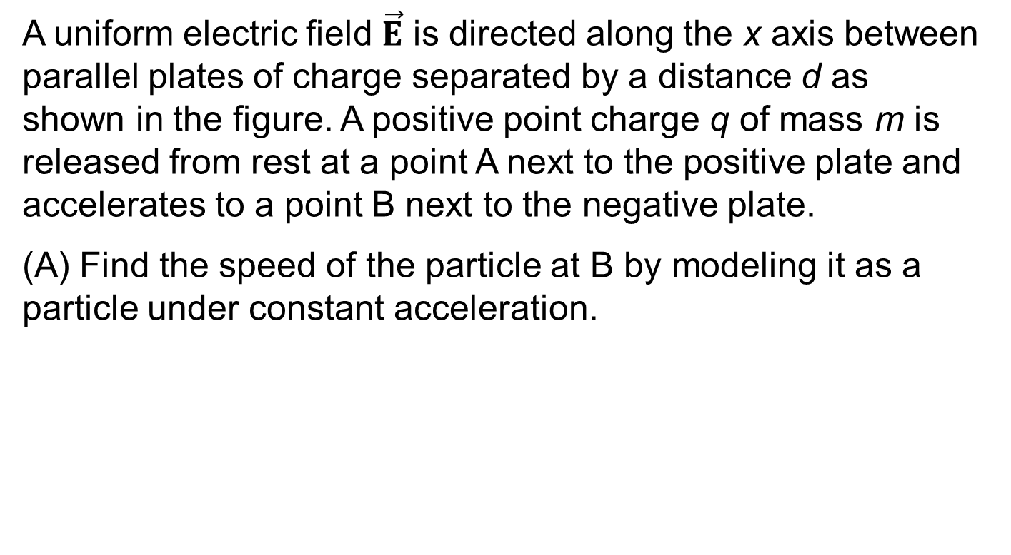
Example 22.7: An Accelerating Positive Charge: Two Models (1 of 3)
A uniform electric field $\vec{E}$ is directed along the x axis between parallel plates of charge separated by a distance d as shown in the figure. A positive point charge q of mass m is released from rest at a point A next to the positive plate and accelerates to a point B next to the negative plate.
(A) Find the speed of the particle at B by modeling it as a particle under constant acceleration.
Notes:
Conceptualize When the positive charge is placed at A, it experiences an electric force toward the right in the figure due to the electric field directed toward the right. As a result, it will accelerate to the right and arrive at B with some speed.
Categorize Because the electric field is uniform, a constant electric force acts on the charge. Therefore, as suggested in the discussion preceding the example and in the problem statement, the point charge can be modeled as a charged particle under constant acceleration.

Slide 47
Example 22.7: An Accelerating Positive Charge: Two Models (2 of 3)
Notes:
Express the velocity of the particle as a function of position. [click to show equation]
Solve for v_{f} and substitute for the magnitude of the acceleration. [click to show equation]

Slide 48
Example 22.7: An Accelerating Positive Charge: Two Models (3 of 3)
(B) Find the speed of the particle at B by modeling it as a nonisolated system in terms of energy.
Notes:
Categorize The problem statement tells us that the charge is a non isolated system for energy. The electric force, like any force, can do work on a system. Energy is transferred to the system of the charge by work done by the electric force exerted on the charge. The initial configuration of the system is when the particle is at rest at A, and the final configuration is when it is moving with some speed at B.
Analyze Write the appropriate reduction of the conservation of energy equation for the system of the charged particle. [click to show equation]
Replace the work and kinetic energies with values appropriate for this situation. [click to show equation]
Substitute for the magnitudes of the electric force F_{e} from the particle in a field model and the displacement Δx. [click to show equation]
Finalize The answer to part (B) is the same as that for part (A), as we expect. This problem can be solved with different approaches. We saw the same possibilities with mechanical problems.

Slide 49
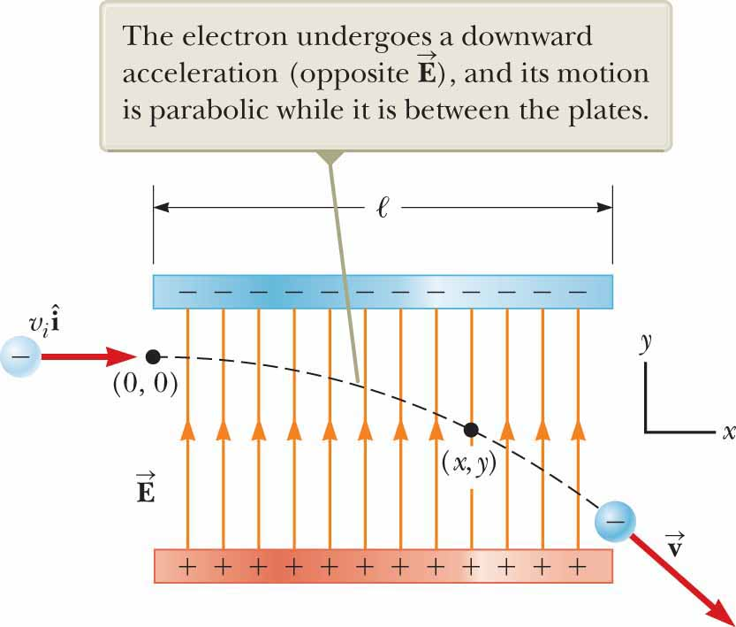
Example 22.8: An Accelerated Electron (1 of 4)
An electron enters the region of a uniform electric field as shown in the figure, with v_{i} = 3.00 × 10⁶ m/s and E = 200 N/C. The horizontal length of the plates is  = 0.100 m.
(A) Find the acceleration of the electron while it is in the electric field.
Notes:
Conceptualize This example differs from the preceding one because the velocity of the charged particle is initially perpendicular to the electric field lines. (In the earlier example, the velocity of the charged particle is always parallel to the electric field lines.) As a result, the electron in this example follows a curved path as shown in the figure. The motion of the electron is the same as that of a massive particle projected horizontally in a gravitational field near the surface of the Earth.
Categorize The electron is a particle in a field (electric). Because the electric field is uniform, a constant electric force is exerted on the electron. To find the acceleration of the electron, we can model it as a particle under a net force.

Slide 50
Example 22.8: An Accelerated Electron (2 of 4)
Notes:
Analyze From the particle in a field model, we know that the direction of the electric force on the electron is downward in the figure, opposite the direction of the electric field lines. From the particle under a net force model, therefore, the acceleration of the electron is downward.
The particle under a net force model was used to develop the equation shown in the case in which the electric force on a particle is the only force. Use this equation to evaluate the y component of the acceleration of the electron.
Substitute numerical values. [click to show equation]

Slide 51
Example 22.8: An Accelerated Electron (3 of 4)
(B) Assuming the electron enters the field at time t = 0, find the time at which it leaves the field.
Notes:
Categorize Because the electric force acts only in the vertical direction in the figure, the motion of the particle in the horizontal direction can be analyzed by modeling it as a particle under constant velocity.
Analyze Solve for the time at which the electron arrives at the right edges of the plates. [click to show equation]
Substitute numerical values. [click to show equation]

Slide 52
Example 22.8: An Accelerated Electron (4 of 4)
(C) Assuming the vertical position of the electron as it enters the field is y_{i} = 0, what is its vertical position when it leaves the field?
Notes:
Categorize Because the electric force is constant in the figure, the motion of the particle in the vertical direction can be analyzed by modeling it as a particle under constant acceleration.
Use the kinematic equation to describe the position of the particle at any time t. [click to show equation]
Substitute numerical values. [click to show equation]
Finalize If the electron enters just below the negative plate in the figure and the separation between the plates is less than the value just calculated, the electron will strike the positive plate. Notice that we have used four analysis models to describe the electron in the various parts of this problem. We have neglected the gravitational force acting on the electron, which represents a good approximation when dealing with atomic particles. For an electric field of 200 N/C, the ratio of the magnitude of the electric force eE to the magnitude of the gravitational force mg is on the order of 10¹² for an electron and on the order of 10⁹ for a proton.

