Slide 1
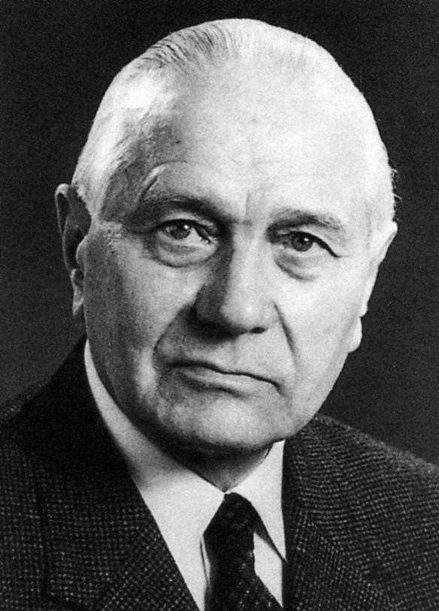
Hydroformylation
Otto Roelen (1897-1993)
* Largest homogeneous catalytic process
* > 15 billion pounds of aldehydes (alcohols) per year
Commercial catalysts are complexes of Co or Rh
Selectivity to linear (normal) aldehyde important

Slide 2
HCo(CO)₄ Catalyst System – Unmodified Co

Slide 6
HCo(CO)₄(PR₃) Catalyst System – Phosphine Modified
Lynn Slaugh and Richard Mullineaux; Shell Chemical Co.

Slide 7
Table 1. Hydroformylation of 1-hexene using Co₂(CO)₈/2P as catalyst precursor. 160°C, 70 atm, 1.2:1 H₂/CO
PR₃ | pK_{a} | Tolman ν (cm⁻¹) | Cone Angle ° | k_{r} x 10³ (min⁻¹) | % Linear Prod | Aldehyde to alcohol
P(i-Pr)₃ | 9.4 | 2059.2 | 160 | 2.8 | 85.0 | --
PEt₃ | 8.7 | 2061.7 | 132 | 2.7 | 89.6 | 0.9
PPr₃ | 8.6 | 2060.9 | 132 | 3.1 | 89.5 | 1.0
PBu₃ | 8.4 | 2060.3 | 136 | 3.3 | 89.6 | 1.1
PEt₂Ph | 6.3 | 2063.7 | 136 | 5.5 | 84.6 | 2.2
PEtPh₂ | 4.9 | 2066.7 | 140 | 8.8 | 71.7 | 4.3
PPh₃ | 2.7 | 2068.9 | 145 | 14.1 | 62.4 | 11.7

Slide 8
HRh(CO)(PR₃)₂ Catalyst System

Slide 9
Need for Excess Phosphine Ligand

Slide 10
Catalyst (1 mM) | Init TOF (min⁻¹) | Aldehyde L:B | % iso
Rh/PPh₃ (1:400) | 13(1) | 9:1 | < 0.5
Rh/Bisbi (1:5) | 25(2) | 70:1 | < 0.5
Rh/Naphos (1:5) | 27(1) | 120:1 | 1.5
Rh/Xantphos (1:5) | 13(2) | 80:1 | 5.0

Slide 11
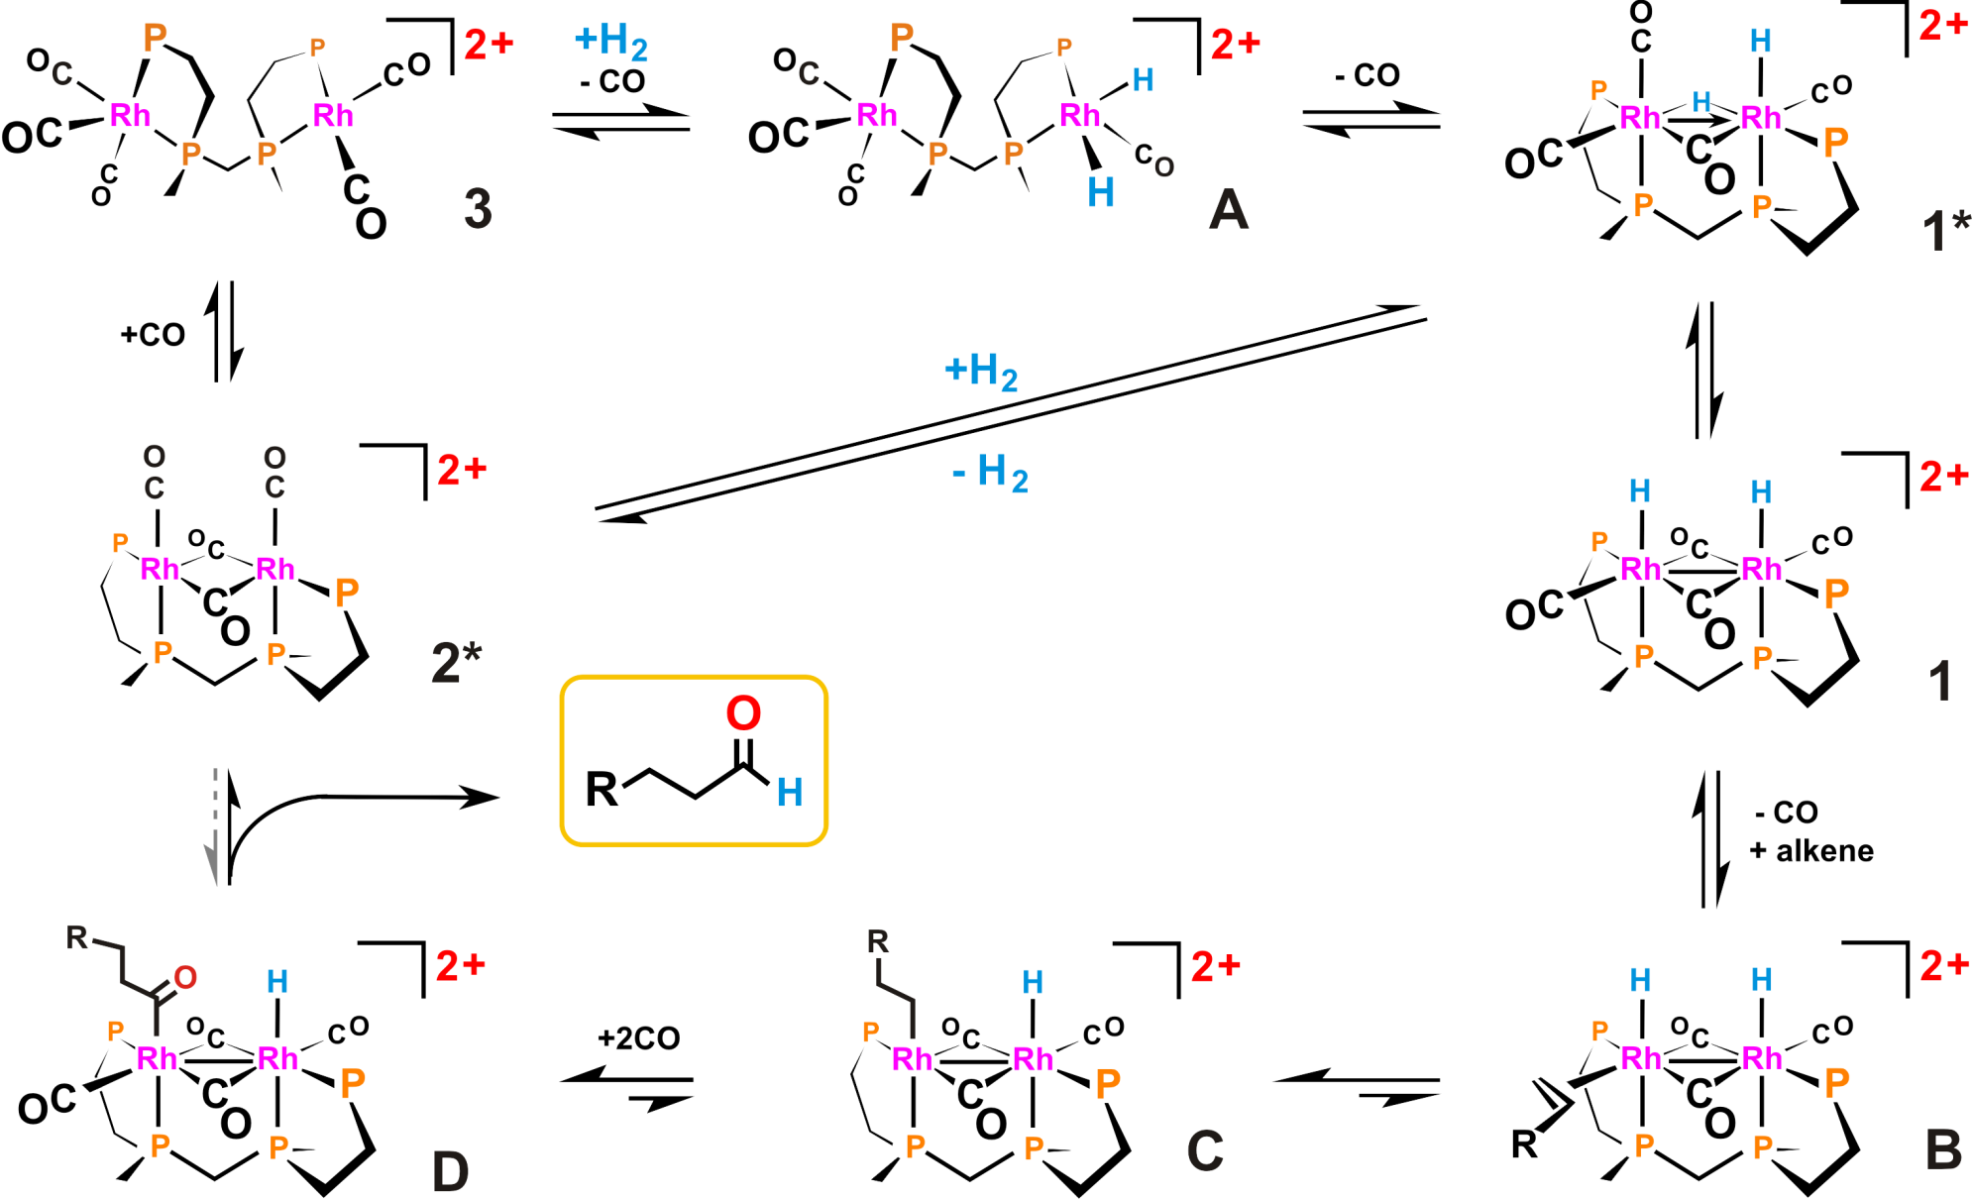
[rac-Rh₂H₂(μ-CO)₂(et,ph-P4)]²⁺ Catalyst System

Slide 12
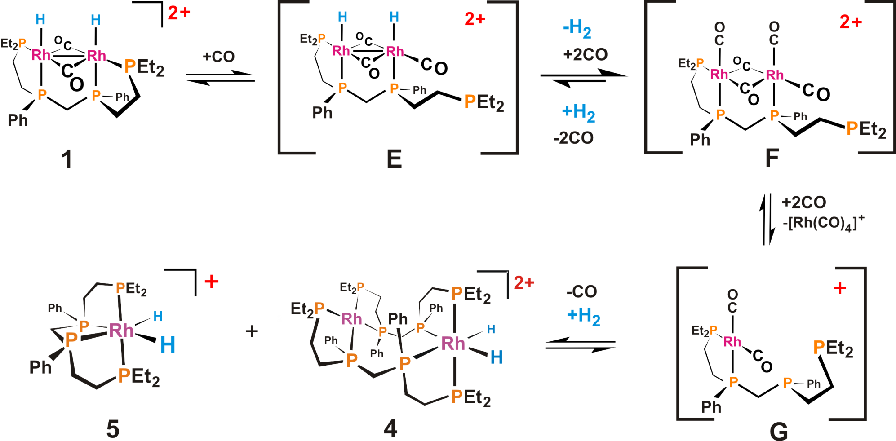
[rac-Rh₂H₂(μ-CO)₂(et,ph-P4)]²⁺ Catalyst Fragmentation

