Slide 1
FUNDAMENTALS OF PHYSICS ( 10th edition )- HALLIDAY & RESNICK

Slide 2
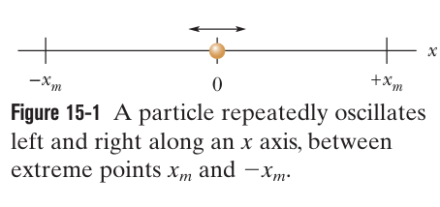
Any motion that repeats at regular intervals is called periodic motion or harmonic motion.
●In simple harmonic motion (SHM), the displacement x(t) of a particle from its equilibrium position is described by the equation:
in which $x_{m}$ is the amplitude of the displacement, $(ωt+φ)$is the phase of the motion, and $φ$is the phase constant ( Phase angle). The angular frequency $ω$ is related to the period and frequency of the motion by:

Slide 3
● The frequency $f$of periodic, or oscillatory, motion is the number of oscillations per second. In the SI system, it is measured in hertz: ${Hz=s}^{−1}$.
● The period T is the time required for one complete oscillation, or cycle. It is related to the frequency by:

Slide 4
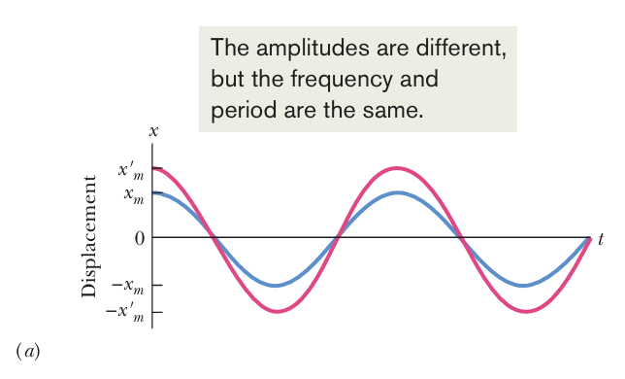
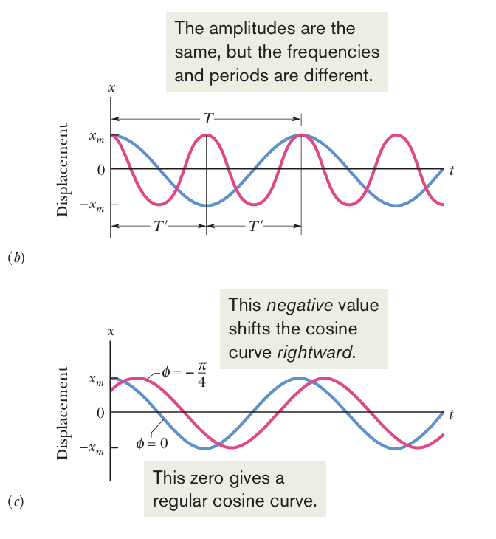
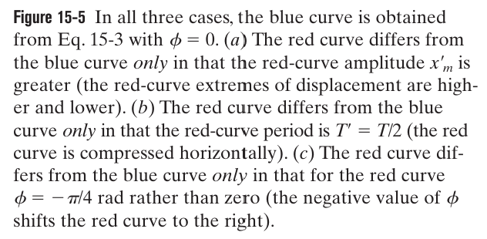

Slide 5
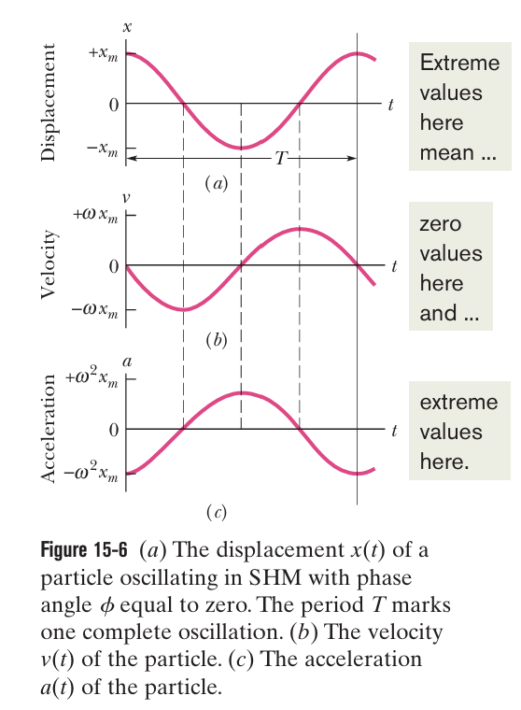
$$⇒$$
In SHM, the acceleration a is proportional to the displacement x but opposite in sign, and the two quantities are related by the square of the angular frequency $ω$.

Slide 6
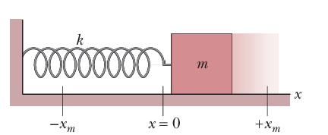
we can apply Newton’s second law to describe the force responsible for SHM:
From Hooke’s law
$$⇒$$

Slide 7
Example

Slide 8
Solution
$$a)$$
$$b)$$
The maximum displacement is :
$$x_{m}=11 cm$$

Slide 9
$$c)$$
The maximum speed $v_{m}$is the velocity amplitude ${ωx}_{m}$
$$d)$$
The magnitude $a_{m}$ of the maximum acceleration is the acceleration amplitude ${ω^{2}x}_{m}$
$$e)$$
At time t= 0, the block is located at ${x=x}_{m}$
$$⇒$$
$$⇒$$
$$f)$$

Slide 10
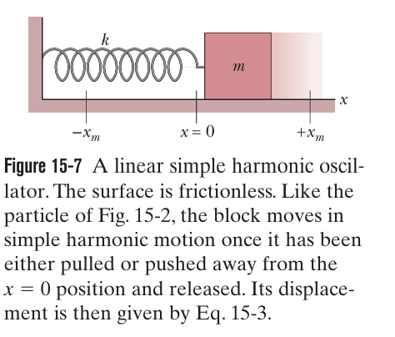
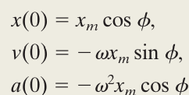
Example
Solution
a) At t=0
$$⇒$$

Slide 11
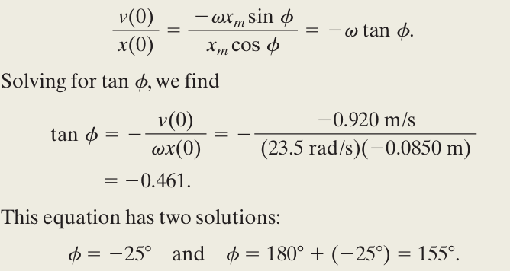
b)
Because the amplitude of SHM must be a positive constant, the correct phase constant and amplitude are $φ$=155
$$x_{m}=\frac{x(0)}{cosφ}=\frac{−0.0850}{cos155}=0.094m$$

Slide 12
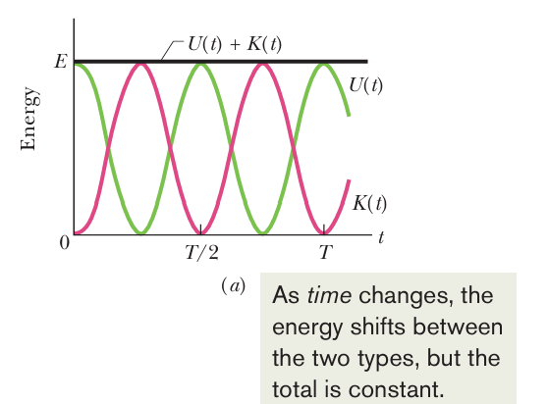

Slide 13
Solution
$$E=\frac{1}{2}kx_{m}^{2}=\frac{1}{2}×(1.3×{10}^{2})×{(2.4×{10}^{−2})}^{2}= {3.7×10}^{−2}J$$

Slide 14
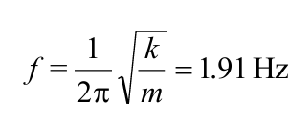
$$c) ω=\sqrt{\frac{k}{m}} and ω=\frac{2π}{T}=2πf$$

Slide 15
Solution
a)

Slide 16
d)

