Slide 1
FUNDAMENTALS OF PHYSICS ( 10th edition )- HALLIDAY & RESNICK

Slide 2
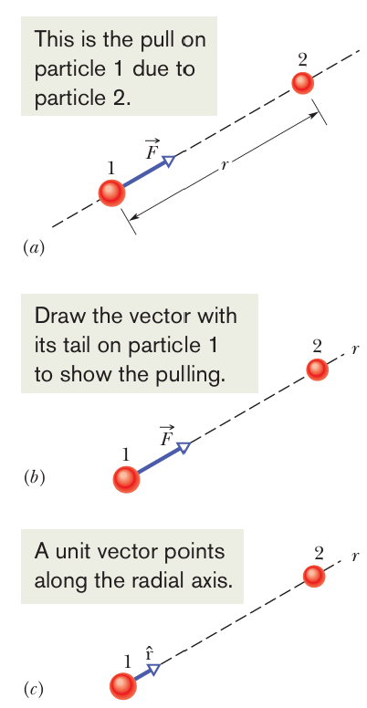
●Any particle in the universe attracts any other particle with a gravitational force whose magnitude is

Slide 3
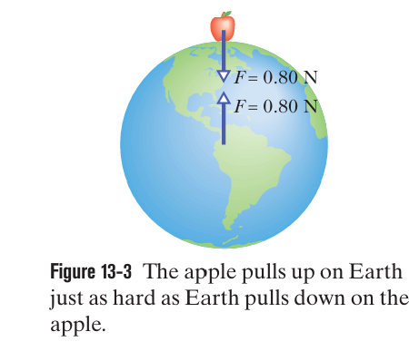
Third-Law Force Pair. If Earth pulls down on an apple with a force of magnitude 0.80 N. The apple must then pull up on Earth with a force of magnitude 0.80 N. The acceleration of the apple is about 9.8$m/{s^{2}}$. The acceleration of Earth, however, measured in a reference frame attached to the center of mass of the apple–Earth system, is only about $1×{10}^{−25}m/{s^{2}}$.
Mass of earth $≈5.98×{10}^{24}$Kg

Slide 4
The magnitude of the gravitational force from Earth on a particle of mass m, located outside Earth a distance r from Earth’s center, is then given by:
Newton’s second law tells us that magnitudes F and gravitational acceleration $a_{g}$ are related by
$$\frac{GmM}{r^{2}}=ma_{g}$$

Slide 6
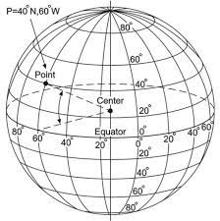
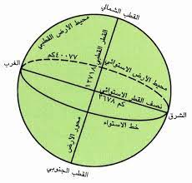
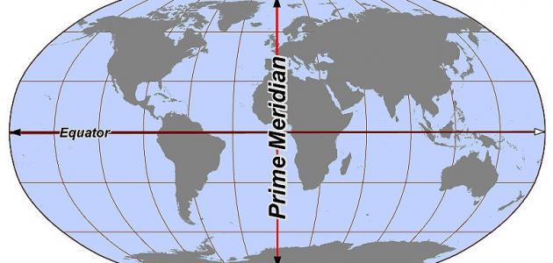

Slide 7
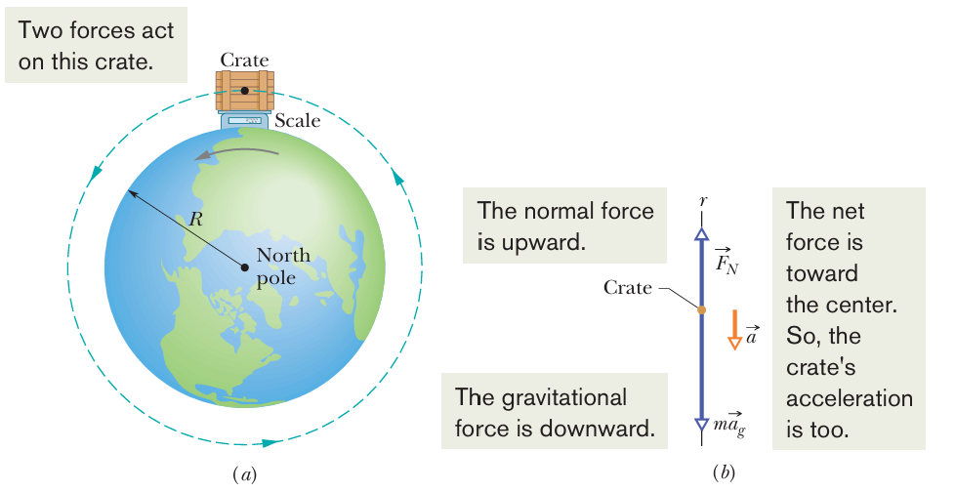
How Earth’s rotation causes g to differ from $a_{g}$?
As Earth turns, the crate has a centripetal acceleration $\vec{a}$ directed toward Earth’s center

Slide 8
Thus, the measured free-fall acceleration is less than the gravitational acceleration because of Earth’s rotation.

Slide 9
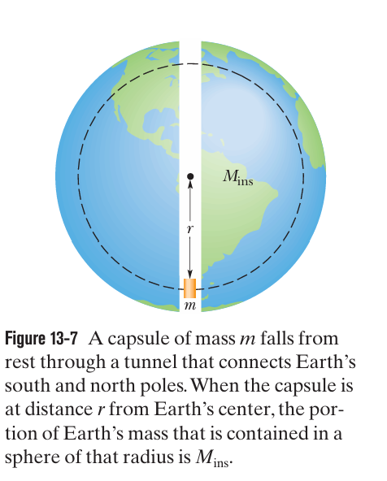
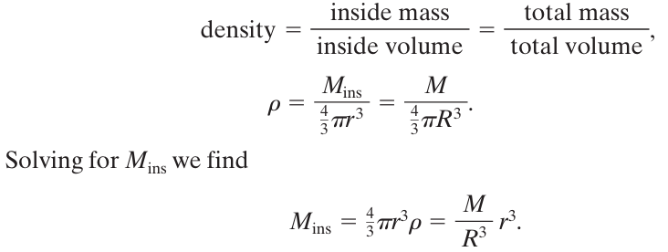
Figure 13-7 shows the capsule (mass m) when it has fallen to a distance r from Earth’s center. At that moment, the net gravitational force on the capsule is due to the mass $M_{ins}$ inside the sphere with radius r (the mass enclosed by the dashed outline)

Slide 10
Solution

Slide 11
Solution

Slide 12
Solution
The gravitational force from Earth on you (with mass m) is
The gravitational force from tiny black hole on you (with mass m) is

Slide 13
Tiny black hole has the same gravitational pull on you as the Earth, then

Slide 14
Solution
$$a)$$
$$W_{Earth}=mg_{Earth}=100 ⇒m= \frac{100}{9.8}=10.2 Kg$$
$$g_{moon}=1.67m/{s^{2} ⇒W_{moon}=mg_{moon}=10.2×1.67=17 N}$$
$$b)$$
$F=G\frac{M_{E}m}{r^{2}} ⇒$ $17=6.67×{10}^{−11}×\frac{(5.98×{10}^{24})×10.2}{r^{2}}$ $⇒$ $r=1.55×{10}^{7}m$
$Because R_{Earth}=6.37×{10}^{6}m ⇒ \frac{r}{R_{E}}$=$\frac{1.55×{10}^{7}}{6.37×{10}^{6}}$= 2.4 $⇒$ $r$= 2.4 $R_{E}$

Slide 15
Solution
$F=G\frac{M_{E}m}{r^{2}}$ $⇒ma_{g}=G\frac{M_{E}m}{{(R_{E}+h)}^{2}}$ $⇒ a_{g}=G\frac{M_{E}}{{(R_{E}+h)}^{2}}$
$4.9=6.67×{10}^{−11}×\frac{5.98×{10}^{24}}{{\left(6.37×{10}^{6}+h\right)}^{2 }} ⇒$ h= $\sqrt{\frac{6.67×{10}^{−11}×5.98×{10}^{24}}{4.9}}−6.37×{10}^{6}$= $2.6×{10}^{6}$m

Slide 16
Solution
$$a)$$
$F=G\frac{Mm}{r^{2}} ⇒ F=6.67×{10}^{−11}×\frac{m×1×{10}^{4}}{({1.5)}^{2 }}$= m($3×{10}^{−7})N$
$⇒F=6.67×{10}^{−11}×\frac{m×1×{10}^{4}×(0.5)}{({1)}^{3 }}$ = $m(3.34×{10}^{−7})N$
$$b)$$
$⇒F=6.67×{10}^{−11}×\frac{m×1×{10}^{4}×(r)}{({1)}^{3 }}$= mr ($6.76×{10}^{−7})N$
$$C)$$

Slide 17
Solution
$$The gravitional acceleration on the surface of the spher{ a}_{g}=G\frac{M}{R^{2}}$$
$$a) at a point inside the sphere ⇒a_{g_{2}}=G\frac{M}{R^{3}}r$$
$a_{g_{2}}$=$\frac{a_{g}}{3}$ $⇒ G\frac{M}{R^{3}}r$= $G\frac{M}{3R^{2}}$ $⇒$ $r=\frac{R}{3}$
b) $at a point outside the sphere ⇒a_{g_{2}}=G\frac{M}{r^{2}}$
$a_{g_{2}}$=$\frac{a_{g}}{3}$ $⇒ G\frac{M}{r^{2}}$= $G\frac{M}{3R^{2}}$ $⇒$ $r=\sqrt{3}$ R

Slide 18
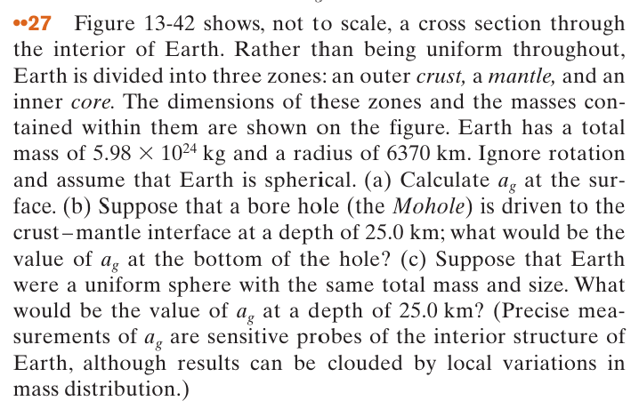
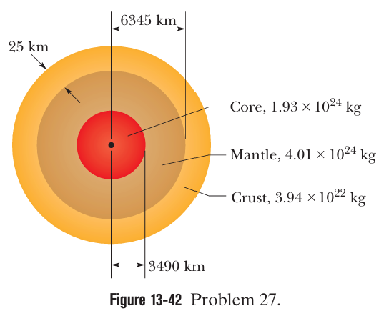

Slide 19
$$a)$$
$$b)$$
The total mass contained in the core and mantle together and R is the outer radius of the mantle $6.345×{10}^{6}m$

Slide 20
F=$\frac{GmM}{R^{3}}r ⇒{ a}_{g}=\frac{F}{m}= \frac{GM}{R^{3}}r$
$$c)$$
$⇒a_{g}=6.67×{10}^{−11}×\frac{5.98×{10}^{24}×(6.345×{10}^{6})}{({6.37×{10}^{6})}^{3 }}$= $9.79m/{s^{2}}$

Slide 21
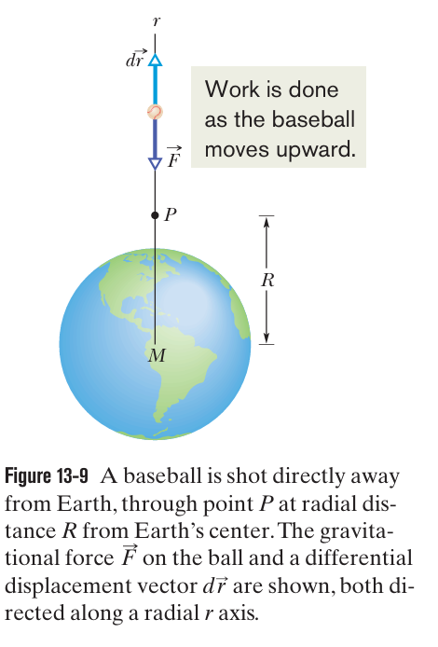
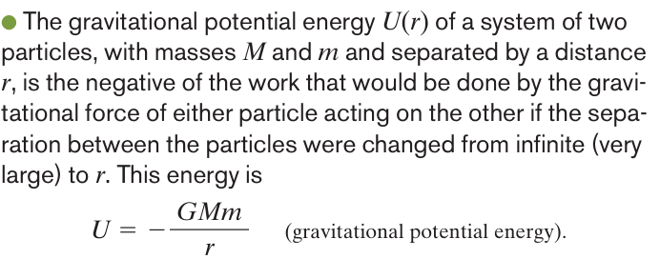
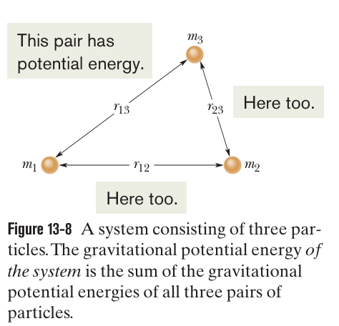

Slide 22
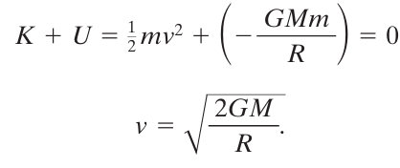
The minimum initial speed of an object to escape gravitational pull of an astronomical body of mass M and radius R called the (Earth) escape speed.
The projectile has a kinetic energy K and potential energy U given by:
$$K=\frac{1}{2}mv^{2}$$
When the projectile reaches infinity, it stops and thus has no kinetic energy and no potential energy because an infinite separation between two bodies is our zero-potential-energy configuration. Its total energy at infinity is therefore zero and From the principle of conservation of energy:

Slide 23
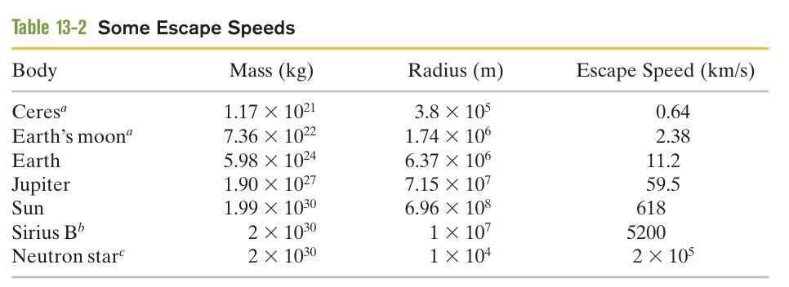

Slide 24
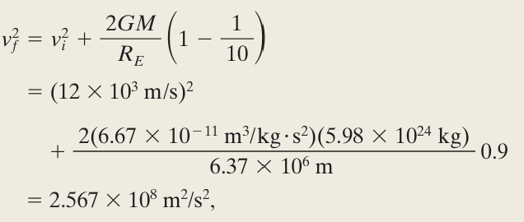
Example
Solution
$$⇒$$
$$⇒$$

Slide 25
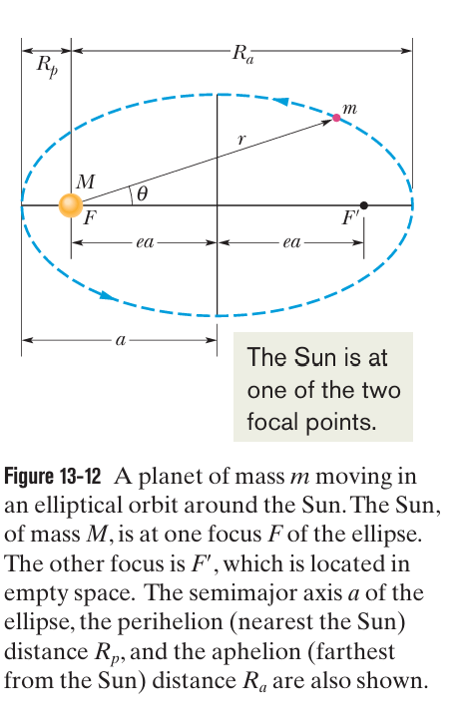
semimajor axis (a) and its eccentricity (e), the latter defined so that ea is the distance from the center of the ellipse to either focus F or $\grave{F.}$

Slide 26
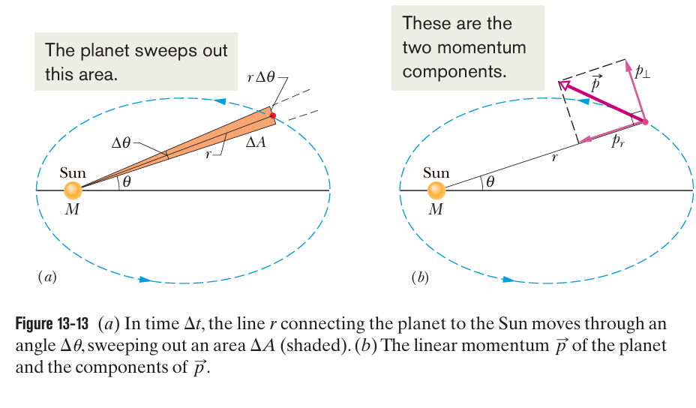
The area $ΔA$ of the wedge is approximately the area of a triangle with base $rΔθ$and height r.
$$ΔA≈\frac{1}{2}r^{2}Δθ$$
The instantaneous rate at which area is being swept out is then
$$⇒$$

Slide 27
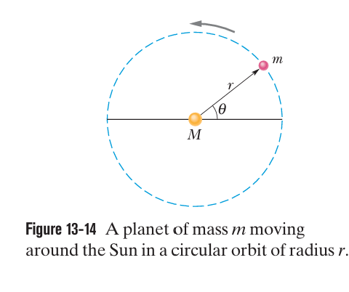
To see this, consider the circular orbit of Fig.13-14,with radius r(the radius of a circle is equivalent to the semimajor axis of an ellipse).Applying Newton’s second law (F= ma) to the orbiting planet in Fig.13-14 yields
$$ω=\frac{2π}{T}$$

Slide 28
Example
Solution
a$={(\frac{6.67×{10}^{−11}×(1.99×{10}^{30})×({2.4×{10}^{9})}^{2}}{4\left({3.14}^{2}\right)})}^{\frac{1}{3}} =2.7×{10}^{12}m$

Slide 29
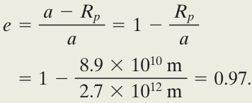
This tells us that, with an eccentricity approaching unity, this orbit must be a long thin ellipse.

Slide 30
●When a planet or satellite with mass m moves in a circular orbit with radius r, its potential energy U and kinetic energy K are given by
To find the kinetic energy of a satellite in a circular orbit, we write Newton’s second law as
$${⇒ v}^{2}=\frac{GM}{r}$$
F =ma $⇒$

Slide 31
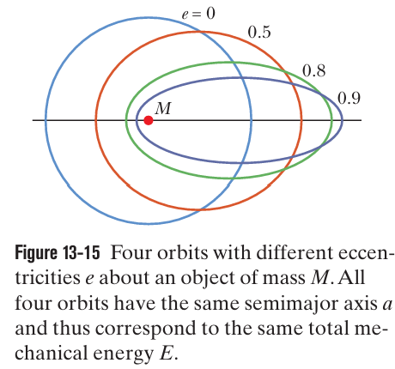
For a satellite in an elliptical orbit of semimajor axis a, we can substitute a for r to find the mechanical energy:

Slide 32
Example
Solution
$$a)$$
The orbital radius must be

Slide 33
b$)$
The kinetic energy $K_{ο}$of the ball is due to the ball’s motion with Earth’s rotation $⇒$ $K_{ο}≈0$

Slide 34
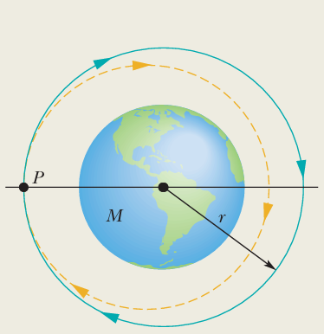
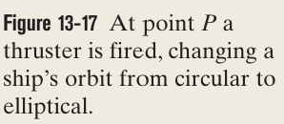
Example
(Transforming a circular orbit into an elliptical orbit)
Solution
$${ T}^{2}=\frac{4π^{2}}{GM}a^{3} ⇒ T={(\frac{4π^{2}}{GM}a^{3})}^{\frac{1}{2}}$$
E$=−\frac{GMm}{2a}$

Slide 35
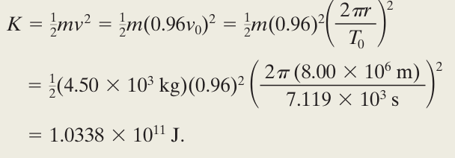
E$=−\frac{GMm}{2a}$

Slide 36
