Slide 1

FUNDAMENTALS OF PHYSICS
( 10th edition )- HALLIDAY & RESNICK

Slide 2



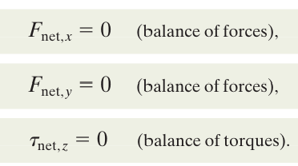
$⇒$ $F_{net,x}=0 ,F_{net,y}=0$, $F_{net,z}=0$
$⇒$ $τ_{net,x}=0 ,τ_{net,y}=0$, $τ_{net,z}=0$
We shall simplify matters by considering only situations in which the forces that act on the body lie in the xy plane. This means that the only torques that can act on the body must tend to cause rotation around an axis parallel to the z axis

Slide 3

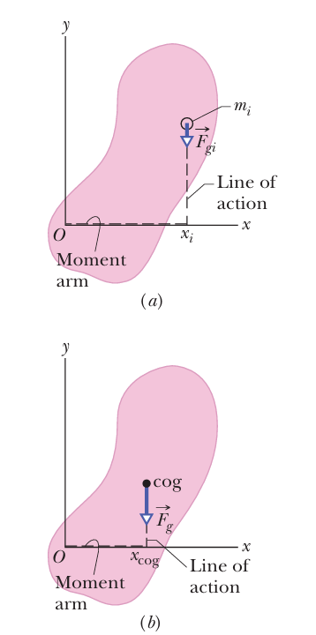

Slide 4

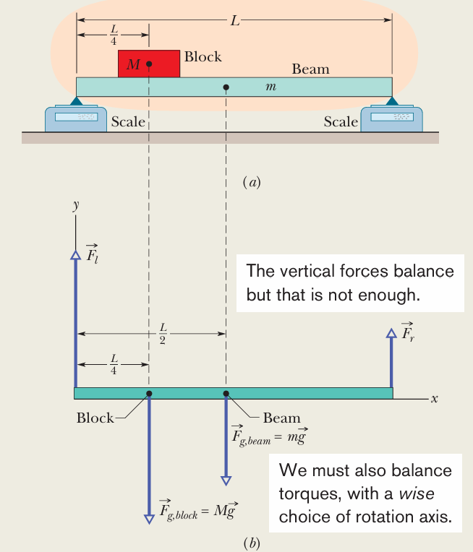
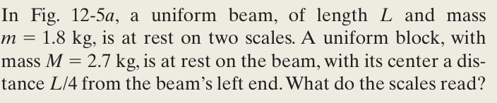





Solution
$$⇒$$
$$⇒$$

Slide 5
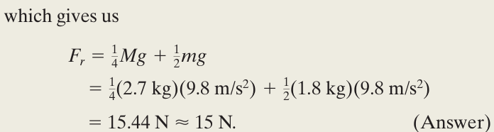
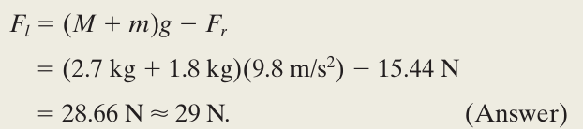

Slide 6
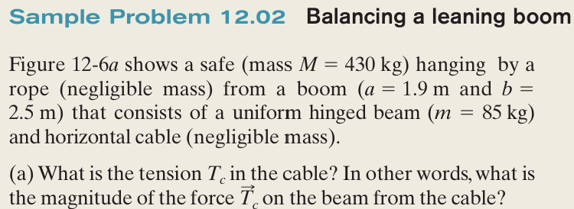
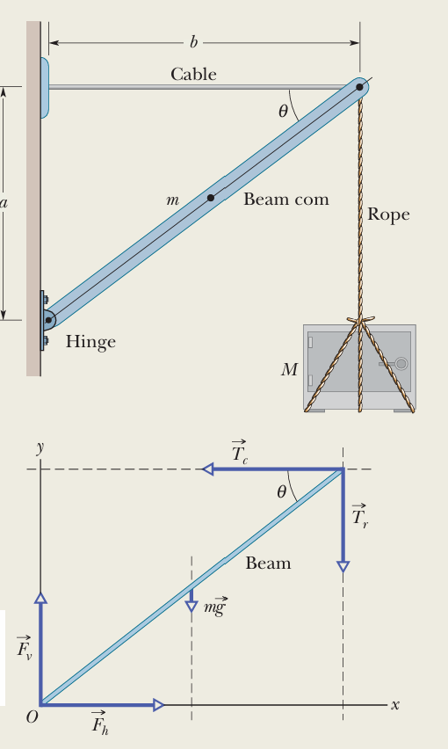



Solution
The system here is the beam alone, and the forces on it are shown in the free-body diagram of Fig.
$$⇒$$

Slide 7
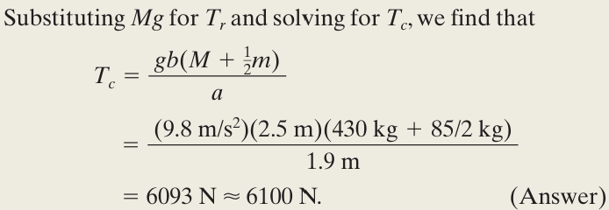
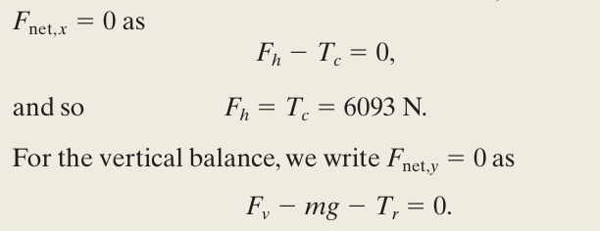
For the horizontal balance

Slide 8
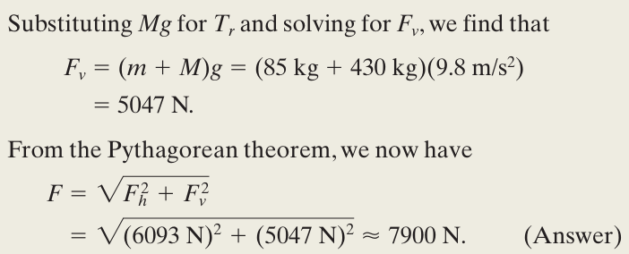

Slide 9
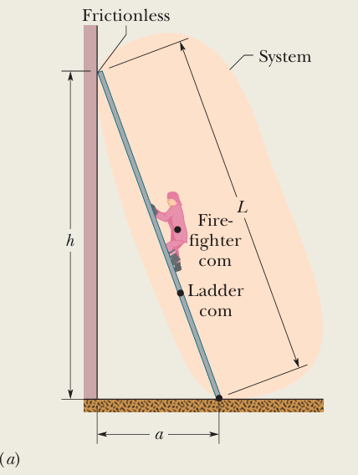
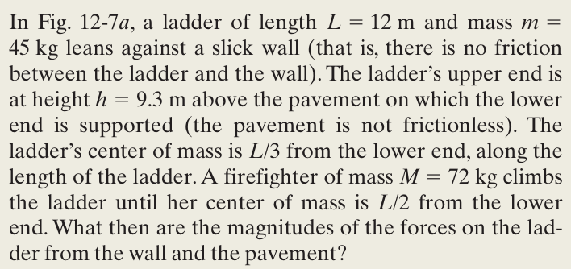

Slide 10
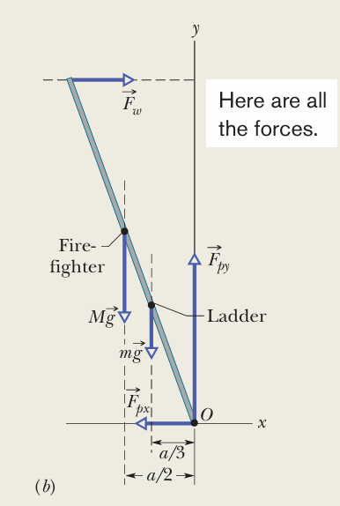



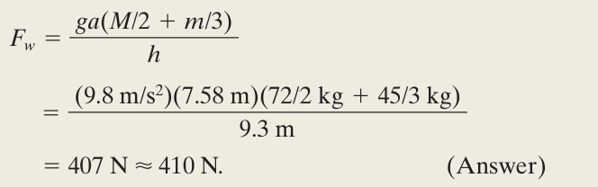
our system as being the firefighter and ladder, together. we choose the axis at point O, perpendicular to the figure (in the Z direction)

Slide 11

