Slide 1
FUNDAMENTALS OF PHYSICS ( 10th edition )- HALLIDAY & RESNICK

Slide 2
We consider only objects that roll smoothly along a surface; that is, the objects roll without slipping or bouncing on the surface. Figure 11-2 shows how complicated smooth rolling motion can be: Although the center of the object moves in a straight line parallel to the surface, a point on the rim certainly does not. However, we can study this motion by treating it as a combination of translation of the center of mass and rotation of the rest of the object around. we can simplify matters by focusing on the center of mass rather than on a point on the rim of the rolling object.

Slide 3
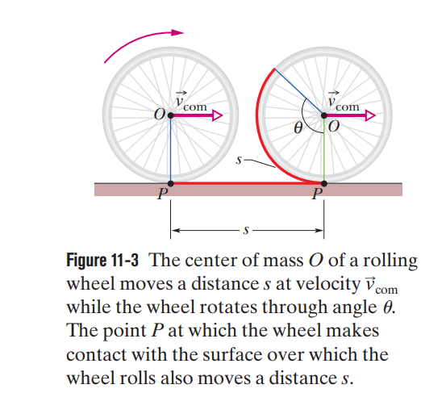

Slide 4
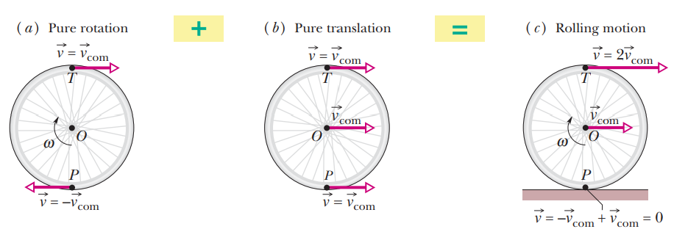

Slide 5
The total kinetic energy of a rolling object is the sum of the rotational kinetic energy about the center of mass and the translational kinetic energy of the center of mass.
$$K=\frac{1}{2}I_{com}ω^{2}+\frac{1}{2}MR^{2}ω^{2}$$
$$K=\frac{1}{2}(I_{com}+MR^{2}{)ω}^{2}$$
From the parallel-axis theorem
$$K=\frac{1}{2}I_{P}ω^{2}$$

Slide 6
If the wheel does not slide, the frictional force that acts is a static frictional force $\vec{f_{s}}$and the motion is smooth rolling. The magnitudes of the linear acceleration $a_{com}$ and the angular acceleration $α$ determen by differentiating $v_{com}$= R$ω$.
$$\frac{dv_{com}}{dt}=R\frac{dω}{dt}$$
If the wheel does slide when the net force acts on it, the frictional force that acts is a kinetic frictional force $\vec{f_{k}}$. The motion then is not smooth rolling, and equation above does not apply to the motion.

Slide 7
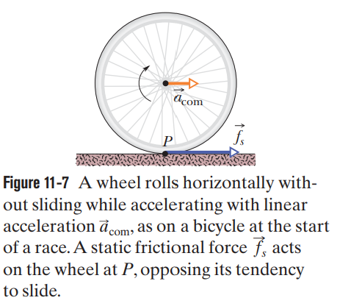
The faster rotation tends to make the bottom of the wheel slide to the left at point P. A frictional force at P, directed to the right, opposes this tendency to slide.
If the rotation decreases, as on a slowing bicycle, we would change the figure in two ways: The directions of the center-of mass acceleration and the frictional force at point P would now be to the left.

Slide 8
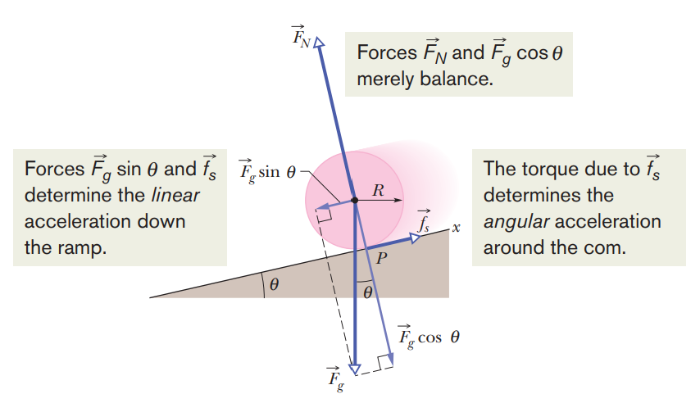

Slide 10
$$a)$$
$$v_{com}=Rω⇒ ω=\frac{v_{com}}{R}$$
$$The enertia for the ball is I_{com}=\frac{2}{5}{MR}^{2}$$
$$\frac{1}{2}(\frac{2}{5}MR^{2}\frac{{v_{com}}^{2}}{R^{2}})+\frac{1}{2}{{Mv}_{com}}^{2}=Mgh$$

Slide 11
$$b)$$

Slide 12
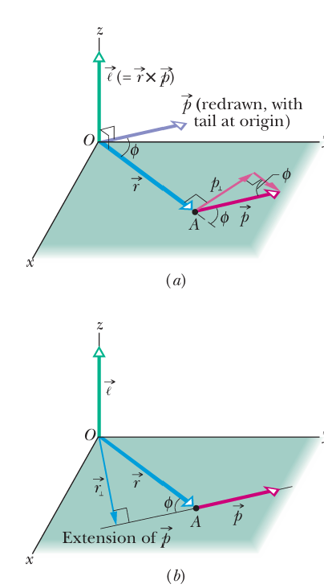

Slide 14
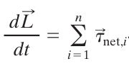
The total angular momentum $\vec{L}$ of the system is the (vector) sum of the angular momenta $\vec{l}$ of the individual particles (here with label $i$):
$$⇒$$

Slide 15
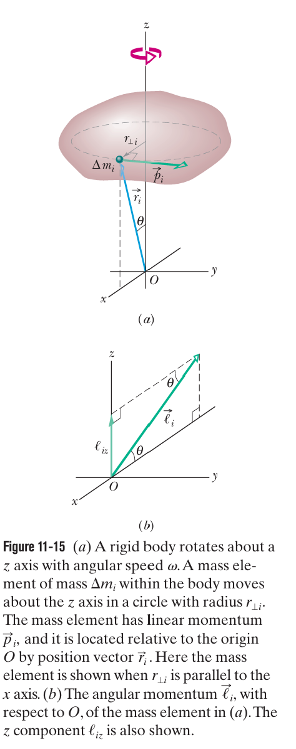
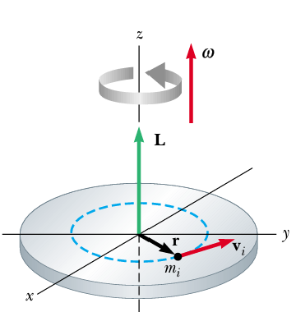
The angular momentum of a system of particles that form a rigid body that rotates about a fixed axis. The magnitude of the angular momentum $\vec{l_{i}}$ of this mass element ,with respect to O is:

Slide 16
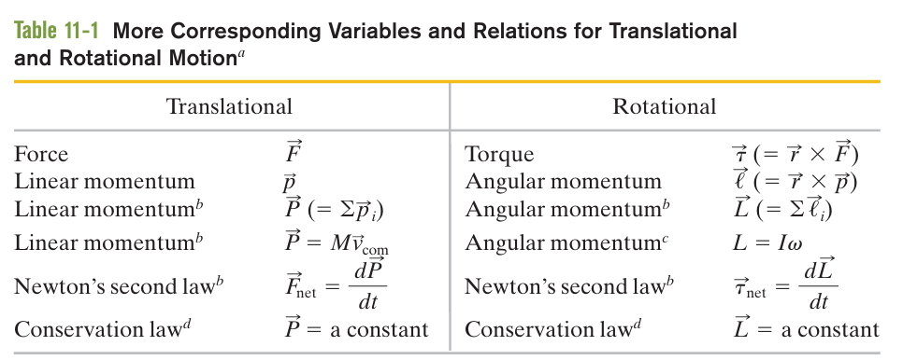

Slide 18
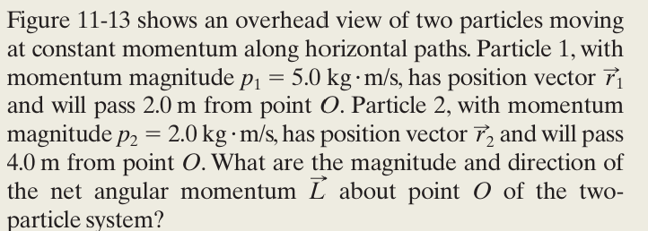
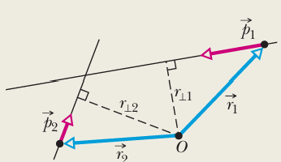
Example
Solution
The vector product is out of the page ,perpendicular to the plane
The vector product is into the page ,perpendicular to the plane

Slide 19
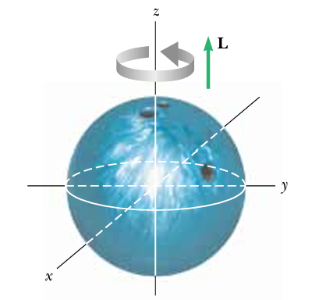
Example
A typical bowling ball might have a mass of 6.0 kg and a radius of 12 cm. The moment of inertia of a solid sphere about an axis through its center is $\frac{2}{5}{MR}^{2}$.Estimate the magnitude of the angular momentum of a bowling ball spinning at 10 rev/s, as shown in Figure.
Solution

Slide 20
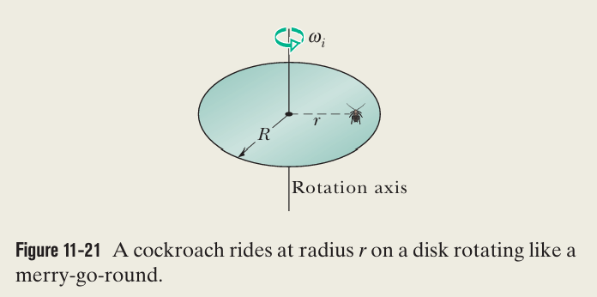
Example
Solution
The rotational inertia of a disk
$I_{d}=\frac{1}{2}MR^{2}=3mR^{2}$
The initial rotational inertia of the cockroach
$I_{ci}=m r^{2}=m ( {0.8R)}^{2}$=0.64 m$R^{2}$
The final rotational inertia of the cockroach
$I_{cf}=m r^{2}=m R^{2}$

Slide 21
So, the cockroach–disk system initially has the rotational inertia
and finally has the rotational inertia
the system’s final angular momentum $L_{f}$ is equal to the system’s initial angular momentum $L_{i}$
${L_{f}=L}_{i}$

Slide 22
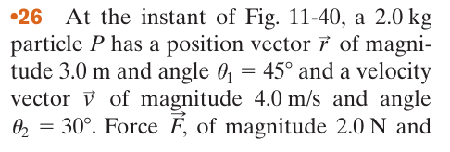
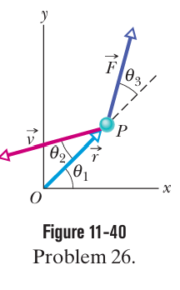
Solution
$$a)$$
$$c)$$

Slide 23
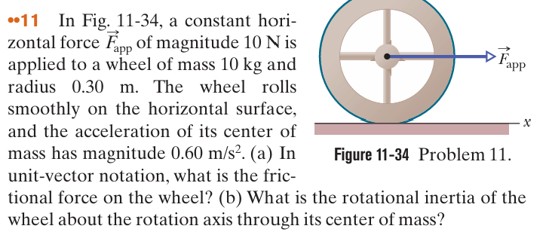

Slide 24
Solution
The only force not directed toward (or away from) the center of mass is fs , and the torque it produces is clockwise:
$$τ_{net}=Iα=$$

