Slide 1

FUNDAMENTALS OF PHYSICS ( 10th edition )- HALLIDAY & RESNICK

Slide 2

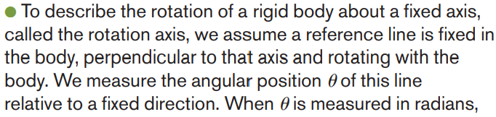


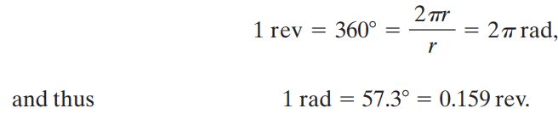

Slide 3

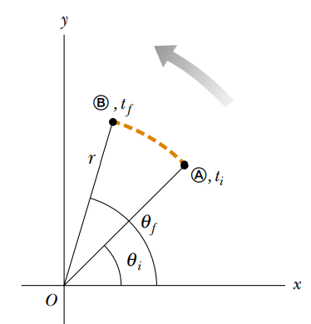





Slide 4




Slide 5

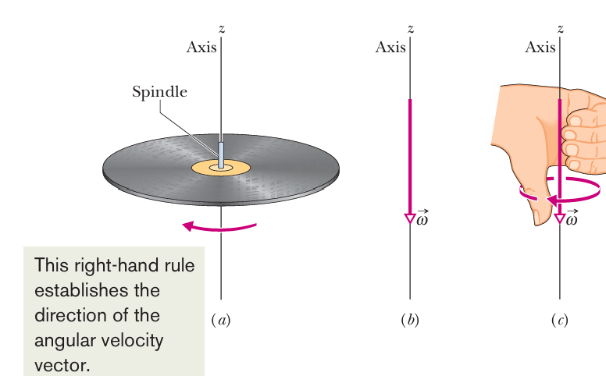
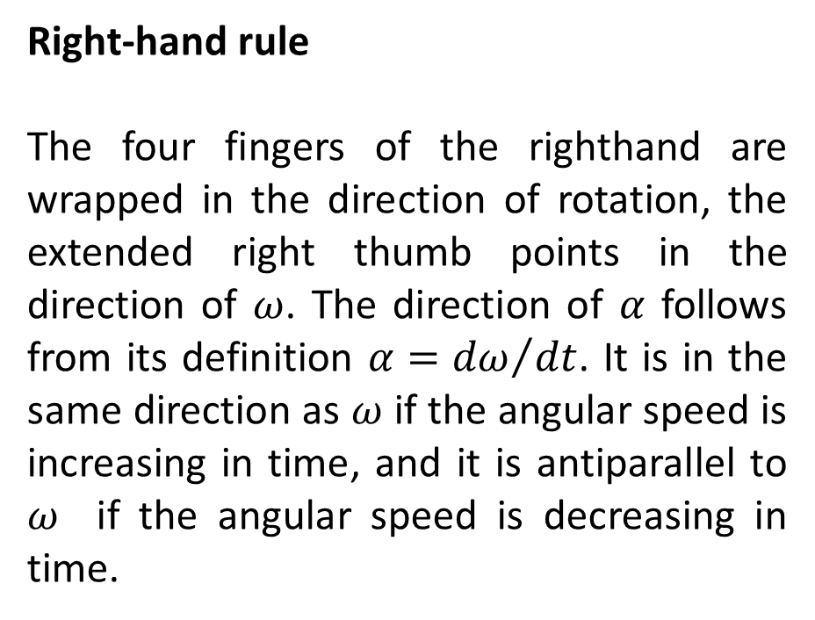
Right-hand rule
The four fingers of the righthand are wrapped in the direction of rotation, the extended right thumb points in the direction of $ω$. The direction of $α$ follows from its definition $α={dω}/{dt}$. It is in the same direction as $ω$ if the angular speed is increasing in time, and it is antiparallel to $ω$ if the angular speed is decreasing in time.

Slide 6
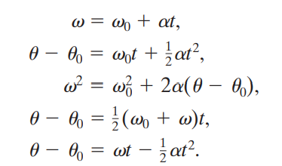
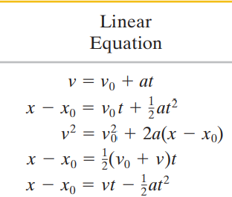

Slide 7
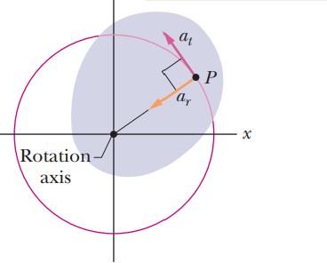




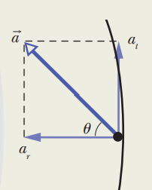





Slide 8
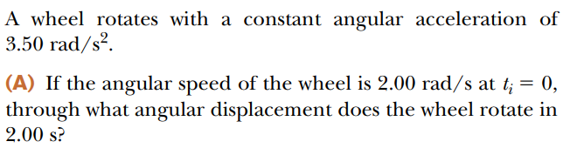

Examples

Slide 9

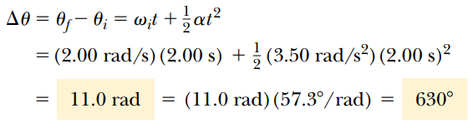





$$a)$$
$$b)$$
$$c)$$

Slide 10
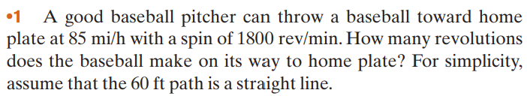
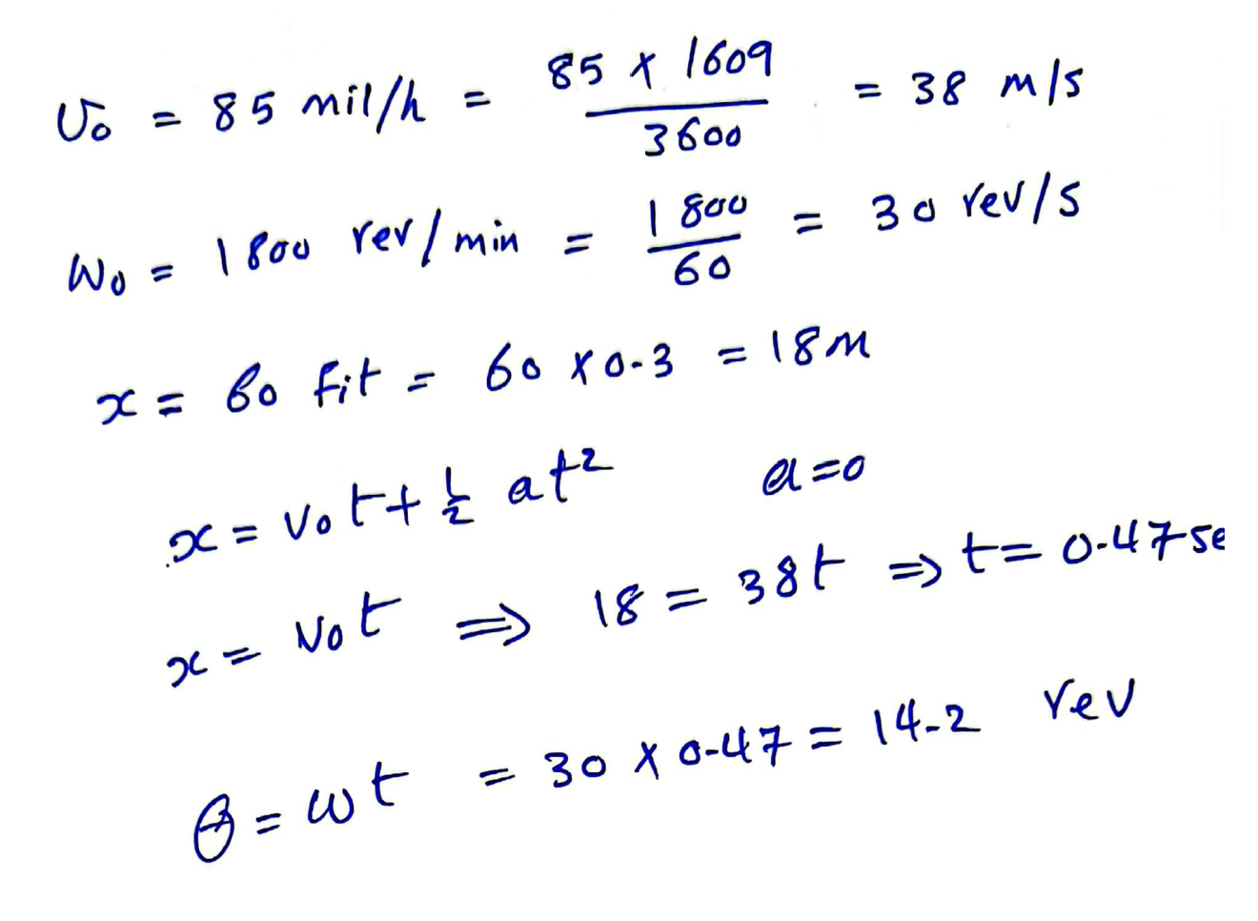

Slide 11
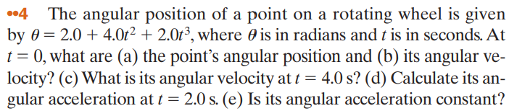
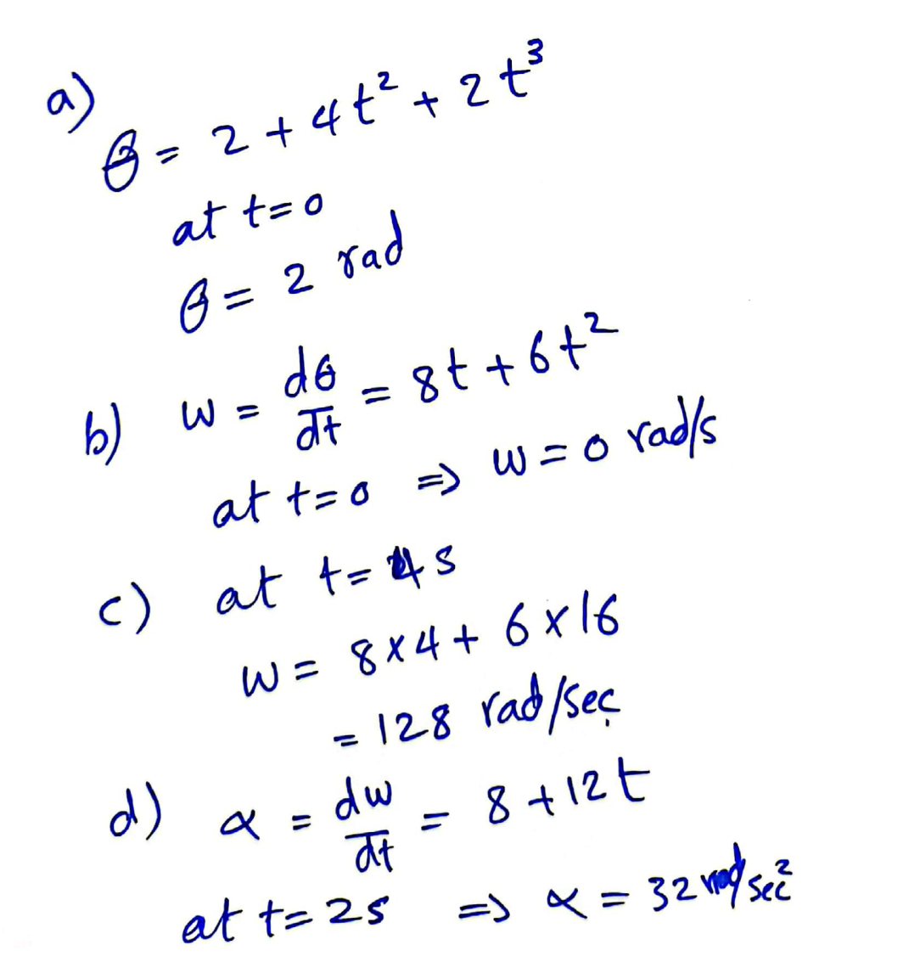

Slide 12

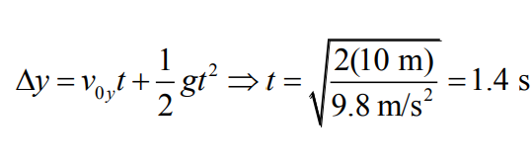
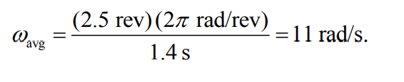

Slide 13
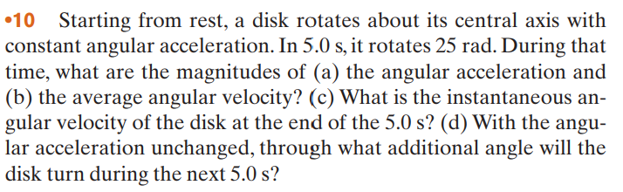
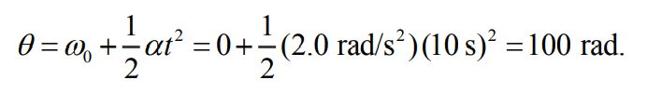


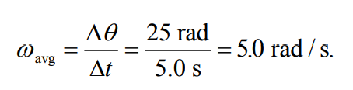



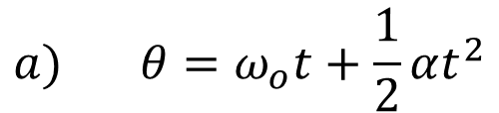



$$a) θ=ω_{ο}t+\frac{1}{2}αt^{2}$$
$$d)$$
$$b)$$
c$)$
$$ω=ω_{ο}+αt$$

Slide 14
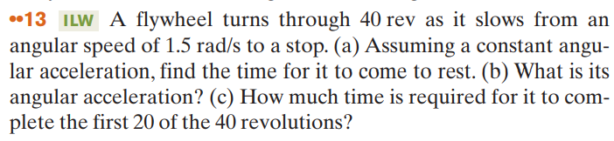



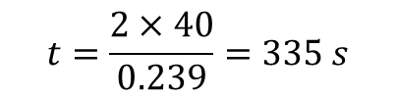
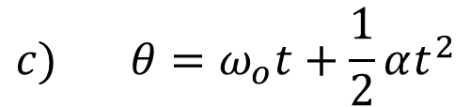
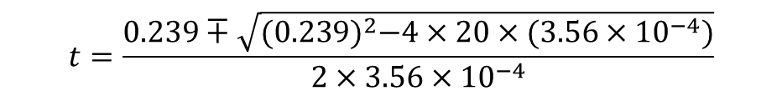


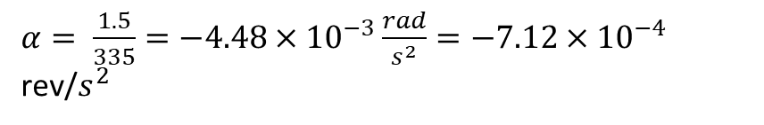



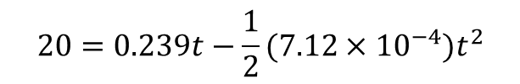
$$c) θ=ω_{ο}t+\frac{1}{2}αt^{2}$$
$θ$ -$θ_{ο}=\frac{1}{2}\left(ω−ω_{ο}\right)t$
$$a)$$
$$20=0.239t−\frac{1}{2}(7.12×{10}^{−4}{)t}^{2}$$
$40$ -$0=\frac{1}{2}\left(\frac{1.5}{2π}−0\right)t$
$$20=0.239t−(3.56×{10}^{−4}{)t}^{2}$$
$$t=\frac{2×40}{0.239}=335 s$$
$(3.56×{10}^{−4}{)t}^{2}$- $0.239t+20=0$
$$t=\frac{0.239∓\sqrt{{(0.239)}^{2}−4×20×(3.56×{10}^{−4})}}{2×3.56×{10}^{−4}}$$
$$b)$$
$$ω=ω_{ο}+αt$$
$$0=1.5+α ×335$$
$t=$98 s or t= 572s
$α= \frac{1.5}{335}=−4.48×{10}^{−3}\frac{rad}{s^{2}}=−7.12×{10}^{−4}$ rev/$s^{2}$

Slide 15
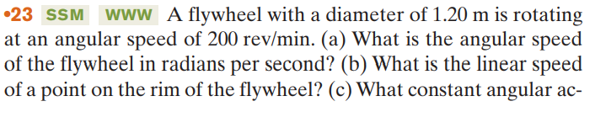

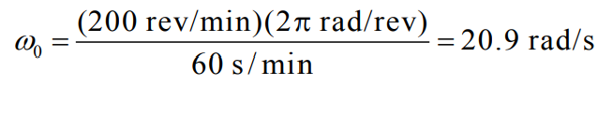










$$d)$$
$$a)$$
$$or$$
$$b)$$
$$c)$$

Slide 16

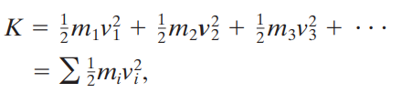




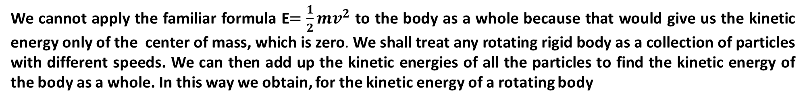
We cannot apply the familiar formula E$=\frac{1}{2}mv^{2}$ to the body as a whole because that would give us the kinetic energy only of the center of mass, which is zero. We shall treat any rotating rigid body as a collection of particles with different speeds. We can then add up the kinetic energies of all the particles to find the kinetic energy of the body as a whole. In this way we obtain, for the kinetic energy of a rotating body
The problem is that $v_{i}$ is not the same for all particles. We solve this problem by substituting for v by $v=ωr$, so that we have:

Slide 17

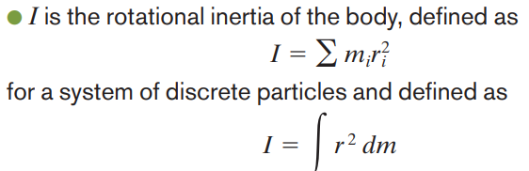


Let h be the perpendicular distance between the given axis and the axis through the center of mass (remember these two axes must be parallel).Then the rotational inertia I about the given axis is:

Slide 18
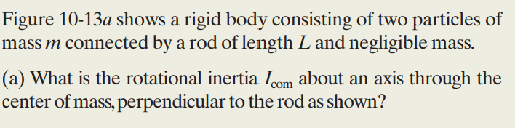
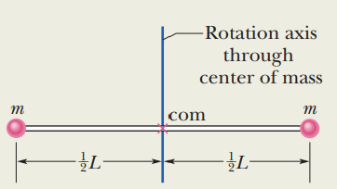
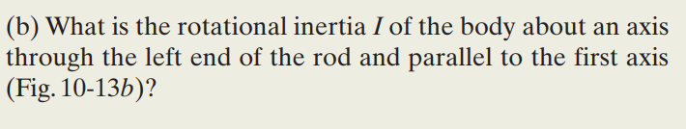
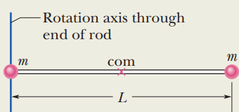




Example
$$a)$$
$$b)$$

Slide 19

Or, we can apply the parallel-axis theorem to find

Slide 20
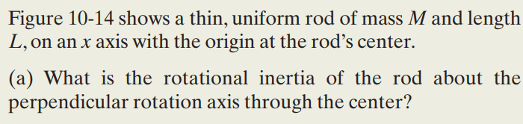
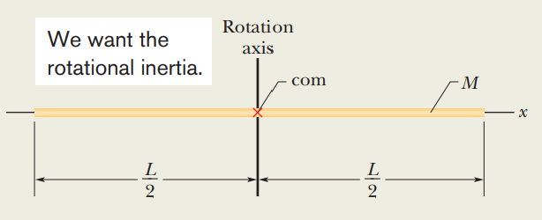

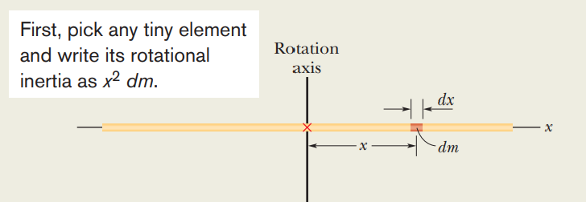

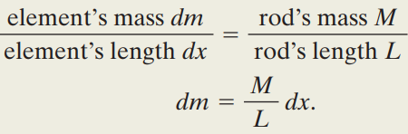
Example
$$a)$$

Slide 21
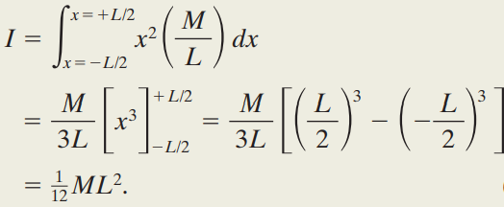
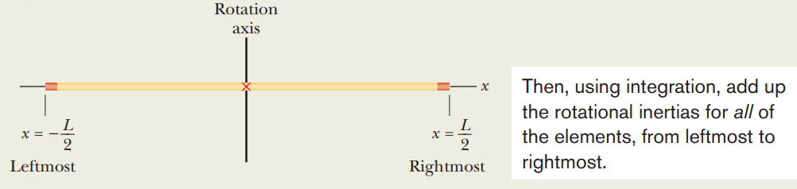
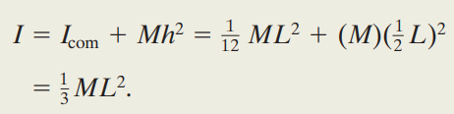

$$b)$$

Slide 22
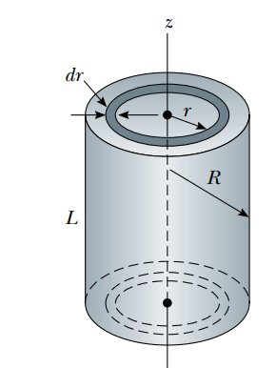




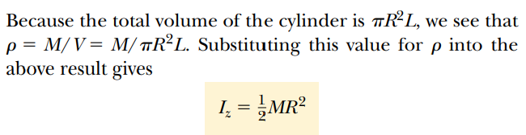
Example Uniform Solid Cylinder
A uniform solid cylinder has a radius R, mass M, and length L. Calculate its moment of inertia about its central axis (the z axis in figure.

Slide 23
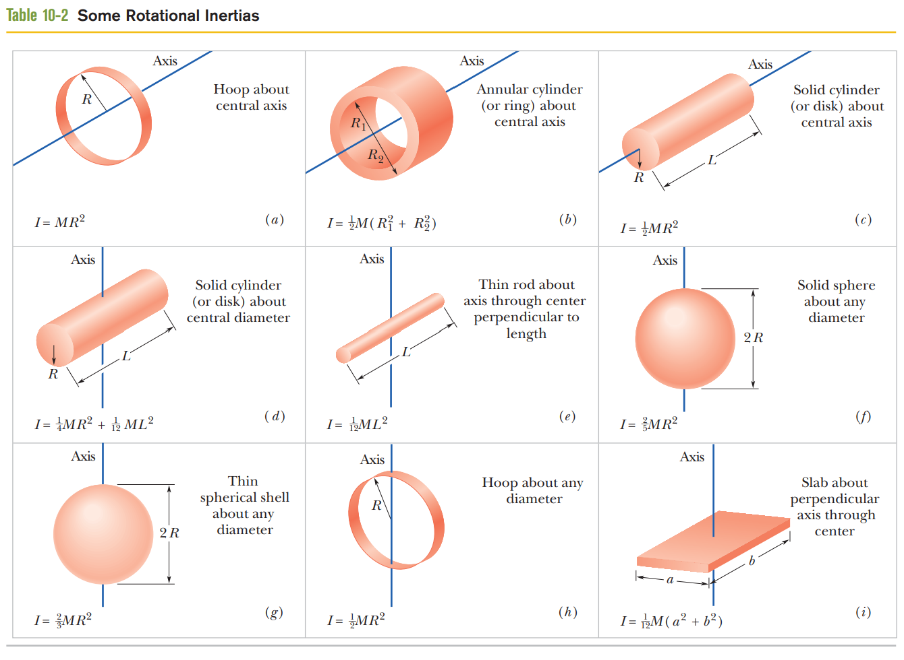

Slide 24
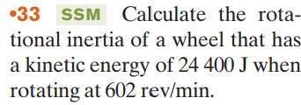
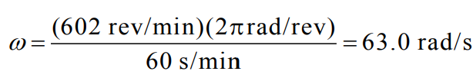
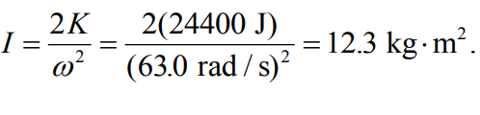

Slide 25
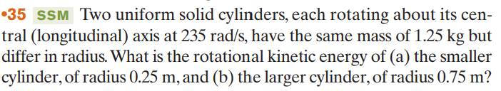





Slide 26





The ability of to rotate the body depends not only on the magnitude of its tangential component Ft , but also on just how far from O the force is applied. To include both these factors, we define a quantity called torque $τ$as the product of the two factors and write it as
$τ$= $r×$ F
If a torque would cause counterclockwise rotation, it is positive. If it would cause clockwise rotation, it is negative

Slide 27




Solution
$$τ_{net}=τ_{1}−τ_{2}$$
= $r_{1} F_{1}sinθ_{1}−$ $r_{2} F_{2}sinθ_{2}$

Slide 28
10- 7 NEWTON’S LAW FOR ROTATION
NEWTON’S FIRST LAW FOR ROTATION
If the resultant of the torque acting on the body is zero, then the body remains in its state of rotation.
$$τ_{net}=0 ⇒ω=constant and α=0$$

Slide 29







NEWTON’S SECOND LAW FOR ROTATION
The angular acceleration of a rigid body rotating about a fixed axis is directly proportional to the resultant of the torque${ τ}_{net}$acting on it with respect to this axis and inversely proportional to its moment of inertia $I$with respect to the same axis.

Slide 30



Example

Slide 31





Solution
There are three forces act on him: your pull $\vec{F}$ , The normal to the surface force $\vec{N}$ (on him from you at the pivot point). and the gravitational force ${\vec{F}}_{g}$ .
$$a)$$
$\vec{N}$ and ${\vec{F}}_{g}$ have moment arm r=0 and thus the torque due $\vec{N}$ and ${\vec{F}}_{g}$ are zero. The only torque is due to $\vec{F}$
$$b)$$
The results indicate that you will have to pull much harder if you do not initially bend your opponent to bring his center of mass to your hip

Slide 32




Example
Solution
(1)

Slide 33








Let $α$ be the magnitude of the negative (clockwise) angular acceleration. From Table 10-2c, the rotational inertia of the disk is $I=\frac{1}{2}MR^{2}$ .
$$τ_{net}=Iα$$
From equation 2
$$a_{t}=αR$$
(2)
From equation 1

Slide 34



The rate at which the work is done is the power

Slide 35


Slide 36





Example
The disk in Fig. start from rest at time t = 0 and also let M = 2.5 kg , radius R = 20 cm and the tension in the massless cord be 6.0 N and the angular acceleration of the disk be (-24rad/$s^{2}$). a) What is the change in rotational kinetic energy K at t = 2.5 s. b) What is the net work W done on the disk.
Solution
a)
$$ΔK=\frac{1}{2} Iω_{f}^{2}−\frac{1}{2}{Iω}_{i}^{2}$$

Slide 37






b)
$$w=−\frac{1}{2}TRαt^{2}$$
$$From the result in and b$$
$$w=ΔK$$

Slide 38



Solution
a)
b)
$$τ=Iα=12 ×28=3.38×{10}^{2}N.m$$

Slide 39






Solution
$$y=v_{0}t+\frac{1}{2}at^{2}$$
$$a)$$

Slide 40










$$b)$$
$$c)$$
$$d)$$
$$e)$$
$$τ_{net}=Iα$$
$T_{2}R−T_{1}R=Iα$ $⇒$

Slide 41


Solution

Slide 42


a) with $ω_{ο}=0$ we find the magnitude of the pulley’s angular acceleration to be

