Slide 1
Metal-Metal Bonding
Covalent: Electron precise bonds. M-M bond counts as one e- from each metal center. Most common type of M-M bonding.
Dative: Where one metal uses a filled d orbital “lone pair” to coordinate to an empty orbital on a second, more unsaturated metal. Most dative bonding situations can also be electron-counted as covalent bonds.
Symmetry: Weak metal-metal interactions caused by molecular orbital symmetry interactions of filled & empty M-M bonding and/or antibonding orbitals. Typically seen for d8 metals. Not at all common.

Slide 2
Electron Count | Resulting M-M Bond
d¹ - d¹ | Single bond
d² - d² | Double bond
d³ - d³ | Triple bond
d⁴ - d⁴ | Quadruple bond optimum
d⁵ - d⁵ | Triple bond
d⁶ - d⁶ | Double bond (M-L bonding usually dominates)
d⁷ - d⁷ | Single bond
d⁸ - d⁸ | No bond (symmetry interaction)

Slide 3
Some Covalent Multiple Bonded Examples:

Slide 4
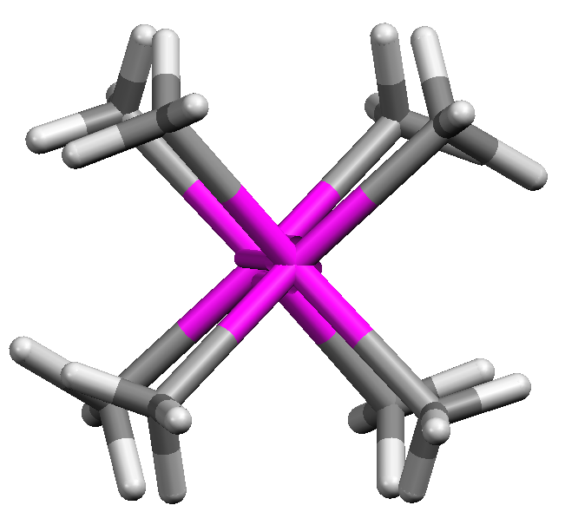
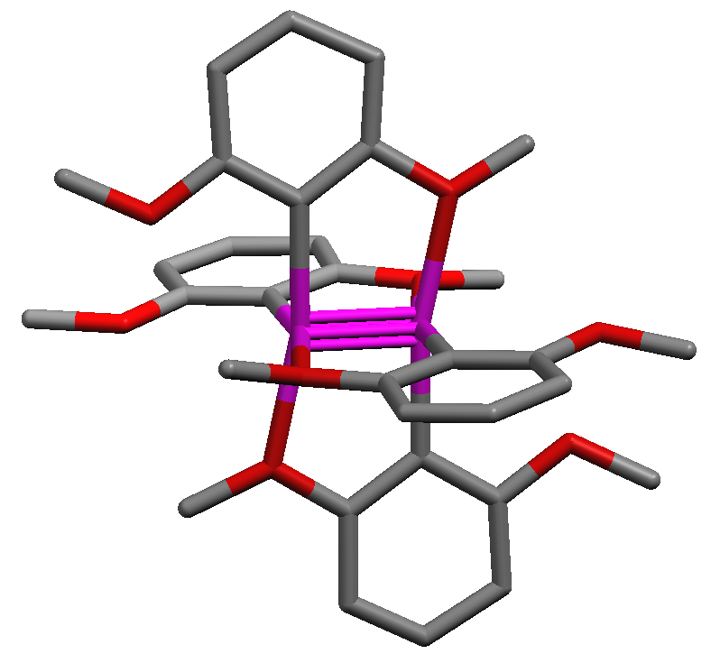
Quadruple Bonds (Cotton)
d⁴-d⁴ electronic configurations often lead to the formation of quadruple M-M bonds. Prof. F. Albert Cotton at Texas A&M was famous for his discovery and extensive studies of M-M quadruple bonds (and other M-M bonded systems).
F. Albert Cotton
Texas A&M University

Slide 5
Dative M-M Bonds (unsymmetrical M-M bonded complexes)
Covalent M-M Bonding
Left Ni | Right Ni
Ni(+1) d9 [μ-PR2]− 2e- μ-PR2 2e- CO 2e- M-M 1e- | Ni(+1) d9 [μ-PR2]− 2e- μ-PR2 2e- 2CO 4e- M-M 1e-
Total 16e- | Total 18e-
Dative
Left Ni | Right Ni
Ni(+2) d8 2[μ-PR2]− 4e- CO 2e- Ni←Ni(0) 2e- | Ni(0) d10 2μ-PR2 4e- 2CO 4e-
Total 16e- | Total 18e-

Slide 6
Problem: Electron-count the following complex using both the covalent and dative M-M bonding methods:
Problem: Electron-count the following complex. What is the order of the Re-Re bond? Why wouldn’t it be appropriate to use the dative bond method for this complex?

Slide 7
Weak M-M Interactions by Symmetry
Based on the MO diagram at the beginning of this section, d⁸-d⁸ systems shouldn’t have any M-M bonding due to the filling of all the M-M antibonding orbitals, which cancels out the M-M bonding orbitals.
But Harry Gray and others noted that more than a few bi- or polymetallic d⁸ complexes do show the presence of weak M-M bonding interactions, both in solution and the solid-state.
Harry Gray Caltech

