Slide 1
IS240- Ch1
Review questions

Slide 2
Tutorial Instructor
Tutorial Instructor: Mohammed Alnajim
E-mail : malnajim1@ksu.edu.sa

Slide 3
Tutorial GRADE
PROJECT | 19
ASSIGNMENT 1&2 | 4
TOTAL | 23

Slide 4
objectives
Learning System Workflows: Activity Diagrams
Functional Requirements: Use Case Diagram
Domain Modeling: Class Diagram
Dynamic Modelling: Sequence Diagram

Slide 5
Review questions

Slide 6
Q1
What is the difference between an information system and a computer application?

Slide 7
Q1-Answer:
a computer application is a computer software that performs a single or set of specific functions, which may or may not be connected to a database, while An information system is normally multiple computer programs that are connected to a database and thus provide as output various types and quantities of information.

Slide 8
Q2
What is the purpose of systems analysis? Why is it important?

Slide 9
Q2-Answer:
System Analysis enable the system developer to understand the user's requirements.
Without a good analysis of the user's needs and requirements the new system will be inadequate in its solution or erroneous in its implementation.

Slide 10
Q3
What is the difference between systems analysis and systems design?

Slide 11
Q3-Answer:
Systems analysis is to determine “what” the new system should do.
Systems design is to determine “how” the new system should be built.

Slide 12
Q4
What is a project?

Slide 13
Q4-Answer:
A project is a planned undertaking that has a beginning and an end, and which usually produces some predefined result

Slide 14
Q5
What are the six core processes for software systems development?

Slide 15
Q5-Answer:
Identify the problem and obtain approval.
Plan and monitor the project.
Discover and understand the requirements.
Design the system components.
Build, test, integrate the system components.
Finalize testing and deploy the solution.

Slide 16
Q6
What is meant by Agile Development?

Slide 17
Q6-Answer:
Agile development is a philosophy of systems development that emphasizes flexibility to handle changing requirements during the development project.

Slide 18
Q7
What is the purpose of a System Vision Document?
Notes:
Problem Description
System Capabilities
Business Benefits

Slide 19
Q7-Answer:
The System Vision Document describes the overall objective of the new system.
Its purpose is to provide basic information about the need and solution approach to assist the client in deciding whether to approve a development project

Slide 20
Q8
What is the difference between a system and a subsystem?

Slide 21
Q8-Answer:
A system usually consists of a complete solution that functions by itself. A subsystem is an identifiable and partitioned portion of the system.
A subsystem usually is not an independent entity but functions within the context of the entire system.

Slide 22
Q9
What is the purpose of a Work Breakdown Structure?

Slide 23
Q9-Answer:
The purpose of a Work Breakdown Structure is to identify all the tasks, e.g. the work, that must be accomplished for a project.

Slide 24
Q10
What are the components of a Work Breakdown Structure? What does it show?

Slide 25
Q10-Answer:
It usually contains a list of all the tasks that must be done, along with an estimate of how much work each task will require.
It is the basis for building a project schedule.

Slide 26
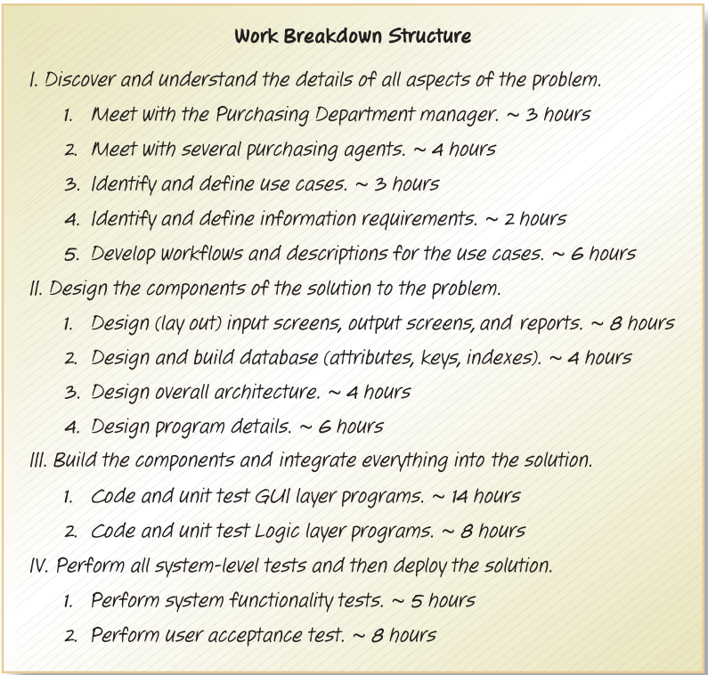

Slide 27
Q11
What information is provided by use cases or a use case diagram?

Slide 28
Q11-Answer:
Use cases show all of the user functions that the new system must support.

Slide 29
Q12
What information is provided by a class diagram?

Slide 30
Q12-Answer:
A class diagram identifies all of the “things” that must be remembered and tracked by the new system.
It usually will be used to design and build the database for the new system.

Slide 31
Q13
How do a use case diagram and a class diagram drive the system development process?

Slide 32
Q13-Answer:
The use case diagram defines the processes (e.g. functions) of the new system,
and the class diagram defines the data of the new system.

Slide 33
Q14
What is another way to describe an activity diagram? What does it show?

Slide 34
Q14-Answer:
An activity diagram is also a “workflow” diagram. It shows the flow of steps that a user, working with a system, follows to complete a business process or use case.

Slide 35
Q15
How does an activity diagram help in user-interface design?

Slide 36
Q15-Answer:
An activity diagram shows the interactions between a user and the system. Those interactions must be supported by the user interface.

Slide 37
Q16
What is the purpose of architectural design?

Slide 38
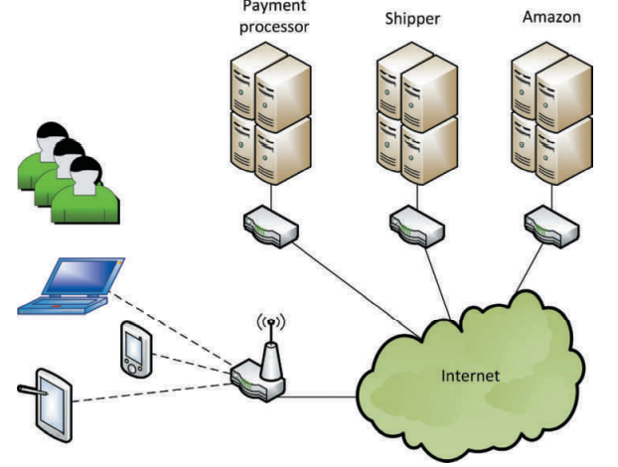
Q16-Answer:
Architectural design is used to design the overall structure of the new system. It defines the major components of the new system and how they relate to each other.

Slide 39
Q17
What new information is provided in a design class diagram (more than a class diagram)?

Slide 40
Q17-Answer:
A design class diagram is an extension of a class diagram and it shows how the attributes become data fields with type information. It also identifies the methods of a class. It also shows which classes have visibility to other classes to access their methods.

Slide 41
Q18
What are the steps of system testing?

Slide 42
Q18-Answer:
Create the test data
Conduct the tests
Identify and document the errors
Fix the errors.
This process repeats until the number of errors is minimal or acceptable.

Slide 43
Q19
What is the purpose of user acceptance testing?

Slide 44
Q19-Answer:
User acceptance testing is to allow the users to verify that the system performs in a manner that does in fact solve the business problem. The system should not only provide correct answers, but it should provide answers for all the issues identified during analysis.

Slide 45
Q20
Why is it a good practice to divide a project into separate iterations?

Slide 46
Q20-Answer:
To divide the work so that it can be managed and controlled better.
It also provides intermediate deliverables to let the project team members and the users know if the new system is going to solve the business problems.

Slide 47
Q21
What should be the objective or result of an iteration?

Slide 48
Q21-Answer:
To produce a portion of the solution system.
Usually this means that some working piece of the system is design, coded, and tested. Sometimes it also allows portions of the final solution to be deployed early.

