Slide 1
Corporate Finance Thirteenth Edition Stephen A. Ross / Randolph W. Westerfield / Jeffrey F. Jaffe / Bradford D. Jordan
Chapter 9
Stock Valuation
© McGraw Hill LLC. All rights reserved. No reproduction or distribution without the prior written consent of McGraw Hill LLC.

Slide 2
Key Concepts and Skills
Understand how stock prices depend on future dividends and dividend growth.
Be able to compute stock prices using the dividend growth model.
Understand valuation comparables.
Understand the basics of the stock market.

Slide 3
Chapter Outline
9.1 The Present Value of Common Stocks
9.2 Estimates of Parameters in the Dividend Discount Model
9.3 Comparables
9.4 Valuing Stocks Using Free Cash Flows
9.5 The Stock Markets

Slide 4
9.1 The Present Value of Common Stocks
The value of any asset is the present value of its expected future cash flows.
Stock ownership produces cash flows from:
Dividends.
Capital Gains.
Valuation of Different Types of Stocks:
Zero Growth.
Constant Growth.
Differential Growth.

Slide 5
Case 1: Zero Growth
Assume that dividends will remain at the same level forever
Since future cash flows are constant, the value of a zero growth stock is the present value of a perpetuity:

Slide 6
Case 2: Constant Growth
Assume that dividends will grow at a constant rate, g, forever, i.e.,
Since future cash flows grow at a constant rate forever, the value of a constant growth stock is the present value of a growing perpetuity:

Slide 7
Constant Growth Example
Suppose Big D, Inc., just paid a dividend of $.50. It is expected to increase its dividend by 2 percent per year. If the market requires a return of 15 percent on assets of this risk level, how much should the stock be selling for?
Notes:
The biggest mistake that students make with the DGM is using the incorrect dividend. Be sure to emphasize that we are finding a present value, so the dividend needed is the one that will be paid NEXT period, not the one that has already been paid.

Slide 8
Case 3: Differential Growth – I
Assume that dividends will grow at different rates in the foreseeable future and then will grow at a constant rate thereafter.
To value a differential growth stock, we need to:
Estimate future dividends in the foreseeable future.
Estimate the future stock price when the stock becomes a constant growth stock (Case 2).
Compute the total present value of the estimated future dividends and future stock price at the appropriate discount rate.

Slide 9
Case 3: Differential Growth – II
Assume that dividends will grow at rate g₁ for N years and grow at rate g₂ thereafter.

Slide 10
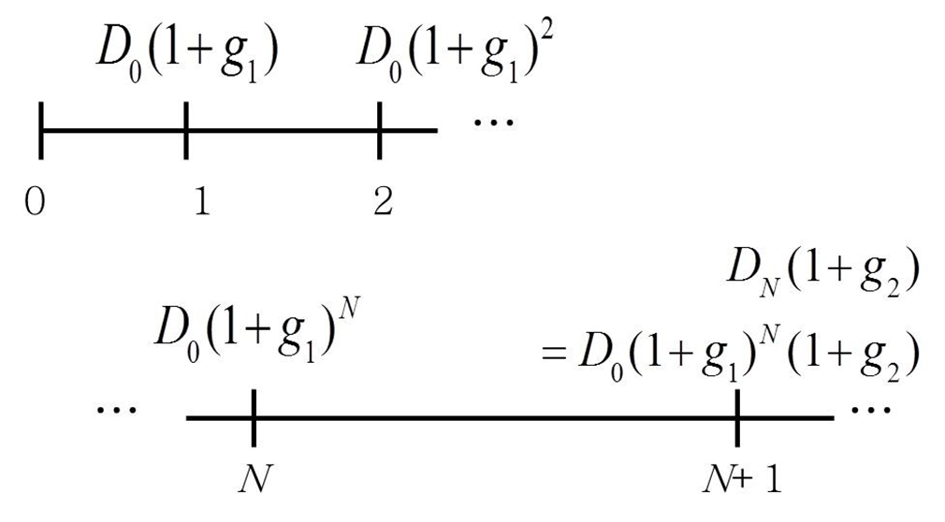
Case 3: Differential Growth – III
Dividends will grow at rate g₁ for N years and grow at rate g₂ thereafter
Access the text alternative for slide images

Slide 11
Case 3: Differential Growth – IV
We can value this as the sum of: a T-year annuity growing at rate g₁
plus the discounted value of a perpetuity growing at rate g₂ that starts in Year T+1
Notes:
It may be good to point out that we have assumed the discount rate is constant; however, it could change across periods, or even across years.

Slide 12
Case 3: Differential Growth - V
Consolidating gives:

Slide 13
A Differential Growth Example
A common stock just paid a dividend of $2. The dividend is expected to grow at 8 percent for 3 years, then it will grow at 4 percent in perpetuity.
What is the stock worth? Assume the discount rate is 12 percent.

Slide 14
With the Formula

Slide 15
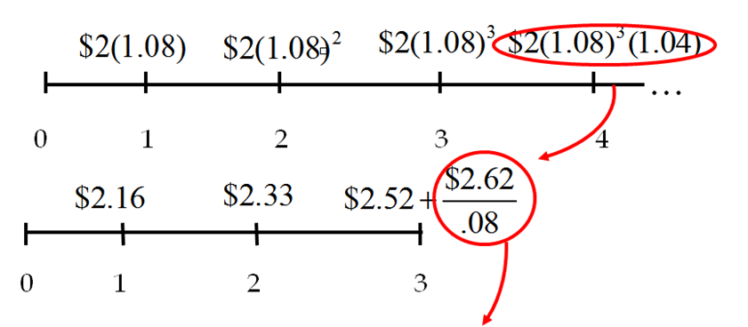
With Cash Flows
The constant growth phase beginning in Year 4 can be valued as a growing perpetuity at Year 3.
Access the text alternative for slide images
Notes:
This type of problem generally separates the “A” students from the rest of the class.

Slide 16
9.2 Estimates of Parameters in the Dividend Discount Model
The value of a firm depends upon its growth rate, g, and its discount rate, R.
Where does g come from?
g = Retention ratio × Return on retained earnings (ROE)

Slide 17
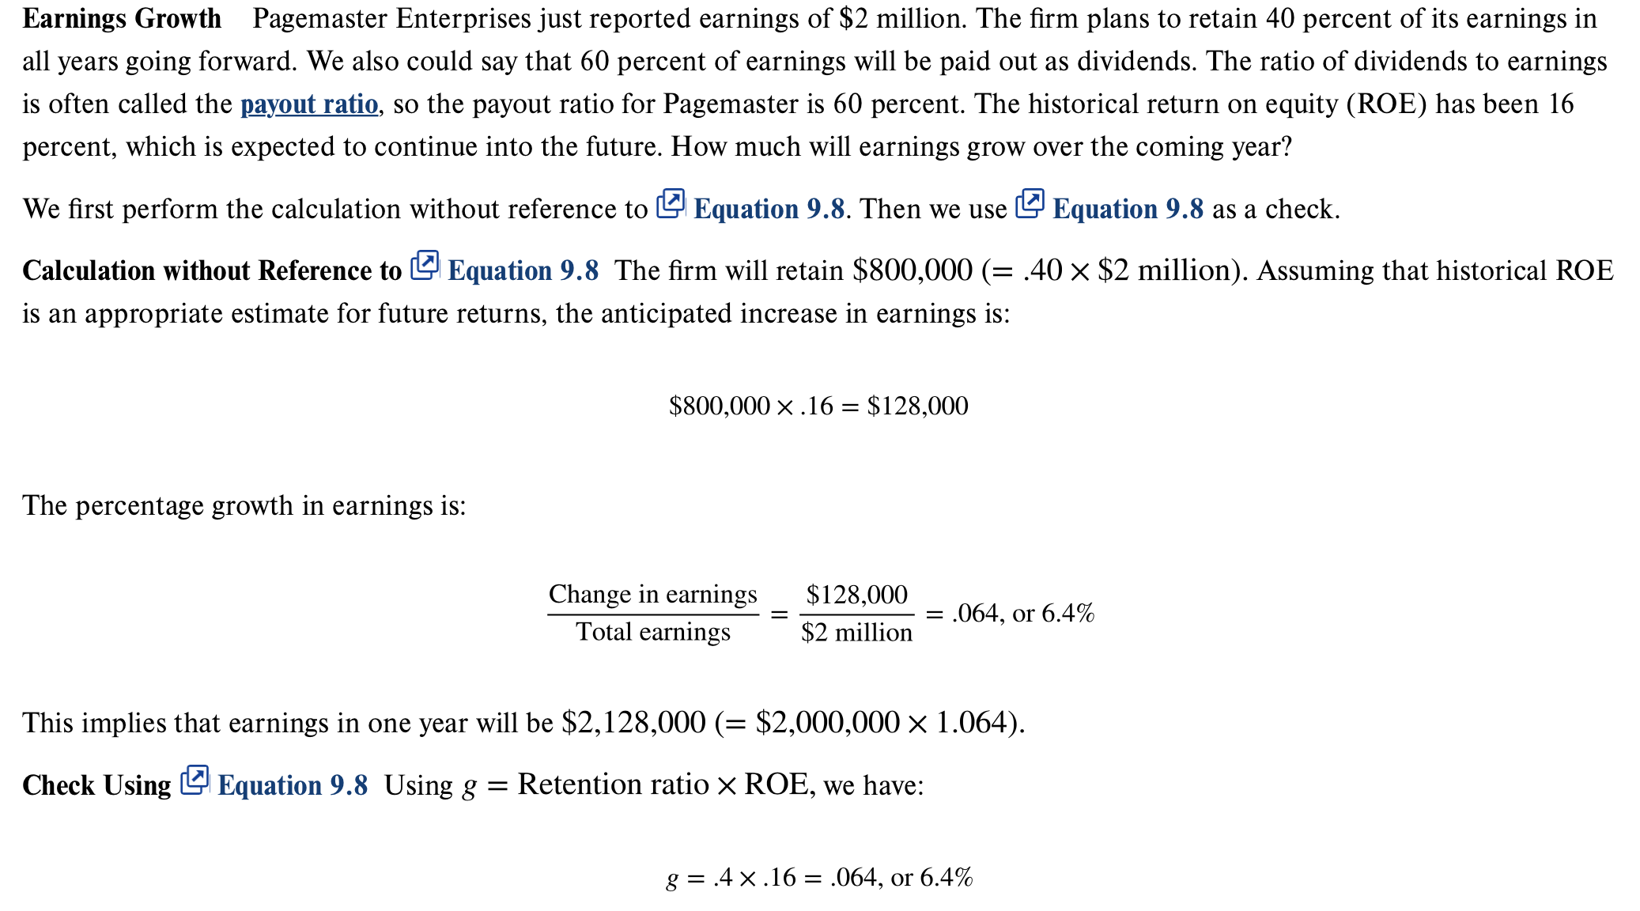

Slide 18
Where Does R Come From?
The discount rate can be broken into two parts.
The dividend yield.
The growth rate (in dividends)
In practice, there is a great deal of estimation error involved in estimating R.

Slide 19
Using the D G M to Find R
Start with the D G M:
Rearrange and solve for R:
Notes:
Point out that D₁ / P₀ is the dividend yield and g is the capital gains yield.
Lecture Tip: It may be useful to rearrange the Dividend Growth Model and solve for g rather than the intrinsic value. Doing so recognizes that the market’s estimate of price is the most meaningful. Thereby, students can evaluate stocks by asking the question “Is the implied growth reasonable?” rather than assuming they are capable of selecting a single value estimate that is better than the consensus of all market participants.

Slide 21
9.3 Comparables
Comparables are used to value companies based primarily on multiples.
Common multiples include:
Price-Earnings Ratios.
Enterprise Value Ratios.

Slide 22
Price-Earnings Ratio
The price-earnings ratio is calculated as the current stock price divided by annual E P S.
The Wall Street Journal uses last four quarters’ earnings.
Notes:
Other sources prefer to use forecasted earnings (i.e., a forward PE) as opposed to trailing twelve months (TTM).
A stock’s PE ratio is likely the function of three factors:
-Growth opportunities (positive relation)
-Risk (negative relation)
-Accounting practices (conservative accounting practices are likely related to higher PE ratios)

Slide 23
Enterprise Value Ratios
The PE ratio focuses on equity, but what if we want the value of the firm?
Use enterprise value:
E V = Market value of equity + Market value of debt − Cash.
Like P E, we compare the value to a measure of earnings. From a firm level, this is E B I T D A, or earnings before interest, taxes, depreciation, and amortization.
E B I T D A represents a measure of total firm cash flow.
Notes:
Accounting policies will also impact the PE ratio, as conservative policies are generally associated with higher PE ratios.

Slide 24
9.4 Valuing Stocks Using Free Cash Flows
In Chapters 5 and 6 you learned that the value of a project (i.e., its N P V) was the discounted value of the cash flows it generates.
The firm value is the consolidated present value of the cash flow from all of its projects.

Slide 25
9.5 The Stock Markets
Dealers vs. Brokers.
New York Stock Exchange (N Y S E)
License holders (formerly “members”)
Entitled to buy or sell on the exchange floor.
Operations.
Floor activity.
Notes:
Dealer: maintains an inventory and stands ready to trade at quoted bid (price at which they will buy) and ask (price at which they will sell) prices. Make their profit from the difference between the bid and ask prices, called the bid-ask spread. The smaller the spread, the more competition and the more liquid the stock. The move to decimalization allows for a smaller bid-ask spread.
Broker: a broker matches buyers and sellers. They perform the search function for a fee (commission). They do not hold an inventory of securities.
NYSE:
DMMs manage the order flow by keeping the limit order book. The limit order book lists the trades that investors have given to their brokers that include desired trading prices. The specialist is also a dealer that holds an inventory in their assigned stock; they post bid and ask prices and they are supposed to maintain an orderly market.
Other participants on the floor of the exchange include floor traders that own exchange seats, commission brokers, and floor brokers.

Slide 26
Market and Limit Orders
Market orders:
You specify ticker and quantity.
Immediate execution at best available price.
Market buy will be executed at lowest ask.
Market sell will be executed at highest bid.
Limit orders:
You specify ticker, quantity, and price.
The order will be executed only if trade can be made at the limit price or better.
Limit buy can only be executed at limit price or lower.
Limit sell can only be executed at limit price or higher.

Slide 27
Stop Orders
The stop price is the trigger or activation point.
If the stop price is reached or passed, the order becomes a market order to be executed at the best available price.
Risk: Price suddenly plummets or rises and the execution price is much different than expected.

Slide 28
Nasdaq
Not a physical exchange but a computer-based quotation system.
Multiple market makers.
Electronic communications networks.
Three levels of information:
Level 1—timely, accurate quotes, freely available.
Level 2—view quotes from all Nasdaq market makers, small fee.
Level 3—view and update quotes, market makers only.
Large portion of technology stocks.
Notes:
Point out that the Nasdaq market site in Times Square is NOT an exchange. It is just offices and basically a place for reporters to report on what is happening with Nasdaq stocks.

Slide 29
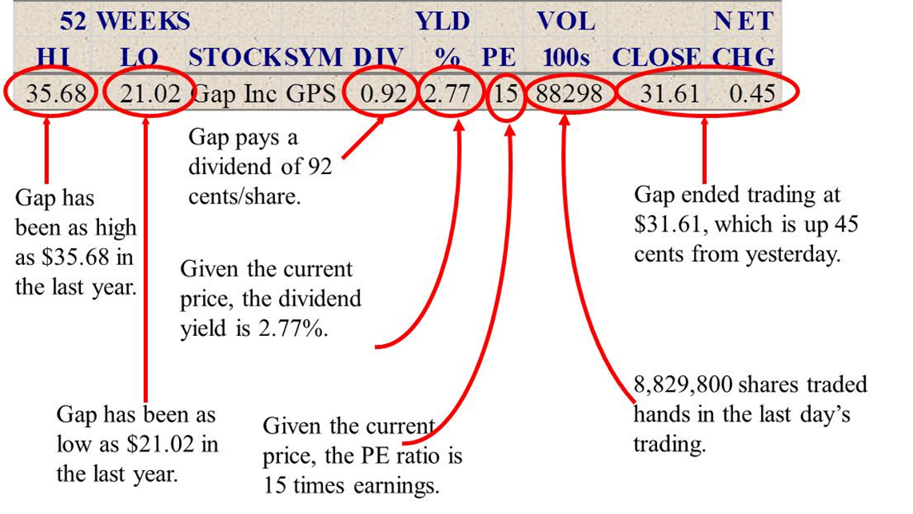
Stock Market Reporting
Access the text alternative for slide images

Slide 30
Quick Quiz
What determines the price of a share of stock?
What determines g and R in the D G M?
Discuss the importance of valuation ratios.
What are some of the major characteristics of N Y S E and Nasdaq?

Slide 31
End of Main Content
© McGraw Hill LLC. All rights reserved. No reproduction or distribution without the prior written consent of McGraw Hill LLC.

Slide 32
Accessibility Content: Text Alternatives for Images

Slide 33
Case 3: Differential Growth – III – Text Alternative
Return to parent-slide containing images
The dividend calculation is: year 1 = D 0 times (1 + G 1); year 1 = D 0 times (1 + G 1) squared; year N = D 0 times (1 + G 1) to power n; year N + 1 = D N times (1 + G 2) which equals D 0 times (1 + G 1) to the power n times (1 + G 2).
Return to parent-slide containing images

Slide 34
With Cash Flows – Text Alternative
Return to parent-slide containing images
Dividends grow at 8% then 4%. Circled portion shows the calculation for dividend in year 4. Arrow points to dividend in year 4. Circled portion shows the calculation for price in year 3. Arrow points to price in year 3. The calculation shown is as follows: year 1 = $2 times (1.08); year 2 = $2 times (1.08) squared; year 2 = $2 times (1.08) squared; year 3 = $2 times (1.08) cubed; year 2 = $2 times (1.08) cubed times 1.04. The other values are: year 1 = $2.16; year 2 = $2.33; year 3 = $2.52 + 2.62 over 0.8.
Return to parent-slide containing images

Slide 35
Stock Market Reporting – Text Alternative
Return to parent-slide containing images
Column heads are 52 Weeks, Hi, Lo, Stock Symbol, Dividend Yield percent, PE, Volume in 100s, Close, Net Change.
Gap Hi is 35.68 with the notation that Gap has been as high as $35.68 in the last year.
Gap Lo is 21.02 and the note: Gap has been as low as $21.02 in the last year.
Dividend is listed as 0.92 and followed by the note: Gap pays a dividend of 92 cents/share. Yield percent is 2.77 and the note: Given the current price, the dividend yield is 2.77%. PE is 15 and the note: Given the current price, the PE ratio is 15 times earnings. Volume is listed as 88298 with the notation: 8,829,800 shares traded hands in the last day's trading. Close is 31.61 and Net change as 0.45 and noted as Gap ending trading at $31.61, which is up 45 cents from yesterday.
Return to parent-slide containing images

