Slide 1
Group 15
The Nitrogen Family
 | symbol | electron configuration
nitrogen | N | [He]2s²2p³
phosphorus | P | [Ne]3s²3p³
arsenic | As | [Ar]3d¹⁰4s² 4p³
antimony | Sb | [Kr]4d¹⁰5s² 5p³
bismuth | Bi | [Xe]4f¹⁴ 5d¹⁰6s² 6p³

Slide 3
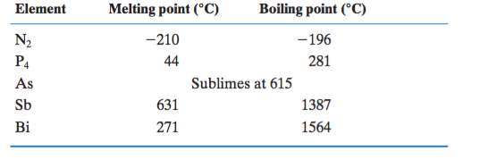
Melting and boiling points of the Group 15 elements

Slide 4
Group 15: The Nitrogen Family
Electron configurations ns²np³ (n is the period number)
Oxidation states that range from - 3 to + 5
The metallic character of the group increases down the group

Slide 5
1) Wider range of properties.
Metallic character and nonmetallic character.
The electronic configuration:
N³⁻ , P³⁻ to +5 also exist but covalent. Sb³⁺, Bi³⁺ exist.
4) Oxides of N, P and As are acidic.
Ex.: N₂O₃, P₄O₆ and As₄O₆ but Sb₄O₆ amphoteric,
Bi₂O₃ is basic.
:N≡N: is unreactive.
Empty d orbitals for others P to Bi form six covalent bonds; PCl₆⁻, SbCl₆⁻, BiCl₅²⁻.
7) Allotropes for P, As, Sb, (P; red, white and black) The white P₄ very toxic.
5

Slide 6
8) The nitrogen cycle; Part of protein, nitrogen-fixation.
a) N₂(g) + O₂(g) 2NO(g)
2NO + O₂ ⎯→ 2NO₂
3NO₂ + H₂O ⎯→ 2HNO₃(l ) + NO(g)
↓ nitrates→ nutrient
b) Industrially: N₂ + 3H₂ ⎯→ 2NH₃ (Haber process)
From plants and animals; *The death of all will produce N₂ to the atmosphere.
Occurrence and preparation:
a) NH₄⁺ + NO₂⁻ ⎯→ N₂ + 2H₂O
b) As₄O₆ + 6C ⎯→ As(g) + 6CO(g)
c) Oxides by roasting sulfide in air;
2Sb₂S₃ + 9O₂ ⎯→ Sb₄O₆ + 6SO₂(g)
6

Slide 7
10) Nitrides and phosphides
N₃⁻; M₃N₂ (M = Be, Mg, Ca, Sr, …)
Ca₃N₂ + 6H₂O ⎯→ 3Ca²⁺ + 6OH⁻ + 2NH₃ (ionic nitride)
Some covalent nitride; P₃N₅, Si₃N₄
Phosphides;
a) Ionic phosphides; Li₃P, Ca₃P
b) covalent phosphides; BP, AlP
11) Hydrogen compounds:
NH₃; N₂ + 3H₂ ⎯→ 2NH₃ (commercially)
NH₄⁺ + OH⁻ ⎯→ NH₃ + H₂O (in Lab.)
Structure: NH₃ Trigonal pyramidal
Amphoteric;
NH₃ + H₂O ⎯→ NH₄⁺ + OH⁻
NH₃ + HCl ⎯→ NH₄Cl
NH₄⁺ is tetrahedral

Slide 8
N₂H₄ Hydrazine; NH₃-H + NH₂
PH₃ Phosphine;
P₄(s) + 3OH⁻ + 3H₂O ⎯→ PH₃(g) + 3H₂PO₂⁻
(hypophosphite ion)
PH₃ pyramidal, no hydrogen bonding
AsH₃; arsino, SbH₃; stibnite, BiH₃, Bismuthine are (poisonous gases)
Halogen compounds: The trihalides are known;
NCl₃(l ) + 3H₂O ⎯→ NH₃ + 3HOCl
PCl₃(l ) + 3H₂O ⎯→ H₃PO₄ + 3H⁺ + 3Cl⁻
*The pentahalides series is not complete because of lack of d orbital in nitrogen. PCl₅ is Trigonal bipyramidal

Slide 9
13) Oxides and oxyacid's of nitrogen:
N₂O dinitrogen oxide
(laughing gas)+1
NO nitrogen oxide +2
N₂O₃ dinitrogen trioxide +3
N₂O₄ dinitrogen tetroxide
2NO₂ ⇌ N₂O₄ +4
N₂O₅ +5
Acids:
nitric acid HNO₃;
NaNO₃ + H₂SO₄ ⎯→ NaHSO₄+ HNO₃
HNO₂ +3 nitrous acid
P₄O₆ (+3); Phosphorous (III) oxide
P₄O₁₀ (+5); Phosphorous (V) oxide
(many acids)
H₃PO₄ (Phosphoric),
H₃PO₃ (Phosphorous),
H₂PO₂ (hypo phosphorous)

Slide 10
Industrial uses of the group:
N; ammonia ⎯→ nitric acid ⎯→ nitrates ⎯→ fertilizers
b) P; P₂O₅ ⎯→ phosphoric acid ⎯→ matches ⎯→ rodent poisons
c) As, Sb and Bi; no much uses, alloys.

Slide 11
The Element (Nitrogen):
Rare in the Earth’s crust but elemental nitrogen (N₂) is the principal component of our atmosphere (76% by mass)
N ≡ N triple bond strength is 944 kJ.mol⁻¹ making it almost as inert as the noble gases
Nitrogen is used in medicines, fertilizers, explosives, and plastics
The biggest commercial use for elemental nitrogen gas is for the
formation of ammonia in the Haber process
N is very electronegative and it is the only group 15 element that can form hydrides capable of hydrogen bonding

Slide 12
N has a wide range of oxidation numbers. Nitrogen compounds are known to have every whole number oxidation number from - 3 to + 5. In addition, some fractional oxidation numbers are known to exists.
N can only form up to four bonds

Slide 13
The Element (Phosphorus)
The radius of phosphorus is nearly 50% bigger than that of nitrogen. Thus P is too big to approach each other close enough for their 3p orbitals to overlap and form π bonds
The availability of the 3d orbitals means that phosphorus can form as many as six bonds
Condensed phosphorus vapor is called white phosphorus and is a soft, white, poisonous, molecular solid consisting of tetrahedral P₄ molecules.
White phosphorus is highly reactive due to strain in its bonding angles and burst into flame when exposed to air

Slide 14
Red phosphorous
White (P₄)→ Red P
Heating to 250 ⁰C, not toxic, not soluble, not reactive.
*there are As₄ and Sb₄
Black phosphorous
White (P₄)→ Black P
High pressure, Hg catalyst, (covalent and London forces)

Slide 15
White phosphorus changes to red phosphorus (amorphous network) when heated in the absence of air. Red phosphorus is much less reactive
Red phosphorus is used in the striking surfaces of matchbook because the phosphorus ignites with friction

Slide 16
Compounds with Hydrogen and the Halogens:
Ammonia (NH₃)
Properties:
Pungent Toxic Gas Condenses to clear liquid at - 33ºC
NH₃ is a reasonably strong Lewis base
NH₃ salts decompose when heated
The pungent smell of decomposing ammonium carbonate ((NH₄)₂CO₃) once made it an effective “smelling salt”

Slide 17
Ammonium nitrate (NH₄NO₃ )
Nitrate anion can oxidize the ammonium cation (products are temperature dependent).
NH₄NO_{3(s)} 250ºC N₂O_{(g)} + 2H₂O_{(g)}
2NH₄NO_{3(s)} >300ºC 2N_{2(g)} + O_{2(g)} + 4H₂O

Slide 18
The higher temperature reaction has explosive power and that is
the reason that NH₄NO₃ is used as a component of dynamite
Plants need nitrogen to grow but the N₂ is so stable that the plants can not break the triple bond to be able to utilize the nitrogen. NH₄NO₃ has a high concentration of N and dissolves in water there fore it is used as a fertilizer.

Slide 19
Hydrazine (NH₂NH₂)
Uses:
Rocket Fuel
Remove dissolved corrosive oxygen from water
N₂H_{4(aq)} + O_{2(g)} N_{2(g)} + 2H₂O_{(l)}
Properties:
Oily Colorless Liquid Dangerous Explosive

Slide 20
Nitrides (solids that contain the nitride ion N³⁻)
Nitrides are only stable for small cations such as lithium or magnesium
Example: Mg₃N₂
Most nitrides dissolve in water to produce ammonia and the corresponding hydroxide
Example:
Mg₃N_{2(s)} + 6H₂O_{(l)} 3Mg(OH)_{2(s)} + 2NH_{3(g)}

Slide 21
Azide ion (N₃⁻)
Highly reactive polyatomic anion
Its most common salt is sodium azide (NaN₃)
Like most of the azide salts, NaN₃ it is shock sensitive
NaN₃ is used in airbags where it decomposes to elemental sodium and nitrogen when detonated
2NaN_{3(s)} 2Na_{(s)} + 3N_{2(g)}
The azide ion is a weak base and accepts a proton to form its conjugate acid, hydrazoic acid (HN₃) which is a weak acid

Slide 22
Nitrites ( compounds that contain NO²⁻)
Nitrites are produced by the reduction of nitrates (compounds with NO³⁻) with hot metal)
Example: KNO_{3(s)} + Pb_{(s)} 350ºC KNO_{2(s)} + PbO_{(s)}
Most nitrites are mildly toxic
Uses: Processing of meat products because they retard bacterial growth. They are responsible for the pink color of ham, sausage and other cured meats.

Slide 23
Phosphine(PH₃)
The nitrogen hydrogen compounds are much more stable that all of the other hydrogen compounds formed by the members of Group 15
PH₃ is much less soluble than ammonia in water because PH₃ can not form hydrogen bonds to water
Properties:
Poisonous Gas Smells faintly of garlic Burst into flame in air if it is slightly impure

Slide 24
Aqueous solutions of PH₃ are neutral because the electronegativity of phosphorus is so low that the lone pair of electrons on PH₃ is spread over the hydrogen atoms as well as the phosphorus atom
PH₃ is a very weak acid

Slide 25
A typical reaction of nonmetal halides, is their reaction with water to give oxoacids (an acid that contains oxygen), without a change in the oxidation number of the nonmetal that it is bonded to
Example:
PCl_{3(l)} + 3H₂O_{(l)} H₃PO_{3(s)} + 3HCl
This reaction is also an example of a hydrolysis reaction (a reaction with water in which new element-oxygen bonds are formed)

Slide 26
Nitrogen Oxide and Oxoacids:
All nitrogen oxides are acidic
Some are acid anhydrides (a compound that forms an oxoacid
when it reacts with water)
In atmospheric chemistry where the oxides play an important two edged role in both maintaining and polluting the atmosphere they are referred to collectively as NO_{x} (read “nox”)

Slide 27
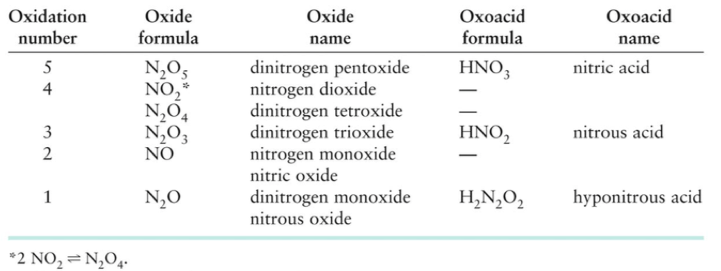
The Oxide and Oxoacids of Nitrogen

Slide 28
Dinitrogen oxide (N₂O)
Uses:
Foaming agent and propellant for whipped cream
Properties:
Tasteless Unreactive Nontoxic in small amounts Soluble in fat

Slide 29
Nitrogen Oxide, Nitrogen Monoxide, or Nitric Oxide (NO)
NO (which is produced from hot airplane and automobile engines) has many harmful effects: leads to acid rain, formation of smog, as well as contributes to the destruction of the ozone layer
NO is rapidly oxidized to NO₂ on exposure to air
2NO_{(g)} + O_{2(g)} 2NO_{2(g)}
The NO₂ then reacts with water, forming acid rain
NO also plays beneficial roles in small amounts. In the body it acts as a neurotransmitter and helps to dilate blood vessels and participates in other physiological changes

Slide 30
Nitrogen Dioxide (NO₂)
Brown poisonous gas that contributes to the color and odor of smog
The molecule has a odd number of electrons and in the gas phase it exist in equilibrium with its colorless dimer N₂O₄
NO₂ dissolves in water to form nitric acid and nitrogen oxide which is what leads to acid rain
3NO_{2(g)} + H₂O_{(l)} 2HNO_{3(aq)} + NO_{(g)}
NO₂ also initiates a complex sequence of smog forming photochemical reactions

Slide 31
Dinitrogen Trioxide (N₂O₃)
Properties:
Blue
Gas
Is the anhydride of nitrous acid (HNO₂)
N₂O_{3(g)} + H₂O_{(l)} 2HNO_{2(aq)}
Nitric acid (HNO₃)
HNO₃ is used in the production of fertilizers and explosives
It is both an acid and an oxidizing agent
It is made in the three-step Ostwald process

Slide 32
STEP 1: Oxidation of ammonia
4NH_{3(g)} + 5O_{2(g)} 850ºC,5atm,Pt/Rh 4NO_{(g)} + 6H₂O_{(g)}
STEP 2: Oxidation of nitrogen oxide
2NO_{(g)} + O_{2(g)} 2NO_{2(g)}
STEP 3: Disproportionation (single atom is both oxidized and
reduced) in water;
3NO_{2(g)} + H₂O_{(l)} 2HNO_{3(aq)} + NO_{(g)}

Slide 33
Phosphorus Oxides and Oxoacids:
Oxoacids and oxoanions of phosphorous are among the most heavily manufactured chemicals.
Phosphate fertilizer production consumes two-thirds of all the sulfuric acid produced in the United States
The structures of the phosphorus oxides are based on the tetrahedral PO₄ unit

Slide 34
Phosphoric acid (H₃PO₄)
Used primarily for the production of fertilizer, food additives, and detergent
Many soft drinks owe their tart taste to the presence of a small amount of phosphoric acid
Although the phosphorus in H₃PO₄ has an oxidation number of + 5 the acid shows appreciable oxidizing power at temperatures above 350ºC

Slide 35
Phosphates (compounds contain PO₄³⁻ )
Phosphate rock is mined in huge quantities in Florida and Morocco
The rock is crushed and treated with sulfuric acid to give a mixture of sulfates and phosphates called superphosphates, a major fertilizer
Ca₃(PO₄)_{2(s)} + 2H₂SO_{4(l)} 2CaSO_{4(s)} + Ca(H₂PO₄)_{2(s)}

