Slide 1
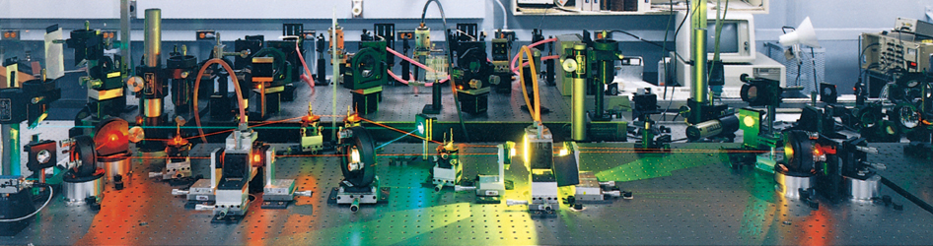
Chapter 7
Quantum Theory and the Electronic Structure of Atoms
Copyright 2022 © McGraw Hill LLC. All rights reserved. No reproduction or distribution without the prior written consent of McGraw Hill LLC.

Slide 2
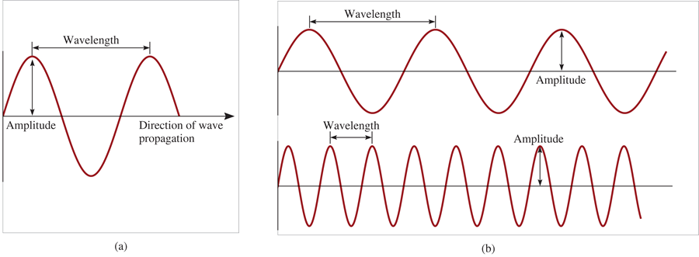
Properties of Waves
Wavelength (λ) is the distance between identical points on successive waves.
Amplitude is the vertical distance from the midline of a wave to the peak or trough.
Frequency (ν) is the number of waves that pass through a particular point in 1 second (Hz = 1 cycle/s).
The speed (u) of the wave = λ × ν

Slide 3
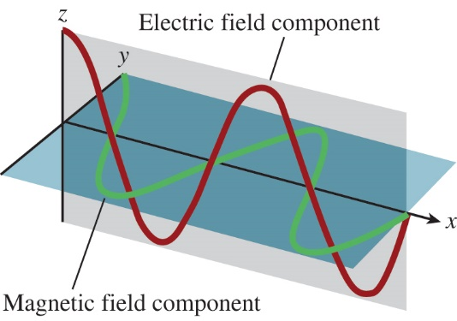
Light as a Wave
Maxwell (1873), proposed that visible light consists of electromagnetic waves.
Electromagnetic radiation is the emission and transmission of energy in the form of electromagnetic waves.
Speed of light (c) in vacuum =
All electromagnetic radiation
λ × ν = c
Access the text alternative for slide images.

Slide 4
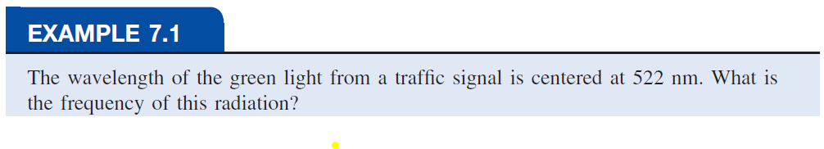
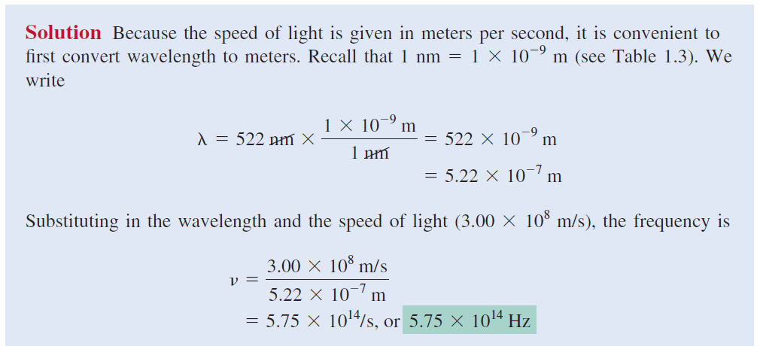

Slide 5
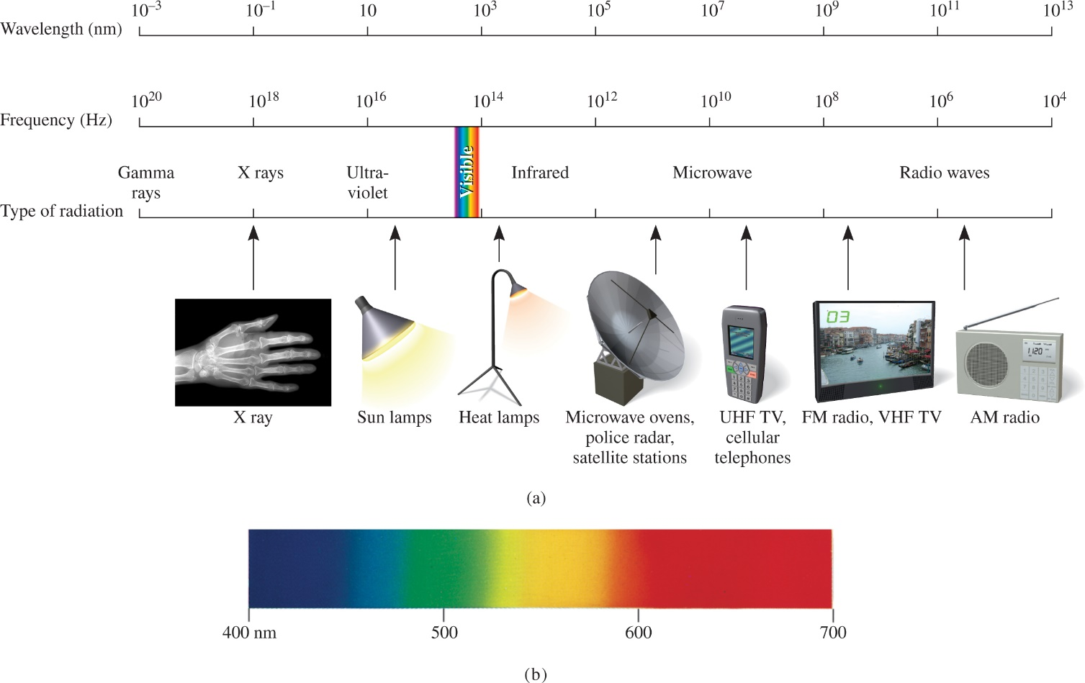
Electromagnetic Spectrum
Access the text alternative for slide images.
a: (X ray): Ted Kinsman/Science Source

Slide 6
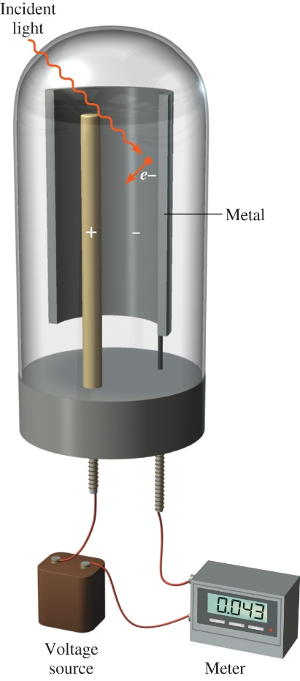
“Photoelectric Effect” Solved by Einstein in 1905
Light has both:
wave nature
particle nature
Photon is a “particle” of light
hv = KE + W
E = hv
h _{Planck constant}= 6.626 070 15 x 10⁻³⁴ J Hz⁻¹
where v is the frequency, and W is the work function and depends how strongly electrons are held in the metal.
Access the text alternative for slide images.

Slide 7
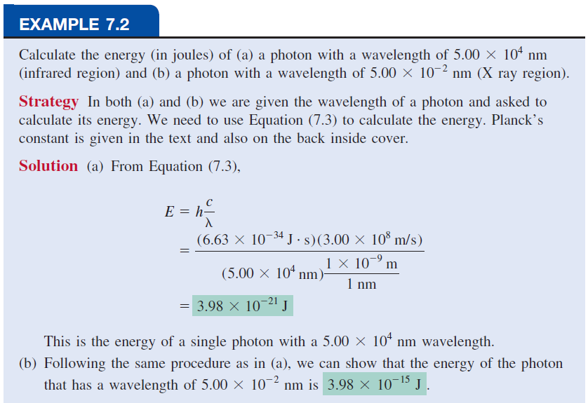

Slide 8
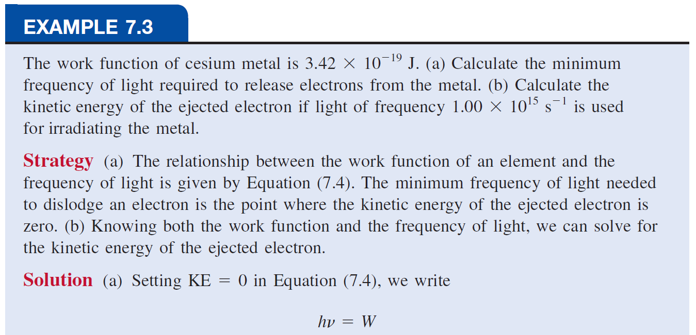
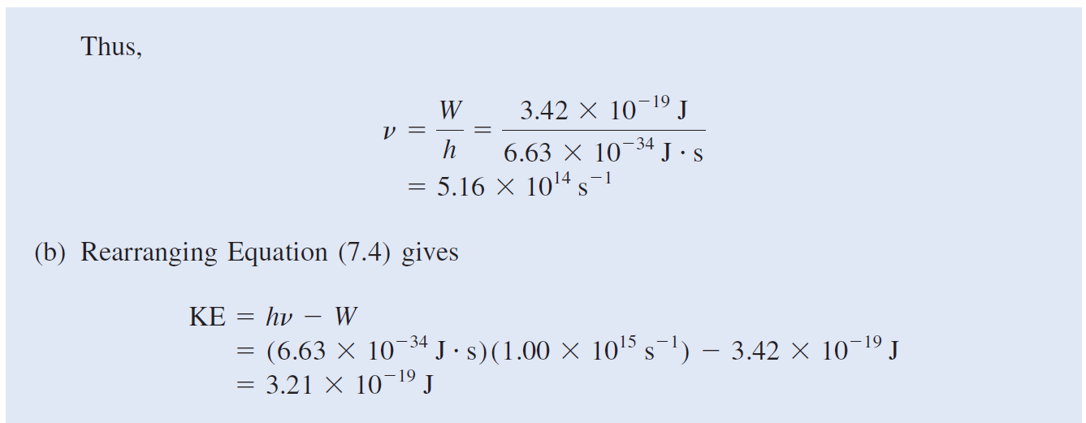

Slide 9
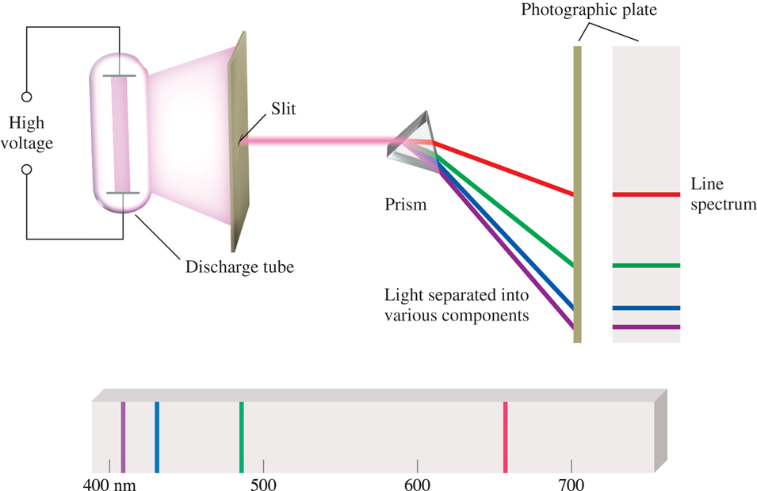
Line Emission Spectrum of Hydrogen Atoms
Access the text alternative for slide images.

Slide 10
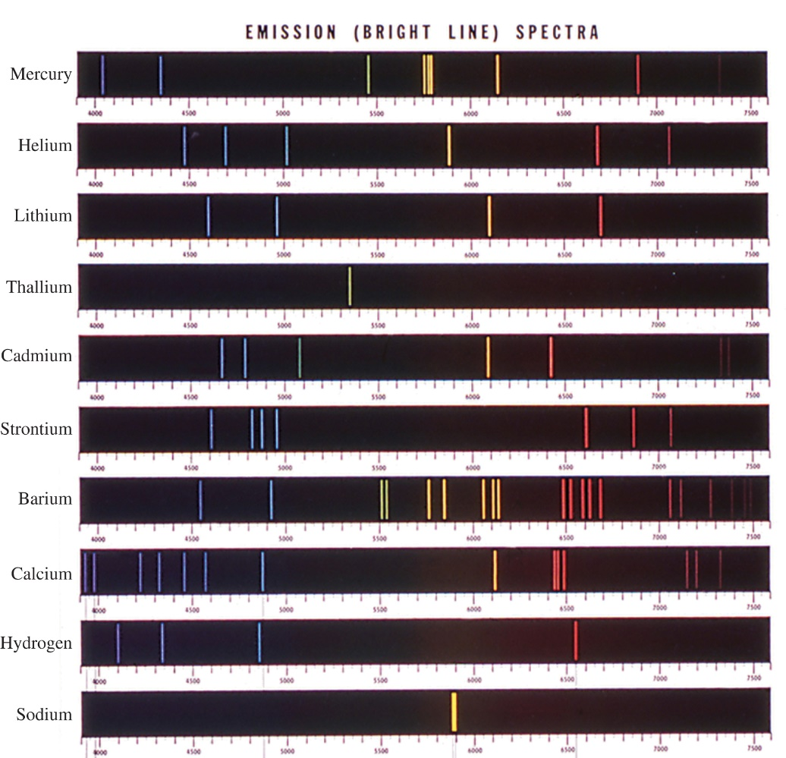
Emission Spectra of Some Elements
Access the text alternative for slide images.
Courtesy of Wabash Instrument Corporation

Slide 11
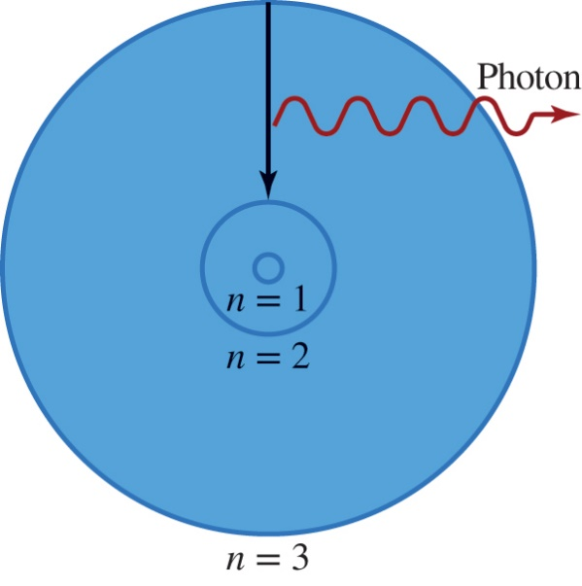
Bohr’s Model of the Atom (1913)
can only have specific
(quantized) energy values
moves
from one energy level to a lower energy level
light is emitted as
n (principle quantum number) =
Access the text alternative for slide images.

Slide 12
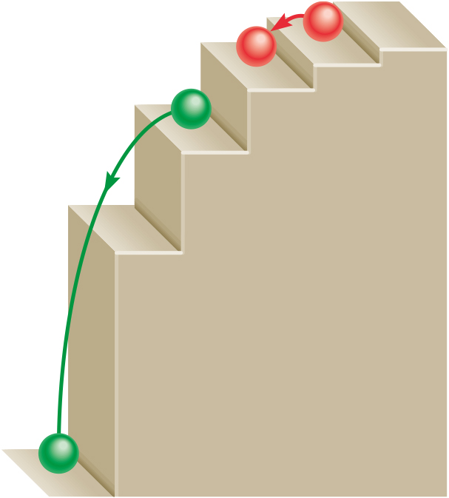
Quantized Energy
When an electron undergoes a transition, it can only exist in an energy level, not between energy levels, because energy levels of the atom are quantized.
A way to think about this is a ball on a staircase. The ball can only rest on steps, not between steps, much like how an electron can only exist in an energy level, not between energy levels.
Access the text alternative for slide images.

Slide 13
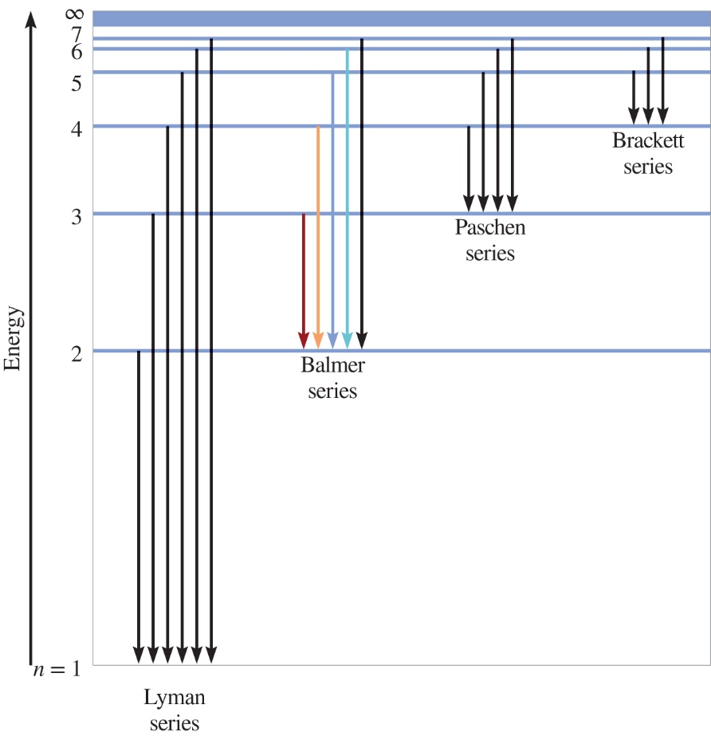
Energy Transitions of the Hydrogen Atom
Access the text alternative for slide images.

Slide 14
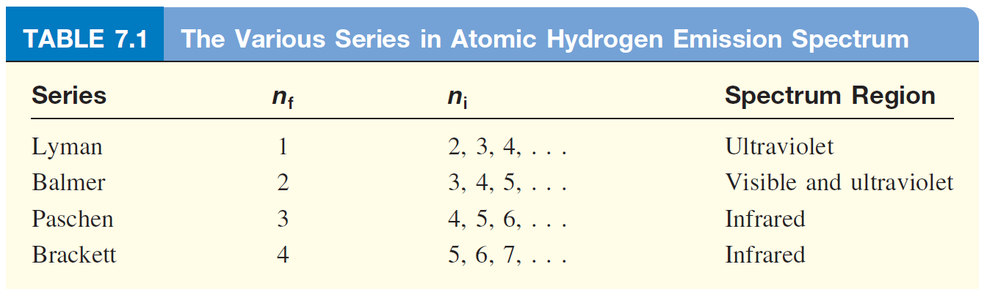
Hydrogen Atom Emission Series
Access the text alternative for slide images.

Slide 15
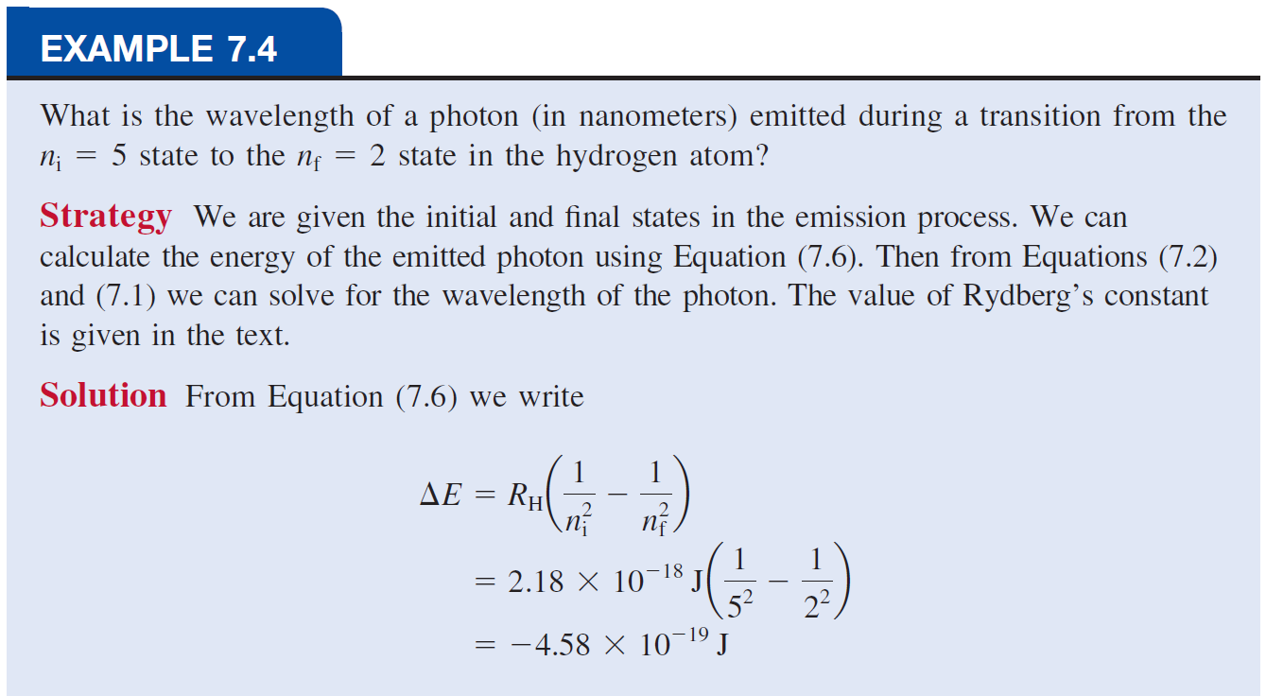
(Continue..)
Access the text alternative for slide images.

Slide 16
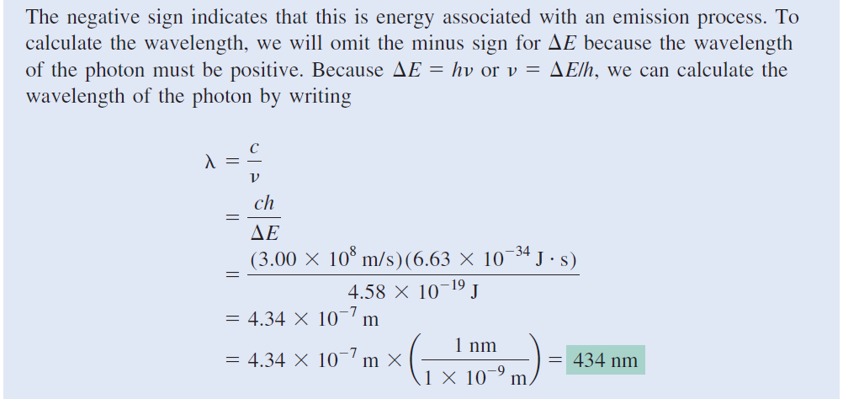
Access the text alternative for slide images.

Slide 17
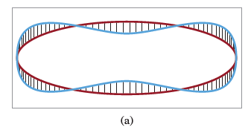
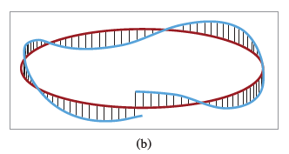
Quantization of Electron Energy
Why is
energy quantized?
De Broglie (1924) reasoned that
is both particle and wave.

Slide 18
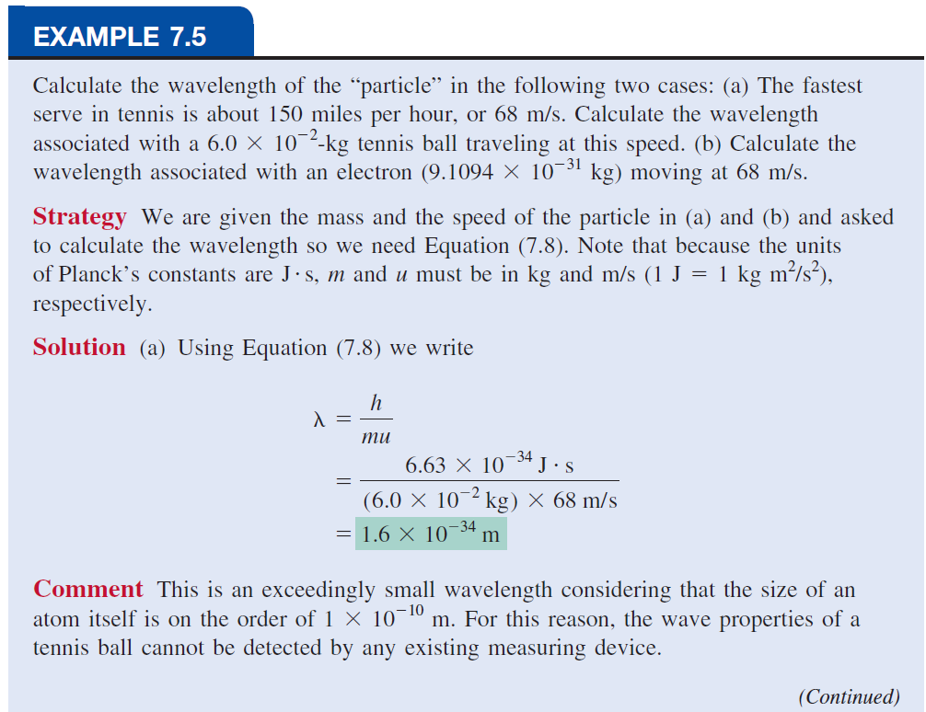

Slide 19
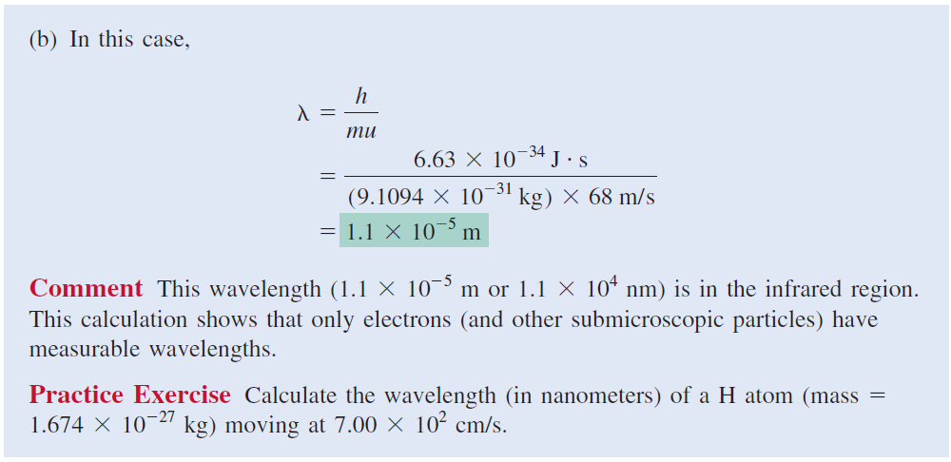

Slide 20
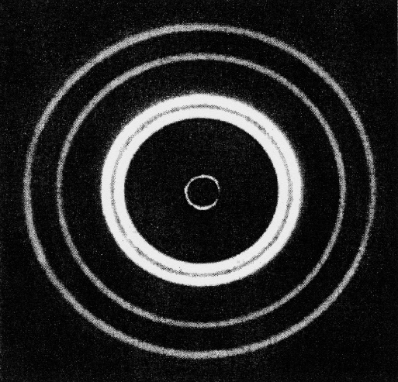
Schrodinger Wave Equation 1
In 1926 Schrodinger wrote an equation that described both the particle and wave nature of the
Wave function
describes:
energy of
with a given
probability of finding
in a volume of space
  Schrodinger’s equation can only be solved exactly for the hydrogen atom Must approximate its solution for multi electron systems.
©Education Development Center, Inc.

Slide 21
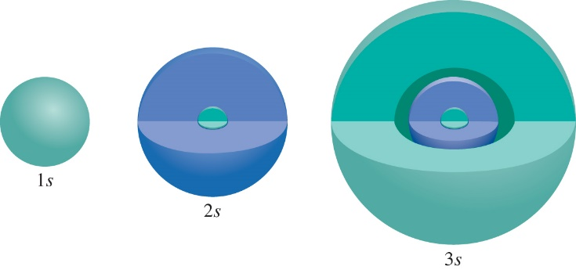
Schrodinger Wave Equation 2
is a function of four numbers called
quantum numbers
principal quantum number n
n =
distance of e⁻ from the nucleus

Slide 22
Schrodinger Wave Equation 3
quantum numbers :
angular momentum quantum number l
Angular momentum quantum number (l) descripts
The shape of the “volume” of space that the e⁻ occupies
for a given value of n, l = 0, 1, 2, 3, … n-1
n = 1, l = 0
n = 2, l = 0 or 1
n = 3, l = 0, 1, or 2
n = 4, l = 0, 1, 2, or 3
l = 0 s orbital
l = 1 p orbital
l = 2 d orbital
l = 3 f orbital

Slide 23
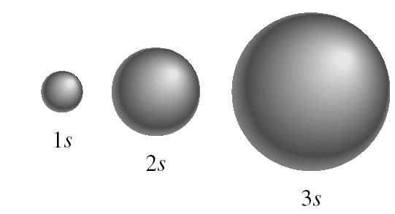
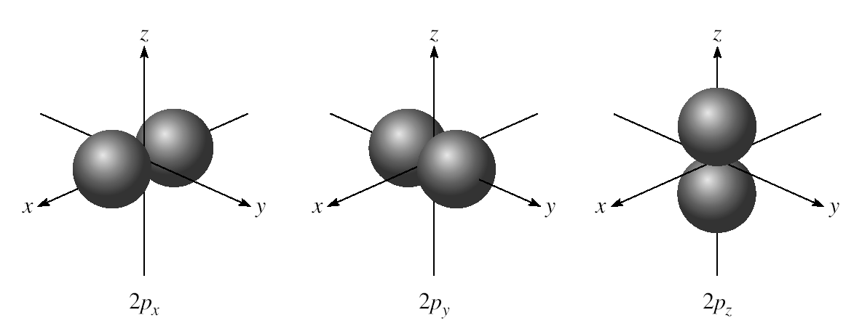
l = 0 (s orbitals)
l = 1 (p orbitals)

Slide 24
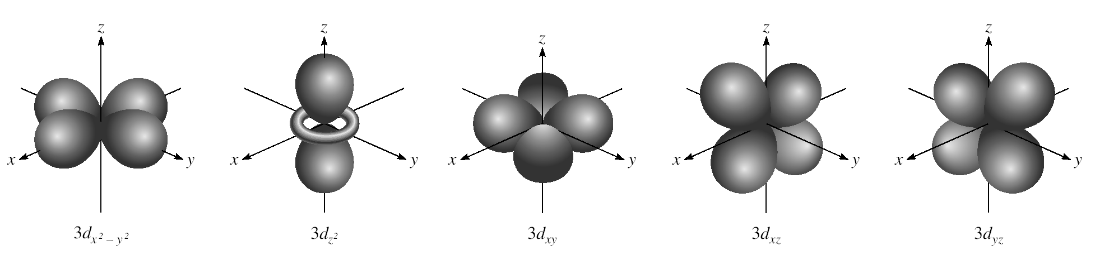
l = 2 (d orbitals)

Slide 25
Schrodinger Wave Equation 4
quantum numbers :
magnetic quantum number
for a given value of l
If l = 1 (p orbital),
If l = 2 (d orbital),
m_{l} = -2, -1, 0, +1, +2
orientation of the orbital in space

Slide 26
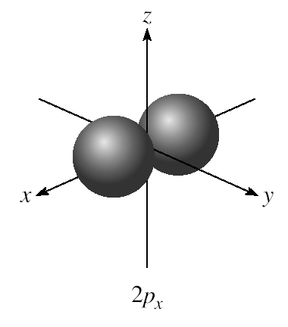
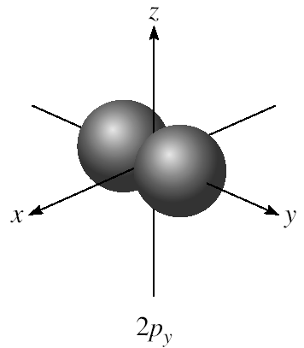
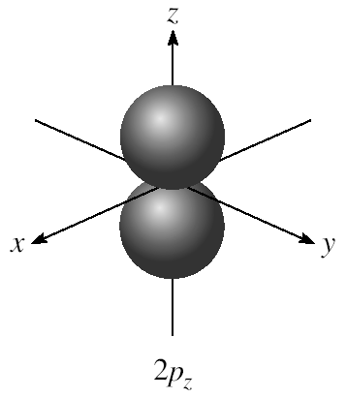
m_{l} = -1, 0, or 1
3 orientations in space

Slide 27
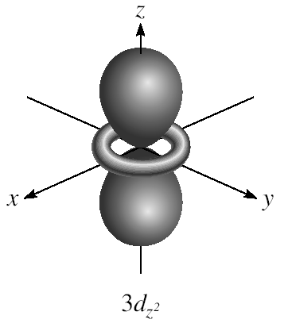
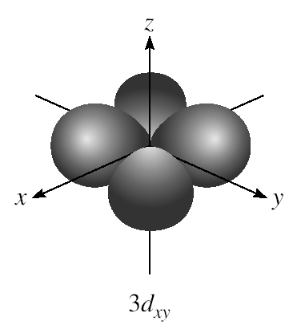
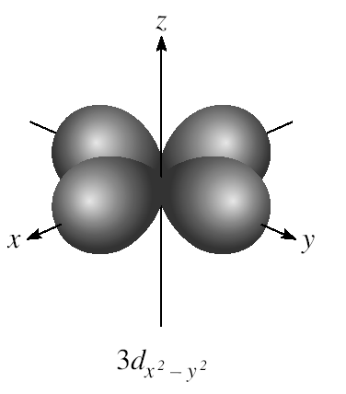
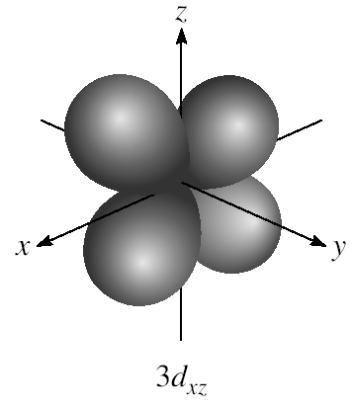
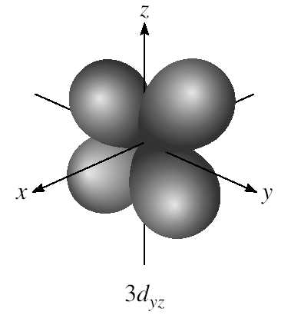
m_{l} = -2, -1, 0, 1, or 2
5 orientations in space

Slide 28
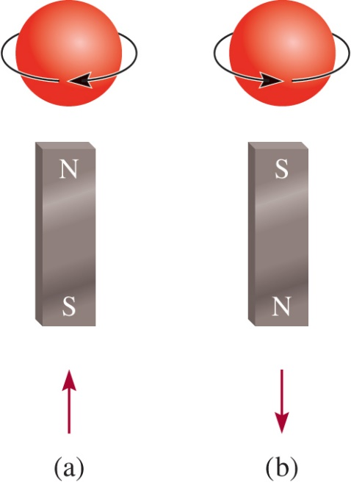
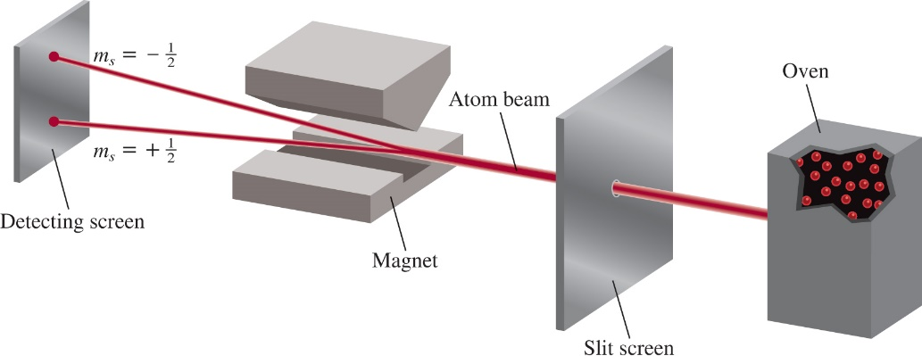
Schrodinger Wave Equation 5
spin quantum number
Access the text alternative for slide images.

Slide 29
Quantum Numbers: (n, l, m_{l}, m_{s})
Existence (and energy) of electron in atom is described
by its unique wave function ψ.
Pauli exclusion principle - no two electrons in an atom
can have the same four quantum numbers.
Each seat is uniquely identified (E, R12, S8)
Each seat can hold only one individual at a time

Slide 30
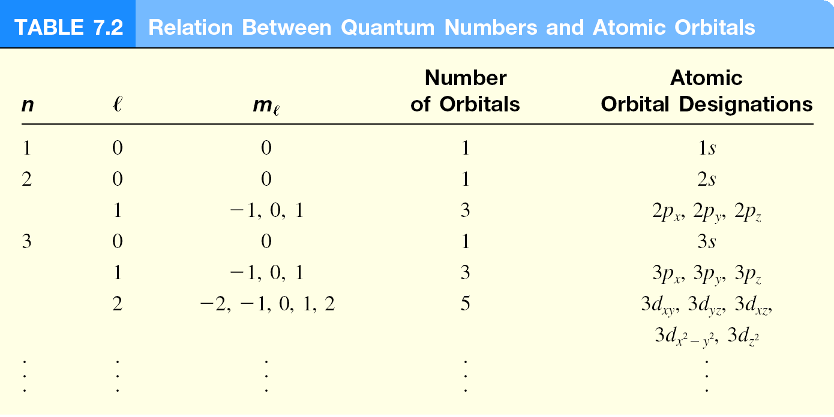

Slide 31
Quantum Numbers: (n, l, m_{l}, m_{s})
Shell – electrons with the same value of n
Subshell – electrons with the same values of n and l
Orbital – electrons with the same values of n, l, and ml
How many electrons can an orbital hold?
If n, l, and m_{l} are fixed, then m_{s} = ½ or - ½
ψ = (n, l, m_{l}, ½)
or ψ = (n, l, m_{l}, -½)
An orbital can hold 2 electrons

Slide 32
How many 2p orbitals are there in an atom?
n = 2
If l = 1, then m_{l} = -1, 0, or +1
2p
3 orbitals
l = 1
How many electrons can be placed in the 3d subshell?
n = 3
If l = 2, then m_{l} = -2, -1, 0, +1, or +2
3d
5 orbitals which can hold a total of 10 e⁻
l = 2

Slide 33
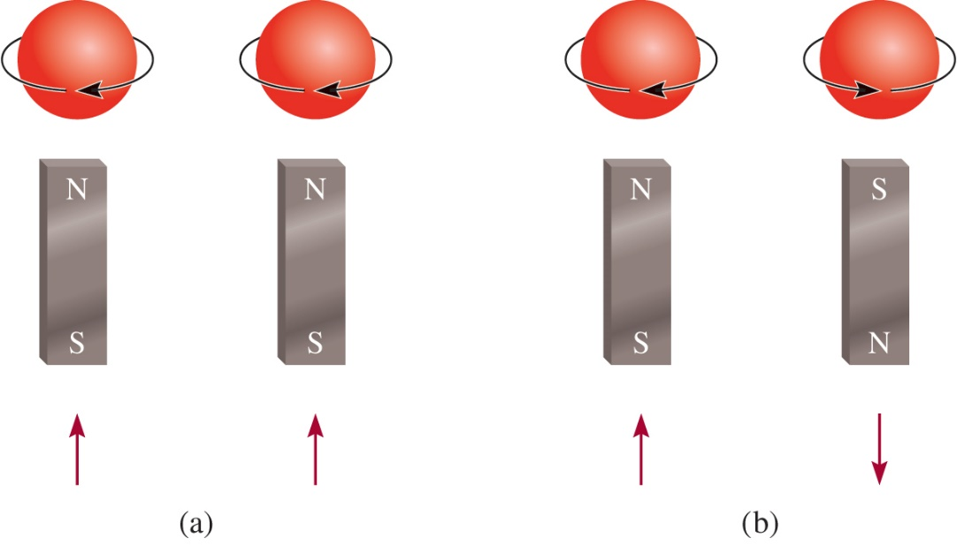
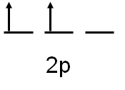
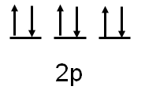
Paramagnetism and Diamagnetism
Paramagnetic
unpaired electrons
Diamagnetic
all electrons paired

Slide 34
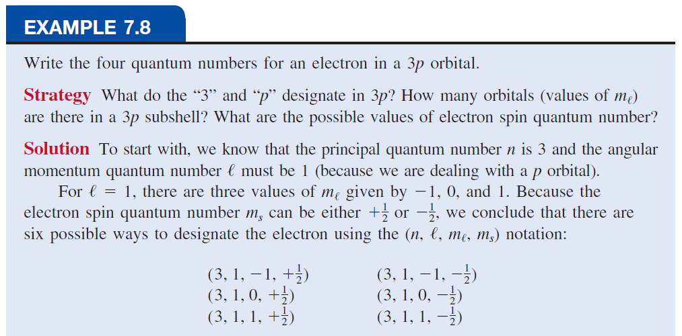

Slide 35
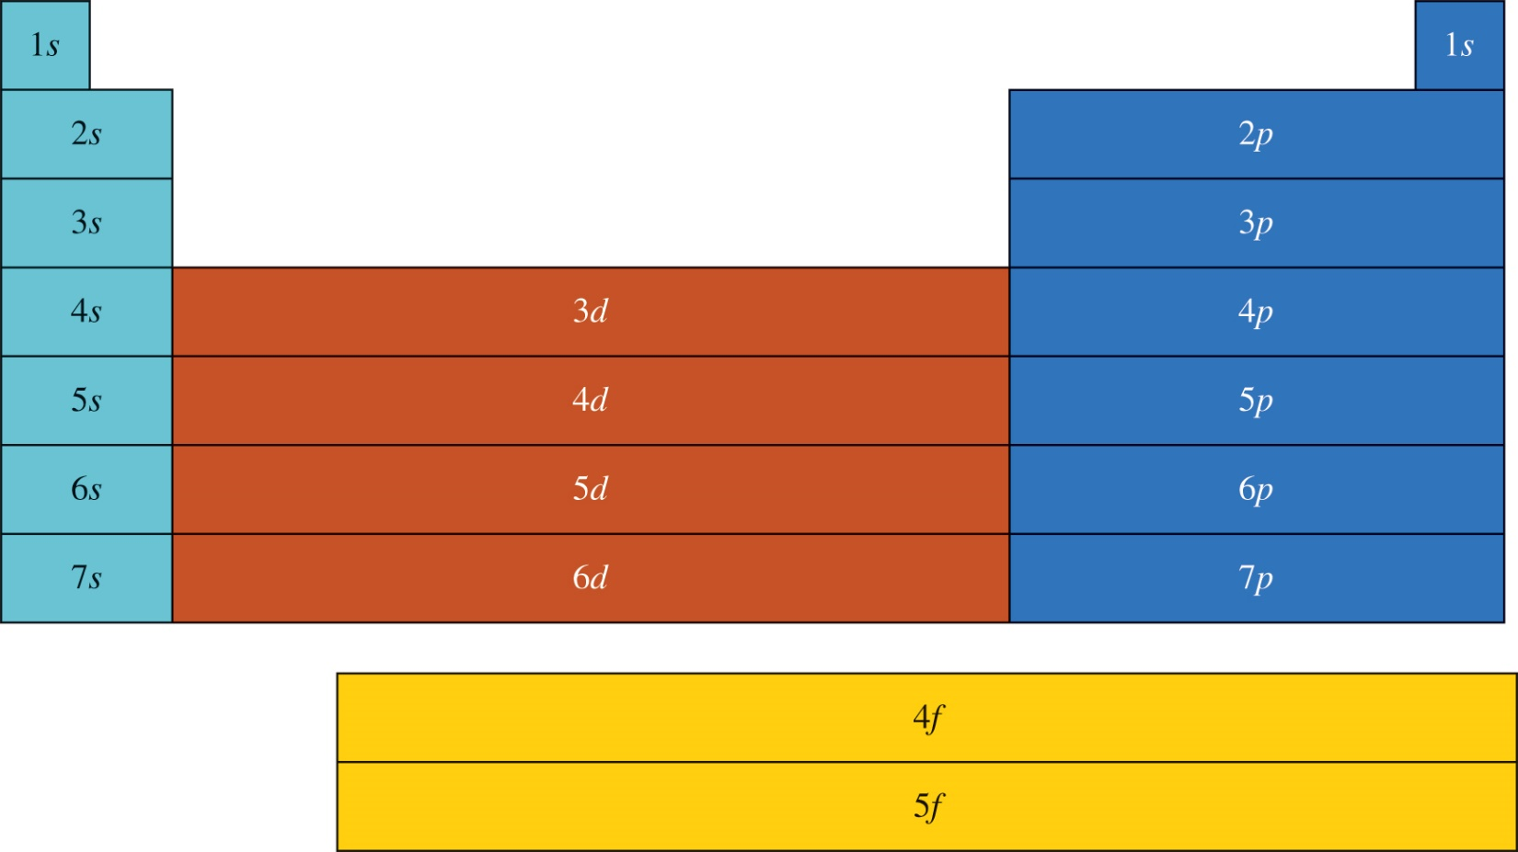
Outermost subshell being filled with electrons
Access the text alternative for slide images.

Slide 36
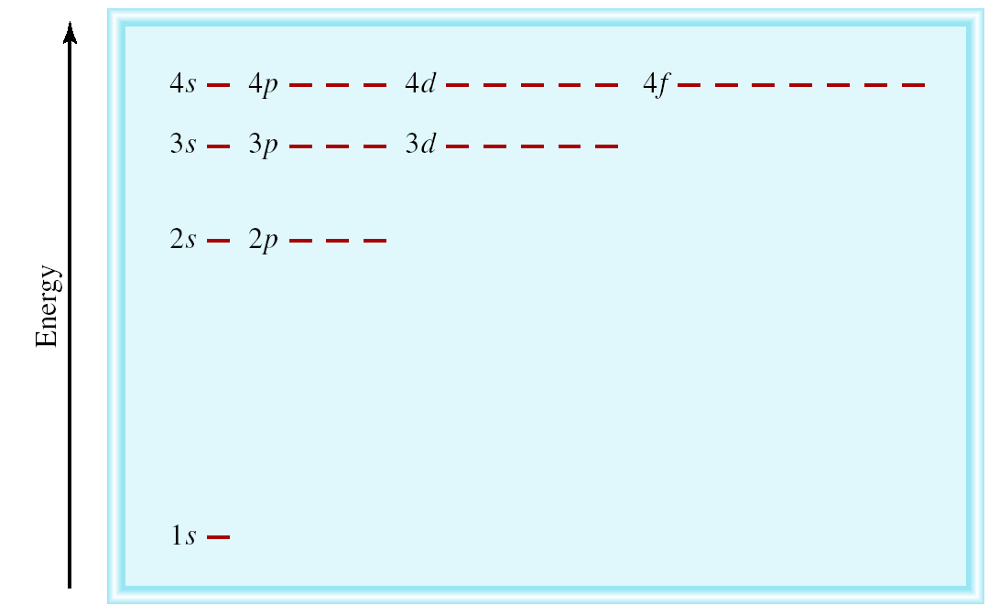
The Energies of Orbitals
Energy of orbitals in a single electron atom
Energy only depends on principal quantum number n
n = 3
n = 2
n = 1

Slide 37
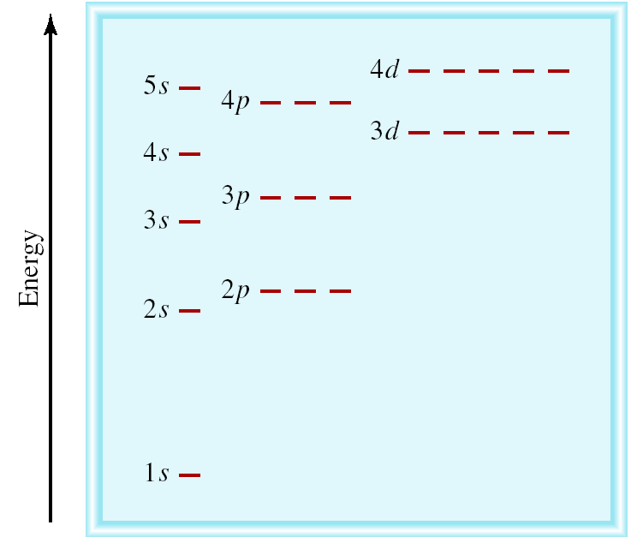
Energy of orbitals in a multi-electron atom
Energy depends on n and l
n = 3 l = 2
n = 3 l = 1
n = 3 l = 0
n = 2 l = 1
n = 2 l = 0
n = 1 l = 0

Slide 38
Aufbau Principle
“Fill up” electrons in lowest energy orbitals (Aufbau principle)
?
?
C 6 e⁻
B 5 e⁻
1s²2s²2p¹
Be 4 e⁻
1s²2s²
Li 3 e⁻
1s²2s¹
He 2 e⁻
1s²
H 1 e⁻
1s¹

Slide 39
Hund’s Rule
The most stable arrangement of electrons in subshells is the one with the greatest number of parallel spins (Hund’s rule).
Ne 10 e⁻
1s²2s²2p⁶
F 9 e⁻
1s²2s²2p⁵
O 8 e⁻
1s²2s²2p⁴
N 7 e⁻
1s²2s²2p³
C 6 e⁻
1s²2s²2p²

Slide 40
Aufbau Principle + Hund’s Rule
Ne 10 e⁻
1s²2s²2p⁶
F 9 e⁻
1s²2s²2p⁵
O 8 e⁻
1s²2s²2p⁴
N 7 e⁻
1s²2s²2p³
C 6 e⁻
1s²2s²2p²
B 5 e⁻
1s²2s²2p¹
Be 4 e⁻
1s²2s²
Li 3 e⁻
1s²2s¹
He 2 e⁻
1s²
H 1 e⁻
1s¹

Slide 41
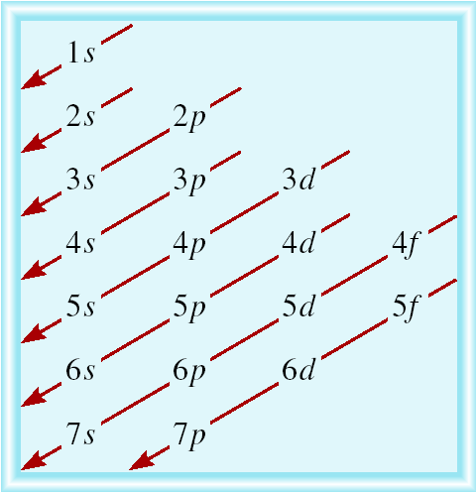
Order of Orbitals (filling) in Multi-electron Atom
1s < 2s < 2p < 3s < 3p < 4s < 3d < 4p < 5s < 4d < 5p < 6s

Slide 42
Electron configuration is how the electrons are distributed among the various atomic orbitals in an atom.
number of electrons
in the orbital or subshell
1s¹
principal quantum
number n
angular momentum
quantum number l
Orbital diagram
H
1s¹

Slide 43
What is the electron configuration of Mg?
Mg 12 electrons
1s < 2s < 2p < 3s < 3p < 4s
1s²2s²2p⁶3s²
2 + 2 + 6 + 2 = 12 electrons
Abbreviated as [Ne]3s²
[Ne] 1s²2s²2p⁶
What are the possible quantum numbers for the last (outermost) electron in Cl?
Cl 17 electrons
1s < 2s < 2p < 3s < 3p < 4s
1s²2s²2p⁶3s²3p⁵
2 + 2 + 6 + 2 + 5 = 17 electrons
Last electron added to 3p orbital
n = 3
l = 1
m_{l} = -1, 0, or +1
m_{s} = ½ or -½

