Slide 1
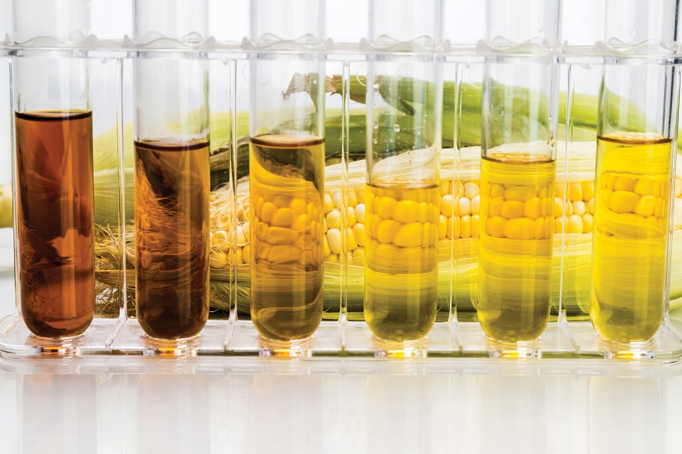
Chapter 6
Thermochemistry
ThamKC/Getty Images
Copyright 2022 © McGraw Hill LLC. All rights reserved. No reproduction or distribution without the prior written consent of McGraw Hill LLC.

Slide 2
Energy
Energy is the capacity to do work.
Radiant energy comes from the sun and is earth’s primary energy source
Thermal energy is the energy associated with the random motion of atoms and molecules
Chemical energy is the energy stored within the bonds of chemical substances
Nuclear energy is the energy stored within the collection of neutrons and protons in the atom
Potential energy is the energy available by virtue of an object’s position

Slide 3
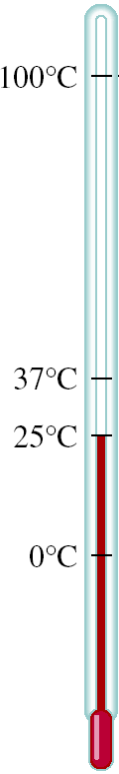
Energy Changes in Chemical Reactions
Thermochemistry is the study of heat change in chemical reactions.
Heat is the transfer of thermal energy between two bodies that are at different temperatures.
Temperature is a measure of the thermal energy.
Temperature = Thermal Energy

Slide 4
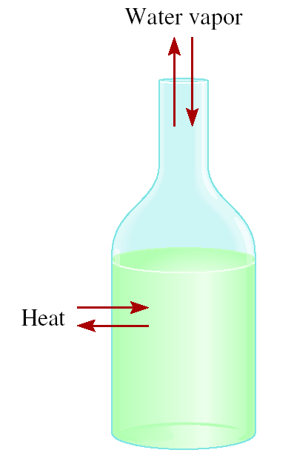
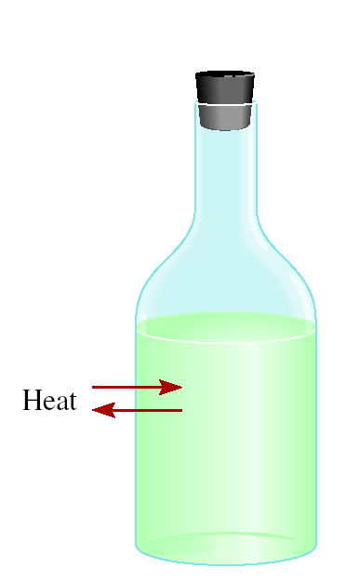

The system is the specific part of the universe that is of interest in the study.
The surroundings are the rest of the universe outside the system.
open
closed
isolated
Exchange:
mass & energy
energy
nothing

Slide 5
Exothermic process is any process that gives off heat – transfers thermal energy from the system to the surroundings.
2H₂ (g) + O₂ (g) 2H₂O (l) + energy
H₂O (g) H₂O (l) + energy
Endothermic process is any process in which heat has to be supplied to the system from the surroundings.
energy + 2HgO (s) 2Hg (l) + O₂ (g)
energy + H₂O (s) H₂O (l)

Slide 6
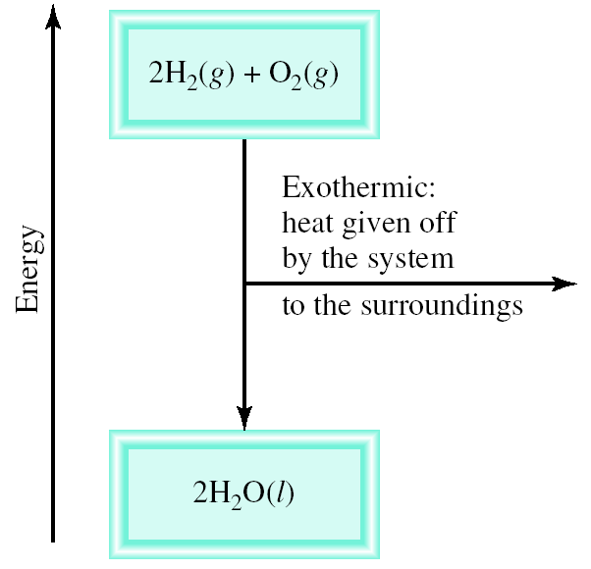
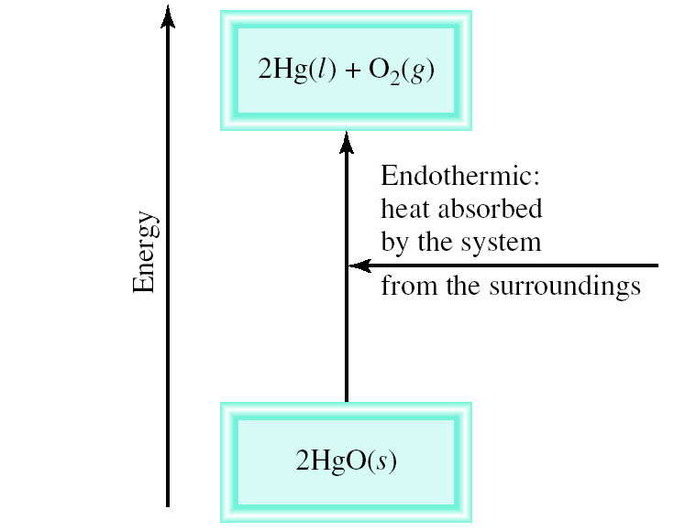
Schematic of Exothermic and Endothermic Processes

Slide 7

Thermodynamics is the scientific study of the interconversion of heat and other kinds of energy.
State functions are properties that are determined by the state of the system, regardless of how that condition was achieved.
energy, pressure, volume, temperature
ΔE = E_{final} - E_{initial}
ΔP = P_{final} - P_{initial}
ΔV = V_{final} - V_{initial}
ΔT = T_{final} - T_{initial}
Potential energy of hiker 1 and hiker 2 is the same even though they took different paths.

Slide 8
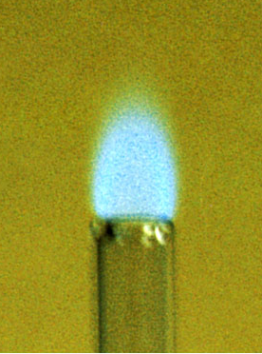
First law of thermodynamics – energy can be converted from one form to another but cannot be created or destroyed.
ΔE_{system} + ΔE_{surroundings} = 0
or
ΔE_{system} = -ΔE_{surroundings}
C₃H₈ + 5O₂ 3CO₂ + 4H₂O
Exothermic chemical reaction!
Chemical energy lost by combustion = Energy gained by the surroundings
system
surroundings

Slide 9
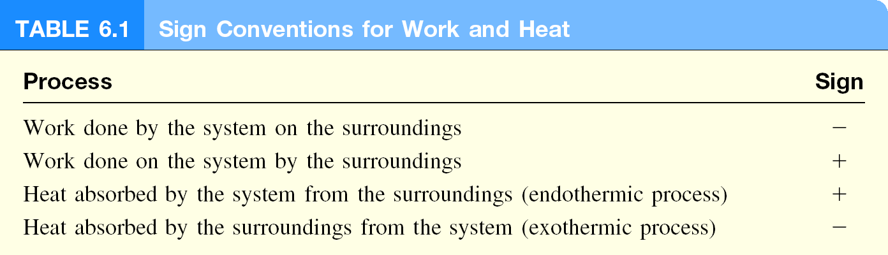
Another form of the First Law for ΔE_{system}
ΔE = q + w
ΔE is the change in internal energy of a system
q is the heat exchange between the system and the surroundings
w is the work done on (or by) the system
w = -PΔV when a gas expands against a constant external pressure

Slide 10
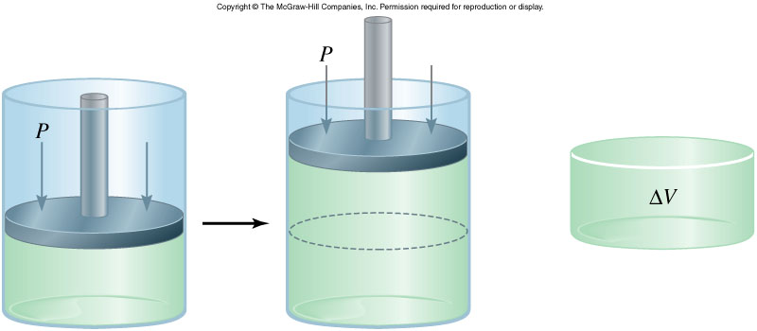
Work Done on the System
w = F x d
ΔV > 0
w = -P ΔV
-PΔV < 0
F
w_{sys} < 0
P x V = x d³ = F x d = w
d²
Work is not a state function.
Δw = w_{final} - w_{initial}
initial
final
The units for work done by or on a gas are liters atmospheres.
1 L • atm = 101.3 J

Slide 11
A sample of nitrogen gas expands in volume from 1.6 L to 5.4 L at constant temperature. What is the work done in joules if the gas expands (a) against a vacuum and (b) against a constant pressure of 3.7 atm?
w = -P ΔV
(a)
ΔV = 5.4 L – 1.6 L = 3.8 L
P = 0 atm
w = -0 atm x 3.8 L = 0 L • atm = 0 joules
(b)
ΔV = 5.4 L – 1.6 L = 3.8 L
P = 3.7 atm
w = -3.7 atm x 3.8 L = -14.1 L • atm
101.3 J
w = -14.1 L • atm x
= -1430 J
1 L • atm

Slide 12
Enthalpy and the First Law of Thermodynamics
ΔE = q + w
At constant pressure:
q = ΔH and w = -PΔV
ΔE = ΔH - PΔV
ΔH = ΔE + PΔV

Slide 13
A sample of nitrogen gas expands in volume from 1.6 L to 5.4 L at constant temperature. What is the work done in joules if the gas expands (a) against a vacuum and (b) against a constant pressure of 3.7 atm?
w = -P ΔV
(a)
ΔV = 5.4 L – 1.6 L = 3.8 L
P = 0 atm
w = -0 atm x 3.8 L = 0 L • atm = 0 joules
(b)
ΔV = 5.4 L – 1.6 L = 3.8 L
P = 3.7 atm
w = -3.7 atm x 3.8 L = -14.1 L • atm
101.3 J
w = -14.1 L • atm x
= -1430 J
1 L • atm

Slide 14
Enthalpy and the First Law of Thermodynamics
ΔE = q + w
At constant pressure:
q = ΔH and w = -PΔV
ΔE = ΔH - PΔV
ΔH = ΔE + PΔV

Slide 15
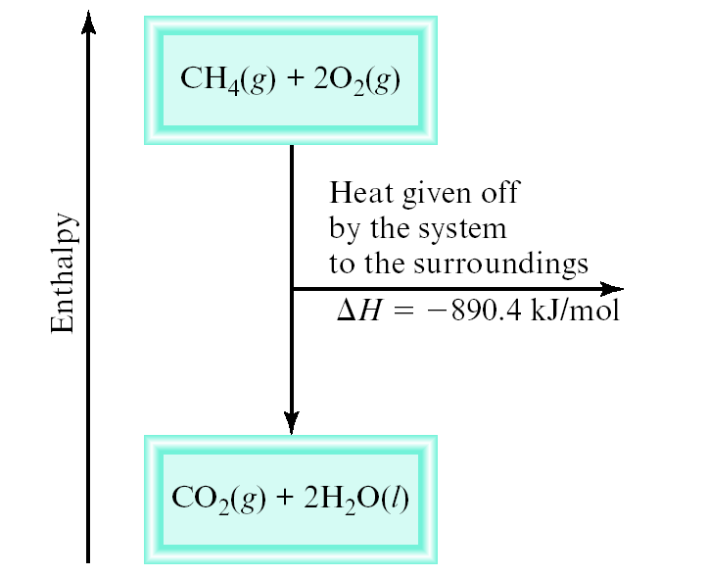
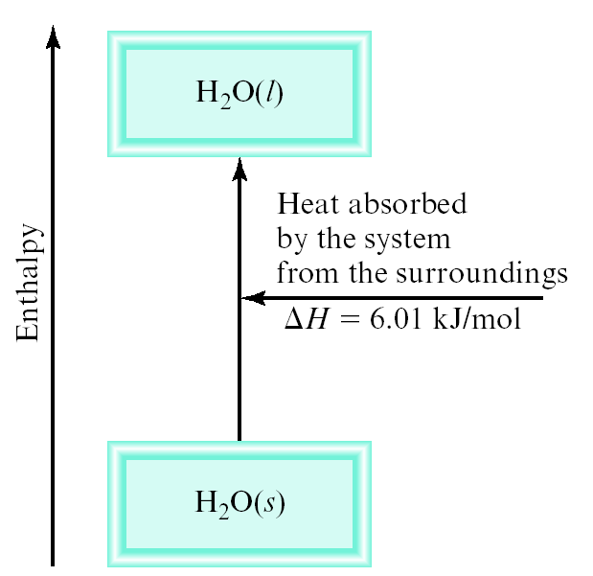
Enthalpy (H) is used to quantify the heat flow into or out of a system in a process that occurs at constant pressure.
ΔH = H (products) – H (reactants)
ΔH = heat given off or absorbed during a reaction at constant pressure
H_{products} < H_{reactants}
H_{products} > H_{reactants}
ΔH < 0
ΔH > 0

Slide 16
Thermochemical Equations
Is ΔH negative or positive?
System absorbs heat
Endothermic
ΔH > 0
6.01 kJ are absorbed for every 1 mole of ice that melts at 0⁰C and 1 atm.
H₂O(s) H₂O(l)
ΔH = 6.01 kJ/mol

Slide 17
Thermochemical Equations
Is ΔH negative or positive?
System gives off heat
Exothermic
ΔH < 0
890.4 kJ are released for every 1 mole of methane that is combusted at 25⁰C and 1 atm.
CH₄(g) + 2O₂(g) CO₂(g) + 2H₂O(l)
ΔH = -890.4 kJ/mol

Slide 18
Thermochemical Equations
The stoichiometric coefficients always refer to the number of moles of a substance
H₂O (s) H₂O (l)
ΔH = 6.01 kJ/mol
If you reverse a reaction, the sign of ΔH changes
H₂O (l) H₂O (s)
ΔH = -6.01 kJ/mol
If you multiply both sides of the equation by a factor n, then ΔH must change by the same factor n.
2H₂O (s) 2H₂O (l)
ΔH = 2 x 6.01 = 12.0 kJ

Slide 19
Thermochemical Equations
The physical states of all reactants and products must be specified in thermochemical equations.
H₂O (s) H₂O (l)
ΔH = 6.01 kJ/mol
H₂O (l) H₂O (g)
ΔH = 44.0 kJ/mol
How much heat is evolved when 266 g of white phosphorus (P₄) burn in air:
P₄ (s) + 5O₂ (g) P₄O₁₀ (s) ΔH = -3013 kJ/mol
1 mol P₄
-3013 kJ
266 g P₄
x
x
= -6470 kJ/mol
123.9 g P₄
1 mol P₄

Slide 20
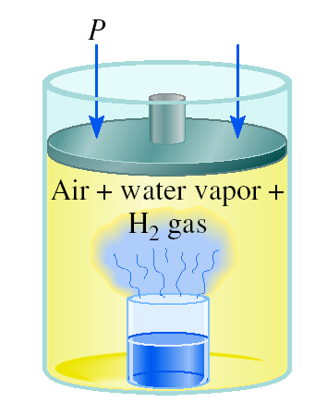

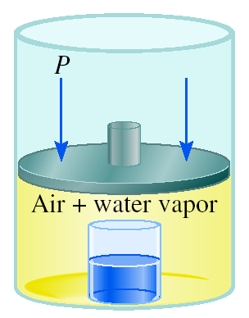
A Comparison of ΔH and ΔE
2Na (s) + 2H₂O (l) 2NaOH (aq) + H₂ (g) ΔH = -367.5 kJ/mol
ΔE = ΔH - PΔV
At 25 ºC, 1 mole H₂ = 24.5 L at 1 atm
PΔV = 1 atm x 24.5 L = 2.5 kJ
ΔE = -367.5 kJ/mol – 2.5 kJ/mol = -370 kJ/mol
The reason ΔH is smaller than ΔE in magnitude is that some of the internal energy released is used to do gas expansion work, so less heat is evolved.

Slide 21
A Comparison of ΔH and ΔE
To calculate the internal energy change of a gaseous reaction is to assume ideal gas behavior and constant temperature

Slide 22
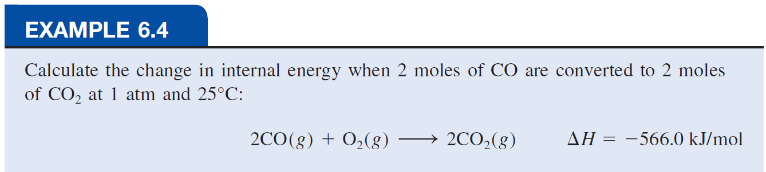
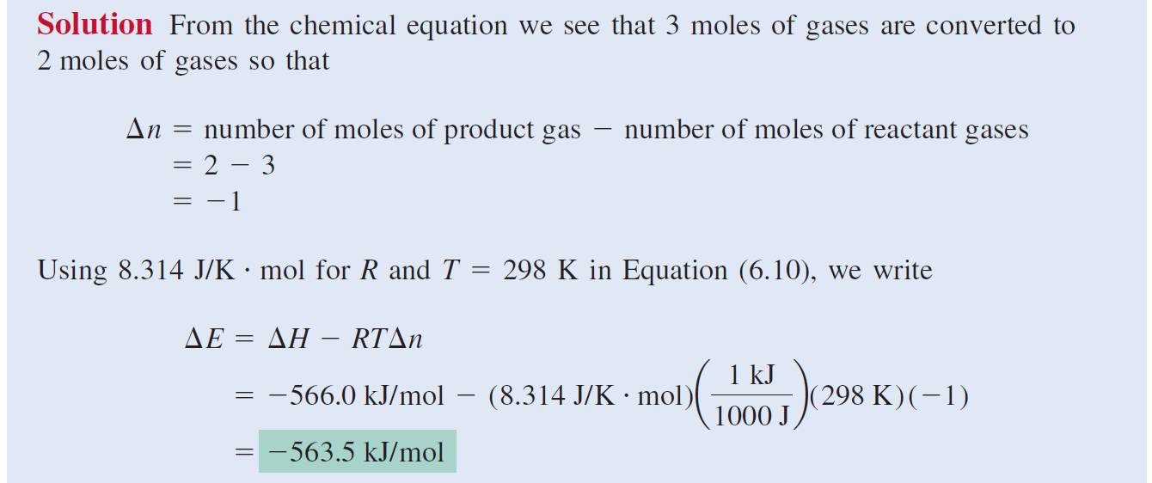

Slide 23
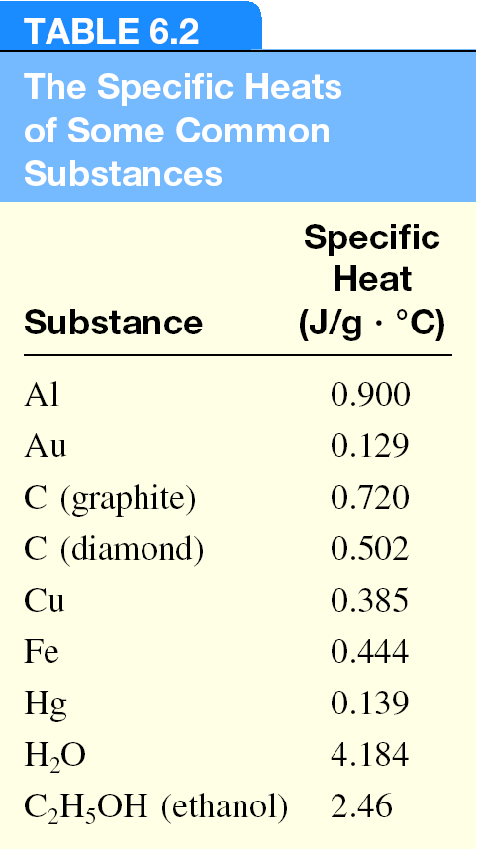
The specific heat (s) of a substance is the amount of heat (q) required to raise the temperature of one gram of the substance by one degree Celsius.
The heat capacity (C) of a substance is the amount of heat (q) required to raise the temperature of a given quantity (m) of the substance by one degree Celsius.
C = m x s
Heat (q) absorbed or released:
q = m x s x Δt
q = C x Δt
Δt = t_{final} - t_{initial}
t : in ºC

Slide 24

How much heat is given off when an 869 g iron bar cools from 94ºC to 5ºC?
(s of Fe = 0.444 J/g • ºC)
Δt = t_{final} – t_{initial} = 5ºC – 94ºC = -89ºC
q = msΔt
= 869 g x 0.444 J/g • ºC x -89ºC
= -34,000 J

Slide 25
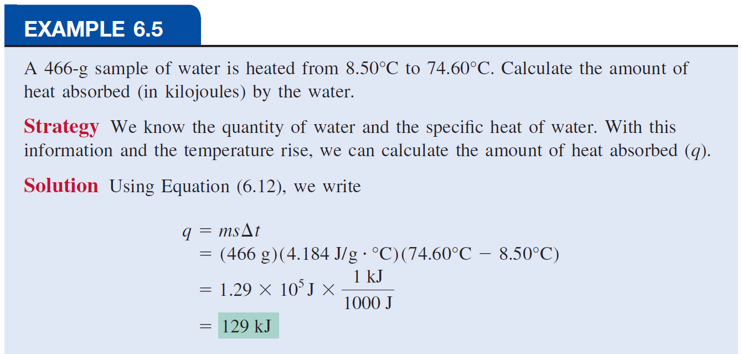

Slide 26
Standard Enthalpy of Formation and Reaction
Because there is no way to measure the absolute value of the enthalpy of a substance, must I measure the enthalpy change for every reaction of interest?
Establish an arbitrary scale with the standard enthalpy of formation (ΔH⁰) as a reference point for all enthalpy expressions.
Standard enthalpy of formation (ΔH⁰) is the heat change that results when one mole of a compound is formed from its elements at a pressure of 1 atm.
The standard enthalpy of formation of any element in its most stable form is zero.
f
f
ΔH⁰ (O₂) = 0
ΔH⁰ (C, graphite) = 0
f
f
ΔH⁰ (O₃) = 142 kJ/mol
ΔH⁰ (C, diamond) = 1.90 kJ/mol
f
f

Slide 27
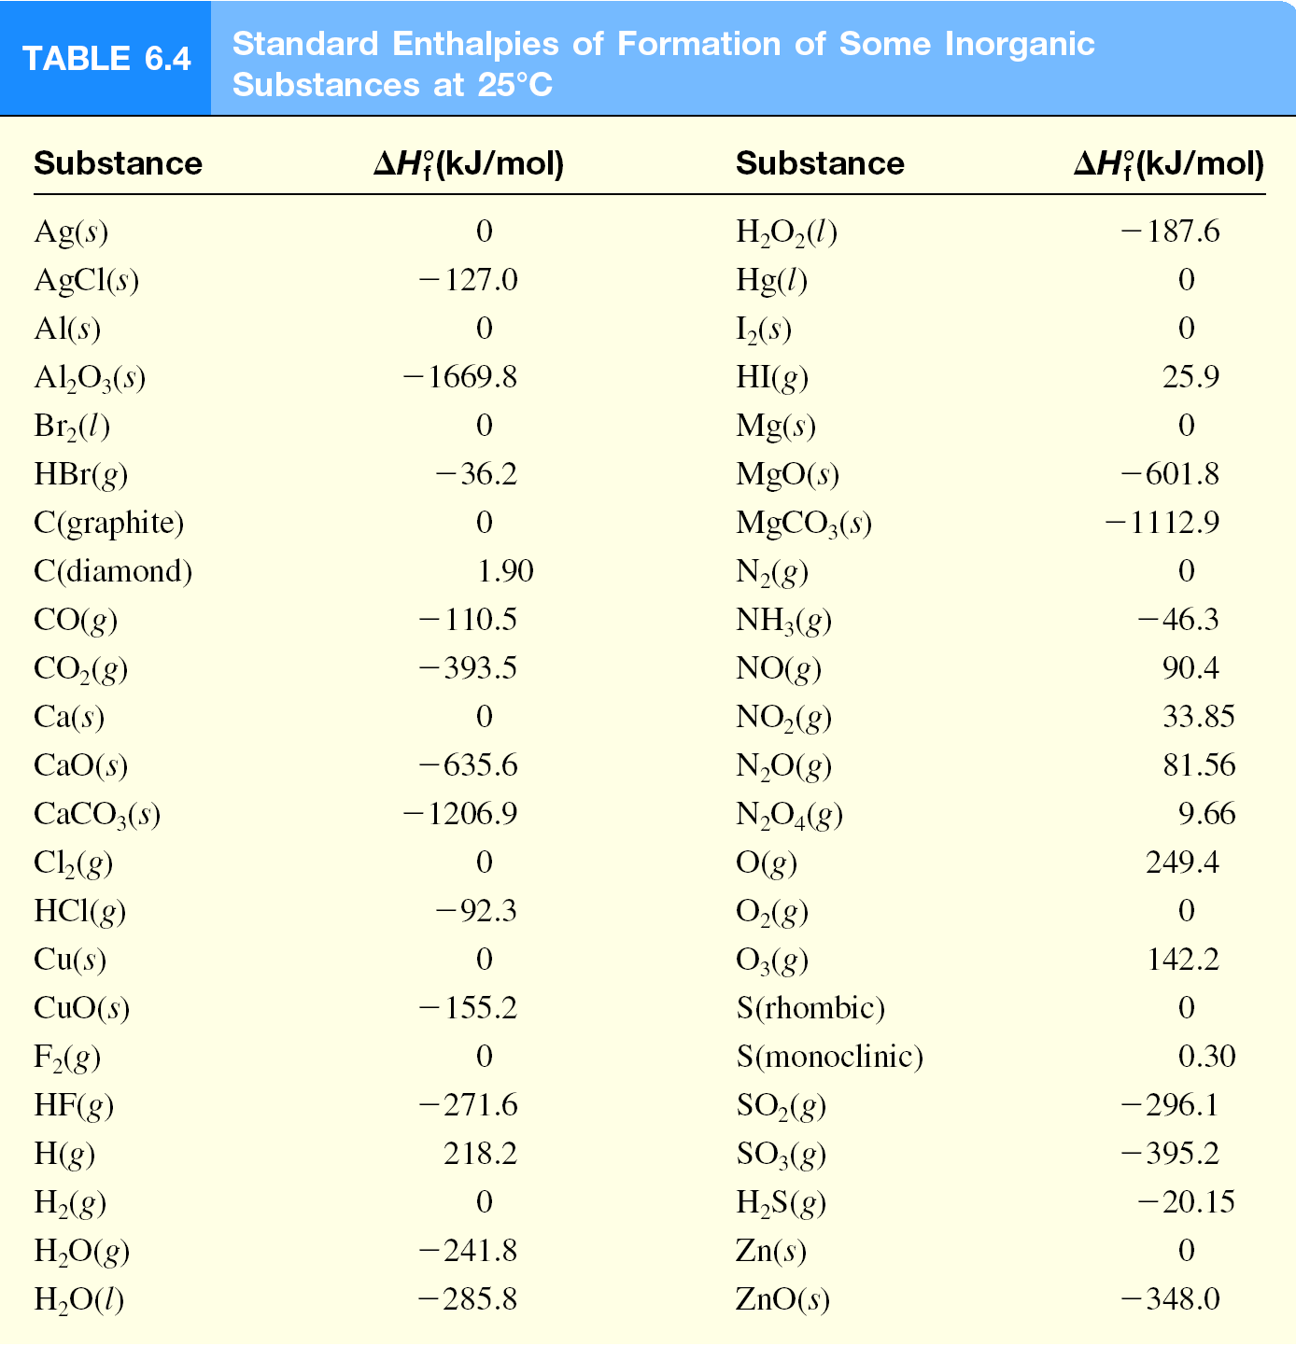

Slide 28
The standard enthalpy of reaction (ΔH⁰ ) is the enthalpy of a reaction carried out at 1 atm.
rxn
aA + bB cC + dD
ΔH⁰
=
Σ
nΔH⁰ (products)
-
Σ
mΔH⁰ (reactants)
rxn
f
f
ΔH⁰
cΔH⁰ (C)
dΔH⁰ (D)
-
aΔH⁰ (A)
bΔH⁰ (B)
=
[
+
]
[
+
]
rxn
f
f
f
f
Hess’s Law: When reactants are converted to products, the change in enthalpy is the same whether the reaction takes place in one step or in a series of steps.
(Enthalpy is a state function. It doesn’t matter how you get there, only where you start and end)

Slide 29
The Direct Method
Suppose we want to know the enthalpy of formation of carbon dioxide.
We must measure the enthalpy of the reaction when carbon (graphite) and molecular oxygen in their standard states are converted to carbon dioxide in its standard state:
ΔH⁰
=
Σ
nΔH⁰ (products)
-
Σ
mΔH⁰ (reactants)
rxn
f
f

Slide 30
Benzene (C₆H₆) burns in air to produce carbon dioxide and liquid water. How much heat is released per mole of benzene combusted? The standard enthalpy of formation of benzene is 49.04 kJ/mol.
ΔH⁰ (CO₂) = -393.5 kJ/mol
ΔH⁰ (H₂O) = -285.8 kJ/mol
f
f
2C₆H₆ (l) + 15O₂ (g) 12CO₂ (g) + 6H₂O (l)
ΔH⁰
=
Σ
nΔH⁰ (products)
-
Σ
mΔH⁰ (reactants)
rxn
f
f
ΔH⁰
12ΔH⁰ (CO₂)
6ΔH⁰ (H₂O)
-
[
2ΔH⁰ (C₆H₆)
=
[
+
]
]
rxn
f
f
f
ΔH⁰
=
[ 12 x -393.5 + 6 x -285.8 ] - [ 2 x 49.04 ] = -5946 kJ
rxn
-5946 kJ
= - 2973 kJ/mol C₆H₆
2 mol

Slide 31
The Indirect Method (Hess’s Law)
Many compounds cannot be directly synthesized from their elements.
The reaction proceeds too slowly, or side reactions produce substances other than the desired compound.
Hess’s Law: When reactants are converted to products, the change in enthalpy is the same whether the reaction takes place in one step or in a series of steps…
(Enthalpy is a state function. It doesn’t matter how you get there, only where you start and end)

Slide 32
Let’s say we are interested in the standard enthalpy of formation of carbon monoxide (CO).
However, burning graphite also produces some carbon dioxide (CO₂), so we cannot measure the enthalpy change for CO directly.
We must employ an indirect route, based on Hess’s law.
It is possible to carry out the following two separate reactions:
First, we reverse Equation (b) to get
we carry out the operation (a) + (c) and obtain

Slide 33
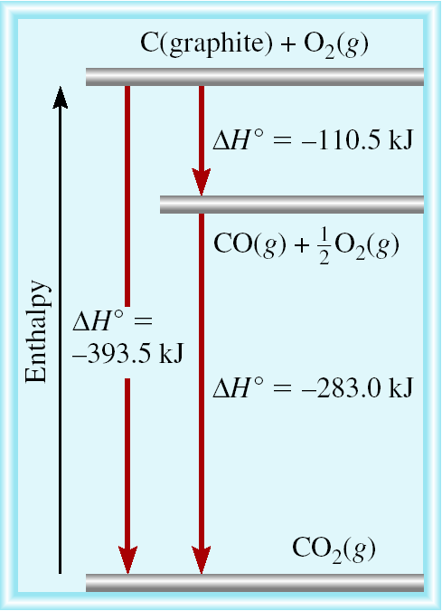
C (graphite) + 1/2O₂ (g) CO (g)
CO (g) + 1/2O₂ (g) CO₂ (g)
C (graphite) + O₂ (g) CO₂ (g)

Slide 34
Calculate the standard enthalpy of formation of CS₂ (l) given that:
C(graphite) + O₂ (g) CO₂ (g) ΔH⁰ = -393.5 kJ/mol
rxn
S(rhombic) + O₂ (g) SO₂ (g) ΔH⁰ = -296.1 kJ/mol
rxn
CS₂ (l) + 3O₂ (g) CO₂ (g) + 2SO₂ (g) ΔH⁰ = -1072 kJ/mol
rxn
1. Write the enthalpy of formation reaction for CS₂
C(graphite) + 2S(rhombic) CS₂ (l)
2. Add the given rxns so that the result is the desired rxn.
C(graphite) + O₂ (g) CO₂ (g) ΔH⁰ = -393.5 kJ/mol
rxn
2S(rhombic) + 2O₂ (g) 2SO₂ (g) ΔH⁰ = -296.1 kJ/mol x 2
rxn
+
CO₂(g) + 2SO₂ (g) CS₂ (l) + 3O₂(g) ΔH⁰ = +1072 kJ/mol
rxn
C(graphite) + 2S(rhombic) CS₂ (l)
ΔH⁰ = -393.5 + (2 x -296.1) + 1072 = 86.3 kJ/mol
rxn

Slide 35
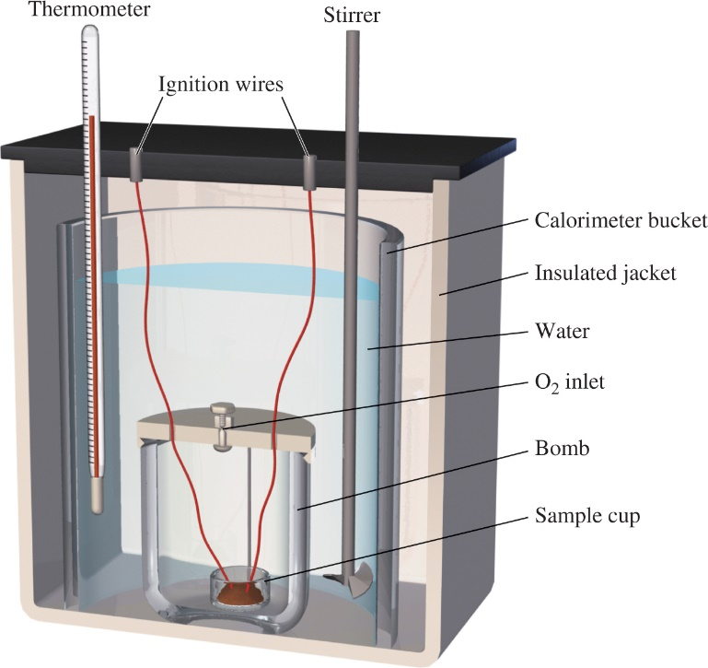
Constant-Volume Calorimetry
Reaction at Constant V
No heat enters or leaves!
Access the text alternative for slide images.

Slide 36
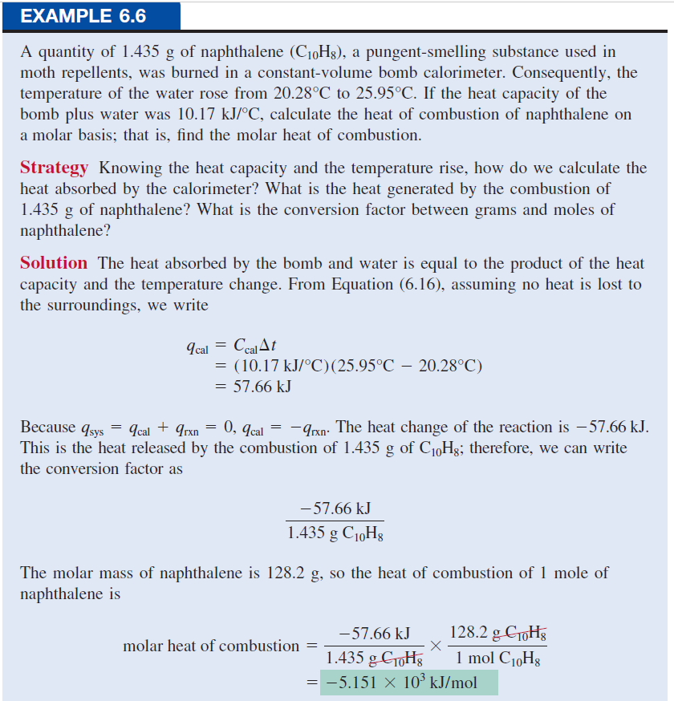

Slide 37
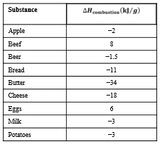
Chemistry in Action:
Fuel Values of Foods and Other Substances
1 cal = 4.184 J
1 cal = 1000 cal = 4184 J
Fuel Values of Foods
Access the text alternative for slide images.

Slide 38
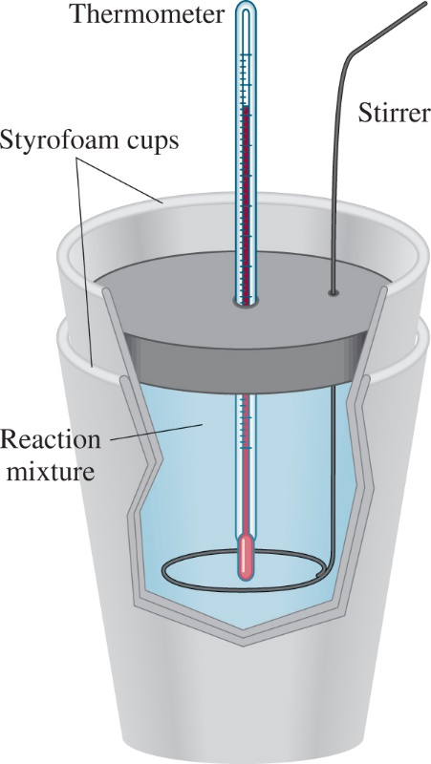
Constant-Pressure Calorimetry
Reaction at Constant P
No heat enters or leaves!
Access the text alternative for slide images.

Slide 39
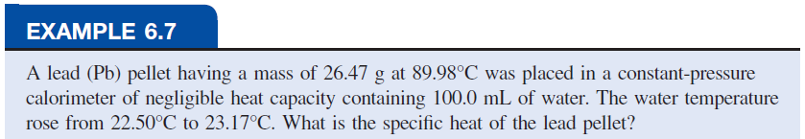
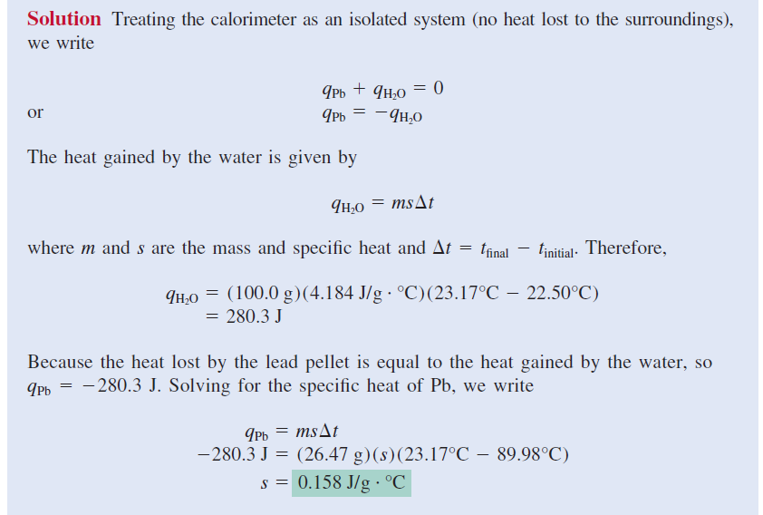

Slide 40
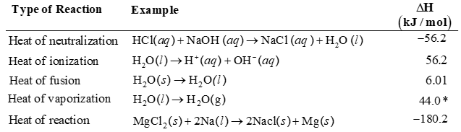
Some Heats of Reaction
Table 6.3 Heats of Some Typical Reactions Measured at Constant Pressure
Access the text alternative for slide images.

Slide 41
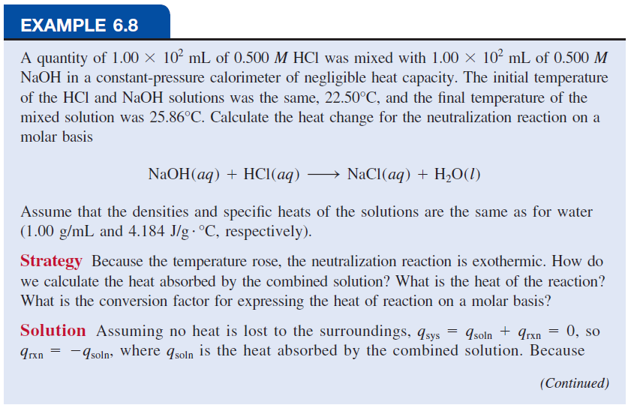

Slide 42
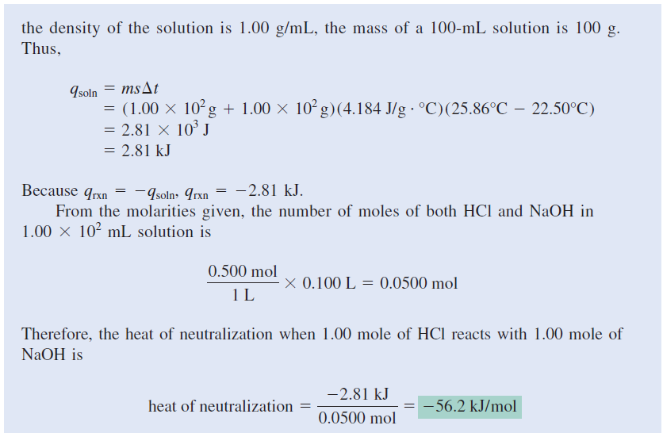

Slide 43
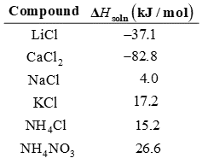
Enthalpy of Solution
The enthalpy of solution (ΔH _{soln}) is the heat generated or absorbed when a certain amount of solute dissolves in a certain amount of solvent.
Table 6.5 Heats of Solution of Some Ionic Compounds
Access the text alternative for slide images.

Slide 44
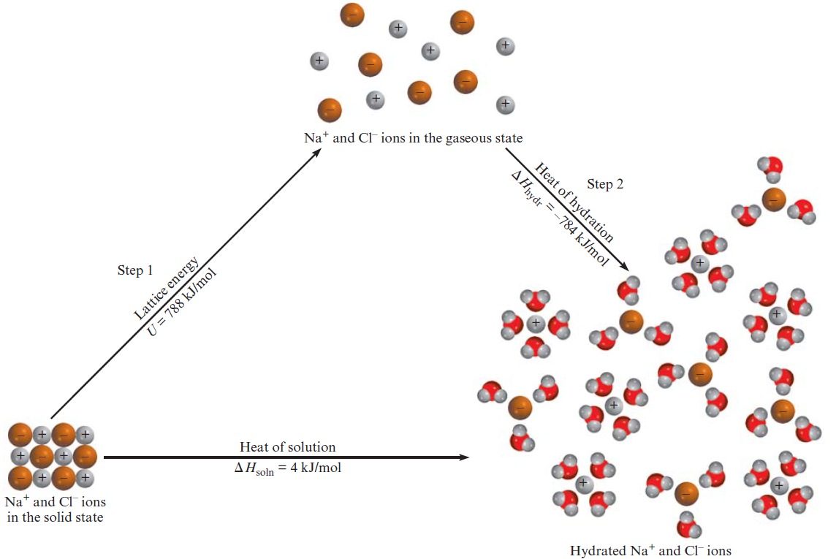
The Solution Process for NaCl
Access the text alternative for slide images.

