Slide 1
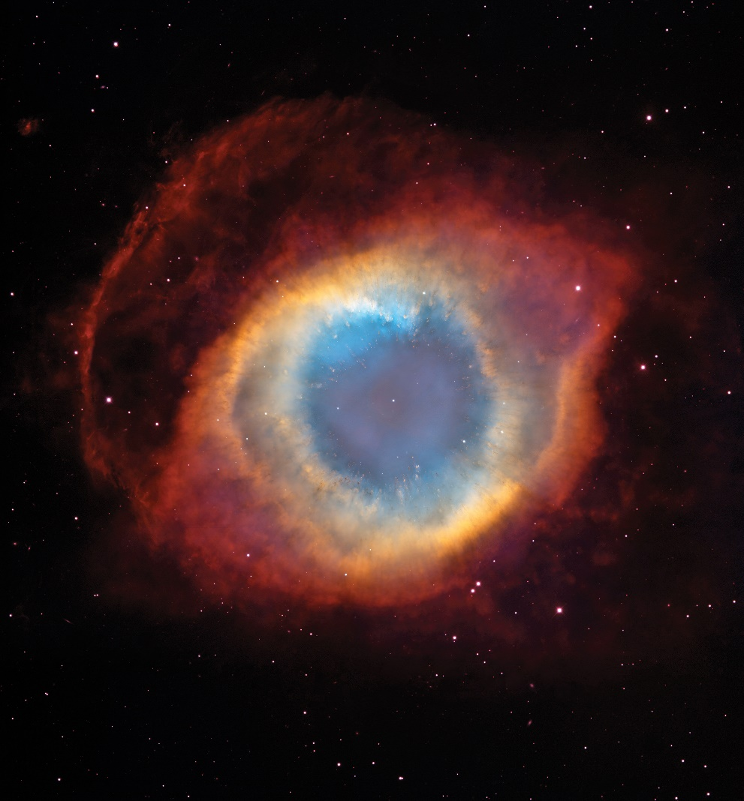
Chapter 5
Gases
Source: STSci/NASA
Copyright 2022 © McGraw Hill LLC. All rights reserved. No reproduction or distribution without the prior written consent of McGraw Hill LLC.

Slide 2
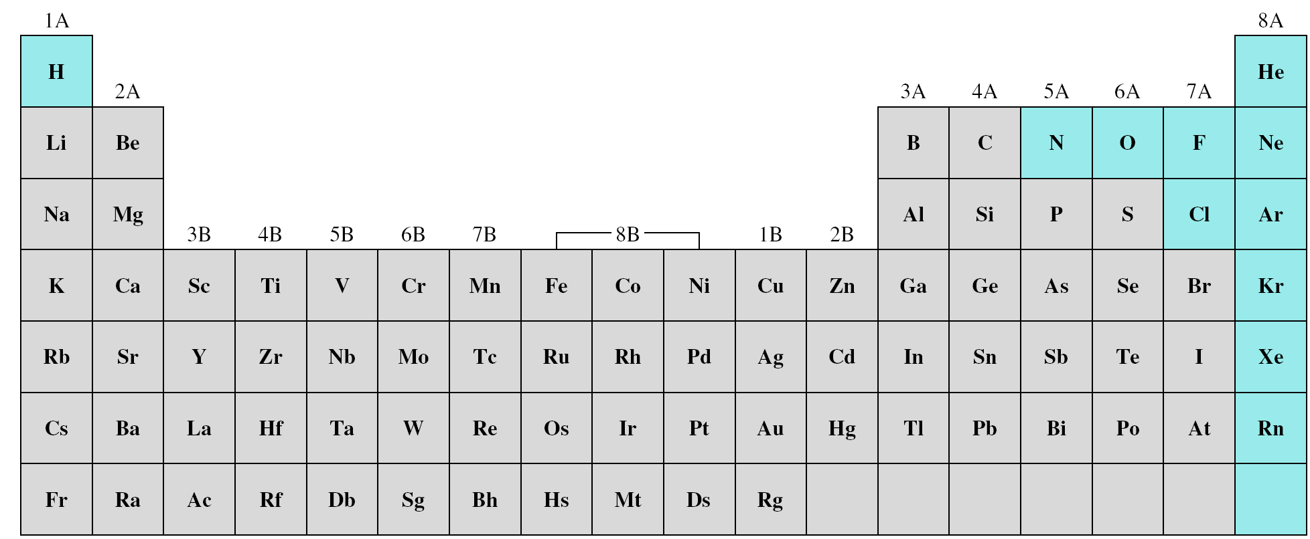
Elements that exist as gases at 25⁰C and 1 atmosphere
Ionic compounds can not be gases at 25 ⁰C and 1 atm because of its strong ionic forces.
Molecular compounds at 25 ⁰C and 1 atm varies; some are gases CO, HCl and others are liquid or solid CH₃OH(l)
No simple rule to help determine if substance is g or l or s
It depends on magnitude of the intermolecular forces among molecules

Slide 3
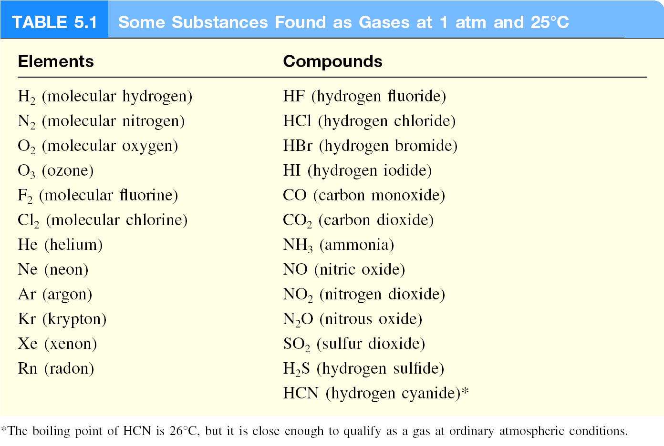

Slide 4
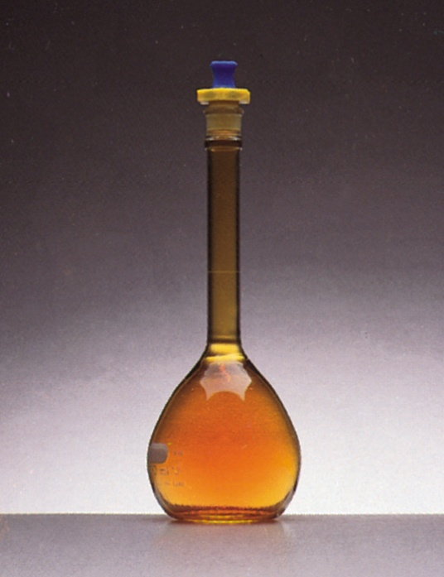
Physical Characteristics of Gases
Gases assume the volume and shape of their containers.
Gases are the most compressible state of matter.
Gases will mix evenly and completely when confined to the same container.
Gases have much lower densities than liquids and solids.
NO₂ gas

Slide 5
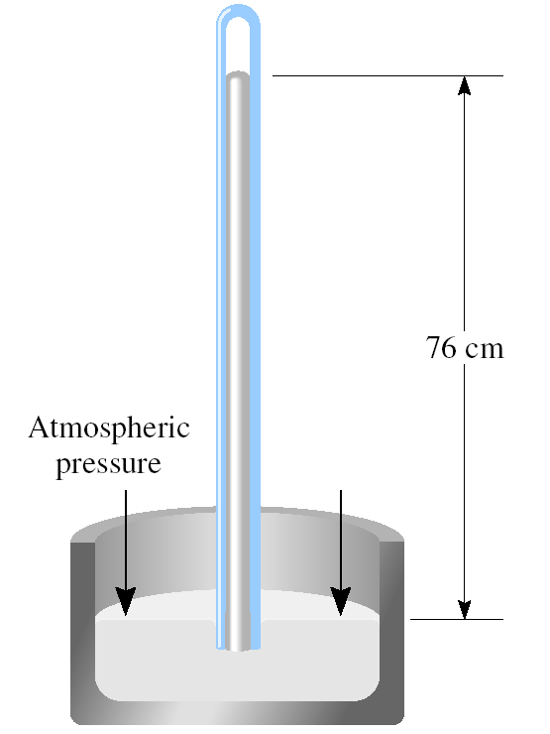
Force
Pressure =
Area
(force = mass x acceleration)
Units of Pressure
1 pascal (Pa) = 1 N/m²
1 atm = 760 mmHg = 760 torr
1 atm = 101,325 Pa

Slide 6
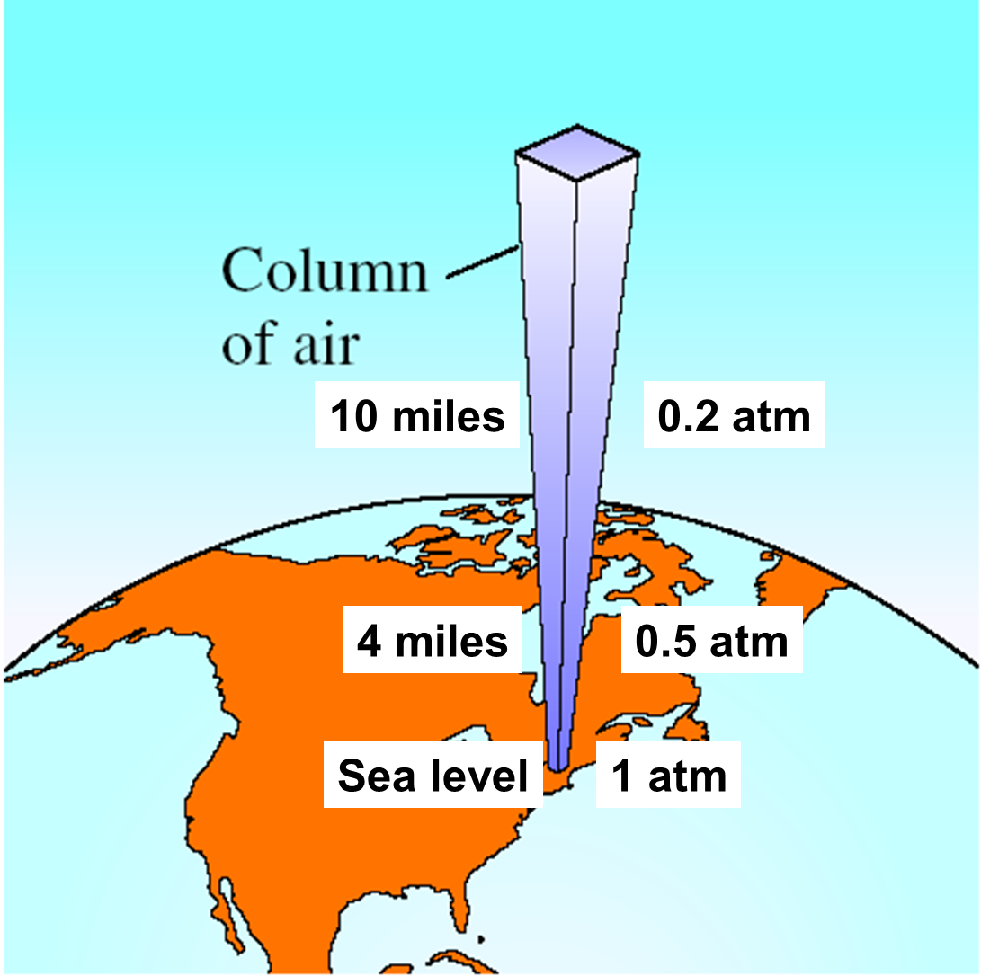
The result of weight of the column of air above it.
Act on all directions (not down word only)
Depends on location, T, Weather conditions

Slide 7
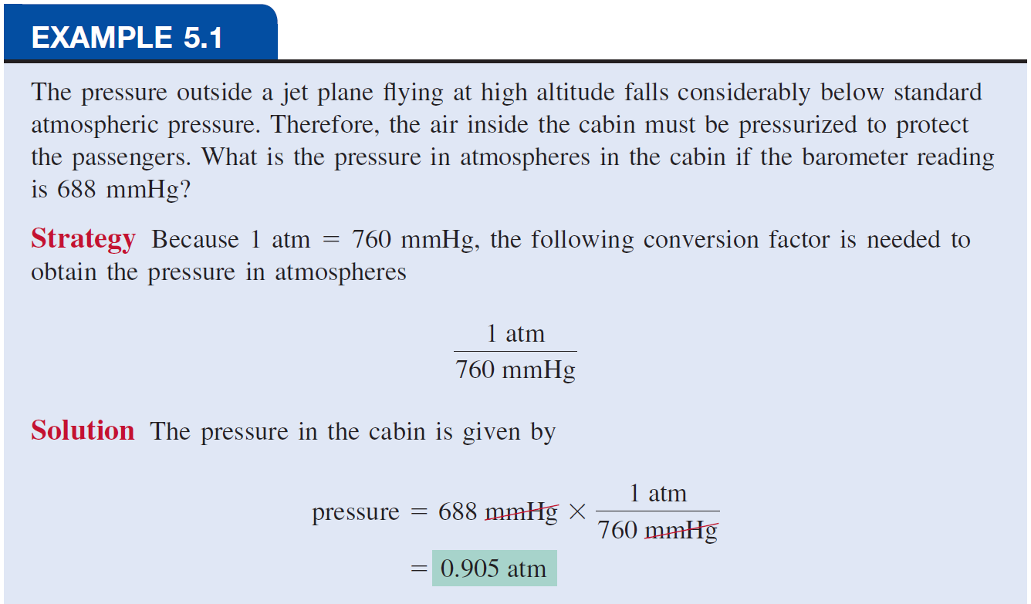
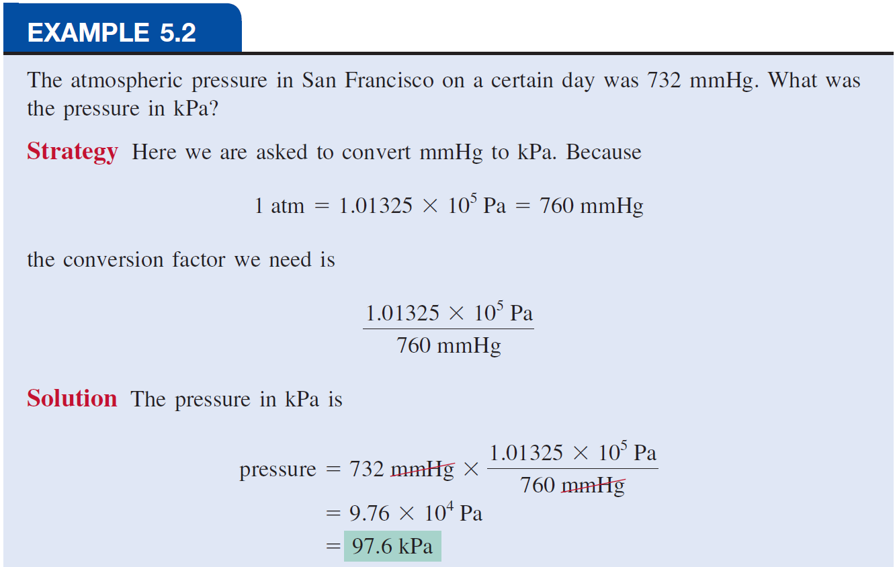

Slide 8
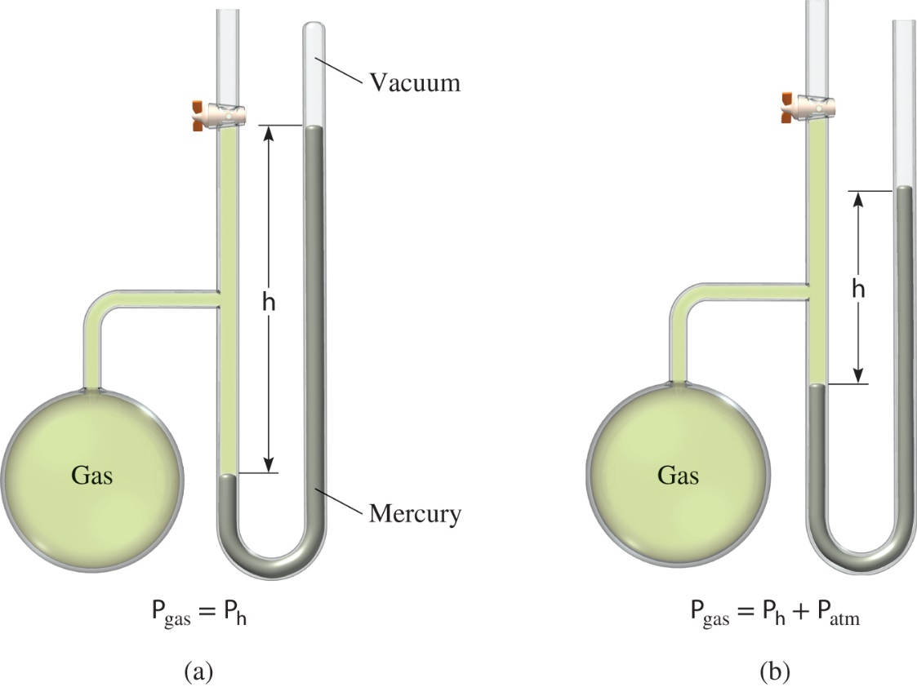
Manometers Used to Measure Gas Pressures
a) Closed tube
b) Open tube
Access the text alternative for slide images.

Slide 9
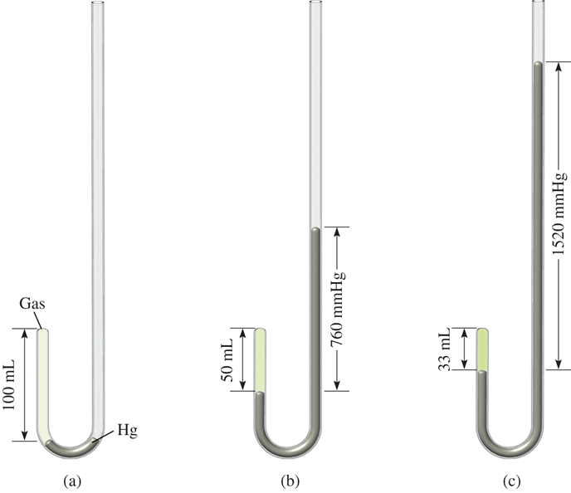
Apparatus for Studying the Relationship Between Pressure and Volume of a Gas
A gas sample is placed into a closed-end tube, and mercury is added.
As more mercury is added to the tube, the pressure increases, and the volume of the gas sample decreases.
Thus, pressure and volume are inversely related.
Access the text alternative for slide images.

Slide 10
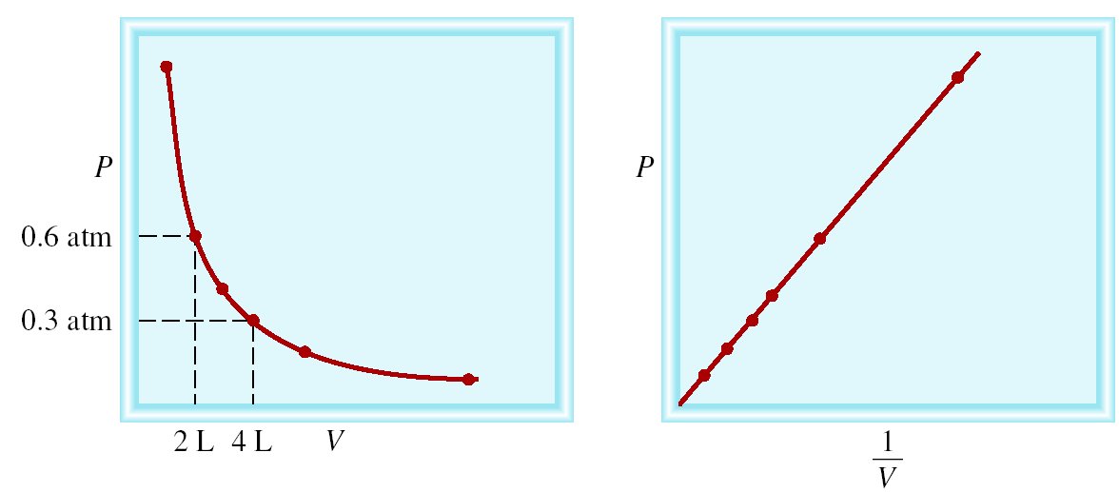
Boyle’s Law
P α 1/V
Constant temperature
Constant amount of gas
P x V = constant
P₁ x V₁ = P₂ x V₂

Slide 11
A sample of chlorine gas occupies a volume of 946 mL at a pressure of 726 mmHg. What is the pressure of the gas (in mmHg) if the volume is reduced at constant temperature to 154 mL?
P x V = constant
P₁ x V₁ = P₂ x V₂
P₁ = 726 mmHg
P₂ = ?
V₁ = 946 mL
V₂ = 154 mL
P₁ x V₁
726 mmHg x 946 mL
P₂ =
=
= 4460 mmHg
V₂
154 mL

Slide 12
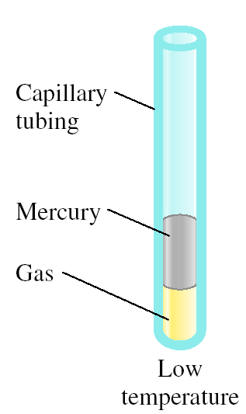
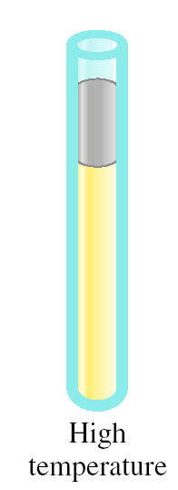
Charles’ & Gay-Lussac’s Law
Variation in Gas Volume with Temperature at Constant Pressure
As T increases
V increases

Slide 13
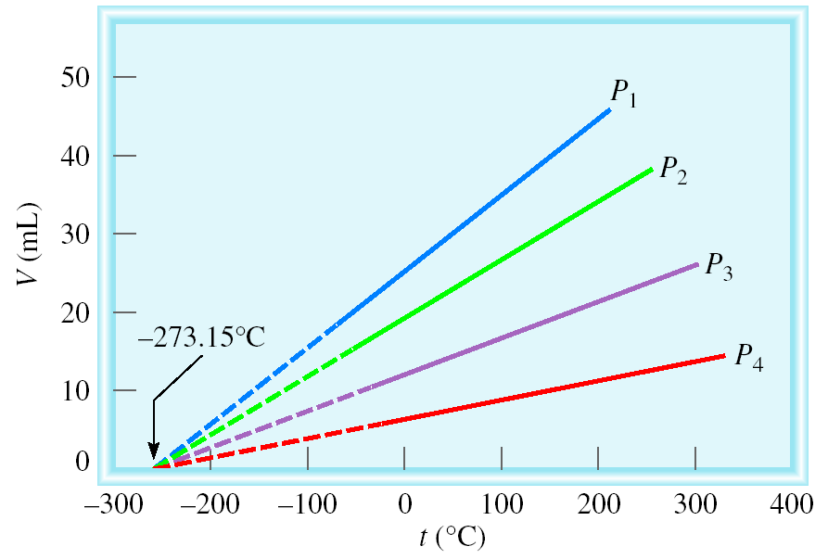
Variation of Gas Volume with Temperature
at Constant Pressure
Charles’ & Gay-Lussac’s Law
V α T
Temperature must be in Kelvin
V = constant x T
T (K) = t (⁰C) + 273.15
V₁/T₁ = V₂ /T₂

Slide 14
A sample of carbon monoxide gas occupies 3.20 L at 125 ⁰C. At what temperature will the gas occupy a volume of 1.54 L if the pressure remains constant?
V₁ /T₁ = V₂ /T₂
V₁ = 3.20 L
V₂ = 1.54 L
T₁ = 398.15 K
T₂ = ?
T₁ = 125 (⁰C) + 273.15 (K) = 398.15 K
V₂ x T₁
1.54 L x 398.15 K
T₂ =
=
= 192 K
V₁
3.20 L

Slide 15
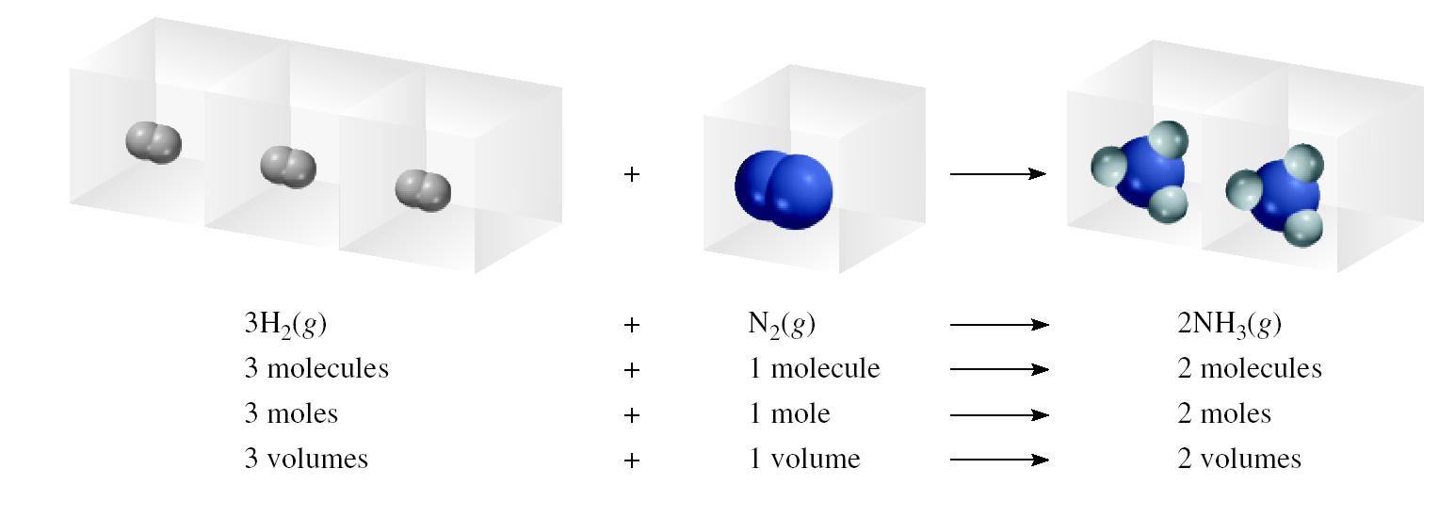
Avogadro’s Law
V α number of moles (n)
V = constant x n
Constant temperature
Constant pressure
V₁ / n₁ = V₂ / n₂

Slide 16
Ammonia burns in oxygen to form nitric oxide (NO) and water vapor. How many volumes of NO are obtained from one volume of ammonia at the same temperature and pressure?
4NH₃ + 5O₂ 4NO + 6H₂O
1 mole NH₃ 1 mole NO
At constant T and P
1 volume NH₃ 1 volume NO

Slide 17
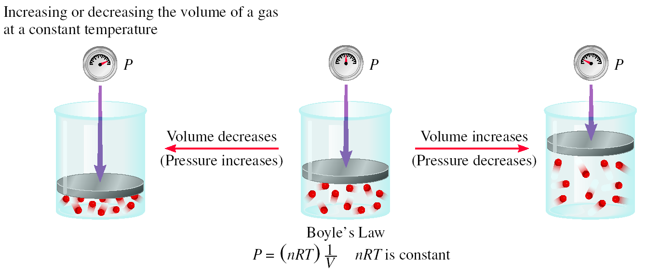
Summary of Gas Laws
Boyle’s Law

Slide 18
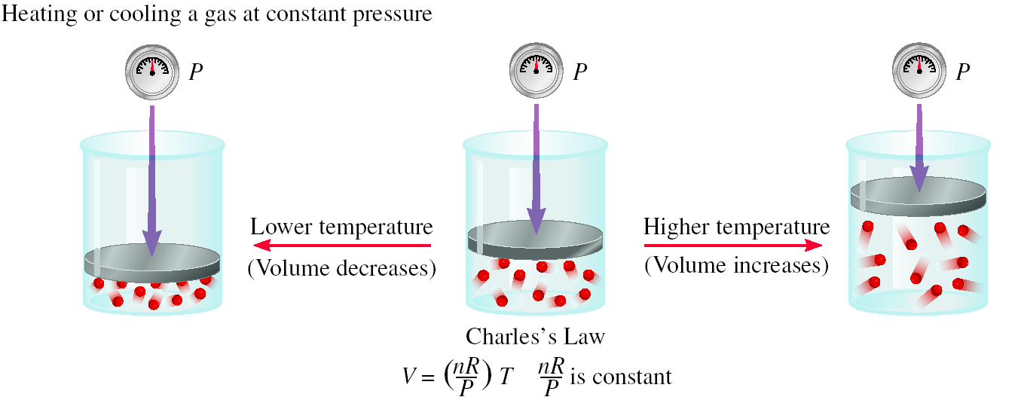
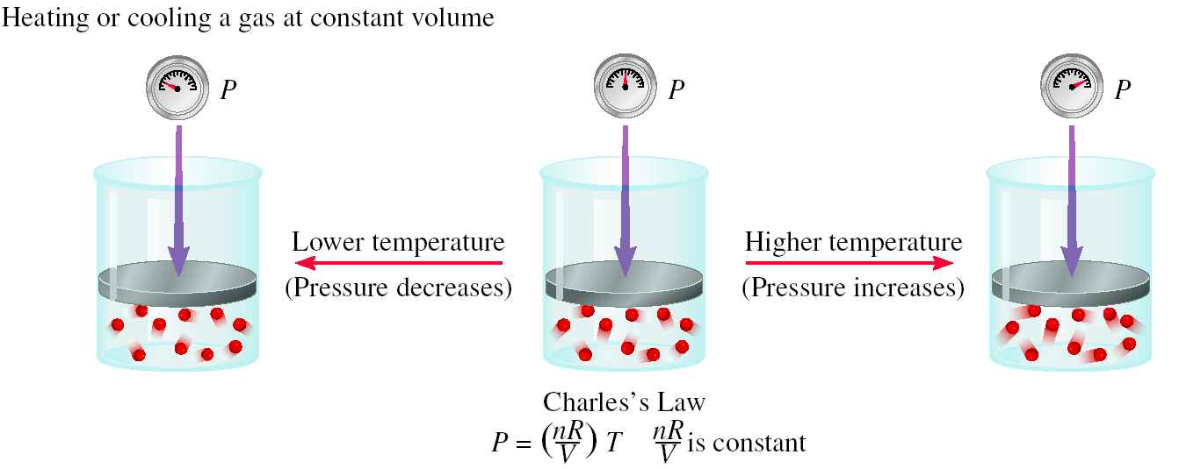
Charles Law

Slide 19
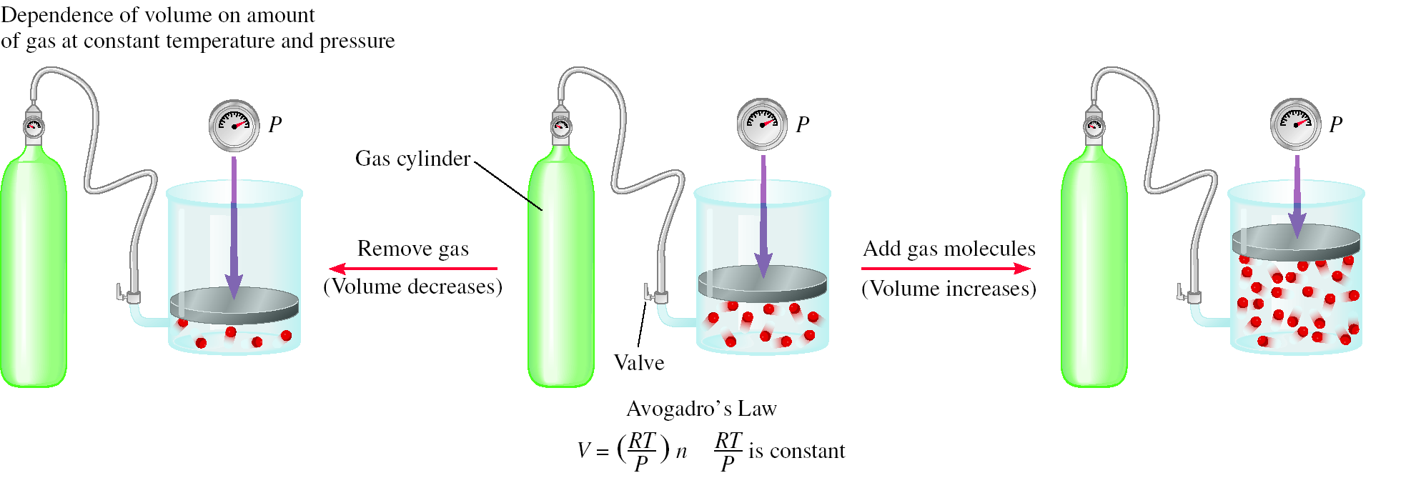
Avogadro’s Law

Slide 20
Ideal Gas Equation
1
Boyle’s law: P α (at constant n and T)
V
Charles’ law: V α T (at constant n and P)
Avogadro’s law: V α n (at constant P and T)
nT
V α
P
nT
nT
V = constant x = R
R is the gas constant
P
P
PV = nRT

Slide 21
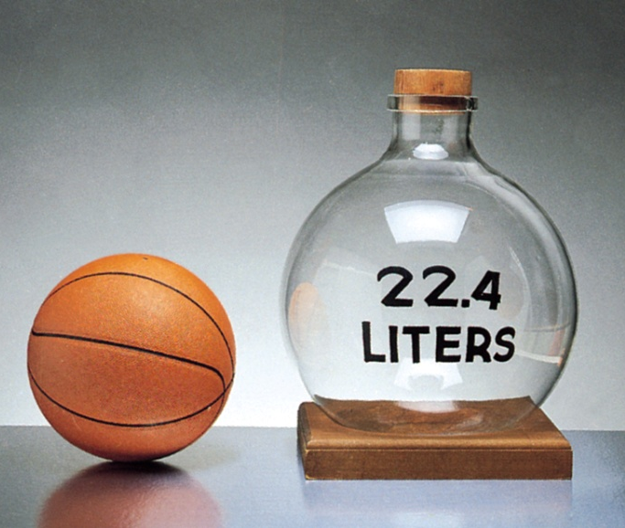
The conditions 0 ⁰C and 1 atm are called
standard temperature and pressure (STP).
Experiments show that at STP, 1 mole
of an ideal gas occupies 22.414 L.
PV = nRT
PV
(1 atm)(22.414 L)
R =
=
nT
(1 mol)(273.15 K)
R = 0.082057 L • atm / mol • K

Slide 22
It is a hypothetical gas which follows ideal gas equation
Ideal gas:
don’t attract or repel one another
Its volume is negligible compare to the volume of the container
If all variables change, we use:
P₁V₁
P₂V₂
P₁V₁
P₂V₂
=
In general, n₁ = n₂ thus
=
n₁T₁
n₂T₂
T₁
T₂

Slide 23
What is the volume (in liters) occupied by 49.8 g of HCl at STP?
T = 0 ⁰C = 273.15 K
P = 1 atm
PV = nRT
1 mol HCl
n = 49.8 g x
= 1.37 mol
nRT
36.45 g HCl
V =
P
L•atm
1.37 mol x 0.0821 x 273.15 K
mol•K
V =
1 atm
V = 30.7 L

Slide 24
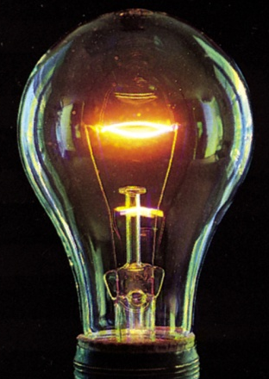
Argon is an inert gas used in lightbulbs to retard the vaporization of the filament. A certain lightbulb containing argon at 1.20 atm and 18 ⁰C is heated to 85 ⁰C at constant volume. What is the final pressure of argon in the lightbulb (in atm)?
PV = nRT
n, V and R are constant
nR
P
=
= constant
V
T
P₁ = 1.20 atm
P₂ = ?
P₁
P₂
T₁ = 291 K
T₂ = 358 K
=
T₁
T₂
T₂
358 K
P₂ = P₁ x
= 1.20 atm x
= 1.48 atm
T₁
291 K

Slide 25
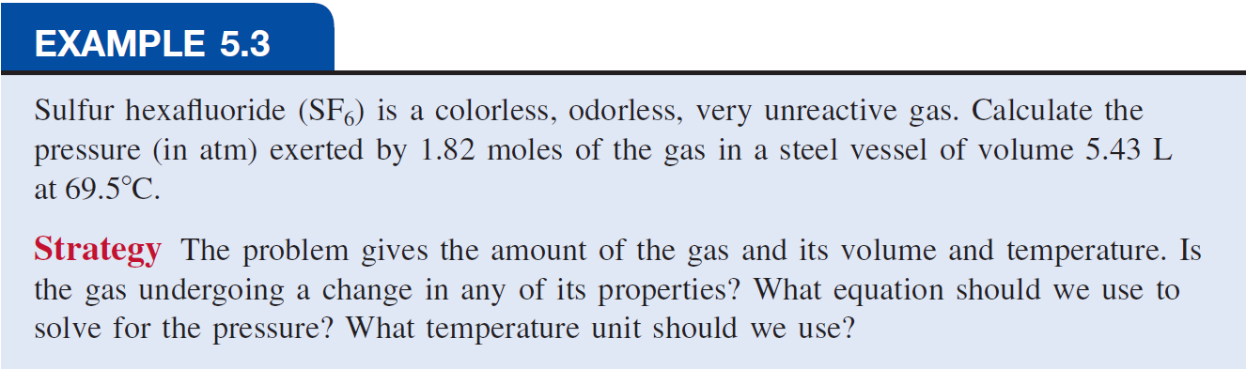
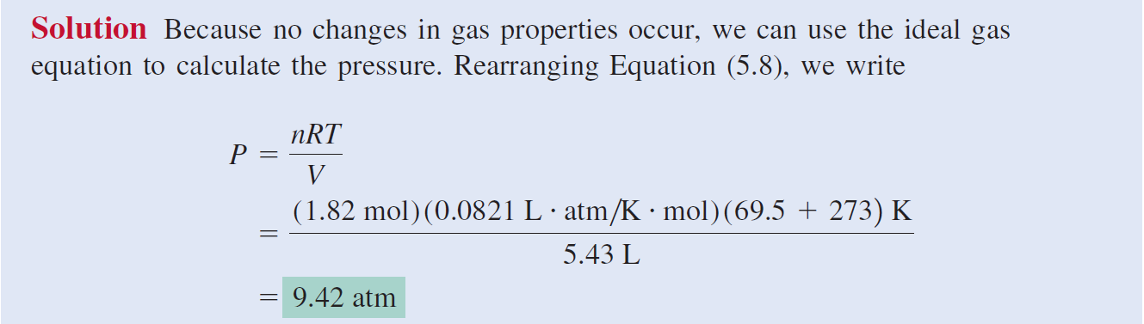

Slide 26
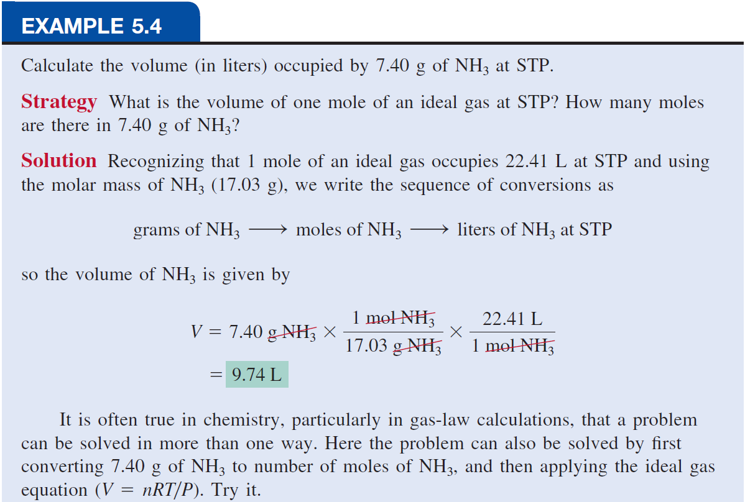

Slide 27
Examples
20.8 g of CH₄ gas was confined in 5.200 L vessel at 50 ⁰C. Calculate the pressure exerted by the gas?
M _{CH4} =16.04 g mol⁻¹ 6.529 atm
2) 1.05 L balloon at 25⁰C , Calculate its volume in a summer day at 50 ⁰C?
1.138 L
3) Gas volume is 2.31 L at 1 atm, Calculate its pressure in mmHg when its volume becomes 7.32 L?
239.8 mmHg

Slide 28
Density (d) Calculations
m
PM
m is the mass of the gas in g
d =
=
V
RT
M is the molar mass of the gas
Molar Mass (M ) of a Gaseous Substance
dRT
M =
d is the density of the gas in g/L
P

Slide 29
A 2.10-L vessel contains 4.65 g of a gas at 1.00 atm and 27.0 ⁰C. What is the molar mass of the gas?
dRT
m
4.65 g
g
M =
d =
=
= 2.21
P
V
2.10 L
L
g
L•atm
2.21
x 0.0821 x 300.15 K
L
mol•K
M =
1 atm
M =
54.5 g/mol

Slide 30
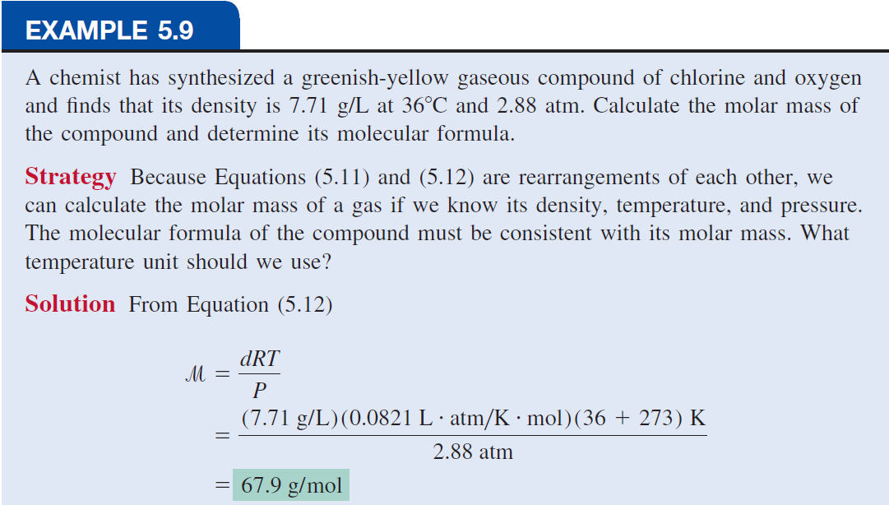
(Continued)

Slide 31
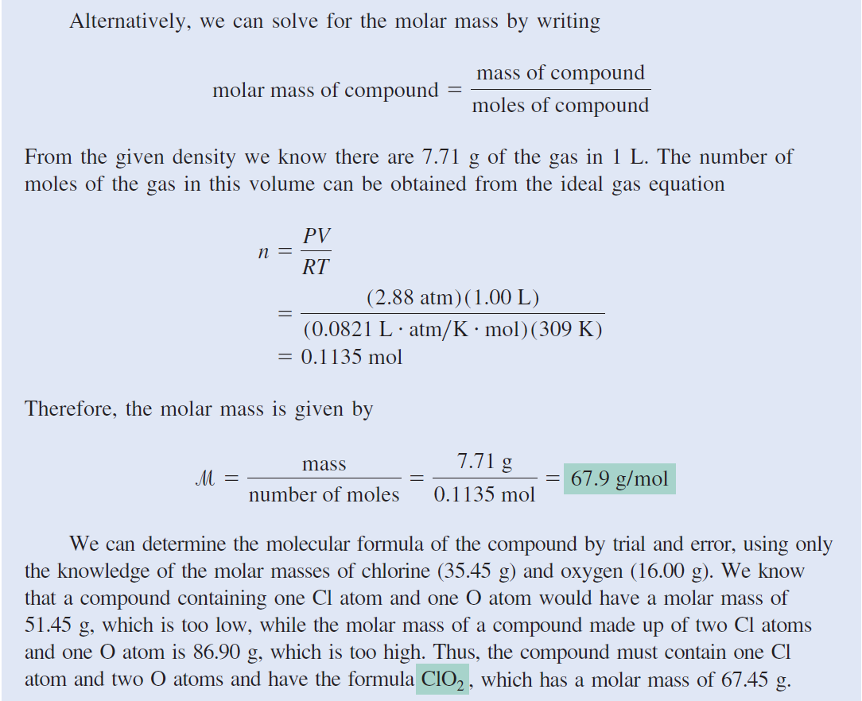

Slide 32
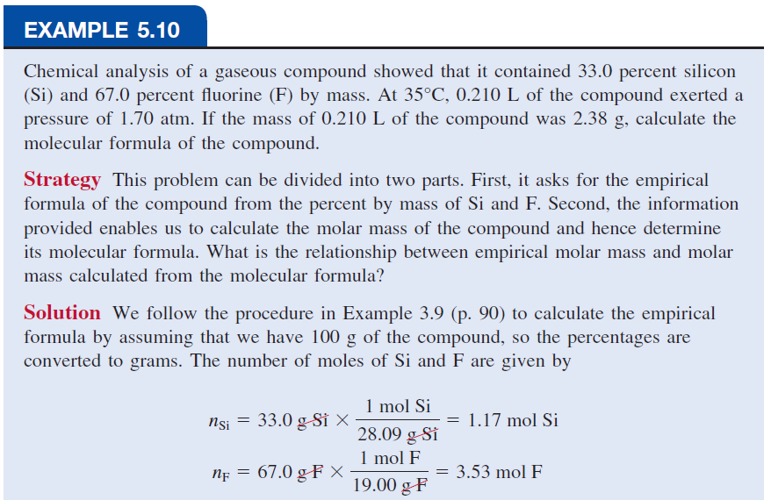
(Continued)

Slide 33
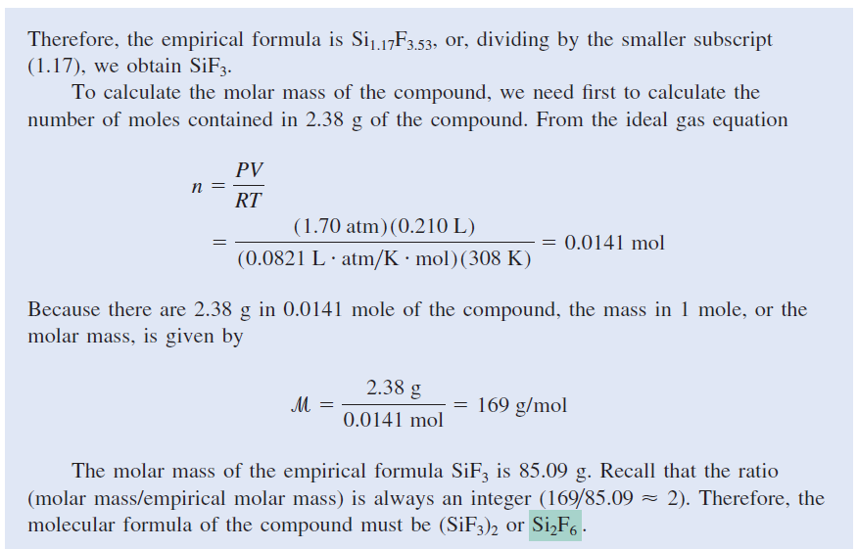

Slide 34
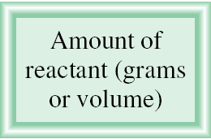

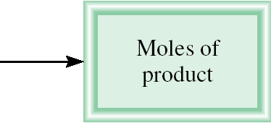
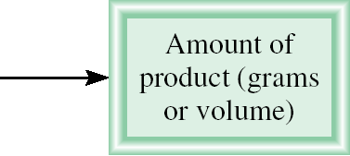
Gas Stoichiometry
What is the volume of CO₂ produced at 37 ⁰C and 1.00 atm when 5.60 g of glucose are used up in the reaction:
C₆H₁₂O₆ (s) + 6O₂ (g) 6CO₂ (g) + 6H₂O (l)
g C₆H₁₂O₆ mol C₆H₁₂O₆ mol CO₂ V CO₂
1 mol C₆H₁₂O₆
6 mol CO₂
5.60 g C₆H₁₂O₆
x
x
= 0.187 mol CO₂
180 g C₆H₁₂O₆
1 mol C₆H₁₂O₆
L•atm
0.187 mol x 0.0821 x 310.15 K
nRT
mol•K
V =
=
= 4.76 L
P
1.00 atm

Slide 35
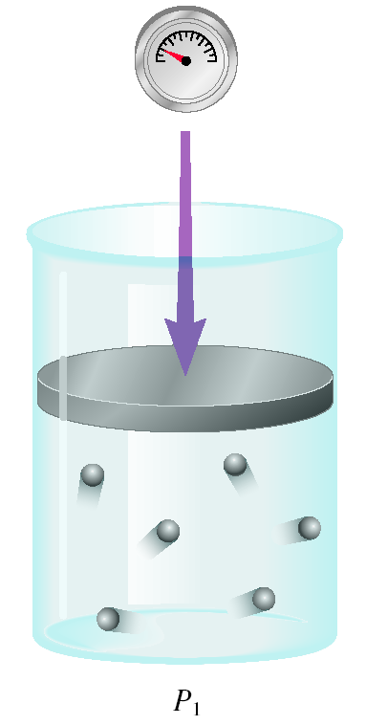
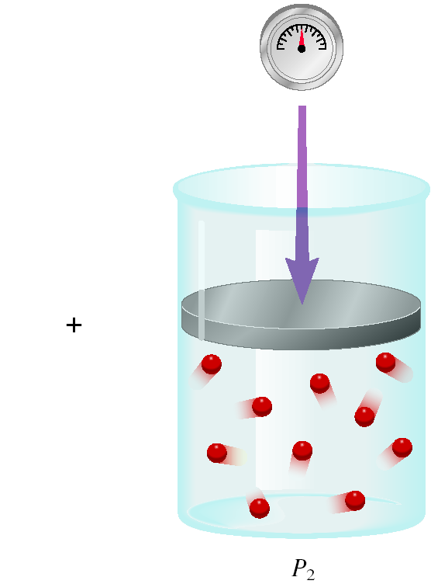
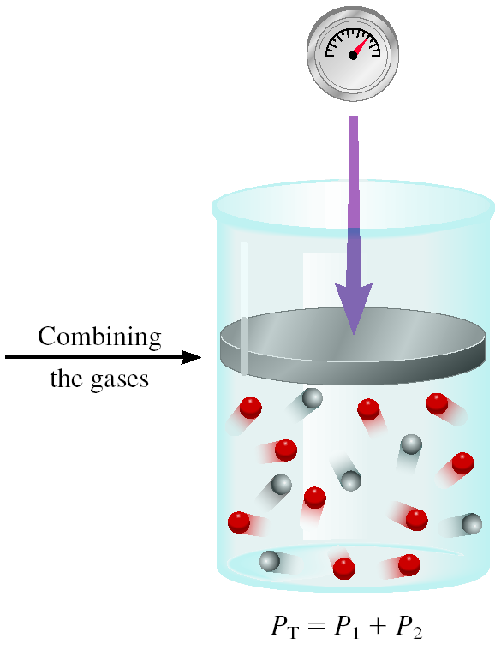
Dalton’s Law of Partial Pressures
V and T are constant
P₁
P₂
P_{total} = P₁ + P₂

Slide 36
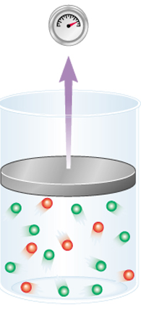
Consider a case in which two gases
A and B, are in a container of volume V.
n_{A} RT
P_{A} =
n_{A} is the number of moles of A
V
n_{B} RT
P_{B} =
n_{B} is the number of moles of B
V
n_{A}
n_{B}
P_{T} = P_{A} + P_{B}
X_{A} =
X_{B} =
n_{A} + n_{B}
n_{A} + n_{B}
P_{A} = X_{A} P_{T}
P_{B} = X_{B} P_{T}
P_{i} = X_{i} P_{T}
n_{i}
mole fraction (X_{i} ) =
n_{T}

Slide 37
A sample of natural gas contains 8.24 moles of CH₄, 0.421 moles of C₂H₆, and 0.116 moles of C₃H₈. If the total pressure of the gases is 1.37 atm, what is the partial pressure of propane (C₃H₈)?
P_{i} = X_{i} P_{T}
P_{T} = 1.37 atm
0.116
X_{propane} =
= 0.0132
8.24 + 0.421 + 0.116
P_{propane} = 0.0132 x 1.37 atm
= 0.0181 atm

Slide 38
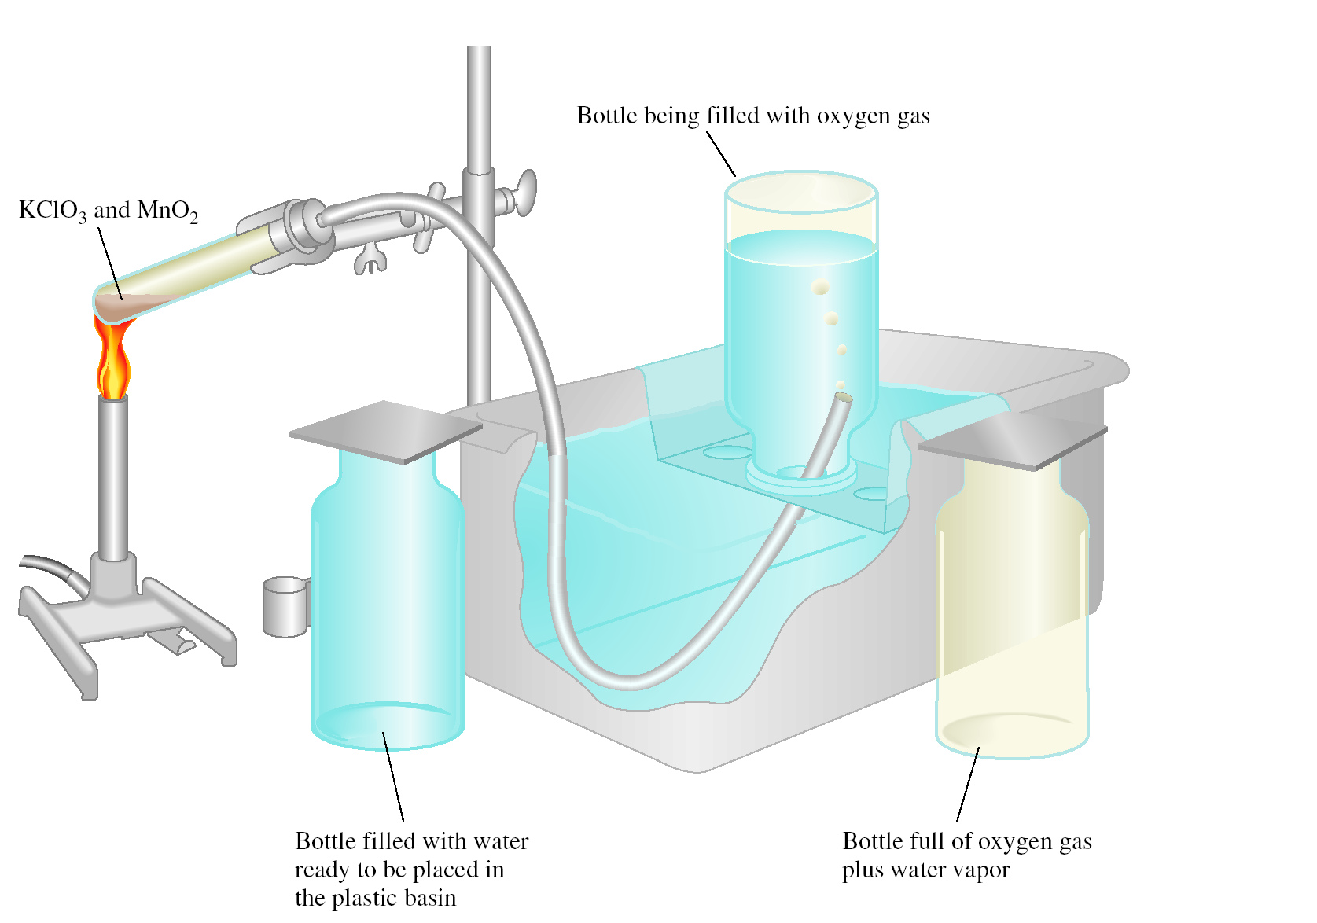
Collecting a Gas over Water
2KClO₃ (s) 2KCl (s) + 3O₂ (g)
P_{T} = P_{O} + P_{H O}
2
2

Slide 39
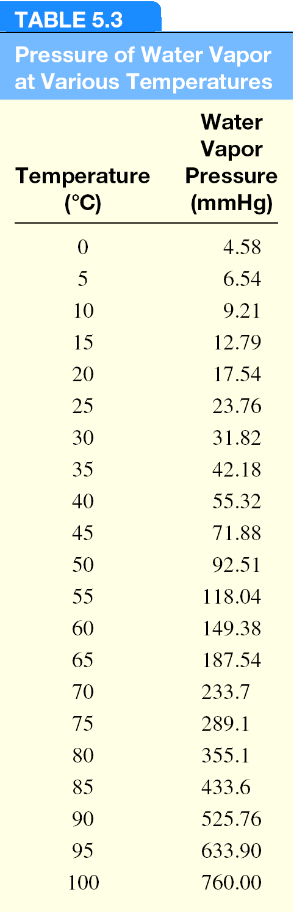
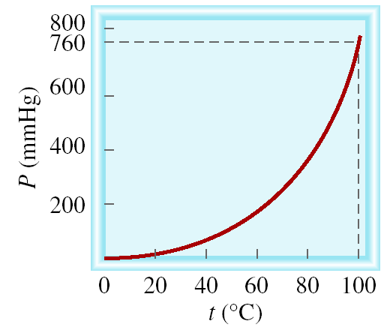
Vapor of Water and Temperature

Slide 40
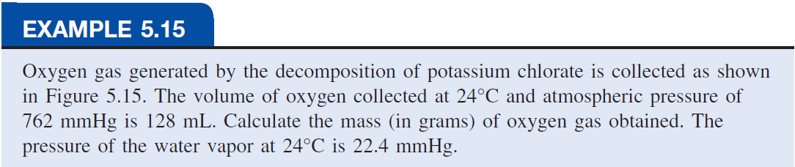
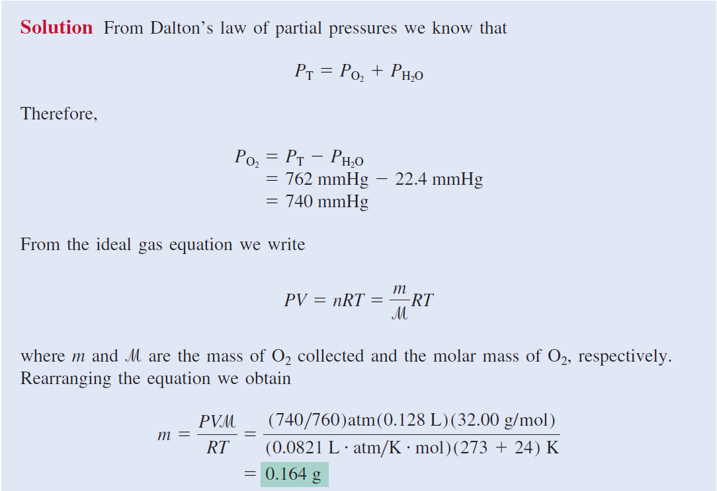

Slide 41
Calculate the mass of Zn_{(s)} used to produce H_{2(g)} over water at 25.0⁰C in a 7.80 L vessel and pressure 0.980 atm knowing that p_{H2O} = 23.8 mmHg according to the following equation:
Zn_{(s)} + 2HCl_{(g)} ZnCl_{2(aq)} + H_{2(g)}
m_{Zn} = 19.8 g

Slide 42
Kinetic Molecular Theory of Gases
A gas is composed of molecules that are separated from each other by distances far greater than their own dimensions. The molecules can be considered to be points; that is, they possess mass but have negligible volume.
Gas molecules are in constant motion in random directions, and they frequently collide with one another. Collisions among molecules are perfectly elastic.
Gas molecules exert neither attractive nor repulsive forces on one another.
The average kinetic energy of the molecules is proportional to the temperature of the gas in kelvins. Any two gases at the same temperature will have the same average kinetic energy
KE = ½ mu²

Slide 43
Kinetic theory of gases and …
Compressibility of Gases
Boyle’s Law
    P α collision rate with wall
    Collision rate α number density
    Number density α 1/V
    P α 1/V
Charles’ Law
    P α collision rate with wall
    Collision rate α average kinetic energy of gas molecules
    Average kinetic energy α T
    P α T

Slide 44
Kinetic theory of gases and …
Avogadro’s Law
    P α collision rate with wall
    Collision rate α number density
    Number density α n
    P α n
Dalton’s Law of Partial Pressures
    Molecules do not attract or repel one another
    P exerted by one type of molecule is unaffected by the presence of another gas
    P_{total} = ΣP_{i}

Slide 45
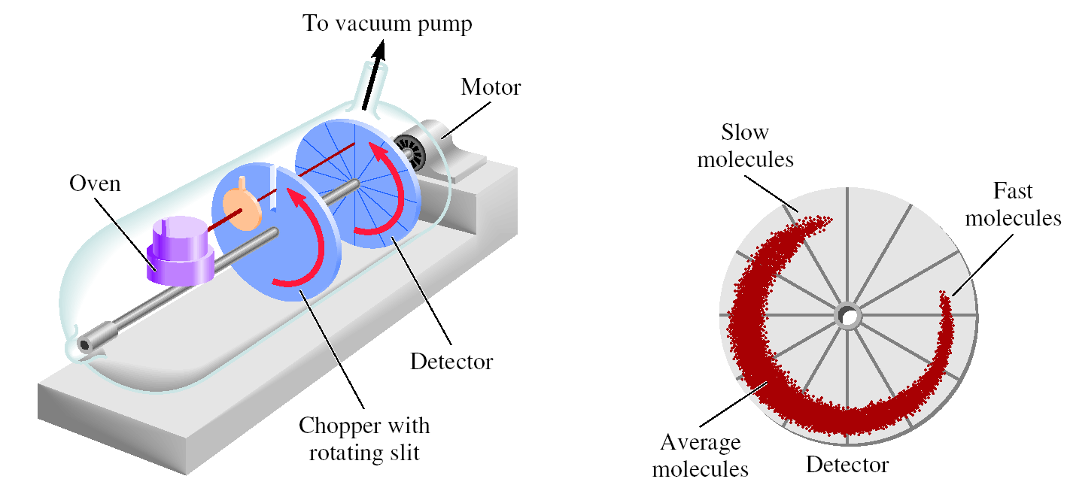
Apparatus for Studying
Molecular Speed Distribution

Slide 46
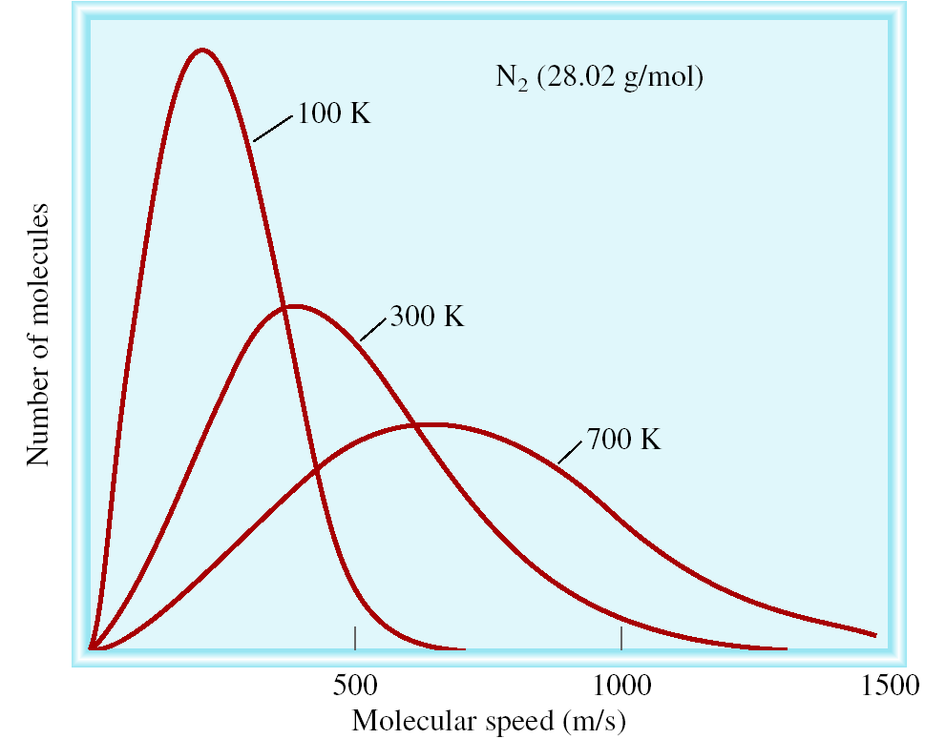
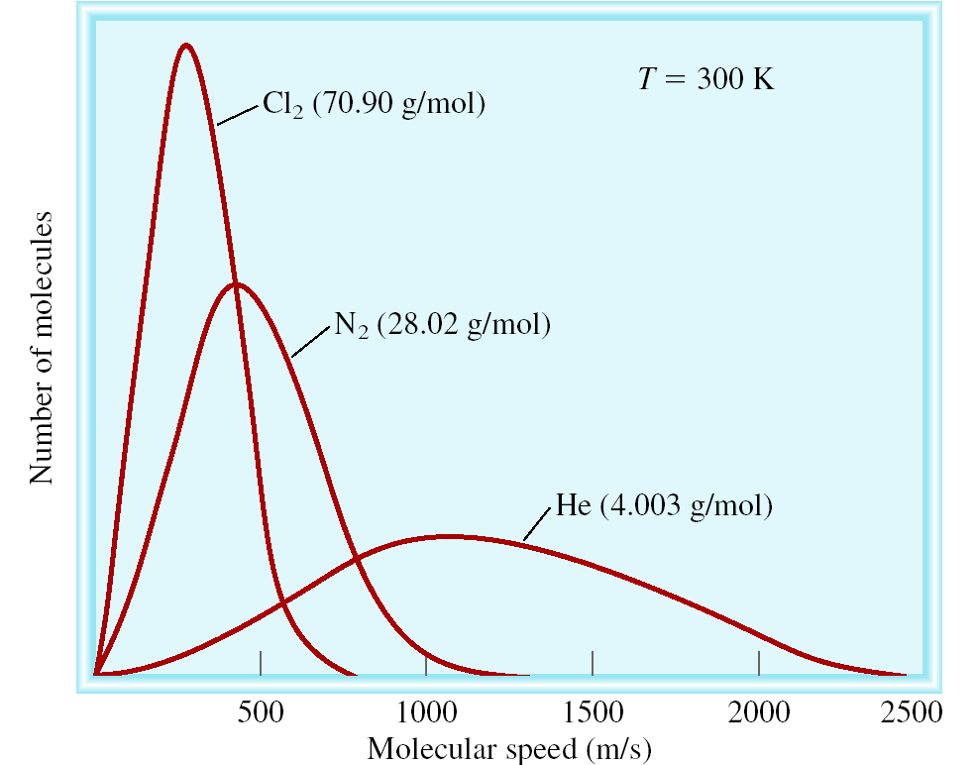
The distribution of speeds
of three different gases
at the same temperature
The distribution of speeds
for nitrogen gas molecules
at three different temperatures
√
3RT
u_{rms} =
M

Slide 47
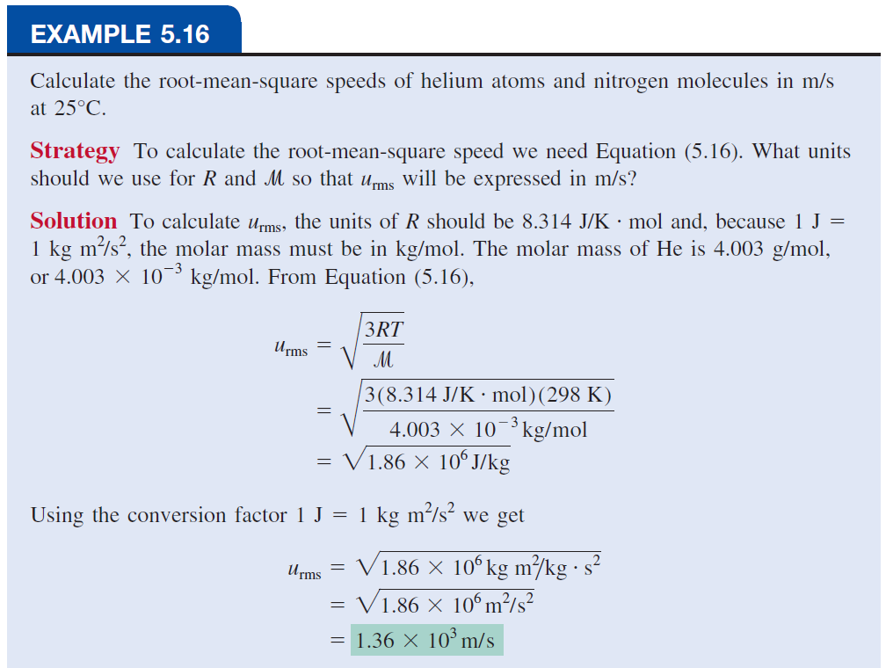
Continue ..

Slide 48
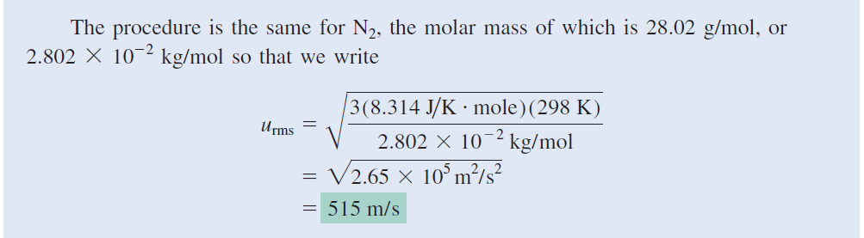

Slide 49

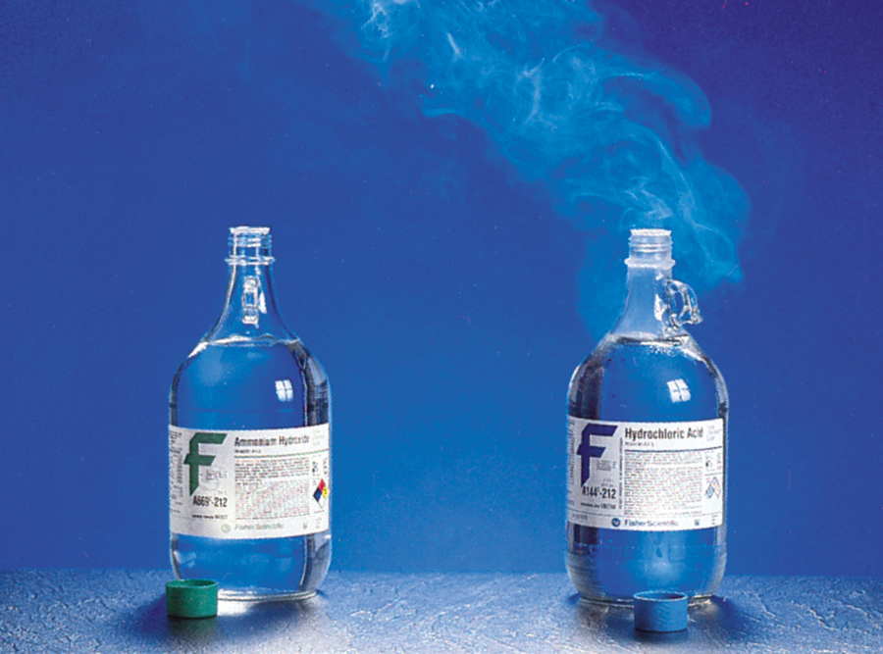
Gas diffusion is the gradual mixing of molecules of one gas with molecules of another by virtue of their kinetic properties.
NH₄Cl
molecular path
r₁
√
M₂
NH₃
17 g/mol
HCl
36 g/mol
=
r₂
M₁

Slide 50
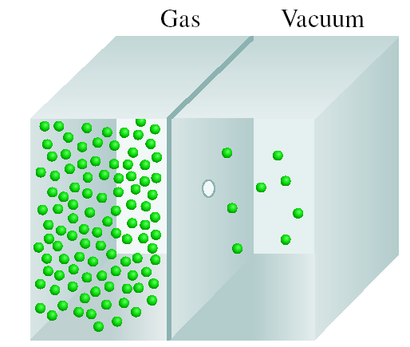
Gas effusion is the process by which gas under pressure escapes from one compartment of a container to another by passing through a small opening.
r₁
t₂
√
M₂
=
=
r₂
t₁
M₁
Nickel forms a gaseous compound of the formula Ni(CO)_{x} What is the value of x given that under the same conditions methane (CH₄) effuses 3.3 times faster than the compound?
(
r₁
)
r₁ = 3.3 x r₂
2
58.7 + (x • 28) = 174.2
M₂ =
x M₁
r₂
M₁ = 16 g/mol
= (3.3)² x 16 = 174.2
x = 4.1 ~ 4

Slide 51
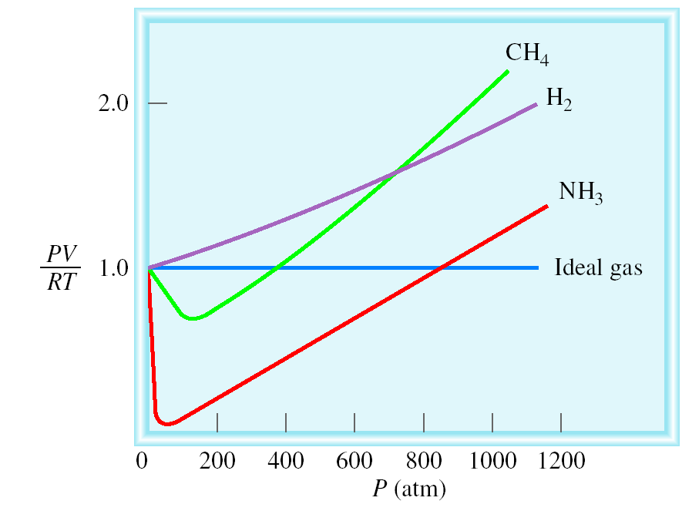
Deviations from Ideal Behavior
1 mole of ideal gas
Repulsive Forces
PV = nRT
PV
n =
= 1.0
RT
Attractive Forces

Slide 52
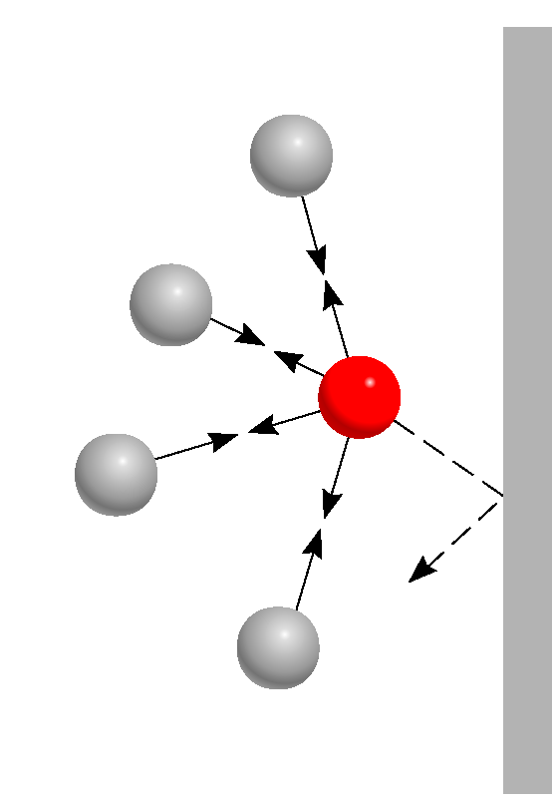
Effect of intermolecular forces on the pressure exerted by a gas.

Slide 53
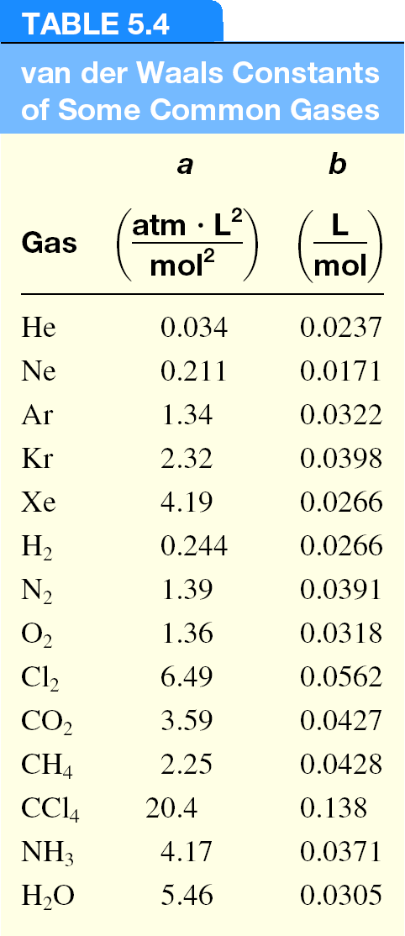
Van der Waals equation
nonideal gas
(
an²
)
P + (V – nb) = nRT
V²
}
}
corrected
pressure
corrected
volume

