Slide 1
Group 1
The Alkali Metals

Slide 2
Group 1: The Alkali Metals
The elements in group 1, on the left of the periodic table, are called the alkali metals.
These metals are all very reactive and are
rarely found in nature in their elemental
form.
Properties:
Soft
Lustrous metals
Electron configuration is ns1
(n is the period number)
Classified as metals
Li
Na
K
Rb
Cs
Fr

Slide 3
Some information of group 1 elements

Slide 4
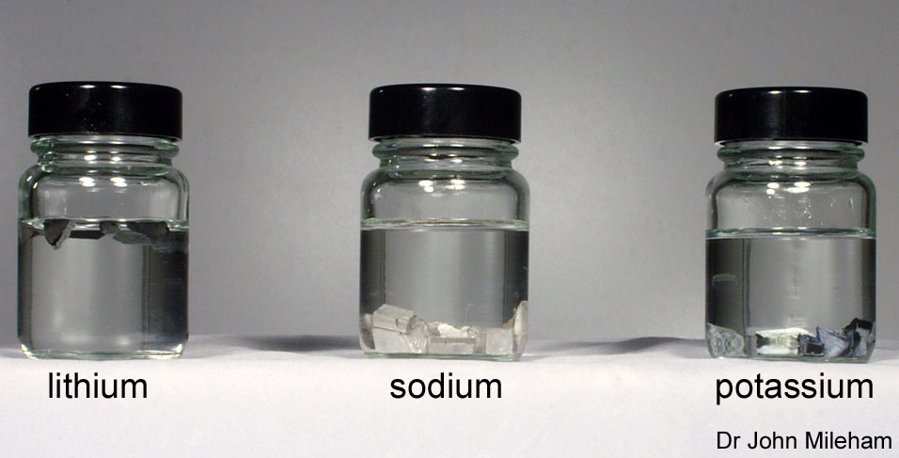
The alkali metals are so reactive that, as elements, they have to be stored in oil. This stops them reacting with oxygen in the air. The alkali metals are unlike most other metals, which are usually hard and dense.
Alkali metals are soft enough to be cut with a knife, and the most common alkali metals, lithium, sodium and potassium, all float on water. The elements in group 1 also react with water and form alkaline compounds. This is why they are called alkali metals.

Slide 5


What is the electron structure of alkali metals?
The alkali metals all have one electron in their outer shell.
This means that:
They are found in group 1of the periodic table.
They have similar physical and chemical properties.
They can readily lose the outer shell electron to form positive ions with a +1 charge and a full outer shell.
lithium
2,1
sodium
2,8,1
potassium
2,8,8,1

Slide 6
How do you identify alkali metals?
The different alkali metals in group 1 can be identified by a flame test.

Slide 7
What are the properties of the alkali metals?
The characteristic properties of the alkali metals are:
They are soft and can be cut by a knife. Softness increases going down the group.
They have a low density. Lithium, sodium and potassium float on water.
The alkali metals generally become more dense going down the group, but the trend is not perfect because potassium is less dense than sodium.

Slide 8
What are the properties of the alkali metals?
They have low melting and boiling points.
The melting points and boiling points of alkali metals decrease going down the group.
The melting and boiling points decrease going down group 1 because the atoms get larger. In each metallic structure, the attraction between the positive metal ions and the delocalized sea of electrons gets weaker and so they become easier to melt, and to boil.

Slide 9
Properties of Alkali Metals

Slide 10
These properties mean that the alkali metals are different to typical metals. However, alkali metals do also share some properties with typical metals:
They are good conductors of heat and electricity.
They are shiny. This is only seen when alkali metals are freshly cut.

Slide 11
Reactions and Reactivity:
How do the alkali metals react with oxygen?
All alkali metals react with oxygen in the air to form metal oxides. This produces a layer of dull oxide on the surface of the metal, called tarnish.
The speed with which alkali metals react with oxygen in the air increases going down the group:
lithium – tarnishes slowly
sodium – tarnishes quickly
potassium – tarnishes very quickly.

Slide 12
Why are alkali metals stored in oil?
The oil prevents them from reacting with oxygen and tarnishing.
The reaction between an alkali metal and oxygen is an example of an oxidation reaction:
Alkali metal + Oxygen Alkali metal oxide (M₂O)

Slide 13
All the alkali metals react vigorously with water.
The reaction with water becomes more vigorous as you go down the group.
It is an exothermic reaction as it releases a lot of heat.
The reaction produces a gas that ignites a lighted splint with a squeaky pop.
2Na_{(s)} + 2H₂O_{(l)} 2NaOH_{(aq)} + H_{2(g)}
The alkali metals are all too easily oxidized to be found in their free state in nature.
Great reducing agents.

Slide 14
How does electron structure affect reactivity?
The reactivity of alkali metals increases going down the group. What is the reason for this?
The atoms of each element get larger going down the group.
This means that the outer shell electron gets further away from the nucleus and is shielded by more electron shells.
The further an electron is from the positive nucleus, the easier it can be lost in reactions.
This is why the reactivity of the alkali metals increases going down group 1.

Slide 15
Compounds of Lithium
Lithium differs slightly from the other element in the group
Small size if the Li⁺ cation Strong polarizing power Forms bonds with highly covalent character
Uses:
Ceramics
Lubricants Medicine (lithium carbonate (treatment for bipolar disorder))

Slide 16
Compounds of Sodium
Importance of Sodium compound:
Low cost
High solubility in water
NaCl (Sodium Chloride commonly know as table salt)
Methods of Obtaining NaCl
Mined as rock salt which is a deposit of sodium chloride left as ancient oceans evaporated
Obtained from the evaporation of brine (sea water)
Properties:
White
Solid salt

Slide 17
Uses:
Electrolytic production of chlorine and sodium hydroxide from brine
2Na⁺ _{(aq)} + 2Cl⁻_{(aq)} + 2H₂O _{(l)} Cl_{2(g)} + 2OH⁻_{(aq)} +H_{2(g)} + 2Na⁺ _{(aq)}

Slide 18
NaOH (Sodium Hydroxide commonly know as lye)
Methods of Obtaining NaOH Electrolysis of brine
Uses: Inexpensive starting material for the production of other sodium salts
Properties:
Soft
waxy
White
Corrosive solid

Slide 19
Sodium Hydrogen Carbonate) NaHCO₃(
(Sodium Bicarbonate) commonly called baking soda)
How baking soda works:
The hydrogen carbonate reacts with a weak acid (HA) that is present in the batter (sour milk, buttermilk, lemon juice, vinegar.....)
HCO₃⁻_{(aq)} + HA _{(aq)} A⁻_{(g)} + H₂O_{(l)} +CO_{2(g)}
The CO_{2(g)} produced causes the batter to rise
Baking powder contains a solid weak acid as well as the hydrogen carbonate therefore CO_{2(g)} is released when water is added

Slide 20
Compounds of Potassium
More expensive than Na compounds
Similar properties to Na compounds
Less hygroscopic (water absorbing than corresponding Na compounds)
Principle mineral source of K is KCl·MgCl₂·6H₂O and KCl
Potassium Nitrate (KNO₃)
Used to facilitate the ignition of matches by releasing O₂ when heated
2KNO₃ _{(s)} ∆ 2KNO _{(s)} + 2O_{2(g)}

Slide 21
Common Reactions
Reaction with Halogens
2M + X₂ 2MX X₂ is any group 7A molecule
Reactions with Oxygen
4Li + O₂ 2Li₂O Need excess Oxygen
2Na + O₂ Na₂O₂
Na₂O₂ + O₂ Na₂O
M + O₂ MO₂ M = K, Rb, or Cs

Slide 22
Reaction with H 2M + H₂ 2MH
Reaction with N 6Li + N₂ 2Li₃N Li only
Reaction with Water 2M + 2H₂O 2MOH + H₂
Reaction with Ions
2M + 2H⁺ 2M⁺ + H₂

Slide 23
Diagonal relationships
The first member of a group is often a bit different.
We typically find that its chemistry is more like that of the chemistry of the second member of the next main group than like that of its own group.

Slide 24
Diagonal relationships
Example: Li and Mg
Li is in many ways more like Mg than like the other alkali metals:
Li is the only alkali metal to form a nitride, whereas this is a typical reaction for the alkaline earth metals.
A number of lithium compounds are much less soluble in water than the corresponding compounds of the other alkali metals (e.g. lithium phosphate).
Li₂CO₃ decomposes to Li₂O and CO₂ like the alkaline earth metal carbonates, but the other alkali metal carbonates are thermally stable.

Slide 25
Group 1 – The alkali metals
Some facts…
1) These metals all have ___ electron in their outer shell
2) Reactivity increases as you go _______ the group. This is because the electrons are further away from the _______ every time a _____ is added, so they are given up more easily.
3) They all react with water to form an alkali (hence their name) and __________, e.g:
Potassium + water potassium hydroxide + hydrogen
2K_{(s)} + 2H₂O_{(l)} 2KOH_{(aq)} + H_{2(g)}
Words – down, one, shell, hydrogen, nucleus

Slide 26
Plenary 1.
Predict
What would happen if rubidium was added to water.
1. how fast will it react?
2. Will it be endothermic or exothermic?
3. What gas will be formed?
4. What would be the word equation
What would happen if caesium was added to water.
1. how fast will it react?
2. Will it be endothermic or exothermic?
3. What gas will be formed?
4. What would be the word equation?

