Slide 1
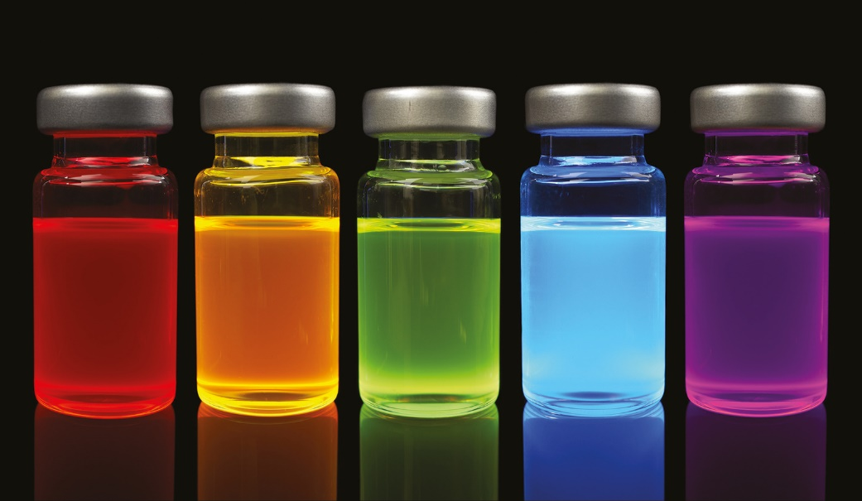
Chapter 4
Reactions in Aqueous Solutions
SPL/Science Source
Copyright 2022 © McGraw Hill LLC. All rights reserved. No reproduction or distribution without the prior written consent of McGraw Hill LLC.

Slide 2
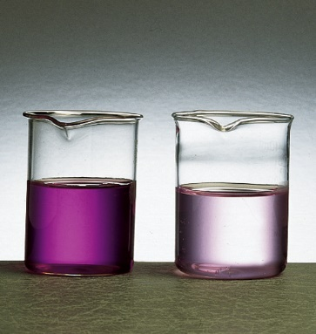
Solutions
A solution is a homogenous mixture of 2 or more substances.
The solute is (are) the substance(s) present in the smaller amount(s).
The solvent is the substance present in the larger amount.
Solution | Solvent | Solute
Soft drink (l) | H₂O | Sugar, CO₂
Air (g) | N₂ | O₂, Ar, CH₄
Soft solder (s) | Pb | Sn
aqueous solutions of KMnO₄
Ken Karp/McGraw-Hill

Slide 3
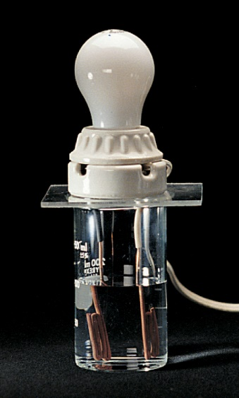
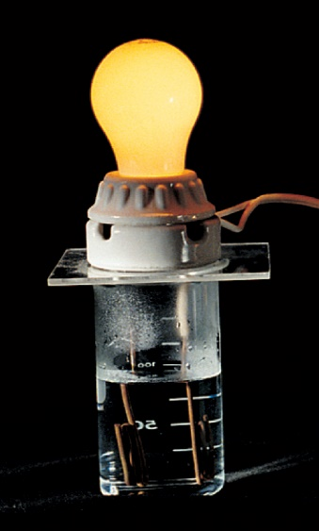
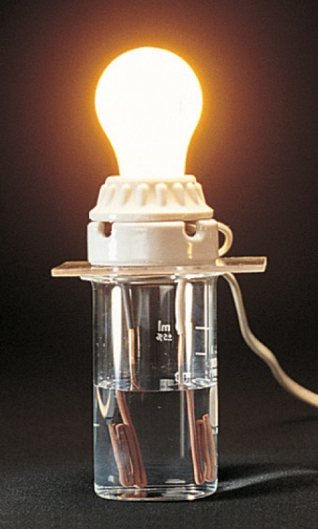
Electrolytes 1
An electrolyte is a substance that, when dissolved in water, results in a solution that can conduct electricity.
A nonelectrolyte is a substance that, when dissolved, results in a solution that does not conduct electricity.
nonelectrolyte
weak electrolyte
strong electrolyte
(Left, middle, right images): Stephen Frisch/McGraw Hill

Slide 4
Electrolytes 2
Conduct electricity in solution?
Cations (+) and Anions (−)
Strong Electrolyte – 100% dissociation
Weak Electrolyte – not completely dissociated

Slide 5
Electrolytes 3
Ionization of acetic acid
⇄ A reversible reaction. The reaction can occur in both directions.
Acetic acid is a weak electrolyte because its ionization in water is incomplete.

Slide 6
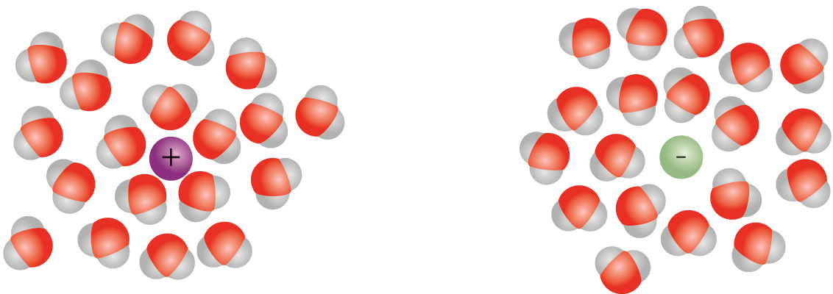
Hydration
Hydration is the process in which an ion is surrounded by water molecules arranged in a specific manner.
Access the text alternative for slide images.

Slide 7
Electrolytes 4
Nonelectrolyte does not conduct electricity
No cations (+) and anions (−) in solution
Table 4.1 Classification of Solutes in Aqueous Solution
Strong Electrolyte | Weak Electrolyte | Nonelectrolyte
HCl | CH₃COOH | (NH₂)₂CO (urea)
HNO₃ | HF | CH₃OH (methanol)
HClO₄ | HNO₂ | C₂H₅OH (ethanol)
H₂SO₄* | NH₃ | C₆H₁₂O₆ (glucose)
NaOH | H₂O† | C₁₂H₂₂O₁₁ (sucrose)
Ba(OH)₂
Ionic compounds
Table divided into 3 columns summarizes classification of solutes in aqueous solution. The column headers are marked from left to right as: Strong electrolyte, weak electrolyte, and nonelectrolyte.
*H₂SO₄ has two ionizable H⁺ ions, but only one of the H⁺ ions is totally ionized.
†Pure water is an extremely weak electrolyte.

Slide 8
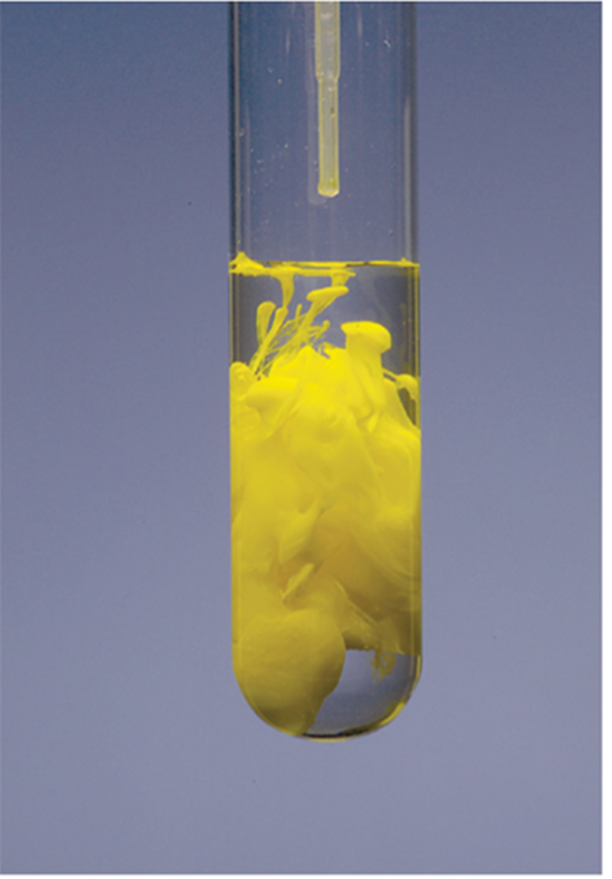
Precipitation Reactions
Precipitate – insoluble solid that separates from solution.
molecular equation
ionic equation
net ionic equation
are spectator ions
PbI₂
Charles D. Winters/McGraw-Hill

Slide 9

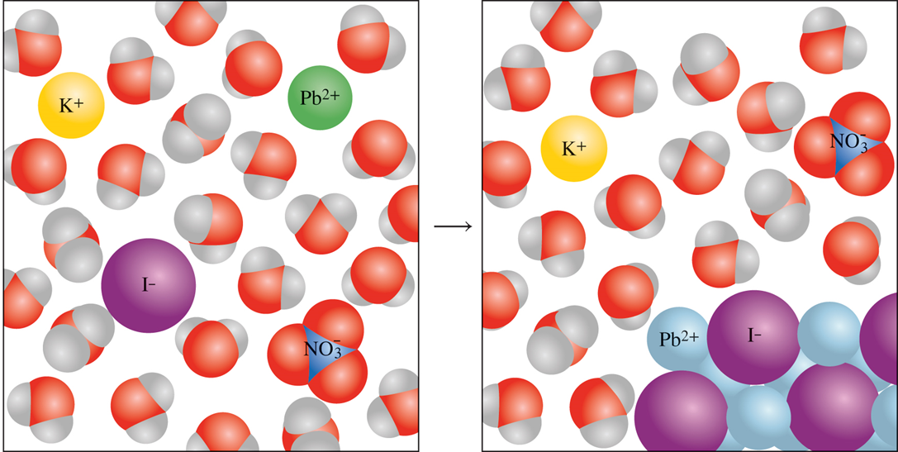
Precipitation of Lead Iodide
PbI₂
Charles D. Winters/McGraw-Hill

Slide 10
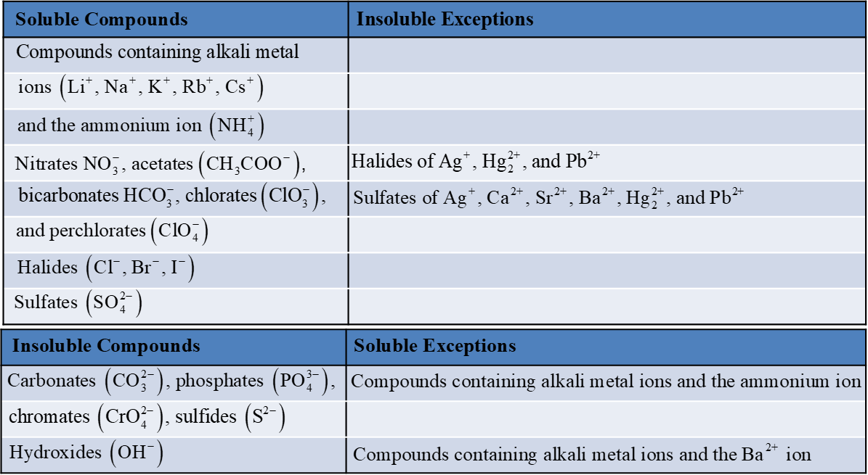
Solubility
Solubility is the maximum amount of solute that will dissolve in a given quantity of solvent at a specific temperature.
Table 4.2 Solubility Rules for Common Ionic Compounds in Water at 25°C
Access the text alternative for slide images.

Slide 11
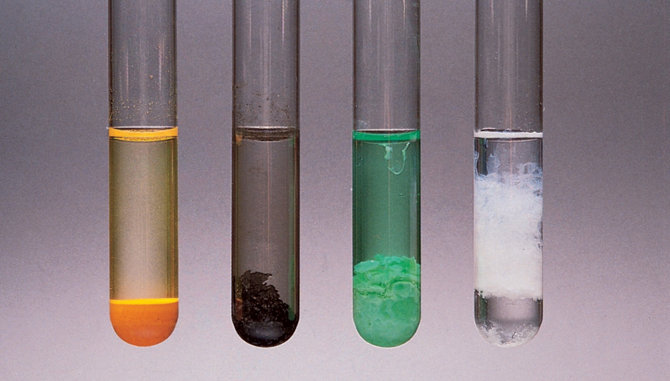
Examples of Insoluble Compounds
CdS
Pbs
Ni(OH)₂
Al(OH)₃
Ken Karp/McGraw-Hill

Slide 12
Writing Net Ionic Equations
Write the balanced molecular equation.
Write the ionic equation showing the strong electrolytes completely dissociated into cations and anions.
Cancel the spectator ions on both sides of the ionic equation.
Check that charges and number of atoms are balanced in the net ionic equation.

Slide 13
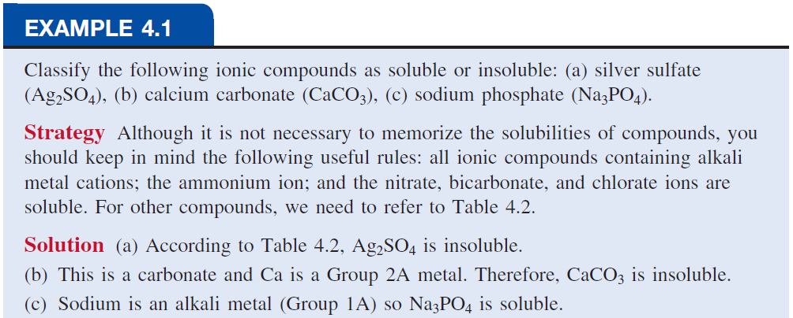

Slide 14
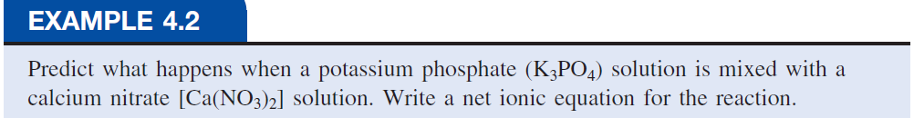
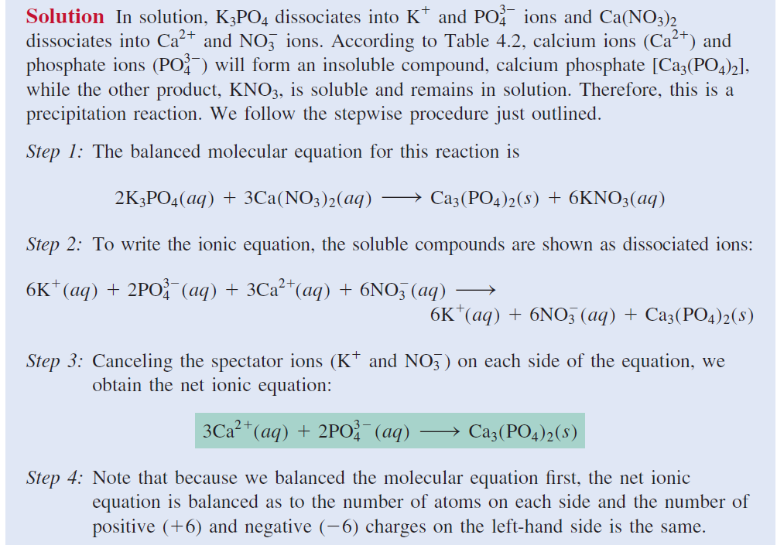

Slide 15
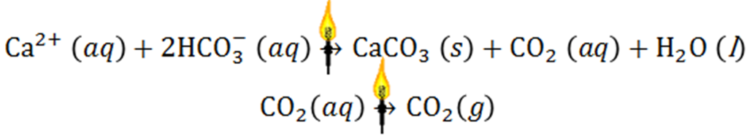
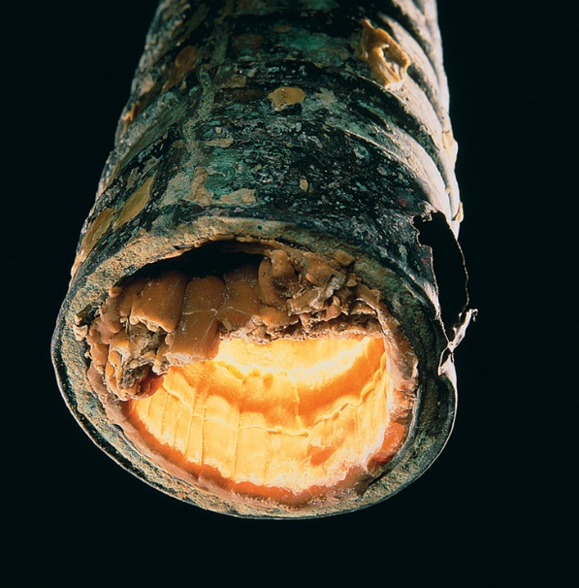
Chemistry In Action: An Undesirable Precipitation Reaction
Boiler Scale Deposits
Access the text alternative for slide images.
Sheila Terry/Science Source

Slide 16
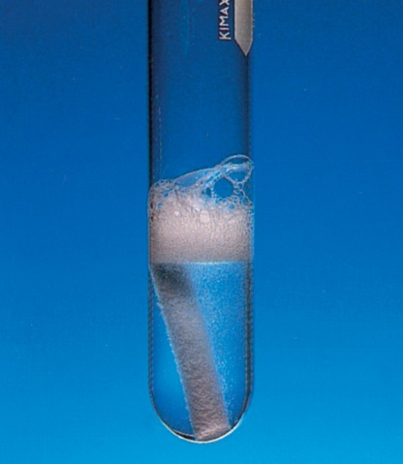
Properties of Acids
Have a sour taste. Vinegar owes its taste to acetic acid. Citrus fruits contain citric acid.
Cause color changes in plant dyes.
React with certain metals to produce hydrogen gas.
2HCl(aq) + Mg(s) → MgCl₂(aq) + H₂(g)
React with carbonates and bicarbonates to produce carbon dioxide gas.
2HCl(aq) + CaCO₃(s) → CaCl₂(aq) + CO₂(g) + H₂O(l)
Aqueous acid solutions conduct electricity.
Ken Karp/McGraw-Hill

Slide 17
Properties of Bases
Have a bitter taste.
Feel slippery. Many soaps contain bases.
Cause color changes in plant dyes.
Aqueous base solutions conduct electricity.

Slide 18
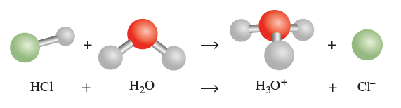
Arrhenius Acids and Bases
Arrhenius acid is a substance that produces
(H₃O⁺) in water.
Arrhenius base is a substance that produces
in water.

Slide 19
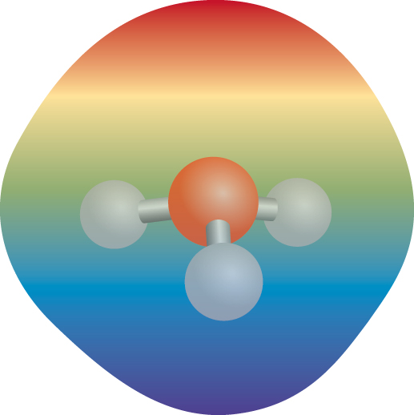
Hydronium ion, hydrated proton, H₃O⁺
Access the text alternative for slide images.

Slide 20
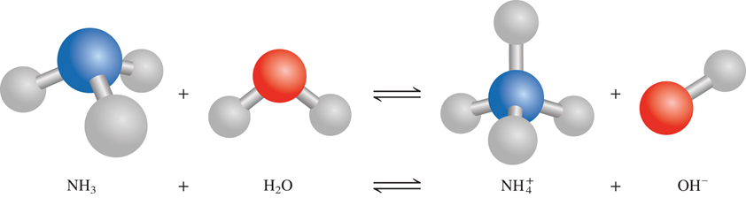
Brønsted Acids and Bases
A Brønsted acid is a proton donor
A Brønsted base is a proton acceptor
A Brønsted acid must contain at least one ionizable proton!
Access the text alternative for slide images.

Slide 21
Types of Acids
Monoprotic acids
Strong electrolyte, strong acid
Strong electrolyte, strong acid
Weak electrolyte, weak acid
Diprotic acids
Strong electrolyte, strong acid
Weak electrolyte, weak acid
Triprotic acids
Weak electrolyte, weak acid
Weak electrolyte, weak acid
Weak electrolyte, weak acid

Slide 22
Common Acids
Table 4.3 Some Common Strong and Weak Acids
Strong Acids | Formula
Hydrochloric acid | HCl
Hydrobromic acid | HBr
Hydroiodic acid | HI
Nitric acid | HNO₃
Sulfuric acid | H₂SO₄
Perchloric | HClO₄
Weak Acids | Formula
Hydrofluoric acid | HF
Nitrous acid | HNO₂
Phosphoric acid | H₃PO₄
Acetic acid | CH₃COOH
The first section summarizes strong acid with formula. The second section summarizes weak acids with formula.

Slide 23
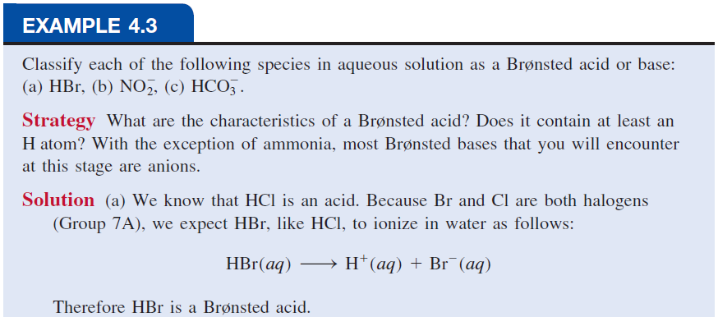
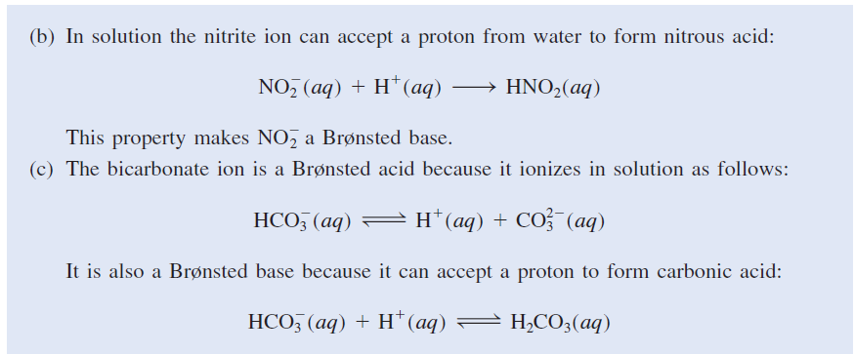

Slide 24
Neutralization Reaction
acid + base → salt + water

Slide 25
Neutralization Reaction Involving a Weak Electrolyte
weak acid + base → salt + water

Slide 26
Example 4.4 1
Write molecular, ionic, and net ionic equations for each of the following acid-base reactions:
a) hydrobromic acid (aq) + barium hydroxide (aq) →
b) sulfuric acid (aq) + potassium hydroxide (aq) →

Slide 27
Example 4.4 3
Solution
a) Molecular equation:
2HBr(aq) + Ba(OH)₂(aq) → BaBr₂(aq) + 2H₂O(l)
Ionic equation:
Net ionic equation:
or
Both Ba²⁺ and Br⁻ are spectator ions.

Slide 28
Example 4.4 4
b) Molecular equation:
H₂SO₄(aq) + 2KOH(aq) → K₂SO₄(aq) + 2H₂O(l)
Ionic equation:
Net ionic equation:
Note that because
is a weak acid and does not ionize appreciably in water, the only spectator ion is

Slide 29
Neutralization Reaction Producing a Gas
acid + base → salt + water + CO₂
2HCl(aq) + Na₂CO₃(aq) → 2NaCl(aq) + H₂O (l) + CO₂ (g)

Slide 30
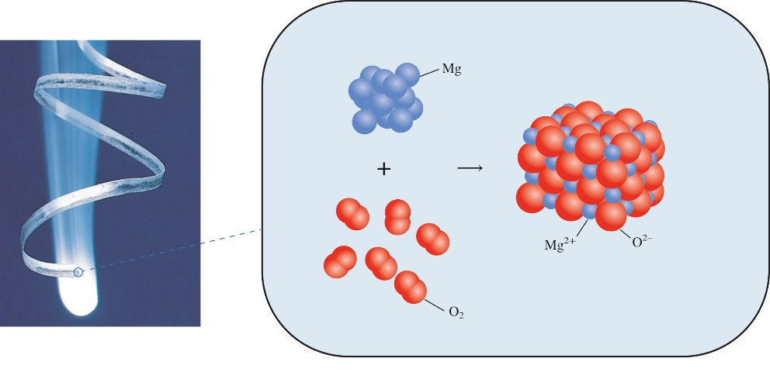
Oxidation-Reduction Reactions 1
(electron transfer reactions)
Oxidation half-reaction (lose e⁻)
Reduction half-reaction (gain e⁻)
2Mg + O₂ → 2MgO
Ken Karp/McGraw-Hill

Slide 31
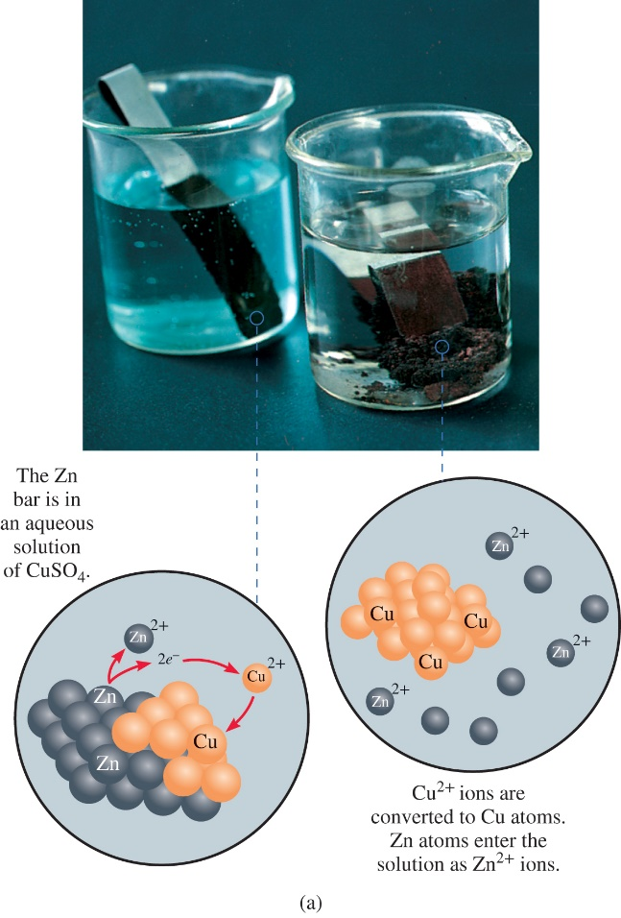
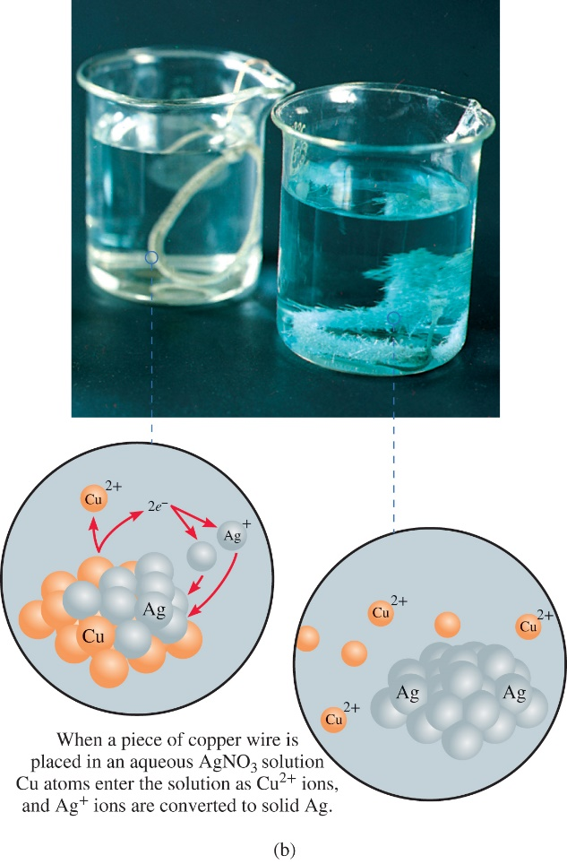
Oxidation-Reduction Reactions 2
Access the text alternative for slide images.
(a and b): Ken Karp/McGraw-Hill

Slide 32
Oxidation-Reduction Reactions 3
Zn(s) + CuSO₄(aq) → ZnSO₄(aq) + Cu(s)
Zn is oxidized
Zn is the reducing agent
Cu²⁺ is reduced
Cu²⁺ is the oxidizing agent

Slide 33
Oxidation Number 1
The charge the atom would have in a molecule (or an ionic compound) if electrons were completely transferred.
Free elements (uncombined state) have an oxidation number of zero.
Na, Be, K, Pb, H₂, O₂, P₄ = 0
In monatomic ions, the oxidation number is equal to the charge on the ion.
The oxidation number of oxygen is usually −2.
In H₂O₂ and
it is −1.

Slide 34
Oxidation Number 2
The oxidation number of hydrogen is +1 except when it is bonded to metals in binary compounds. In these cases, its oxidation number is −1.
Group IA metals are +1, IIA metals are +2, and fluorine is always −1.
The sum of the oxidation numbers of all the atoms in a molecule or ion is equal to the charge on the molecule or ion.
Oxidation numbers do not have to be integers. The oxidation number of oxygen in the superoxide ion,
, is

Slide 35
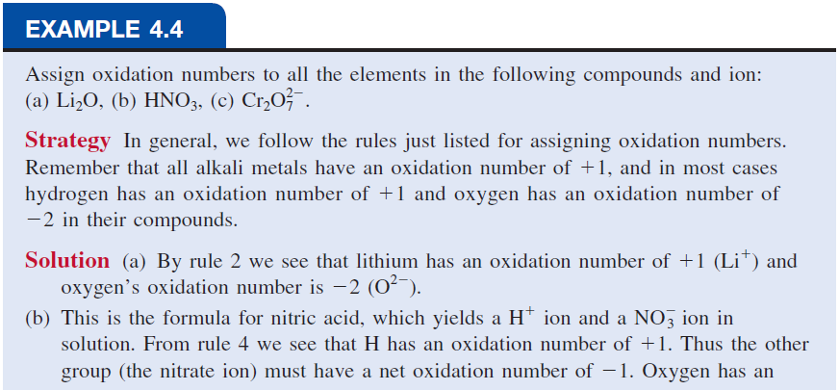
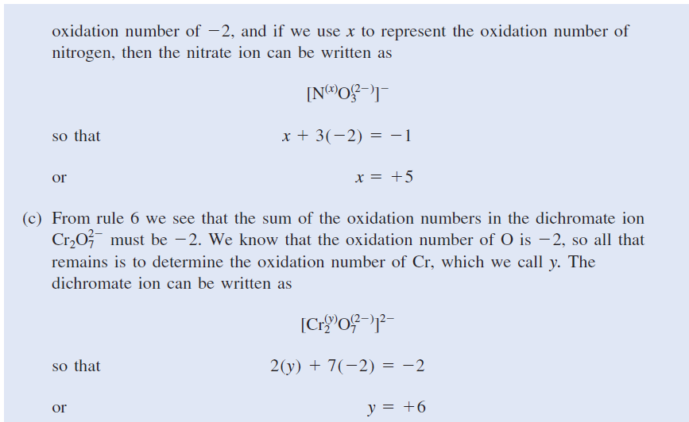

Slide 36
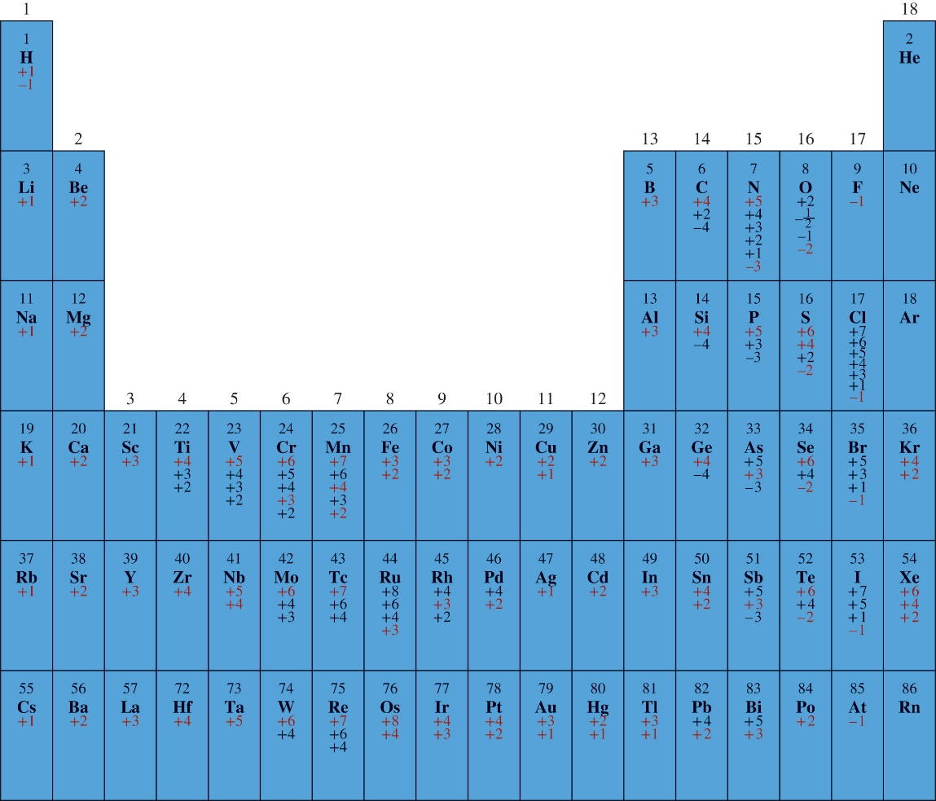
The Oxidation Numbers of Elements in their Compounds
Access the text alternative for slide images.

Slide 37
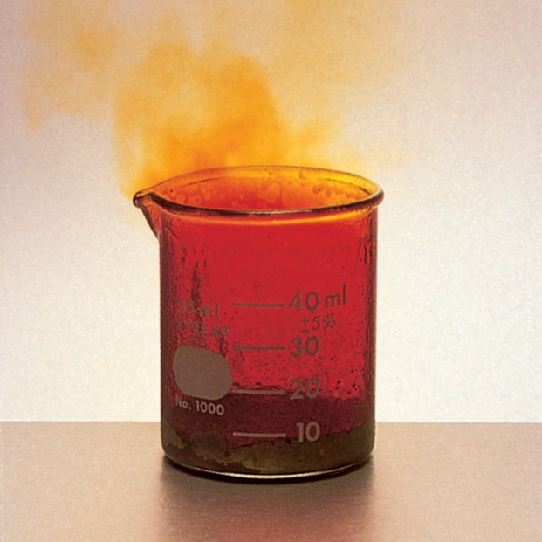
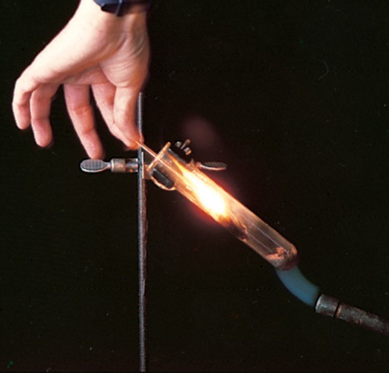
Types of Oxidation-Reduction Reactions 1
Combination Reaction
A + B → C
Decomposition Reaction
C → A + B
Access the text alternative for slide images.
(Top & bottom images): Ken Karp/McGraw Hill

Slide 38
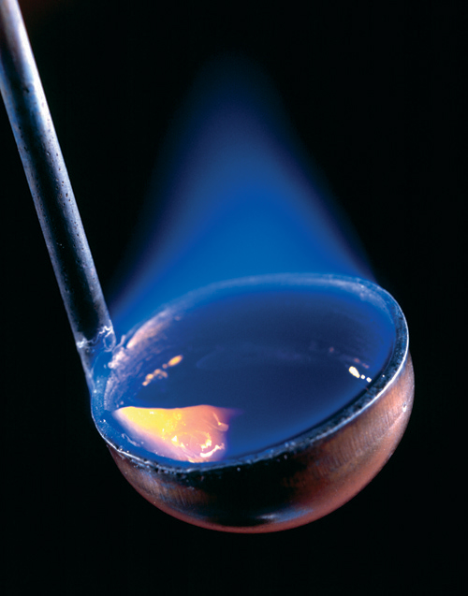
Types of Oxidation-Reduction Reactions 2
Combustion Reaction
A + O₂ → B
Access the text alternative for slide images.
Ken Karp/McGraw-Hill

Slide 39
Types of Oxidation-Reduction Reactions 3
Displacement Reaction
A + BC → AC + B
Hydrogen Displacement
Metal Displacement
Halogen Displacement

Slide 40
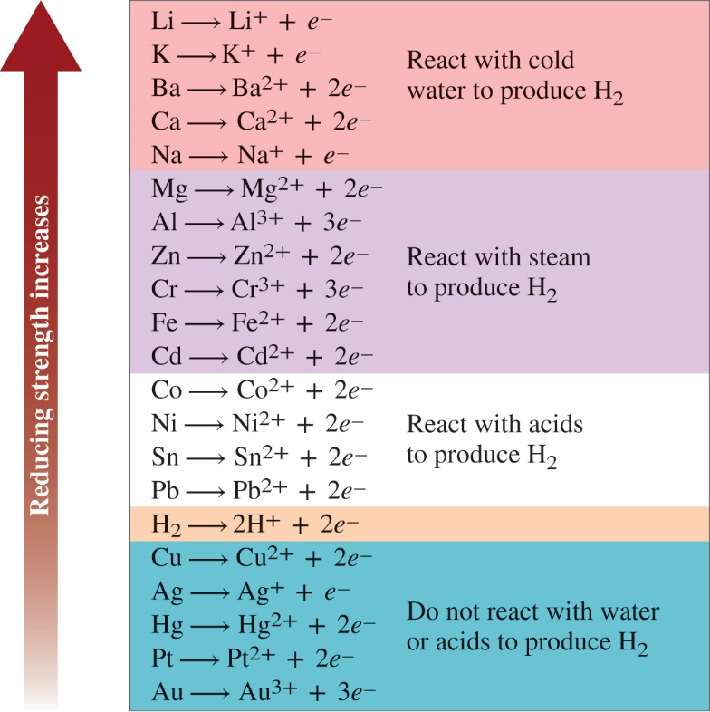

The Activity Series for Metals
Hydrogen Displacement Reaction
M + BC → MC + B
M is metal
BC is acid or H₂O
B is H₂
Ca + 2H₂O → Ca(OH)₂ + H₂
Access the text alternative for slide images.

Slide 41
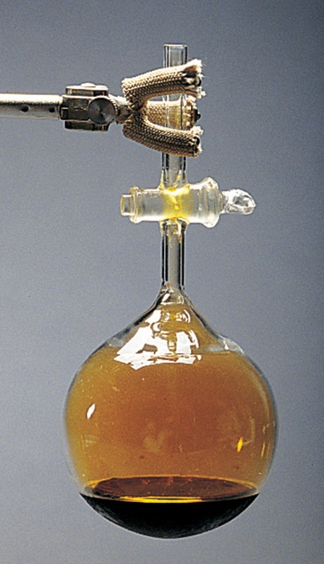

The Activity Series for Halogens
F₂ > Cl₂ > Br₂ > I₂
Halogen Displacement Reaction
Stephen Frisch/McGraw Hill

Slide 42
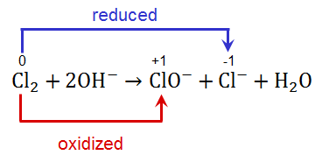
Types of Oxidation-Reduction Reactions 4
Disproportionation Reaction
The same element is simultaneously oxidized and reduced.
Example:
Access the text alternative for slide images.

Slide 43
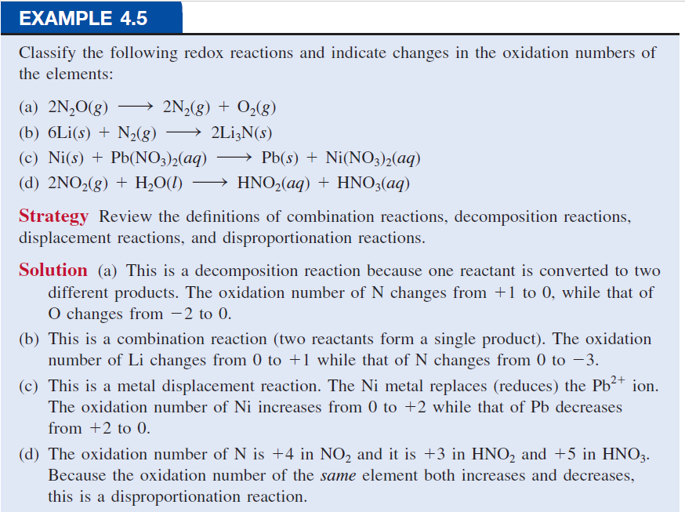

Slide 44
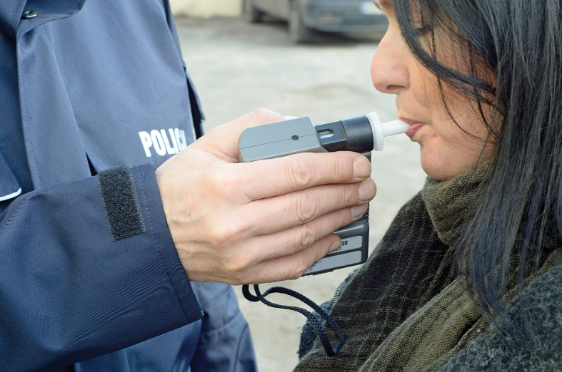
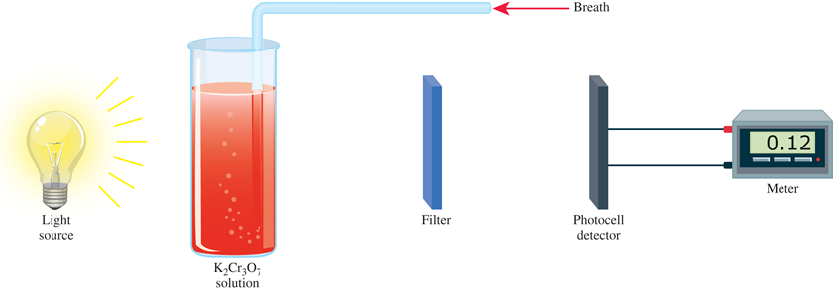
Chemistry in Action: Breath Analyzer
Access the text alternative for slide images.
Piotr290/iStock/Getty Images

Slide 45
Solution Stoichiometry
The concentration of a solution is the amount of solute present in a given quantity of solvent or solution.

Slide 46
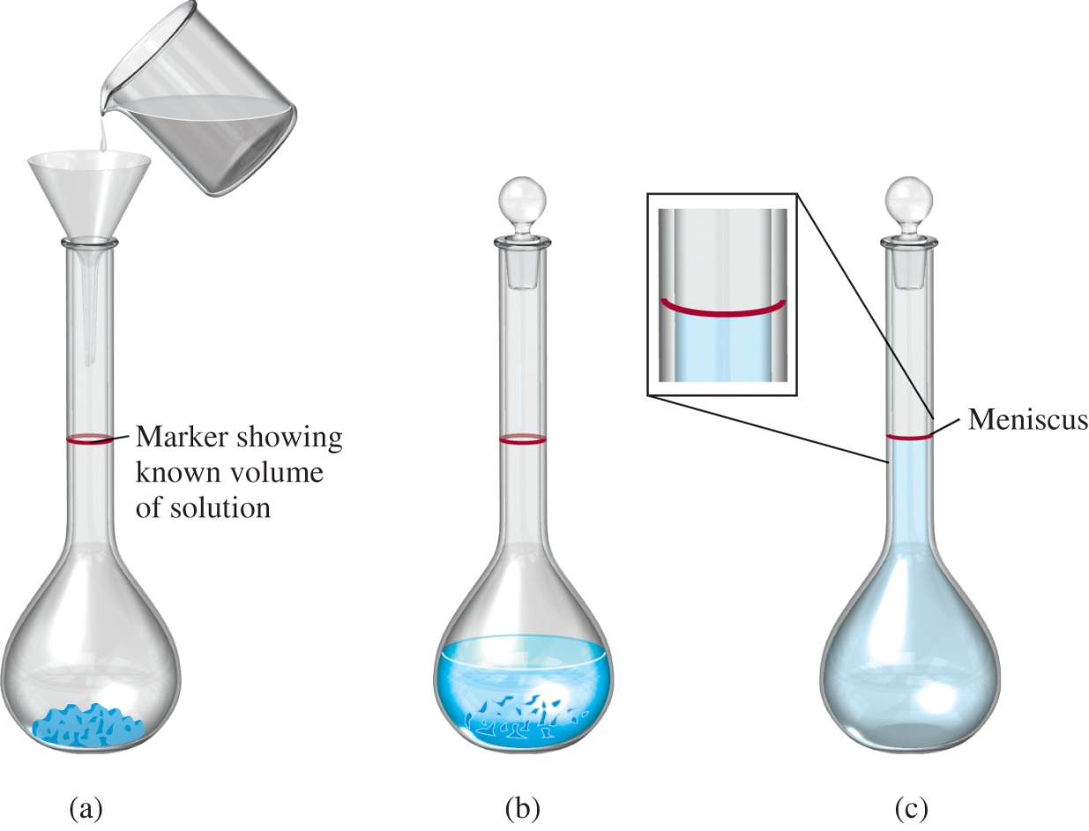
Preparing a Solution of Known Concentration
Access the text alternative for slide images.

Slide 47
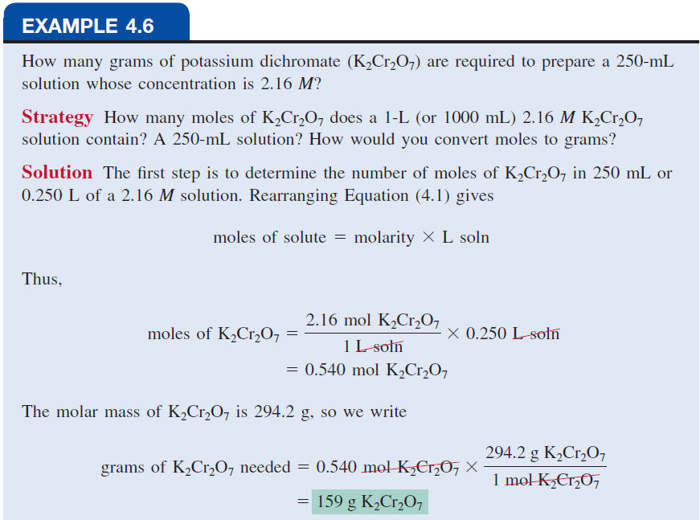
Ken Karp/McGraw-Hill

Slide 48
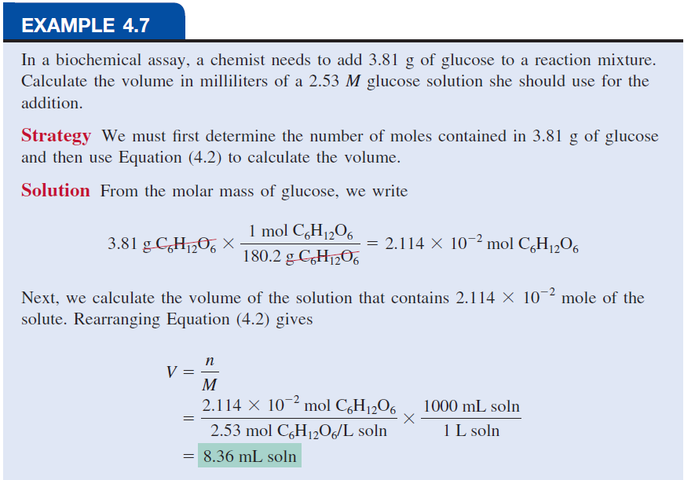

Slide 49
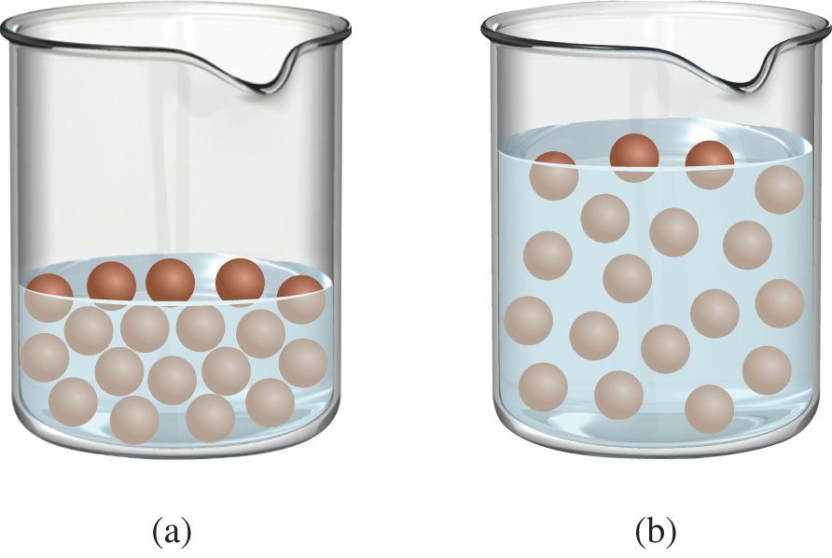
Dilution
Dilution is the procedure for preparing a less concentrated solution from a more concentrated solution.
Moles of solute before dilution (i)
Moles of solute after dilution (f)
=

Slide 50
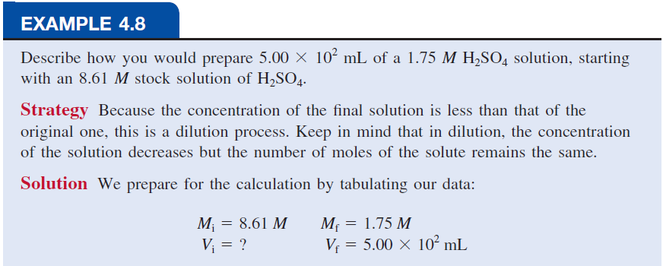
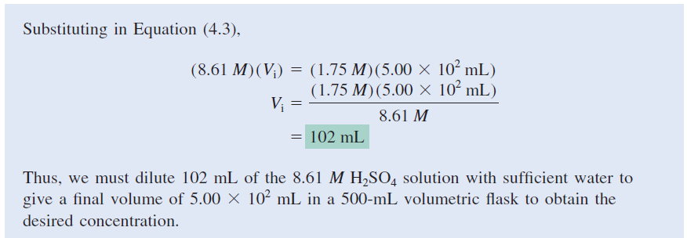

Slide 51
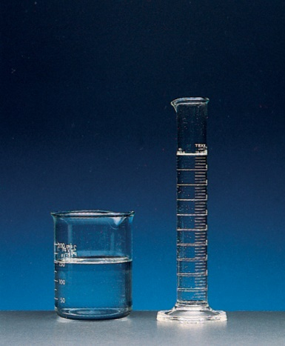
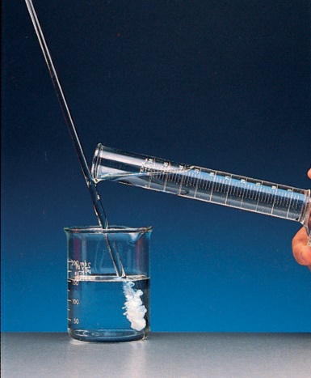
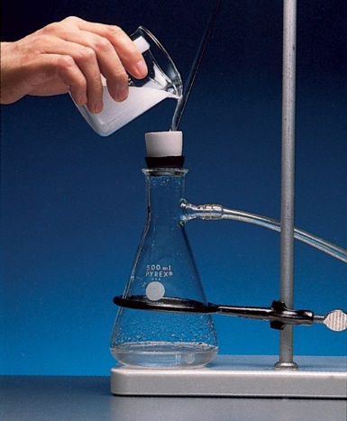
Gravimetric Analysis
Dissolve unknown substance in water
React unknown with known substance to form a precipitate
Filter and dry precipitate
Weigh precipitate
Use chemical formula and mass of precipitate to determine amount of unknown ion
(Left, middle, and right images): Ken Karp/McGraw-Hill

Slide 52
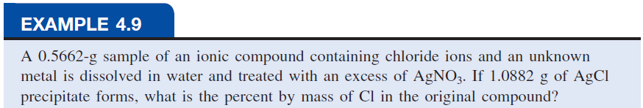
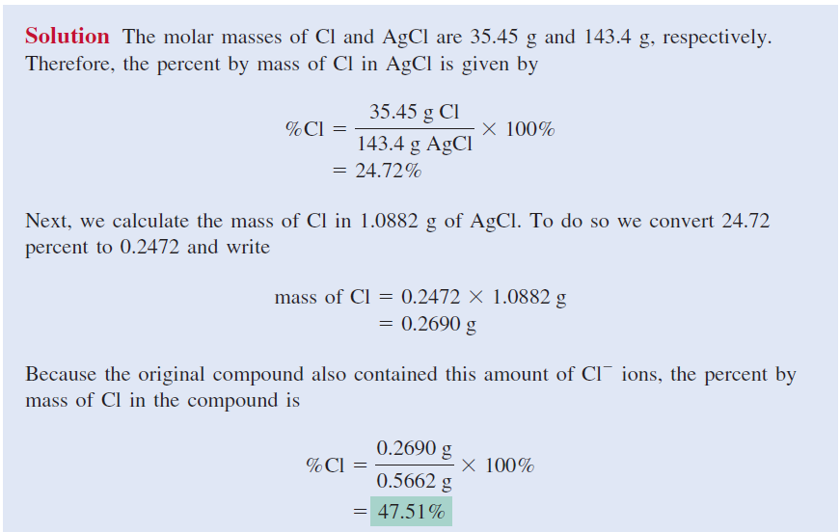

Slide 53
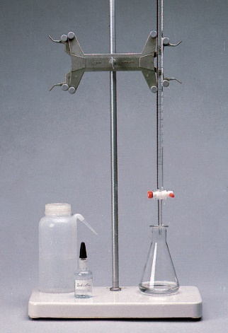
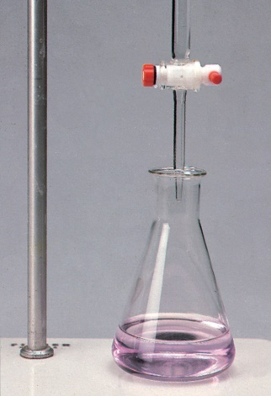
Titrations 1
In a titration, a solution of accurately known concentration is added gradually added to another solution of unknown concentration until the chemical reaction between the two solutions is complete.
Equivalence point – the point at which the reaction is complete
Indicator – substance that changes color at (or near) the equivalence point
Slowly add base to unknown acid UNTIL
the indicator changes color
Access the text alternative for slide images.
(Left & right images): Ken Karp/McGraw-Hill

Slide 54

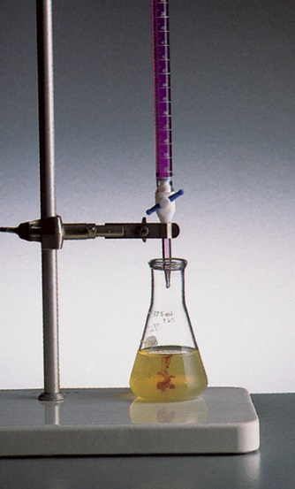
Titrations 2
Titrations can be used in the analysis of:
Acid-base reactions
H₂SO₄ + 2NaOH → 2H₂O + Na₂SO₄
Redox reactions
(Left & right images): Ken Karp/McGraw-Hill

Slide 55



Slide 56



Slide 57



Ken Karp/McGraw-Hill

