Slide 1
Hydrogen Chemistry
Hydrogen: Greek- hydro-water and genes-forming
¹_{1.0079}H
The lightest element and has only proton and one electron and it has no neutron.
All other elements were originally made from hydrogen atoms or other elements that were originally made from hydrogen atoms.

Slide 2
Hydrogen
Hydrogen has a very simple structure:
the nucleus has a single positive charge, and has 1 electron.
Hydrogen is the most abundant element in the universe.
Hydrogen exists as a diatomic gas, H₂.
H₂ is colorless and odorless with very low melting and boiling points.
H is abundant in combination with oxygen as H₂O.
In modern periodic table it is located separately
Electron configuration is 1s¹(similar to the electron configurations of group 1 elements)
Classified as a non metal
Therefore it doesn’t fit into any group

Slide 3
Location in the Periodic Table
1 | 2 |  | 17 | 18
¹_{1.008}H 1s¹ | ↔ |  | ¹_{1.008}H 1s¹ | ²He 1s²
³Li ….2s¹ | ⁴Be |  | ⁹F 2s²2p⁷ | ¹⁰Ne 2s²sp⁶
¹¹Na….3s¹ | ¹²Mg |  | ¹⁷Cl
¹⁹K…. 4s¹ | ²⁰Ca |  | ³⁵Br
³⁷Rb …5s¹ | ³⁸Sr |  | ⁵³I
⁵⁵Cs …6s¹ | ⁵⁶Ba |  | ⁸⁵At
⁸⁷Fr … 7s¹ | ⁸⁸Ra

Slide 4
Resemblance with alkali metals:-
Electronic configuration 1H = 1s¹ 11Na = 1s², 2s², 2p⁶, 3s¹ 19K = 1s², 2s², 2p⁶, 3s² , 3p⁶, 4s¹
Electropositive character: H+, Na+, K+ etc.
Oxidation state: +1
Combination with electronegative elements: form binary compounds with electronegative elements like alkali metals. Halides: HCl NaCl, KCl etc.
Sulphides: H₂S Na₂S, K₂S etc.

Slide 5
Hydrogen and the Alkali Metals
Like the Group 1A(1) elements, hydrogen
has an outer electron configuration of ns¹,
has a single valence electron, and
has a common +1 oxidation state.
Unlike the alkali metals, hydrogen
Shares electrons with nonmetals rather than transferring e⁻ to them.
has a much higher ionization energy than any alkali metal, due to its small size.

Slide 6
Resemblance with halogens:-
Electronic configuration: Both contain one electron less than the nearest noble gas configuration 1H = 1s¹ (near to 2He) 9F = 1s², 2s², 2p⁵ (near to 8Ne) 17Cl = 1s², 2s², 2p⁶, 3s²3p⁵ (near to 18Ar)
Non-metallic character: like halogens, hydrogen is non-metallic in nature.
Atomicity: Diatomic molecules.
Formation of similar types of compounds: i. Halides: CCl₄, SiCl₄, GeCl₄ ii. Hydrides: CH₄, SiH₄, GeH₄
Oxidation state: –1 Na⁺¹H⁻¹ Na⁺¹Cl⁻¹

Slide 7
Hydrogen and the Halogens
Like the halogens or Group 7A(17), hydrogen
exists as a diatomic molecule and
needs only 1 electron to fill its valence shell.
Unlike the halogens
H has a much lower electronegativity than any halogen,
H lacks the three valence e⁻ pairs that halogens have, and
halide ions (X⁻) are common and stable, but the hydride ion (H⁻) is rare and reactive.

Slide 8
Difference from alkali metals:-
Ionization enthalpy:- the ionization enthalpy of hydrogen is very high in comparison to alkali metals.
Non-metallic character: alkali metals are typical metals while hydrogen is non-metal
Atomicity: hydrogen is diatomic while alkali metals are monoatomic.
Nature of compounds: the compounds of hydrogen are predominantly covalent while those of alkali metals are ionic.
For example: HCl is covalent while NaCl is ionic.
The oxides of alkali metals are basic while hydrogen oxide is neutral.

Slide 9
Difference from halogens:-
Less tendency for hydride formation: Hydrogen has less tendency to take up electron to form hydride ion (H⁻) as compared to the halogens which from halide ions (X⁻) very easily.
Absence of unshared pairs of electrons
Nature of oxides: The oxides of halogens are acidic while hydrogen oxide is neutral.
Occurrence of Hydrogen:
* Hydrogen, the most abundant element in the universe and the third most abundant on the surface of the globe, is being visualized as the major future source of energy

Slide 10
The Element
The elemental form of H is H₂
H₂ is small and nonpolar so the H atoms can only attract each other through weak London forces.
London Forces: The force of attraction that arises from the interaction between instantaneous electric dipoles on neighboring molecules.

Slide 11
Summary
Despite its position on top of Group I, it is not really part of this group:
It is a gas and not a metal.
It does not react with water.
Far more electronegative than the alkali
Electronegativity is the tendency of an atom in a molecule to attract electrons.
Electronegativity is useful in predicting the general chemical behavior of an element.
In general large difference in electronegativity between two elements leads to the formation of ions and small difference in electronegativity leads to sharing of electrons.
Selected Electronegativities (Pauling Scale)
F | 4.0
Cl | 3.0
O | 3.5
N | 3.0
S | 2.5
C | 2.5
H | 2.1
B | 2.0
Na | 0.9

Slide 12
Nuclear Properties Hydorgen Isotopes*
Isotope | Symbol | Natural Abundance, % | ½-life | Nuclear Spin | NMR Sensitivity
Protium** | ¹H | 99.985 | Stable | ½ | 1.000
Deuterium***, † | ₁²H, D | 0.01 | Stable | 1 | 0.0097
Tritium†† | ₁³H, T | 10⁻¹⁷ | Radio-active b-emitter† 12.4 year | 1/2 | 1.21
*Have the largest isotope effect of all elements because of the largest mass differences. **The dominant isotope. *** Natural hydrogen contains ~ 0.002% D. † b-radiation ≡ ⁰₋₁e

Slide 13
Physical Properties of Hydrogen
Z | Name | symbol | Molar mass (g.mol⁻¹) | Abundance (%) | Melting point (ºC) | boiling point (ºC) | Density (g.L⁻¹)
1 | hydrogen | H | 1.008 | 99.98 | - 259 (14 K) | - 253 (20 K) | 0.089
1 | deuterium | ²H or D | 2.014 | 0.02 | - 254 (19 K) | - 249 (24 K) | 0.18
1 | tritium | ³H or T | 3.016 | radioactive | - 252 (21 K) | - 248 (25 K) | 0.27

Slide 14
Most H is made up of only two particles (an electron and a proton)
H is the most abundant element in the universe and accounts for 89% of all atoms.
Little free H on earth
H₂ gas is so light that it moves very fast and can escape the earths gravitational pull
Need heavier planets to confine H₂

Slide 15
Preparation of Hydrogen
Reaction of electropositive metals with water
e.g.
2 Na + 2 H₂O → H₂+ 2 Na⁺ + 2 OH⁻
Ca + 2 H₂O → H₂+ Ca²⁺ + 2 OH⁻
NaH + H₂O → H₂(g) + NaOH
In the lab: reaction of Fe or Zn with acids
Zn + 2 H₃O⁺ → H₂ + Zn²⁺ + 2 H₂O

Slide 16
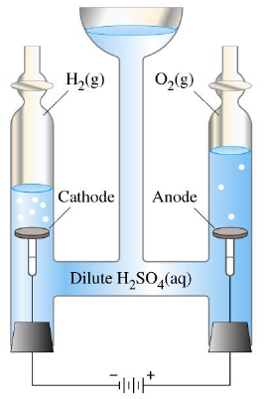
Preparation:
Methods for commercial production of dihydrogen
Electrolysis of water
2H₂O(l) 2H_{2(g)} + O_{2(g)}
The hydrogen prepared by this method is of very high purity. However, this method is not commonly used because it is very expensive.
This method is can be used only at those places where the electricity is cheap. Hydrogen as a fuel source
Light (low density)
Clean Burning
Plenty of abundant H in H₂O

Slide 17
By the reaction of steam on coke :-
C + H₂O_{(g)} CO + H₂
Water gas
Since the mixture of CO and H₂ is used for the synthesis of methanol and a number of hydrocarbons, it is also called synthesis gas or syngas.

Slide 18
Most commercial H_{2(g)} is obtained as a by product of petroleum refining
Example:
CH_{4(g)} + H₂O_{(g)} ^{NiCatalyst} CO_{(g)} + H_{2(g)}
Can’t Separate CO from H₂
CO_{(g)} + H₂O_{(g)} ^{Fe/Cu Catalyst} CO_{2(g)} + H_{2(g)}
Membranes that can separate CO₂ from H₂

Slide 19
Properties of Hydrogen:-
Physical Properties:-
It is slightly soluble in water (about 2 %)
It is highly combustible and therefore should be handled carefully.
It lightest substance. The weight of one liter hydrogen at NTP is only 0.0899 g.

Slide 20
Chemical properties:-
Not very reactive due to high bond dissociation energy (435.88 kJ mol⁻¹at 298.2 K)
Combustion: - It burns with pale blue flame 2H_{2(g)} + O_{2(g)} 2H₂O_{(l)}
Reaction with metals:-
Reactive metals like Na, K, Ca, Li and form hydrides.
Ca + H₂ CaH₂
Metals like Pt, Pd, Ni (elements of d block) form interstitial hydrides by absorbing large volume of hydrogen.
Such hydrogen is called ‘occluded hydrogen and this property adsorption of a gas by a metal is called occlusion.

Slide 21
3. Reaction with metal oxides:-
Hydrogen reduces oxides of less active metals to corresponding metal.

Slide 22
Hydrogen Compounds
Hydrogen can form both cations (H⁺) and anions (H⁻)
Hydrogen has an intermediate electronegativity
Forms covalent bonds with both nonmetals and metalloids

Slide 23
The large radius makes it highly polarizable in compounds since it is hard for the single proton to control the two electrons.
Anion
Cl⁻ (181 pm)
H⁻ (154 pm)
F⁻ (133 pm)
Na⁺ (102 pm)
The hydride ion is very large

Slide 24
Hydrocarbon:
Compounds that contain H and C
1/3 of the H produced is used for hydrometallurgical extractions of copper and other materials since H is a strong reducing agent.

Slide 25
Hydrogenation of oils:-
Vegetable oils are polyunsaturated in nature. The C=C bonds in oils can easily undergo oxidation and the oil becomes rancid i.e., unpleasant in taste. Hydrogenation reduces the number of double bonds but completely.
Uses of Hydrogen:-
As a reducing agent.
In the manufacture of Vanaspati fat, ammonia, metal hydrides, methanol, fertilizers such as urea etc.

Slide 26
3. In the manufacture of synthetic petrol.
4. In the atomic hydrogen torch and oxy hydrogen torches for cutting and welding. Dihydrogen is dissociated with the help of an electric arc and the hydrogen atoms produced are allowed to recombine on the surface to be welded. High temperature of about 4000 k is generated. 5. In the fuel cell for generating electrical energy.

Slide 27
Hydrides:-
Under certain conditions H₂ combines with almost all the elements ,except noble gases to form compounds called hydrides.
There are three types of hydrides ,they are
Ionic or saline hydrides
Covalent or molecular hydrides
Metallic or non-stoichiometric hydrides
Ionic or saline hydrides:-
These are the compounds of H₂ formed with most of the s-block elements which are highly electro positive.

Slide 28
Covalent or molecular hydrides:-
These are the compounds of hydrogen formed with most of the p-block elements
Electron deficient:-
The hydrides which do not have sufficient number of electrons to form normal covalent bonds is called electron deficient hydride.
For example, hydride of group 13 (BH₃,AlH₃, etc.).
They are known as Lewis acids i.e., electron acceptors. To make up their deficiency they generally exist in polymeric forms such as B₂H₆, Al₂H₆,etc.

Slide 29
Covalent Hydrides
The electrons in the bond are shared between M & H.
The electronegativity of the element ~2.1 and varies from ~2.5-1.5.
Bond polarity depends on electronegativity differences between M &H and varies from d⁺ (e.g. S-H) to d⁻ (e.g. B-H and Ga-H)
Electronegativity
H | 2.1
P | 2.2
S | 2.5

Slide 30
Hydrides
1 | 2 | 13 | 14 | 15 | 16 | 17
LiH | BeH₂ | (BH₃)_{2, ….} | CH₄ | NH₃ | H₂O | HF
NaH | MgH₂ | (AlH₃)_{n} | SnH₄ | PH₃ | H₂S | HCl
KH | CaH₂ | GaH₃ | GeH₄ | AsH₃ | H₂Se | HBr
RbH | SrH₂ | InH₃ | SnH₄ | SbH₃ | H₂Te | HI
Ionic Hydrides E⁺H⁻ | Ionic E^{d+}H^{d-} |  | Covalent E-H |  |  | Covalent H^{d+}E^{d-}
Red | Blue

Slide 31
Selected hydrides of p-block elements that contain M-H covalent Bonds*, **
13 | 14 | 15 | 16 | 17
B₂H₆ | C_{n}H_{2n+2} | NH₃ | H₂O | HF
 | C_{n}H_{2n}
 | C_{n}H_{2n-2}
(AlH₃)_{n} | Si_{n}H_{2n+2} (n ≤ 8) | PH₃ | H₂S | HCl
 |  | P₂H₄ | H₂S_{n}
 | Ge_{n}H_{2n+2} (n ≤ 9) | AsH₃ | H₂Se | HBr
 | SnH₄ | SbH₃ | H₂Te | HI
* Polarity varies depending on electronegativity differences of M-H bond. ** Group 13 hydrides are electron deficient-

Slide 32
Classification of covalent hydrides
Electron-precise hydrides – all electrons of the central atom are engaged in bonds. E.g. MH₄ where M is a group 14 metal (C, Sn, Si).
Electron-deficient hydrides – insufficient electrons to satisfy the octet rule—share electrons to reach the Noble Gas (NG) configuration. E.g. BH₃ and AlH₃
Electron-rich hydrides – more electron pairs on the central atom than are needed for bond formation. E.g. NH₃

Slide 33
Electron precise:-
The hydrides which have sufficient number of electrons required for forming covalent bonds is called electron precise hydride.
For example, hydrides of group 14 (CH₄, SiH₄, GeH₄, SnH₄, PbH₄ etc.) they have tetrahedral geometry.

Slide 34
Electron rich hydrides:-
The hydrides which have excess electrons as required to form normal covalent bonds is called electron rich hydride.
For example, hydrides of group 15 to 17
(NH₃, PH₃, H₂O, H₂S, H₂Se, H₂Te, HF etc.)
Metallic or non-stoichiometric hydrides:-
These are formed by many d-block and f-block elements
These hydrides conducts heat and electricity though not efficient.

Slide 35
Water
Water! It is the major part of all living organisms. water is also known as the river of life.
Human body has about 65% and some plants have as much as 95%water.
STRUCTUREOF WATER
In a gas phase water is bent molecule with a bond angle of 104.5 and O-H bond length of 95.7 pm. It is highly polar molecule.
Structure of ice
Ice has a highly ordered 3D hydrogen bonded structure. Each oxygen atom is surrounded tetrahedrally by four other oxygen atoms at a distance of 276 pm.

Slide 36
Chemical Properties of water
It has the ability to act as an acid as well as base
It acts as an acid with NH₃ and as a base with H₂S
H₂O_{(l)} + NH_{3(aq)} OH⁻_{(aq)} + NH⁴⁺_{(aq)}
H₂O_{(l)} + H₂S_{(aq)} H₃O⁺_{(aq)} + HS⁻_{(aq)}
REDOX REACTIONS INVOLVING WATER
Water can be easily reduced to H₂ by highly electropositive metals
2Na + 2H₂O ⎯⎯→ 2HaOH +H₂ +energy
Ca + 2H₂O ⎯⎯→ Ca(OH₂) + H₂
2H₂O_{(l)} + 2Na_{(s)} 2NaOH_{(aq)} + H_{2(g)}

Slide 37
HYDROLYSIS REACTION
Due to high dielectric constant, it has a very strong hydrating tendency It dissolves many ionic compounds
P₄O_{10(s)} + 6H₂O_{(l)} 4H₃PO_{4(aq)}
SiCl_{4(l)} + 2H₂O_{(l)} SiO_{2(s)} + 4HCl_{(aq)}
2F₂ + 2H₂O ⎯⎯→ 4HF + O₂
2Cl₂ + 2H₂O ⎯⎯→ 2HCl + 2HOCl
2HOCl ⎯⎯→ 2HCl + O₂

Slide 38
C + 2H₂O ⎯⎯→ CO + H2
Si + 2H₂O ⎯⎯→ SiO₂ + 2H₂
Na₂O + H₂O ⎯⎯→ 2NaOH
CaO + H₂O ⎯⎯→ Ca(OH)₂
CO₂ + H₂O H₂CO₂
SO₃ + H₂O ⎯⎯→ H₂SO₄
Hydrolysis .
PCl₃ + 3H₂O ⎯⎯→ P (OH)₃ + 3HCl
P (OH)₃ ⎯⎯→ H₃PO₃ Phosphorous acid
SOCl₂ + 2H₂O ⎯⎯→ SO (OH)₂+ 2HCl
SO (OH)₂ ⎯⎯→ H₂SO₃ Sulphorous acid
SbCl₃ + H₂O ⎯⎯→ SbOCl + 2HCl
2SbOCl + H₂O ⎯⎯→ Sb₂O₃ + 2HCl
AlCl₃ + 3H₂O ⎯⎯→ Al(OH)₃ + 3HCl

Slide 39
Hydrogen Compounds
Hydrogen Bonding
Small elements
Between H and highly electronegative atoms (ex: N, O, and F)
5% as strong as covalent bonds (between the same atoms)
Coulombic interactions between the partially positive charge on a hydrogen atom and the partially negative charge of another atom form the H bond
O^{δ-}---^{δ+}H-O

Slide 40
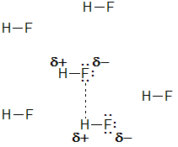
Hydrogen and Bonding: H-Bonding
Often, hydrogen bonding will markedly affect the physical properties (e.g. boiling point) and even the reactivity (the interactions of many drugs with the body depend on hydrogen bonding) of molecules
Hydrogen bonds are formed between an H atom attached to an electronegative atom and an electronegative atom that possesses a lone pair of electrons
Intermolecular hydrogen bonds are those that exist between two molecules
Intra molecular hydrogen bonds exist among atoms of the same molecule.
an intermolecular
H-bond (longer than
typical H-F bond)

Slide 41
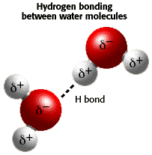
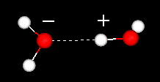
Hydrogen Bonds
*is a bond formed between polar molecules in which hydrogen atoms lies between to atoms of high electron gativity as ( oxygen ) or ( fluorine ) , so the hydrogen atom binds with one atom by polar covalent bond and binds with the second atom by hydrogen bond .
**So hydrogen atom acts as a bridge to bind molecules together .
Explanation of hydrogen bond in water :
( 1 ) oxygen atoms has small volume , so it has high electronegativity ( 3.5 ) , while
electronegativity of hydrogen is 2.1 . so oxygen atom will carry a charge ,
while hydrogen atom will carry a ( ) charge .
( 2 ) hydrogen bond is formed due to the attraction force between one hydrogen atom of one molecule and one molecule and one oxygen atom of another molecule , so molecule of water are collected by hydrogen bonds , so water exists in a liquid state and has high boiling point .
Chemistry of Water
The polarity of water

Slide 42
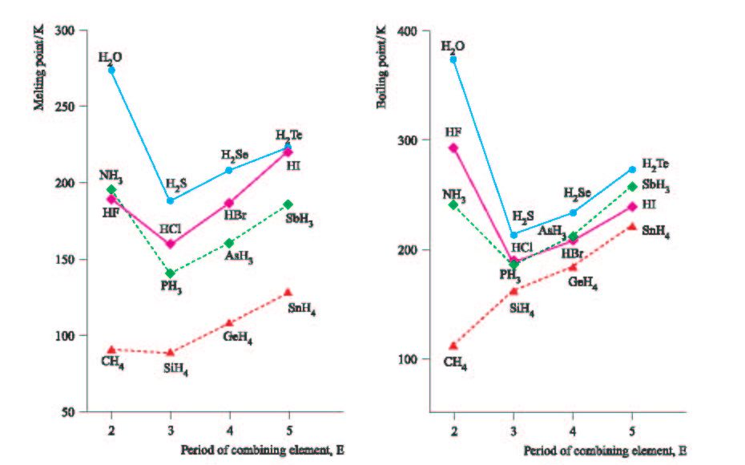
H-Bonding
It is evident that as molecular weight increases, boiling points and melting points increase as a result of increased intermolecular forces (dispersion)
Except for first case in each series, dispersion forces determine boiling point
For first hydride of each series, H-bonding is the main factor which determines b.p., m.p.
What would be the expected boiling point of water
in the absence of H-bonding?

