Slide 1
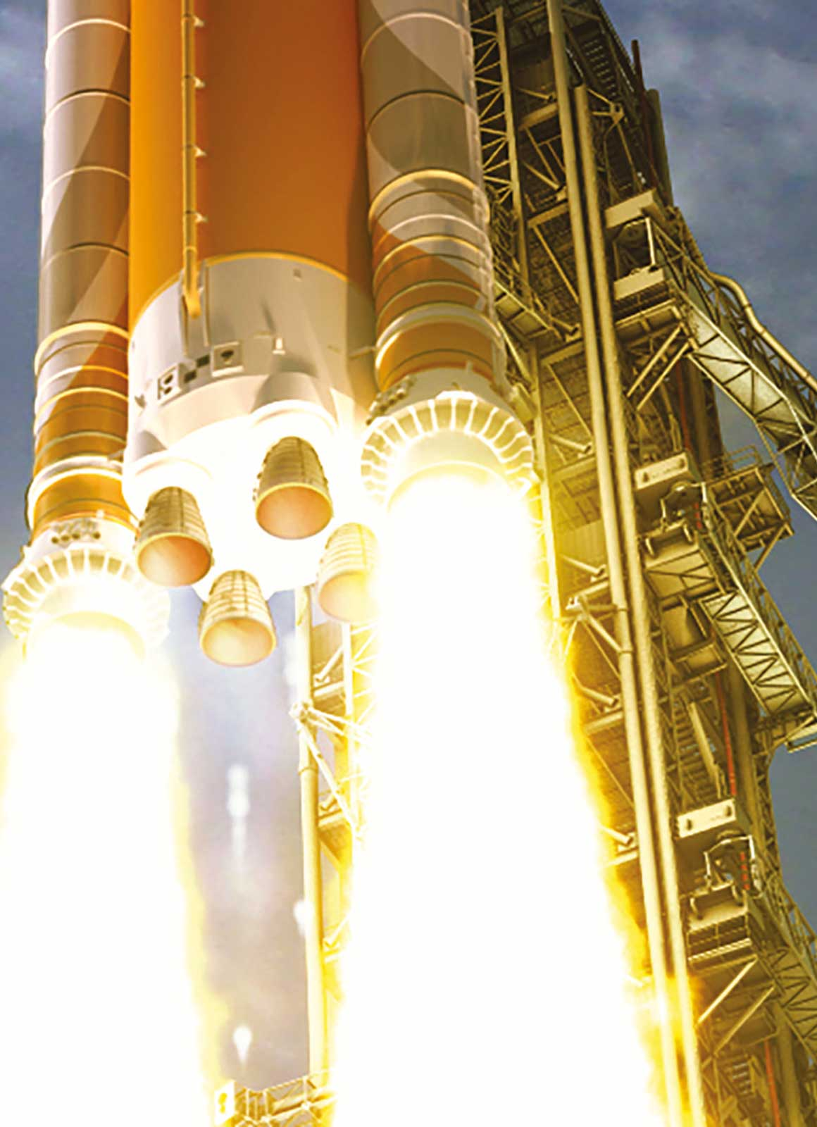
Chapter 3
Mass Relationships in Chemical Reactions
NASA
Copyright 2022 © McGraw Hill LLC. All rights reserved. No reproduction or distribution without the prior written consent of McGraw Hill LLC.

Slide 2
Atomic mass
Micro World
atoms & molecules
Macro World
grams
Atomic mass is the mass of an atom in atomic mass units (amu)
amu definition: the mass exactly equal to 1/12 the mass of one ¹²C atom
¹²C = 6p, 6n = 12.00 amu me⁻ = 0
Experiment shows one atom ¹H = 8.400% of ¹²C atom thus; mass of one atom¹H = 1.008 amu
(12.00 x .08400)
¹⁶O = 16.00 amu, ²⁶Fe = 55.85 amu

Slide 3
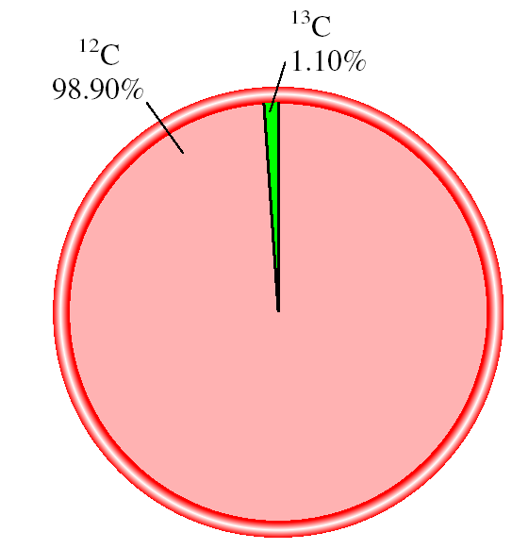
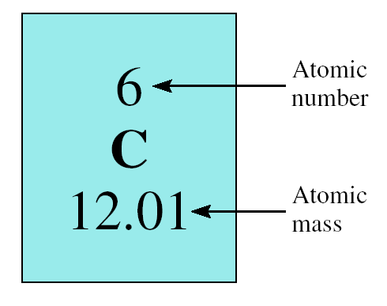
The average atomic mass is the weighted average of all the naturally occurring isotopes of the element.
¹³C = 13.00335 amu
average atomic mass of C =
(0.9890 x 12.00000 amu) + (0.0110 x 13.00335) = 12.01 amu

Slide 4
Naturally occurring lithium is:
7.42% ⁶Li (6.015 amu)
92.58% ⁷Li (7.016 amu)
Average atomic mass of lithium:
(7.42 x 6.015) + (92.58 x 7.016)
= 6.941 amu
100

Slide 5
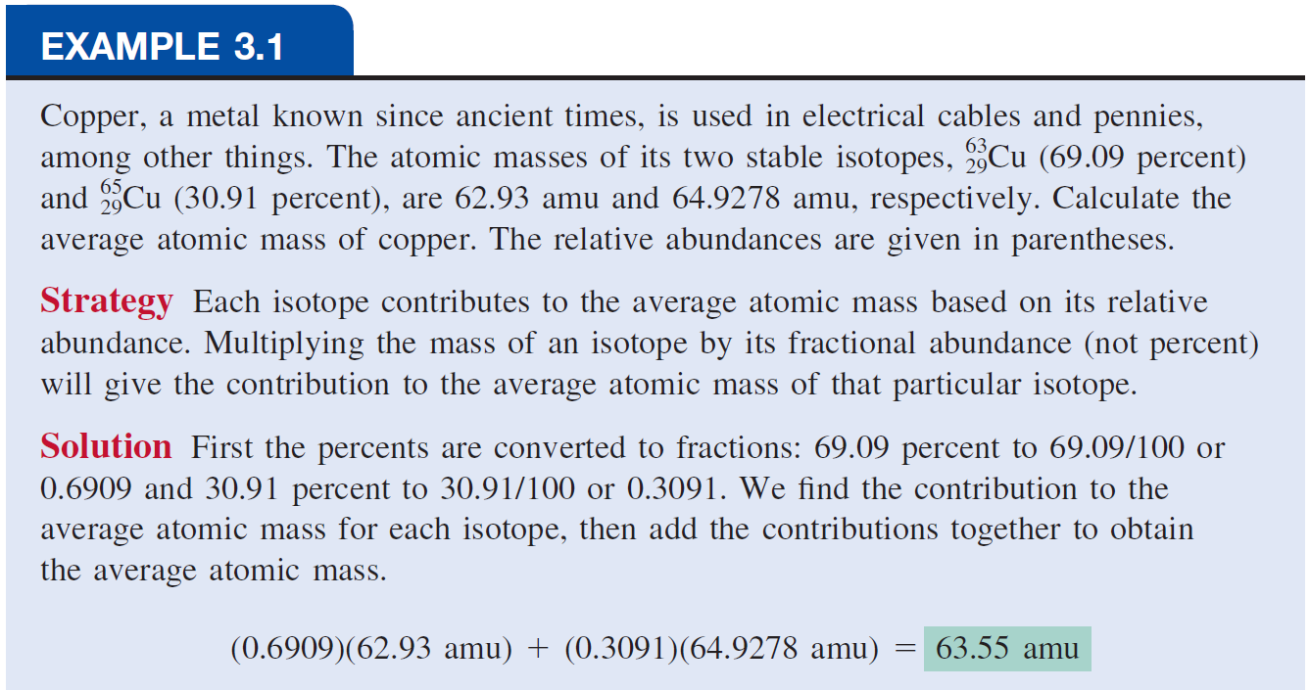

Slide 6
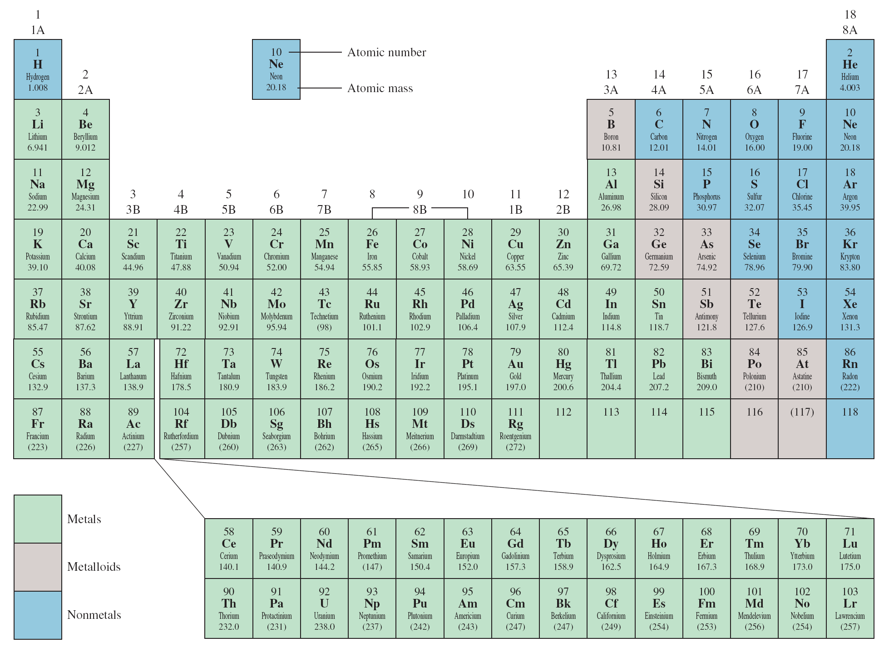
Average atomic mass (6.941)

Slide 7
The Mole
The Mole (mol): A unit to count numbers of particles
Dozen = 12
Pair = 2
The mole (mol) is the amount of a substance that contains as many elementary entities as there are atoms in exactly 12.00 grams of ¹²C
1 mol = N_{A} = 6.0221367 x 10²³
Avogadro’s number (N_{A})

Slide 8
eggs
shoes
Molar mass is the mass of 1 mole of in grams
marbles
atoms
1 mole ¹²C atoms = 6.022 x 10²³ atoms = 12.00 g
1 ¹²C atom = 12.00 amu
1 mole ¹²C atoms = 12.00 g ¹²C
1 mole lithium atoms = 6.941 g of Li
For any element
atomic mass (amu) = molar mass (grams)

Slide 9
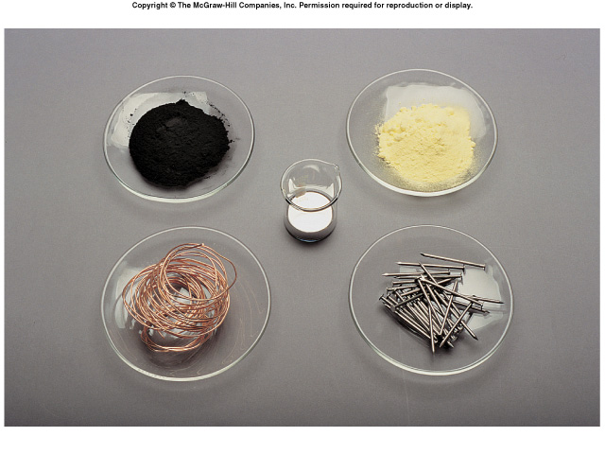
One Mole of:
C
S
Hg
Cu
Fe

Slide 10
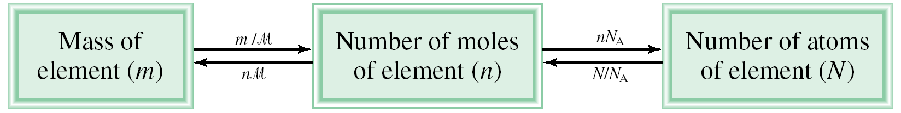
Conversion Between Mass and Atoms
1 ¹²C atom
12.00 g
1.66 x 10⁻²⁴ g
x
=
12.00 amu
6.022 x 10²³ ¹²C atoms
1 amu
1 amu = 1.66 x 10⁻²⁴ g or 1 g = 6.022 x 10²³ amu
M = molar mass in (g/mol)
N_{A} = Avogadro’s number

Slide 11
How many atoms are in 0.551 g of potassium (K) ?
1 mol K = 39.10 g K
1 mol K = 6.022 x 10²³ atoms K
1 mol K
6.022 x 10²³ atoms K
0.551 g K
x
x
=
39.10 g K
1 mol K
8.49 x 10²¹ atoms K

Slide 12
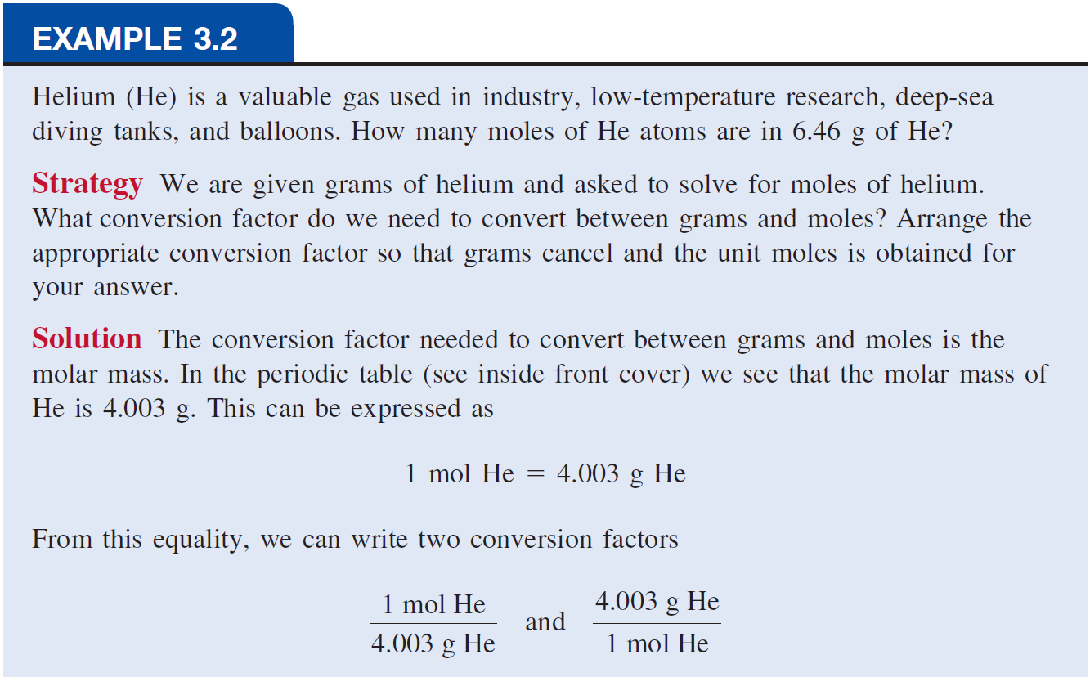
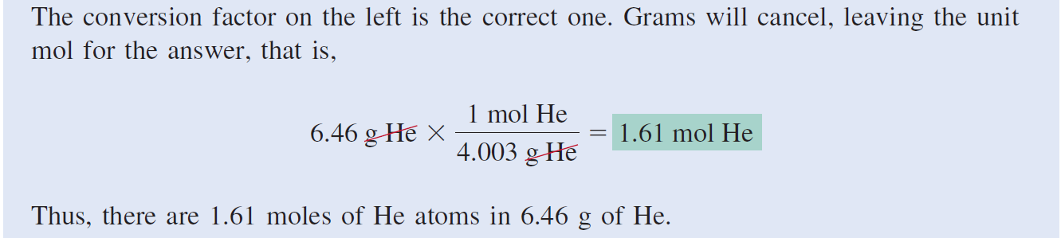

Slide 13
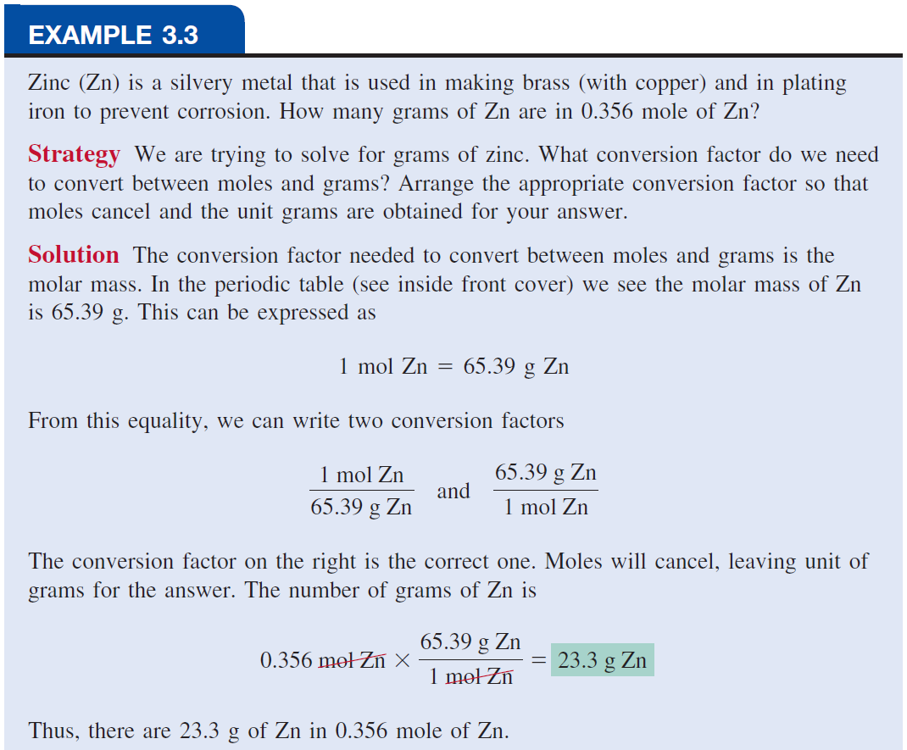

Slide 14
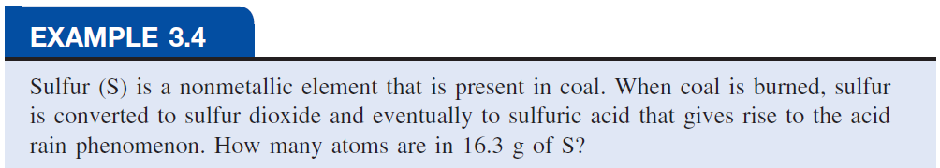
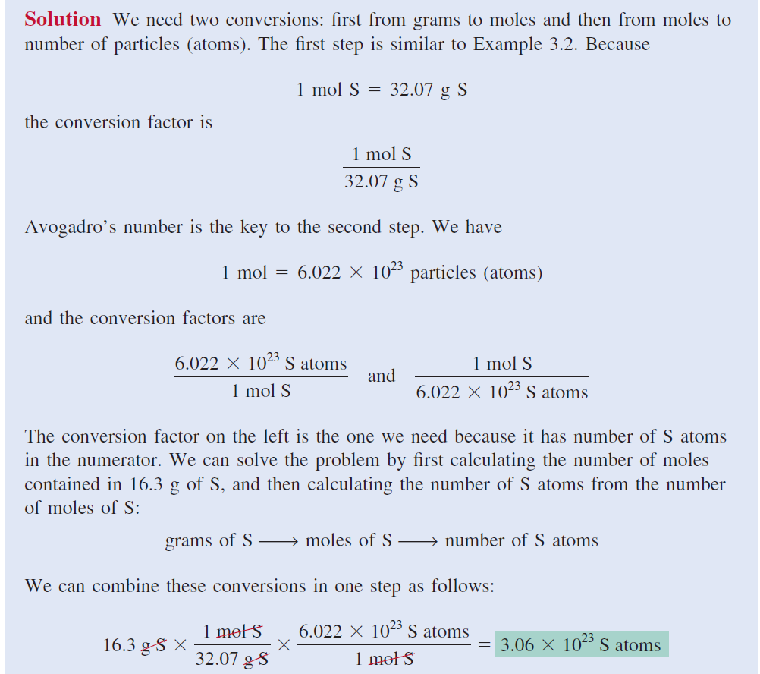

Slide 15
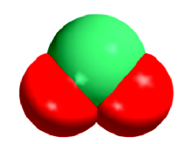
Molecular Mass
Molecular mass (or molecular weight) is the sum of
the atomic masses (in amu) in a molecule.
1S
32.07 amu
2O
+ (2 x 16.00 amu)
SO₂
SO₂
64.07 amu
For any molecule
molecular mass (amu) = molar mass (grams)
1 molecule SO₂ = 64.07 amu
1 mole SO₂ = 64.07 g SO₂

Slide 16
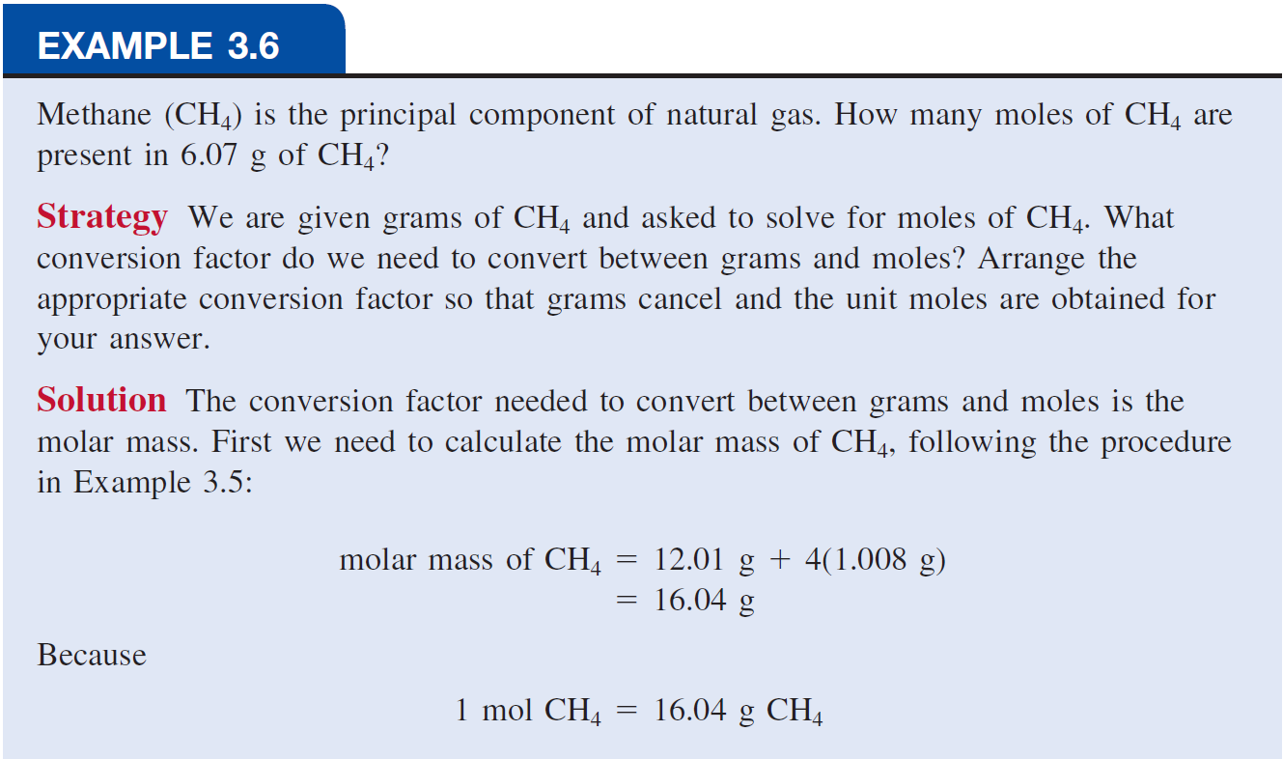
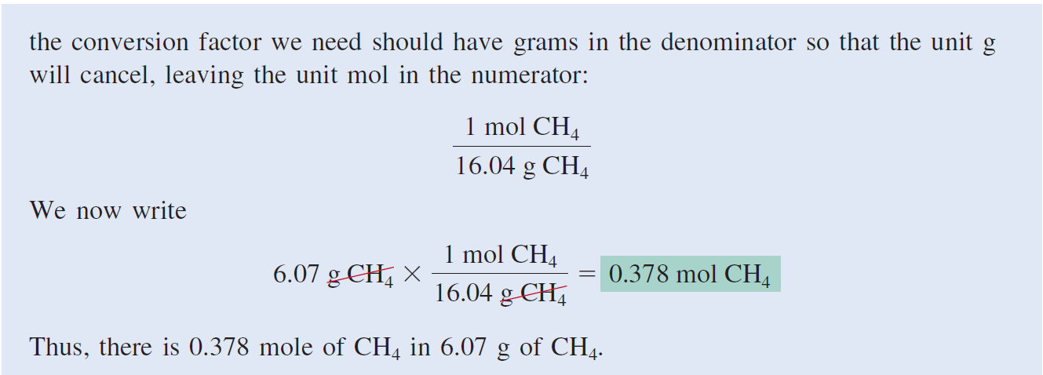

Slide 17
How many H atoms are in 72.5 g of C₃H₈O?
1 mol C₃H₈O = (3 x 12) + (8 x 1) + 16 = 60 g C₃H₈O
1 mol C₃H₈O molecules = 8 mol H atoms
1 mol H = 6.022 x 10²³ atoms H
1 mol C₃H₈O
8 mol H atoms
6.022 x 10²³ H atoms
72.5 g C₃H₈O
x
x
x
=
60 g C₃H₈O
1 mol C₃H₈O
1 mol H atoms
5.82 x 10²⁴ atoms H

Slide 18
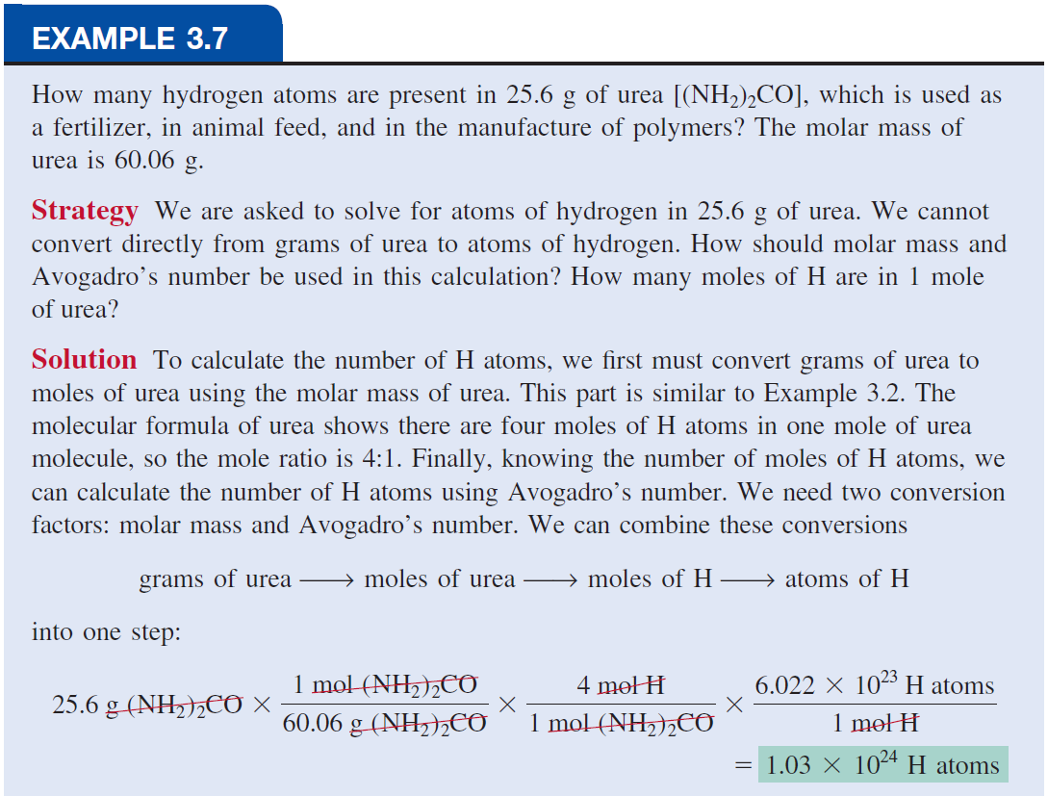

Slide 19
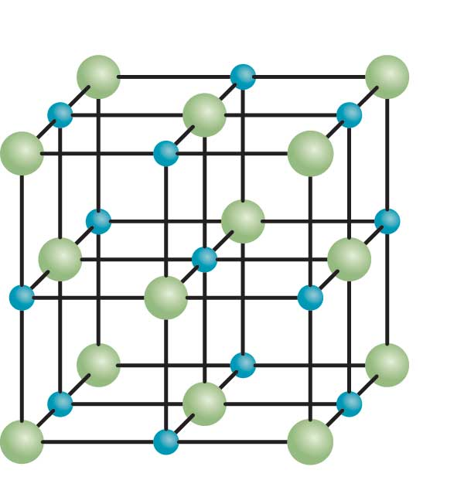
Formula Mass
Formula mass is the sum of the atomic masses (in amu) in a formula unit of an ionic compound.
For any ionic compound
formula mass (amu) = molar mass (grams)
1 formula unit NaCl = 58.44 amu
1 mole NaCl = 58.44 g NaCl

Slide 20
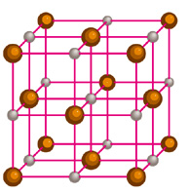
Formula mass is the sum of the atomic masses
(in amu) in a formula unit of an ionic compound.
1Na
22.99 amu
NaCl
1Cl
+ 35.45 amu
NaCl
58.44 amu
For any ionic compound
formula mass (amu) = molar mass (grams)
1 formula unit NaCl = 58.44 amu
1 mole NaCl = 58.44 g NaCl

Slide 21
What is the formula mass of Ca₃(PO₄)₂?
1 formula unit of Ca₃(PO₄)₂
3 Ca
3 x 40.08
2 P
2 x 30.97
8 O
+ 8 x 16.00
310.18 amu

Slide 22
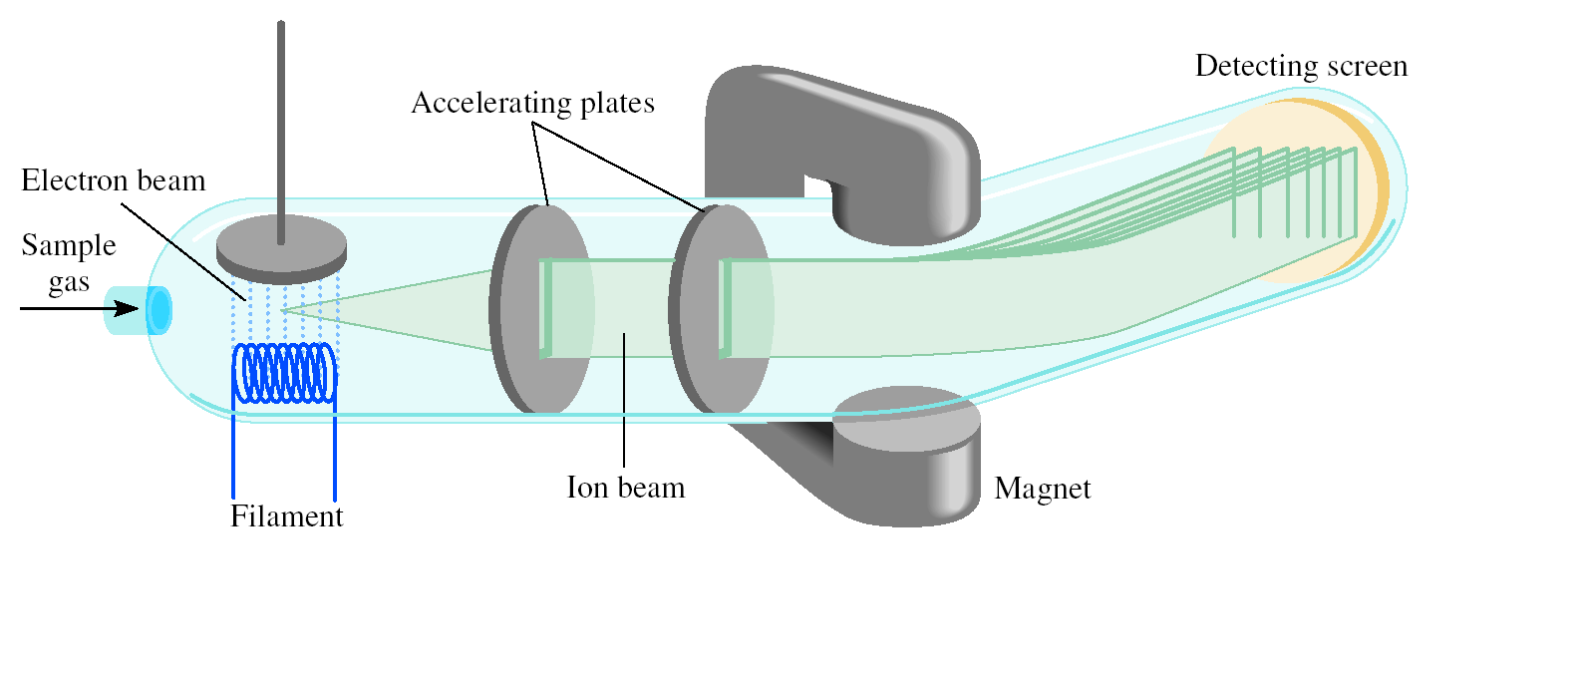
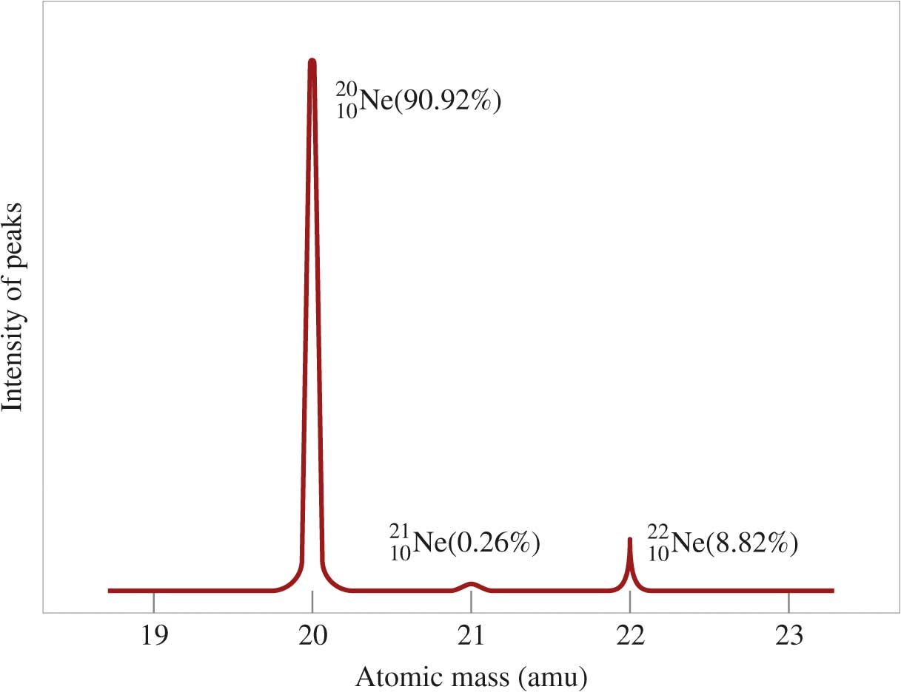
Mass Spectrometer
Light
Heavy
Mass Spectrum of Ne

Slide 23
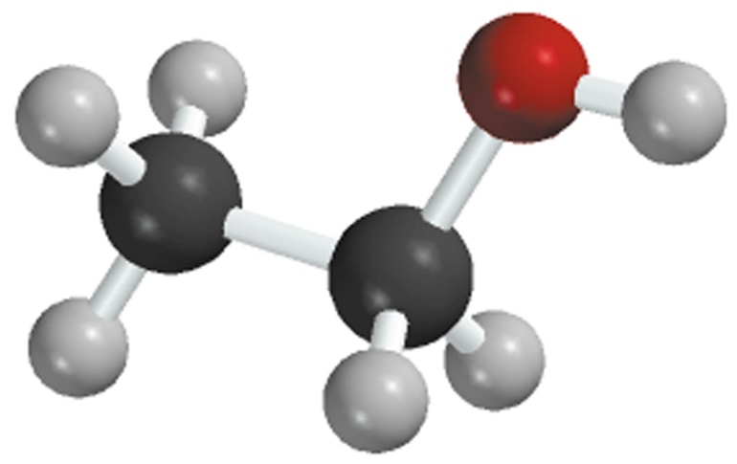
Percent composition of an element in a compound =
n x molar mass of element
x 100%
molar mass of compound
n is the number of moles of the element in 1 mole of the compound
2 x (12.01 g)
%C =
x 100% = 52.14%
46.07 g
6 x (1.008 g)
%H =
x 100% = 13.13%
46.07 g
1 x (16.00 g)
%O =
x 100% = 34.73%
46.07 g
C₂H₆O
52.14% + 13.13% + 34.73% = 100.0%

Slide 24
Examples
What is the mass of H ,Cl in 10 g HCl?
What is % composition of the elements C in CH₃COOH?
What is % composition of the elements in 25.00 g H₂SO₄
if m_{H} = 0.5142 g and m_{O} = 16.3239 g and m_{S}= 8.1619 g ?

Slide 25
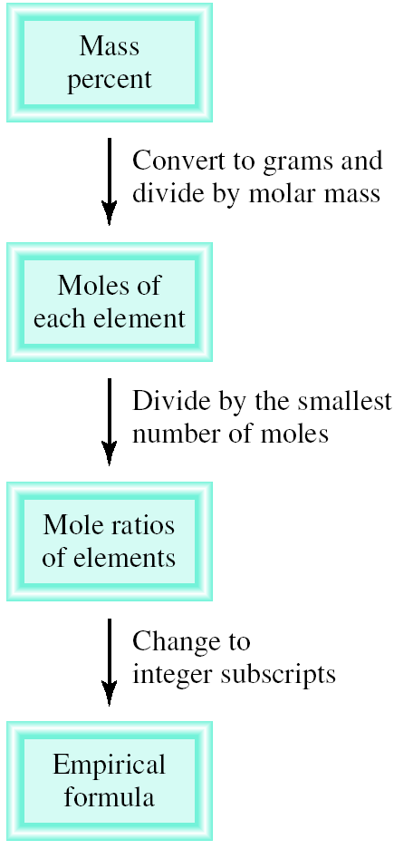
Percent Composition and Empirical Formulas
Determine the empirical formula of a compound that has the following percent composition by mass:
K 24.75, Mn 34.77, O 40.51 percent.
1 mol K
n_{K} = 24.75 g K x
= 0.6330 mol K
39.10 g K
1 mol Mn
n_{Mn} = 34.77 g Mn x
= 0.6329 mol Mn
54.94 g Mn
1 mol O
n_{O} = 40.51 g O x
= 2.532 mol O
16.00 g O

Slide 26
Percent Composition and Empirical Formulas
n_{K} = 0.6330, n_{Mn} = 0.6329, n_{O} = 2.532
0.6330
K :
~
1.0
~
0.6329
0.6329
Mn :
= 1.0
0.6329
2.532
O :
~
4.0
~
0.6329
KMnO₄

Slide 27
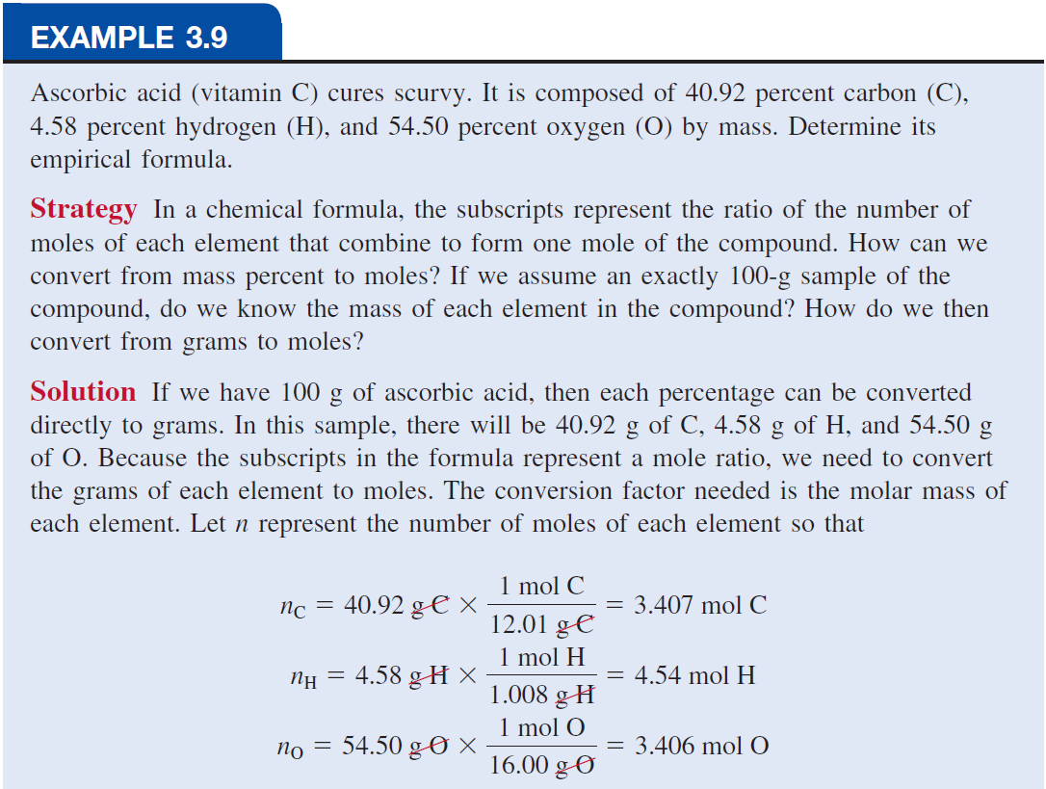
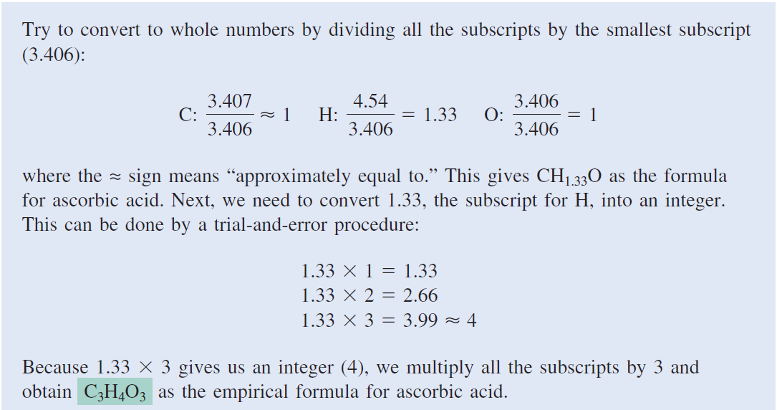

Slide 28
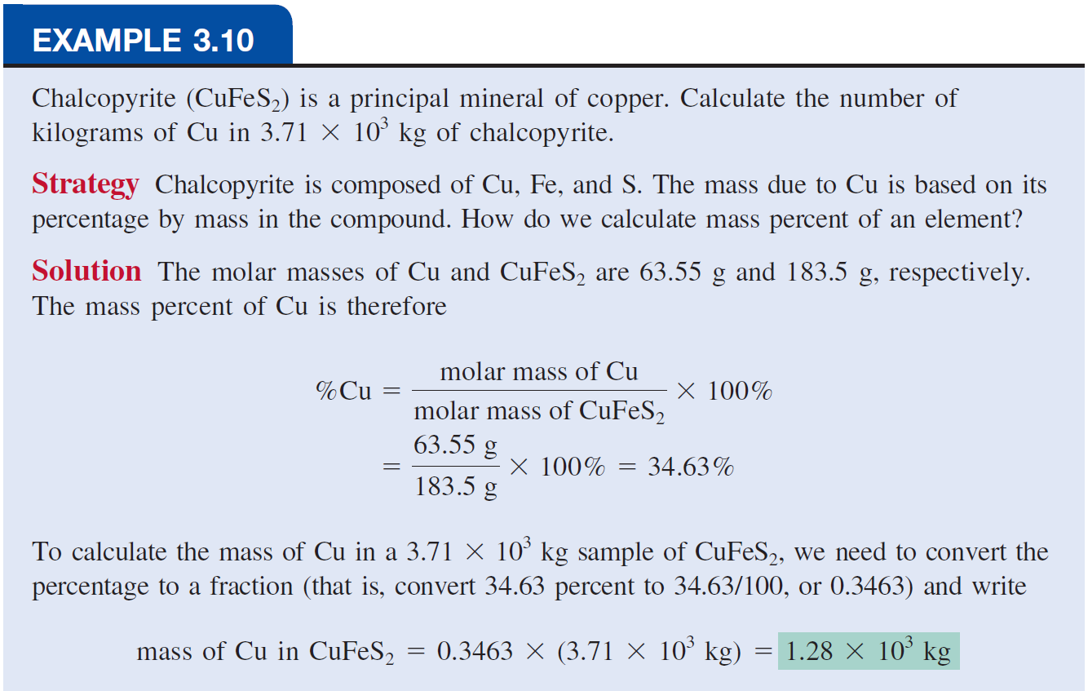

Slide 29
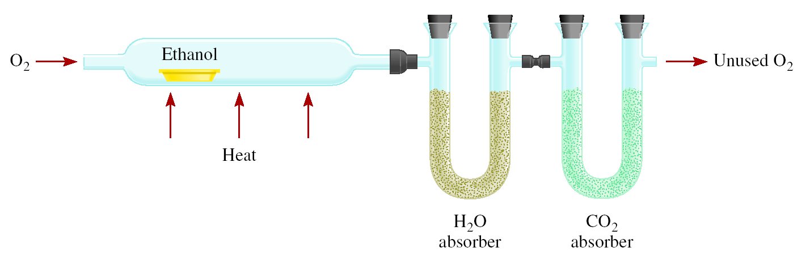
Combust 11.5 g ethanol
Collect 22.0 g CO₂ and 13.5 g H₂O
g CO₂
mol CO₂
mol C
g C
6.0 g C = 0.5 mol C
g H₂O
mol H₂O
mol H
g H
1.5 g H = 1.5 mol H
g of O = g of sample – (g of C + g of H)
4.0 g O = 0.25 mol O
Empirical formula C_{0.5}H_{1.5}O_{0.25}
Divide by smallest subscript (0.25)
Empirical formula C₂H₆O

Slide 30
Molecular Formulas
Molecular weight of the compound should be known
M _{actual}
Multiply the empirical formula by the integer x
X =
M _{empirical}
A compound has empirical formula C₆H₁₀S₂O but its molecular weight is 324 g/mol !
C₁₂H₂₀S₄O₂
Calculate the number of grams of Al in 371 g of Al₂O₃?
196.5 g

Slide 31
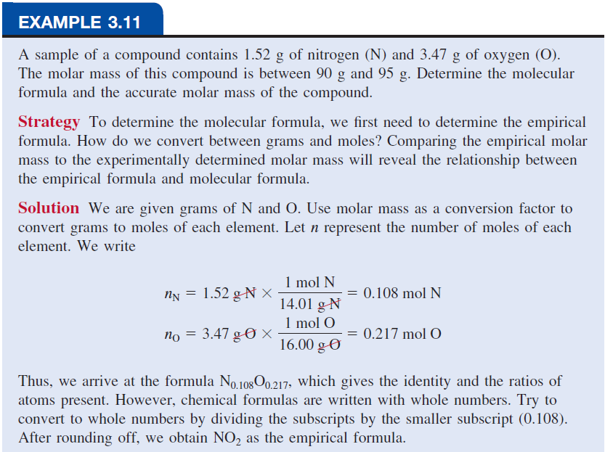
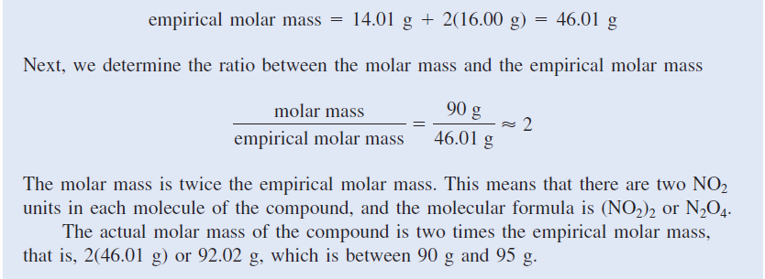

Slide 32
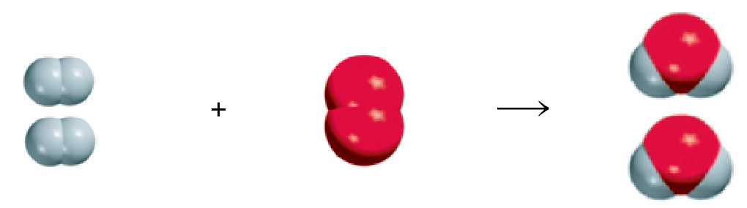
Chemical Reaction
A process in which one or more substances is changed into one or more new substances is a chemical reaction
A chemical equation uses chemical symbols to show what happens during a chemical reaction
reactants
products
3 ways of representing the reaction of H₂ with O₂ to form H₂O

Slide 33
How to “Read” Chemical Equations
2 Mg + O₂ 2 MgO
2 atoms Mg + 1 molecule O₂ makes 2 formula units MgO
2 moles Mg + 1 mole O₂ makes 2 moles MgO
48.6 grams Mg + 32.0 grams O₂ makes 80.6 g MgO
NOT
2 grams Mg + 1 gram O₂ makes 2 g MgO

Slide 34
Balancing Chemical Equations
Write the correct formula(s) for the reactants on the left side and the correct formula(s) for the product(s) on the right side of the equation.
Ethane reacts with oxygen to form carbon dioxide and water
C₂H₆ + O₂
CO₂ + H₂O
Change the numbers in front of the formulas (coefficients) to make the number of atoms of each element the same on both sides of the equation. Do not change the subscripts.
2C₂H₆
NOT
C₄H₁₂

Slide 35
Balancing Chemical Equations
Start by balancing those elements that appear in only one reactant and one product.
C₂H₆ + O₂
CO₂ + H₂O
start with C or H but not O
2 carbon
on left
1 carbon
on right
C₂H₆ + O₂
2CO₂ + H₂O
multiply CO₂ by 2
6 hydrogen
on left
2 hydrogen
on right
C₂H₆ + O₂
2CO₂ + 3H₂O
multiply H₂O by 3

Slide 36
Balancing Chemical Equations
Balance those elements that appear in two or more reactants or products.
7
C₂H₆ + O₂
2CO₂ + 3H₂O
multiply O₂ by
2
2 oxygen
on left
4 oxygen
(2x2)
+ 3 oxygen
(3x1)
= 7 oxygen
on right
7
remove fraction
multiply both sides by 2
C₂H₆ + O₂
2CO₂ + 3H₂O
2
2C₂H₆ + 7O₂
4CO₂ + 6H₂O

Slide 37
Balancing Chemical Equations
Check to make sure that you have the same number of each type of atom on both sides of the equation.
2C₂H₆ + 7O₂
4CO₂ + 6H₂O
Reactants
Products
4 C (2 x 2)
4 C
12 H (2 x 6)
12 H (6 x 2)
14 O (7 x 2)
14 O (4 x 2 + 6)

Slide 38
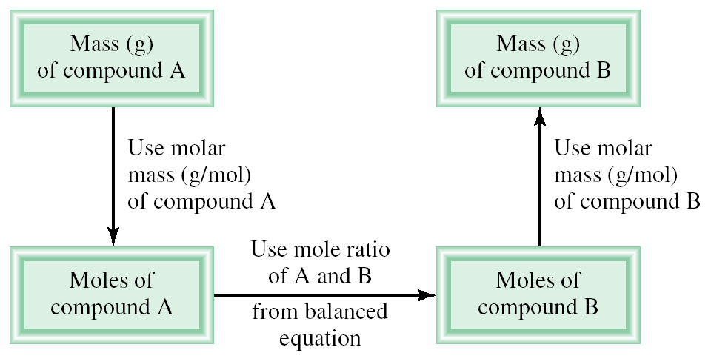
Amounts of Reactants and Products
Write balanced chemical equation
Convert quantities of known substances into moles
Use coefficients in balanced equation to calculate the number of moles of the sought quantity
Convert moles of sought quantity into desired units

Slide 39
Methanol burns in air according to the equation
2CH₃OH + 3O₂ 2CO₂ + 4H₂O
If 209 g of methanol are used up in the combustion, what mass of water is produced?
grams CH₃OH
moles CH₃OH
moles H₂O
grams H₂O
molar mass
CH₃OH
coefficients
chemical equation
molar mass
H₂O
1 mol CH₃OH
4 mol H₂O
18.0 g H₂O
209 g CH₃OH
x
x
x
=
32.0 g CH₃OH
2 mol CH₃OH
1 mol H₂O
235 g H₂O

Slide 40
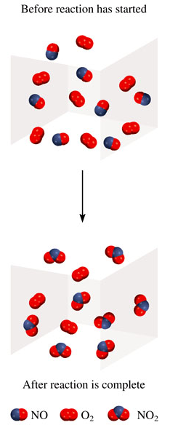
Limiting Reagent
Reactant used up first in the reaction
2NO + O₂ 2NO₂
NO is the limiting reagent
O₂ is the excess reagent

Slide 41
In one process, 124 g of Al are reacted with 601 g of Fe₂O₃
2Al + Fe₂O₃ Al₂O₃ + 2Fe
Calculate the mass of Al₂O₃ formed.
g Al
mol Al
mol Fe₂O₃ needed
g Fe₂O₃ needed
OR
g Fe₂O₃
mol Fe₂O₃
mol Al needed
g Al needed
1 mol Al
1 mol Fe₂O₃
160. g Fe₂O₃
124 g Al
x
x
x
=
367 g Fe₂O₃
27.0 g Al
2 mol Al
1 mol Fe₂O₃
Start with 124 g Al
need 367 g Fe₂O₃
Have more Fe₂O₃ (601 g) so Al is the limiting reagent

Slide 42
Use limiting reagent (Al) to calculate amount of product that
can be formed.
g Al
mol Al
mol Al₂O₃
g Al₂O₃
2Al + Fe₂O₃ Al₂O₃ + 2Fe
1 mol Al
1 mol Al₂O₃
102.0 g Al₂O₃
124 g Al
x
x
x
=
234.4 g Al₂O₃
26.98 g Al
2 mol Al
1 mol Al₂O₃
At this point, all the Al is consumed and Fe₂O₃ remains in excess.

Slide 43
Another method
2Al + Fe₂O₃ Al₂O₃ + 2Fe
124 g
4.596 mol
601 g
3.7633 mol
4.599 mol Al
3.763 mol Al
2 mol Al
1 mol Al
2.300
3.763
Al is the least thus it is the limiting reagent

Slide 44
Use limiting reagent (Al) to calculate amount of product that
can be formed.
g Al
mol Al
mol Al₂O₃
g Al₂O₃
2Al + Fe₂O₃ Al₂O₃ + 2Fe
1 mol Al
1 mol Al₂O₃
102.0 g Al₂O₃
124 g Al
x
x
x
=
234.4 g Al₂O₃
26.98 g Al
2 mol Al
1 mol Al₂O₃
At this point, all the Al is consumed and Fe₂O₃ remains in excess.

Slide 45
Reaction Yield
Theoretical Yield is the amount of product that would
result if all the limiting reagent reacted.
Actual Yield is the amount of product actually obtained
from a reaction.
Actual Yield
% Yield =
x 100%
Theoretical Yield

Slide 46
Calculate % yield if 803 g of CaO is produced?
5Ca + V₂O₅ 5 CaO + 2V
1.96 x 10³ g
1.54 x 10³ g
? g
48.90 mol
8.467 mol
42.34 mol
48.90 mol Ca
8.467 mol V₂O₅
5 mol Ca
1 mol V₂O₅
2374.2 g CaO
9.78
8.467
803 g
% Yield =
x 100 = 33.8%
2374.2 g

Slide 47
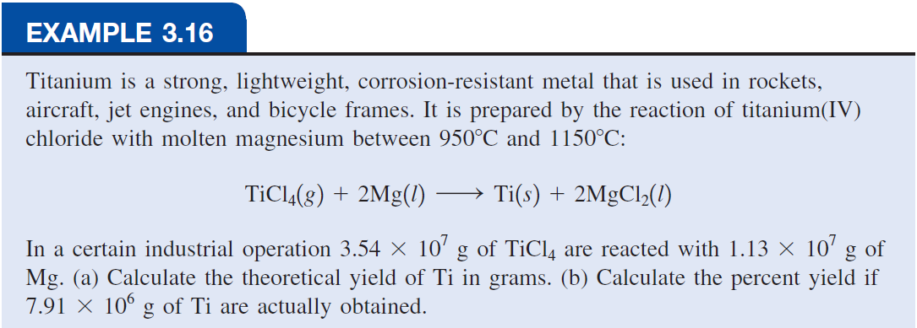
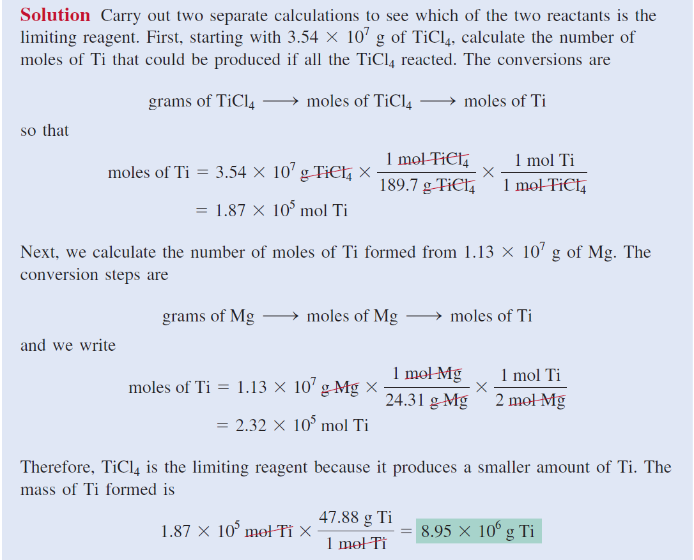
(Continued)

Slide 48
