Slide 1
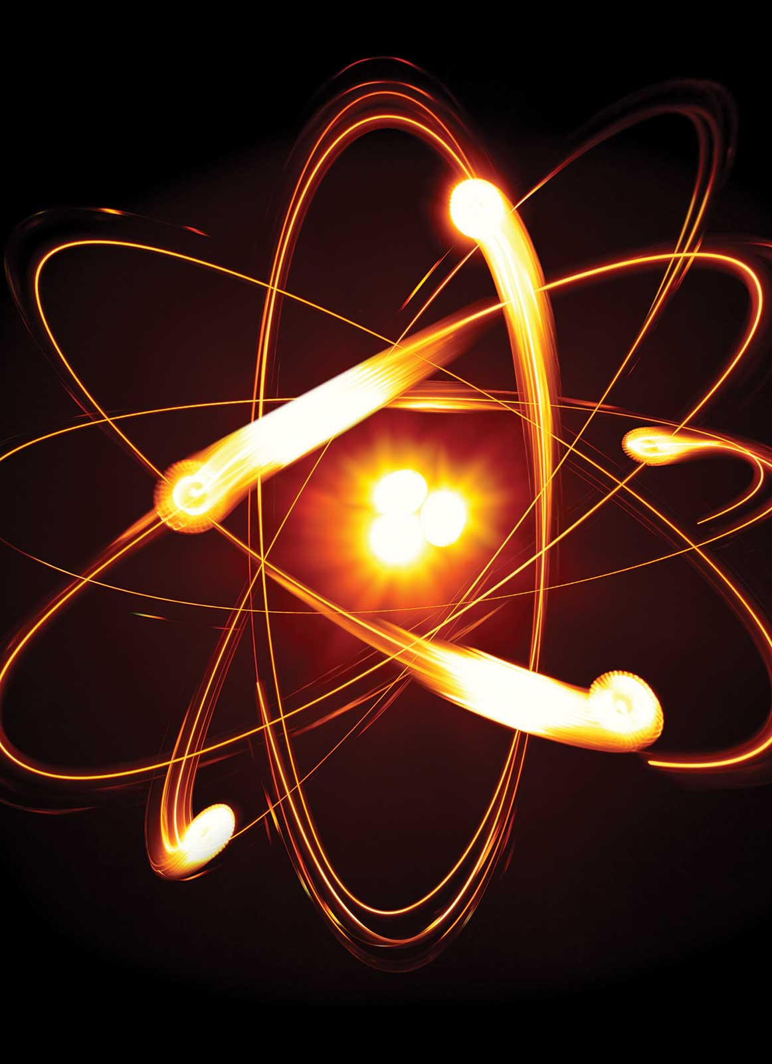
Chapter 2
Atoms, Molecules, and Ions
zoom-zoom/Getty Images
Copyright 2022 © McGraw Hill LLC. All rights reserved. No reproduction or distribution without the prior written consent of McGraw Hill LLC.

Slide 2
Dalton’s Atomic Theory (1808)
Elements are composed of extremely small particles called atoms.
All atoms of a given element are identical, having the same size, mass and chemical properties. The atoms of one element are different from the atoms of all other elements.
Compounds are composed of atoms of more than one element. In any compound, the ratio of the numbers of atoms of any two of the elements present is either an integer or a simple fraction.
A chemical reaction involves only the separation, combination, or rearrangement of atoms; it does not result in their creation or destruction.

Slide 3
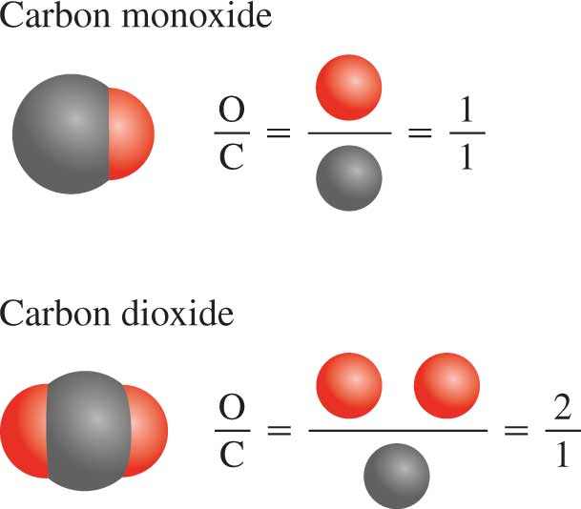
Dalton’s Atomic Theory
Law of Multiple Proportions
Access the text alternative for slide images.

Slide 4
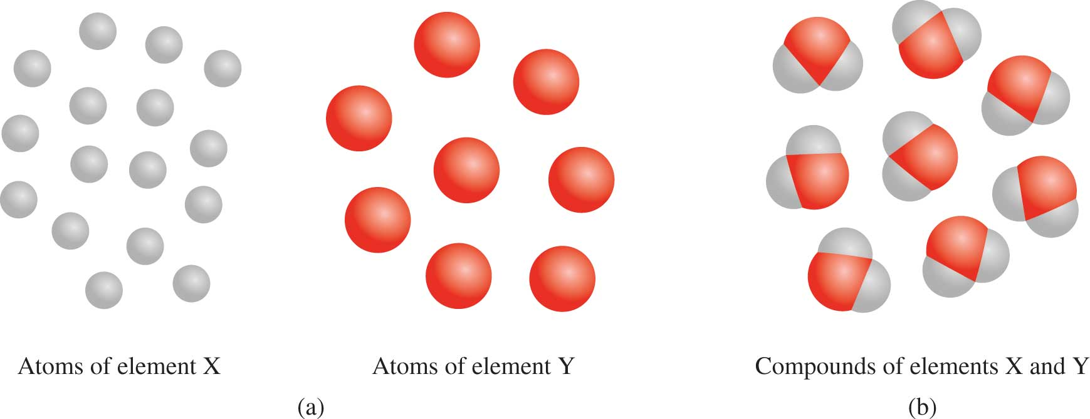
Law of Conservation of Mass
Access the text alternative for slide images.

Slide 5
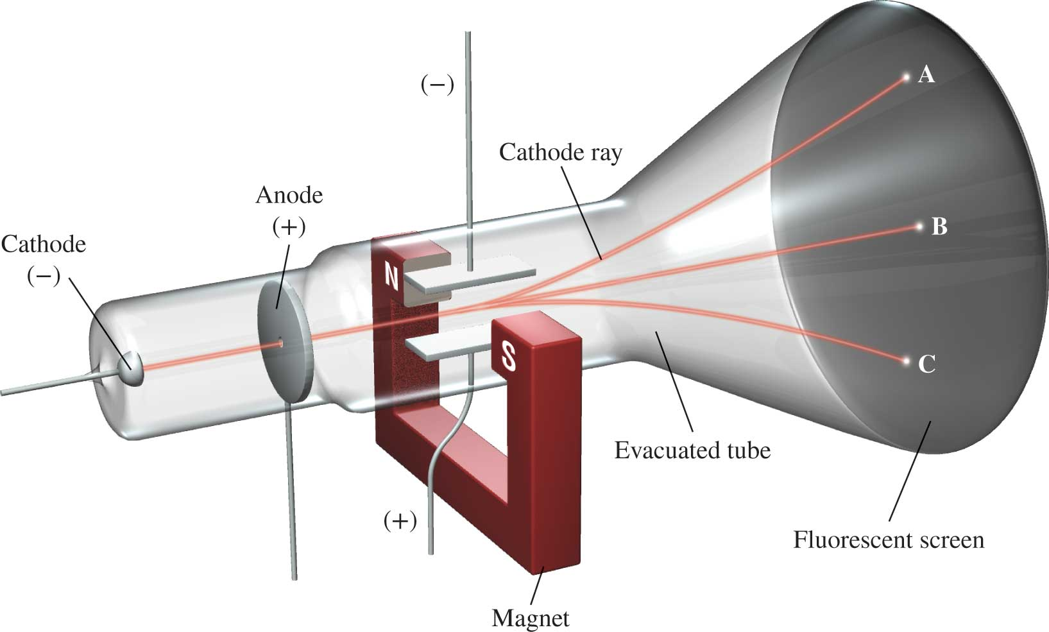
Cathode Ray Tube 1
J.J. Thomson, measured mass/charge of
(1906 Nobel Prize in Physics)
Access the text alternative for slide images.

Slide 6
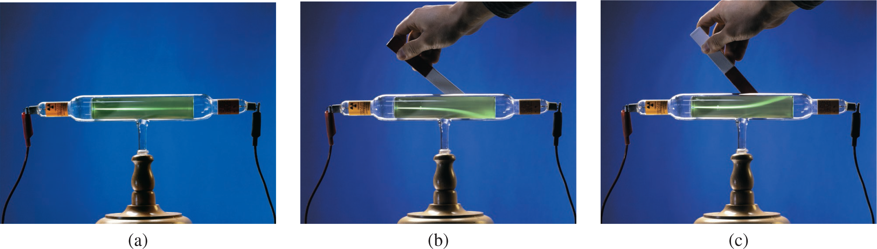
Cathode Ray Tube 2
Access the text alternative for slide images.
Charles D. Winters/McGraw-Hill

Slide 7
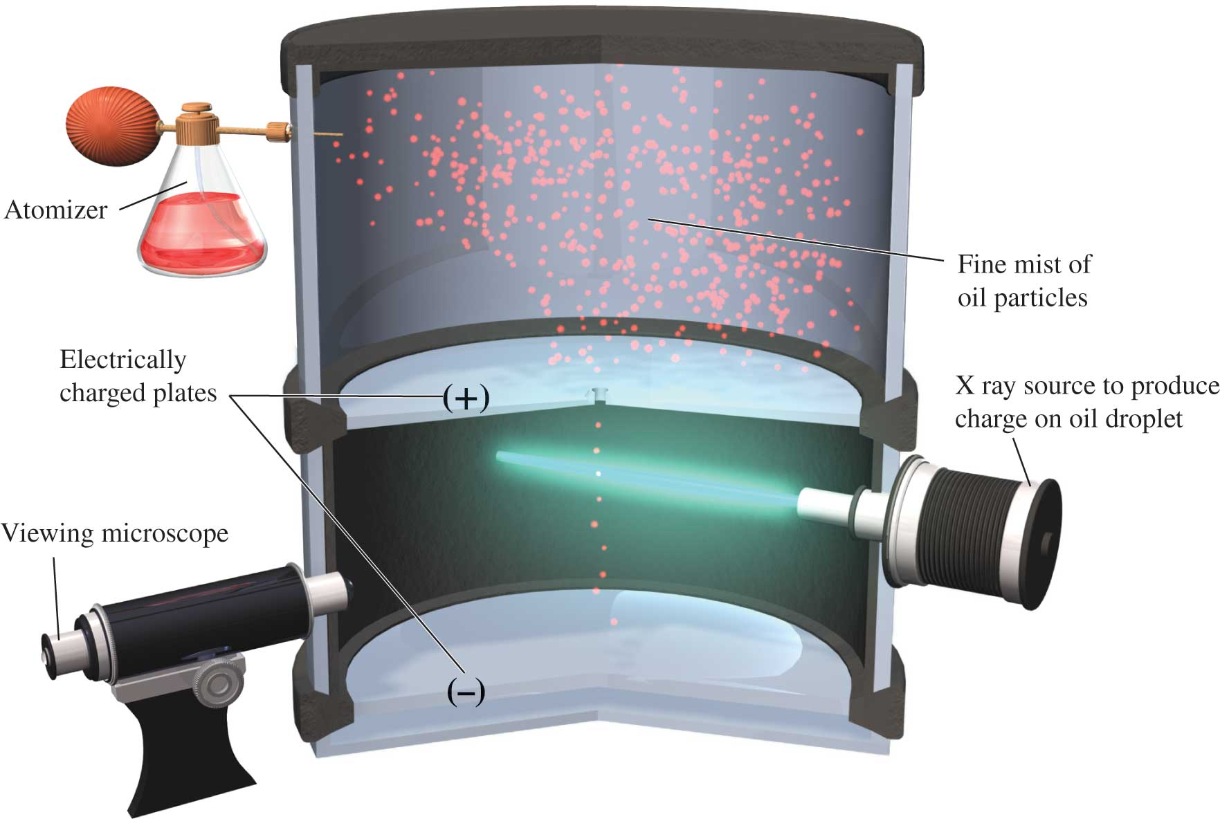
Millikan’s Experiment
Measured mass of
(1923 Nobel Prize in Physics)
Thompson’s
Access the text alternative for slide images.

Slide 8
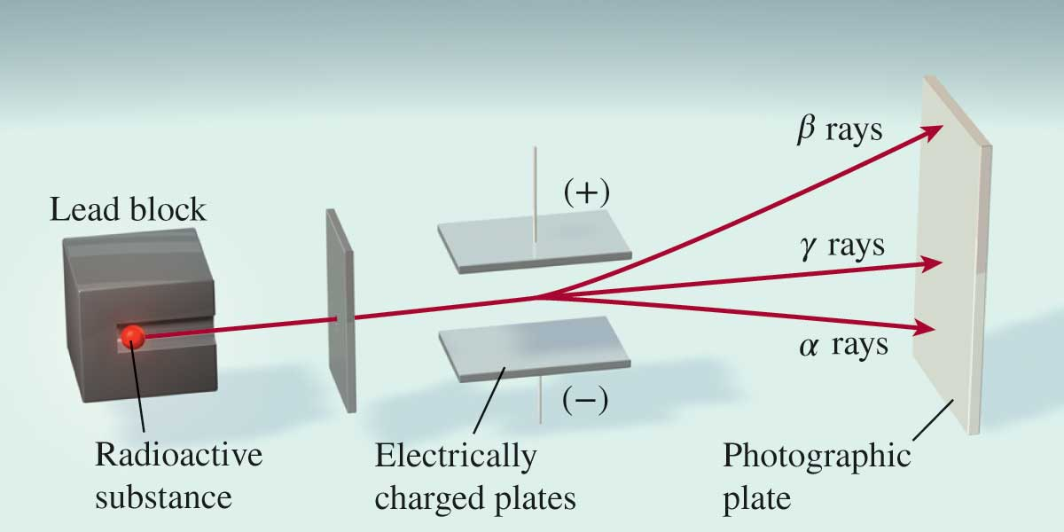
Types of Radioactivity
(uranium compound)
Access the text alternative for slide images.

Slide 9
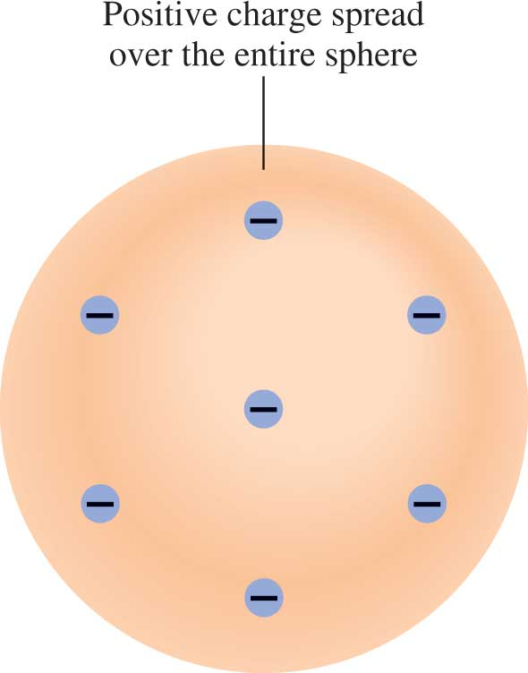
Thomson’s Model
Access the text alternative for slide images.

Slide 10
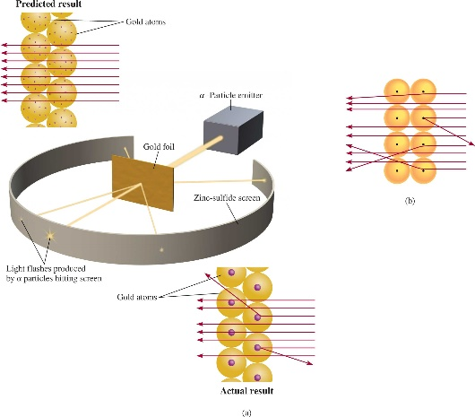
Rutherford’s Experiment
(1908 Nobel Prize in Chemistry)
atoms positive charge is concentrated in the nucleus
proton (p) has opposite (+) charge of electron (−)
mass of p is
Access the text alternative for slide images.

Slide 11
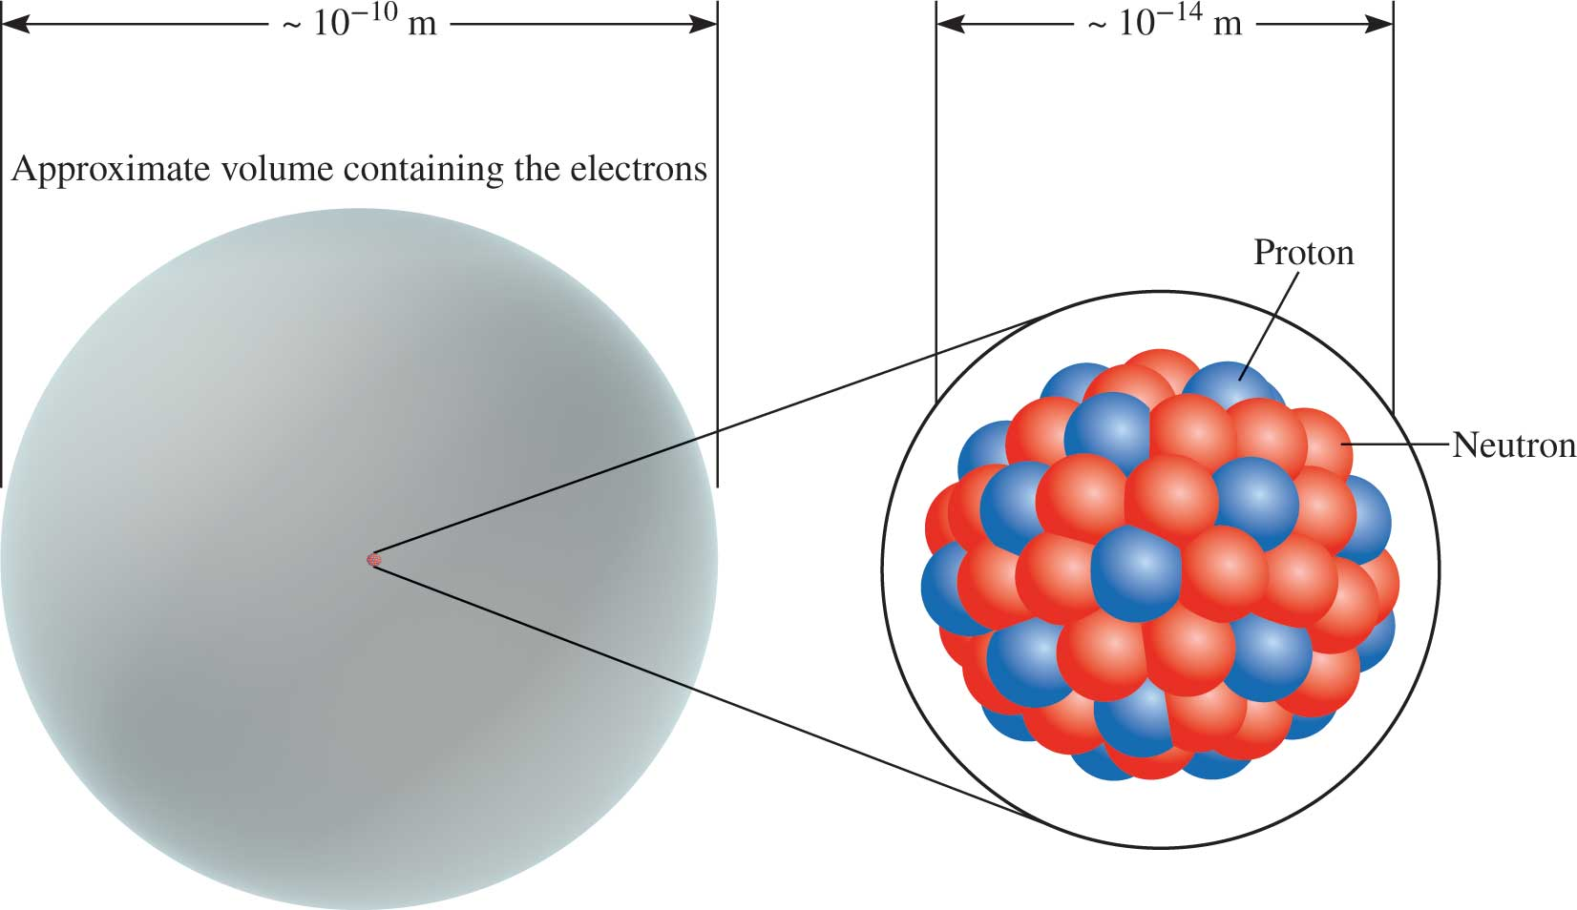

Rutherford’s Model of the Atom
“If the size of an atom were expanded to that of this sports stadium, the size of the nucleus would be that of a marble.”
(Bottom image): Kanuman/Shutterstock

Slide 12
Chadwick’s Experiment (1932)
(1935 Noble Prize in Physics)
H atoms: 1 p; He atoms: 2 p
mass He/mass H should = 2
measured mass He/mass H = 4
neutron (n) is neutral (charge = 0)

Slide 13
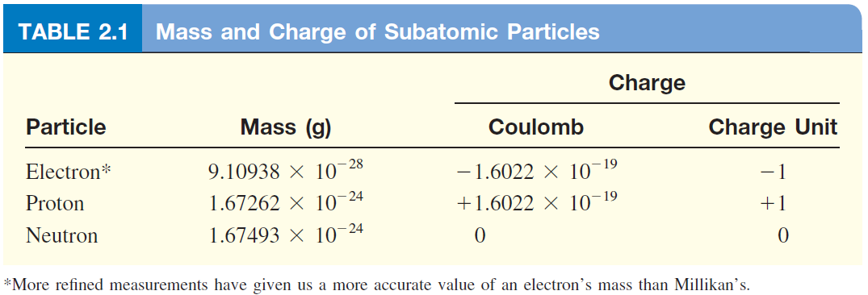
Properties of Subatomic Particles
mass p ≈ mass n ≈ 1840 x mass e⁻
Access the text alternative for slide images.

Slide 14
Atomic Number, Mass Number, and Isotopes
Atomic number (Z) = number of protons in nucleus
Mass number (A) = number of protons + number of neutrons
= atomic number (Z) + number of neutrons
Isotopes are atoms of the same element (X) with different numbers of neutrons in their nuclei

Slide 15
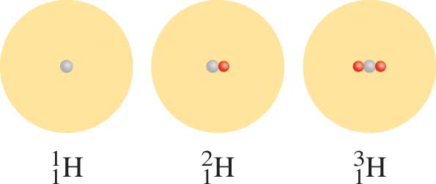
The Isotopes of Hydrogen
hydrogen deuterium tritium
Access the text alternative for slide images.

Slide 16
Atomic number, Mass number and Isotopes
Atoms are electrically neutral; the number of electrons is equal to the number of protons.
How many protons, neutrons, and electrons are in
14
C
?
6
6 protons, 8 (14- 6) neutrons, 6 electrons
11
How many protons, neutrons, and electrons are in
C
?
6
6 protons, 5 (11 - 6) neutrons, 6 electrons

Slide 17
Find number of electrons, protons, and neutrons?
Atomic number, Mass number and Isotopes
63
239
26
17
202
Hg
48
Ti
Cu
Pu
Al
O
29
94
13
8
80
22
 |  |  |  |  |  | e⁻
 |  |  |  |  |  | p⁺
 |  |  |  |  |  | n
29
29
34
94
94
145
13
13
13
8
8
9
80
80
122
22
22
26

Slide 18
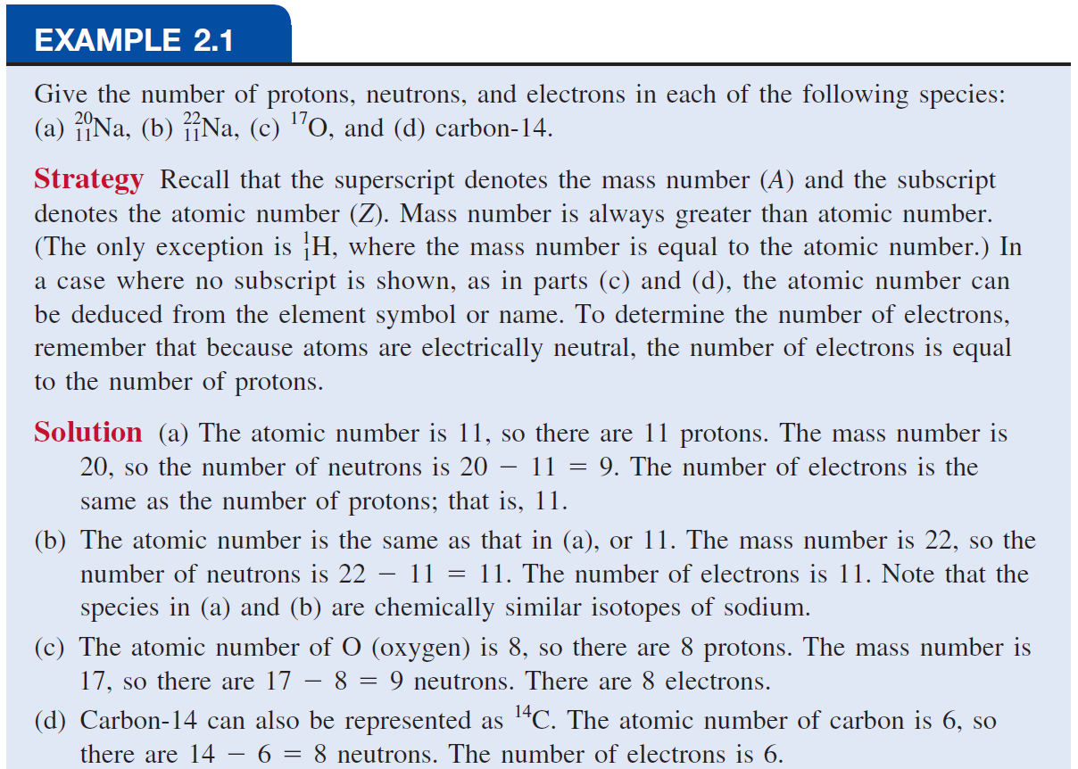

Slide 19
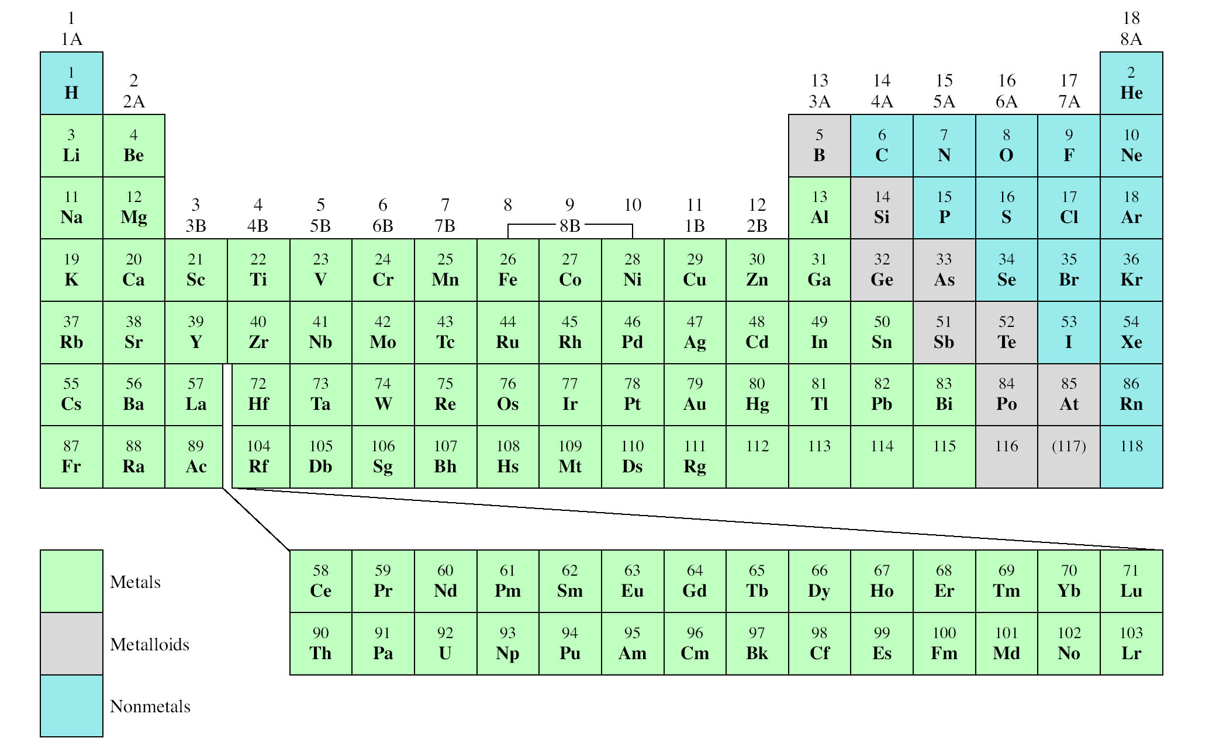
The Modern Periodic Table
Alkali Earth Metal
Alkali Metal
Noble Gas
Period
Group
Halogen
½ of elements discovered between (1800-1900)
Only noble gases exists as single atoms called monoatomic

Slide 20
Period : increasing Z
Metals Metalloids Nonmetals
Metals
- good conductors of heat and electricity
- occupy most of the table
Group : similar chemical properties
Nonmetals
- not good conductors of heat and electricity
- only 17 elements
Metalloids
- Intermediate between metals and nonmetals
- only 8 elements

Slide 21
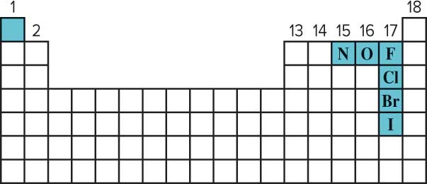
Molecules
A molecule is an aggregate of two or more atoms in a definite arrangement held together by chemical forces.
A diatomic molecule contains only two atoms:
H₂, N₂, O₂, Br₂, HCl, C O
diatomic elements
A polyatomic molecule contains more than two atoms:
O₃, H₂O, NH₃, CH₄

Slide 22
Ions
An ion is an atom, or group of atoms, that has a net positive or negative charge.
cation – ion with a positive charge
If a neutral atom loses one or more electrons it becomes a cation.
11 protons
11 electrons
11 protons
10 electrons
Na
Na⁺
anion – ion with a negative charge
If a neutral atom gains one or more electrons it becomes an anion.
17 protons
17 electrons
17 protons
18 electrons
Cl
Cl–

Slide 23
Types of Ions
A monatomic ion contains only one atom:
A polyatomic ion contains more than one atom:

Slide 24
27
3+
How many protons and electrons are in ?
Al
13
13 protons, 10 (13 – 3) electrons
78
2-
How many protons and electrons are in ?
Se
34
34 protons, 36 (34 + 2) electrons

Slide 25
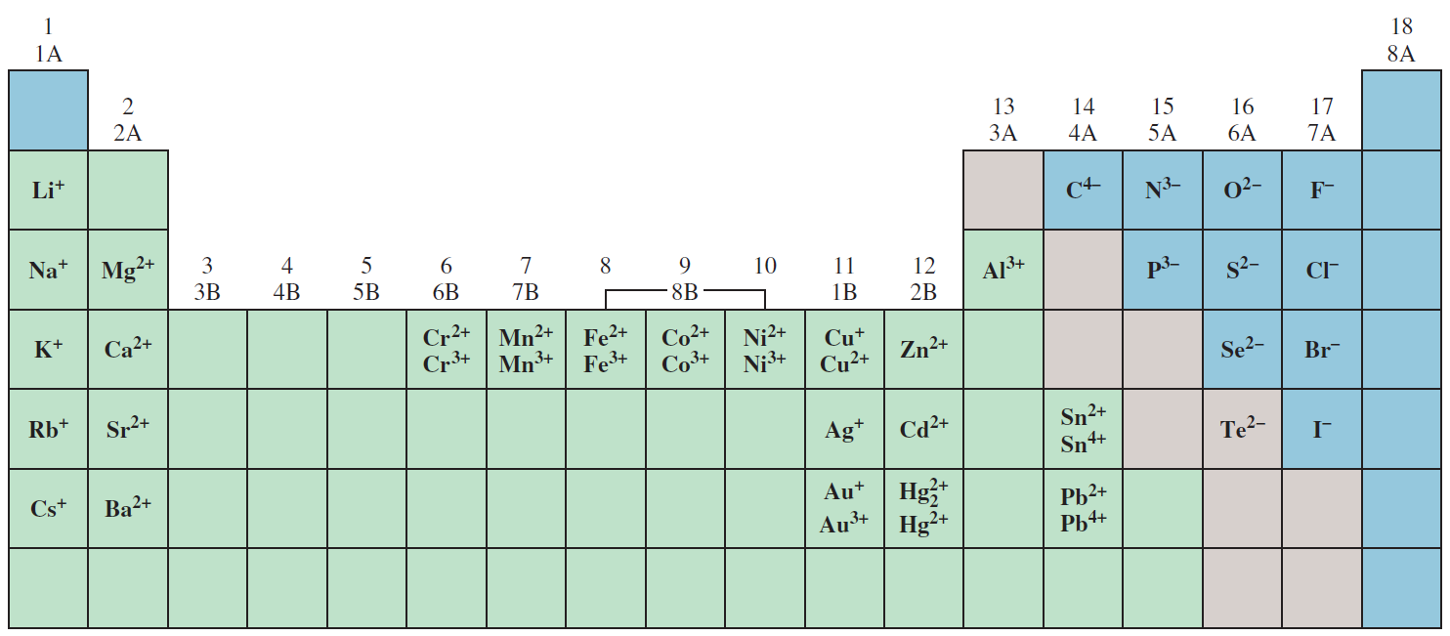
Common Ions Shown on the Periodic Table
Access the text alternative for slide images.

Slide 26
Types of Formulas
A molecular formula shows the exact number of atoms of each element in the smallest unit of a substance.
An empirical formula shows the simplest whole-number ratio of the atoms in a substance.
molecular empirical
H₂O H₂O
C₆H₁₂O₆ CH₂O
O₃ O
N₂H₄ NH₂

Slide 27
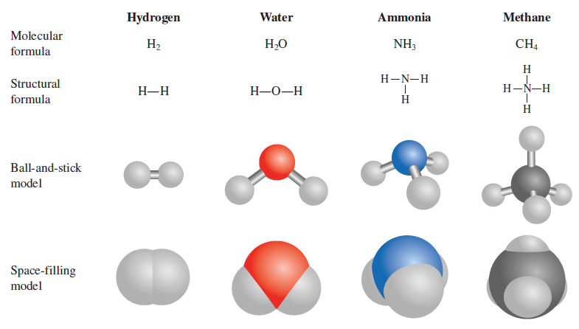
Formulas and Models
Access the text alternative for slide images.

Slide 28
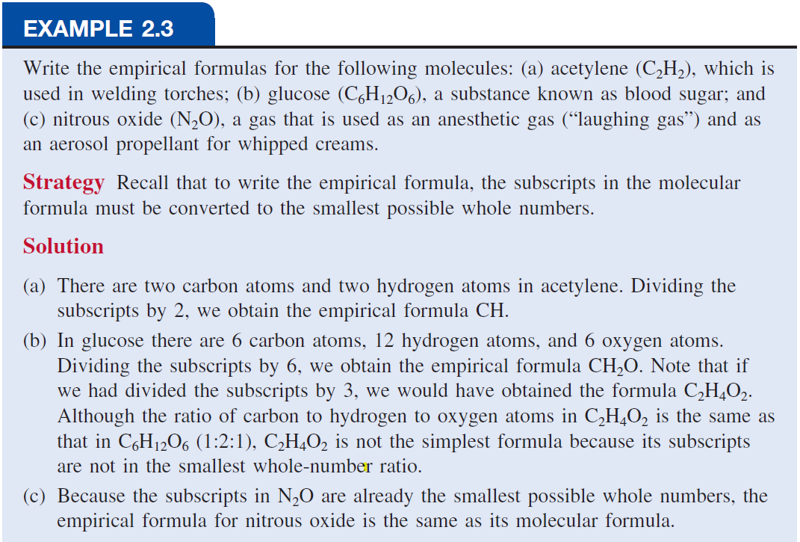

Slide 29
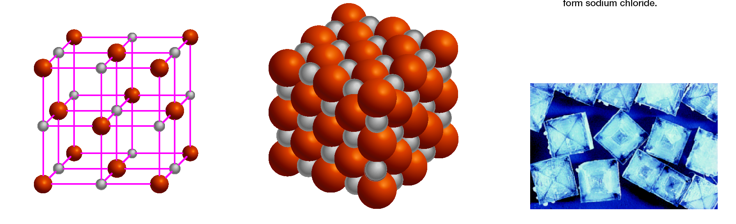
Ionic Compounds
Ionic compounds consist of a combination of cations and anions.
The formula is usually the same as the empirical formula.
The sum of the charges on the cation(s) and anion(s) in each formula unit must equal zero.
The ionic compound NaCl
(c): oBebee/Shutterstock

Slide 30
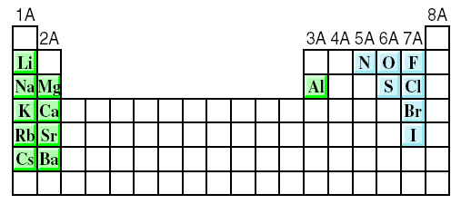
Reactive Elements
The most reactive metals (green)
and the most reactive nonmetals (blue)
combine to form ionic compounds.

Slide 31
Formula of Ionic Compounds
If the charges on the cation and anion are numerically different, we apply the following rule to make the formula electrically neutral.
The subscript of the cation is numerically equal to the charge
on the anion, and the subscript of the anion is numerically
equal to the charge on the cation.
Aluminum Oxide. The cation is Al³⁺ and the oxygen anion is O²⁻
The sum of the charges is 2(+3) + 3(-2) = 0 Thus, the formula for aluminum oxide is Al₂O₃.

Slide 32
Formula of Ionic Compounds
2 x +3 = +6
3 x -2 = -6
Al₂O₃
Al³⁺
O²⁻
1 x +2 = +2
2 x -1 = -2
CaBr₂
Ca²⁺
Br⁻
2 x +1= +2
1 x -2 = -2
Na₂CO₃
Na⁺
CO₃²⁻

Slide 33
Chemical Nomenclature
Ionic Compounds
Often a metal + nonmetal
Anion (nonmetal), add “-ide” to element name
BaCl₂ barium chloride
K₂O potassium oxide
Mg(O H)₂ magnesium hydroxide
KN O₃ potassium nitrate

Slide 34
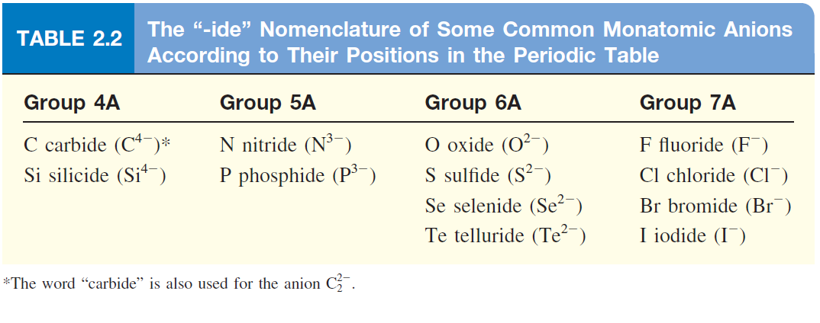
Naming Monatomic Anions
Access the text alternative for slide images.

Slide 35
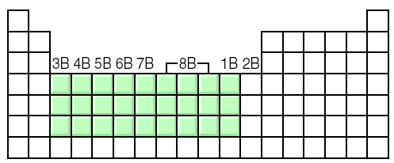
Transition metal ionic compounds
Indicate charge on metal with Roman numerals (I, II, III, ..)
FeCl₂
2 Cl⁻ -2, so Fe is +2
Iron (II) chloride
FeCl₃
3 Cl⁻ -3, so Fe is +3
Iron (III) chloride
Cr₂S₃
3 S⁻² -6, so Cr is +3 (6/2)
Chromium (III) sulfide

Slide 36
If transition metals can form more than one type of cations we use (–ic ) for higher charge and (-ous ) for lower charge .
FeCl₂ iron(II) chloride becomes ferrous chloride
FeCl₃ iron(III) chloride becomes ferric chloride
CuCl cupper(I) chloride becomes cupperous chloride
CuCl₂ cupper(II) chloride becomes cupperic chloride

Slide 37
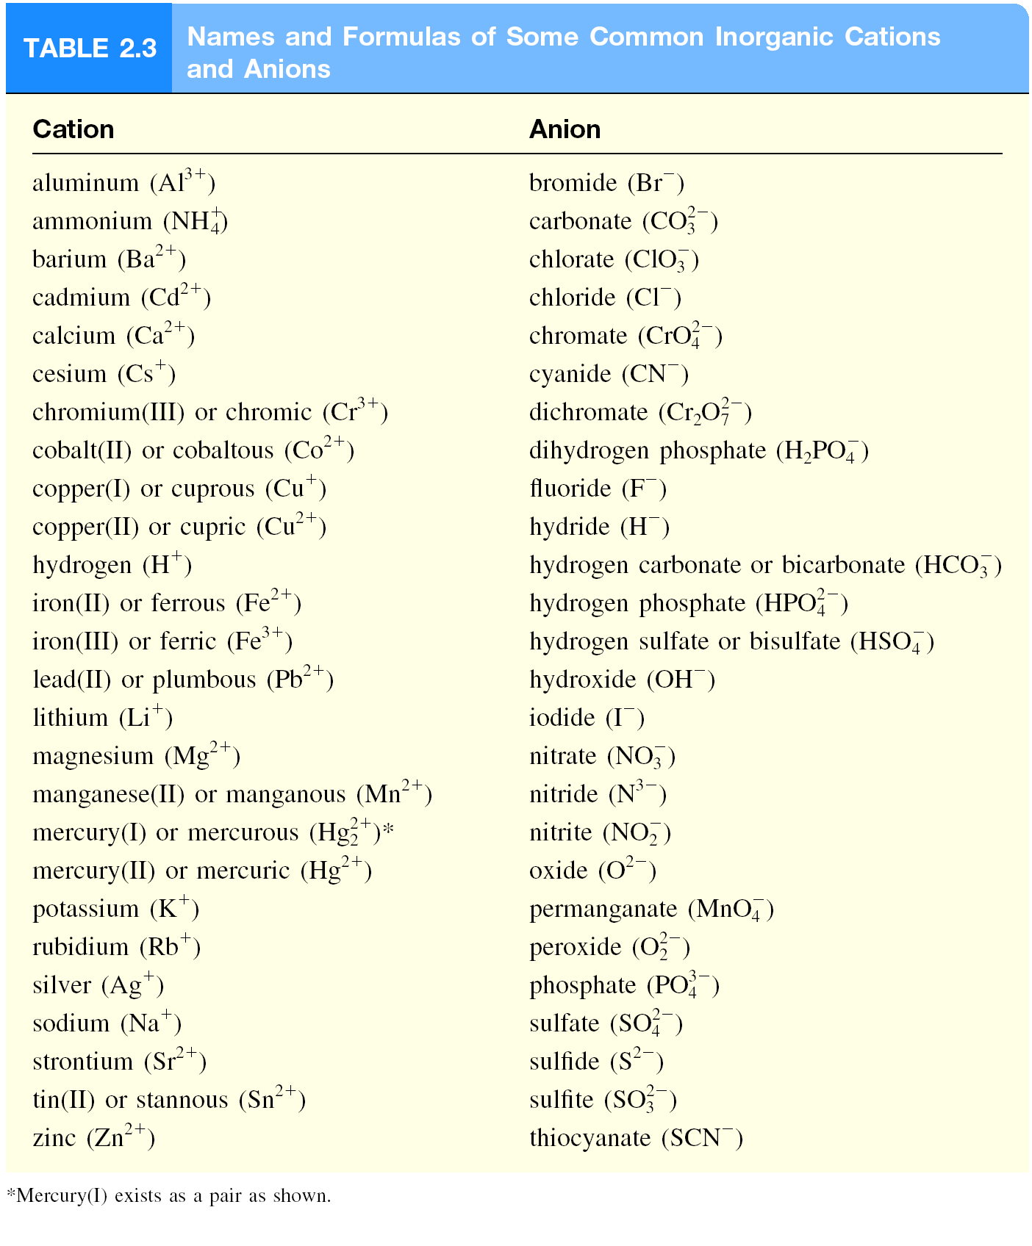

Slide 38
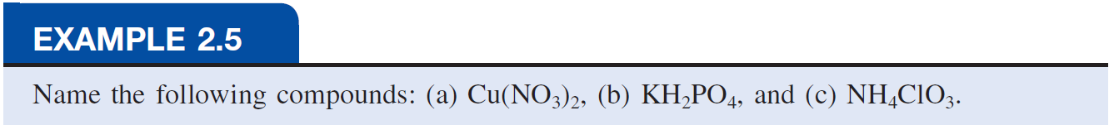
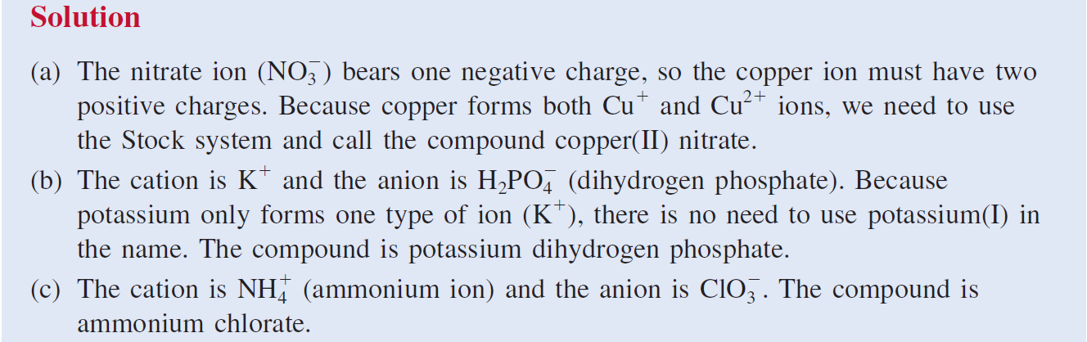

Slide 39
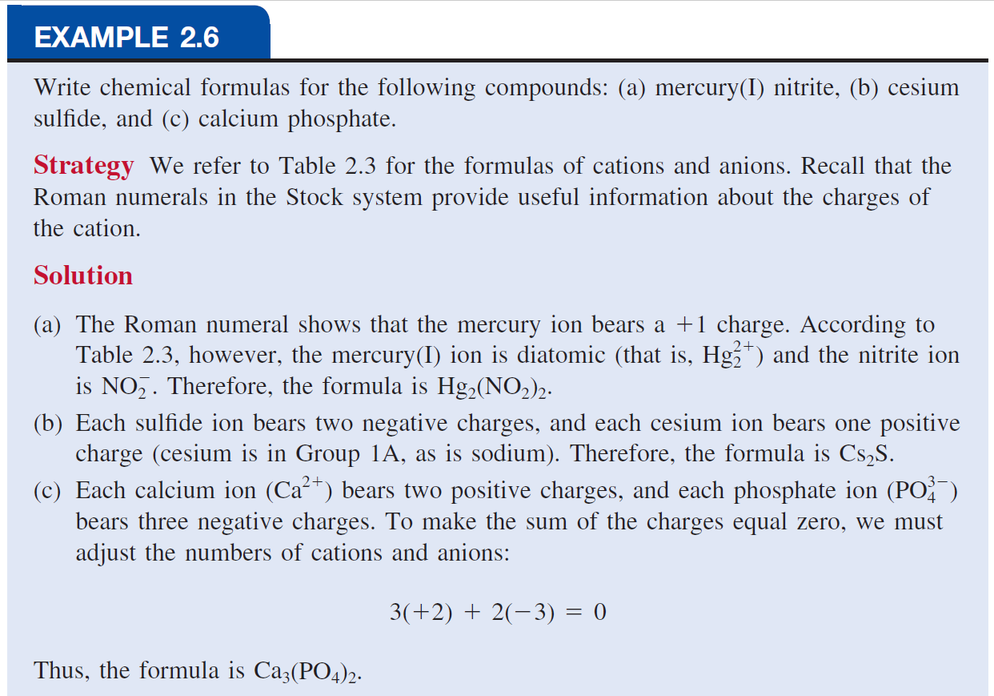

Slide 40
Molecular Compounds
  They are usually composed of nonmetallic elements.
  Many molecular compounds are binary compounds.
  Naming binary molecular compounds is similar to naming binary ionic compounds.
  We place the name of the first element in the formula first, and the second element is named by adding -ide to the root of the element name.
HCl hydrogen chloride
HBr hydrogen bromide
SiC silicon carbide

Slide 41
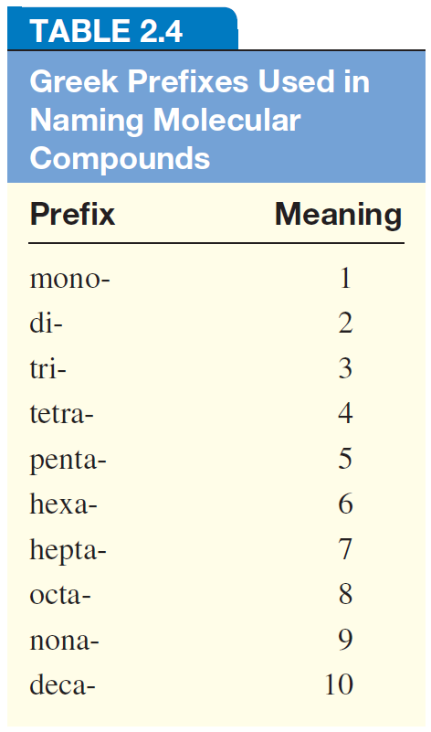
  If a pair of elements form more than one compound, use prefixes to indicate number of each kind of atom
Notes in naming compounds with prefixes:
The prefix “mono-” may be omitted for the first element.
For example, PCl₃ is named
phosphorus trichloride, not
monophosphorus trichloride.
For oxides, the ending “a” in the prefix is sometimes omitted.
For example, N₂O₄ may be called
dinitrogen tetroxide rather than
dinitrogen tetraoxide.

Slide 42
Name the following compounds:
HI
hydrogen iodide
NF₃
nitrogen trifluoride
SO₂
sulfur dioxide
N₂Cl₄
dinitrogen tetrachloride
NO₂
nitrogen dioxide
N₂O
dinitrogen monoxide

Slide 43
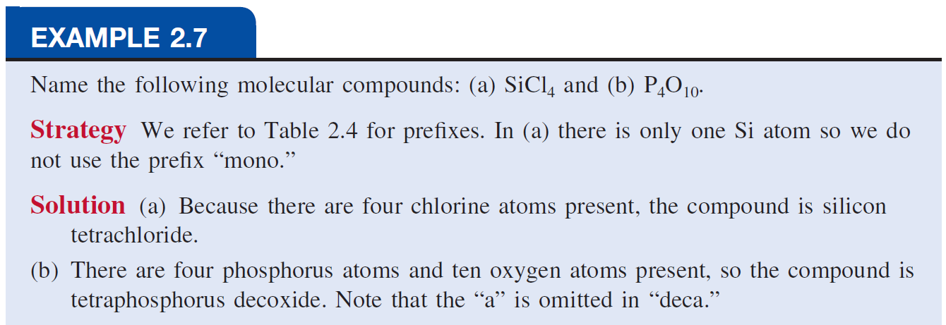
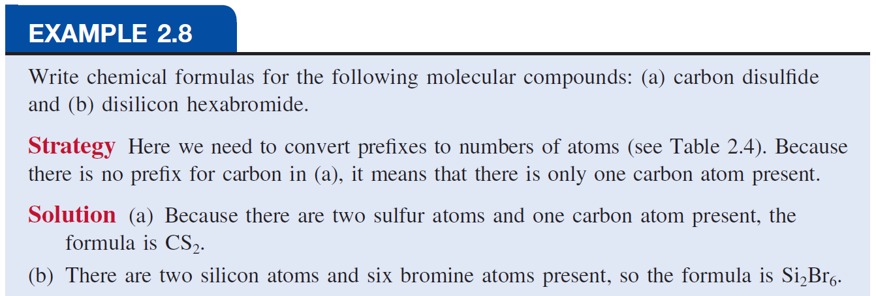

Slide 44
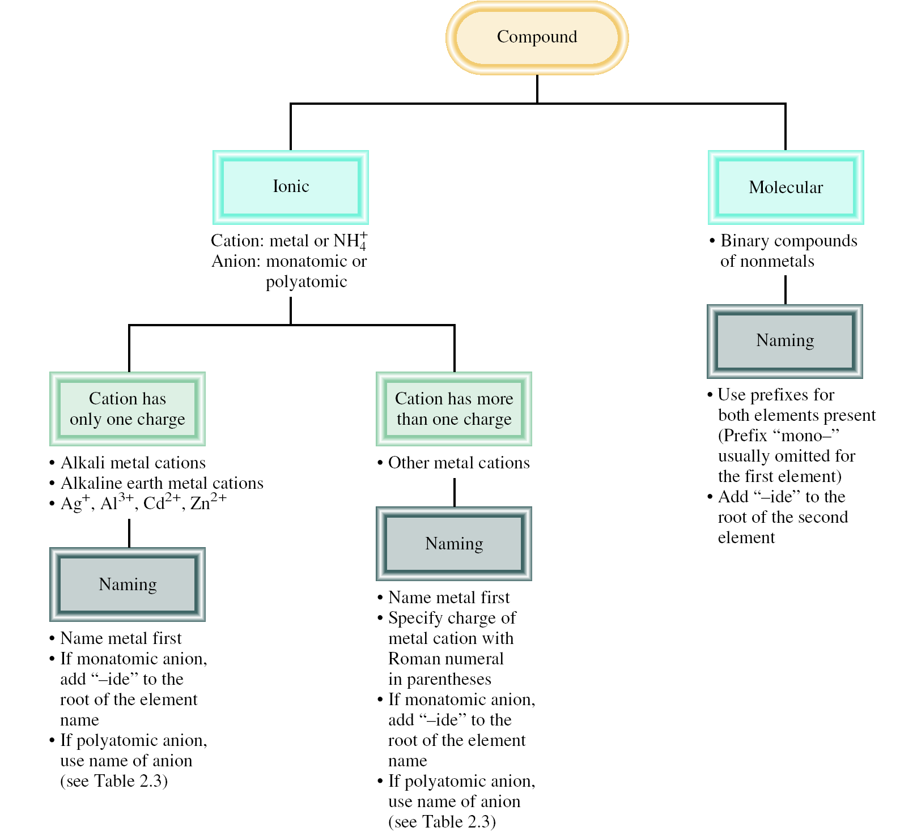

Slide 45
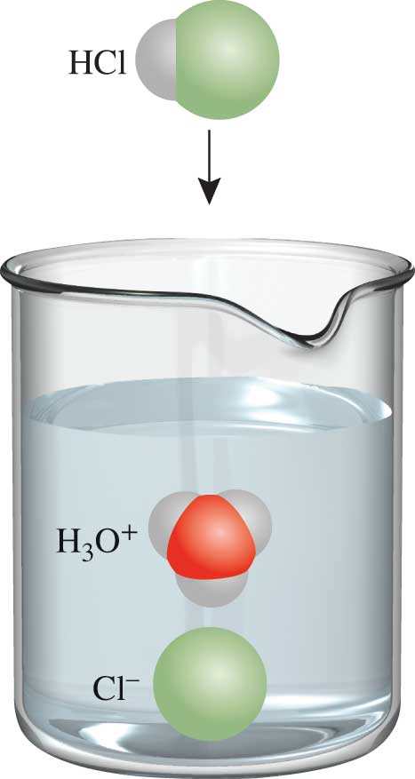
Acids
An acid can be defined as a substance that yields hydrogen ions (H⁺) when dissolved in water.
For example: HCl gas and HCl in water
  Pure substance: hydrogen chloride
  Dissolved in water (H₃O⁺ and Cl⁻), hydrochloric acid
Anions whose names end in “-ide” form acids with a “hydro-” prefix and an “-ic” ending.
HCl hydrogen chloride
HCl hydrochloric acid

Slide 46
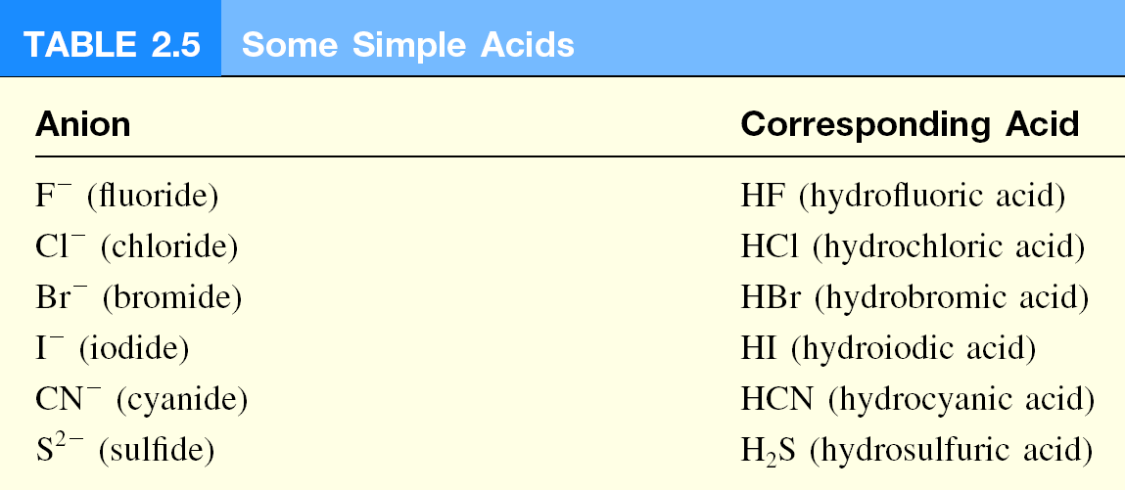
Some Examples of Acids

Slide 47
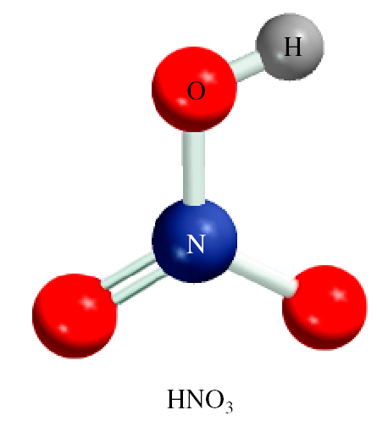
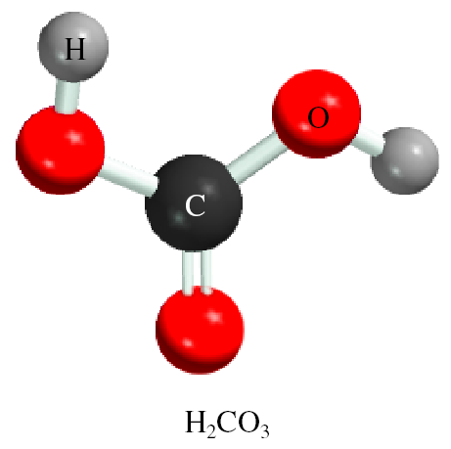
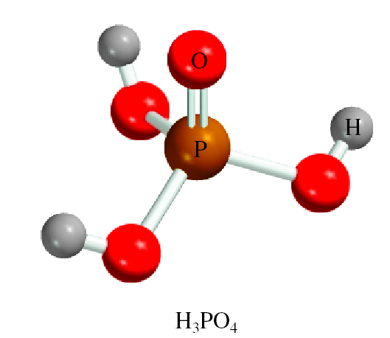
Naming Oxoacids and Oxoanions
An oxoacid is an acid that contains hydrogen, oxygen, and another element.
nitric acid
carbonic acid
phosphoric acid
The formulas of oxoacids are usually written with the H first, followed by the central element and then O.
H₂CO₃ (carbonic acid), HClO₃ (chloric acid),
HNO₃ (nitric acid), H₃PO₄ (phosphoric acid), H₂SO₄ (sulfuric acid)

Slide 48
Two or more oxoacids have the same central atom but a different number of O atoms; the following rules to name these compounds.
1. Addition of one O atom to the “-ic” acid: The acid is called “per . . -ic” acid. ( --ate)
HClO₃ chloric acid
HClO₄ perchloric acid
2. Removal of one O atom from the “-ic” acid: The acid is called “-ous” acid. ( --ite)
HNO₃ nitric acid
HNO₂ nitrous acid
3. Removal of two O atoms from the “-ic” acid: The acid is called “hypo . . . -ous” acid.
HBrO₃ Bromic acid
HBrO hypobromous acid.

Slide 49
The rules for naming oxoanions, anions of oxoacids, are as follows:
1. When all the H ions are removed from the “-ic” acid, the anion’s name ends with “-ate.”
2. When all the H ions are removed from the “-ous” acid, the anion’s name ends with “-ite.”
3. The names of anions in which one or more but not all the hydrogen ions have been removed must indicate the number of H ions present.
For example:
  H₃PO₄ phosphoric acid
  H₂PO₄⁻ dihydrogen phosphate
  HPO₄ ²⁻ hydrogen phosphate
  PO₄³⁻ phosphate

Slide 50
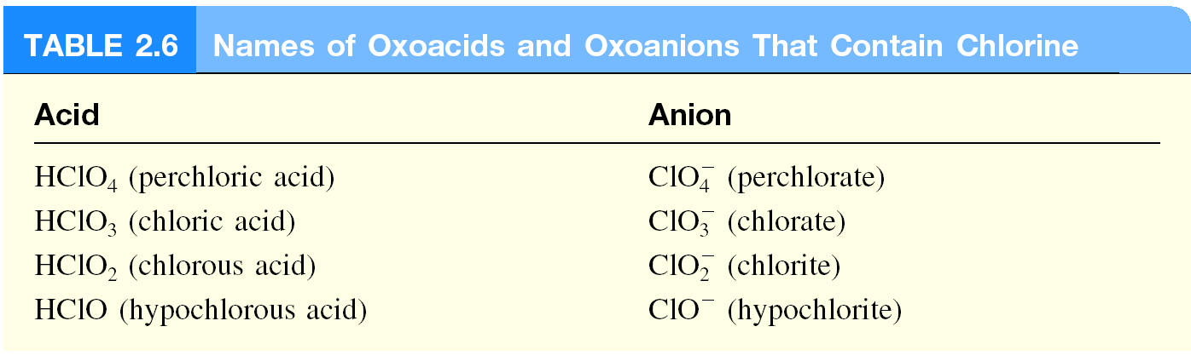
parent acid for all halogenic acids is:
HXO₃ Halogenic acid

Slide 51
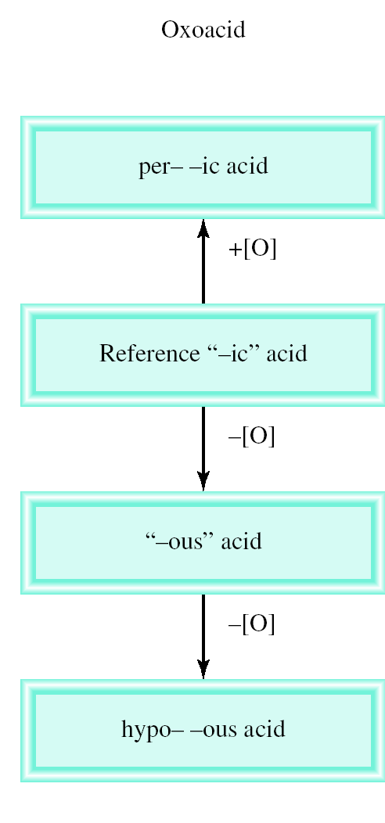
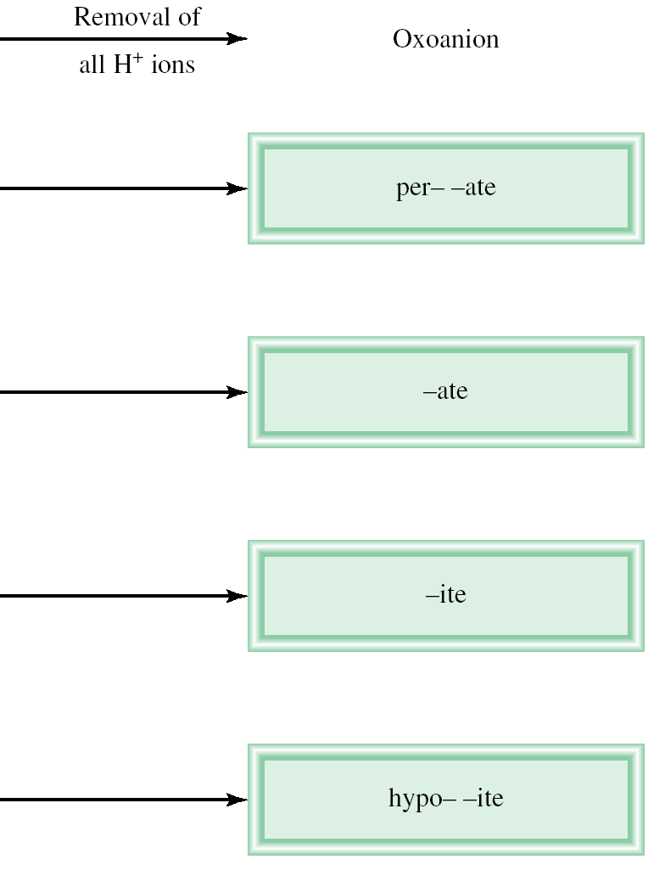

Slide 52
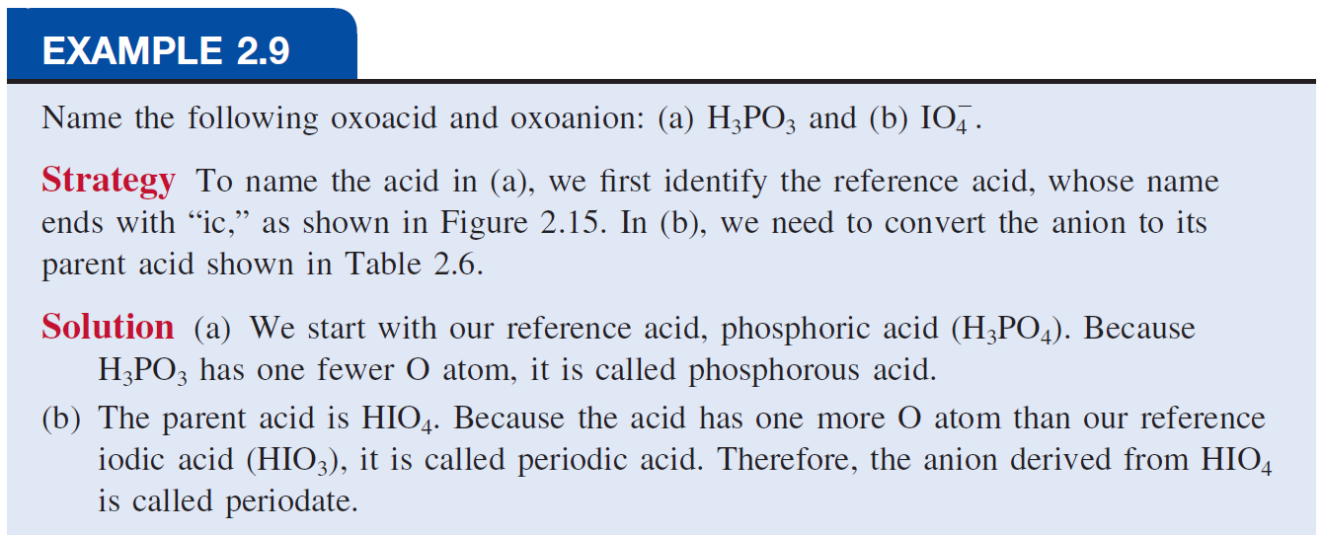

Slide 53
Bases
A base can be defined as a substance that yields hydroxide ions (OH⁻) when dissolved in water.
NaOH
sodium hydroxide
KOH
potassium hydroxide
Ba(OH)₂
barium hydroxide

Slide 54
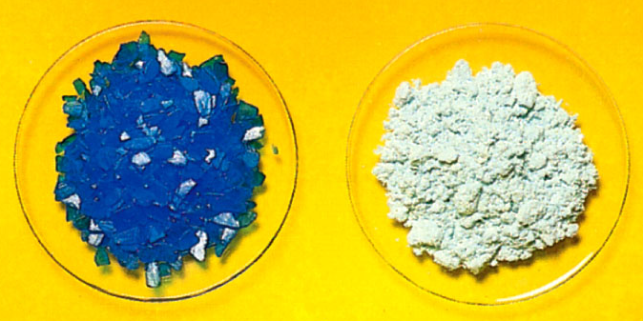
Hydrated Compounds
Hydrates are compounds that have a specific number of water molecules attached to them.
BaCl₂•2H₂O
barium chloride dihydrate
LiCl•H₂O
lithium chloride monohydrate
MgSO₄•7H₂O
magnesium sulfate heptahydrate
Sr(NO₃)₂•4H₂O
strontium nitrate tetrahydrate
CuSO₄•5H₂O
CuSO₄

Slide 55
Common and Systematic Names of Compounds
Table 2.7 Common and Systematic Names of Some Compounds
Formula | Common Name | Systematic Name
H₂O | Water | Dihydrogen monoxide
NH₃ | Ammonia | Trihydrogen nitride
C O₂ | Dry ice | Solid carbon dioxide
NaCl | Table salt | Sodium chloride
N₂O | Laughing gas | Dinitrogen monoxide
CaC O₃ | Marble, chalk, limestone | Calcium carbonate
CaO | Quicklime | Calcium oxide
Ca(O H)₂ | Slaked lime | Calcium hydroxide
NaHC O₃ | Baking soda | Sodium hydrogen carbonate
Na₂C O₃·10H₂O | Washing soda | Sodium carbonate decahydrate
MgS O₄·7H₂O | Epsom salt | Magnesium sulfate heptahydrate
Mg(O H)₂ | Milk of magnesia | Magnesium hydroxide
CaSO₄·2H₂O | Gypsum | Calcium sulfate dehydrate
Table divided into 3 columns summarizes common and systematic names of some compounds. The column headers are marked from left to right as: Formula, common name, and systematic name.

