Slide 1
The History of the Periodic Table

Slide 2
chlorine
nitrogen
silver
gold
mercury
oxygen
helium
sodium
niobium
neodymium
carbon
The most abundant element in the earth’s crust is oxygen.

Slide 3
The History of the Modern Periodic Table
During the nineteenth century, chemists began to categorize the elements according to similarities in their physical and chemical properties. The end result of these studies was our modern periodic table.

Slide 4
John Newlands 1838 - 1898
Law of Octaves
In 1863, he suggested that elements be arranged in “octaves” because he noticed (after arranging the elements in order of increasing atomic mass) that certain properties repeated every 8th element.

Slide 5
Law of Octaves
Newlands' claim to see a repeating pattern was met with savage ridicule on its announcement. His classification of the elements, he was told, was as arbitrary as putting them in alphabetical order and his paper was rejected for publication by the Chemical Society.
His law of octaves failed beyond the element calcium. WHY?
Would his law of octaves work today with the first 20 elements?

Slide 6
Lothar Meyer 1830 - 1895
At the same time as Mendeleev he published his own table of the elements organized by increasing atomic mass.
Both Mendeleev and Meyer arranged the elements in order of increasing atomic mass.
Both left vacant spaces where unknown elements should fit.

Slide 7
Mendeleev...
Stated that if the atomic weight of an element caused it to be placed in the wrong group, then the weight must be wrong. (He corrected the atomic masses of Be, In, and U)
Was so confident in his table that he used it to predict the physical properties of three elements that were yet unknown.
After the discovery of these unknown elements between 1874 and 1885, and the fact that Mendeleev’s predictions for Sc, Ga, and Ge were amazingly close to the actual values, his table was generally accepted.

Slide 8
However, in spite of Mendeleev’s great achievement, problems arose when new elements were discovered and more accurate atomic weights determined. By looking at our modern periodic table, can you identify what problems might have caused chemists?
Ar and K
Co and Ni
Te and I
Th and Pa

Slide 9
Henry Moseley 1887 - 1915
In 1913, through his work with X-rays, he determined the actual nuclear charge (atomic number) of the elements*. He rearranged the elements in order of increasing atomic number.
*“There is in the atom a fundamental quantity which increases by regular steps as we pass from each element to the next. This quantity can only be the charge on the central positive nucleus.”

Slide 10
Modern Periodic Table
Uses ATOMIC NUMBER…. fundamental property
Elements Arranged In Order of Increasing Atomic Number
Elements 1-92 Naturally Occurring
93 - 1** Man Made

Slide 11
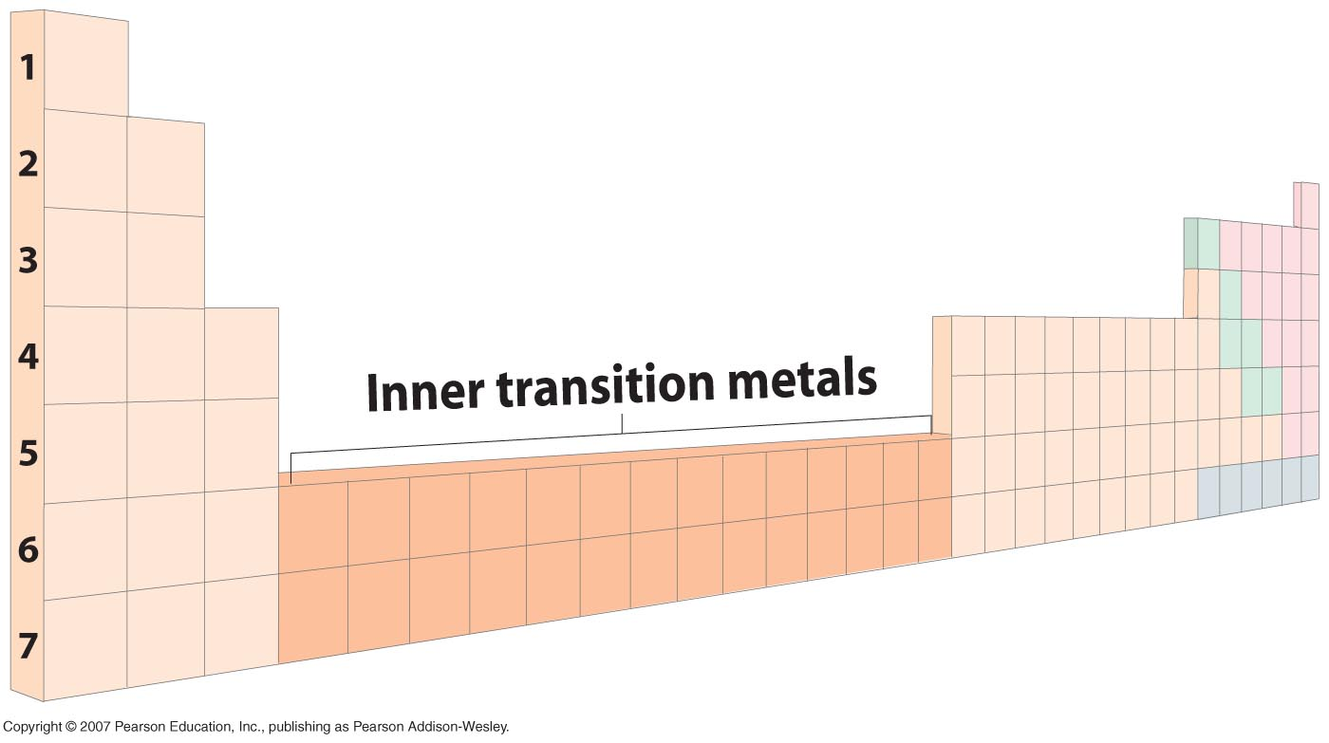
Nonmetals
Metals
Metalloids

Slide 12
Periodic Table
The periodic table organizes the elements in a particular way. A great deal of information about an element can be gathered from its position in the period table.
For example, you can predict with reasonably good accuracy the physical and chemical properties of the element. You can also predict what other elements a particular element will react with chemically.
Understanding the organization and plan of the periodic table will help you obtain basic information about each of the 118 known elements.

Slide 13
Chemical Groups
The set of elements in the same column in the table is called a chemical group (having similar chemical and physical properties).
These properties, however, vary from element to element in a column.

Slide 14
Periods
The horizontal rows of elements are called periods. The first period contains two elements: hydrogen and helium.
As you go from left to right within a row, the atomic number increases and the elements gradually change from metallic (lithium) to non-metallic (flourine), and then finally to noble gases (neon) at the far right.

Slide 15
Three Classes of the Elements: Metals, Nonmetals, Metalloids (Semimetals)
Nonmetals occupy the upper-right- hand corner.
Metalloids (semimetals) are located along the boundary between metals and nonmetals (stair-step line)
The majority of the elements are metals. They occupy the entire left side and center of the periodic table.
Each of these classes has characteristic chemical and physical properties, so by knowing whether an element is a metal, nonmetal, or metalloid, you can make predictions about its behavior. Three Classes of the Elements.

Slide 16
Families
Columns of elements are called groups or families.
Elements in each family have similar but not identical properties.
For example, lithium (Li), sodium (Na), potassium (K), and other members of family IA are all soft, white, shiny metals.
All elements in a family have the same number of valence electrons.
Group Relationship Elements in the same group have similar physical and chemical properties.

Slide 17
The groups or families are divided into eight “A” groups and eight “B” groups.
The “A” groups are often referred to as the main group or representative elements because they possess a wide range of chemical and physical properties.
The “B” groups are referred to as the transition elements. Notice their numbering is not in consecutive order from left to right as with the “A” groups.
A more recent numbering system of the groups numbers them consecutively 1-18 from left to right.

Slide 18
1- S – block consists of two groups because the S – sublevel consists of one orbital which is filled with two electrons only .
2- P – block consists of (6) groups because the P – sublevel consists of three orbitals which filled with six electrons .
3- d – block consists of (10) groups because the d – sublevel consists of five orbitals which are filled with ten electrons .
4- f block are separated from the table so that the table is not too wide ( long )
5- The first period contains two elements because it consists of elements of the sublevel 1S = 2 electrons .
6- The second period contains eight elements because it consists of the sublevel ( 2S + 2P ) = 8 electrons .
7- The third period contains eight elements because it consists of element of sublevel ( 3S + 3P ) = ( 2 + 6 ) = 8 electrons .
8- The fourth period contains eighteen elements because it consists of elements of the sublevels ( 4S + 3d + 4P ) = 2 + 10 + 6 = 18 electrons .
9- The fifth period contains (32) elements because it consists of elements of the sublevels ( 5S + 4d + 5P ) = 2 + 10 + 6 = 18 electrons .
10- The six period contains ( 32 ) elements because it consists of elements of the sublevels ( 6S + 4P + 5d + 6P ) = 2 + 14 + 10 + 6 = 32 electrons .

Slide 19
How can you find the location and the type of element in the periodic table ?
1- Write the electronic configuration of element in quantum levels .
2- Number of period = The maximum value of principle energy level ( quantum number ) .
Example :
Find the number of period and group for each of the following element :
Na : The atomic number = 11
Cl : The aomic number = 17
Noble gases : They are the elements of the last column of the P – block all their energy levels are completely filled with electrons .
The representative elements : They are the elements of main group ( S – and P – blocks ) all their energy levels are completely filled with electrons except for the external energy level .
The transition elements : They are the elements of the d – block all their energy levels are completely filled with electrons except for the two external energy levels .
The inner transition elements : They are the elements of the f – block all their energy levels are completely filled with electrons except for the three external levels .

Slide 20
Metals
All metals except mercury(circled) are solids at room temperature, in fact, most have extremely high melting points. The periodic table shows that most of the metals are not main group or representative elements. They are transition and inner transition metals
The elements in Groups 3 through 12 of the periodic table are called the transition elements. All transition elements are metals.
With the exception of tin, lead, and bismuth, metals have one, two, or three valence electrons. These are outer energy level electrons that greatly affect the properties of an element. Metals are elements that have luster, are good conductors of heat and electricity, are malleable and ductile, and usually bend without breaking.

Slide 21
Metals
Some are less common but still important, such as titanium (Ti), manganese (Mn), and platinum (Pt). Some period 7 transition elements are synthetic and radioactive. Many are commonplace, including chromium (Cr), iron (Fe), nickel (Ni), copper (Cu), zinc (Zn), silver (Ag), and gold (Au).
In the periodic table, two series of elements, atomic numbers 58-71 and 90-103, are placed below the main body of the table. These elements are separated from the main table because putting them in their proper position would make the table very wide. The elements in these two series are known as the inner transition elements.

Slide 22
Metals
The first series of inner transition elements is called the lanthanides because they follow element number 57, lanthanum. The lanthanides consist of the 14 elements from number 58 (cerium, Ce) to number 71 (lutetium, Lu). Because of their natural abundance on Earth is less than 0.01 percent, the lanthanides are sometimes called the rare earth elements. All of the lanthanides have similar properties.
The second series of inner transition elements, the actinides, have atomic numbers ranging from 90 (thorium, Th) to 103 (lawrencium, Lr). All of the actinides are radioactive, and none beyond uranium (92) occur in nature. Like the transition elements, the chemistry of the lanthanides and actinides is unpredictable because of their complex atomic structures.

Slide 23
Nonmetals
Although the majority of the elements in the periodic table are metals, many nonmetals are abundant in nature The nonmetals oxygen and nitrogen make up 99 percent of Earth’s atmosphere.
Carbon, another nonmetal, is found in more compounds than all the other elements combined. The many compounds of carbon, nitrogen, and oxygen are important in a wide variety of applications.

Slide 24
Nonmetals
Most nonmetals don’t conduct electricity, are much poorer conductors of heat than metals, and are brittle when solid. Many are gases at room temperature; those that are solids lack the luster of metals. Their melting points tend to be lower than those of metals. With the exception of carbon, nonmetals have five, six, seven, or eight valence electrons.

Slide 25
Metalloids (Semimetals)
have some chemical and physical properties of metals and other properties of nonmetals. In the periodic table, the metalloids lie along the border between metals and nonmetals.
Silicon (Si) is probably the most well-known metalloid. Some metalloids such as silicon, germanium (Ge), and arsenic (As) are semiconductors.
The ability of a semiconductor to conduct an electrical current can be increased by adding a small amount of certain other elements. Silicon’s semiconducting properties made the computer revolution possible. A semiconductor is an element that does not conduct electricity as well as a metal, but does conduct slightly better than a nonmetal.

Slide 26
Metalloids (Semimetals)
Semiconductors and their uses television, computer, handheld electronic games, and calculator are electrical devices that depend on silicon semiconductors. All have miniature electrical circuits that use silicon’s properties as a semiconductor.

Slide 27
Differentiation between metal and non metal
Metals Non metals
Valence shell has less than Valence shell has more halp its capacity of electrons than half its capacity of electrons
( 1 or 2 or 3 ) They are ( 5 or 6 or 7 ) They are called
called electropositive electronegative elements
Relatively large atomic radius have small atomic radius
the ionization energy and electron affinity,
electronegativity and electronegativity and
electron affinity have small value ionization energy have
high value
They have a good conductivity they have a bad
of electricity . conductivity of electricity .

Slide 28
1- Fluorine is the strongest non metal while caesium is the strongest metals Because fluorine has smallest radius while caesium has the biggest radius .
2- Metals are considered as electropositive elements because metals lose electrons to form positive ions .
3- Non metals are considered as electronegative elements because non metals gains electrons to from negative ions .
4- Metal are good conductors of electricity because they have few valence electrons which can transfer easily from one position to another in the metal structure .
5- Non metals are bad conductors of electricity because their valence electrons are strongly bounded to the nucleus due to the small atomic size therefore it is difficult for the valency electrons to be transferred .
6- Metals have small values for ionization energy and electron affinity because they have large atomic radius .
7- The strongest metal lie at the bottom on the left and side of the periodic table because of the increasing in the atomic number the atomic radius increases gradually so the attractive force of the nucleus to the valency electrons decreases therefore it is very easy for the atom to lose the valency electrons so the metalic property increases .

Slide 29
Metalloids
1- They are elements whose valency shell contains 4 electrons .
2- Sometimes they act as metal ( when they gains electrons ) .
3- They act as semiconductors ( Boron – silicon ) which are used in or transistors and knows as semiconductors electronic instruments .
metals metalloids non metal
* Because the atomic size decrease and the attractive force of nucleus on the valence electron will be increased therefore it is difficult for the atom to lose the valence electron .
Metalloids increase in period because the atomic size decrease and the attractive force of nucleus to electron will be increased therefore it becomes easier for the nucleus to gain a new electron .
In groups : Metals increase in group because the increase in the atomic number makes to increase of energy levels and screen ( decrease ) the attractive force of the nucleus on the valence electrons therefore it is easy for the atom to lose the valence electrons .
In groups : non metals decrease because the increase in the atomic number makes to increase the energy level and screen the attractive force of nucleus on the valence electrons therefore it is difficult for the atom to gain a new electron . Non metallic prop inc
Metallic prop decNon metallic prop dec
Metallic prop inc Strongest non metalStrongest metal
Fluorine is considered as the strongest non – metal because the atomic size of fluorine is very small therefore the attractive force of the nucleus to the electrons will be increased therefore it is very easy for the atom to gain a new electrons .

Slide 30
GROUP IA
Li Na K Rb Cs Fr
1s² 2s¹
1s² 2s² 2p⁶ 3s¹
1s² 2s² 2p⁶ 3s² 3p⁶ 4s¹
1s² 2s² 2p⁶ 3s² 3p⁶ 4s² 3d¹⁰ 4p⁶ 5s¹
1s² 2s²................................4d¹⁰ 5p⁶ 6s¹
1s² 2s².............................. 4f¹⁴ 5d¹⁰ 6p⁶ 7s¹
Stable core
What do these elements all have in common?

Slide 31
GROUP IA
Li Na K Rb Cs Fr
{-core} 2s¹
{---core---} 3s¹
{------core------} 4s¹
{---------core---------} 5s¹
{-----------core-----------} 6s¹
{-------------core-------------} 7s¹
Similar chemical reactions from same number of valence electrons
INCREASING ATOMIC #...SIZE OF CORE INCREASES (atomic size can slightly modify chemical properties)

Slide 32
GROUP IA
Li Na K Rb Cs Fr
{-core} 2s¹
{---core---} 3s¹
{------core------} 4s¹
{---------core---------} 5s¹
{-----------core-----------} 6s¹
{-------------core-------------} 7s¹
General formula for Group 1A elements based on valence electron and period it is ns¹
n = period
1 = valence electron

Slide 33
GROUP IIA
GROUP IIIA
BeMg Ca Sr Ba Ra
{core} 2s² {core} 3s² {core} 4s² {core} 5s² {core} 6s² {core} 7s²
B Al Ga In Tl
Nh
{core} 2s² 2p¹ {core} 3s² 3p¹ {core} 4s² 4p¹ {core} 5s² 5p¹ {core} 6s² 6p¹
{core} 7s² 7p¹
General formula:
ns² {n=2,...7}
General formula:
ns² np¹ {n = 2,..7}

Slide 34
GROUP
OUTER ELECTRON STRUCTURE
IA
IIA
IIIA
IVA
VA
VIA
VIIA
VIIIA
{core} ns¹
{core} ns²
{core} ns² np¹
{core} ns² np²
{core} ns² np³ {core} ns² np⁴ {core} ns² np⁵ {core} ns² np⁶

Slide 35
GROUP VIIIA
(inert or noble gases)
He Ne Ar Kr Xe Rn
Chemically Unreactive
Stable Electron Configurations He 1s² (filled “1” level)
Ne - Rn {core} ns² np⁶
n = 2, …6

