Slide 1
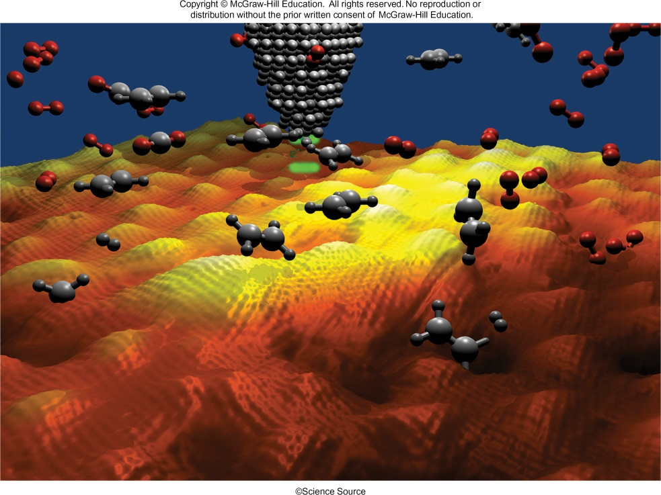
Chemistry:
The Study of Change
Chapter 1

Slide 2
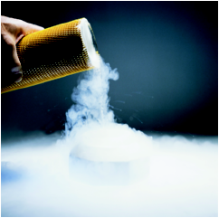
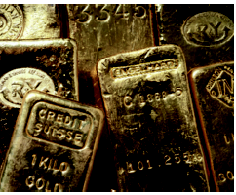
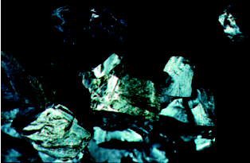
Defining Chemistry
Chemistry is the study of matter and the changes it undergoes
Matter is anything that occupies space and has mass.
A substance is a form of matter that has a definite composition and distinct properties.
liquid nitrogen
gold ingots
silicon crystals

Slide 3
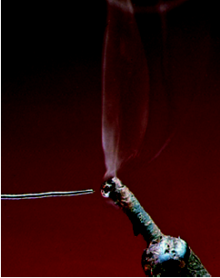
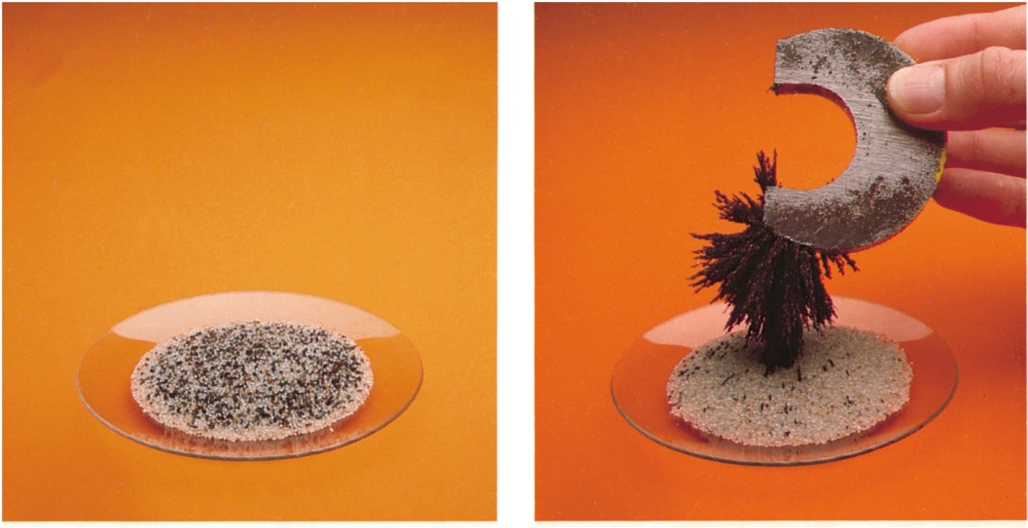
Mixtures
A mixture is a combination of two or more substances in which the substances retain their distinct identities.
Homogenous mixture – composition of the mixture is the same throughout.
soft drink, milk, solder
Heterogeneous mixture – composition is not uniform throughout.
cement, iron filings in sand

Slide 4
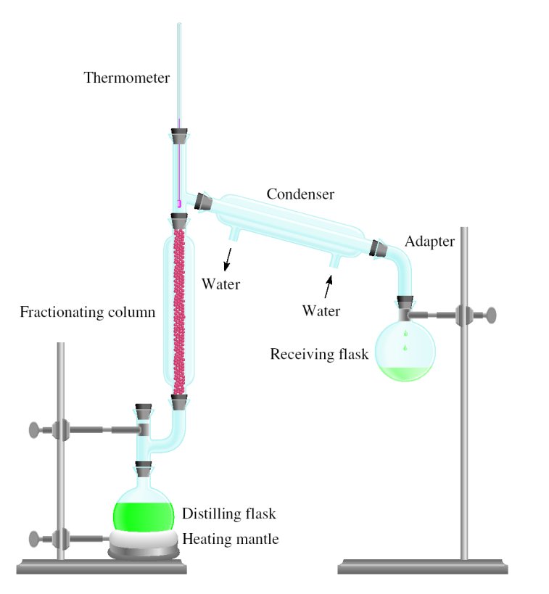
Physical means can be used to separate a mixture into its pure components.
distillation
magnet

Slide 5
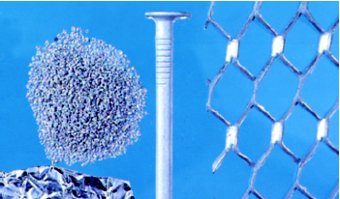
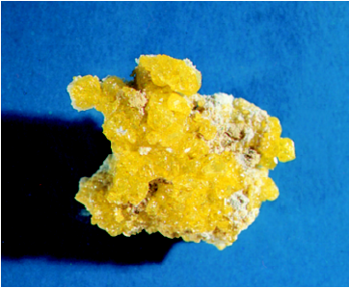
Elements
An element is a substance that cannot be separated into simpler substances by chemical means.
  114 elements have been identified
    82 elements occur naturally on Earth
      gold, aluminum, lead, oxygen, carbon, sulfur
    32 elements have been created by scientists
      technetium, americium, seaborgium

Slide 6
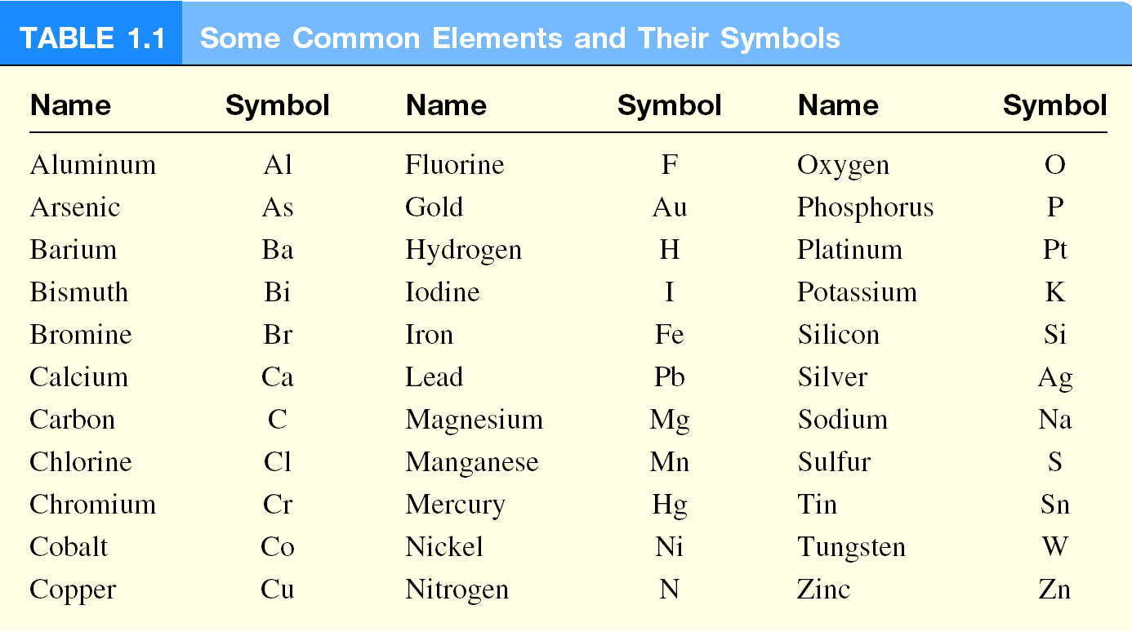

Slide 7
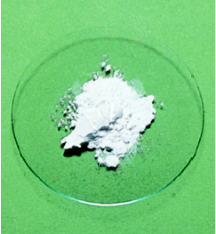
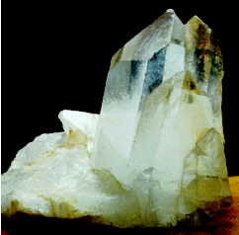
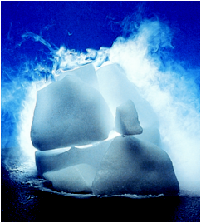
Compounds
A compound is a substance composed of atoms of two or more elements chemically united in fixed proportions.
Compounds can only be separated into their pure components (elements) by chemical means.
lithium fluoride
quartz
dry ice
(carbon dioxide)

Slide 8
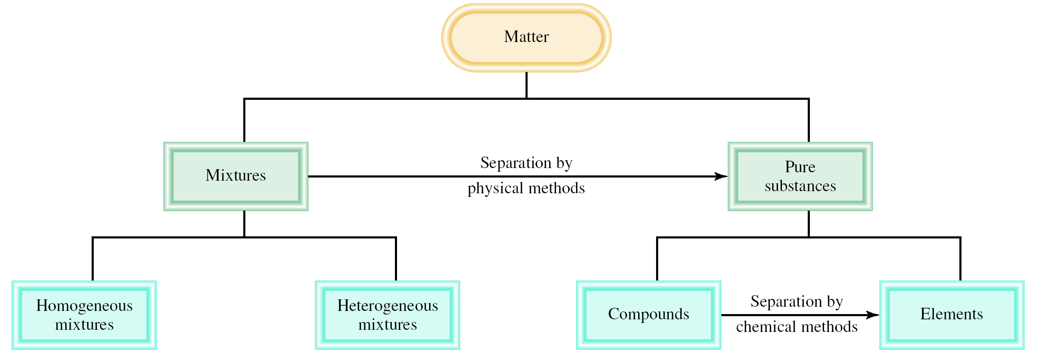
Classifications of Matter

Slide 9
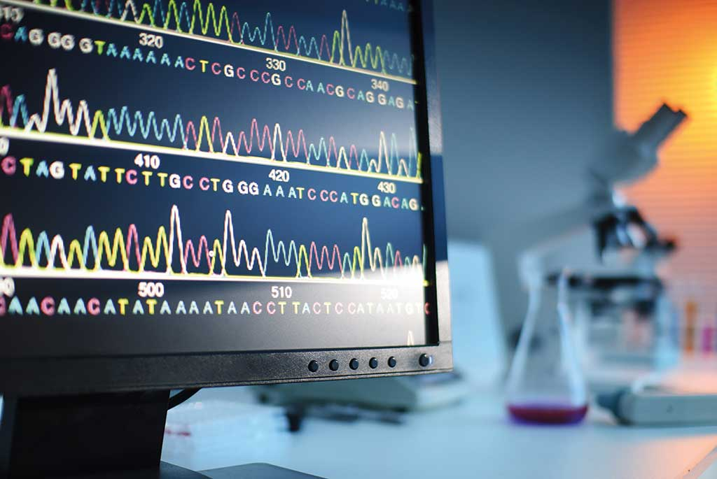
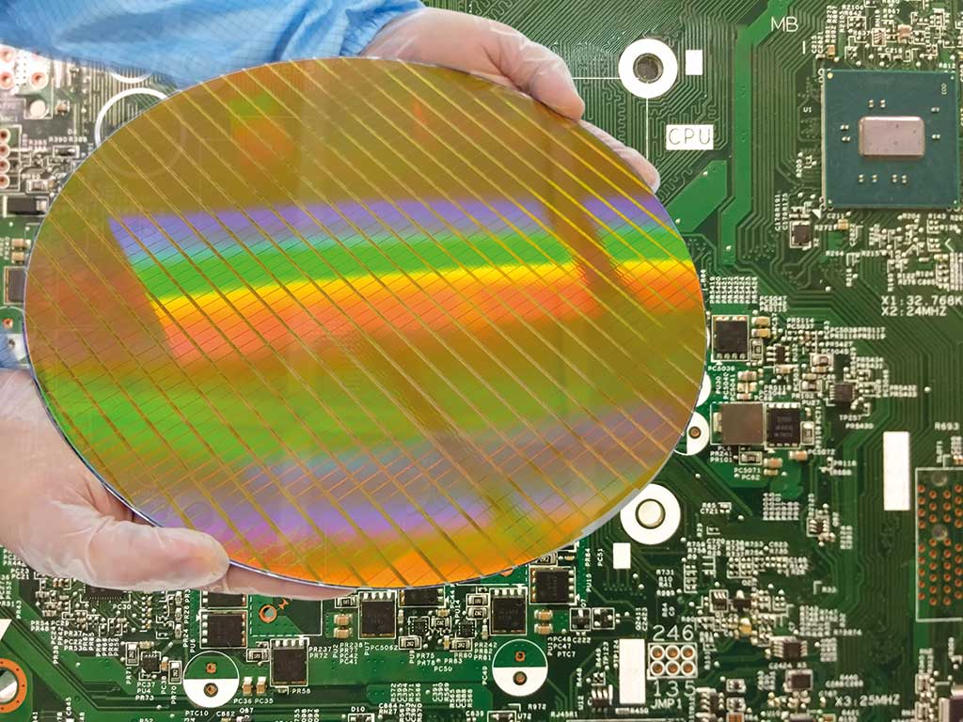
Chemistry: A Science for the 21st Century 1
Health and Medicine
Sanitation systems
Surgery with anesthesia
Vaccines and antibiotics
Gene therapy
Energy and the Environment
Fossil fuels
Solar energy
Nuclear energy

Slide 10
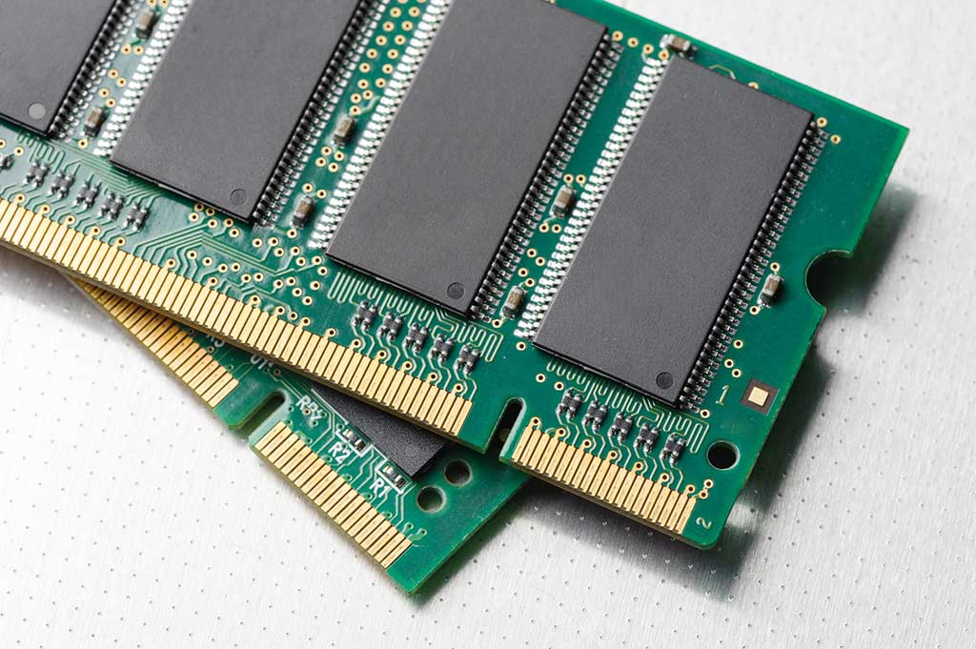
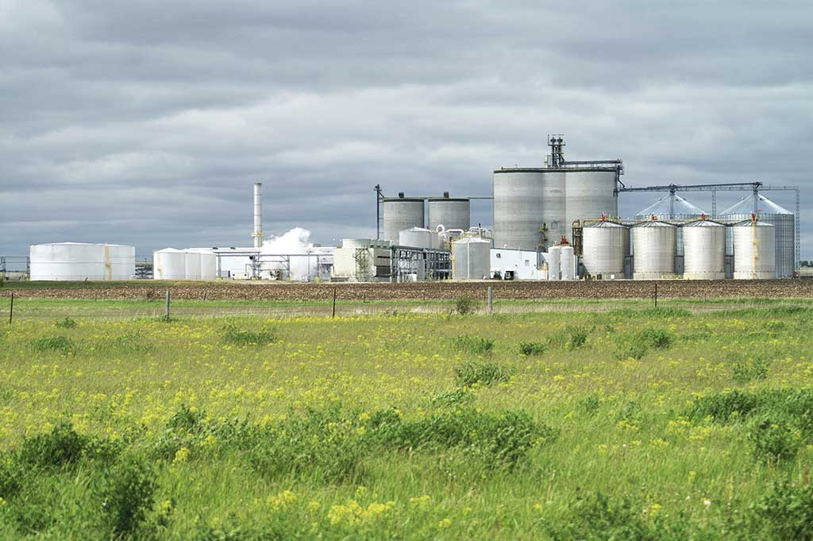
Chemistry: A Science for the 21st Century 2
Materials and Technology
Polymers, ceramics, liquid crystals
Room-temperature superconductors?
Molecular computing?
Food and Agriculture
Genetically modified crops
“Natural” pesticides
Specialized fertilizers

Slide 11
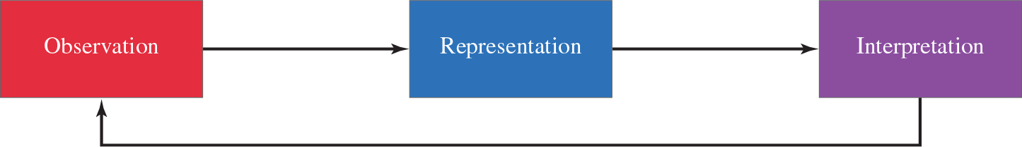
The Scientific Method 1
The scientific method is a systematic approach to research.
A hypothesis is a tentative explanation for a set of observations.

Slide 12
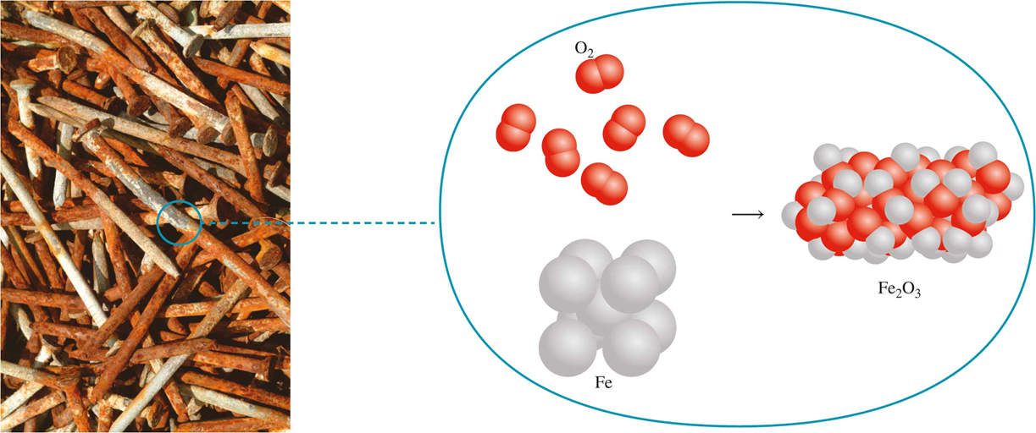
The Scientific Method 2
A law is a concise statement of a relationship between phenomena that is always the same under the same conditions.
A theory is a unifying principle that explains a body of facts and/or those laws that are based on them.
Atomic Theory

Slide 13
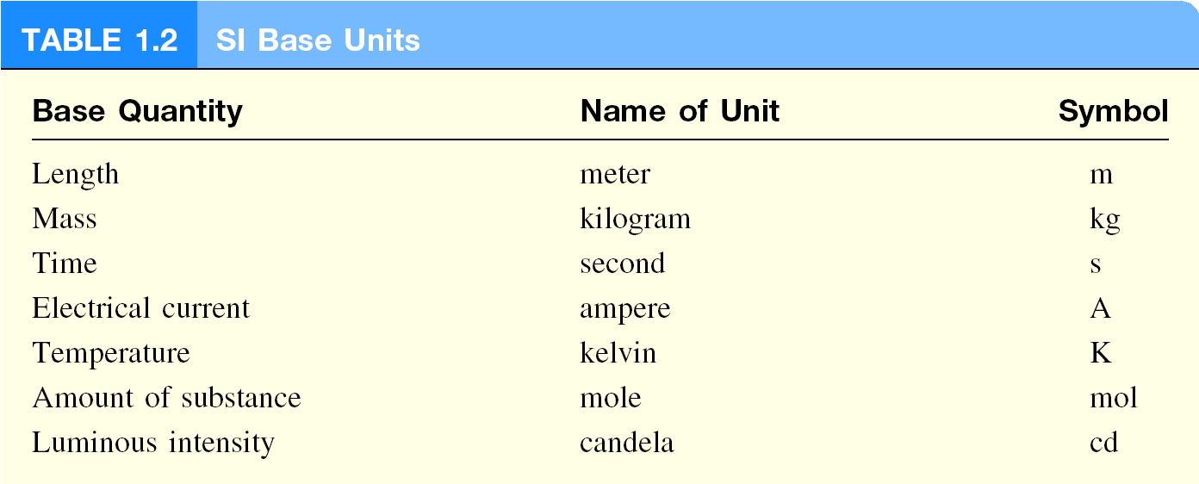
International System of Units (SI)

Slide 14
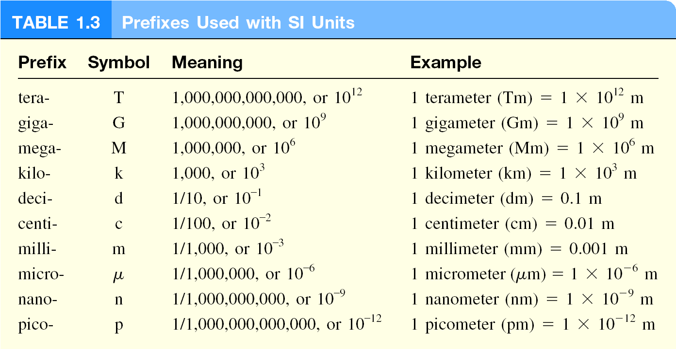

Slide 15
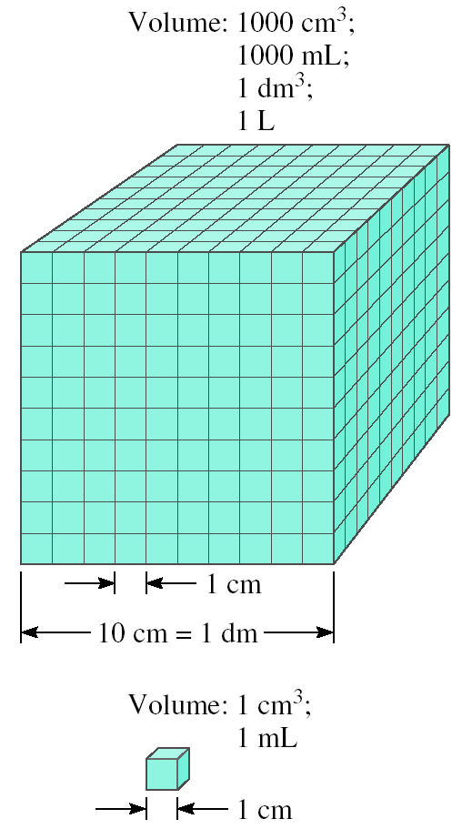
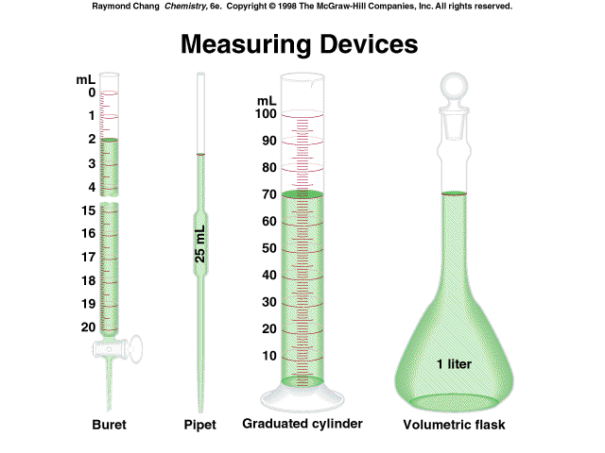
Volume
Volume – SI derived unit for volume is cubic meter (m³)
1 cm³ = (1 x 10⁻² m)³ = 1 x 10⁻⁶ m³
1 dm³ = (1 x 10⁻¹ m)³ = 1 x 10⁻³ m³
1 L = 1000 mL = 1000 cm³ = 1 dm³
1 mL = 1 cm³

Slide 16
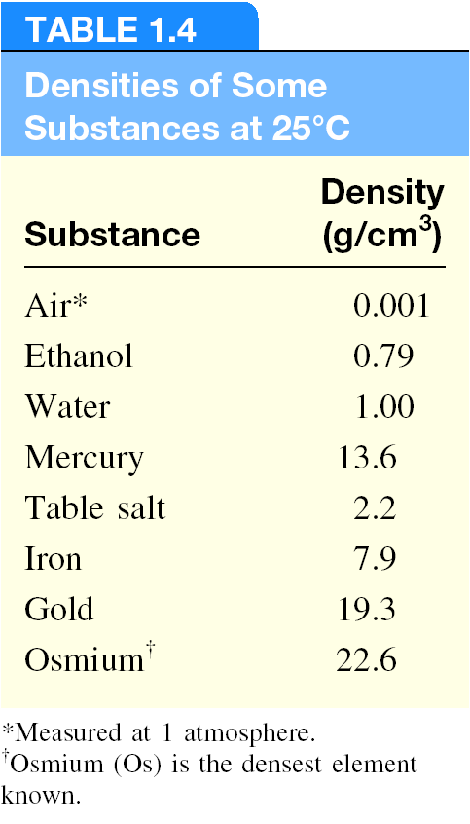
Density
The density of a substance is its mass per unit volume (the volumetric mass).
SI derived unit for density is kg/m³
1 g/cm³ = 1 g/mL = 1000 kg/m³
mass
density =
volume
m
d =
V

Slide 17
A piece of platinum metal with a density of 21.5 g/cm³ has a volume of 4.49 cm³. What is its mass?
m
d =
V
m = d x V
= 21.5 g/cm³ x 4.49 cm³ = 96.5 g

Slide 18
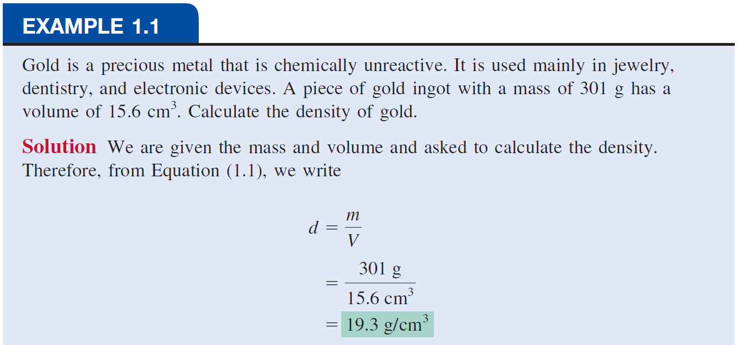

Slide 19
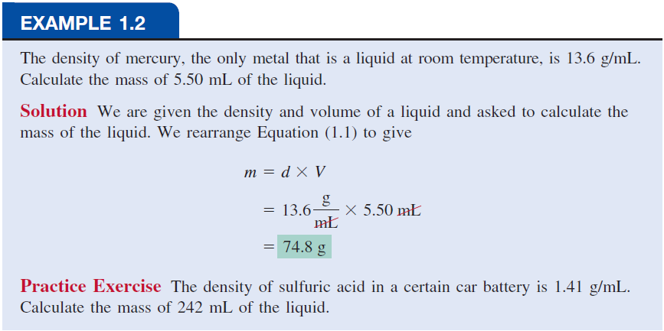

Slide 20
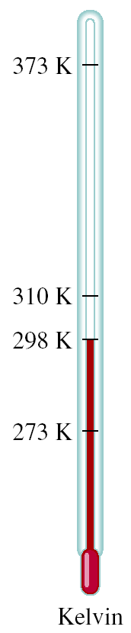
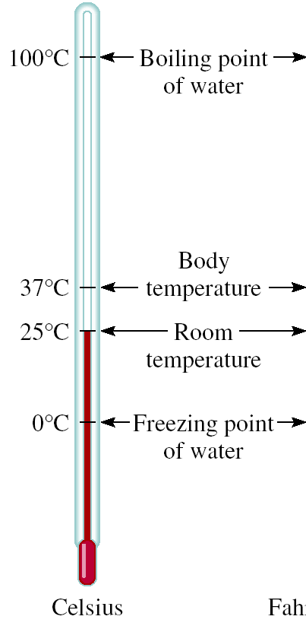
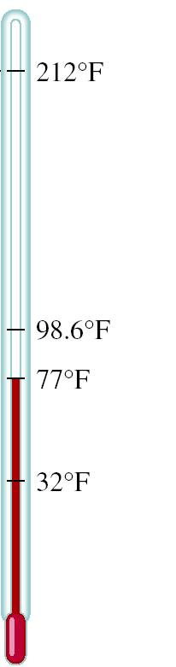


A Comparison of Temperature Scales
K = ⁰C + 273.15
273 K = 0 ⁰C
373 K = 100 ⁰C
9
⁰F = x ⁰C + 32
5
32 ⁰F = 0 ⁰C
212 ⁰F = 100 ⁰C

Slide 21
Convert 172.9 ⁰F to degrees Celsius.
9
⁰F = x ⁰C + 32
5
9
⁰F – 32 = x ⁰C
5
5
x (⁰F – 32) = ⁰C
9
5
⁰C = x (⁰F – 32)
9
5
⁰C = x (172.9 – 32) = 78.3
9

Slide 22
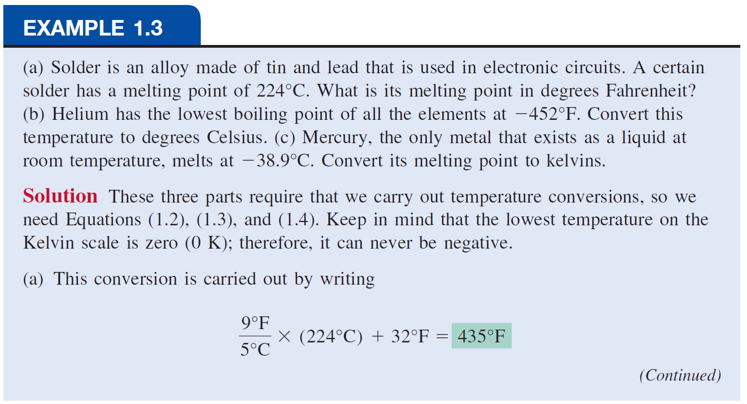

Slide 23
Scientific Notation 1
The number of atoms in 12 g of carbon:
602,200,000,000,000,000,000,000
The mass of a single carbon atom in grams:
0.0000000000000000000000199
N is a number between 1 and 10
n is a positive or negative integer

Slide 24
Scientific Notation 2
n > 0
n < 0
Addition or Subtraction
Write each quantity with the same exponent n
Combine
The exponent, n, remains the same

Slide 25
Scientific Notation 3
Multiplication
Multiply
Add exponents
Division
Divide
Subtract exponents

Slide 26
Significant Figures 1
Any digit that is not zero is significant
1.234 kg 4 significant figures
Zeros between nonzero digits are significant
606 m 3 significant figures
Zeros to the left of the first nonzero digit are not significant
0.08 L 1 significant figure
If a number is greater than 1, then all zeros to the right of the decimal point are significant
2.0 mg 2 significant figures
If a number is less than 1, then only the zeros that are at the end and in the middle of the number are significant
0.00420 g 3 significant figures

Slide 27
(1) Express 568.762 in scientific notation:
568.762 = 5.68762 × 10²
Note that the decimal point is moved to the left by two places and n = 2
(2) Express 0.00000772 in scientific notation:
0.00000772 = 7.72 × 10^{–6}
Here the decimal point is moved to the right by six places and n = –6

Slide 28
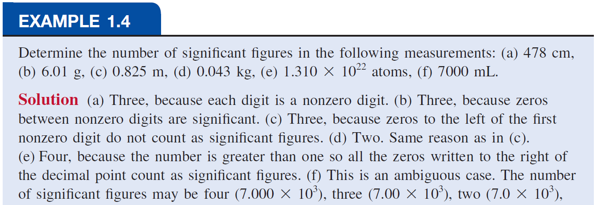

Slide 29
Significant Figures 2
Addition or Subtraction
The answer cannot have more digits to the right of the decimal point than any of the original numbers.

Slide 30
Significant Figures 3
Multiplication or Division
The number of significant figures in the result is set by the original number that has the smallest number of significant figures.

Slide 31
Significant Figures 4
Exact Numbers
Numbers from definitions or numbers of objects are considered to have an infinite number of significant figures.
The average of three measured lengths: 6.64, 6.68 and 6.70?
Because 3 is an exact number

Slide 32
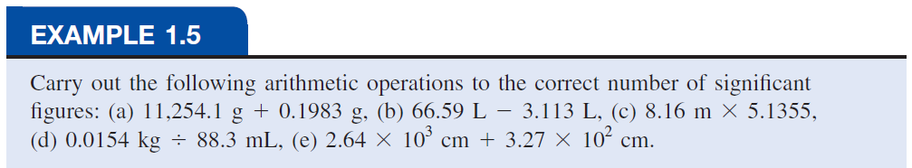
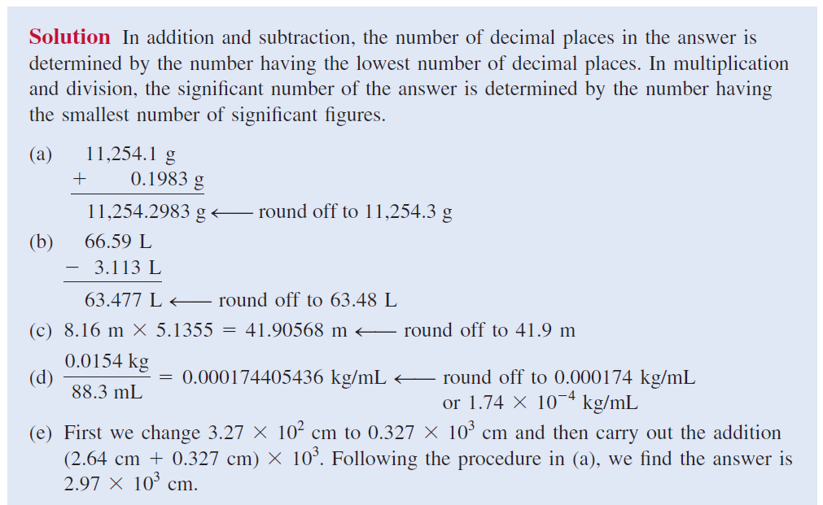

Slide 33
Dimensional Analysis Method of Solving Problems
Determine which unit conversion factor(s) are needed
Carry units through calculation
If all units cancel except for the desired unit(s), then the problem was solved correctly.

Slide 34
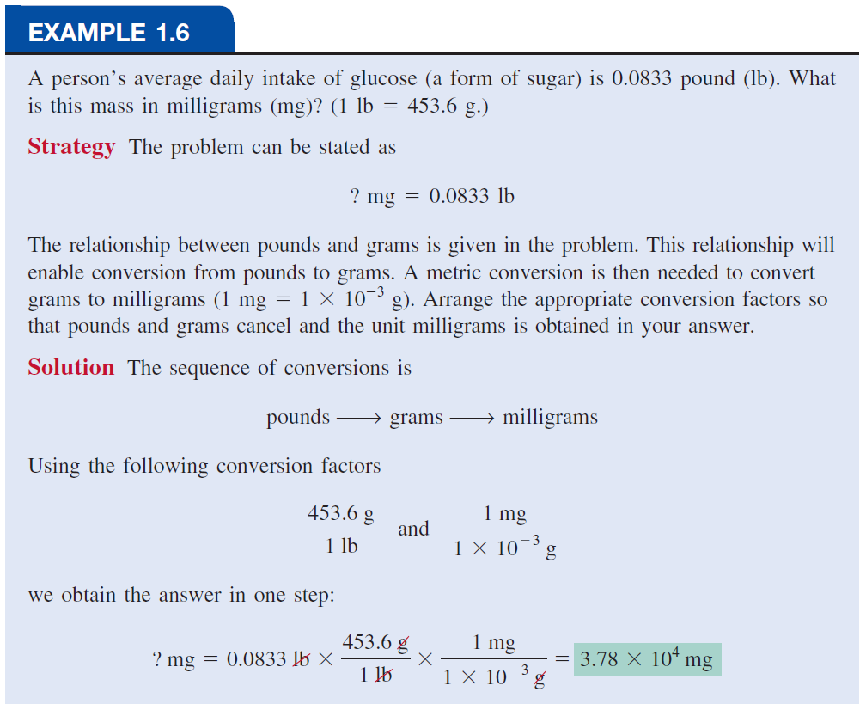

Slide 35
