Slide 1
Management of Economic Exposure
Chapter Nine
Copyright © 2021 by the McGraw-Hill Companies, Inc. All rights reserved.
Notes:
This chapter provides a way to measure economic exposure, discusses its determinants, and presents methods for managing and hedging economic exposure.

Slide 2
Chapter Outline
How to Measure Economic Exposure
Operating Exposure: Definition
Illustration of Operating Exposure
Determinants of Operating Exposure
Managing Operating Exposure
Summary
Copyright © 2021 by the McGraw-Hill Companies, Inc. All rights reserved.
9-2

Slide 3
Economic Exposure
Changes in exchange rates can affect not only firms that are directly engaged in international trade but also purely domestic firms.
Furthermore, changes in exchange rates may affect not only the operating cash flows of a firm by altering its competitive position but also dollar (home currency) values of the firm’s assets and liabilities
Exchange rate changes can systematically affect the value of the firm by influencing its operating cash flows as well as the domestic currency values of its assets and liabilities
Copyright © 2021 by the McGraw-Hill Companies, Inc. All rights reserved.
9-3
Notes:
for example, a U.S. bicycle manufacturer that sources only domestic materials and sells exclusively in the U.S. market, with no foreign-currency receivables or payables in its accounting book. This seemingly purely domestic U.S. firm can be subject to foreign exchange exposure if it competes against imports, say, from a Taiwanese bicycle manufacturer. When the Taiwanese dollar depreciates against the U.S. dollar, this is likely to lead to a lower U.S. dollar price of Taiwanese bicycles, boosting their sales in the United States, thereby hurting the U.S. manufacturer.
Example of Laker Airways. Operating CF, A classic example of the peril of facing currency exposure is provided by Laker Airways, a British firm founded by Sir Freddie Laker, which pioneered the concept of mass-marketed, low-fare air travel. The company heavily borrowed U.S. dollars to finance acquisitions of aircraft while it derived more than half of its revenue in sterling. As the dollar kept appreciating against the British pound (and most major currencies) throughout the first half of the 1980s, the burden of servicing the dollar debts became overwhelming for Laker Airways, forcing it to default.

Slide 4
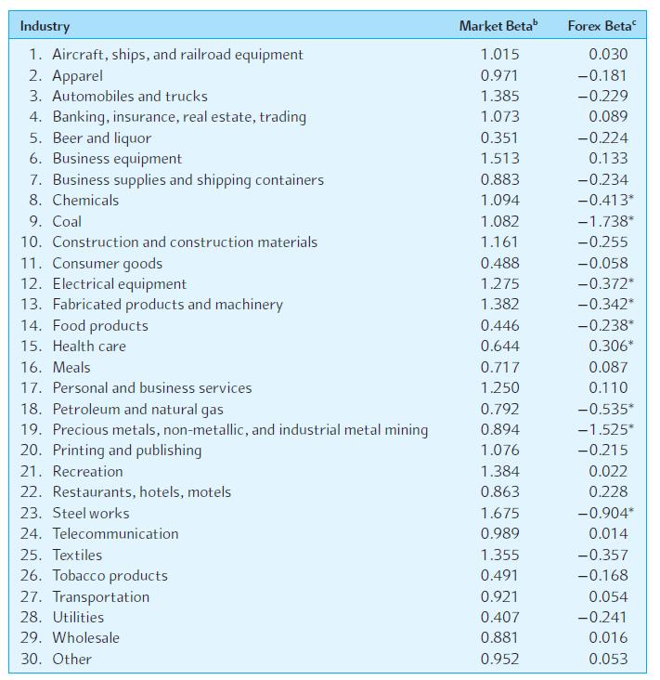
Exchange Rate Exposure of U.S. Industry Portfolios
Copyright © 2021 by the McGraw-Hill Companies, Inc. All rights reserved.
9-4
Notes:
This exhibit provides an estimate of the U.S. industries’ market betas as well as the “forex” betas during the period of 2000-2018.
A negative (positive) forex beta means that stock returns tend to move down (up) as the dollar appreciates. Out of the 30 total industries studied, 9 were found to have a significant exposure to exchange rate movements.

Slide 5
How to Measure Economic Exposure
Currency risk (or uncertainty) represents random changes in exchange rates, while currency exposure measures “what is at risk”
Under certain conditions, a firm may not face any exposure at all, that is, nothing is at risk, even if the exchange rates change randomly.
Exposure to currency risk can be properly measured by the following:
Sensitivity of the future home currency values of the firm’s assets and liabilities to random changes in exchange rates
Sensitivity of the firm’s operating cash flows to random changes in exchange rates
Copyright © 2021 by the McGraw-Hill Companies, Inc. All rights reserved.
9-5
Notes:
Not Exposed Example: Suppose your company maintains a vacation home for employees in the British countryside and the local price of this property is always moving together with the pound price of the U.S. dollar. As a result, whenever the pound depreciates against the dollar, the local currency price of this property goes up by the same proportion. In this case, your company is not exposed to currency risk even if the pound/dollar exchange rate fluctuates randomly.
No sensitivity to exchange rates example: if your company’s operating cash flows are sensitive to exchange rate changes, the company is again exposed to currency risk.

Slide 6
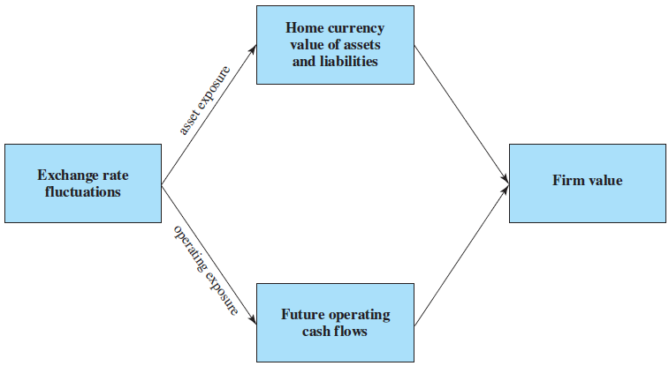
Channels of Economic Exposure
Copyright © 2021 by the McGraw-Hill Companies, Inc. All rights reserved.
9-6

Slide 7
Measuring Asset Exposure
From the perspective of a U.S. firm that owns an asset in Britain, the exposure can be measured by the coefficient (b) in regressing the dollar value (P) of the British asset on the dollar/pound exchange rate (S)
P = a + b×S + e
Where
a is the regression constant
e is the random error term with mean zero
the regression coefficient b measures the sensitivity of the dollar value of the asset (P) to the exchange rate (S)
Copyright © 2021 by the McGraw-Hill Companies, Inc. All rights reserved.
9-7

Slide 8
Measuring Asset Exposure (Continued)
The exposure coefficient, b, is defined as follows:
Cov(P,S)
b =
Var(S)
Where
Cov(P,S) is the covariance between the dollar value of the asset and the exchange rate
Var(S) is the variance of the exchange rate
Copyright © 2021 by the McGraw-Hill Companies, Inc. All rights reserved.
9-8

Slide 9
Example
Suppose a U.S. firm has an asset in Britain whose local currency price is random.
For simplicity, suppose there are only three states of the world and each state is equally likely to occur.
The future local currency price of this British asset (P*) as well as the future exchange rate (S) will be determined, depending on the realized state of the world.
Copyright © 2021 by the McGraw-Hill Companies, Inc. All rights reserved.
9-9

Slide 10
Measurement of Currency Exposure
Copyright © 2021 by the McGraw-Hill Companies, Inc. All rights reserved.
9-10
Notes:
First, consider Case 1, described in Panel A. Case 1 indicates that the local currency price of the asset (P*) and the dollar price of the pound (S) are positively correlated, so that depreciation (appreciation) of the pound against the dollar is associated with a declining (rising) local currency price of the asset. The dollar price of the asset on the future (liquidation) date can be $1,372, or $1,500 or $1,712, depending on the realized state of the world. (For illustration, the computations of the parameter values for Case 1 are shown in the next slide.)
Key takeaway:
A positive correlation between P* and S amplifies exchange rate risk. If the exchange rate changes, the dollar price of the asset changes significantly.
Next, consider Case 2. This case indicates that the local currency value of the asset is clearly negatively correlated with the dollar price of the British pound. In fact, the effect of exchange rate changes is exactly offset by movements of the local currency price of the asset, rendering the dollar price of the asset totally insensitive to exchange rate changes. The future dollar price of the asset will be uniformly $1,400 across the three states of the world. One thus can say that the British asset is effectively denominated in terms of the dollar. Although this case may be unrealistic, it shows that uncertain exchange rates or exchange risk does not necessarily constitute exchange exposure.
Key takeaway:
Despite exchange rate variability, the asset's dollar price is completely insensitive to exchange rate changes. This means there’s no exchange exposure, even though exchange rates fluctuate.
It’s as if the asset were denominated in dollars.
We now turn to Case 3, where the local currency price of the asset is fixed at £1,000. In this case, the U.S. firm faces a “contractual” cash flow that is denominated in pounds. This case, in fact, represents an example of the special case of economic exposure, transaction exposure. Intuitively, what is at risk is £1,000, that is, the exposure coefficient, b, is £1,000.
Key takeaway:
This is a clear case of transaction exposure: the dollar price of the asset depends entirely on the exchange rate because the local currency price (P∗) is fixed. The risk lies in the variability of S
Case 1: P∗ and S move in the same direction, creating variability in the dollar price (PPP).Case 2: P∗ and S move in opposite directions, canceling out dollar price variability (P is constant).Case 3: P∗ is fixed, so the dollar price (P) depends only on S, reflecting pure exchange rate risk.
b=£1,700b Means
Exposure Coefficient:
It essentially tells us how much of the asset's value in GBP (P∗) is at risk due to changes in the exchange rate (S).
This means if the exchange rate (SSS) changes by 1%, the dollar price (PPP) will change by approximately 1% of £1700.

Slide 11
Computations of Regression Parameters: Case 1
Copyright © 2021 by the McGraw-Hill Companies, Inc. All rights reserved.
9-11

Slide 12
Hedging Asset Exposure
Once the magnitude of the exposure is known, the firm can hedge the exposure by simply selling the exposure forward
We can decompose the variability of the dollar value of the asset, Var(P), into two separate components: exchange rate-related and residual
Consequences of hedging the exposure by forward contracts are illustrated in the next slide
Copyright © 2021 by the McGraw-Hill Companies, Inc. All rights reserved.
9-12
Notes:
The first term in the right-hand side of the equation, b²Var(S), represents the part of the variability of the dollar value of the asset that is related to random changes in the exchange rate, whereas the second term, Var(e), captures the residual part of the dollar value variability that is independent of exchange rate movements.

Slide 13
Consequences of Hedging Currency Exposure
Copyright © 2021 by the McGraw-Hill Companies, Inc. All rights reserved.
9-13

Slide 14
Operating Exposure: Definition
Many managers do not fully understand the effect of volatile exchange rates on operating cash flows
Operating exposure is the extent to which the firm’s operating cash flows will be affected by random changes in the exchange rates
In many cases, operating exposure may account for a larger portion of the firm’s total exposure than contractual exposure
Copyright © 2021 by the McGraw-Hill Companies, Inc. All rights reserved.
9-14

Slide 15
Illustration of Operating Exposure
“Suppose a U.S. computer company has a wholly owned British subsidiary, Albion Computers PLC, that manufactures and sells PCs in the U.K. market. Albion Computers imports microprocessors from Intel, which sells them for $512 per unit. At the current exchange rate of $1.60 per pound, each Intel microprocessor costs £320. Albion Computers hires British workers and sources all the other inputs locally. Albion faces a 50 percent income tax rate in the U.K.”
Copyright © 2021 by the McGraw-Hill Companies, Inc. All rights reserved.
9-15

Slide 16
Projected Operations for Albion Computers PLC: Benchmark Case ($1.60/)
Copyright © 2021 by the McGraw-Hill Companies, Inc. All rights reserved.
9-16

Slide 17
Illustration of Operating Exposure (Continued)
Consider the possible effect of a depreciation of the pound on the projected dollar operating cash flow of Albion Computers.
Assume the pound may depreciate from $1.60 to $1.40 per pound
The dollar operating cash flow may change following a pound depreciation due to:
Competitive effect
Conversion effect
Copyright © 2021 by the McGraw-Hill Companies, Inc. All rights reserved.
9-17

Slide 18
Illustration of Operating Exposure (Concluded)
Consider the following cases with varying degree of realism:
Case 1: No variables change, except the price of the imported input.
Case 2: The selling price as well as the price of the imported input changes, with no other changes.
Case 3: All the variables change.
Copyright © 2021 by the McGraw-Hill Companies, Inc. All rights reserved.
9-18

Slide 19
Projected Operations for Albion Computers PLC: Case 1 ($1.40/£)
Copyright © 2021 by the McGraw-Hill Companies, Inc. All rights reserved.
9-19

Slide 20
Projected Operations for Albion Computers PLC: Case 2 ($1.40/£)
Copyright © 2021 by the McGraw-Hill Companies, Inc. All rights reserved.
9-20

Slide 21
Projected Operations for Albion Computers PLC: Case 3 ($1.40/£)
Copyright © 2021 by the McGraw-Hill Companies, Inc. All rights reserved.
9-21

Slide 22
Summary of Operating Exposure Effect of Pound Depreciation on Albion Computers
Copyright © 2021 by the McGraw-Hill Companies, Inc. All rights reserved.
9-22

Slide 23
Determinants of Operating Exposure
Operating exposure cannot be readily determined from the firm’s accounting statements, unlike transaction exposure
A firm’s operating exposure is determined by:
The structure of the markets in which the firm sources its inputs, such as labor and materials, and selling its products
The firm’s ability to mitigate the effect of exchange rate changes by adjusting its markets, product mix, and sourcing
Copyright © 2021 by the McGraw-Hill Companies, Inc. All rights reserved.
9-23

Slide 24
Determinants of Operating Exposure (Continued)
A firm is usually subject to high degrees of operating exposure when either its cost or its price is sensitive to exchange rate changes
When both the cost and the price are sensitive or insensitive to exchange rate changes, the firm has no major operating exposure
The extent to which a firm is subject to operating exposure depends on the firm’s ability to stabilize cash flows in the face of exchange rate changes
Copyright © 2021 by the McGraw-Hill Companies, Inc. All rights reserved.
9-24

Slide 25
Managing Operating Exposure
Objective of managing operating exposure is to stabilize cash flows in the fact of fluctuating exchange rates
Firms may use the following strategies for managing operating exposure:
Selecting low-cost production sites
Flexible sourcing policy
Diversification of the market
Product differentiation and R&D efforts
Financial hedging
Copyright © 2021 by the McGraw-Hill Companies, Inc. All rights reserved.
9-25

Slide 26
Selecting Low Cost Production Sites
When the domestic currency is strong or expected to become strong, a firm may choose to locate production facilities in a foreign country where costs are low
Low costs may be due to either the undervalued currency or underpriced factors of production
The firm may choose to establish and maintain production facilities in multiple countries to deal with the effect of exchange rate changes
Example: Nissan has manufacturing facilities in the U.S., U.K., and Mexico, as well as Japan
Copyright © 2021 by the McGraw-Hill Companies, Inc. All rights reserved.
9-26

Slide 27
Flexible Sourcing Policy
Even if a firm has manufacturing facilities only in the domestic country, it can substantially lessen the effect of exchange rate changes by sourcing from where input costs are low
Example: In the early 1980s when the dollar was very strong against most major currencies, U.S. multinational firms often purchased materials and components from low-cost foreign suppliers
Flexible sourcing policy is a strategy for managing operating exposure that involves sourcing from areas where input costs are low
Copyright © 2021 by the McGraw-Hill Companies, Inc. All rights reserved.
9-27

Slide 28
Diversification of the Market
Diversifying the market for the firm’s products is another way to managing exchange exposure
Example: If GE is selling power generators in Mexico and Germany, reduced sales in Mexico (due to the dollar appreciation against the peso) could be compensated by increased sales in Germany (due to the dollar depreciation against the euro)
Note that expansion into a new business should be justified on is own right, not solely as a solution to currency exposure
Copyright © 2021 by the McGraw-Hill Companies, Inc. All rights reserved.
9-28

Slide 29
R&D Efforts and Product Differentiation
Investment in research and development (R&D) can allow the firm to maintain and strengthen its competitive position in the face of adverse exchange rate movements
Successful R&D allows the firm to do the following:
Cut costs and enhance productivity
Introduce new and unique products for which competitors offer no close substitutes
Copyright © 2021 by the McGraw-Hill Companies, Inc. All rights reserved.
9-29

Slide 30
Financial Hedging
Financial hedging can be used to stabilize the firm’s cash flows
Financial hedging refers to hedging exchange risk exposure using financial contracts such as currency forward and options contracts
If operational hedges, which involve redeployment of resources, are costly or impractical, financial contracts can provide the firm with a flexible and economical way of dealing with exchange exposure
Copyright © 2021 by the McGraw-Hill Companies, Inc. All rights reserved.
9-30

