Slide 1
Carrier particle Agglutination
Latex agglutination
flocculation

Slide 2
Carrier particle agglutination test
Agglutination test: Qualitative/ Quantitative(Ab titer) agglutination test. It is used to determine Ag or Ab presence and amount(titer)
Carrier particles: Latex, RBC’s, charcoal, protein A of Staph. Aureus.
It is an indirect test.
It is used to detect Ag or Ab in the patient sample.
Latex particles are inert polystyrene substance(0.79-0.81mm).Ag or Ab attach spontaneously to it.

Slide 3
Latex Agglutination Test
Rheumatoid arthritis (RA)
Is traditionally considered a chronic, inflammatory autoimmune disorder that causes the immune system to attack the joints.
It is a disabling and painful inflammatory condition, which can lead to substantial loss of mobility due to pain and joint destruction.
RA is a systemic disease, often affecting extra- articular tissues throughout the body including the skin, blood vessels, heart, lungs, and muscles.
About 60% of RA patients are unable to work 10 years after the onset of their disease.

Slide 4
The Rheumatoid arthritis immune response appears to be directed against multiple antigenic determinants on the gamma globulin molecule.( Anti-IgG)
In the test kit, latex particles are coated with human gamma globulin IgG molecule.
In the screening test, however, positive results may also be obtained due to others disorders such as:
    Systemic Lupus Erythematosis (SLE)
    Polyarteritis nodosa
    Dermatomyositis or Scleroderma.
Some diseases such as Cirrhosis, Hepatitis,, Syphilis, Sub acute bacterial endocarditis and Lymphomas may also give rise to agglutination reactions. Titers in these conditions are usually less than 1:20

Slide 5
Method:
Sample collection:
    Collect 5 – 10 ml venous blood into sterile tube without anticoagulant
    Allow to clot at room temp.
    Formation of clot must be complete
    Separate serum and store at 2-8 °C
    It is preferable to test samples within 2-3 days

Slide 6
Method:
Screening test
    Bring all reagents to room temp.
    Prepare 1:20 dilution of test serum by adding 50 μl of serum to 1 ml of glycine buffer
    Place 50 μl of diluted serum on to the test slide
    Add 1 drop of well shaken latex reagent
    Mix the two drops together with a clean stirrer and spread out to the edge of the test area
    Rock the slide gently and observe for macro agglutination
    Read at 2 minutes under a direct light source
    A definite clumping is reported as reactive (R).
    No clumping is reported as non-reactive (N).

Slide 7
CRP Latex Kit
C-reactive protein (CRP) is a non-specific test.
It is used by a doctor to detect inflammation if there is a high suspicion of tissue injury or infection somewhere in the body, but the test cannot tell where the inflammation is or what condition is causing it.
CRP is not diagnostic of any condition, but it can be used together with signs and symptoms and other tests to evaluate an individual for an acute or chronic inflammatory condition

Slide 8
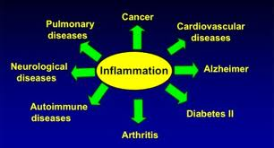
CRP Latex Kit

Slide 9
CRP Latex Agglutination test
The same principle of Latex kits .
CRP is a protein present normally in human serum.
Anti-CRP is coated on latex to detect CRP in patient sample to detect CRP in patient sample.
CRP is used mainly as a marker of inflammation
It may also be ordered on a regular basis to monitor conditions such as rheumatoid arthritis and Lupus and is often repeated at intervals to determine whether treatment is effective

Slide 10
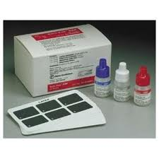
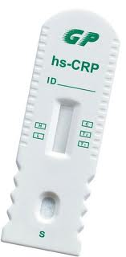
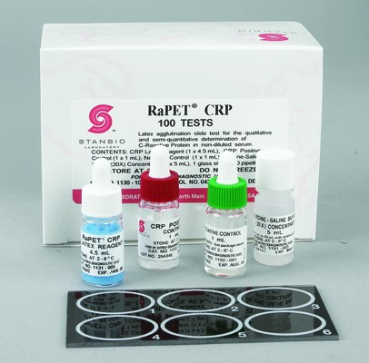
CRP Test
Elisa Kit
Latex kit
Latex Kit

Slide 11
Flocculation Test
Rapid Plasma Reagin (RPR)
Syphilis is a sexually transmitted disease caused by the spirochete Treponema pallidum.
The RPR (Rapid Plasma Reagin) Card test is a presumptive serologic screening test for syphilis.
The serum of a person with syphilis contains a non-specific anti-lipid antibody (termed Reagin), which is not found in normal serum.

Slide 12
Syphilis infection starts the breakdown of the patient's own tissue cells.
Fatty substances which are released, combine with protein from Treponema pallidum to form an antigen which stimulates the body to produce antibodies against both the body's tissue lipids (non-specific or non-treponemal) as well as the T. pallidum protein (specific or treponemal).
The RPR Card test detects the nonspecific antilipid antibody and is referred to as a non- treponemal test for syphilis.

Slide 13
Principle of the Method
The RPR test is a non-treponemal slide agglutination test for the qualitative and semi-quantitative detection of plasma reagins in human serum.
Carbon particles coated with a lipid complex are agglutinated when mixed with samples containing reagins.

Slide 14
The known RPR antigen consists of Cardiolipin, lecithin, and cholesterol bound to charcoal particles
Charcoal makes the reaction visible.
If the patient has syphilis, the antilipid antibodies (Reagin) in his/her serum will cross-react with the known RPR lipid antigens giving a visible clumping of the charcoal particles.

Slide 15
Procedure:
Place 50 µl of sample and one drop of each +ve and –ve controls into separate circles on the test slide.
Swirl the RPR-carbon reagent gently before using.
Place the micropipette in a vertical position and perpendicular to the slide, and add one drop (20 µl) of this reagent next to the samples to be tested.
Mix the drops with a stirrer, spreading them over the entire surface of the circle. Use different stirrers for each samples.
Place the slide on a mechanical rotor (shaker) at 80-100 r.p.m. for 8 minutes.
Read the test results immediately.

Slide 16
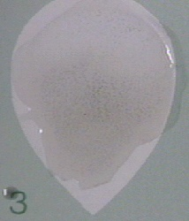

Read the results as follows:
A definite clumping of the charcoal particles is reported as reactive (R)
No clumping is reported as non-reactive (N).

Slide 17
Co-agglutination
Protein A which is a cell wall component of Staphylococcus aureus is able to bind to Fc portion of most IgG Ab leaving Fab portion free to interact with Ag present in specimens.
This test is used to detect Ag in specimens or isolated bacteria from cultures.
Example: streptococcal serotyping, Bacterial Ag detection kit for meningitis.

Slide 18
Co-agglutination
It is an agglutination where Ab is coated on protein A of Staph. aureus .
+
Co-agglutination
Y
Y
Y
Y
Y
Y
Y
Y
Y
Y
TEST Ag
Coated Ab on Staph protein A

