Slide 1
Candida Albicans

Slide 2
Candida Albicans
Candida is yeast
Typically found in small amounts on your mouth, intestines and skin
Often when Candida is off-balance, the yeast overgrows and causes infection (candidiasis).

Slide 3
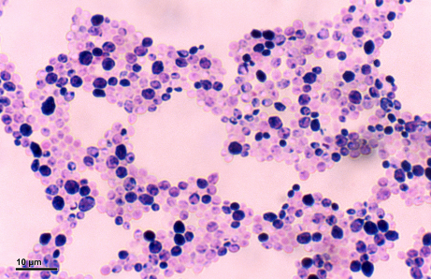
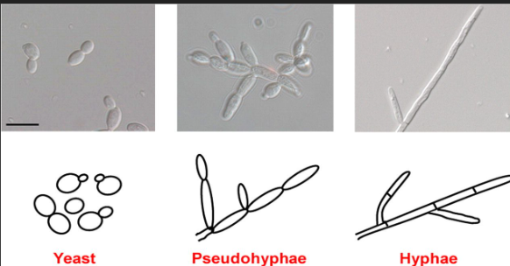
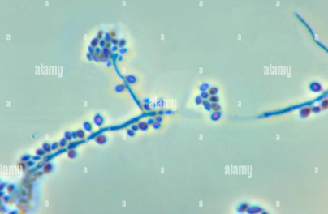
Morphology:
Candida albicans (gram-positive yeast)
It is generally referred to as a dimorphic fungus since it grows both as yeast and filamentous cells.
However, it has other different morphological phenotypes including pseudo-hyphal/pseudo-mycelium forms, Which formed from budding yeast cells that remain attached to each other
Spores may be formed on the pseudomycelium, called chlamydospores and can be used to identify different species of Candida.
Chlamydospores
Notes:
Filamentous/

Slide 4
Invasion
(Pathogenicity mechanisms)
.
Yeast cells adhere to host cell surfaces
Contact to host cells triggers the
yeast-to-hypha transition
Virulence Factors that cause disease in a host.
Proteolytic enzymes: these enzymes are associated with tissue invasion of the host.
protein adhesions: responsible for invading the host cells and tissue damage

Slide 5
Candidiasis
Candidiasis is a fungal infection caused by yeasts that belong to the genus Candida
There are over 20 species of Candida yeasts that can cause infection in humans, the most common of which is Candida albicans.
Symptoms of candidiasis vary depending on the area of the body that is infected.

Slide 6
Oral candidiasis (thrush):
Candida albicans can cause infections an infection that causes white sores in your mouth, throat, or tongue

Slide 7
Candida granuloma:
A severe, chronic infection that targets your skin, scalp, or fingernails.
On skin:Appear as itchy, rashy infections in areas where skin is warm and moist, like the armpits, between skin folds, in between toes and fingers
An infected scalp may have white flakes and pimples.
C. albicans can also infect toenails and fingernails.
Typically, nails will be discolored and thickened

Slide 8
Candidemia
Candidemia is a blood infection with Candida species.
It can lead to long hospitalization and an increase in mortality due to concurrent conditions.
Risk factors for candidemia include:
1-immunosuppression
2-major surgery
3-placement of a medical device such as a feeding tube or catheter

Slide 9
Diagnosis of Candidiasis
Direct Microscopy:
Skin and nails should be examined using 10% KOH
(B) Body fluids should be centrifuged and the sediment examined using either 10% KOH and or Gram stain
(C) Tissue sections can be stained using Gram stain
⦿ Examine specimens for the presence of small, round to oval,, clusters of budding yeast cells (blastoconidia) and branching pseudohyphae
Candida albicans (gram-positive yeast)
Blastoconidia
Chlamydospores
Pseudomycelium

