Slide 1

41 Digital Cryptography Techniques
CY
B 2
In
troduction

Slide 2
Course Description
This course will introduce students to topics in cryptography techinques . Topics will include
  Security Concepts, Types of attacks, Services
  Classical Encryption
  Block ciphers (DES and AES)
  Public-Key Cryptography
  RSA
  Authentication: Hash functions, User authentication Protocols
  Digital Signature
  Key Management

Slide 3
Course Learning Outcomes
    Identify the main security attack types, for cryptography system.
  Discuss the implementation of cryptography protocols at various systems.
  Apply symmetric and asymmetric ciphers
  Illustrate the operation of authentication protocols and key management.
3.1) Analyze the main components of cryptography system.

Slide 4
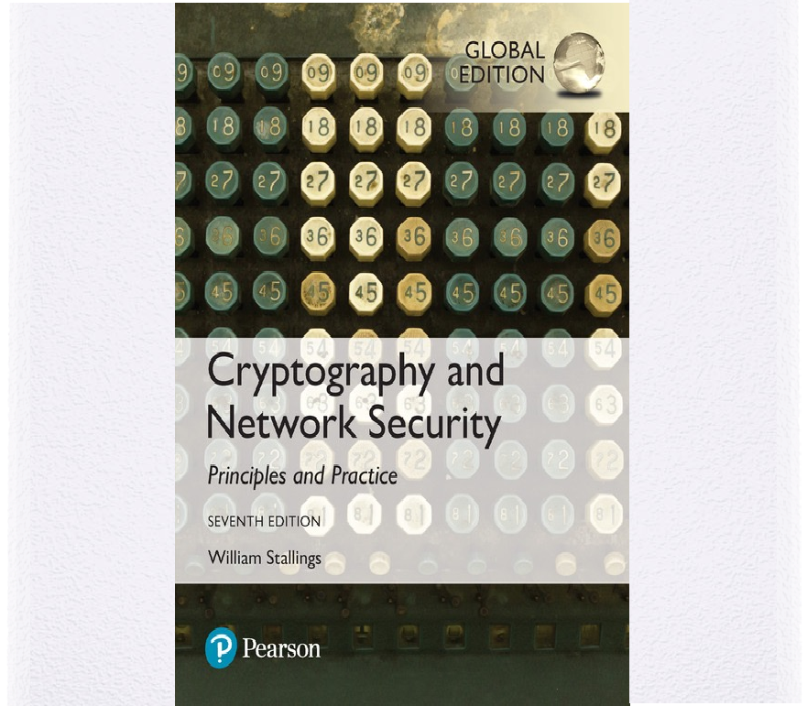
Basic Course Information
Textbook
Cryptography And Network Security, Seventh Edition by William Stallings

Slide 5
Basic Course Information
Grading (tentative)
25%
5%
10%
10%
10%
40%
Midterm Exam-1 (Week 8, 27 Feb)
Online discussion
HW
Programming assignment
Quizzes Q1 W5 Feb 6, Q2 W15 April 17
Final

Slide 6
Course Policy
I will use Blackboard LMS for announcement and to post course materials (lecture slides,.. etc.). You are responsible to check it regularly.
Attendance in the lecture is a must. Students failed to achieve more than 75% attendance will be reported to the concerned authority; excuse should be directly submitted to the concerned authority; excuses of absence are accepted no later than one week of the absence.
Cheating or plagiarism in any form will not be tolerated. A grade of zero will be registered for any infraction.

Slide 7












Cryptographic algorithms and protocols can be grouped into four main areas:
Symmetric encryption
Used to conceal the contents of blocks or streams of data of any size, including messages, files, encryption keys, and passwords
Asymmetric encryption
Used to conceal small blocks of data, such as encryption keys and hash function values, which are used in digital signatures
Data integrity algorithms
Used to protect blocks of data, such as messages, from alteration
Authentication protocols
Schemes based on the use of cryptographic algorithms designed to authenticate the identity of entities

Slide 8




The field of network and Internet security consists of:
measures to prevent, detect, and correct security violations that involve the transmission of information

Slide 9
Motivation Examples
A transmits file which contains sensitive information to B
  C, unauthorized, monitor transmission and get a copy of the file during its transmission
Network manager, D, sends file to computer E to update accounts file with new users
  F intercept message, add/delete, transmit
F constructs his own message and send it to E as if it had come from D
Fired employee delays a message to deactivate his account until he retrieves sensitive information
Customer sends instructions to stockbroker
  investments lose value; customer denies sending

Slide 10
Computer Security
The NIST Computer Security Handbook defines the term computer security as:
“the protection afforded to an automated information system in order to attain the applicable objectives of preserving the integrity, availability and confidentiality of information system resources” (includes hardware, software, firmware, information/ data, and telecommunications)

Slide 11






Computer Security Objectives
Confidentiality
Data confidentiality
  Assures that private or confidential information is not made available or disclosed to unauthorized individuals
Privacy
  Assures that individuals control or influence what information related to them may be collected and stored and by whom and to whom that information may be disclosed
Integrity
Data integrity
  Assures that information and programs are changed only in a specified and authorized manner
System integrity
  Assures that a system performs its intended function in an unimpaired manner, free from deliberate or inadvertent unauthorized manipulation of the system
Availability
Assures that systems work promptly and service is not denied to authorized users

Slide 12


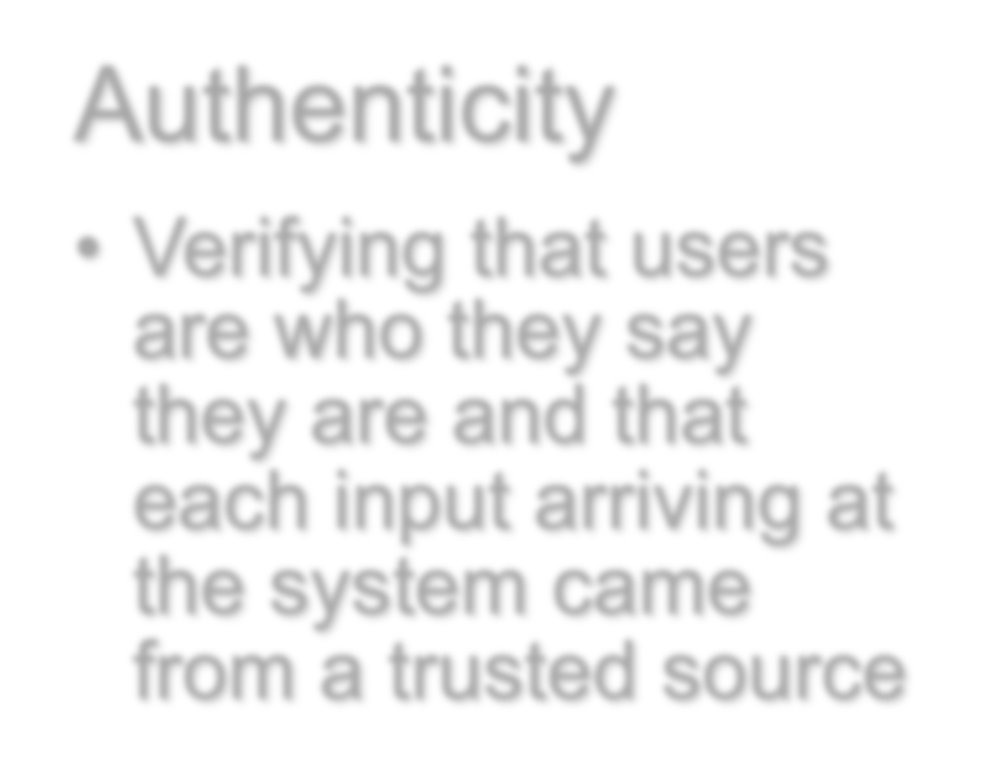
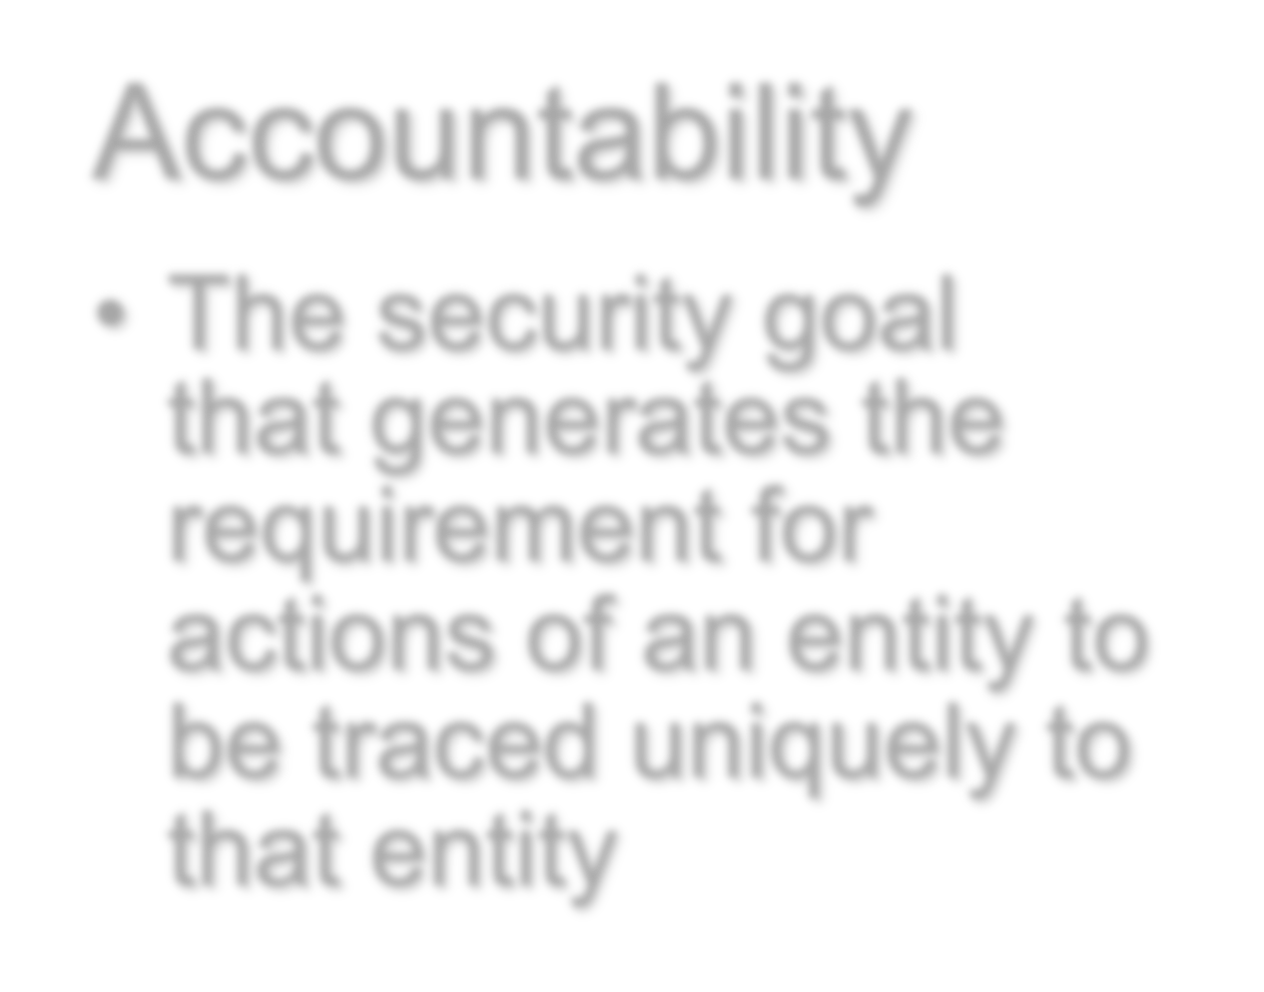
















Possible additional concepts:
Authenticity
Verifying that users are who they say they are and that each input arriving at the system came from a trusted source
Accountability
The security goal that generates the requirement for actions of an entity to be traced uniquely to that entity

Slide 13
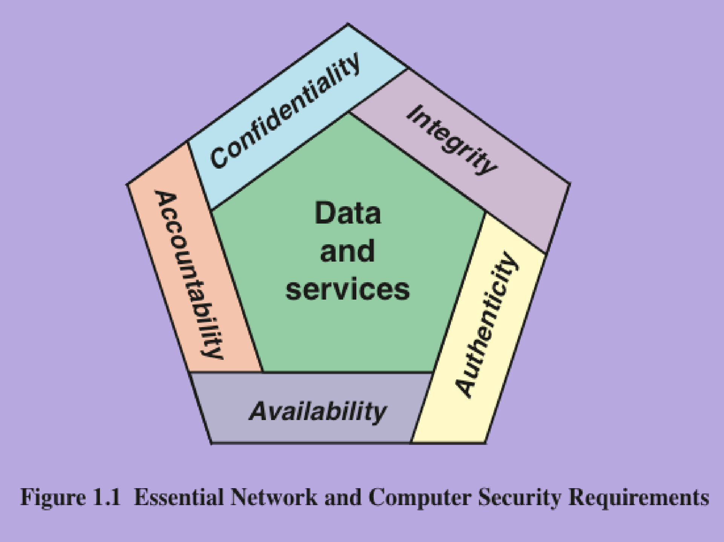
14

Slide 14





Breach of Security - Levels of Impact
High
The loss could be expected to have a severe or catastrophic adverse effect on organizational operations, organizational assets, or individuals
Moderate
The loss could be expected to have a serious adverse effect on organizational operations, organizational assets, or individuals
The loss could be expected to have a limited adverse effect on organizational operations, organizational assets, or individuals
Low

Slide 15
Examples
 | Confidentiality | Integrity | Availability
High | Student grade | Patient’s allergy information | Authentication of critical system
Moderate | Student’s enrollment info | Online forum | Public university website
Low | Student’s contact information | Anonymous online poll | Public telephone directory

Slide 16
Question
Think of other examples of high, moderate and low security breaches

Slide 17
Computer Security Challenges
Security is not simple
You have to consider the Potential attacks
It is necessary to decide where to use the various security mechanisms
Security required integrating more than a particular algorithm or protocol
The attacker needs to be right once, while the defender must be right all the time.
Little benefit from security investment is perceived until a security failure occurs.
Requires constant monitoring
The security is too often added later after design (vs. secure by design)
Strong security is often viewed as an impediment to efficient and user- friendly operation

Slide 18
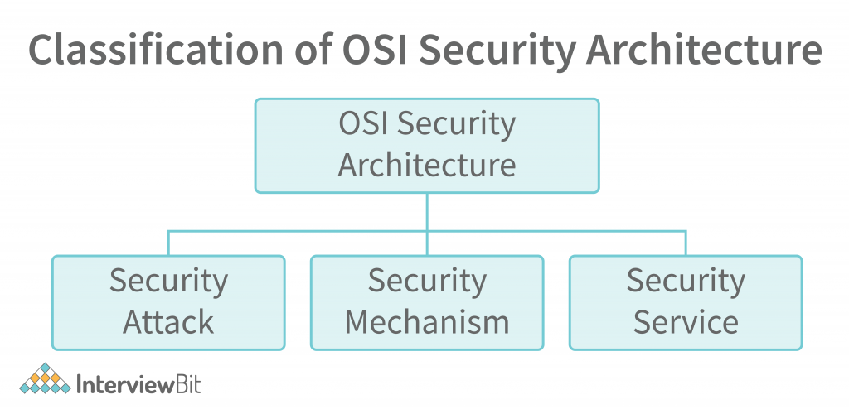
The OSI Security Architecture

Slide 19

Threats vs. Attacks
19
Threat
A potential for violation of security, which exists when there is a circumstance, capability, action, or event that could breach security and cause harm. That is, a threat is a possible danger that might exploit a vulnerability.
Attack
An assault on system security that derives from an intelligent threat; that is, an intelligent act that is a deliberate attempt (especially in the sense of a method or technique) to evade security services and violate the security policy of a system.
Copyright © 2017 Pearson Education, Inc. All Rights Reserved

Slide 20
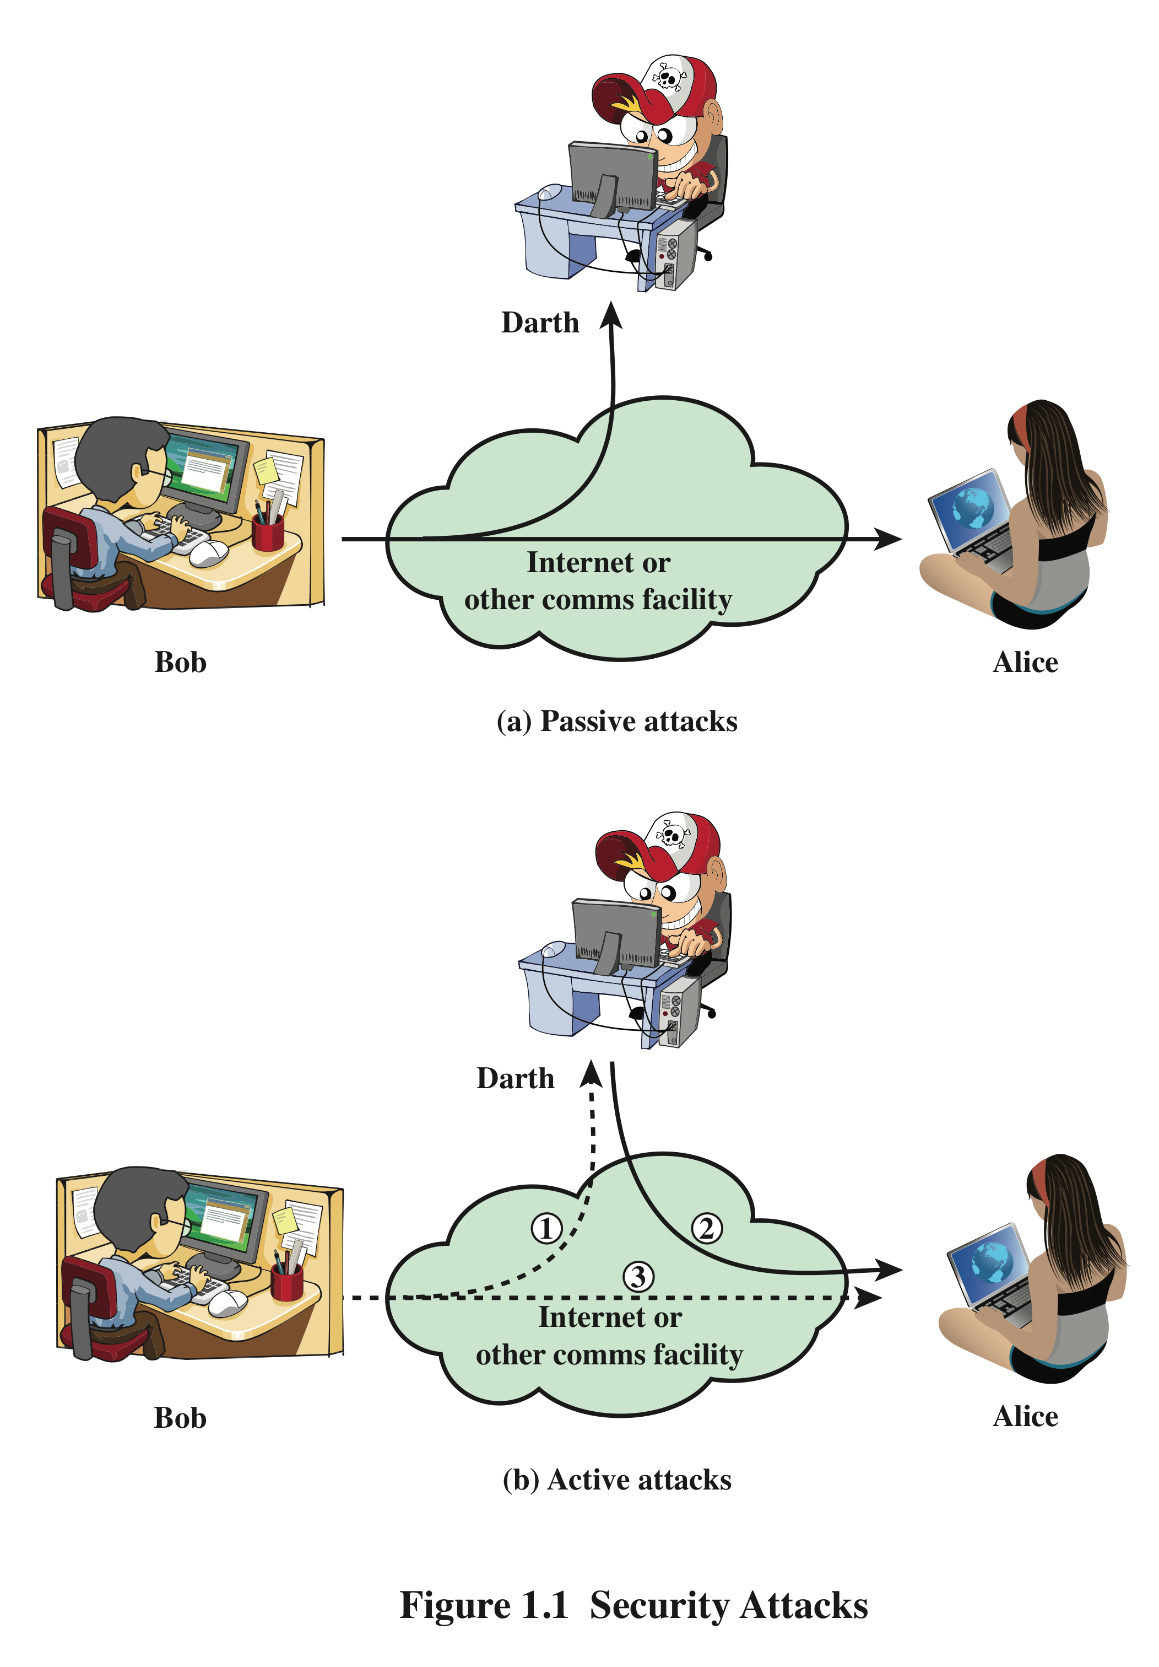
Security Attacks
We can classify the security attacks in terms of passive attacks and active attacks
A passive attack attempts to learn or make use of information from the system but does not affect system resources
An active attack attempts to alter system resources or affect their operation

Slide 21

Passive Attacks
Are in the nature of eavesdropping on, or monitoring of, transmissions
Goal of the opponent is to obtain information that is being transmitted
  Two types of passive attacks are:
    The release of message contents
      tap on phone line to hear conversation
      get unauthorized copy of email message
    Traffic analysis
      determine location and identity of parties
      observe the pattern of these messages.

Slide 22

















Active Attacks
Involve some modification of the data stream or the creation of a false stream
Difficult to prevent because of the wide variety of potential physical, software, and network vulnerabilities
Goal is to detect attacks and to recover from any disruption or delays caused by them
Takes place when one entity pretends to be a different entity
Usually includes one of the other forms of active attack
Masquerade
Involves the passive capture of a data unit and its subsequent retransmission to produce an unauthorized effect
Replay
Some portion of a legitimate message is altered, or messages are delayed or reordered to produce an unauthorized effect
Modification of messages
Denial of service
Prevents or inhibits the normal use or management of communications facilities

Slide 23
Security Services
X.800:
“a service provided by a protocol layer of communicating open systems, which ensures adequate security of the systems or of data transfers”
RFC 4949:
“a processing or communication service provided by a system to give a specific kind of protection to system resources”

Slide 24
Security Services (X.800)
Authentication - assurance that communicating entity is the one claimed
Access Control - prevention of the unauthorized use of a resource
Data Confidentiality –protection of data from unauthorized disclosure
Data Integrity - assurance that data received is as sent by an authorized entity
Non-Repudiation - protection against denial by one of the parties in a communication
Availability – resource accessible/usable
24
Slides of W. Stallings 5/E by L. Brawn.

Slide 25
Security Mechanism
The security mechanism is an entire process that is specifically designed to identify the attack and develops a strategy to recover or prevent the attack.

Slide 26
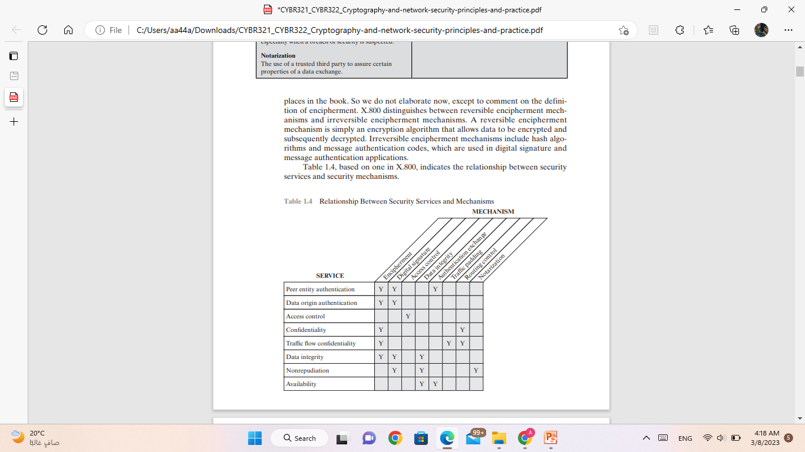
Security Mechanism

Slide 27
Reading Assignment
Textbook
  chapter 1: sections [1.1 - 1.4]
25

