Slide 1
Chapter 11: Project Risk Management
Information Technology Project Management, Seventh Edition
Note: See the text itself for full citations.

Slide 2
The Importance of Project Risk Management
Project risk management is the art and science of identifying, analyzing, and responding to risk throughout the life of a project and in the best interests of meeting project objectives
Risk management is often overlooked in projects, but it can help improve project success by helping select good projects, determining project scope, and developing realistic estimates

Slide 3
The Importance of Project Risk Management
Good project risk management often goes unnoticed, unlike crisis management, which indicates an obvious danger to the success of a project. The crisis, in turn, receives the intense interest of the entire project team. Resolving a crisis has much greater visibility, often accompanied by rewards from management, than successful risk management. In contrast, when risk management is effective, it results in fewer problems, and for the few problems that exist, it results in more expeditious resolutions

Slide 4
Negative Risk
A dictionary definition of risk is “the possibility of loss or injury”
Negative risk involves understanding potential problems that might occur in the project and how they might impede project success
Negative risk management is like a form of insurance; it is an investment

Slide 5
Risk Can Be Positive
Positive risks are risks that result in good things happening; sometimes called opportunities
A general definition of project risk is an uncertainty that can have a negative or positive effect on meeting project objectives
The goal of project risk management is to minimize potential negative risks while maximizing potential positive risks

Slide 6
Risk Utility
Risk utility is the amount of satisfaction or pleasure received from a potential payoff
Utility rises at a decreasing rate for a risk-averse person or organization. In other words, when more payoff or money is at stake, a person or organization that is risk-averse gains less satisfaction from the risk, or has lower tolerance for the risk.
Those who are risk-seeking have a higher tolerance for risk and their satisfaction increases when more payoff is at stake. A risk-seeking person or organization prefers outcomes that are more uncertain and is often willing to pay a penalty to take risks
The risk-neutral approach achieves a balance between risk and payoff

Slide 7
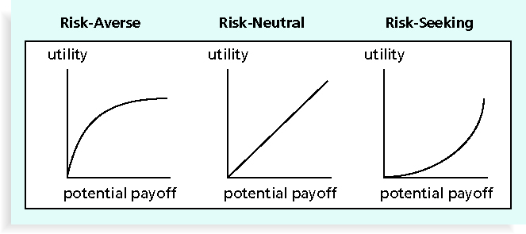
Figure 11-2. Risk Utility Function and Risk Preference

Slide 8
For example, a risk-averse organization might not purchase hardware from a vendor who has not been in business for a specified period of time. A risk-seeking organization might deliberately choose start-up vendors for hardware purchases to gain new products with unusual features that provide an advantage. A risk-neutral organization might perform a series of analyses to evaluate possible purchase decisions. This type of organization evaluates decisions using a number of factors—risk is just one of them.

Slide 9
Project Risk Management Processes
Planning risk management : Deciding how to approach and plan the risk management activities for the project
Identifying risks: Determining which risks are likely to affect a project and documenting the characteristics of each
Performing qualitative risk analysis: Prioritizing risks based on their probability and impact of occurrence

Slide 10
Project Risk Management Processes (cont’d)
Performing quantitative risk analysis: Numerically estimating the effects of risks on project objectives
Planning risk responses: Taking steps to enhance opportunities and reduce threats to meeting project objectives
Controlling risk: Monitoring identified and residual risks, identifying new risks, carrying out risk response plans, and evaluating the effectiveness of risk strategies throughout the life of the project

Slide 11
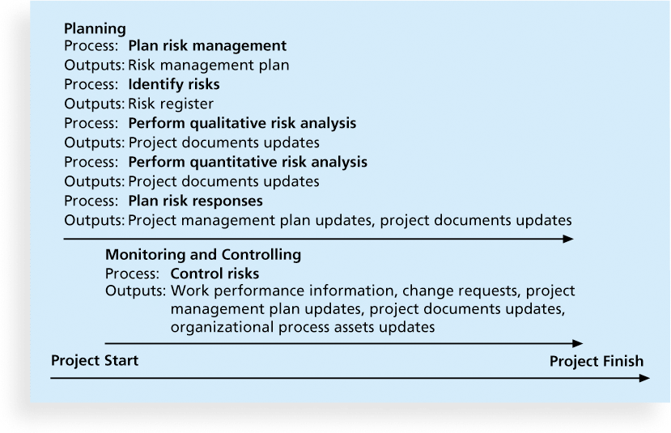
Figure 11-3. Project Risk Management Summary

Slide 12
1.Planning Risk Management
The main output of this process is a risk management plan—a plan that documents the procedures for managing risk throughout a project
The project team should review project documents and understand the organization’s and the sponsor’s approaches to risk
The level of detail will vary with the needs of the project

Slide 13
Table 11-2. Topics Addressed in a Risk Management Plan
Methodology
Roles and responsibilities
Budget and schedule
Risk categories
Risk probability and impact
Revised stakeholders’ tolerances
Tracking
Risk documentation

Slide 15
1.1 Planning Risk Management
In addition to a risk management plan, many projects also include contingency plans, fallback plans, contingency reserves, and management reserves.
Contingency plans are predefined actions that the project team will take if an identified risk event occurs. For example, if the project team knows that a new release of a software package may not be available in time to use for the project, the team might have a contingency plan to use the existing, older version of the software.

Slide 16
1.1 Planning Risk Management
Fallback plans are developed for risks that have a high impact on meeting project objectives and are put into effect if attempts to reduce the risk do not work. For example, a new college graduate might have a main plan and several contingency plans for where to live after graduation, but if these plans do not work out, a fallback plan might be to live at home for a while. Sometimes the terms contingency plan and fallback plan are used interchangeably.

Slide 17
1.1 Planning Risk Management
Contingency reserves or contingency allowances are funds included in the cost baseline that can be used to mitigate cost or schedule overruns if known risks occur. For example, if a project appears to be off course because the staff is not experienced with a new technology and the team had identified that as a risk, the contingency reserves could be used to hire an outside consultant to train and advise the project staff in using the new technology.

Slide 18
1.1 Planning Risk Management
Management reserves are funds held for unknown risks that are used for management control purposes. They are not part of the cost baseline, as discussed in Chapter 7, but they are part of the project budget and funding requirements. If the management reserves are used for unforeseen work, they are added to the cost baseline after the change is approved.

Slide 19
Common Sources of Risk in Information Technology Projects
A risk breakdown structure is a hierarchy of potential risk categories for a project
Similar to a work breakdown structure but used to identify and categorize risks

Slide 20
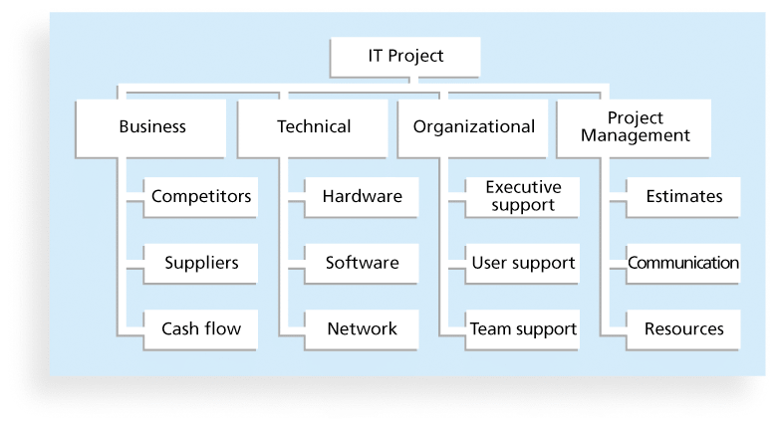
Figure 11-4. Sample Risk Breakdown Structure

Slide 21
Common Sources of Risk in Information Technology Projects
it is also important to identify potential risks according to project management knowledge areas, such as scope, time, cost, and quality.

Slide 22
2. Identifying Risks
Identifying risks is the process of understanding what potential events might hurt or enhance a particular project
Another consideration is the likelihood of advanced discovery
Risk identification tools and techniques include:
Brainstorming
The Delphi Technique
Interviewing Interviewing people with similar project experience
SWOT analysis

Slide 23
Brainstorming
Brainstorming is a technique by which a group attempts to generate ideas or find a solution for a specific problem by amassing ideas spontaneously and without judgment
An experienced facilitator should run the brainstorming session

Slide 24
Delphi Technique
The Delphi Technique is used to derive a consensus among a panel of experts who make predictions about future developments
Provides independent and anonymous input regarding future events
Uses repeated rounds of questioning and written responses and avoids the biasing effects possible in oral methods, such as brainstorming

Slide 25
SWOT Analysis
SWOT analysis (strengths, weaknesses, opportunities, and threats) can also be used during risk identification
Helps identify the broad negative and positive risks that apply to a project

Slide 26
Risk Register
The main output of the risk identification process is a list of identified risks and other information needed to begin creating a risk register
A risk register is:
A document that contains the results of various risk management processes and that is often displayed in a table or spreadsheet format
A tool for documenting potential risk events and related information

Slide 27
Risk Register Contents
An identification number for each risk event
A rank for each risk event: a number ,1 is he highest risk
The name of each risk event
A description of each risk event
The category under which each risk event falls
The root cause of each risk

Slide 28
Risk Register Contents (cont’d)
Triggers for each risk; triggers are indicators or symptoms of actual risk events . For example, cost overruns on early activities may be symptoms of poor cost estimates
Potential responses to each risk
The risk owner or person who will own or take responsibility for each risk
The probability and impact of each risk occurring.
The status of each risk

Slide 29
Table 11-5. Sample Risk Register
• No.: R44
• Rank: 1
• Risk: New customer
• Description: We have never done a project for this organization before and don’t know too much about them. One of our company’s strengths is building good customer relationships, which often leads to further projects with that customer. We might have trouble working with this customer because they are new to us.
• Category: People risk
• Etc.

Slide 30
3. Performing Qualitative Risk Analysis
Assess the likelihood and impact of identified risks to determine their magnitude and priority
Risk qualitative tools and techniques include:
Probability/impact matrixes
The Top Ten Risk Item Tracking
Expert judgment

Slide 31
Probability/Impact Matrix
A probability/impact matrix or chart lists the relative probability of a risk occurring on one side of a matrix or axis on a chart and the relative impact of the risk occurring on the other
List the risks and then label each one as high, medium, or low in terms of its probability of occurrence and its impact if it did occur

Slide 32
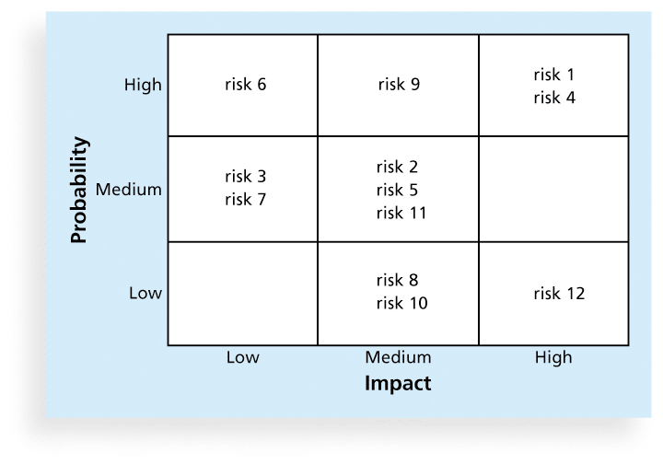
Figure 11-5. Sample Probability/Impact Matrix

Slide 33
Top Ten Risk Item Tracking
Top Ten Risk Item Tracking is a qualitative risk analysis tool that helps to identify risks and maintain an awareness of risks throughout the life of a project
Establish a periodic review of the top ten project risk items
List the current ranking, previous ranking, number of times the risk appears on the list over a period of time, and a summary of progress made in resolving the risk item

Slide 34
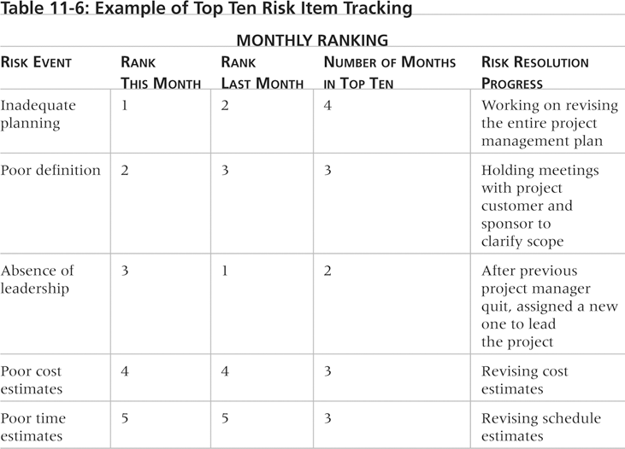
Table 11-6. Example of Top Ten Risk Item Tracking

Slide 35
4. Performing Quantitative Risk Analysis
Often follows qualitative risk analysis, but both can be done together
Large, complex projects involving leading edge technologies often require extensive quantitative risk analysis
Main techniques include:
Decision tree analysis
Simulation
Sensitivity analysis

Slide 36
4.1 Decision Trees
A decision tree is a diagramming analysis technique used to help select the best course of action in situations in which future outcomes are uncertain
Estimated monetary value (EMV) is the product of a risk event probability and the risk event’s monetary value
You can draw a decision tree to help find the EMV

Slide 37
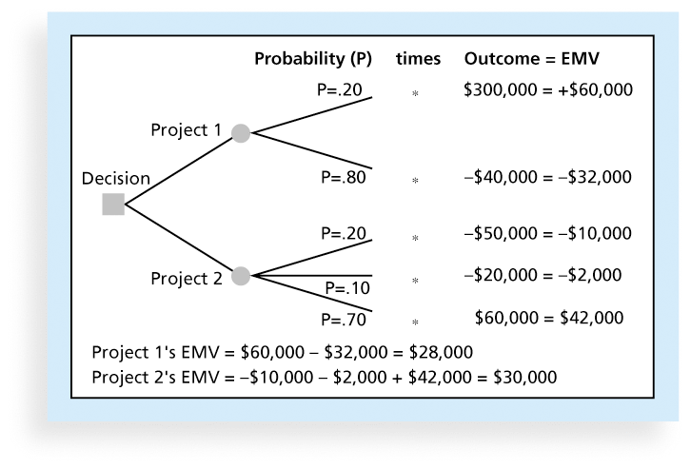
Figure 11-7. Expected Monetary Value (EMV) Example
4.1 Decision Trees
Higher and Positive is better
Notes:
To create a decision tree, and to calculate expected monetary value specifically, you must estimate the probabilities or chances of certain events occurring. For example, Figure 11-7 shows a 20 percent probability (P=.20) that Cliff’s firm will win the contract for Project 1, which is estimated to be worth $300,000 in profits—the outcome of the top branch in the figure. There is an 80 percent probability (P=.80) that the firm will not win the contract for Project 1, and the outcome is estimated to be −$40,000, meaning that the firm will have invested $40,000 into Project 1 with no reimbursement if it does not win the contract. The sum of the probabilities for outcomes for each project must equal one (for Project 1, .20 plus .80). Probabilities are normally determined based on expert judgment. Cliff or other people in his firm should have a sense of the likelihood of winning certain projects.
Figure 11-7 also shows probabilities and outcomes for Project 2. Suppose there is a 20 percent probability that Cliff’s firm will lose $50,000 on Project 2, a 10 percent probability that it will lose $20,000, and a 70 percent probability that it will earn $60,000. Again, experts would need to estimate these dollar amounts and probabilities.
To calculate the EMV for each project, multiply the probability by the outcome value for each potential outcome for each project and sum the results. To calculate the EMV for Project 1, going from left to right, multiply the probability by the outcome for each branch and sum the results. In this example, the EMV for Project 1 is $28,000.
Because the EMV provides an estimate for the total dollar value of a decision, you want to have a positive number; the higher the EMV, the better. Because the EMV is positive for both Projects 1 and 2, Cliff’s firm would expect a positive outcome from each and could bid on both projects. If it had to choose between the two projects, perhaps because of limited resources, Cliff’s firm should bid on Project 2 because it has a higher EMV.

Slide 38
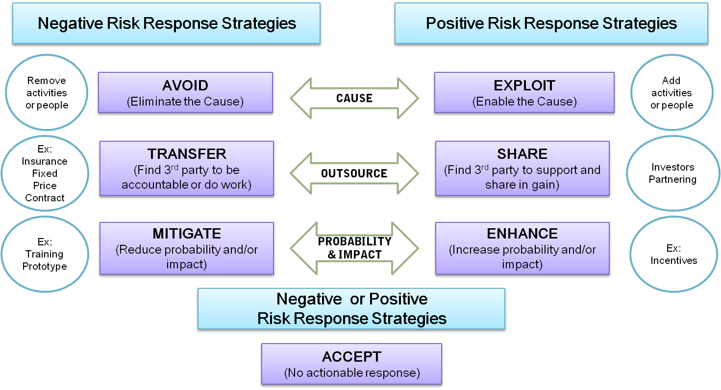
5. Planning risk response
Notes:
Refer to the book for clear examples

Slide 39
Residual and Secondary Risks
It’s also important to identify residual and secondary risks
Residual risks are risks that remain after all of the response strategies have been implemented
Secondary risks are risks that can be a direct result of implementing a risk response

Slide 40
6. Controlling Risks
Controlling risk: Monitoring identified and residual risks, identifying new risks, carrying out risk response plans, and evaluating the effectiveness of risk strategies throughout the life of the project
Project teams sometimes use workarounds—unplanned responses to risk events—when they do not have contingency plans in place.
Tools and techniques for monitoring risks include data analysis, audits, and meetings

Slide 41
Using Software to Assist in Project Risk Management
Risk registers can be created in a simple Word or Excel file or as part of a database
More sophisticated risk management software, such as Monte Carlo simulation tools, help in analyzing project risks
You can purchase add-ons for Excel and Project 2010 to perform simulations

