Slide 1
Chapter 10: Project Communications Management
Information Technology Project Management, Seventh Edition
Note: See the text itself for full citations.

Slide 2
Importance of Good Communications
The greatest threat to many projects is a failure to communicate
Our culture does not portray IT professionals as being good communicators
Research shows that IT professionals must be able to communicate effectively to succeed in their positions
Strong verbal and non-technical skills are a key factor in career advancement for IT professionals
Most IT-related degree programs have many technical requirements, but few require courses in communications (speaking, writing, listening), psychology, sociology, and the humanities.

Slide 3
Project Communications Management Processes
Planning communications management: Determining the information and communications needs of the stakeholders
Managing communications: Creating, distributing, storing, retrieving, and disposing of project communications based on the communications management plan
Controlling communications: Monitoring and controlling project communications to ensure that stakeholder communication needs are met

Slide 4
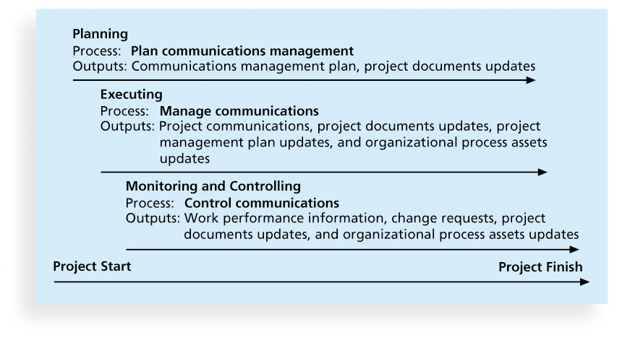
Figure 10-1. Project Communications Management Summary

Slide 5
Keys to Good Communications
Project managers say they spend as much as 90 percent of their time communicating
Need to focus on group and individual communication needs
Use formal and informal methods for communicating
Distribute important information in an effective and timely manner
Set the stage for communicating bad news
Determine the number of communication channels (limit the number of people in one group to limit the number and complexity of communication channel)

Slide 6
Understanding Group and Individual Communication Needs
People are not interchangeable parts
As illustrated in Brooks’ book The Mythical Man-Month, you cannot assume that a task originally scheduled to take two months of one person’s time can be done in one month by two people
Nine women cannot produce a baby in one month!

Slide 7
Importance of Face-to-Face Communication
Research says that in a face-to-face interaction:
58 percent of communication is through body language.
35 percent of communication is through how the words are said
7 percent of communication is through the content or words that are spoken
Pay attention to more than just the actual words someone is saying
A person’s tone of voice and body language say a lot about how he or she really feels

Slide 8
Personal Preferences Affect Communication Needs
Introverts like more private communications, while extroverts like to discuss things in public
Intuitive people like to understand the big picture, while sensing people need step-by-step details
Thinkers want to know the logic behind decisions, while feeling people want to know how something affects them personally

Slide 9
Encouraging More Face-to-Face Interactions
Short, frequent meetings are often very effective in IT projects
Stand-up meetings force people to focus on what they really need to communicate
Some companies have policies preventing the use of e-mail between certain hours or even entire days of the week

Slide 10
Other Communication Considerations
Rarely does the receiver interpret a message exactly as the sender intended
Geographic location and cultural background affect the complexity of project communications

Slide 11
Determining the Number of Communications Channels
As the number of people involved increases, the complexity of communications increases because there are more communications channels or pathways through which people can communicate.
Number of communications channels = n(n-1)
2 where n is the number of people involved

Slide 12
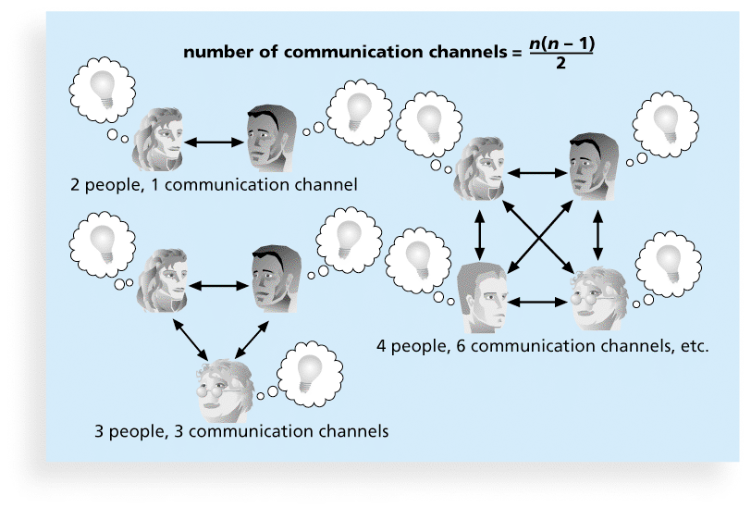
Figure 10-2. The Impact of the Number of People on Communications Channels

Slide 13
1. Planning Communications Management
Every project should include some type of communications management plan, a document that guides project communications
The communications management plan varies with the needs of the project, but some type of written plan should always be prepared
For small projects, the communications management plan can be part of the team contract
For large projects, it should be a separate document

Slide 14
Communications Management Plan Contents
1. Stakeholder communications requirements
2. Information to be communicated, including format, content, and level of detail
3. Who will receive the information and who will produce it
4. Suggested methods or technologies for conveying the information
5. Frequency of communication
6. Escalation procedures for resolving issues
7. Revision procedures for updating the communications management plan
8. A glossary of common terminology

Slide 15
Table 10-1. Sample Stakeholder Analysis for Project Communications

Slide 16
2. Managing Communications
Managing communications is a large part of a project manager’s job
Getting project information to the right people at the right time and in a useful format is just as important as developing the information in the first place
Important considerations include the use of technology, the appropriate methods and media to use, and performance reporting

Slide 17
Using Technology to Enhance Creation and Distribution
Technology can facilitate the process of creating and distributing information, when used properly
It is important to select the appropriate communication method and media

Slide 18
Classifications for Communication Methods
Interactive communication: Two or more people interact to exchange information via meetings, phone calls, or video conferencing. Most effective way to ensure common understanding
Push communication: Information is sent or pushed to recipients without their request via reports, e-mails, faxes, voice mails, and other means. Ensures that the information is distributed, but does not ensure that it was received or understood
Pull communication: Information is sent to recipients at their request via Web sites, bulletin boards, e-learning, knowledge repositories like blogs, and other means

Slide 19
Reporting Performance
Performance reporting keeps stakeholders informed about how resources are being used to achieve project objectives
Status reports describe where the project stands at a specific point in time
Progress reports describe what the project team has accomplished during a certain period of time
Forecasts predict future project status and progress based on past information and trends

Slide 20
3.Controlling Communications
The main goal of controlling communications is to ensure the optimal flow of information throughout the entire project life cycle
The project manager and project team should use their various reporting systems, expert judgment, and meetings to assess how well communications are working. If problems exist, the project manager and team need to take action, which often requires changes to the earlier processes of planning and managing project communications
It is often beneficial to have a facilitator from outside the project team assess how well communications are working

Slide 21
Suggestions for Improving Project Communications
Develop better communication skills
Run effective meetings
Use e-mail and other technologies effectively
Use templates for project communications

Slide 22
Running Effective Meetings
Determine if a meeting can be avoided
Define the purpose and intended outcome of the meeting
Determine who should attend the meeting
Provide an agenda to participants before the meeting
Prepare handouts and visual aids, and make logistical arrangements ahead of time
Run the meeting professionally
Set the ground rules for the meeting
Build relationships

Slide 23
Sample Collaborative Tools
A SharePoint portal allows users to create custom Web sites to access documents and applications stored on shared devices
Google Docs allow users to create, share, and edit documents, spreadsheets, and presentations online
A wiki is a Web site designed to enable anyone who accesses it to contribute or modify Web page content

Slide 24
Using Templates for Project Communications
Many technical people are afraid to ask for help
Providing examples and templates for project communications saves time and money
Organizations can develop their own templates, use some provided by outside organizations, or use samples from textbooks
Recall that research shows that companies that excel in project management make effective use of templates

Slide 25
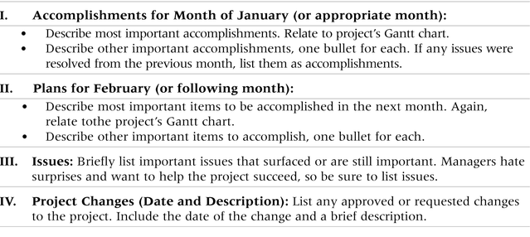
Table 10-3. Sample Template for a Monthly Progress Report

Slide 26
Project Archives
It is also important to organize and prepare project archives
Project archives are a complete set of organized project records that provide an accurate history of the project
These archives can provide valuable information for future projects as well

Slide 27
Project Web Sites
Many project teams create a project Web site to store important product documents and other information
Can create the site using various types of software, such as enterprise project management software

Slide 28
Using Software to Assist in Project Communications
There are many software tools to aid in project communications
Project management software includes new capabilities to enhance virtual communications

