Slide 1
Chapter 12: Project Procurement Management
Information Technology Project Management, Seventh Edition
Note: See the text itself for full citations.

Slide 2
Importance of Project Procurement Management
Procurement means acquiring goods and/or services from an outside source
Other terms include purchasing and outsourcing
Organizations or individuals who provide procurement services are referred to as suppliers, vendors, contractors, subcontractors, or sellers; of these terms, suppliers is the most widely used.
People continue to debate whether offshore outsourcing helps their own country or not
Notes:
Andy Bork, chief operating officer of a computer network service provider, described outsourcing as an essential part of a healthy business diet. He described the idea of good versus bad outsourcing as something like good versus bad cholesterol. He said that most people view offshoring as being bad because it takes jobs away from domestic workers. However, many companies are realizing that they can use offshoring and create more jobs at home. Other companies, like Walmart, successfully manage the majority of their IT projects in-house with very little commercial software and no outsourcing at all. Other organizations are moving IT services back in-house, such as General Motors (GM).

Slide 3
IT Outsourcing Market Continues to Grow
U.S. companies are transferring more work abroad, especially in the areas of IT infrastructure, application development and maintenance, and innovation processes
India, China, and the Philippines are the preferred locations for outsourcing, and Latin America is growing in popularity
A shortage of qualified personnel, not cost savings, is the top reason for global outsourcing of IT services

Slide 4
Why Outsource?
To access skills and technologies
To reduce both fixed and recurrent costs
To allow the client organization to focus on its core business
To provide flexibility: Outsourcing to provide extra staff during periods of peak workloads can be much more economical than trying to staff entire projects with internal resources
To increase accountability: A well-written contract—a mutually binding agreement that obligates the seller to provide specified products or services and obligates the buyer to pay for them—can clarify responsibilities and sharpen focus on key deliverables of a project.

Slide 5
Why not outsource?
Organizations must also consider reasons they might not want to outsource.
When an organization outsources work, it often does not have as much control over the aspects of projects that suppliers carry out.
An organization could become too dependent on particular suppliers. If those suppliers went out of business or lost key personnel, it could cause great damage to a project.
Organizations must also be careful to protect strategic information that could become vulnerable in the hands of suppliers.

Slide 6
Project Procurement Management Processes
Project procurement management: Acquiring goods and services for a project from outside the performing organization
Processes include:
Planning procurement management: Determining what to procure and when and how to do it
Conducting procurements: Obtaining seller responses, selecting sellers, and awarding contracts
Controlling procurements: Managing relationships with sellers, monitoring contract performance, and making changes as needed
Closing procurements: Completing and settling each contract or agreement, including resolving of any open items

Slide 7
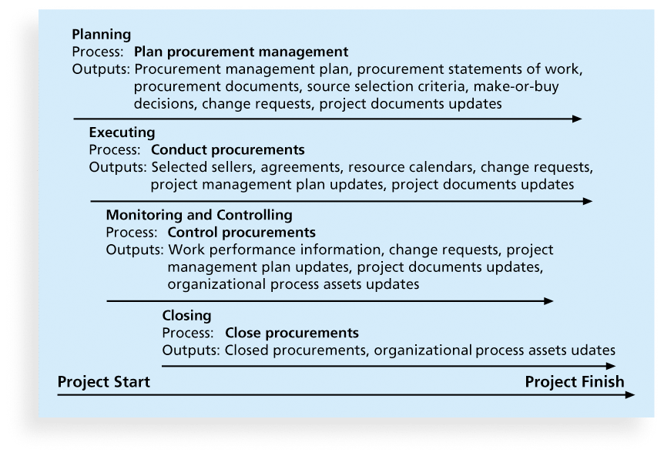
Figure 12-1. Project Procurement Management Summary

Slide 8
1.Planning Procurement Management
Identifying which project needs can best be met by using products or services outside the organization
It involves deciding whether to procure, how to procure, what to procure, how much to procure, and when to procure. An important output of this process is the make-or-buy decision, in which an organization decides whether it should make certain products and perform certain services inside the organization, or if it is better to buy those products and services from an outside organization.
If there is no need to buy any products or services from outside the organization, then there is no need to perform any of the other procurement management processes

Slide 9
Types of Contracts
Different types of contracts can be used in different situations:
Fixed price or lump sum contracts: Involve a fixed total price for a well-defined product or service
Cost reimbursable contracts: Involve payment to the seller for direct and indirect costs
Time and material contracts: Hybrid of both fixed price and cost reimbursable contracts, often used by consultants
Unit price contracts: Require the buyer to pay the seller a predetermined amount per unit of service
A single contract can actually include all four of these categories, if it makes sense for that particular procurement
Notes:
FP example: For example, a company could award a fixed-price contract to purchase 100 laser printers with a certain print resolution and print speed to be delivered to one location within two months. In this example, the product and delivery date are well defined. Several sellers could create fixed-price estimates for completing the job.
Time and material contracts : For example, an independent computer consultant might have a contract with a company based on a fee of $80 per hour for services, plus a fixed price of $10,000 for providing specific project materials. The materials fee might also be based on approved receipts for purchasing items, with a ceiling of $10,000. The consultant would send an invoice to the company each week or month; the invoice would list the materials fee, the number of hours worked, and a description of the work produced. This type of contract is often used for required services when the work cannot be specified clearly and total costs cannot be estimated in a contract. Many contract programmers and consultants, such as those Marie’s company hired in the chapter’s opening case, prefer time and material contracts.

Slide 10
Contract Clauses
Contracts should include specific clauses to take into account issues unique to the project
A termination clause is a contract clause that allows the buyer or supplier to end the contract
Some termination clauses state that the buyer can terminate a contract for any reason and give the supplier only 24 hours’ notice.
Suppliers, by contrast, must often give a one-week notice to terminate a contract and must have sufficient reasons for the termination. The buyer could also include a contract clause that specifies hourly rates based on the education and experience of consultants.
These contract clauses reduce the risk incurred by the buyer while providing flexibility for accomplishing the work.

Slide 11
Tools and Techniques for Planning Purchases and Acquisitions
Expert judgment
Market research
Make-or-buy analysis: General management technique used to determine whether an organization should make or perform a particular product or service inside the organization or buy from someone else

Slide 12
Make-or-Buy Example
Assume you can lease an item you need for a project for $800/day. To purchase the item, the cost is $12,000 plus a daily operational cost of $400/day
How long will it take for the purchase cost to be the same as the lease cost?

Slide 13
Make-or Buy Solution
Set up an equation so both options, purchase and lease, are equal
In this example, use the following equation. Let d be the number of days to use the item:
$12,000 + $400d = $800d
Subtracting $400d from both sides, you get: $12,000 = $400d
Dividing both sides by $400, you get: d = 30
If you need the item for more than 30 days, it is more economical to purchase it

Slide 14
Procurement Management Plan
Output of Plan Procurement Process
Describes how the procurement processes will be managed, from developing documentation for making outside purchases or acquisitions to contract closure
Contents varies based on project needs

Slide 15
Contract Statement of Work (SOW)
A statement of work is a description of the work required for the procurement
If a SOW is used as part of a contract to describe only the work required for that particular contract, it is called a contract statement of work
A SOW is a type of scope statement
A good SOW gives bidders a better understanding of the buyer’s expectations

Slide 16
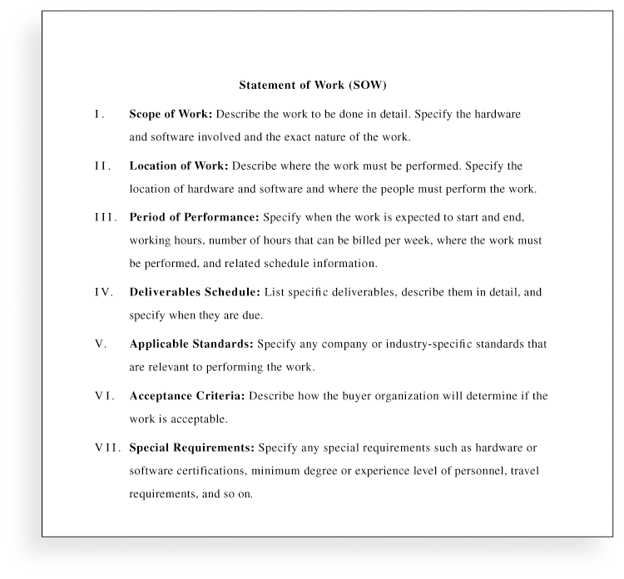
Statement of Work (SOW) Template

Slide 17
Procurement Documents
Request for Proposals (RFP): Used to solicit proposals from prospective sellers
A proposal is a document prepared by a seller when there are different approaches for meeting buyer needs
Requests for Quotes (RFQ): Used to solicit quotes or bids from prospective suppliers
A bid, also called a tender or quote (short for quotation), is a document prepared by sellers providing pricing for standard items that have been clearly defined by the buyer
Writing a good RFP is a critical part of project procurement management, but many people have never had to write or respond to one. To generate a good RFP, expertise is invaluable.

Slide 18
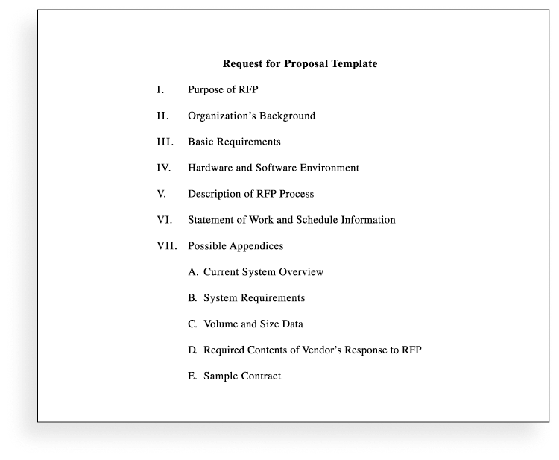
Request for Proposal (RFP) Template

Slide 19
Source Selection Criteria
It’s important to prepare some form of evaluation criteria for source selection, preferably before issuing a formal RFP
Beware of proposals that look good on paper; be sure to evaluate factors, such as past performance and management approach
Can require a technical presentation as part of a proposal
Organizations use criteria to rate or score proposals, and they often assign a weight to each criterion to indicate its importance. Some examples of criteria and weights include the technical approach (30 percent weight), management approach (30 percent weight), past performance (20 percent weight), and price (20 percent weight).

Slide 20
2. Conducting Procurements
Deciding whom to ask to do the work
Sending appropriate documentation to potential
Sellers
Obtaining proposals or bids
Selecting a seller
Awarding a contract

Slide 21
Approaches for Procurement
Organizations can advertise to procure goods and services in several ways:
Approaching the preferred vendor
Approaching several potential vendors
Advertising to anyone interested
A bidders’ conference, also called a supplier conference or pre-bid conference, is a meeting with prospective sellers prior to preparation of their proposals or bids. To help ensure that everyone has a clear, common understanding of the buyer’s desired products or services

Slide 22
Approaches for Procurement
Once buyers receive proposals or bids, they can select a supplier or decide to cancel the procurement.
Selecting suppliers or sellers, often called source selection, involves evaluating proposals or bids from sellers, choosing the best one, negotiating the contract, and awarding the contract.
Buyers typically develop a short list of the top three to five suppliers to reduce the work involved in selecting a source.
Experts in source selection highly recommend that buyers use formal proposal evaluation sheets during source selection.

Slide 23
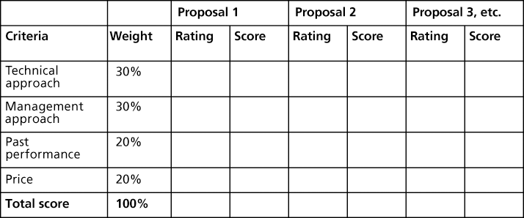
Sample Proposal Evaluation Sheet

Slide 24
Seller Selection
After developing a short list of possible sellers, organizations often follow a more detailed proposal evaluation process. For example, they might list more detailed criteria for important categories, such as the management approach.
Sellers on the short list often asked to prepare a best and final offer (BAFO)
Final output is a contract signed by the buyer and the selected seller

Slide 25
3.Controlling Procurements
Ensures that the seller’s performance meets contractual requirements
Contracts are legal relationships, so it is important that legal and contracting professionals be involved in writing and administering contracts
It is critical that project managers and team members watch for constructive change orders, which are oral or written acts or omissions by someone with actual or apparent authority that can be construed to have the same effect as a written change order

Slide 26
Suggestions for Change Control in Contracts
Changes to any part of the project need to be reviewed, approved, and documented by the same people in the same way that the original part of the plan was approved
Evaluation of any change should include an impact analysis. How will the change affect the scope, time, cost, and quality of the goods or services being provided?
Changes must be documented in writing. Project team members should also document all important meetings and telephone phone calls

Slide 27
Suggestions for Change Control in Contracts (cont’d)
Project managers and teams should stay closely involved to make sure the new system will meet business needs and work in an operational environment
Have backup plans in case new systems does not work as planned
Use tools and techniques, such as a contract change control system, buyer-conducted performance reviews, inspections and audits, and so on

Slide 28
4 Closing Procurements
Involves completing and settling contracts and resolving any open items
The project team should:
Determine if all work was completed correctly and satisfactorily
Update records to reflect final results
Archive information for future use
The contract itself should include requirements for formal acceptance and closure

Slide 29
Using Software to Assist in Project Procurement Management
most organizations use word-processing software to write proposals or contracts, spreadsheet software to create proposal evaluation worksheets, databases to track suppliers, and presentation software to present procurement-related information.
Many companies are now using more advanced software to assist in procurement management. The term e-procurement often describes various procurement functions that are now done electronically

