Slide 1
Lecture 9 JQuery
Internet & World Wide Web How to Program, 5/e

Slide 2
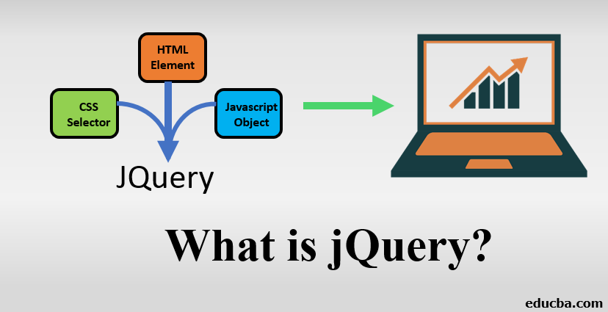
What is jQuery?
jQuery is a lightweight, "write less, do more", JavaScript library.

Slide 3
Introduction
jQuery is a JavaScript Library.
jQuery greatly simplifies JavaScript programming.
jQuery is easy to learn.

Slide 4
Introduction
jQuery is a fast, small, and feature-rich JavaScript library. It makes things like HTML document traversal and manipulation, event handling, animation, jQuery has changed the way that millions of people write JavaScript.
jQuery's syntax is designed to make it easier to navigate a document,select DOM elements, create animations, handle events, and develop Ajax applications.

Slide 5
Introduction
jQuery takes a lot of common tasks that require many lines of JavaScript code to accomplish, and wraps them into methods that you can call with a single line of code.
jQuery also simplifies a lot of the complicated things from JavaScript, like AJAX calls and DOM manipulation.

Slide 6
The jQuery library contains the following features:
HTML/DOM manipulation
CSS manipulation
HTML event methods
Effects and animations
AJAX
Utilities

Slide 7
Many of the biggest companies on the Web use jQuery, such as:
Google
Microsoft
IBM
Netflix

Slide 8
How does jQuery make working so Easy?
It was created with a nice moto “Write less and do more”.
jQuery’s entire functionality revolves around simplifying every line of code.
It makes it easier to navigate a document.
It offers a very effective way to catch a wide variety of events, such as user clicks without a need to clutter the HTML code; It takes care of all the things in between.
It simplifies DOM manipulation, event handling, and basically every other thing.

Slide 9
jQuery Syntax
With jQuery you select (query) HTML elements and perform "actions" on them.
The jQuery syntax is tailor-made for selecting HTML elements and performing some action on the element(s).
Basic syntax is: $(selector).action()
A $ sign to define/access jQuery
A (selector) to "query (or find)" HTML elements
A jQuery action() to be performed on the element(s)

Slide 10
Example
$(document).ready(function(){ // jQuery methods go here... });
This is to prevent any jQuery code from running before the document is finished loading (is ready).

Slide 11
jQuery Selectors- The element Selector
jQuery selectors allow you to select and manipulate HTML element(s).
jQuery selectors are used to "find" (or select) HTML elements based on their name, id, classes, types, attributes, values of attributes and much more. It's based on the existing CSS Selectors, and in addition, it has some own custom selectors.
All selectors in jQuery start with the dollar sign and parentheses: $().
You can select all <p> elements on a page like this:
$("p")

Slide 12
jQuery Selectors- The #id Selector
The jQuery #id selector uses the id attribute of an HTML tag to find the specific element.
To find an element with a specific id, write a hash character, followed by the id of the HTML element:
$("#test")

Slide 13
jQuery Selectors- The .class Selector
The .class Selector
The jQuery .class selector finds elements with a specific class.
To find elements with a specific class, write a period character, followed by the name of the class:
$(".test")

Slide 14
jQuery Syntax For Event Methods
In jQuery, most DOM events have an equivalent jQuery method.
To assign a click event to all paragraphs on a page, you can do this:
$("p").click();
Examples here:
https://www.w3schools.com/jquery/jquery_events.asp

