Slide 1

CT1452 – Javascript: Arrays
Internet & World Wide Web
How to Program, 5/e

Slide 2
Arrays
Arrays
  Data structures consisting of related data items
JavaScript arrays
  “dynamic” entities that can change size after they are created

Slide 3
Arrays (Cont.)
An array is a group of memory locations
  All have the same name and normally are of the same type (although this attribute is not required in JavaScript)
Each individual location is called an element
We may refer to any one of these elements by giving the array’s name followed by the position number of the element in square brackets ([]) e.g. x[2]

Slide 4
Arrays (Cont.)
The first element in every array is the 0th element.
The i^{th} element of array c is referred to as c[i-1].
Array names follow the same conventions as other identifiers
A subscripted array name
  can be used on the left side of an assignment to place a new value into an array element
  can be used on the right side of an assignment operation to use
its value
Every array in JavaScript knows its own length, which it stores in its length attribute and can be found with the expression arrayname.length

Slide 5
Declaring and Allocating Arrays
JavaScript arrays are Array of objects.
You use the new operator to create an array and specify the number of elements in an array
  e.g. var X= new Array(10); //10 elements array
  var Y= new Array(); //empty array
The new operator creates an object as the script executes by obtaining enough memory to store an object of the type specified to the right of new .

Slide 6
Example using Arrays
Zero-based counting is usually used to iterate through arrays
JavaScript reallocates an Array when a value is assigned to an element that is outside the bounds of the original Array

Slide 7
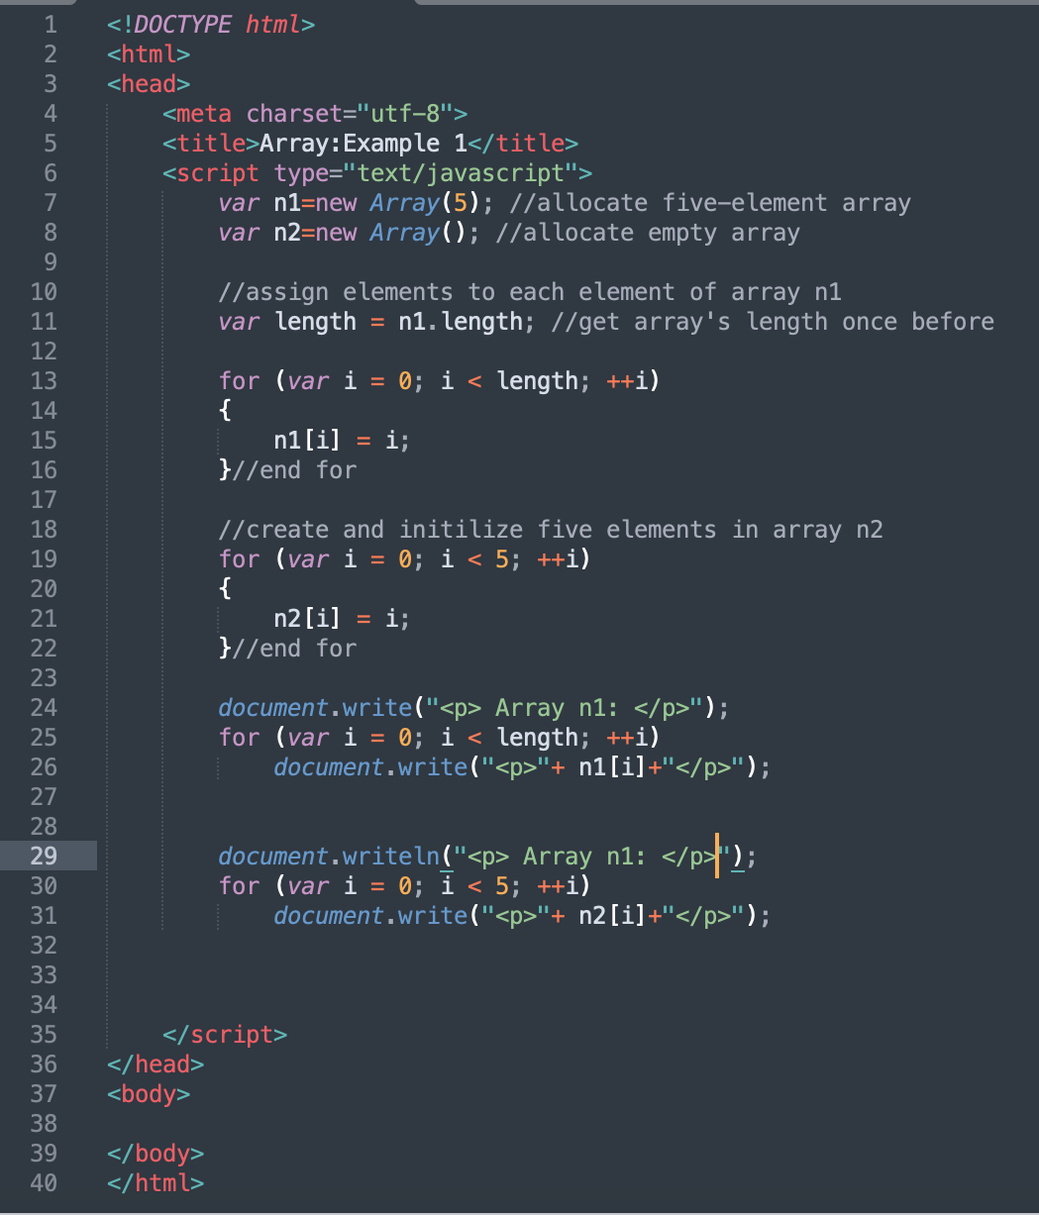
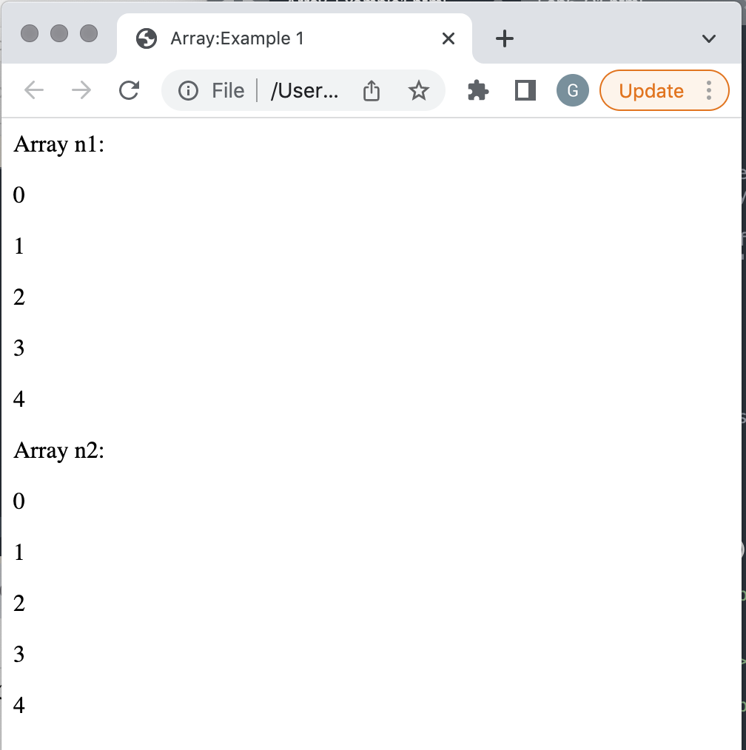
Example 1

Slide 8
Initializing Arrays with Initializer List
Arrays can be created using a comma- separated initializer list enclosed in square brackets []
  The array’s size is determined by the number of values in the initializer list
  e.g. var X= [‘a’, ‘b’, ‘c’]; //3 elements array
The initial values of an array can be specified as arguments in the parentheses following new Array
  The size of the array is determined by the number of values in parentheses
  var Y= new Array(‘a’, ‘b’, ‘c’);

Slide 9
Initializing Arrays with Initializer List (Cont.)
Example 2 creates three Array objects to demonstrate different ways of initializing arrays.
  Using initializer list.
  As arguments during declaration.

Slide 10
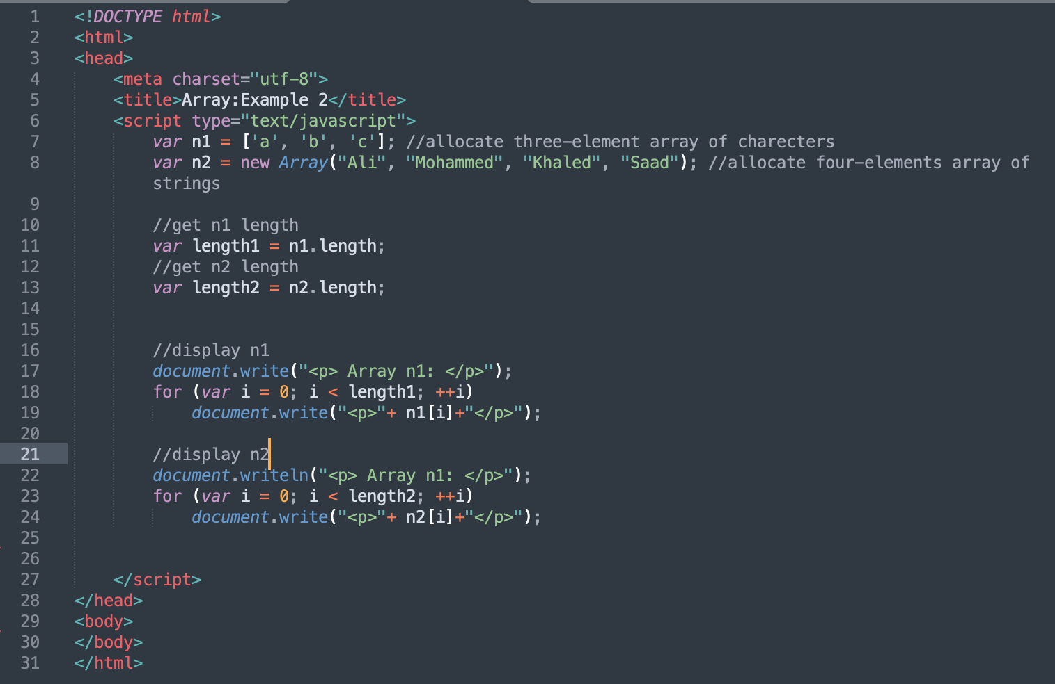
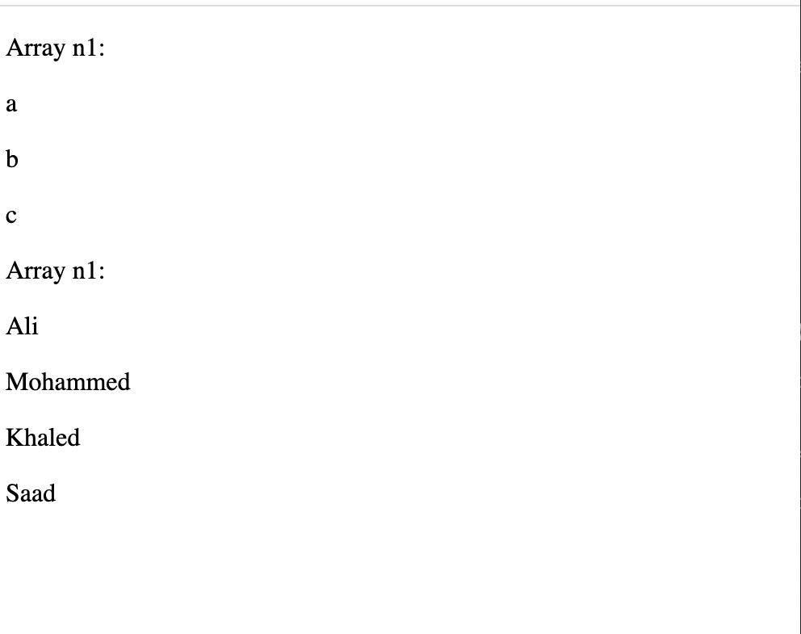
Example 2

Slide 11
Summing the Elements of an Array with for and for…in
Example 3 shows 2 different ways to sum the elements of an array:
  Using a counter-controlled loop e.g. for.
  Using for…in loop.
JavaScript’s for…in repetition statement enables a script to perform a task for each element in an array.

Slide 12
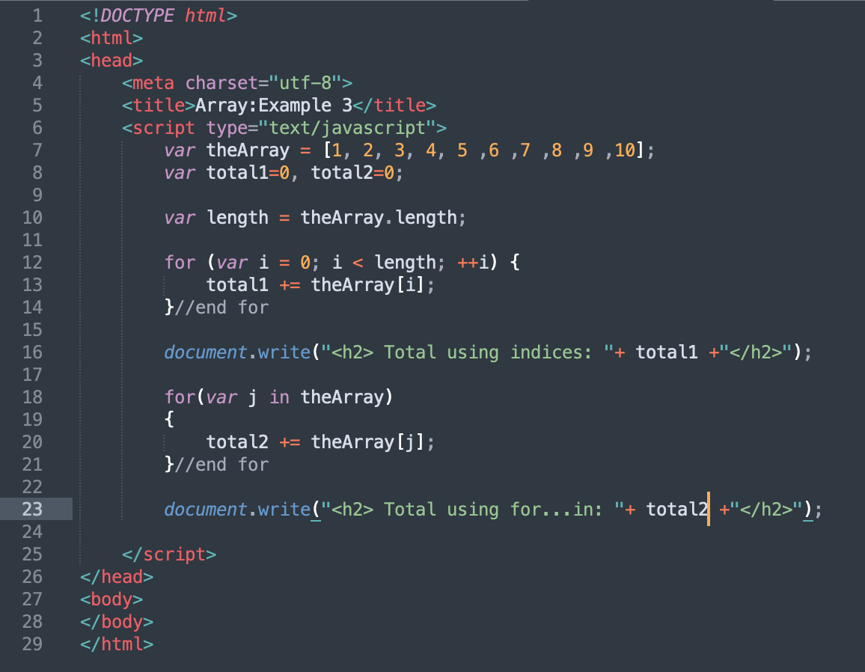
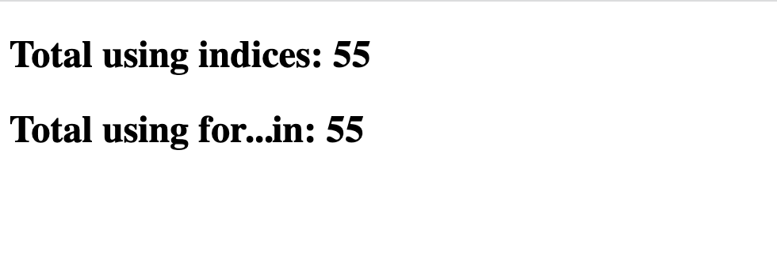
Example 3

Slide 13
Sorting an Array with Array Method sort
Sorting data
  is One of the most important computing functions
  it involves Putting data in a particular order, such as ascending or descending.

Slide 14
Sorting an Array with Array Method sort
Array object in JavaScript has a built-in method sort
  Method sort takes as its argument the name of a function that compares its two arguments and returns
🞄 a negative value if the first argument is less than the second argument,
🞄 Zero if the arguments are equal, or
🞄 a positive value if the first argument is greater than the
second
  With no arguments, the method uses string comparisons to determine the sorting order of the array elements

Slide 15
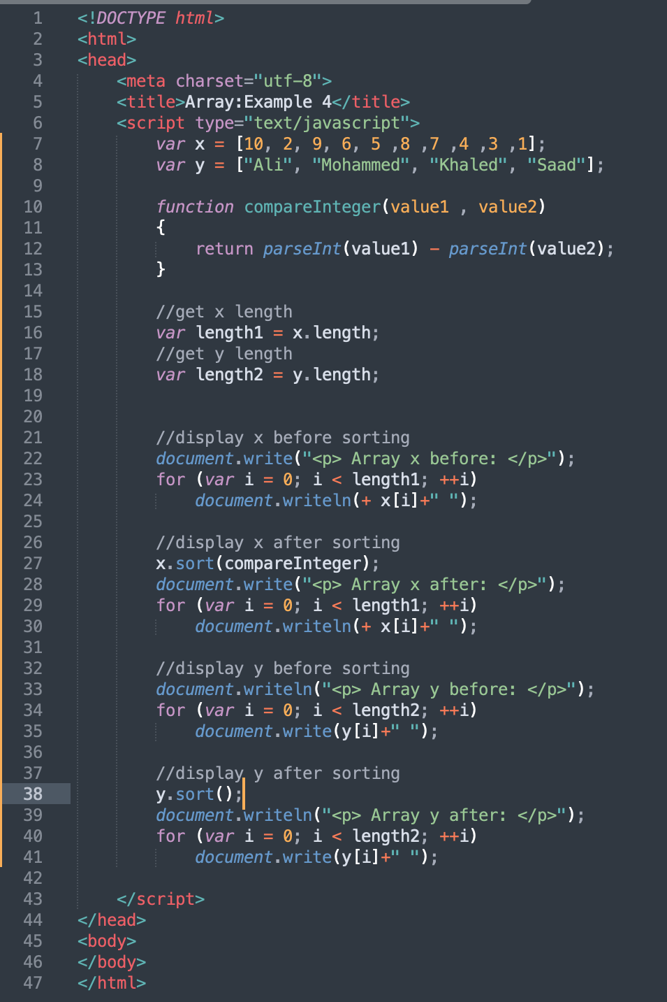
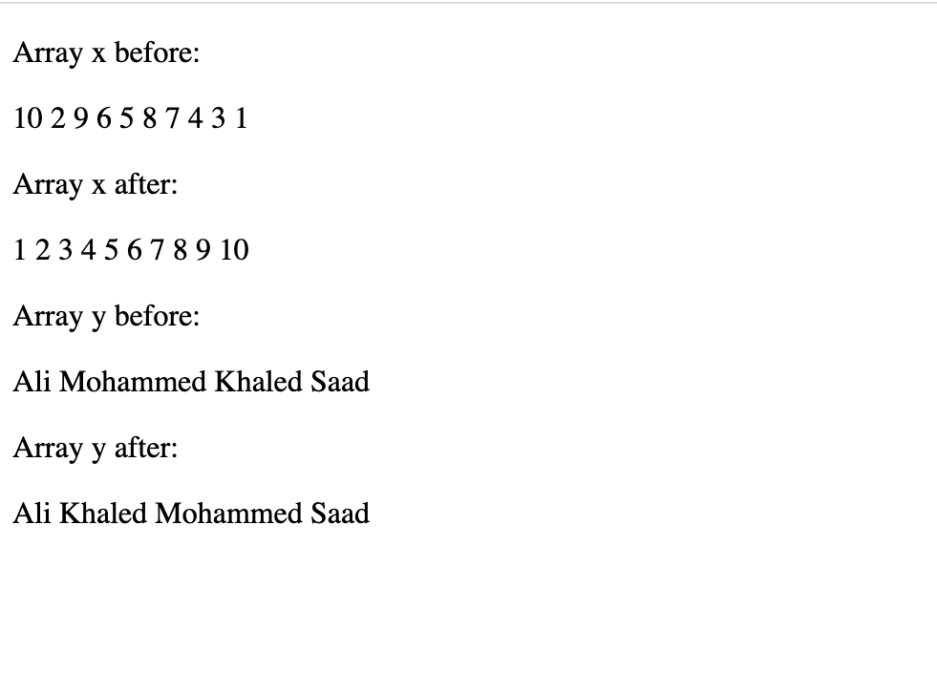
Example 4

Slide 16
Searching an Array with Array Method indexOf
It’s often necessary to determine whether an array contains a value that matches a certain key value.
The process of locating a particular element value in an
array is called searching.
The Array object in JavaScript has built-in methods
indexOf and lastIndexOf for searching arrays.
  Method indexOf searches for the first occurrence of the specified key value
  Method lastIndexOf searches for the last occurrence of the specified key value.
If the key value is found in the array, each method returns the index of that value; otherwise, -1 is returned.

Slide 17
Searching an Array with Array Method indexOf
Optional Second Argument to indexOf and lastIndexOf
  You can pass an optional second argument to methods indexOf and lastIndexOf that represents the index from which to start the search.
By default, this argument’s value is 0 and the methods search
the entire array.
If the argument is greater than or equal to the array’s length, the methods simply return -1.
If the argument’s value is negative, it’s used as an offset from the end of the array.

Slide 18
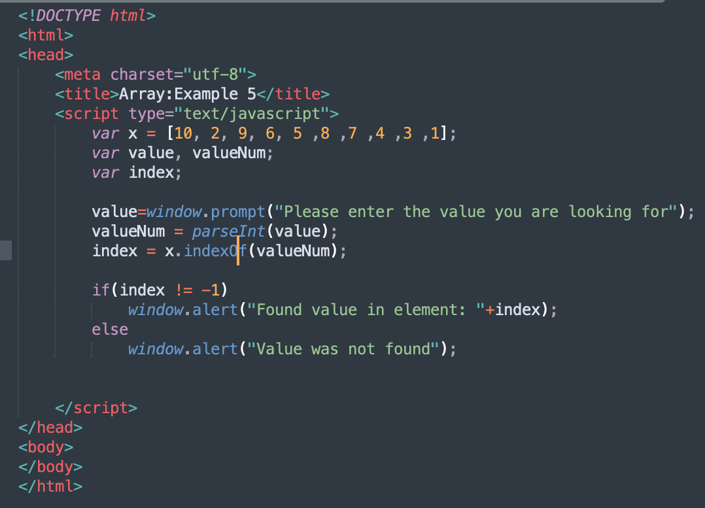
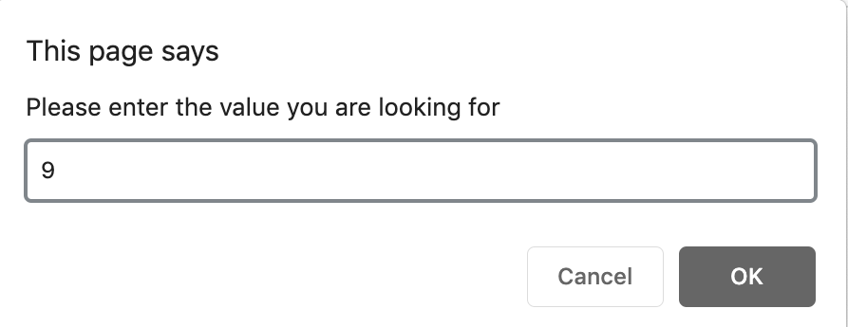
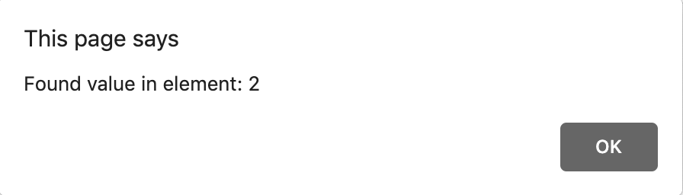
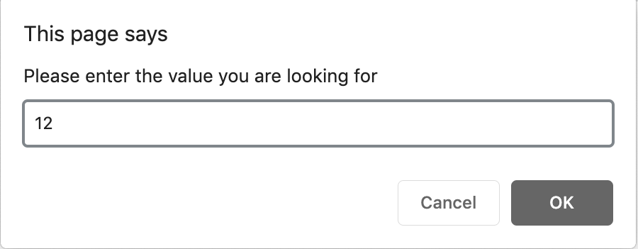

Example 5

Slide 19
Multidimensional Array
To identify a particular two-dimensional multidimensional array element
  Specify the two indices
  By convention, the first identifies the element’s row, and the
second identifies the element’s column
In general, an array with m rows and n columns is
called an m-by-n array
Two-dimensional array element accessed using an element name of the form a[ row ][ column ]
  a is the name of the array
row and column are the indices that uniquely identify the row and column

Slide 20
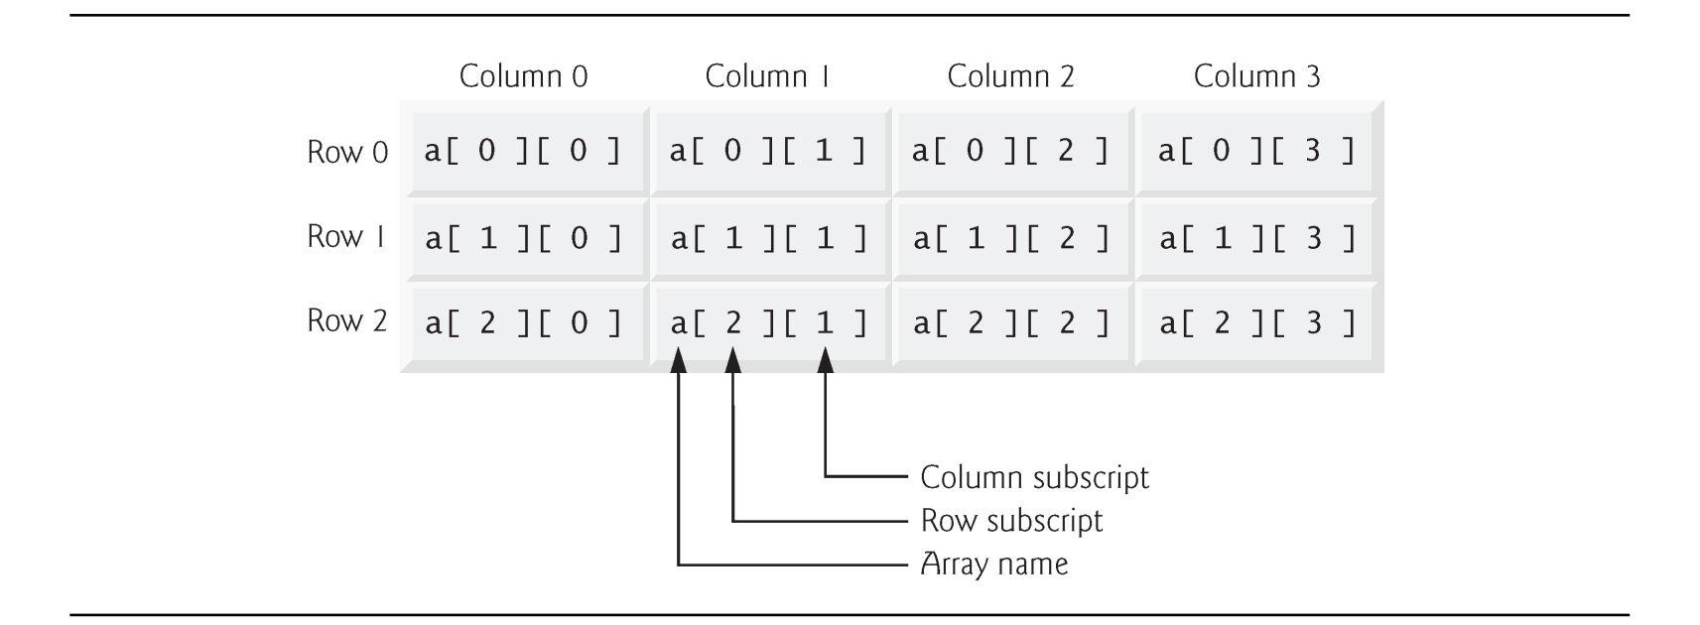

Slide 21
Multidimensional Array (Cont.)
Multidimensional arrays can be initialized in declarations like a one-dimensional array, with values grouped by row in square brackets
  The interpreter determines the number of rows by counting the
number of sub initializer
  The interpreter determines the number of columns in each row by counting the number of values in the sub-array that initializes the row
The rows of a two-dimensional array can vary in
length
A multidimensional array in which each row has a different number of columns can be allocated dynamically with operator new

Slide 22
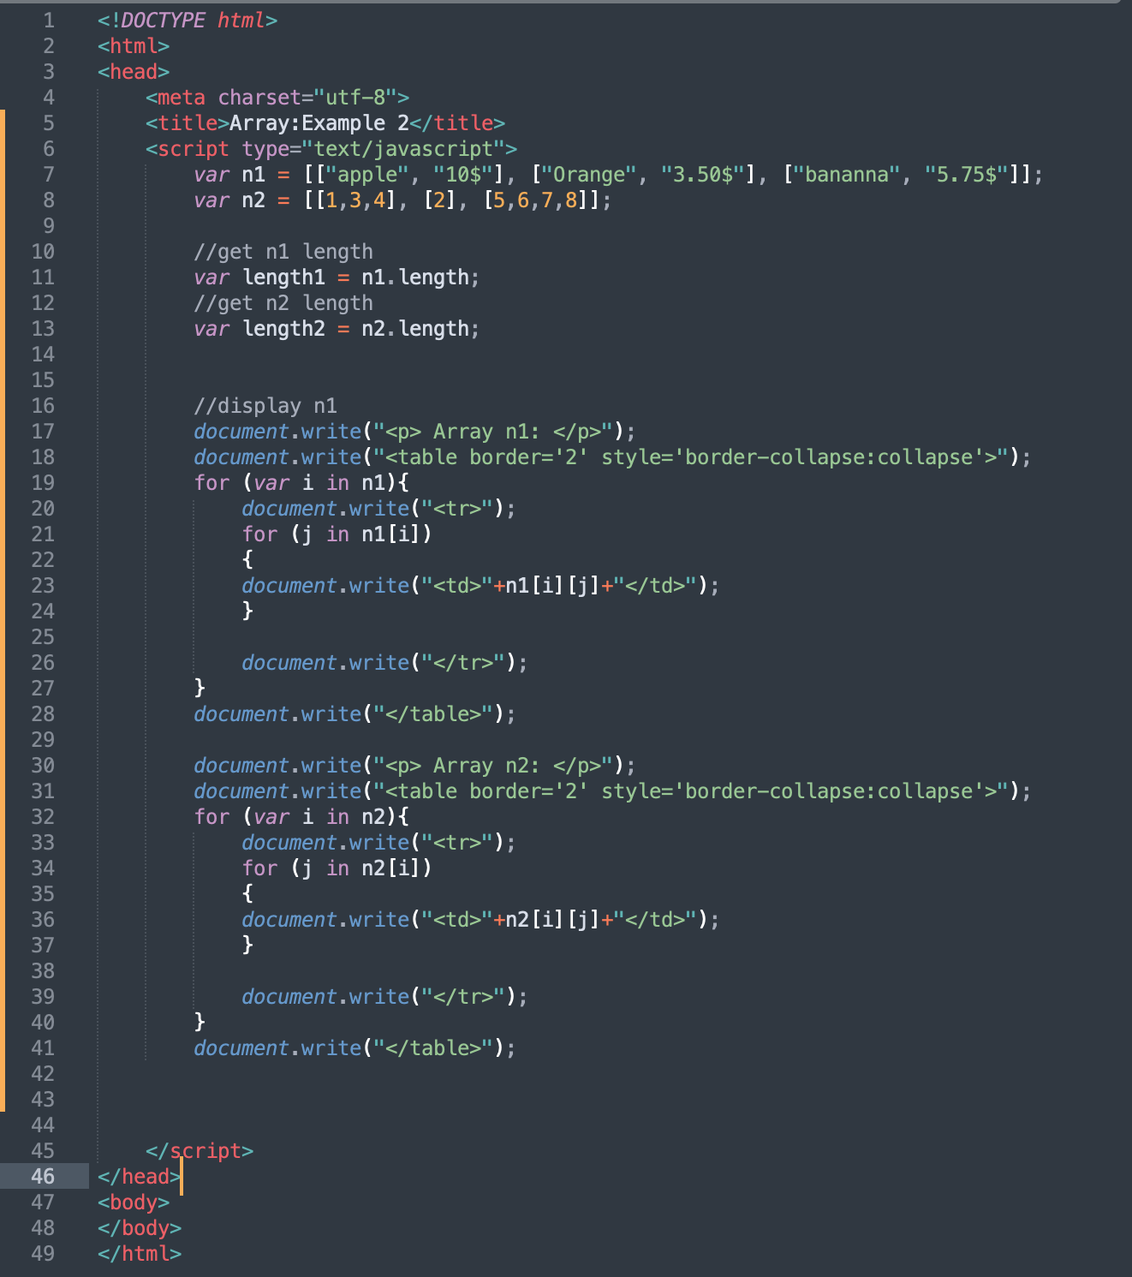
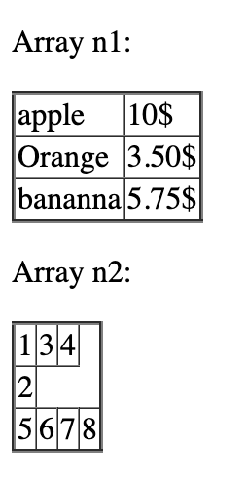
Example 6

