Slide 1

CT1452 – Javascript: Control statements
Internet & World Wide Web How to Program, 5/e
Binhadba Edit

Slide 2
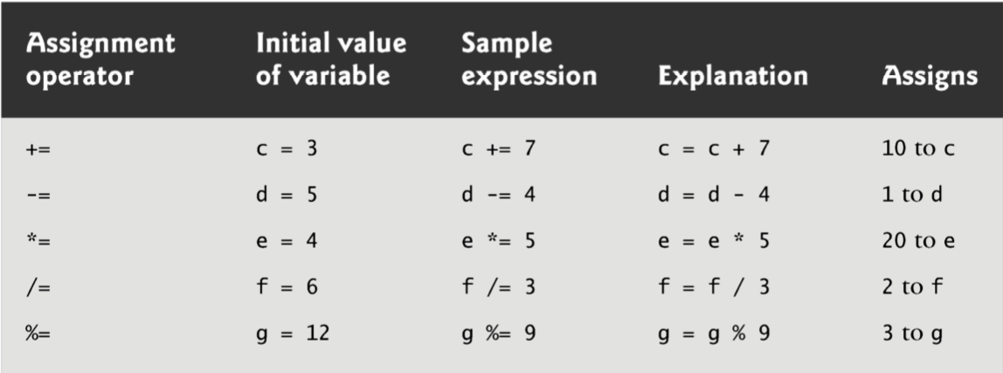
Assignments Operators
JavaScript provides the arithmetic assignment operators +=, -=, *=, /= and %=, which abbreviate certain common types of expressions.

Slide 3
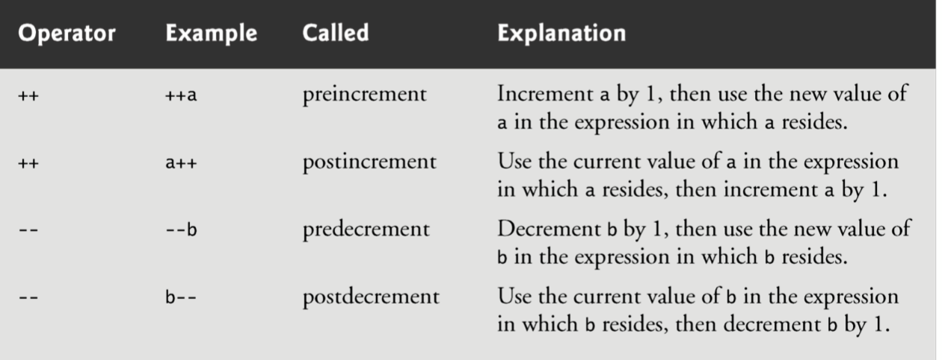
Increment/Decrement Operators
The increment operator, ++, and the decrement operator, --, increment or decrement a variable by 1, respectively.
If the operator is prefixed to the variable, the variable is incremented or decremented by 1, then used in its expression.
If the operator is postfixed to the variable, the variable is used in its expression, then incremented or decremented by 1.

Slide 4
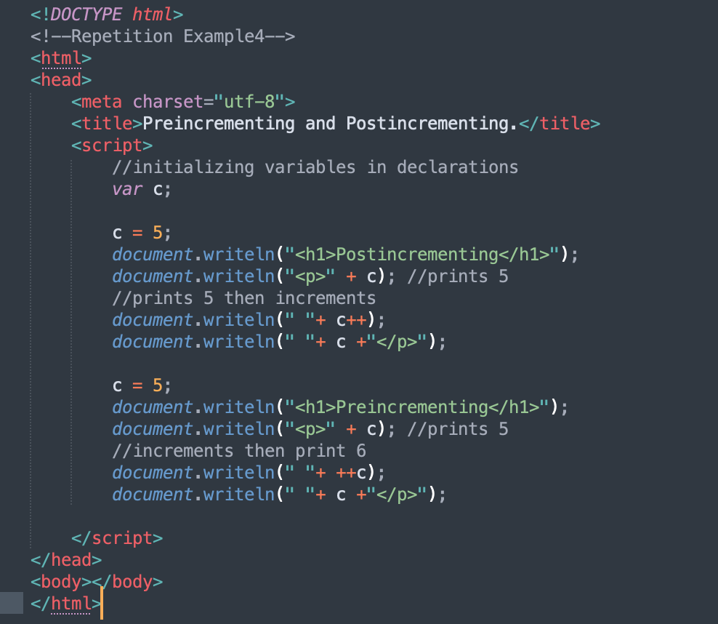
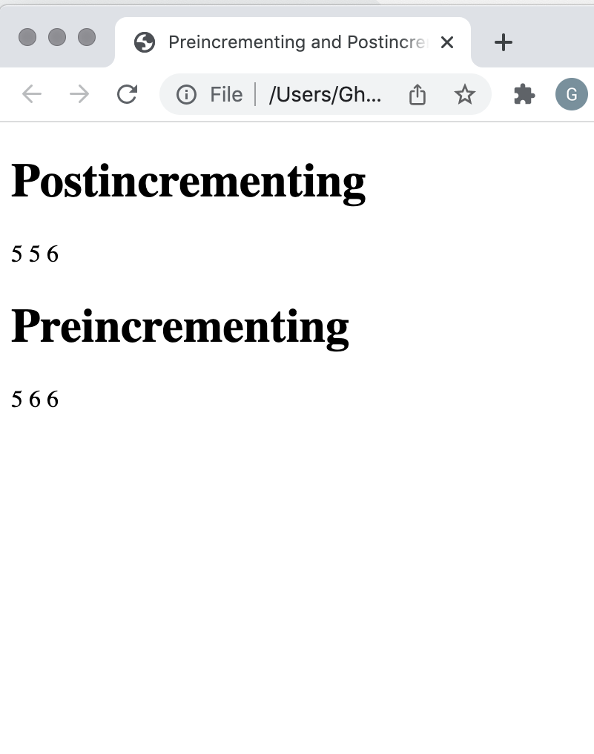
Example 1

Slide 5
Control Statements
Sequential execution
Execute statements in the order they appear in the code
Transfer of control
Changing the order in which statements execute
All scripts can be written in terms of only three control statements
sequence
selection
repetition

Slide 6
Control Statements : Selection
JavaScript provides three selection structures*.
if
if...else
else…if
switch

Slide 7
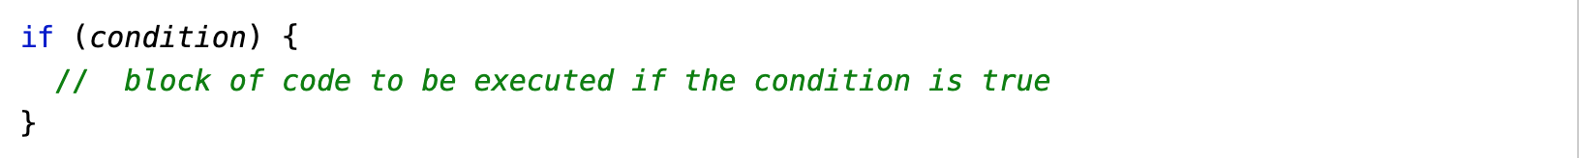
if Selection Statement
Not that any selection statement expects only one statement in its body.
To include several statements, enclose the statements in the curly brackets { and }
A set of statements contained within a pair of brackets is called a block
The script in Example 2 uses four if statements to display a time-sensitive greeting on a welcome page.
The example uses also the Date object to
acquire the current local time
Create a new instance of an object by using the new operator followed by the type of the object, Date, and a pair of parentheses

Slide 8
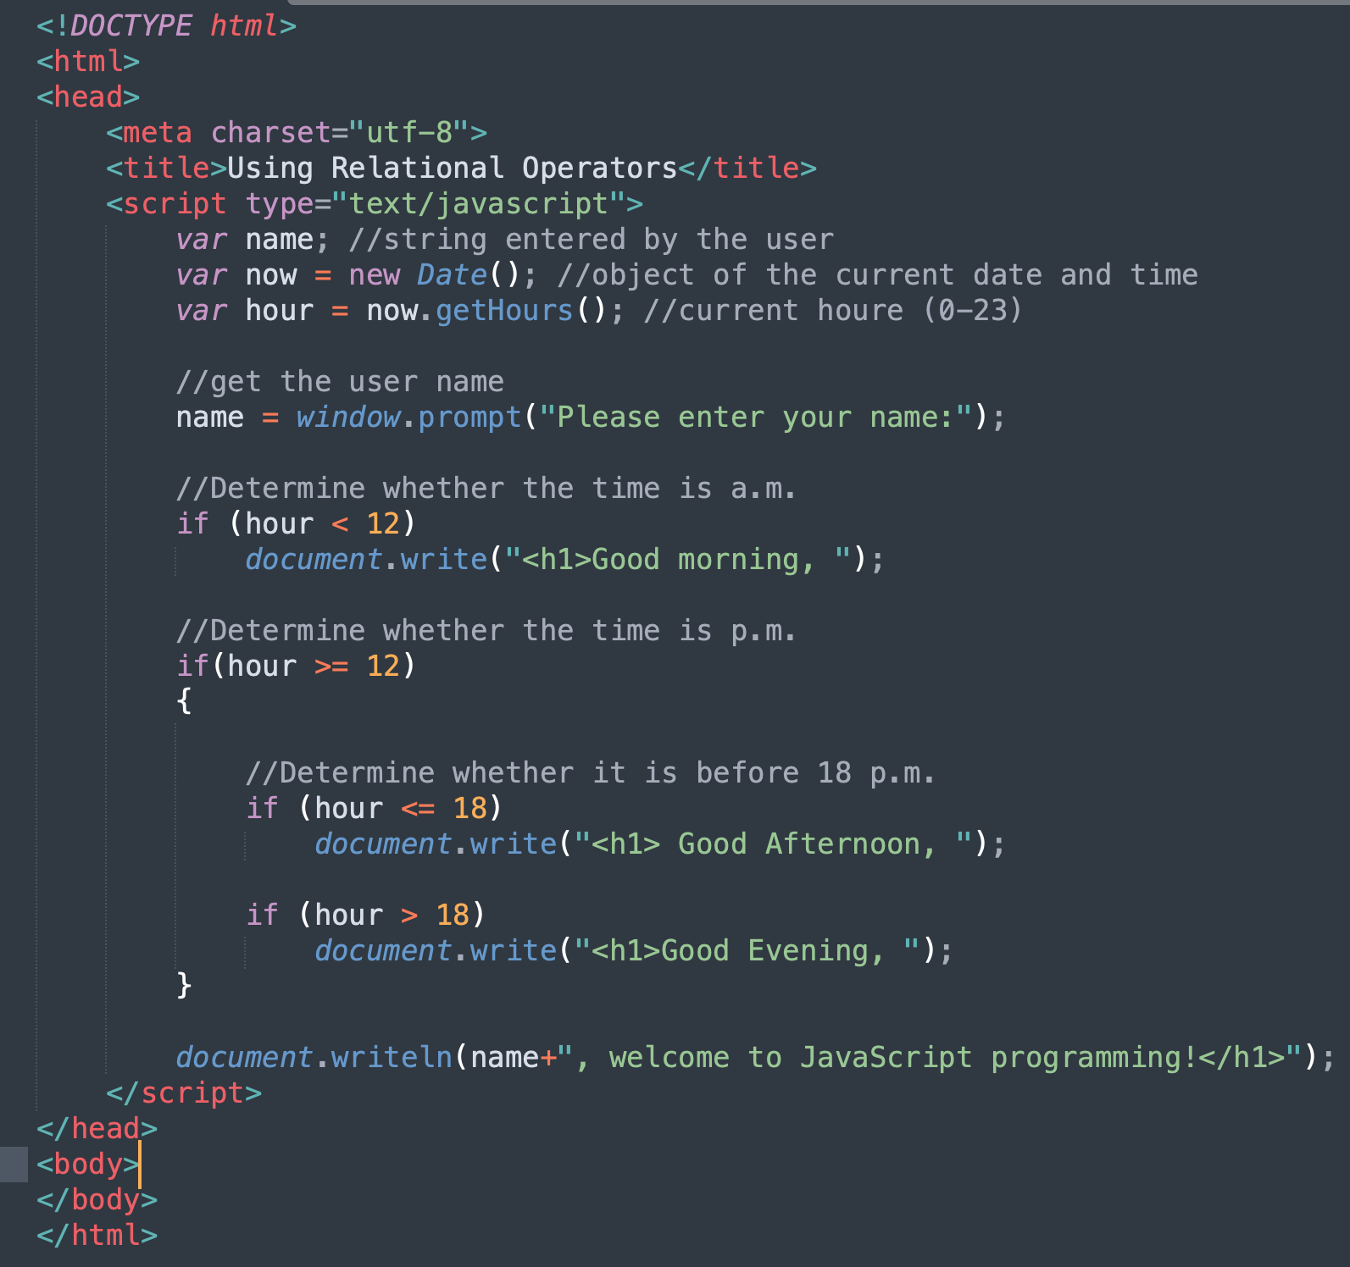
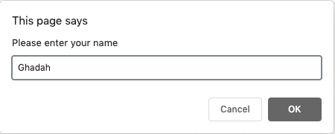
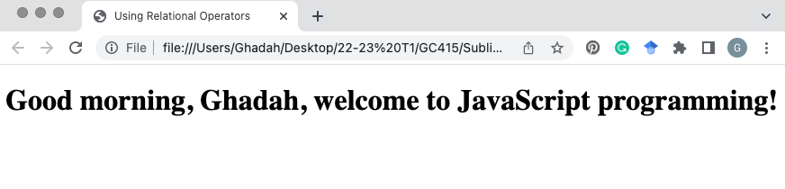
Example 2

Slide 9
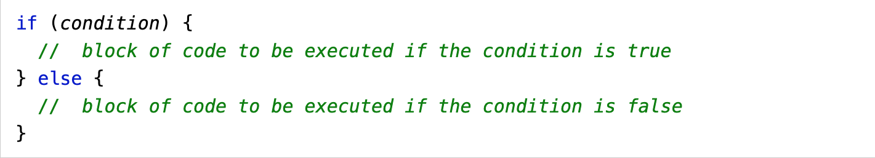
if…else Selection Statement
Conditional operator (?:)
Closely related to the if...else statement
JavaScript’s only ternary operator—it takes three operands
The operands together with the ?: operator form a conditional expression
The first operand is a boolean expression
The second is the value for the conditional expression if the boolean expression evaluates to true
Third is the value for the conditional expression if the boolean expression evaluates to false

Slide 10
if…else Selection Statement: Example
The following statement contains a conditional expression that evaluates to the string "Passed" if the condition studentGrade >= 60 is true and evaluates to the string "Failed" if the condition is false.
document.writeln( studentGrade >= 60 ? "Passed" : "Failed" );

Slide 11
if…else Selection Statement (Cont.)
Nested if...else statements
Test for multiple cases by placing if...else statements inside other if...else statements
The JavaScript interpreter always associates an else with the previous if, unless told to do otherwise by the placement of curly brackets { } (see next slides).

Slide 12
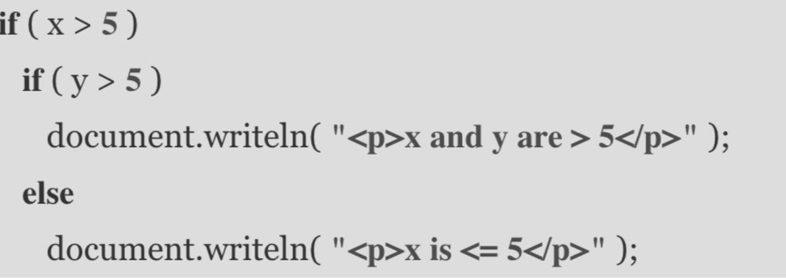
Dangling else Problem
This statement tests whether x is greater than 5. If so, execution continues by testing whether y is also greater than 5. If the second condition is true, the proper string—"x and y are > 5"—is displayed. However, if the second condition is false, the string "x is <= 5" is displayed, even though we know that x is greater than 5.

Slide 13
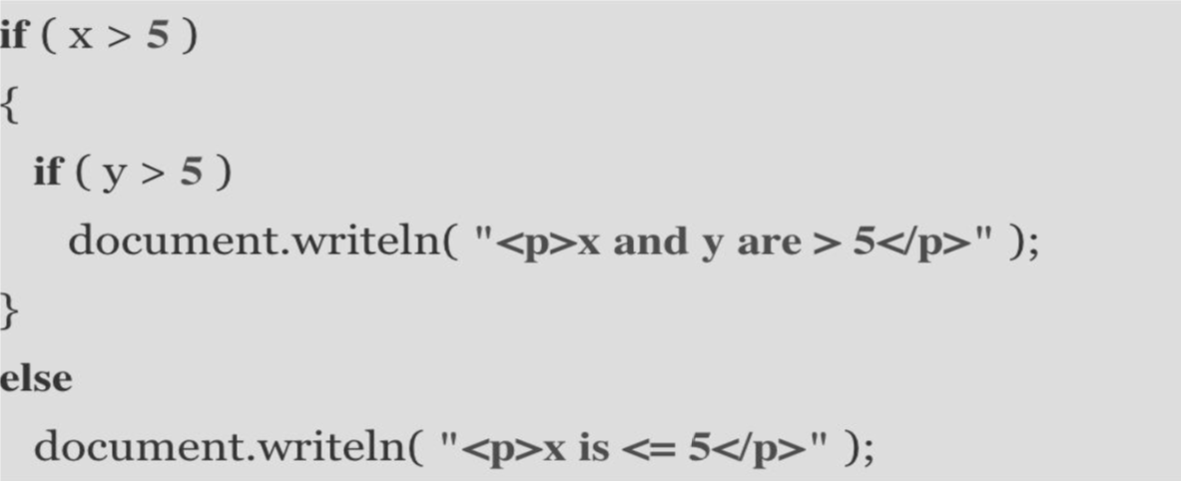
Dangling else Problem
To force the first nested if statement to execute as it was intended originally, we must write it as follows:
The brackets ({}) indicate to the JavaScript interpreter that the second if statement is in the body of the first if statement and that the else is matched with the first if statement.

Slide 14
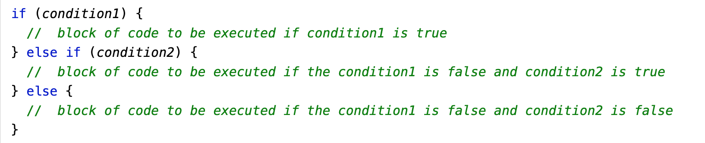
else…if Selection Statement

Slide 15
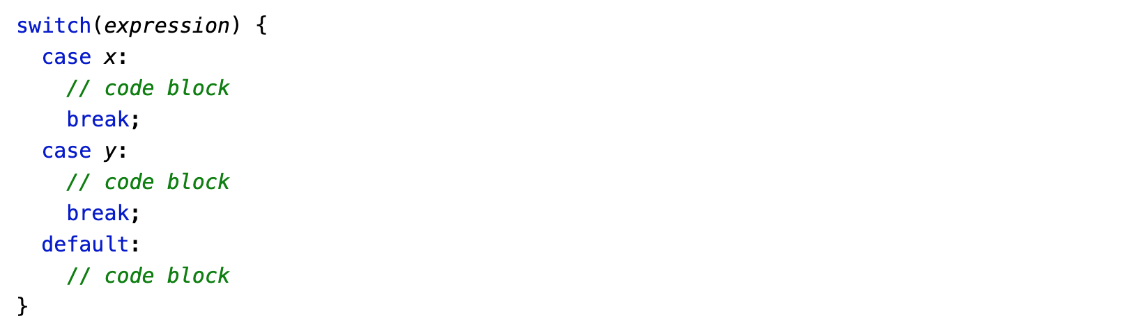
switch Selection Statement

Slide 16
switch Selection Statement (Cont.)
switch multiple-selection statement
Tests a variable or expression separately for each of the values it may assume
Different actions are taken for each value
switch statement
Consists of a series of case labels and an optional default case
When control reaches a switch statement
The script evaluates the controlling expression in the parentheses
Compares this value with the value in each of the case labels
If the comparison evaluates to true, the statements after the case label are executed in order until a break statement is reached
The break statement is used as the last statement in each case to exit the switch statement immediately
The default case allows you to specify a set of statements to execute if no other case is satisfied
Usually (but not necessary) the last case in the switch statement

Slide 17
switch Selection Statement (Cont.)
Each case can have multiple actions (statements)
Curly brackets are not required around multiple actions in a case of a switch
The break statement is not required for the last case because program control automatically continues with the next statement after the switch
Having several case labels listed together (e.g., case 1: case 2: with no statements between the cases) executes the same set of actions for each case

Slide 18
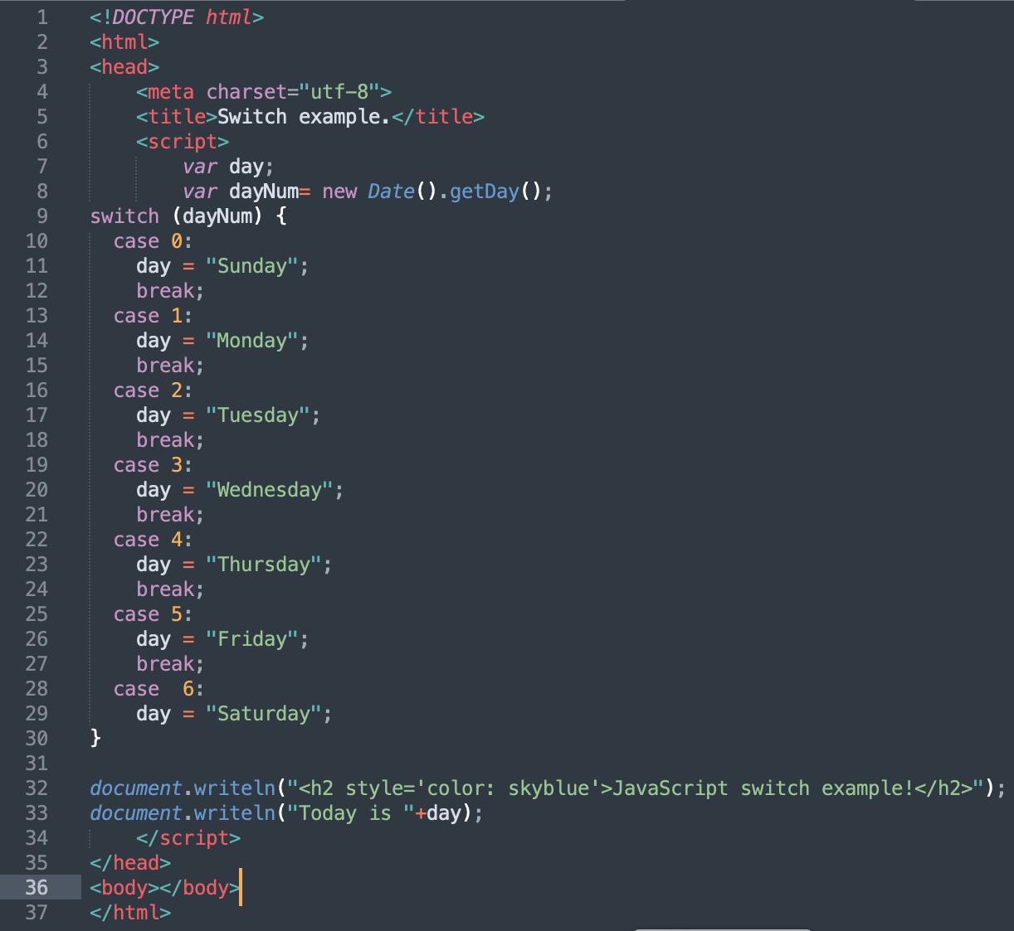
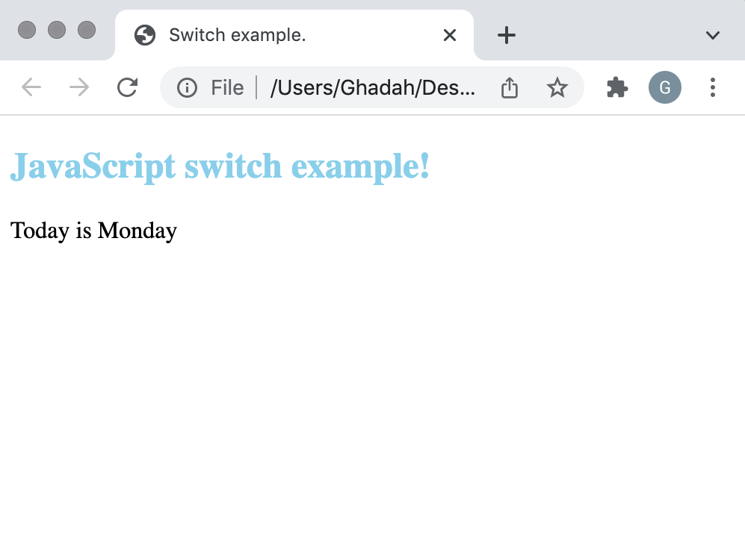
Example 3
Again, Date object acquire the current local time, and getDay() method returns the weekday as a number between 0 and 6:
(Sunday=0, Monday=1, Tuesday=2 ..)

Slide 19
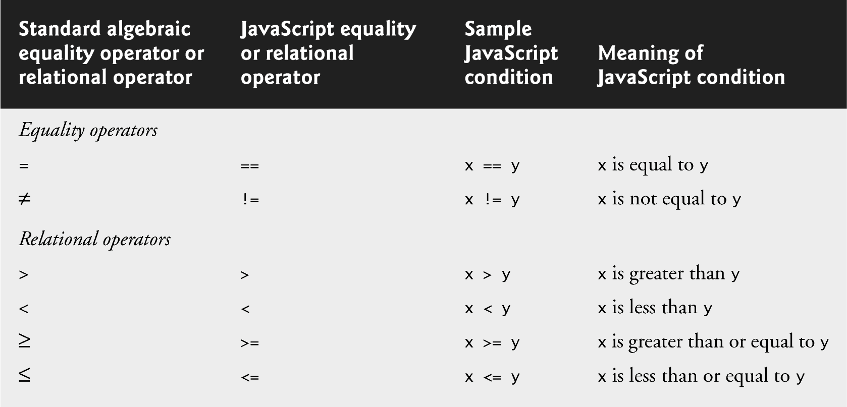
Conditions
Conditions in selection and repetition statements can be formed by using the equality operators and relational operators
Equality operators both have the same level of precedence, which is lower than the precedence of the relational operators.
The equality operators associate from left to right.

Slide 20
Logical Operators
Logical operators can be used to form complex conditions by combining simple conditions
logical AND (&&)
logical OR (|| )
logical NOT, also called logical negation (!)
JavaScript evaluates to false or true all expressions that include relational operators, equality operators and/or logical operators

Slide 21
Logical Operators (Cont.)
The && operator is used to ensure that two conditions are both true before choosing a certain path of execution
The || operator is used to ensure that either or both of two conditions are true before choosing choose a certain path of execution
The && operator has a higher precedence than the || operator
Both operators associate from left to right.
An expression containing && or || operators is evaluated only until truth or falsity is known
This is called short-circuit evaluation

Slide 22
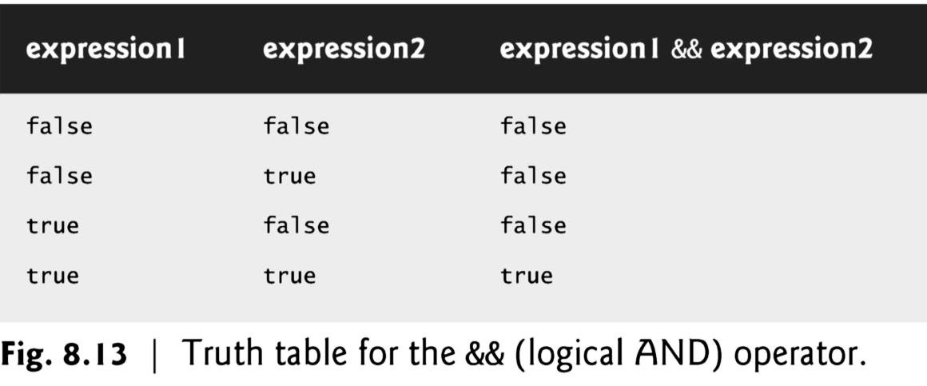
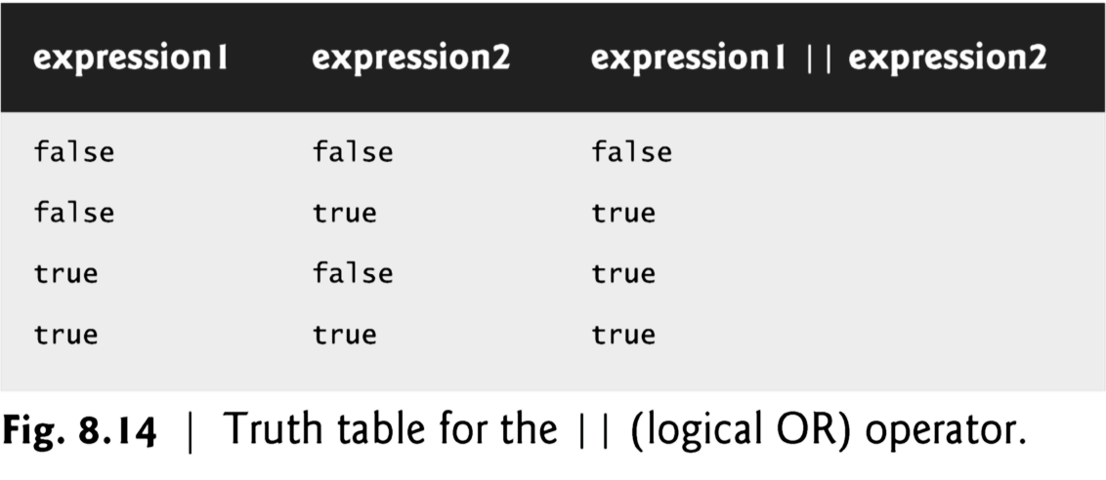

Slide 23
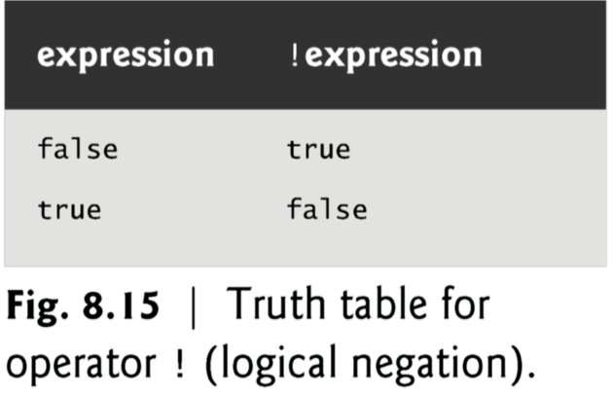
Logical Operators (Cont.)
The ! operator
reverses the meaning of a condition (i.e., a true value becomes false, and a false value becomes true)
Has only a single condition as an operand (i.e., it is a unary operator)

Slide 24
Logical Operators (Cont.)
Most nonboolean values can be converted to a boolean true or false value
Nonzero numeric values are considered to be true
The numeric value zero is considered to be false
Any string that contains characters is considered to be true
The empty string is considered to be false
The value null and variables that have been declared but not initialized are considered to be false
All objects are considered to be true

Slide 25
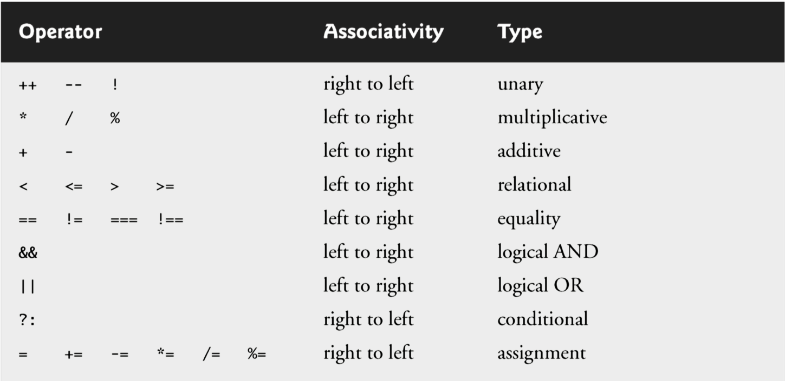
Precedence and Associativity
Precedence and associativity of the operators discussed so far

Slide 26
Control Statements : Repetition
JavaScript provides four repetition statements, namely:
while
for
do...while
break and continue

Slide 27
While Repetition Statement
while
Allows you to specify that an action is to be repeated while some condition remains true
The body of a loop may be a single statement or a block
Eventually, the condition becomes false and repetition terminates

Slide 28
Counter-Controlled Repetition
Counter-controlled repetition requires
name of a control variable
initial value of the control variable
the increment (or decrement) by which the control variable is modified each time through the loop
the condition that tests for the final value of the control variable to determine whether looping should continue

Slide 29
Counter-Controlled Repetition (Cont.)
Example 4
Uses a counter controlled while loop to asks the user to enter 5 students’ grades then display their average.
Example 5
Uses a counter controlled while loop to incrementally changes the font-size of a displayed paragraph.

Slide 30
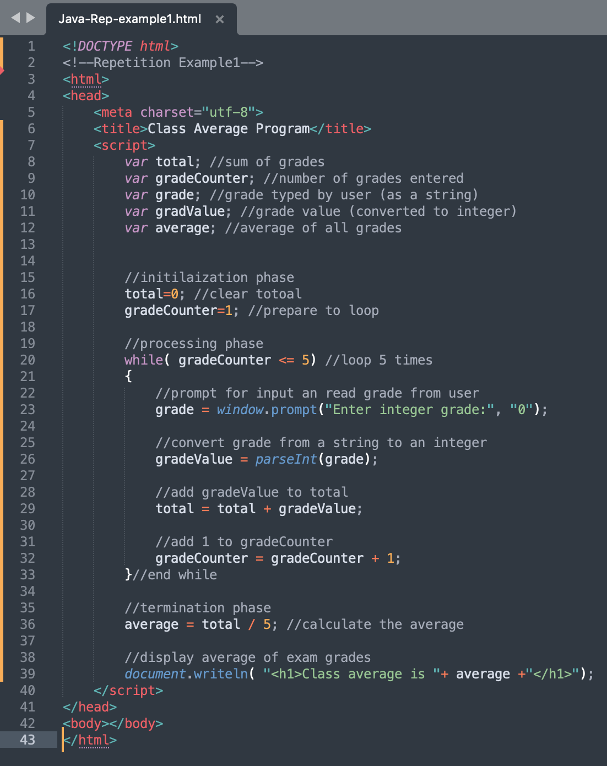
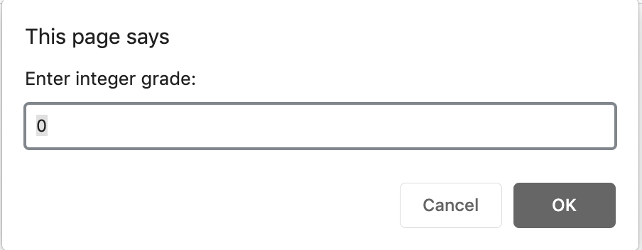
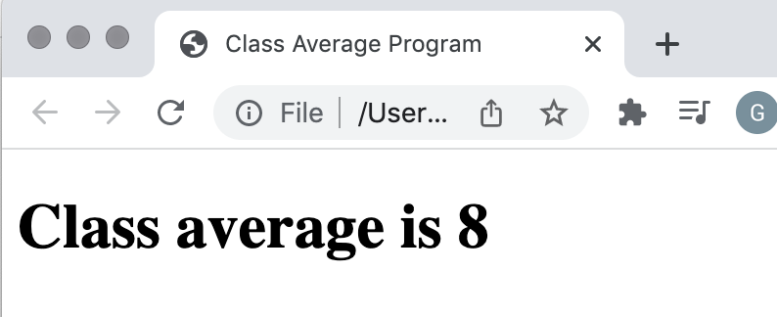
Example 4
This prompt will appear 5 times requesting 5
grades to be entered.
assuming the user has entered the grades: 10, 5, 10, 5 and 10; the class average is given below

Slide 31
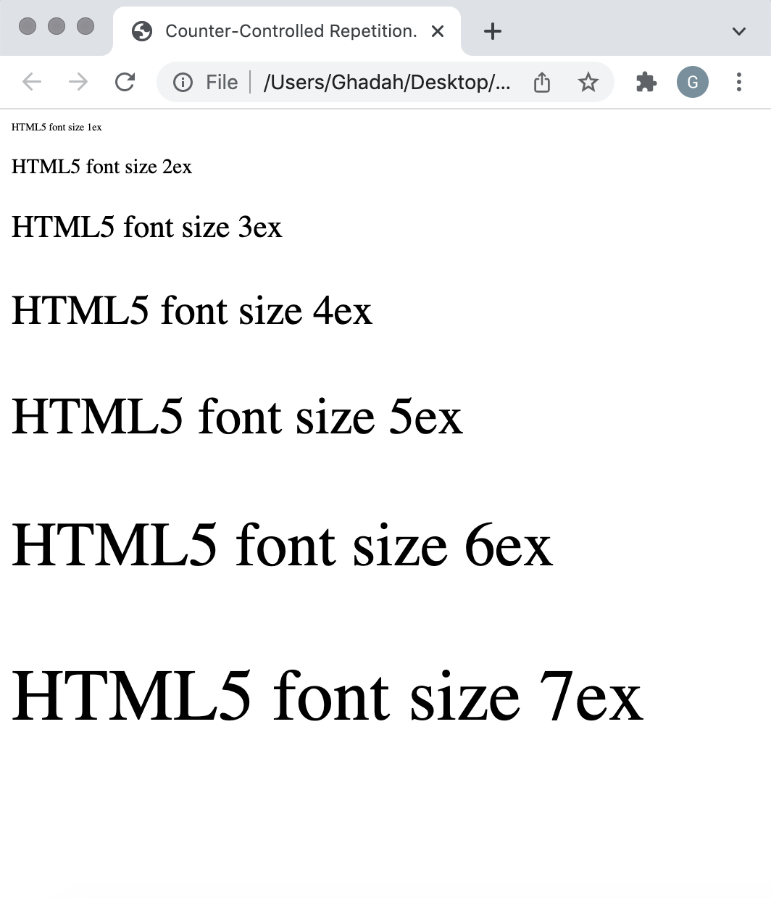
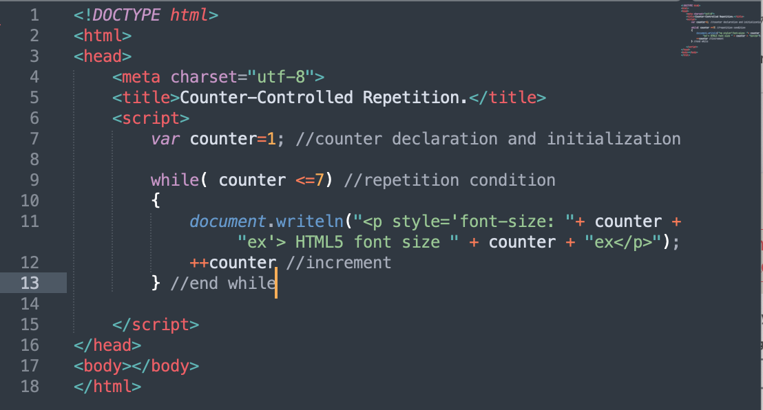
Example 5: while loop

Slide 32
Counter-Controlled Repetition (Cont.)
Some notes on Example 5
The double-quote character delimits the beginning and end of a string literal in JavaScript
it cannot be used in a string unless it is preceded by a \ to create the escape sequence \”
HTML5 allows either single quotes (') or double quotes (") to be placed around the value specified for an attribute
JavaScript allows single quotes to be placed in a string literal

Slide 33
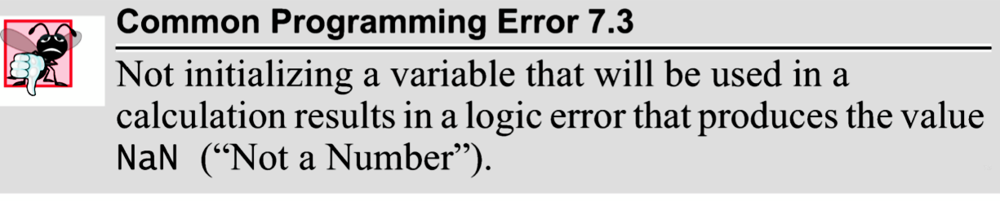

Slide 34
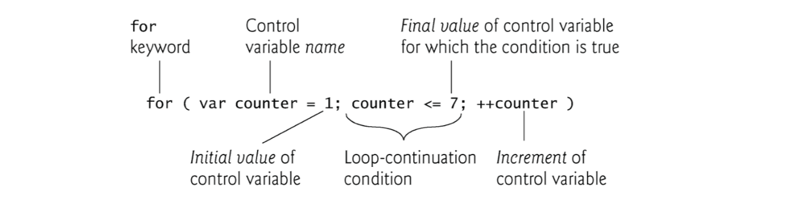
For Repetition Statement
for statement is a counter-controlled repetition statement that includes three expressions in its header:
Initialization
Condition
Increment Expression
The two semicolons in the for statement are required
The initialization, loop-continuation condition and increment portions of a for statement can contain arithmetic expressions

Slide 35
For Repetition Statement
Example 5 in next slide
is the same as the one we saw before but using a for loop this time
Example 6
uses the for statement to sum the even integers from 2 to 100

Slide 36
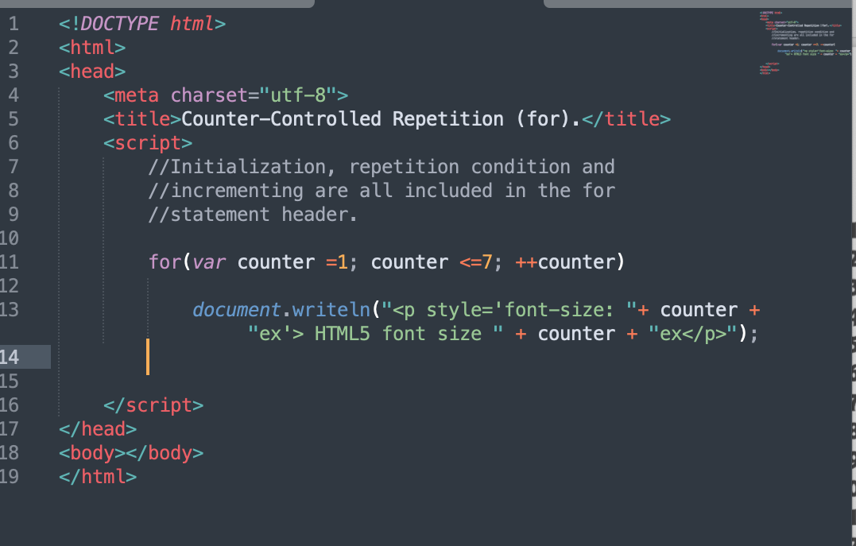
Example 5: for loop

Slide 37
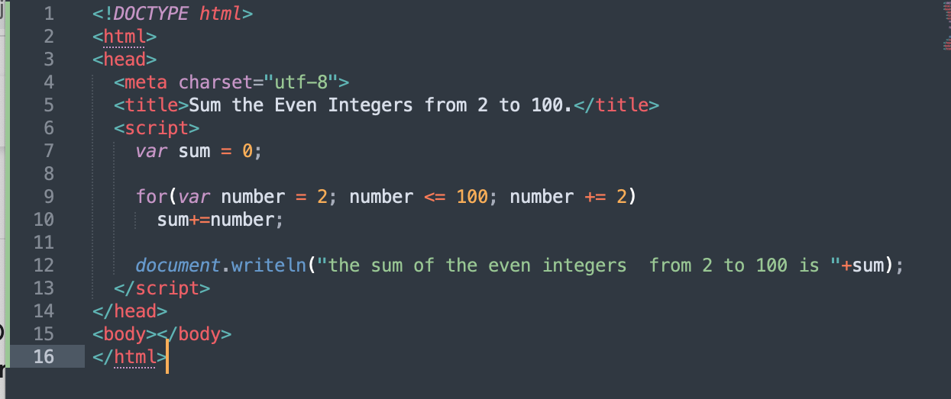
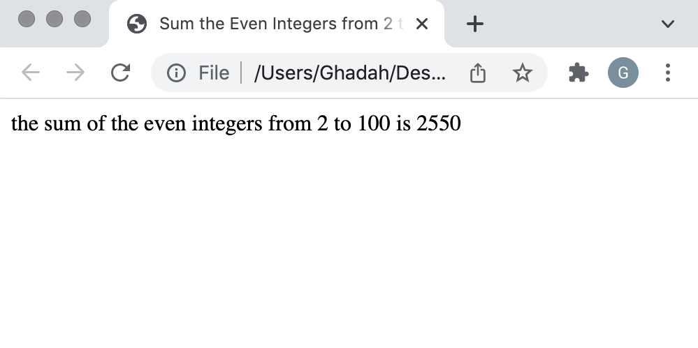
Example 6: for loop

Slide 38
For Repetition Statement
If the loop’s condition uses a < or > instead of a <= or >=, or vice-versa, it can result in an off-by-one error
The part of a script in which a variable name can be used is known as the variable’s scope
The “increment” of a for statement may be negative, in which case it is called a decrement and the loop actually counts downward
If the loop-continuation condition initially is false, the body of the for statement is not performed
Execution proceeds with the statement following the for statement

Slide 39
Sentinel-Controlled repetition
Sentinel-controlled repetition
Special value called a sentinel value (also called a signal value, a dummy value or a flag value) indicates the end of data entry
Often is called indefinite repetition, because the number of repetitions is not known in advance
Choose a sentinel value that cannot be confused with an acceptable input value
Example 7
prompt the user to enter students grades then display their average. To stop the entering process the user should type -1

Slide 40
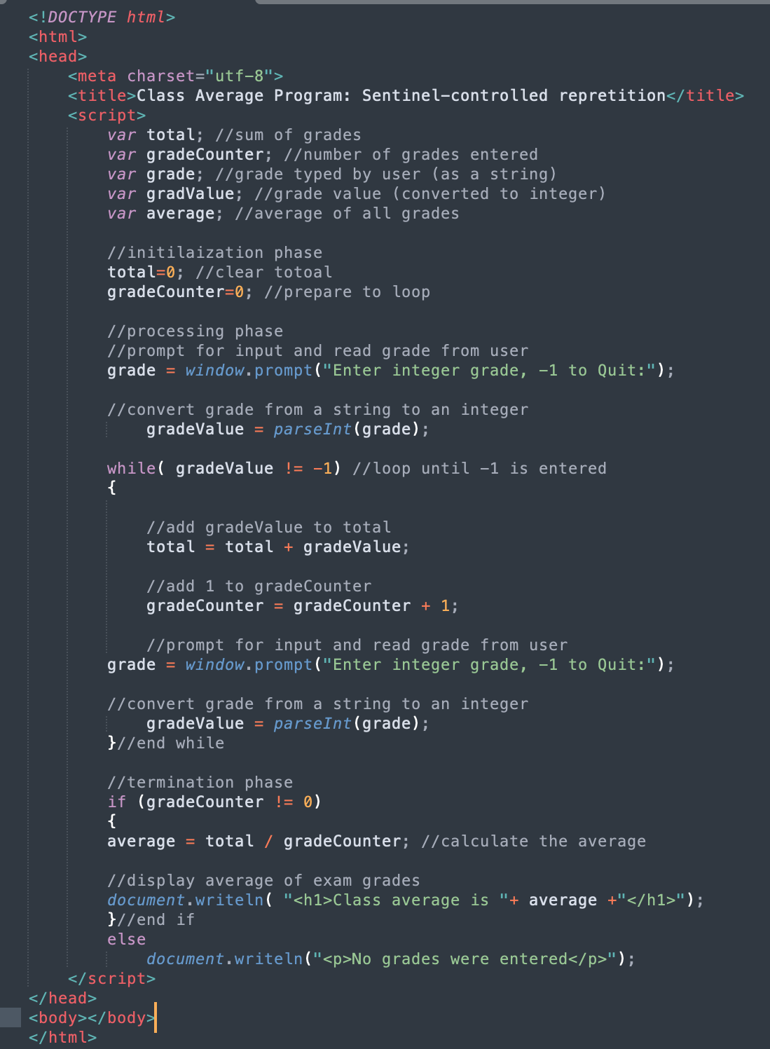
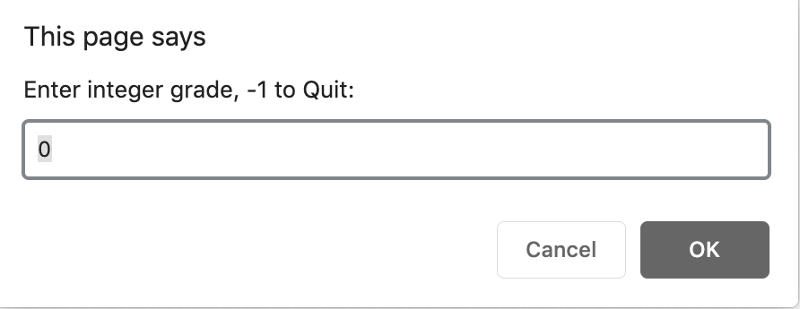
Example 7
This prompt will stop appearing when the user
enters -1

Slide 41

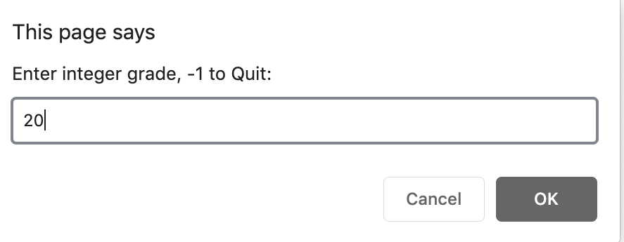
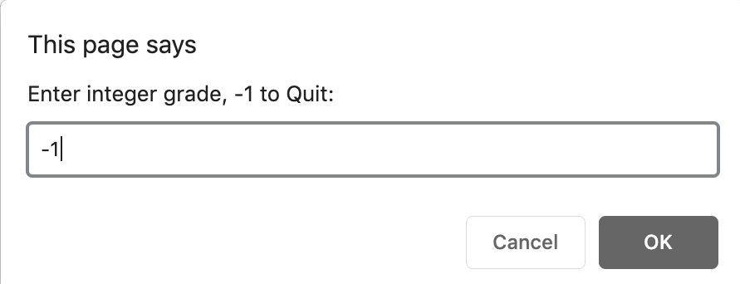
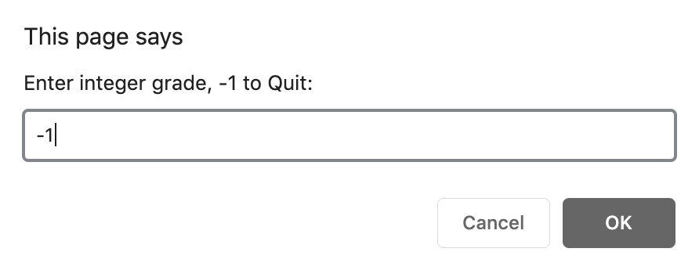
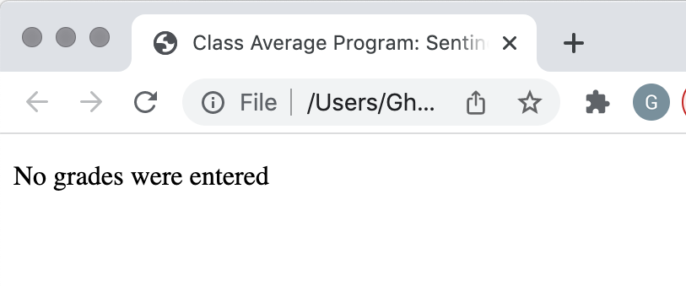
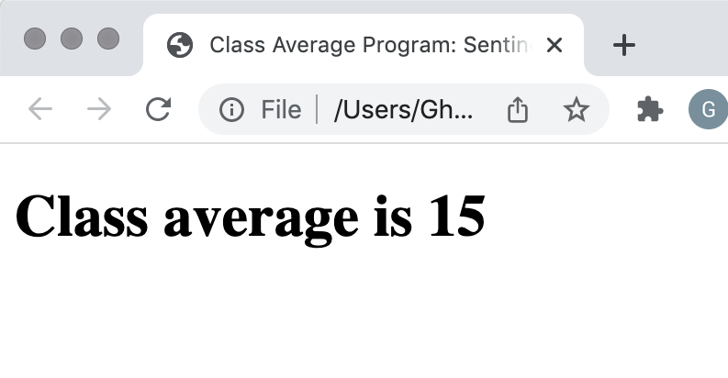

Slide 42
Nested Control Statement
Control structures may be nested inside of one another
For instance, in Example 8 , we have an if…else selection statement inside a counter-controlled while loop.
The loop is to prompt the user to enter the exam result for 10 students.
the selection statement is to check whether an entered value indicates a pass or fail result and then add that result to the total number of passed or failed students.

Slide 43
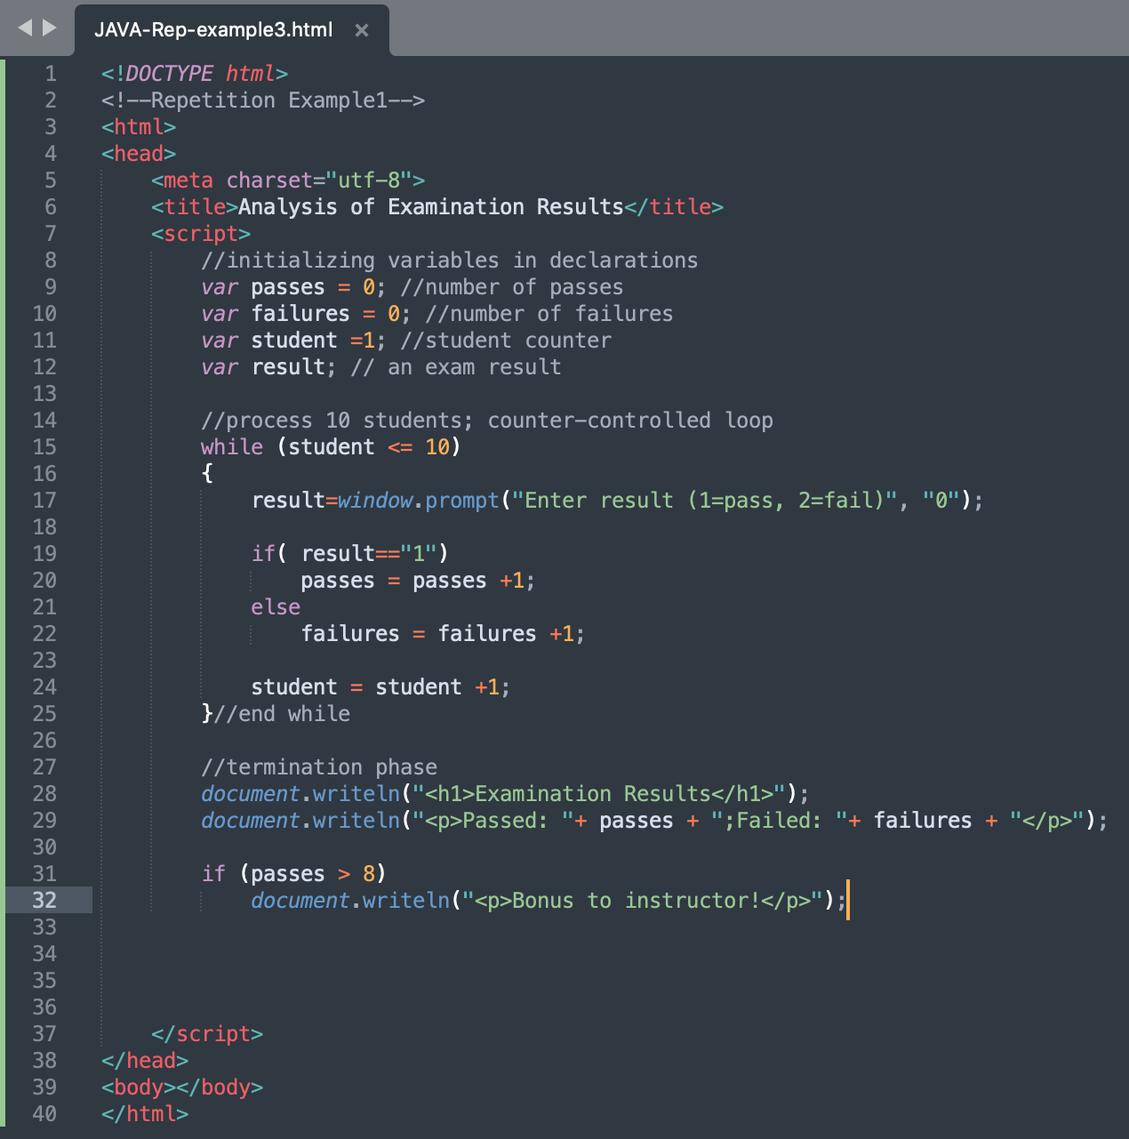
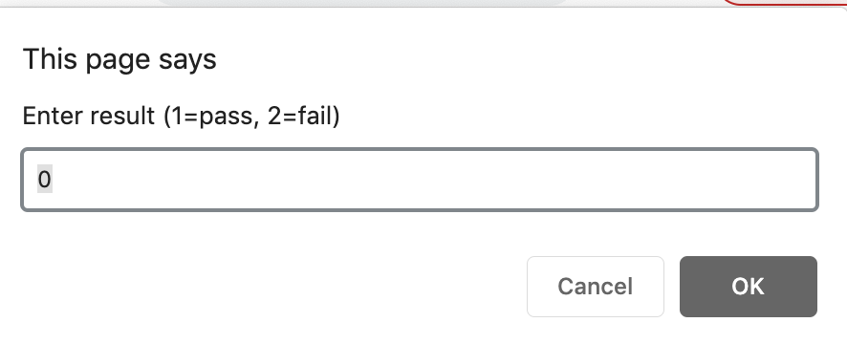
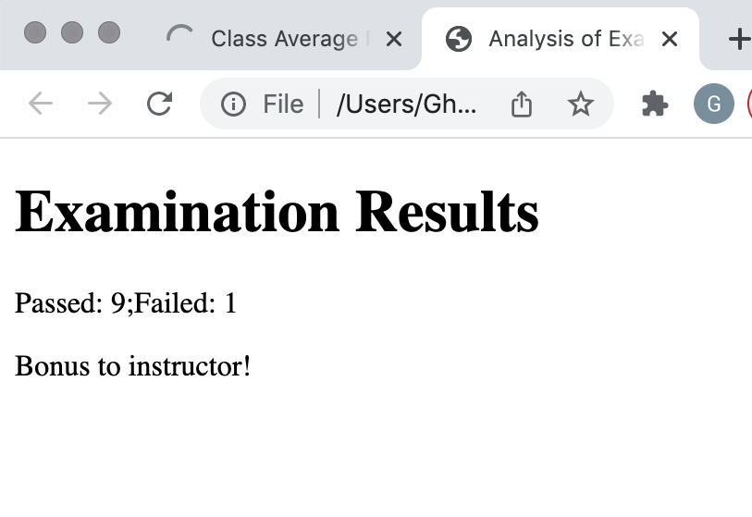
Example 8
This dialog is displayed 10 times and the
user input is: 1, 1, 1, 1, 1, 1, 1, 1, 1 and 2
9 students passed and 1 failed so the
instructor gets a bonus

Slide 44
do…while Control Statement
do...while statement
tests the loop-continuation condition after the loop body executes
The loop body always executes at least once

Slide 45
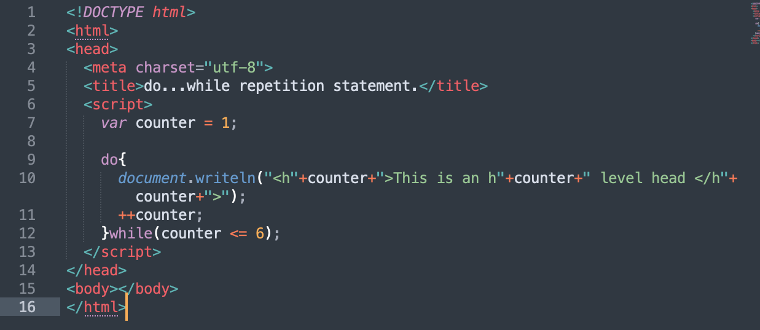
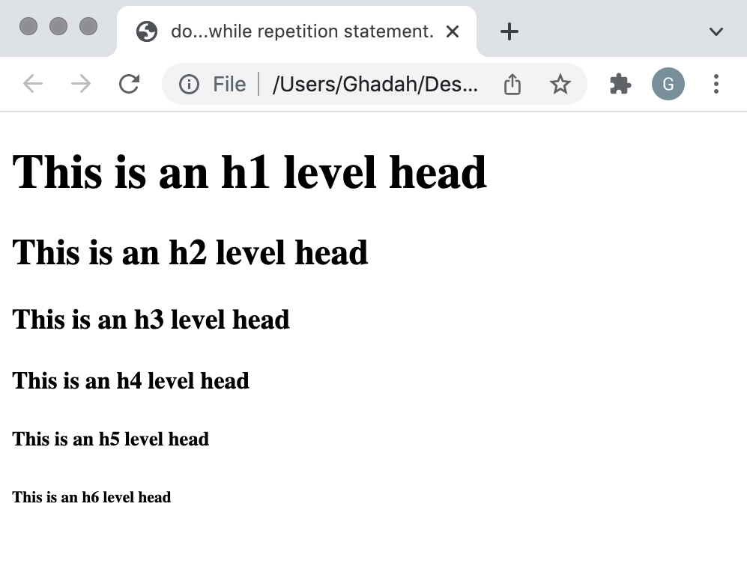
Example 9: do..while

Slide 46
Break and Continue statements
break statement in a while, for, do...while or switch statement
Causes immediate exit from the statement
Execution continues with the next statement in sequence
break statement common uses
Escape early from a loop
Skip the remainder of a switch statement

Slide 47
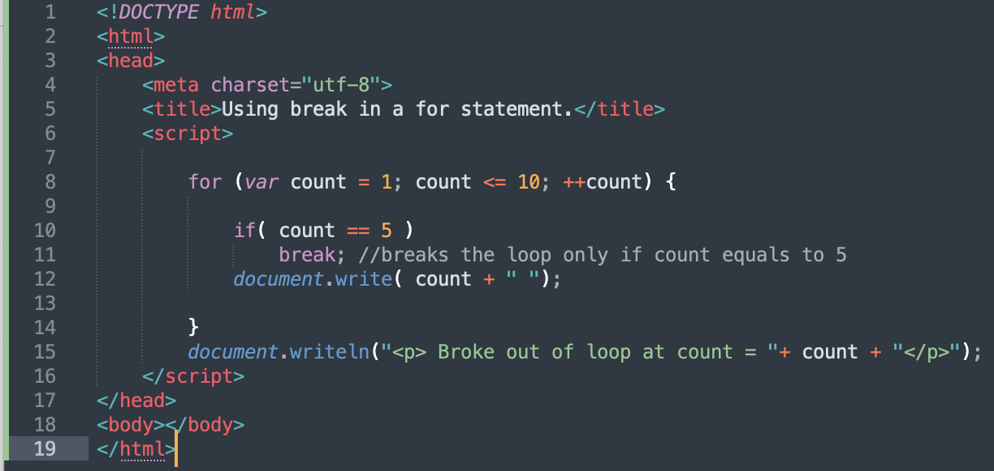
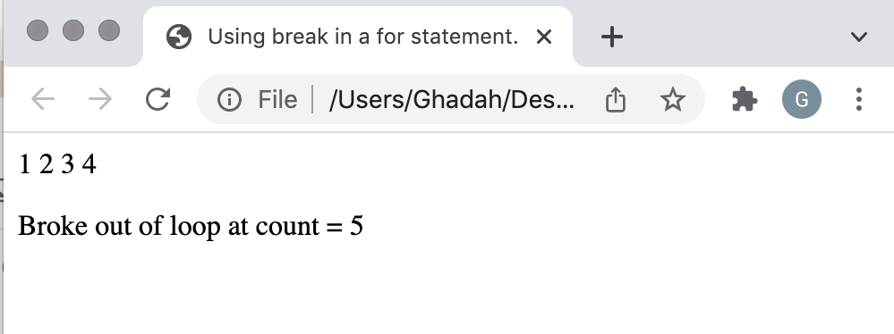
Example 10

Slide 48
Break and Continue statements
continue statement in a while, for or do...while
skips the remaining statements in the body of the statement and proceeds with the next iteration of the loop
In while and do...while statements, the loop- continuation test evaluates immediately after the continue statement executes
In for statements, the increment expression executes, then the loop-continuation test evaluates

Slide 49
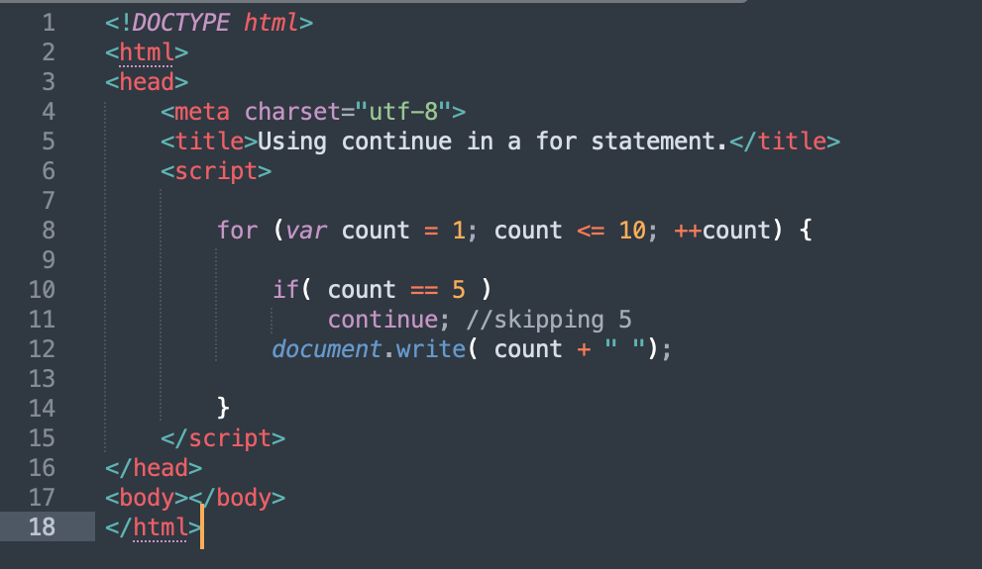
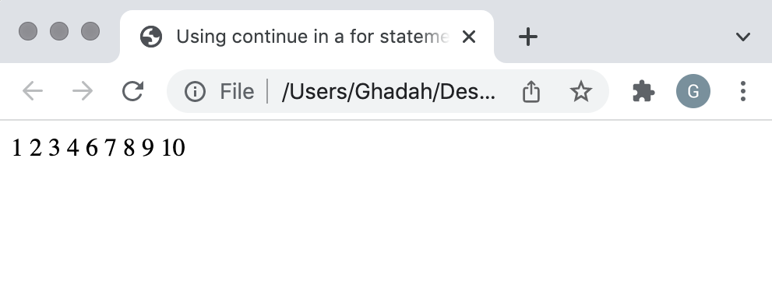
Example 11

