Slide 1

CT1452 – Javascript: introduction to scripting
Internet & World Wide Web
How to Program, 5/e

Slide 2
Introduction
JavaScript
  Scripting language which is used to enhance the functionality and appearance of web pages.
Before you can run code examples with JavaScript on your computer, you may need to change your browser’s security settings.
  IE9 prevents scripts on the local computer from running by default
  Firefox, Chrome, Opera, Safari (including on the iPhone) and the Android browser have JavaScript enabled by default.

Slide 3
Common Uses of JavaScript
Display a message box
Select list navigation
Edit and validate form information
Create a new window with a specified size and screen position
Image Rollovers
Status Messages
Display Current Date
Calculations

Slide 4
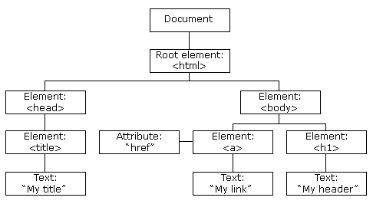
The HTML DOM (Document Object Model)
When a web page is loaded, the browser creates a Document Object Model of the page.
The HTML DOM model is constructed as a tree of Objects.

Slide 5
Your First Script: Displaying a Line of Text with JavaScript in a Web Page
We begin with a simple script that displays the text "Welcome to JavaScript Programming!" in the HTML5 document.
All major web browsers contain JavaScript interpreters, which process the commands written in JavaScript.
The JavaScript code and its result are shown in Example 1.

Slide 6
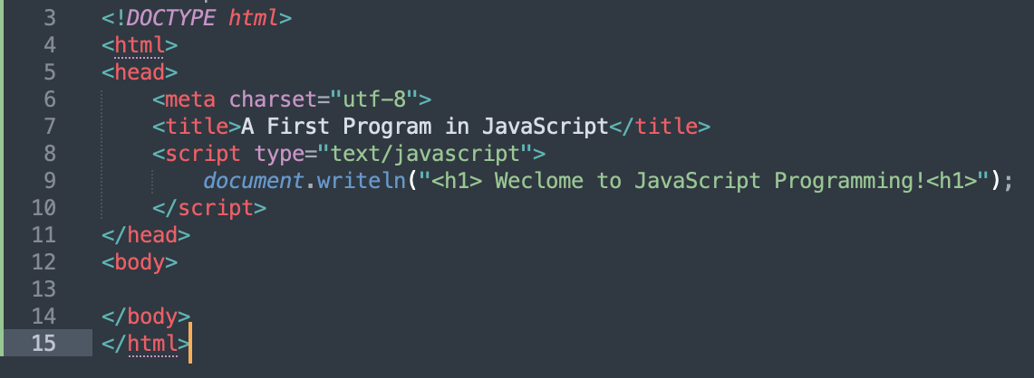
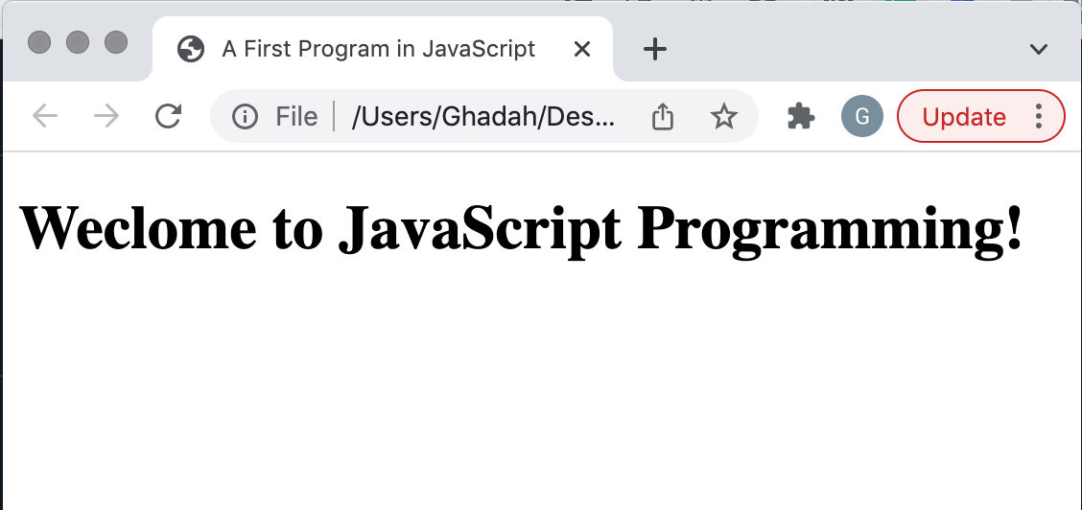
Example 1

Slide 7
Your First Script: Displaying a Line of Text with JavaScript in a Web Page
<script type="text/javascript">
…
</script>
The <script> tag indicates to the browser that the text that follows is part of a script.
The type attribute specifies the MIME type of the script as well as the scripting language used in the script—in this case, a text file written in javascript

Slide 8
Your First Script: Displaying a Line of Text with JavaScript in a Web Page
Often, JavaScripts appear in the <head> section of the HTML5 document and that is because browser interprets the contents of the <head> section first.
*However, JavaScripts can appear in the <body> section of the HTML5 document or in an external file that has the extension (myScript.js).
In case of the latter, the JavaScript external file can be references using:
<script src="myScript.js"></script>
and that reference can be placed in either the <head> or <body> part of the HTML5 document.

Slide 9
Your First Script: Displaying a Line of Text with JavaScript in a Web Page
document.writeln("<h1> Weclome to JavaScript Programming!<h1>");
Object
method
Argument/action
A string of characters can be contained between double quotation (") marks (also called a string literal)
The parentheses (following the name of a method contain the arguments that the method requires to perform its task (or its action)
Every statement end with a semicolon (also known as the statement terminator), although none is required by JavaScript
JavaScript is case sensitive
  Not using the proper uppercase and lowercase letters is a syntax error

Slide 10
Your First Script: Displaying a Line of Text with JavaScript in a Web Page
The document object’s writeln method
  Writes a line of HTML5 text in the HTML5 document
  Text displayed is dependent on the contents of the string written, which is subsequently rendered by the browser;
  Browser will interpret the HTML5 elements as it normally does to render the final text in the document

Slide 11
Your First Script: Displaying a Line of Text with JavaScript in a Web Page
A Note About Embedding JavaScript Code into HTML5 Documents
As stated before, JavaScript code can be placed in a separate file, then included in the HTML5 document that uses the script.
This makes the code more reusable, because it can be included into any HTML5 document—as is the case with the many JavaScript libraries used in professional web development today.

Slide 12
Modifying Your First Script
A script can display Welcome to JavaScript Programming! in many ways.
Example 2 displays the text in magenta, using the CSS color property.
Method write displays a string like writeln, but does not position the output cursor in the HTML5 document at the beginning of the next line after writing its argument.
The + operator (called the “concatenation operator” when used in this manner) allows a string and a value of another data type (including another string) to be concatenated

Slide 13
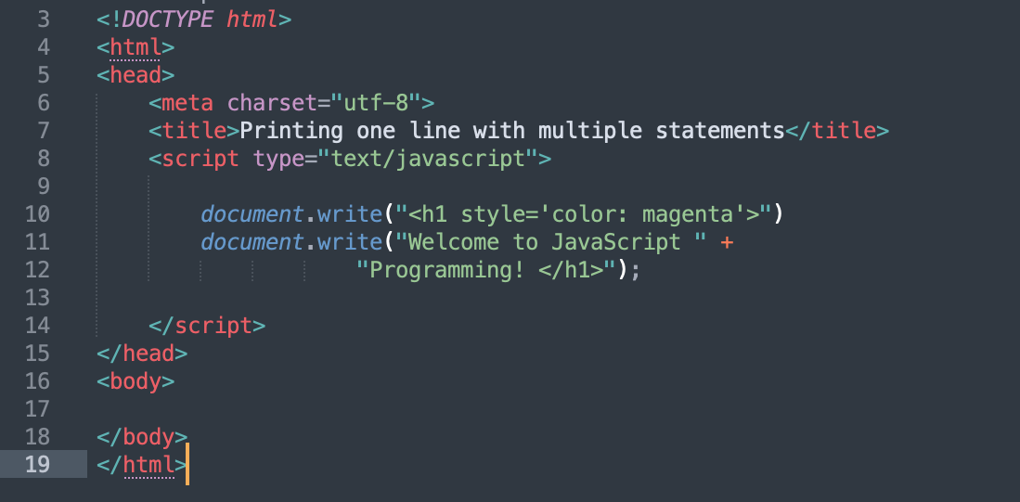
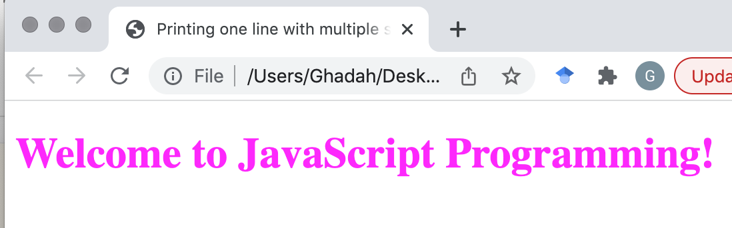
Example 2

Slide 14
Displaying Text in an Alert Dialog
Alert dialogs
  Useful to display information in windows that “pop up” on the screen to grab the user’s attention
  Typically used to display important messages to the user browsing the web page
  Browser’s window object uses method alert to display an alert dialog
  Method alert requires as its argument the string to be displayed
Escape Sequences
When a backslash is encountered in a string of characters, the next character is combined with the backslash to form an escape sequence. The escape sequence \n is the newline character. It causes the cursor in the HTML5 document to move to the beginning of the next line.

Slide 15
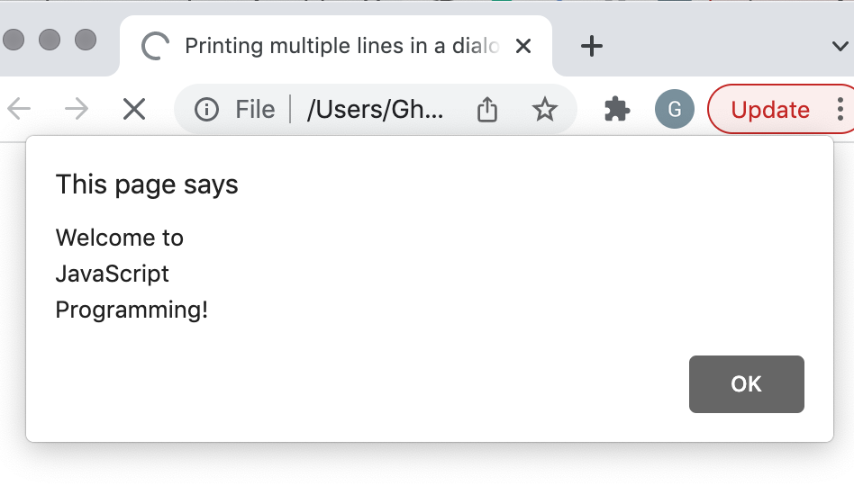
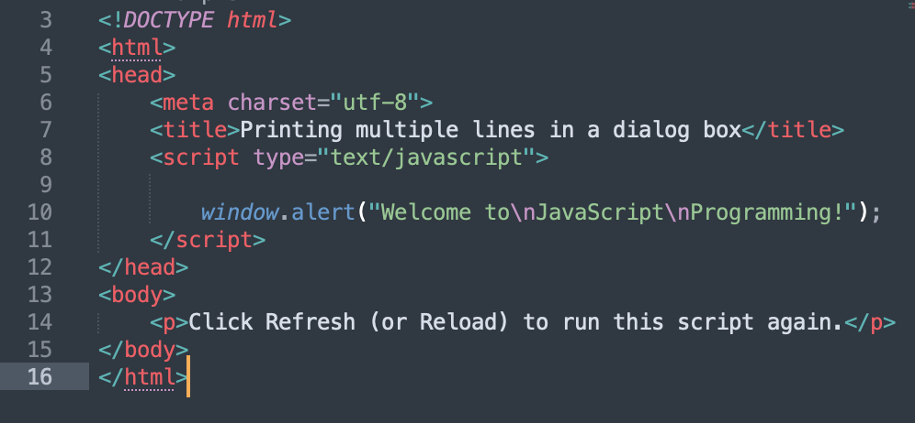
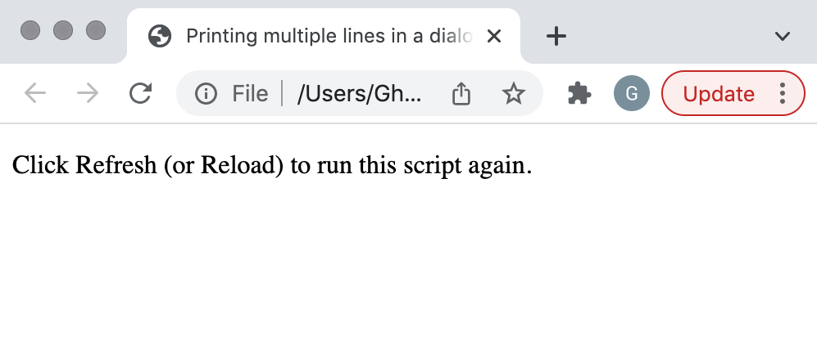

Example 3
Clicking the OK button
dismisses the dialog

Slide 16
Dynamic Web pages
Scripting
  Gives you the ability to generate part or all of a web page’s content at the time it is shown to the user
  Such web pages are said to be dynamic, as opposed to static, since their content has the ability to change.

Slide 17
Dynamic Web pages (Cont.)
Obtaining user input with prompt dialogs
The next script creates a dynamic welcome page that obtains the user’s name, then displays it on the page.
The script uses another predefined dialog box from the window object—a prompt dialog—which allows the user to enter a value that the script can use.
Example 4 presents the script and sample output.

Slide 18
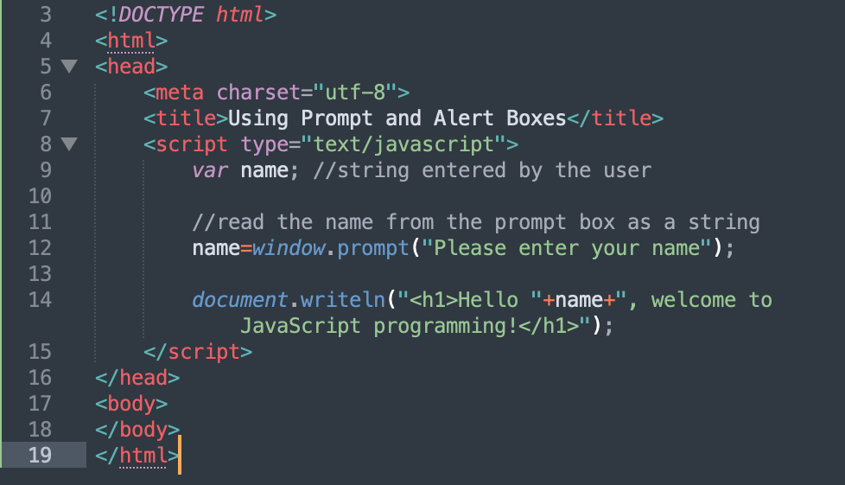
Example 4

Slide 19
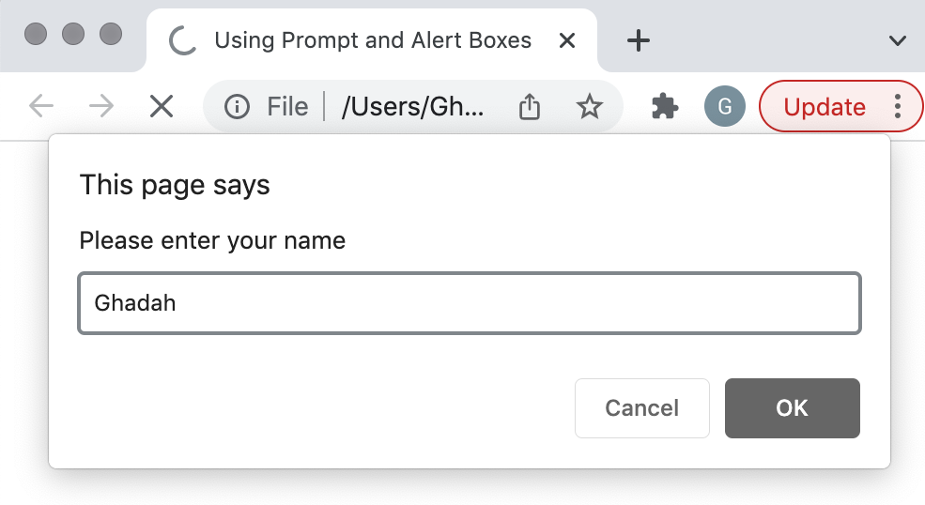
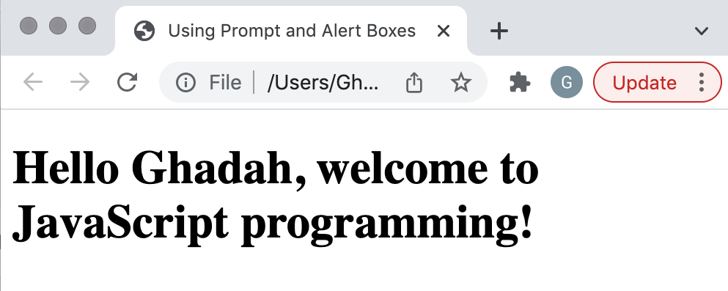
Example 4
The prompt to the user
The value the user types
into the text field
When the user clicks OK,
the typed value is returned to the program as a string
When the user clicks Cancel,
the returned value is typically null and, in some browsers, (such as safari) it is an empty string

Slide 20
Dynamic Web pages (Cont.): Prompt method
The window object’s prompt method displays a dialog into which the user can type a value.
  The first argument is a message (called a prompt) that directs the user to take a specific action.
  The optional second argument is the default string to display in the text field.
Script can then use the value that the user inputs.

Slide 21
Dynamic Web pages (Cont.): Variables and Comments
Keywords are words with special meaning in JavaScript
In Example 4 the user’s returned value was stored in a variable named name
That variable was declared using the Keyword var
A variable:
  is a location in the computer’s memory where a value can be stored for use by a script
  has a name, value and a type (determined by the type of data stored in it – see slide 32).

Slide 22
Dynamic Web pages (Cont.): *Variables and Comments
Variables must be identified with unique names.
These unique names are called identifiers.
Identifiers can be short names (like x and y) or more descriptive names (age, sum, totalVolume).
The general rules for constructing names for variables (unique identifiers) are:
  Names can contain letters, digits, underscores, and dollar signs.
  Names cannot start with digits.
  Names are case sensitive (y and Y are different variables)
  Reserved words (like JavaScript keywords-see next slide) cannot be used as names

Slide 23
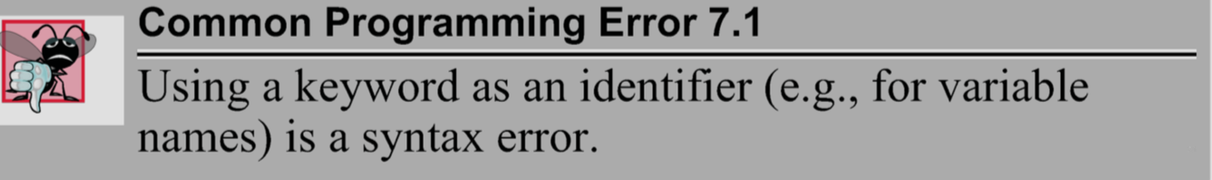
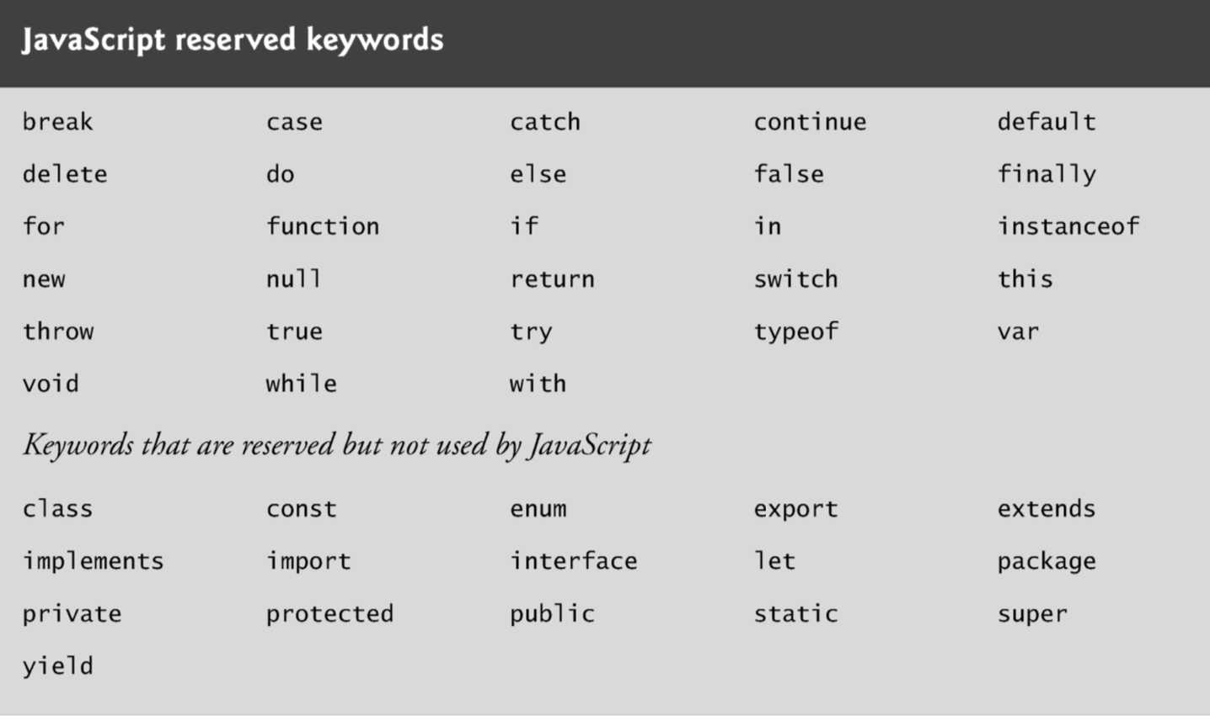
Dynamic Web pages (Cont.): *Variables and Comments

Slide 24
Dynamic Web pages (Cont.): Variables and Comments
Variable declaration statements end with a semicolon (;) and can be split over several lines, with each variable in the declaration separated by a comma (forming a comma-separated list of variable names). e.g.
  Several variables may be declared in one declaration (left) or in multiple declarations (right).
A variable is assigned a value with an assignment statement, using the assignment operator, =.
var num1,
num2,
num3;
var num1;
var num2;
var num3;
var num1, num2, num3;

Slide 25
Dynamic Web pages (Cont.): Variables and Comments
Comments
  A single-line comment begins with the characters // and terminates at the end of the line
  Comments do not cause the browser to perform any action when the script is interpreted; rather, comments are ignored by the JavaScript interpreter
  Multiline comments begin with delimiter /* and end with delimiter */
    All text between the delimiters of the comment is ignored by the interpreter..

Slide 26
Adding Integers
Our next script illustrates another use of prompt dialogs to obtain input from the user.
Example 5 inputs two integers (whole numbers, such as 7, –11, 0 and 31914) typed by a user at the keyboard, computes the sum of the values and displays the result.

Slide 27
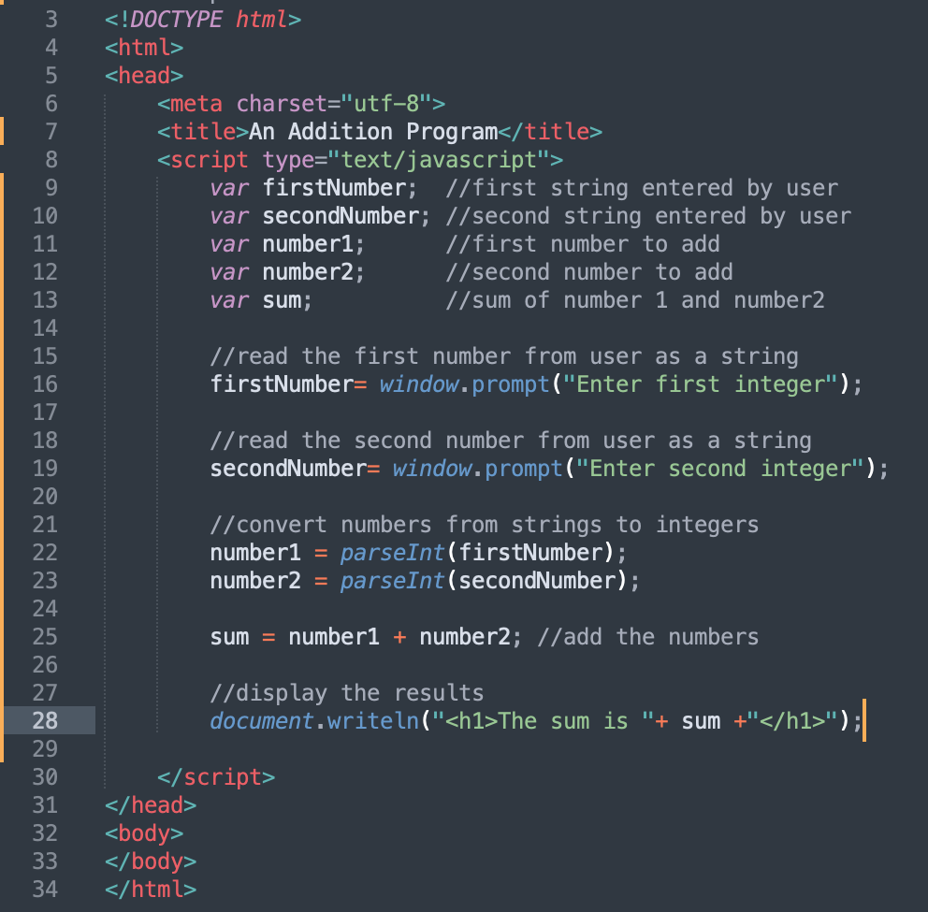
Example 5
Function parseInt converts its string argument to an integer

Slide 28
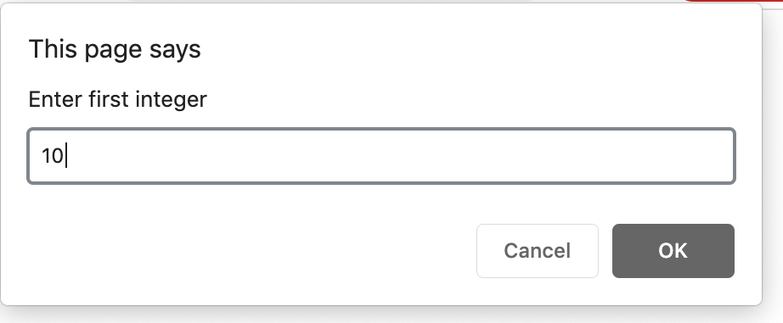
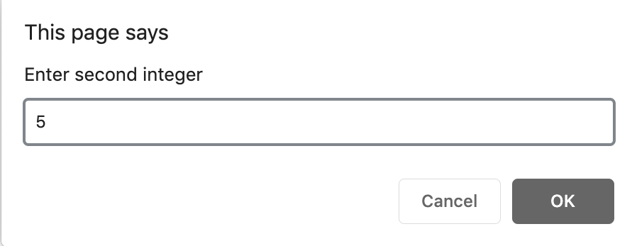
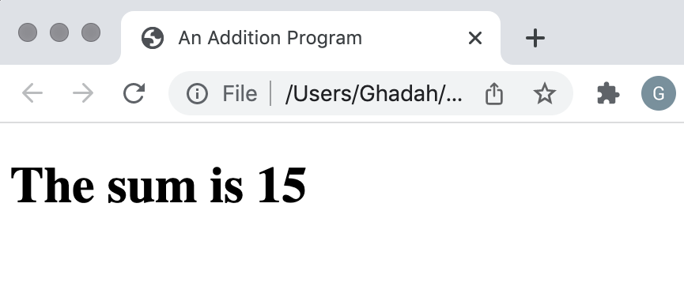

Slide 29
Arithmetic
The basic arithmetic operators (+, -, *, /, and %) are binary operators, because they each operate on two operands
JavaScript provides the remainder operator, %, which yields the remainder after division
Arithmetic expressions in JavaScript must be written in straight-line form to facilitate entering programs into the computer

Slide 30
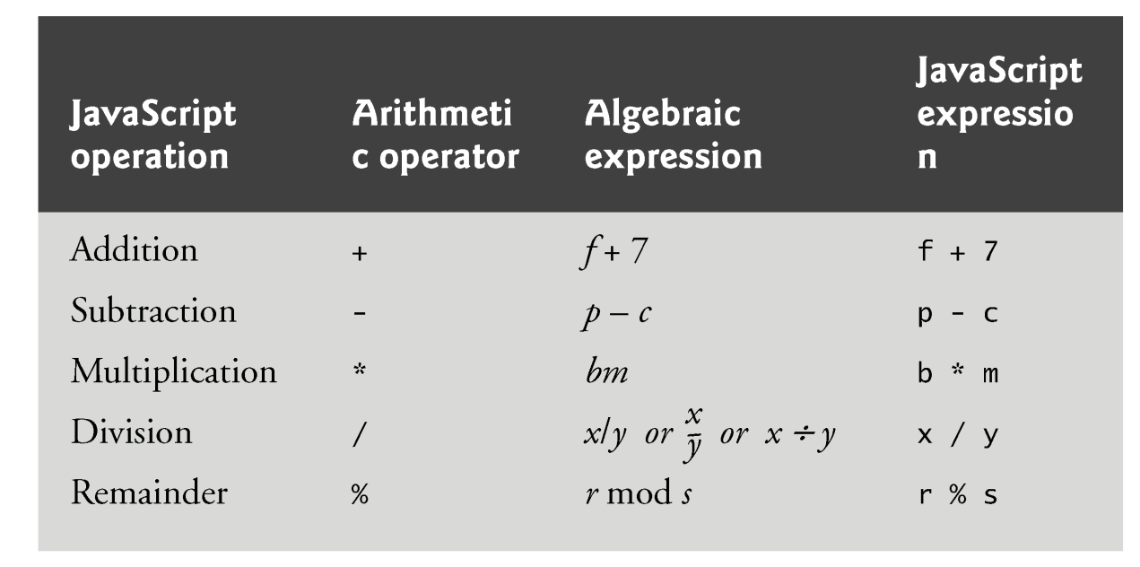
Arithmetic

Slide 31
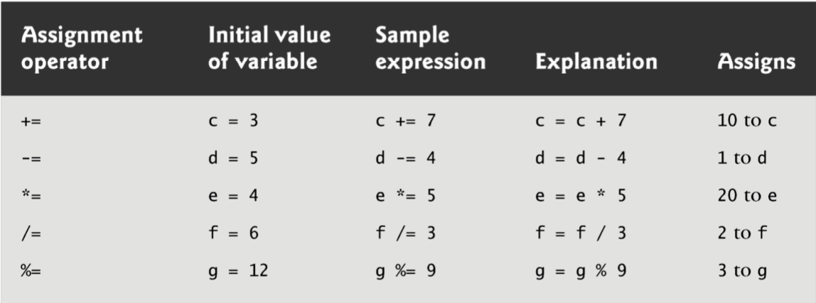
Assignments Operators
JavaScript provides the arithmetic assignment operators +=, -=, *=, /= and %=, which abbreviate certain common types of expressions.

Slide 32
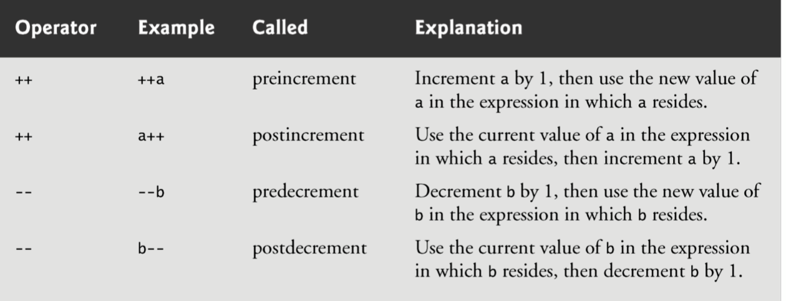
Increment/Decrement Operators
The increment operator, ++, and the decrement operator, --, increment or decrement a variable by 1, respectively.
If the operator is prefixed to the variable, the variable is incremented or decremented by 1, then used in its expression.
If the operator is postfixed to the variable, the variable is used in its expression, then incremented or decremented by 1.

Slide 33
Memory Concepts
JavaScript does not require variables to have a type before they can be used in a script
A variable in JavaScript can contain a value of any data type, and in many situations, JavaScript automatically converts between values of different types for you
JavaScript is referred to as a loosely typed language
When a variable is declared in JavaScript, but is not given a value, it has an undefined value.
  Attempting to use the value of such a variable is normally a logic error.
When variables are declared, they are not assigned default values, unless specified otherwise by the programmer.
  To indicate that a variable does not contain a value, you can assign the value null to it.

