Slide 1
12
Document Object Model (DOM): Objects and Collections

Slide 2
12.1 Introduction
The Document Object Model gives you scripting access to all the elements on a web page. Using JavaScript, you can create, modify and remove elements in the page dynamically.

Slide 4
12.2 Modeling a Document: DOM Nodes and Trees
getElementById method
Returns objects called DOM nodes
Every piece of an HTML5 page (elements, attributes, text, etc.) is modeled in the web browser by a DOM node
The nodes in a document make up the page’s DOM tree, which describes the relationships among elements
Nodes are related to each other through child-parent relationships
A node can have multiple children, but only one parent
Nodes with the same parent node are referred to as siblings
The html node in a DOM tree is called the root node, because it has no parent

Slide 5
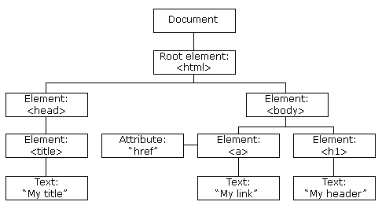
The HTML DOM (Document Object Model)
When a web page is loaded, the browser creates a Document Object Model of the page.
The HTML DOM model is constructed as a tree of Objects.

Slide 8
12.3 Traversing and Modifying a DOM Tree (Cont.)
The DOM element methods setAttribute and getAttribute allow you to modify an attribute value and get an attribute value, respectively.
document.getElementById("myAnchor").getAttribute("target");
document.getElementById("myAnchor").setAttribute("href", "http://www.w3schools.com");

Slide 9
<!DOCTYPE html>
<html>
<head>
<script>
function myFunction() { document.getElementById("myAnchor").setAttribute("href", "http://www.w3schools.com");}
</script>
</head>
<body>
<a id="myAnchor">A Link: Go to w3schools.com</a>
<p>Click the button to set the href attribute with a value of "www.w3schools.com" of the a element above.</p>
<button onclick="myFunction()">Try it</button>
<p><strong>Note:</strong> Internet Explorer 8 and earlier does not support the setAttribute method.</p>
</body>
</html>

Slide 10
Before clicking
After clicking

Slide 11
12.3 Traversing and Modifying a DOM Tree (Cont.)
document object createElement method
Creates a new DOM node, taking the tag name as an argument. It does not insert the element on the page.
document object createTextNode method
Creates a DOM node that contains only text. Given a string argument, createTextNode inserts the string into the text node.
Method appendChild
Inserts a child node (passed as an argument) after any existing children of the node on which it’s called
Property parentNode contains the node’s parent
insertBefore method
Inserts a node as a child, right before an existing child, which you specify.
node.insertBefore(newnode,existingnode)
replaceChild method
Receives as its first argument the new node to insert and as its second argument the node to replace. node.replaceChild(newnode,oldnode)
removeChild method
removes a specified child node of the specified element. Returns the removed node as a Node object, or null if the node does not exist. node.removeChild(node)

Slide 12
<!DOCTYPE html>
<html>
<head>
<script>
var para=document.createElement("p");
var node = document.createTextNode("This is new.");
para.appendChild(node);
var element = document.getElementById("div1");
element.appendChild(para);
</script>
</head>
<body>
<div id="div1">
<p id="p1">This is a paragraph.</p>
<p id="p2">This is another paragraph.</p>
</div>
</body>
</html>

Slide 13
<!DOCTYPE html>
<html>
<head>
<script>
function myFunction() {
var newItem = document.createElement(“lI");
var textnode = document.createTextNode("Water"); newItem.appendChild(textnode);
var list = document.getElementById("myList"); list.insertBefore(newItem, list.childNodes[0]);}
</script>
</head>
<body>
<ul id="myList">
<li>Coffee</li>
<li>Tea</li>
</ul>
<p>Click the button to insert an item to the list.</p>
<button onclick="myFunction()">Try it</button>
<p><strong>Example explained:</strong><br>First create a LI node,<br> then create a Text node,<br> then append the Text node to the LI node.<br>Finally insert the LI node before the first child node in the list.</p>
</body>
</html>

Slide 14
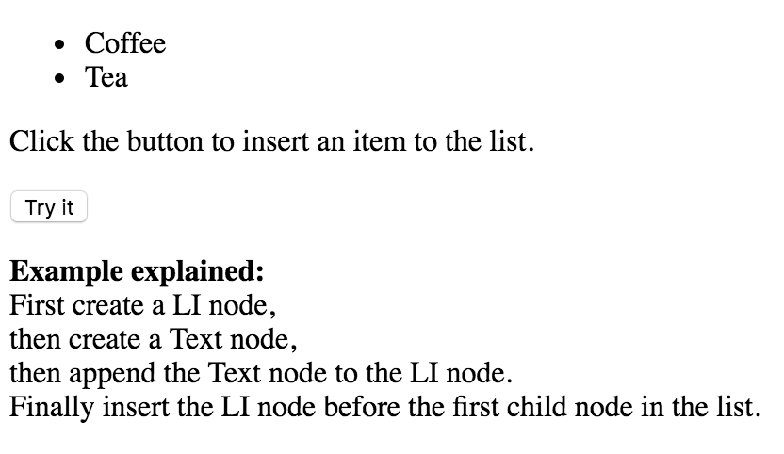
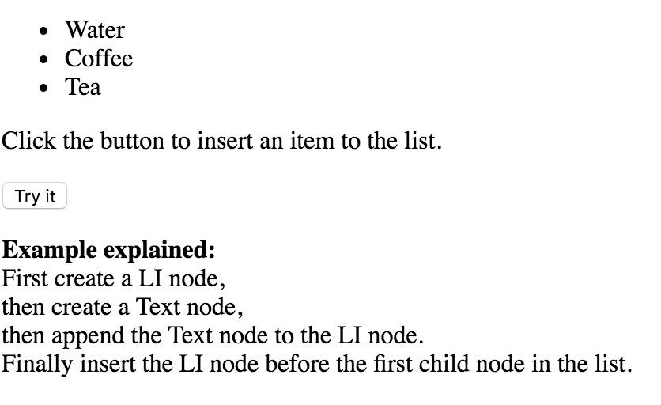
Before clicking
After clicking

Slide 15
<!DOCTYPE html>
<html>
<body>
<ul id="myList">
<li>Coffee</li>
<li>Tea</li>
<li>Milk</li>
</ul>
<p>Click the button to remove the first item from the list.</p>
<button onclick="myFunction()">Try it</button>
<script>function myFunction() {
var list = document.getElementById("myList"); list.removeChild(list.childNodes[0]);}
</script>
</body>
</html>

Slide 16
Before clicking
After clicking

Slide 17
12.4 DOM Collections
DOM has collections—groups of related objects on a page
The document object has properties containing the images collection, links collection, forms collection and anchors collection
Contain all the elements of the corresponding type on the page
The collection’s length property specifies the number of items in the collection

Slide 18
12.4 DOM Collections (Cont.)
You access the elements of the collection using indices in square brackets
href property of a DOM link node
Refers to the link’s href attribute
Collections allow easy access to all elements of a single type in a page
Useful for gathering elements into one place and for applying changes across an entire page

Slide 19
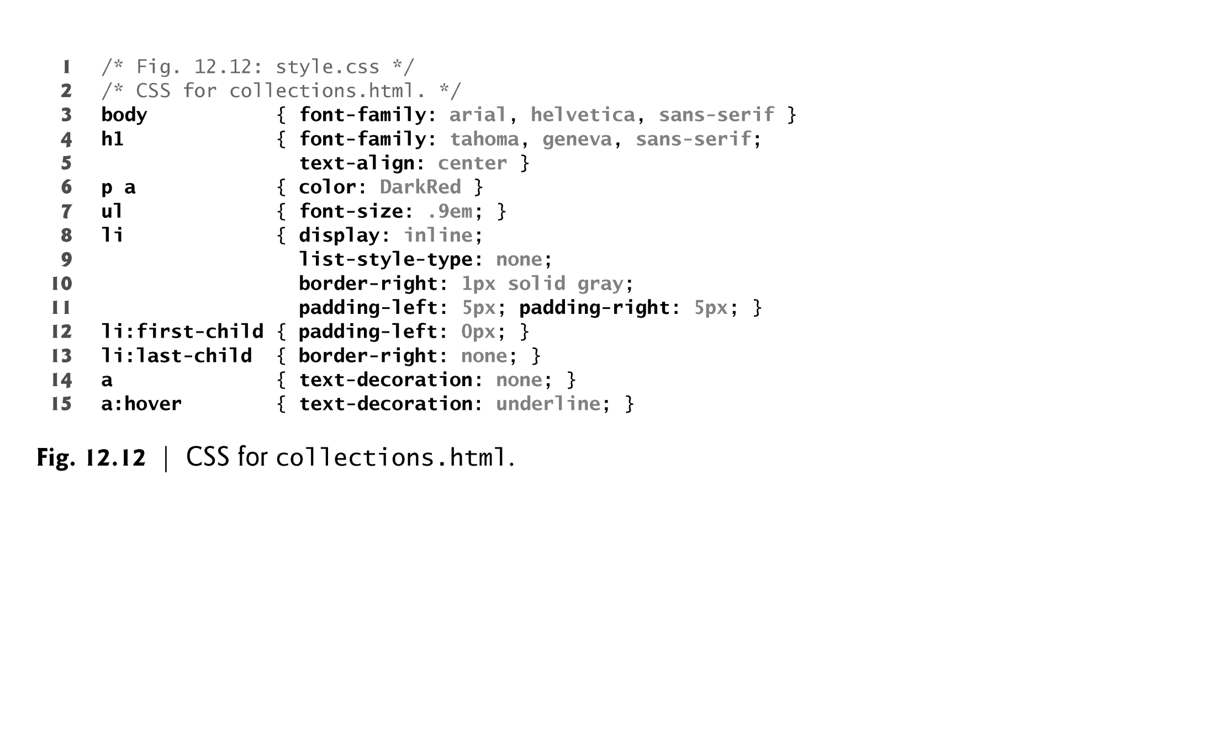

Slide 23
12.5 Dynamic Styles
An element’s style can be changed dynamically
E.g., in response to user events
Can create mouse-hover effects, interactive menus and animations
The document object’s body property
Refers to the body element
The setAttribute method is used to set the style attribute with the user-specified color for the background-color CSS property.
If you have predefined CSS style classes defined for your document, you can also use the setAttribute method to set the class attribute.

Slide 24
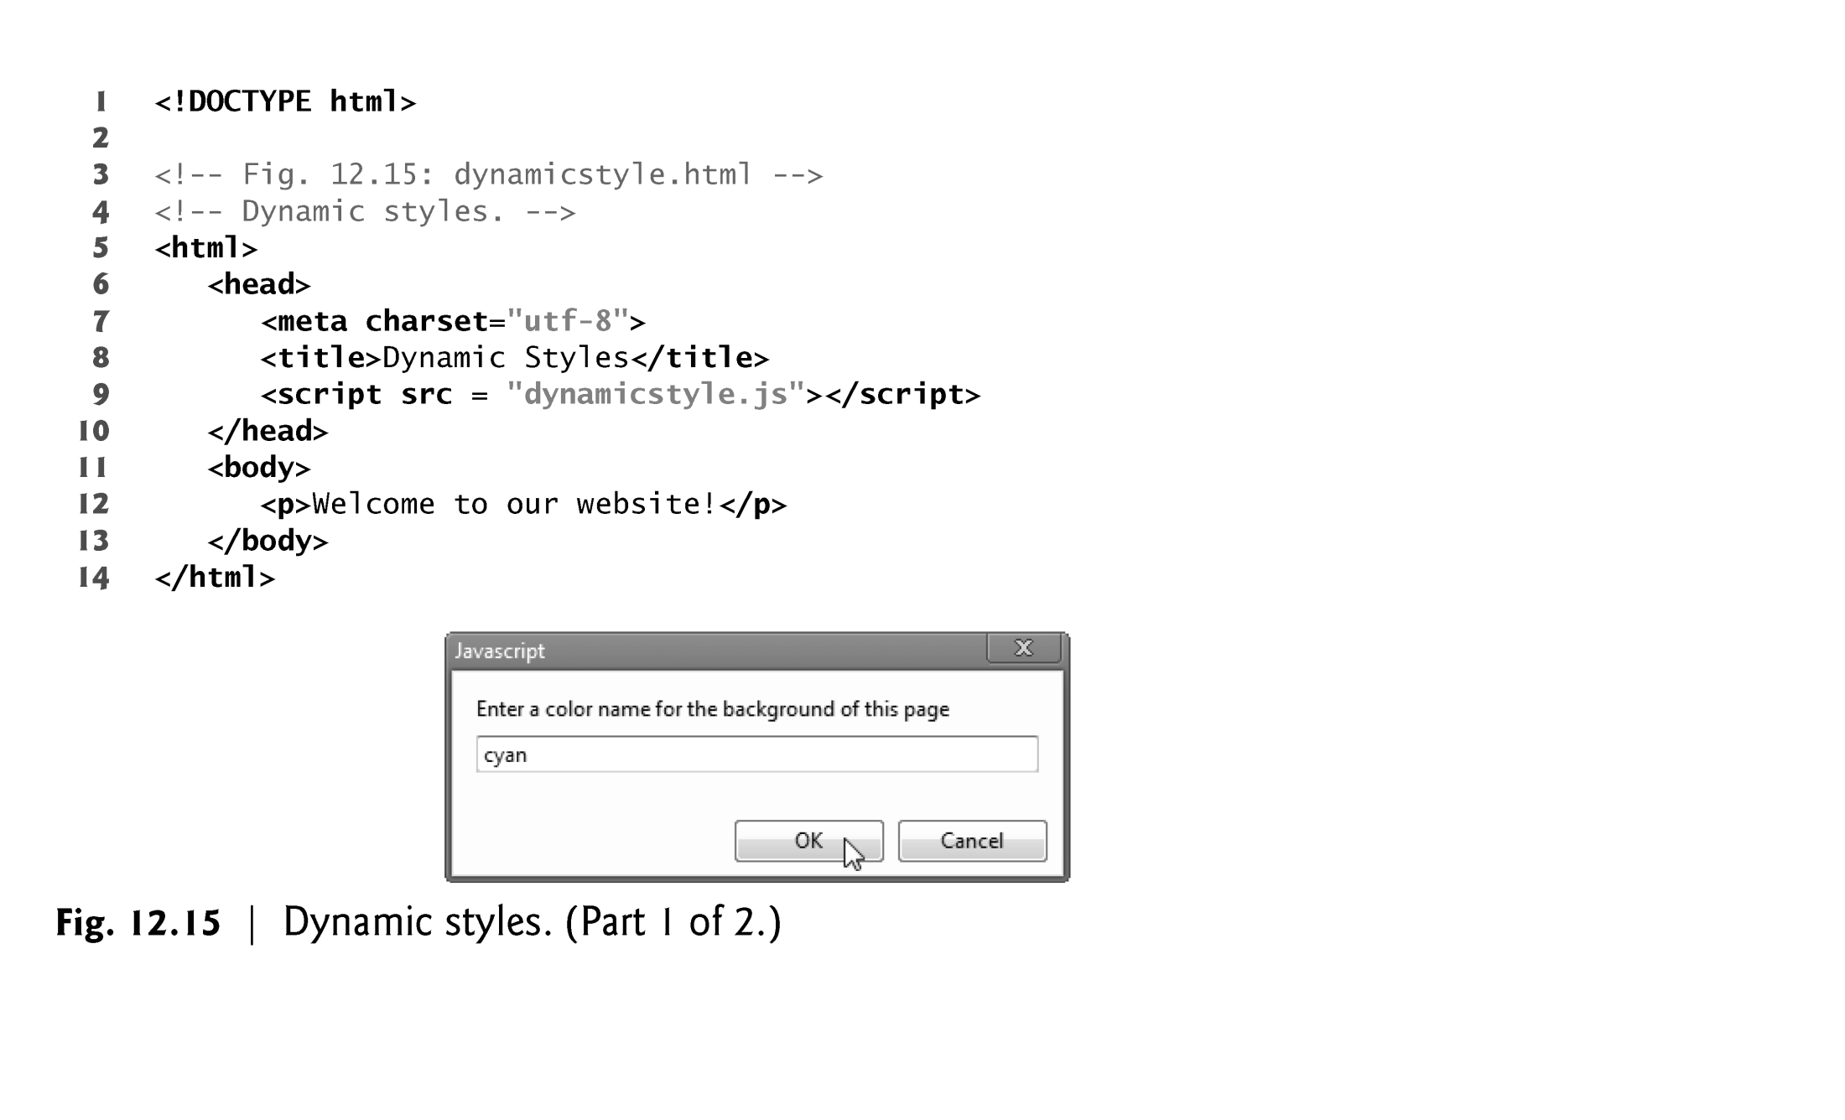

Slide 25
