Slide 1
CT1211 programming 2
Python revision

Slide 2
Tips for Learning Python
Tip #1: Code Everyday
Tip #2: Write It Out : research suggests that taking notes by hand
is most beneficial for long-term remembering
Tip #3: Go Interactive!
Tip #4: Surround Yourself With Others Who Are Learning
Tip #5: Teach

Slide 3
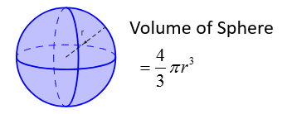
Exercises : Write a Python program
*calculate the volume of a sphere with radius entered by the user .
* get the difference between a given number and 17(the absolute difference), if the number is greater than 17 return the double of the the absolute difference

Slide 4
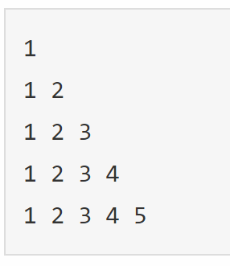
Exercises : Write a Python program
*Print First 10 natural numbers using loop
Print the following pattern

Slide 5
Exercises : Write a Python program
*ask the user to enter a sequence of comma-separated numbers 6, 7 ,3,….
and generate a list with those numbers
count the number 4 in a given list

Slide 6
Exercises : Write a Python program
* *display the first and last items from the following list
color_list = ["Red","Green","White" ,"Black"]
Reverse the following list using for loop
list1 = [10, 20, 30, 40, 50]

Slide 7
Exercises : Write a Python program
removing duplicates from lists
Example:
L=[3, 4, 6, 2, 3, 4, 5, 8, 2]
Expected output:
[3, 4, 6, 2, 5, 8]

Slide 8
Exercises : Write a Python program
* ask the user to enter a sentence and add the word “IS” in the beginning of the string
If the given string already begins with "Is" then leave the string unchanged

Slide 9
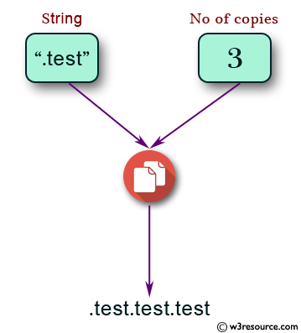
Exercises : Write a Python program
* ask the user to enter a word and a number of copies of that word and print the result.

Slide 10
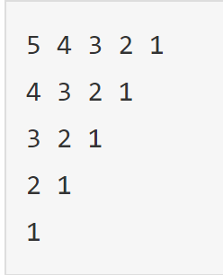
Exercises : Write a Python program
Try it
“YourSelf”
* Accept number from user and calculate the sum of all number between 1 and given number
For example, user given 10 so the output should be 55
* Print the following pattern using while loop
* Find the factorial of any number ,For example: calculate the factorial of 5 5! = 5 × 4 × 3 × 2 × 1 = 120

