Slide 1
Flow of Control: Branching
3.2 The Type Boolean
3.3 The Switch Statement

Slide 2
The Type boolean
The type boolean is a primitive type with only two values: true and false.
Boolean variables can make programs more readable. Like for example:
if (systemsAreOK)
instead of
if((temperature <= 100) && (thrust >= 12000) &&
(cabinPressure > 30) && …)
You would have to initialize systemsAreOK something like this
systemsAreOK = (temperature <= 100) &&
(thrust >= 12000) &&
(cabinPressure > 30) && …)

Slide 3
Boolean Expressions and Variables
Variables, constants, and expressions of type boolean all evaluate to either true or false.
A boolean variable can be given the value of a boolean expression by using an assignment operator.
boolean isPositive = (number > 0);
...
if (isPositive) ...

Slide 4
Naming Boolean Variables
Choose names such as isPositive or systemsAreOk.
Avoid names such as numberSign or systemStatus.
For example:
If you need a boolean variable to indicate if a house is for rent or for sale, with true meaning for rent and false meaning for sale
an appropriate choice would be forRent
an inapproproate choice would be RentOrSale
forSale
What name would you choose if you want true to indicate the house is for sale and false for rent?

Slide 5
Reminder: Precedence Rules
Parentheses should be used to indicate the order of operations.
When parentheses are omitted, the order of operation is determined by precedence rules.
Operations with higher precedence are performed before operations with lower precedence.
Operations with equal precedence:
are generally done left-to-right
except for unary operations which are done right-to-left.

Slide 6
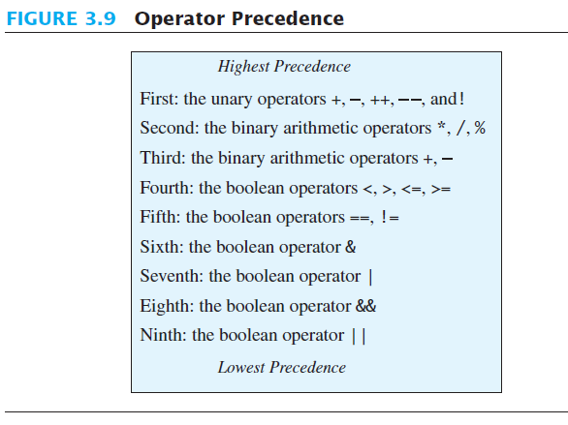
Precedence Rules

Slide 7
Precedence Rules
In what order are the operations performed?
score < min/2 - 10 || score > 90
score < (min/2) - 10 || score > 90
score < ((min/2) - 10) || score > 90
(score < ((min/2) - 10)) || score > 90
(score < ((min/2) - 10)) || (score > 90)
((score < ((min/2) - 10)) || (score > 90))
Sometimes we do NOT need the last 2 steps. Think of the truth table for the logical OR
This would be short-circuiting

Slide 8
Short-circuit Evaluation
Sometimes only part of a boolean expression needs to be evaluated to determine the value of the entire expression.
If the first operand associated with an || is true, the expression is true.
If the first operand associated with an && is false, the expression is false.
This is called short-circuit or lazy evaluation.

Slide 9
Short-circuit Evaluation
Short-circuit evaluation is not only efficient, sometimes it is essential!
A run-time error can result, for example, from an attempt to divide by zero.
if ((number != 0) && (sum/number > 5))
Complete evaluation can be achieved by substituting & for && or | for ||.
Note: bitwise-and & and bitwise-or |
will not be covered in this course

Slide 10
Input and Output of Boolean Values
Example
boolean booleanVar = false;
System.out.println(booleanVar);
System.out.println("Enter a boolean value:");
Scanner keyboard = new Scanner(System.in);
booleanVar = keyboard.nextBoolean();
System.out.println("You entered " + booleanVar);
false
Enter a boolean value:
true You entered true
Sample screen output

Slide 11
Input Validation
You should check your input to ensure that it is within a valid or reasonable range. For example, consider a program that converts feet to inches. You might write the following:
int feet = keyboard.nextInt();
int inches = feet * 12;
What if:
The user types a negative number for feet?
The user enters an unreasonable value like 100? Or a number larger than can be stored in an int? (2,147,483,647)

Slide 12
Input Validation
Address these problems by ensuring that the entered values are reasonable:
int feet = keyboard.nextInt();
if ((feet >= 0) && (feet < 10))
{
int inches = feet * 12;
... }

Slide 13
switch
Section 3.3

Slide 14
The switch Statement
The switch statement is a multiway branch that makes a decision based on an integral (integer or character) expression.
Java 7 allows String expressions

Slide 15
The switch Statement
The switch statement:
begins with the keyword switch
followed by an integral expression in parentheses () and called the controlling expression.
followed by list of cases, enclosed in braces {} .
Each case consists of:
the keyword case followed by
A constant called the case label
A colon :
A list of statements, typically ending with break;
An optional default: case
Syntax
switch (Controlling_Expr)
{ case Case_Label1:
Statement(s);
break;
case Case_Label2:
…
default:
…
}
Example
switch (option)
{ case ‘a’: // add
result = x + y;
break;
case ‘s’: // subtract
result = x – y;
break;
default:
result = 0;
}

Slide 16
The switch Statement
The list is searched for a case label matching the controlling expression.
The action associated with a matching case label is executed.
If no match is found, the case labeled default is executed.
The default case is optional, but recommended, even if it simply prints a message.
Execution of statements continues until:
break is reached
or the } of the switch statement is reached
Repeated case labels are not allowed.

Slide 17
import java.util.Scanner;
public class MultipleBirths
{ public static void main (String [] args)
{ int numberOfBabies;
System.out.print ("Enter number of babies: ");
Scanner keyboard = new Scanner (System.in);
numberOfBabies = keyboard.nextInt ();
switch (numberOfBabies)
{
case 1:System.out.println ("Congratulations.");
break;
case 2:System.out.println ("Wow. Twins.");
break;
case 3:System.out.println ("Wow. Triplets.");
break;
case 4:
case 5:System.out.print ("Unbelieveable; ");
System.out.println (numberOfBabies + " babies.");
break;
default:
System.out.println ("I don't believe you.");
} // end switch
} // end main
} // end MultipleBirths
What will happen if the user enters -2?
If we change case 4 to be as follows:
case 4: System.out.println(“More than 3!”);
What will be the output if the user enters 4?
the default case will be executed
More than 3!
Unbelievable; 4 babies.

Slide 18
Example for omitting break
When the same action is to be taken for several case labels, then we may write the program as follows:
1
2
3
4
5
6
7
8
9
10
11
12
13
14
15
16
public static void main (String[] args)
{ Scanner read = new Scanner (System.in);
char letter;
String vowel = “This is a vowel”;
letter = read.next().charAt(0);
switch (letter)
{
case ‘a’:
case ‘e’:
case ‘o’:
case ‘i’:
case ‘u’: System.out.println (vowel);
break;
default: System.out.println (“This is not a vowel”);
} //end switch
} //end main
This is equivalent to:
if ( (letter==‘a’) || (letter==‘e’) ||
(letter==‘o’) || (letter==‘i’) ||
(letter==‘u’))
System.out.println (vowel);
else
System.out.println
(“This is not a vowel”);

Slide 19
switch vs multibranching if
The switch statement is an elegant way to apply multiple selections. It is less confusing.
However, the programmer is forced sometimes to use the nested if. For example:
If the selection involves a range of values.
Example: if (score >= 60) && (score < 70)
If the selector’s type is double or float.
Example: if (salary == 5000.0)

