Slide 1
Flow of Control:
Branching
Chapter 3.1 – The if-else Statement

Slide 2
Objectives
Use Java branching statements
Compare values of primitive types
Compare objects such as Strings
Use the primitive type boolean

Slide 3
Outline
The if-else Statement
The Type boolean
The switch statement

Slide 4
The if-else Statement: Outline
Basic if-else Statement
Boolean Expressions
Comparing Strings
Nested if-else Statements
Multibranch if-else Statements
The switch Statament
The Conditional Operator (: ?)
The exit Method (optional)

Slide 5
Flow of Control
Flow of control is the order in which a program performs actions.
  Up to this point, the order has been sequential.
A branching statement chooses between two or more possible actions.
  A simple if-else statement chooses between two possible actions
  A multibranch if-else statement chooses between more possible actions
  Another multibranch statement is switch
A loop statement repeats an action until a stopping condition occurs.

Slide 6
The if-else Statement
SYNTAX
if (logical expression)
Statement1;
else
Statement2;
FLOWCHART
1
Logical Expression?
If the logical expression is true:
True
False
Statement 1 is executed
Execution continues at point 2
Statement 1
Statement 2
If the logical expression is false:
Statement 2 is executed
Execution continues at point 2
2

Slide 7
The if-else Statement
Example
  Once a month, a bank gives a small interest if your balance is positive, but will deduct a penalty if it is negative:
if (balance >= 0)
balance = balance + (INTEREST_RATE * balance)/12;
else
balance = balance - OVERDRAWN_PENALTY;

Slide 8
import java.util.Scanner;
public class BankBalance
{
public static final double OVERDRAWN_PENALTY = 8.00;
public static final double INTEREST_RATE = 0.02; //2% annually
public static void main (String [] args)
{
double balance;
System.out.print ("Enter your checking account balance: $");
Scanner keyboard = new Scanner (System.in);
balance = keyboard.nextDouble ();
System.out.println ("Original balance $" + balance);
if (balance >= 0)
balance = balance + (INTEREST_RATE * balance) / 12;
else
balance = balance - OVERDRAWN_PENALTY;
System.out.print ("After adjusting for one month ");
System.out.println ("of interest and penalties,");
System.out.println ("your new balance is $" + balance);
}
}

Slide 9
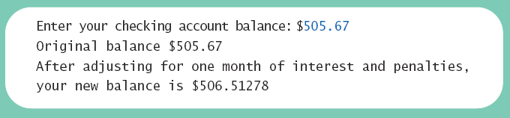
The if-else Statement
Sample
screen output

Slide 10
Omitting the else Part
SYNTAX
if (logical expression) statement1;
FLOWCHART
1
Logical Expression?
True
If the logical expression is true:
Statement 1
Statement 1 is executed
False
Execution continues at point 2
If the logical expression is false:
2
Statement 1 is NOT executed
Execution continues at point 2

Slide 11
Two-Way Selection – Caution!
What if we delete line 2, but keep the ; on line 1?
//The following statement shows an example of a syntax error
// WHY ?
if (hours > 40.0); //Line 1
wages = 40.0 * rate + 1.5 * rate *(hours - 40.0); //Line 2
else //Line 3
wages = hours * rate; //Line 4
Because a semicolon follows the closing parenthesis of the if statement (Line 1), the else statement stands alone.
The semicolon at the end of the if statement (see Line 1) ends the if statement.
The statement at Line 2 separates the else clause from the if statement. That is, else is by itself.
Because there is no separate else statement in Java, this code generates a syntax error.

Slide 12
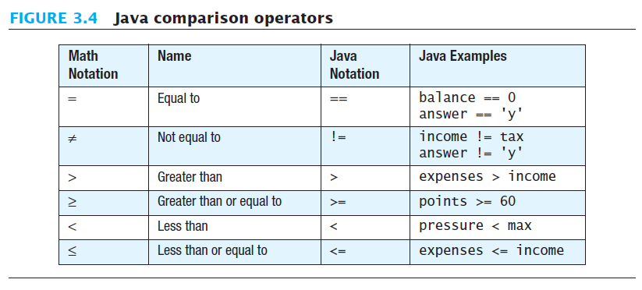
Introduction to Boolean Expressions
The value of a boolean expression is either true or false.
Examples
  time < limit
  balance <= 0

Slide 13
Compound Boolean Expressions
Boolean expressions can be combined using:
  the "and" (&&) operator.
  the “or" (||) operator
Example
  if ((0 < score) && (score <= 100))
  ... ;
  if ((value<lowerLimit) || (value>upperLimit))
  ... ;
Not allowed
  if (0 < score <= 100) ...;
  if (lowerLimit > value < upperLimit) ...;

Slide 14
Compound Boolean Expressions
Syntax of “and” operator (&&)
  (Sub_Expression_1) && (Sub_Expression_2)
  Parentheses often are used to enhance readability.
  The larger expression is true only when both of the smaller expressions are true.
Syntax of “or” operator (||)
  (Sub_Expression_1) || (Sub_Expression_2)
  Parentheses often are used to enhance readability.
  The larger expression is true
    When either of the smaller expressions is true
    When both of the smaller expressions are true.
this is the inclusive or which allows either or both to be true.

Slide 15
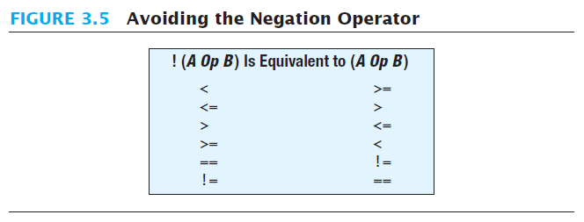
Negating a Boolean Expression
A boolean expression can be negated using the "not" (!) operator.
Syntax
  !(Boolean_Expression)
Example
  (a || b) && !(a && b)
this example is the exclusive or which allows ONLY one to be true.

Slide 16
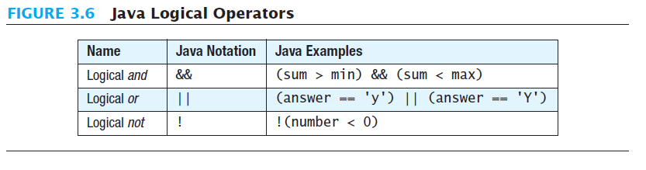
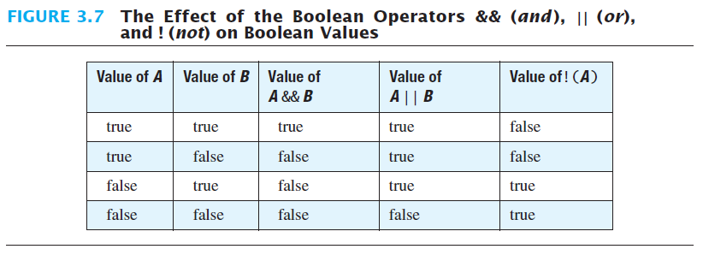
Java Logical Operators

Slide 17
Boolean equality (==)
== is appropriate for determining if two integers or characters have the same value.
  if (a == 3)
  where a is an integer type
== is not appropriate for determining if two floating points values are equal.
  Instead use < and some appropriate tolerance instead.
  if (abs(b - c) < epsilon)
  where b, c, and epsilon are floating point types

Slide 18
Boolean equality (==) for Objects
== is not appropriate for determining if two objects have the same value.
  if (s1 == s2), where s1 and s2 refer to Strings, determines only if s1 and s2 refer the a common memory location.
  If s1 and s2 refer to Strings with identical sequences of characters, but stored in different memory locations, (s1 == s2) is false.

Slide 19
Testing equality for Strings
To test the equality of objects of class String, use method equals.
  s1.equals(s2) or s2.equals(s1)
To test for equality ignoring case, use method equalsIgnoreCase.
  ("Hello".equalsIgnoreCase("hello"))
Syntax
  String.equals(Other_String)
  String.equalsIgnoreCase(Other_String)

Slide 20
import java.util.Scanner;
public class StringEqualityDemo
{ public static void main (String [] args)
{ String s1, s2;
System.out.println ("Enter two lines of text:");
Scanner keyboard = new Scanner (System.in);
s1 = keyboard.nextLine ();
s2 = keyboard.nextLine ();
if (s1.equals (s2))
System.out.println ("The two lines are equal.");
else
System.out.println ("The two lines are not equal.");
if (s2.equals (s1))
System.out.println ("The two lines are equal.");
else
System.out.println ("The two lines are not equal.");
if (s1.equalsIgnoreCase (s2))
System.out.println ("But the lines are equal, ignoring case.");
else
System.out.println ("Lines are not equal, even ignoring case.");
}}

Slide 21
Testing Strings for Equality
Sample
screen output

Slide 22
Lexicographic Order
Lexicographic order is similar to alphabetical order, but is it based on the order of the characters in the ASCII (and Unicode) character set.
  All the digits come before all the letters.
  All the uppercase letters come before all the lower case letters.

Slide 23
Compound Statements
When a list of statements is enclosed in braces ({}), they form a single compound statement.
Syntax
  {
  Statement_1;
  Statement_2;
  ...
  }

Slide 24
Compound Statements
A compound statement can be used wherever a statement can be used.
Example
  To include multiple statements in a branch, enclose the statements in braces {}.
    if (total > 10)
    {
    sum = sum + total;
    total = 0;
    }
All this will be executed if the condition is true

Slide 25
Compound Statements
SYNTAX
if (logical expression)
{
Statement i;
Statement i+1;
…
Statement m;
}
else
{
Statement j;
Statement j+1;
…
Statement n;
}
FLOWCHART
1
Logical Expression?
True
False
Statement i
Statement j
Statement i+1
Statement j+1
2

Slide 26
Nested if-else Statements
An if-else statement can contain any sort of statement within it.
In particular, it can contain another if-else statement.
  An if-else may be nested within the "if" part.
  An if-else may be nested within the "else" part.
  An if-else may be nested within both parts.

Slide 27
Nested Statements
Syntax
  if (Boolean_Expression_1)
  if (Boolean_Expression_2)
  Statement_1;
  else
  Statement_2;
  else
  if (Boolean_Expression_3)
  Statement_3;
  else
  Statement_4;

Slide 28
Nested Statements
Each else is paired with the nearest unmatched if.
If used properly, indentation communicates which if goes with which else.
Braces can be used like parentheses to group statements.

Slide 29
Nested Statements
Subtly different forms
First Form
if (a > b)
{
if (c > d)
e = f
}
else
g = h;
Second Form
if (a > b)
if (c > d)
e = f
else
g = h;
// oops

Slide 30
Nested Statements
Subtly different forms
a = 2 and b=5
First Form
if (a > b)
{
if (c > d)
e = f
}
else
g = h;
Second Form
if (a > b)
if (c > d)
e = f
else
g = h;
// oops

