Slide 1
Keyboard and Screen
I/O

Slide 2
The Outline
Screen output
Keyboard input

Slide 3
Screen Output
We've seen several examples of screen output already.
System.out is an object that is part of Java.
println() is one of the methods available to the System.out object.

Slide 4
Screen Output
The concatenation operator (+) is useful when everything does not fit on one line.
  System.out.println("Lucky number = " + 13 +
  "Secret number = " + number);
Do not break the line except immediately before or after the concatenation operator (+).

Slide 5
Screen Output
Alternatively, use print()
  System.out.print("One, two,");
  System.out.print(" buckle my shoe.");
  System.out.println(" Three, four,");
  System.out.println(" shut the door.");
  ending with a println().

Slide 6
Output Statements
SYNTAX
System.out.print (expression);
Example
System.out.print (29/4);
Output
1
7_
Note the cursor position (_): it is on the same line as the output.
Note that 29/4 is not enclosed between quotes ➔ it is evaluated.
SYNTAX
System.out.println (expression);
Example
System.out.println (29/4);
Output
1
2
7
_
Note the cursor position (_): it is on the next line to the output.
SYNTAX
System.out.println ();
Skips a line.
Output
1
2
_

Slide 7
Output Statments
ESCAPE SEQUENCES
Escape sequences allow you to control the output.
All escape sequences start with a backslash \ character.
The following table shows some of the most commonly used escape sequences:
Syntax | Escape Sequence | Description
\n | New line | Cursor moves to the beginning of the next line.
\r | Return | Cursor moves to the start of the current line.
\t | Tab | Cursor moves to the next tab stop.
\b | Backspace | Cursor moves one space to the left.
\\ | Backslash | Backslash is printed.
\’ | Single quote | Single quotation is printed.
\” | Double quotes | Double quote is printed

Slide 8
Output Statments
PROGRAM 2
1
2
3
4
5
6
7
8
9
10
11
12
13
14
// import necessary libraries
public class userOutput2
{
public static void main (String[] args)
{
// Declaration section: to declare needed variables
// Input section: to enter values of used variables
// Processing section: processing statements
// Output section: display program output
System.out.print (“Hello there \t”); //output line 1
System.out.print (“My name is Fatma\n”); //output line 1
System.out.println (“I am studying \”Java\””);//output line 2
} // end main
} // end class
The output of Program 2 is as follows:
1
2
3
Hello there My name is Fatma
I am studying “Java”
_

Slide 9
The Outline
Screen output
Keyboard input

Slide 10
Keyboard Input
Java has reasonable facilities for handling keyboard input.
These facilities are provided by the Scanner class in the java.util package.
  A package is a library of classes.

Slide 11
Using the Scanner Class
Near the beginning of your program, insert
  import java.util.Scanner;
Create an object of the Scanner class
  Scanner keyboard =
  new Scanner (System.in);
Read data (an int or a double, for example)
  int n1 = keyboard.nextInt();
  double d1 = keyboard.nextDouble();

Slide 12
Keyboard Input Demonstration
View sample program
class ScannerDemo, listing 2.5
Sample Screen Output

Slide 13
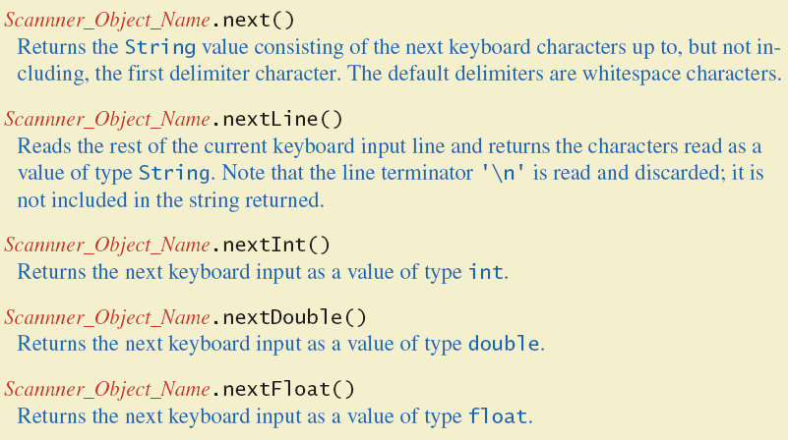
Some Scanner Class Methods
Figure 2.7a

Slide 14
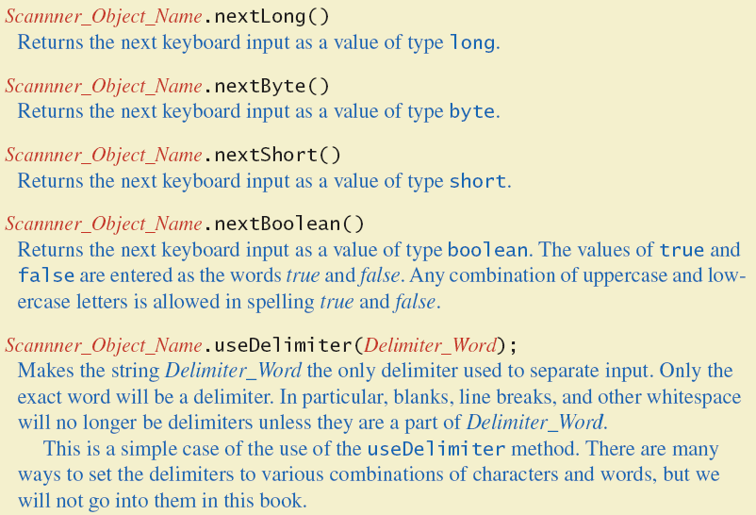
Some Scanner Class Methods
Figure 2.7b

Slide 15
nextLine()Method Caution
The nextLine() method reads
  The remainder of the current line,
  Even if it is empty.

Slide 16
nextLine()Method Caution
Example – given following declaration.
  int n;
  String s1, s2;
  n = keyboard.nextInt();
  s1 = keyboard.nextLine();
  s2 = keyboard.nextLine();
Assume input shown
  n is set to 42
  but s1 is set to the empty string.
  42
  and don't you
  forget it.

Slide 17
The Empty String
A string can have any number of characters, including zero.
The string with zero characters is called the empty string.
The empty string is useful and can be created in many ways including
  String s3 = "";

Slide 18
Self-Check Exercises
A milk carton can hold 3.78 liters of milk. Each morning, a dairy farm ships cartons of milk to a local grocery store. The cost of producing one liter of milk is $0.38, and the profit of each carton of milk is $0.27. Write a program that does the following:
  Prompts the user to enter the total amount of milk produced in the morning.
  Outputs the number of milk cartons needed to hold milk (Round your answer to the nearest integer).
  Outputs the cost of producing milk.
  Output the profit for producing milk.

