Slide 1
Strings
Chapter 2.2

Slide 2
Outline
Class “String”
String Declaration
String Concatenation
String Methods
Escape Characters
Unicode Character set
CompareTo

Slide 3
CLASS “String”
A String:
  is a sequence of zero or more characters treated as a single item
  is enclosed between “double quotations”.
  has a length = number of characters it contains
Examples of strings include:
  “College of Computer and Information Sciences”
  “#Saudi_National_Day”
  “Vision 2030”
  “”
Is that a mistake?
A null string or an empty string:
  Is a String that contains no characters
  It is written as “”
  It’s length is zero

Slide 4
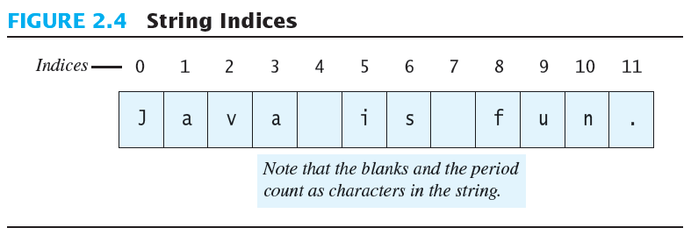
String Indices
Positions start with 0, not 1.
  The 'J' in "Java is fun." is in position 0
A position is referred to an an index.
  The 'f' in "Java is fun." is at index 8.

Slide 5
String Declaration
Example 1
String greeting;
greeting = “How are you?”;
Where have we used “new” before?
Example 2
String greeting = “How are you?”;
Example 3
String greeting = new String(“How are you?”);
What is the relationship between the length of a string and the indices?
greeting
102
102 | ‘H’ | ‘o’ | ‘w’ | ‘ ’ | ‘a‘ | ‘r’ | ‘e’ | ‘ ‘ | ‘y’ | ‘o’ | ‘u’ | ‘?’
 | 0 | 1 | 2 | 3 | 4 | 5 | 6 | 7 | 8 | 9 | 10 | 11

Slide 6
String Declaration
Where have we used “new” before?
Example 3
String greeting = new String(“How are you?”);
Similar
Scanner input = new Scanner (System.in);
In Java, String is NOT a primitive data type.
A variable declared as a String class is a reference variable.
A reference variable stores an address rather than the value.

Slide 7
String Concatenation
String concatenation appends the second string to the first.
The + operator is used to concatenate two strings.
Examples:
  “Programming with “ + “Java I” → “Programming with Java I”
  “My name is “ + “Sara” → “My name is Sara”
When a String is concatenated with a numeric value, the latter is converted into a String.
Examples:
  “Price is SR” + 28 → “Price is SR28”
  “Pay rate is SR ” + 30.5 → “Pay rate is SR 30.5”
  “The sum is “ + 12 + 24 → “The sum is 1224”
Why?
What happens if we add ( ) like this:
“The sum is “ + (12 + 24)
→ “The sum is 36”

Slide 8
String Methods
An object of the String class stores data consisting of a sequence of characters.
Objects have methods as well as data
The length() method returns the number of characters in a particular String object.
  String greeting = "Hello";
  int n = greeting.length();

Slide 9
1
2
String s1 , s2 ;
s1 = “abcdeFeg” ; s2=”abcdefe”;
method | Description
example | result
int length() | return the length of the string
int len = s1.length(); | value of len = 8
char charAt(int index) | This method extracts the character at the position index
System.out.println(s1.charAt(3)); | ‘d’
int indexOf (char ch) | This method returns the position of the character ch (the parameter) in the string.
System.out.println(s1.indexOf(‘e’)); | 4
int indexOf (char ch, int pos) | This method searches for the character ch in string. The search starts from the position pos.
System.out.println(s1.indexOf(‘e’,5)); | 6
int indexOf (String str) | If the string str (parameter) exists in the string, this method returns the position of its first character.
System.out.println(s1.indexOf(“cd”)); | 2
int indexOf (String str, int pos) | This method seeks for the string str (the first parameter) starting from the position pos (the second parameter).
System.out.println(s1.indexOf(“cd”,3)); | -1

Slide 10
1
2
String s1 , s2 ;
s1 = “abcdeFeg” ; s2=”abcdefe”;
method | Description
example | result
String substring (int beginIndex) | Extracts a substring from string starting from the position beginIndex (parameter) till the end of string.
System.out.println(s1.substring(1)); | bcdeFeg
String substring (int beginIndex, int endIndex) | Extracts a substring from string starting from the position beginIndex (the 1st parameter) till endIndex-1 (the 2nd parameter).
System.out.println(s1.substring(1 , 4)); | bcd
String toLowerCase() | converts all characters in the string into lower case letters.
System.out.println(s1.toLowerCase()); | abcdefeg
String toUpperCase() | converts all characters in the string into upper case letters.
System.out.println(s1.toUpperCase()); | ABCDEFEG
String concat(String str) | This method concatenates the string with the parameter str.
System.out.println(s1.concat(“xyz”)); | abcdeFegxyz

Slide 11
1
2
String s1 , s2 ;
s1 = “abcdeFeg” ; s2=”abcdefe”;
method | Description
example | result
String replace (char CharToBeReplaced, char CharReplacedWith) | This method replace all occurrences of the first parameter CharToBeReplaced in string with the second parameter CharReplacedWith.
System.out.println( s1.replace(‘d’ ,’D’)); | abcDeFeg
boolean equals (String str) | Returns true if string is equal to str (parameter); otherwise, it returns false.
System.out.println(s1.equals(s2)); | false
boolean equalsIgnoreCase(String str) | Returns true if this string is equal to str (parameter) considering uppercase and lowecase versions of a letter to be the same; otherwise, it returns false.
System.out.println(s1.equalsIgnoreCase(“ABCDefEg)); | true
int compareTo (String str) | Compares this string with str, the result can be : - a negative value if this string comes before str - 0 if this string is equal to str. - a positive value if this string comes after str. comparison is in lexicographic order.
System.out.println(s1.compareTo(s2)); | -1 (or another –ve number)

Slide 12
Escape Characters
How would you print
  "Java" refers to a language. ?
The compiler needs to be told that the quotation marks (") do not signal the start or end of a string, but instead are to be printed.
  System.out.println(
  "\"Java\" refers to a language.");

Slide 13
Escape Characters
Figure 2.6
Each escape sequence is a single character even though it is written with two symbols.

Slide 14
Examples
System.out.println("abc\\def");
System.out.println("new\nline");
char singleQuote = '\'';
System.out.println(singleQuote);
abc\def
new
line
'

Slide 15
The Unicode Character Set
Most programming languages use the ASCII character set.
Java uses the Unicode character set which includes the ASCII character set.
The Unicode character set includes characters from many different alphabets (but you probably won't use them).

Slide 16
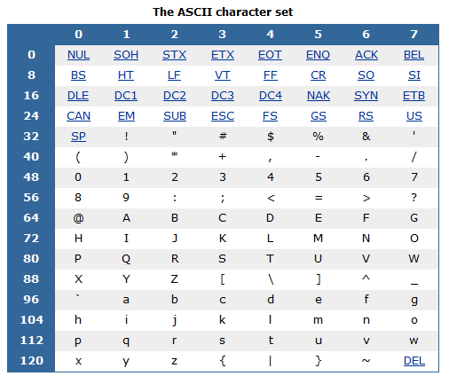
The Unicode Character Set

Slide 17
compareTo public int compareTo(String anotherString)
Compares two strings lexicographically.
The comparison is based on the Unicode value of each character in the strings.
The character sequence represented by this String object is compared lexicographically to the character sequence represented by the argument string.
  The result is a negative integer if this String object lexicographically precedes the argument string.
  The result is a positive integer if this String object lexicographically follows the argument string.
  The result is zero if the strings are equal; compareTo returns 0 exactly when the equals(Object) method would return true.
Source:
https://docs.oracle.com/en/java/javase/17/docs/api/java.base/java/lang/String.html#compareTo(java.lang.String)

Slide 18
compareTo public int compareTo(String anotherString)
This is the definition of lexicographic ordering.
If two strings are different, then either they have:
  different characters at some index that is a valid index for both strings
  or their lengths are different
  or both.

Slide 19
compareTo public int compareTo(String anotherString)
If they have different characters at one or more index positions:
  let k be the smallest such index; then the string whose character at position k has the smaller value, as determined by using the < operator, lexicographically precedes the other string. In this case, compareTo returns the difference of the two character values at position k in the two string -- that is, the value:
  this.charAt(k)-anotherString.charAt(k)

Slide 20
compareTo public int compareTo(String anotherString)
If there is no index position at which they differ:
  then the shorter string lexicographically precedes the longer string. In this case, compareTo returns the difference of the lengths of the strings -- that is, the value:
  this.length()-anotherString.length()

Slide 21
compareTo public int compareTo(String anotherString)
String s1="apple",s2="Apple"; System.out.println(s1.compareTo(s2));

Slide 22
compareTo public int compareTo(String anotherString)
String s1="apple",s2="Apple"; System.out.println(s1.compareTo(s2));
first index position at which they differ is 0
s1.charAt(0) is ‘a’ and s2.charAt(0) is ‘A’
The Unicode value of ‘a’ is 97
The Unicode value of ‘A’ is 65
97-65 =32
s1.compareTo(s2) will return 32
a positive value → s1 comes after s2

Slide 23
compareTo public int compareTo(String anotherString)
String s1="apple",s2="apple123"; System.out.println(s1.compareTo(s2));

Slide 24
compareTo public int compareTo(String anotherString)
String s1="apple",s2="apple123"; System.out.println(s1.compareTo(s2));
No index position at which they differ (valid index for both)
Compare based on length
s1.length()is 5
s2.length()is 8
5-8=-3
s1.compareTo(s2) will return -3
a negative value → s1 comes before s2

