Slide 1
Variables & Expressions
Chapter 2.1 (PART 1)

Slide 2
Variables and Expressions: Outline
Variables
Data Types
Java Identifiers
Assignment Statements
Simple Input
Simple Screen Output
Constants
Named Constants

Slide 3
Variables
Variables store data such as numbers and letters.
Think of them as places to store data.
They are implemented as memory locations.
The data stored by a variable is called its value.
The value is stored in the memory location.
Its value can be changed within the program.
… as opposed to “named constants” whose values can not be changed

Slide 4
Variables
Name some variables used in this program
numberOfBaskets, eggsPerBasket, totalEggs
public class EggBasket
{ public static void main (String [] args)
{ int numberOfBaskets, eggsPerBasket, totalEggs;
numberOfBaskets = 10;
eggsPerBasket = 6;
totalEggs = numberOfBaskets * eggsPerBasket;
System.out.println ("If you have");
System.out.println (eggsPerBasket +
" eggs per basket and");
System.out.println (numberOfBaskets + " baskets, then");
System.out.println ("the total number of eggs is " +
totalEggs);
}
}
What do you think this would mean?
eggsPerBasket = eggsPerBasket -2;
It would subtract 2 from the current value of eggsPerBasket making it 6
Sample Screen Output

Slide 5
Variable Declaration - Syntax and Examples
A variable has a type and a name.
Syntax
type variable_1, variable_2, …;
(variable_1 is a generic variable called a syntactic variable)
Examples
int styleChoice, numberOfChecks;
double balance, interestRate;
char jointOrIndividual;
String CustomerName;

Slide 6
Naming and Declaring Variables
A variable must be declared before it is used.
When you declare a variable, you provide its name and type.
Choose names that are helpful such as count or speed, but not c or s.
A variable's type (int, double, char, String, etc.) determines:
what kinds of values it can hold
how much space needs to be allocated in memory, i.e, it determines the number of bytes (size) it will occupy.

Slide 7
Java Identifiers
But NOT only variables
An identifier is a name, such as the name of a variable.
Identifiers may contain only
Letters
Digits (0 through 9)
The underscore character (_)
And the dollar sign symbol ($)
which has a special meaning, try to avoid using it
The first character cannot be a digit.
An identifier can not be a reserved word.
Could be the name of a class, or a method, or a constant, etc.

Slide 8
Keywords or Reserved Words
Words such as if are called keywords or reserved words and have special, predefined meanings.
Cannot be used as identifiers.
See Appendix 1 for a complete list of Java keywords.
Example keywords: int, public, class

Slide 9
Java Identifiers
Identifiers may not contain any spaces, dots (.), asterisks (*), or other characters:
7-11 oracle.com util.* (not allowed)
Identifiers can be arbitrarily long.
Since Java is case sensitive, stuff, Stuff, and STUFF are different identifiers.

Slide 10
Naming Conventions
Identifier for … | convention | example
Class types | begin with an uppercase letter | String
Primitive types | begin with a lowercase letter | int
Variables | begin with a lowercase letters | number
 | separating words within a multiword identifier with a capital letter | myName
Named Constants | are written in ALL captials | PI
 | separating words within a multiword identifier with the underscore _ | MAX_SECTION_SIZE

Slide 11
Where to Declare Variables
Declare a variable
Just before it is used or
At the beginning of the section of your program that is enclosed in {}.
public static void main(String[] args)
{ /* declare variables here */ . . . }

Slide 12
Data Types
In Java there are:
Class types
Primitive types
A class type is used for a class of objects and has both data and methods.
"Java is fun" is a value of class type String
A primitive type is used for simple, non-decomposable values such as an individual number or individual character.
int, double, and char are primitive types.

Slide 13
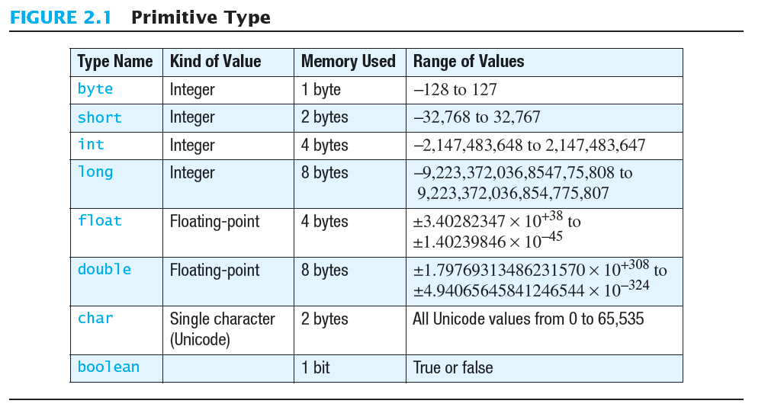
Primitive Types

Slide 14
Primitive Types
Integer types
Four types: byte, short, int, and long
int is most common
Floating-point types
Two types: float and double
double is more common
One character type (char)
One boolean type (boolean)

Slide 15
Examples of Primitive Values
Integer types
0 -1 365 12000
Floating-point types
0.99 -22.8 3.14159 5.0
Character type
'a' 'A' '#' ' '
Boolean type
true false

Slide 16
Assignment Statements
An assignment statement is used to assign a value to a variable.
answer = 42;
The "equal sign" is called the assignment operator.
We say:
"The variable answer is assigned a value of 42"
Or "answer is assigned 42.“
Or “We assigned 42 to the variable answer"

Slide 17
Assignment Statements
Syntax
variable = expression;
where expression can be:
another variable,
a literal (such as a number),
or something more complicated which combines variables and literals using operators (such as + and -)

Slide 18
Assignment Examples
amount = 3.99;
firstInitial = 'W';
score = numberOfCards + handicap;
eggsPerBasket = eggsPerBasket - 2;
Do you think these are possible?
amount = “three”;
amount = 3.0;
amount = 3;
What do you think it depends on?

Slide 19
Initializing Variables
A variable that has been declared, but no yet given a value is said to be uninitialized.
Uninitialized class variables have the value null.
Uninitialized primitive variables may have a default value.
It's good practice not to rely on a default value.
To protect against an uninitialized variable, assign a value at the time the variable is declared.

Slide 20
Initializing Variables
syntax
type variable_1 = expression_1,
variable_2 = expression_2, …;
example
int eggsPerBasket = 5;
double sales = 34557903.75;
float GPA = 4.23f;
What is the f at the end of the number?
In Java, double is the default type of a floating-point number.
When using float literals, the number should be written as shown; otherwise, the compiler would give an error message (syntax error)
It has to do with the compatibility of the types … explained ahead

Slide 21
Simple Input
Sometimes the data needed for a computation are obtained from the user at run time.
Keyboard input requires
import java.util.Scanner
at the beginning of the file.

Slide 22
Simple Input
Data can be entered from the keyboard using Scanner keyboard =
new Scanner(System.in);
followed, for example, by
eggsPerBasket = keyboard.nextInt();
which reads one int value from the keyboard and assigns it to eggsPerBasket.

Slide 23
Simple Screen Output
System.out.println("The count is " + count);
Outputs the string literal "the count is "
Followed by the current value of the variable count.

Slide 24
Constants (Literals)
Literal expressions such as 2, 3.7, or 'y' are called constants.
Integer constants can be preceded by a + or - sign, but cannot contain commas.
Floating-point constants can be written
With digits after a decimal point or
Using e notation.
The literal 3.0 is considered a floating-point constant; even though the value after the decimal point is 0, it is not an integer constant.

Slide 25
Named Constants
Java provides mechanism to …
Define a variable
Initialize it
Fix the value so it cannot be changed
Syntax:
public static final type identifier = Constant_value;
Example
public static final double PI = 3.14159;

Slide 26
Variables & Expressions
Chapter 2.1 (PART 2)

Slide 27
Variables and Expressions: Outline
Assignment Compatibilities
Type Casting
Arithmetic Operations
Parentheses and Precedence Rules
Specialized Assignment Operators
Increment and Decrement Operators

Slide 28
Assignment Compatibilities
Java is said to be strongly typed.
You can't, for example, assign a floating point value to a variable declared to store an integer.
Sometimes conversions between numbers are possible.
doubleVariable = 7;
is possible even if doubleVariable is of type double, for example.

Slide 29
Assignment Compatibilities
Consider this sequence:
A value of one type can be assigned:
to a variable of any type further to the right
but not to a variable of any type further to the left.
You can also assign a value of type char to a variable of type int . (or any type further to the right)
byte
short
int
long
float
double
char
Remember:
you do NOT want to lose information

Slide 30
Type Casting
Remember:
Casting truncates numbers as needed
A type cast forces a value to change from the declared type to some other type.
Syntax:
(data type) expression
Example:
double distance = 9.0;
int points;
Considering the declaration above, if you want to assign to points the value of distance, you must use a cast:
points = (int)distance;
points will be 9
What if the value of distance was 9.75?
Still 9.0
What is the value of distance after the cast?

Slide 31
Arithmetic Operators
Arithmetic expressions can be formed using the +, -, *, and / operators together with variables or numbers referred to as operands.
Expressions with two or more operators can be viewed as a series of steps, each involving only two operands.
When both operands are of the same type, the result is of that type.
If at least one of the operands is a floating-point type and the rest are integers, the result will be a floating point type.
The result is the rightmost type from the following list that occurs in the expression.
byte
short
int
long
float
double

Slide 32
Arithmetic Operations
Example
If you have:
int hoursWorked = 40;
double payRate = 8.25;
Then the result of
hoursWorked * payRate
is a double with a value of 330.0.

Slide 33
The Division Operator
The division operator (/) behaves as expected if one of the operands is a floating-point type.
When both operands are integer types, the result is truncated, not rounded.
Hence, 99/100 has a value of 0.

Slide 34
The mod Operator
The mod (%) operator is used to obtain the remainder after integer division.
14 divided by 4 is 3 with a remainder of 2.
Hence, 14 % 4 is equal to 2.
The mod operator has many uses, including
determining if an integer is odd or even
determining if one integer is evenly divisible by another integer.
Note: mod (%) is usually used with integer operands, but can also be used with floating-point numbers.

Slide 35
Precedence Rules
From highest precedence | If equal precedence
Parenthesis ( ) | inside-out
Increment (++), Decrement (--) Uniary + or - | from right to left
* / % | from left to right
+ - | from left to right
< > <= >= | from left to right
== != | from left to right
&& | from left to right
|| | from left to right
= += -= *= /= %=
To lowest precedence

Slide 36
Sample Expressions
Figure 2.3 Some Arithmetic Expressions in Java

Slide 37
Specialized Assignment Operators
Assignment operators can be combined with arithmetic operators (including -, *, /, and %).
amount = amount + 5;
can be written as
amount += 5;
yielding the same results.

Slide 38
Specialized Assignment Operators
Assignment operators can be combined with arithmetic operators (including -, *, /, and %).
Assume:
int amount = 5; double num = 2.5;
consider each of the following separately:
Combined operator | Equivalent | Result
amount += 5; | amount = amount + 5; | 10
num *= 2; | num = num * 2; | 5.0
amount %= 2; | amount = amount % 2; | 1
num /= amount; | num = num / amount; | 0.5
num *= amount – 3.0; | num = num * (amount – 3.0); | 5.0

Slide 39
Type Casting – more examples
Cast statement
Resulting value
(int)7.9;
(double)25;
(double)(5 + 3);
(double)(15)/ 2;
(double)(15 / 2);
(int)(7.8 + 15/(double)2);
(int)(7.8+(double)(15/2));
7
25.0
(double)(8) = 8.0
15.0 / 2 = 7.5
(double)(7) = 7.0
(int)(7.8 + 15/2.0)
(int)(7.8 + 7.5) = 15
(int)(7.8 + 7.0) = 14

Slide 40
7. TYPE CASTING
Examples
char ch = ‘a’; //Unicode of ‘a’ = 97
int unicode;
unicode = (int)(ch); //unicode = 97
System.out.println (unicode);
97
Examples
int x = 98;
char ch;
ch = (char)(x);
System.out.println (ch);
b

Slide 41
Increment and Decrement Operators
To increase the value of a variable by 1 use ++
To decrease the value of a variable by 1 use --
Syntax:
variable++ or variable--
++variable or --variable
Example:
int count = 10;
count++; ++count;
count--;
11
If I print count at the end, what value will be printed?

Slide 42
Pre/Post – Increment/Decrement
When the ++ or -- come before the variable they are called pre-increment and pre-decrement operators.
When the ++ or -- come after the variable they are called prost-increment and post-decrement operators.
It affects the order of execution:
If pre, it is executed before any other use of the variable
If post, it is executed after the variable is used

Slide 43
Pre/Post – Increment/Decrement
If used standing alone, pre and post does not matter and lead to equivalent results:
count++; and ++count;
both mean: count = count + 1;
count--; and --count;
both mean: count = count - 1;
What about when used inside a print statement?
Try it yourself ;-)

Slide 44
Pre/Post – Increment/Decrement
Example of pre…
int m = 4, n = 6;
int num1 = 3 * (++m);
int num2 = --n + 5;
Result:
num1 will be 15
because m will be incremented before the multiplication
num2 will be 10
because n will be decremented before the addition
Example of post…
int m = 4, n = 6;
int num1 = 3 * (m++);
int num2 = n-- + 5;
Result:
num1 will be 12
because m will be incremented after the multiplication
num2 will be 11
because n will be decremented after the addition
In both cases the value of m and n will become 5

