Slide 1
Array Basics
Ch7

Slide 2
Array Basics: Outline
Creating and Accessing Arrays
Array Details
The Instance Variable length
More About Array Indices
Initializing Arrays
Printing an array
Common operations
Array of Strings
Array Assignment and Equality

Slide 3

Creating and Accessing Arrays
An array is a special kind of object
Think of as collection of variables of same type that are stored in adjacent memory locations.
Creating an array with 7 variables of type double
To access an element use
  The name of the array
  An index number enclosed in square brackets
Array indices begin at zero

Slide 4
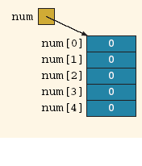
Array declaration - example
Declaring the array num :
int[] num = new int[5];
^{When an array is instantiated,} Java automatically initializes its elements to their default values.
numeric arrays are initialized to 0,
char arrays are initialized to the null character, which is '\u0000',
boolean arrays are initialized to false.
To save space, we also draw an array, as shown in Figures ^{(a) and b).}

Slide 5
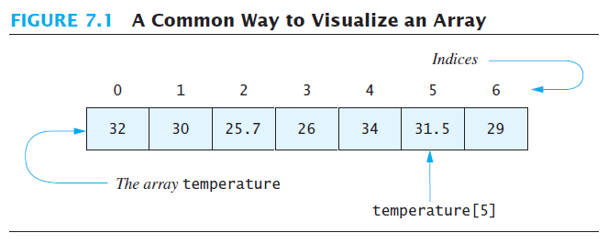
Creating and Accessing Arrays
Note sample program, listing 7.1
class ArrayOfTemperatures

Slide 6
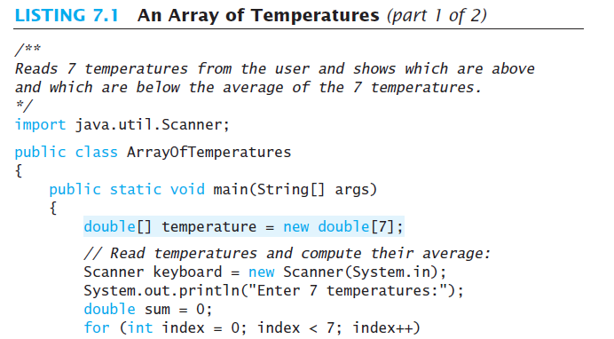

Slide 7
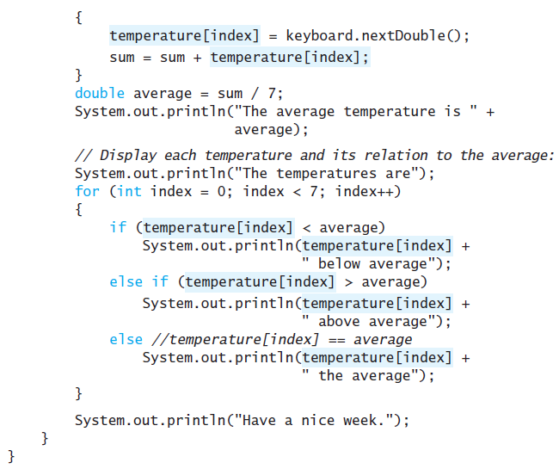

Slide 9
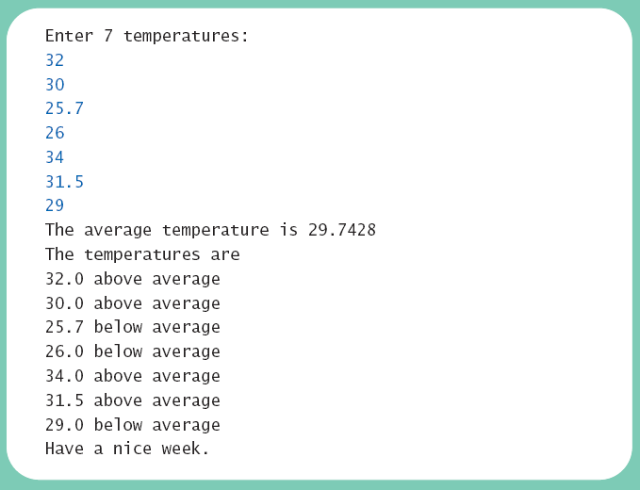
Creating and Accessing Arrays
Sample
screen output

Slide 10

Array Details
Syntax for declaring an array with new
The number of elements in an array is its length
The type of the array elements is the array's base type

Slide 11
Square Brackets [ ] with Arrays
They are used as follows:
  With a data type when declaring an array
  int [ ] pressure;
  To enclose an integer expression to declare the length of the array
  pressure = new int [100];
  To name an indexed value of the array
  pressure[3] = keyboard.nextInt();

Slide 12
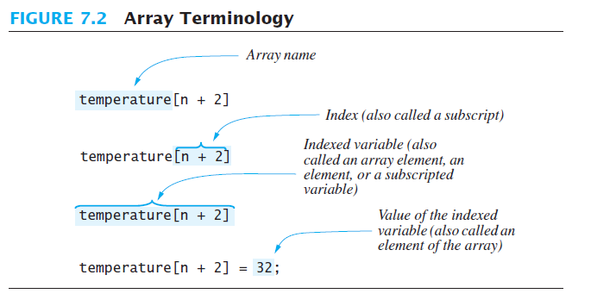
Array Details

Slide 13


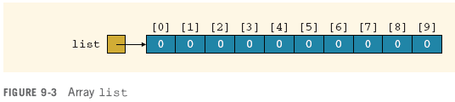

ACCESSING ARRAY ELEMENTS

Slide 14
ACCESSING ARRAY ELEMENTS - Example
Consider the following declarations and their reflection in the memory:
1
double[] list = new double[10];
 | list[0] | list[1] | list[2] | list[3] | list[4] | list[5] | list[6] | list[7] | list[8] | list[9]
list→ | 0.0 | 0.0 | 0.0 | 0.0 | 0.0 | 0.0 | 0.0 | 0.0 | 0.0 | 0.0
2
3
int i = 2;
list[2*i-1] = 46.0; // list[??] = 46.0
 | list[0] | list[1] | list[2] | list[3] | list[4] | list[5] | list[6] | list[7] | list[8] | list[9]
list→ | 0.0 | 0.0 | 0.0 | 46.0 | 0.0 | 0.0 | 0.0 | 0.0 | 0.0 | 0.0
4
list[2*i+1] = 20.0; // list[??] = 20.0
 | list[0] | list[1] | list[2] | list[3] | list[4] | list[5] | list[6] | list[7] | list[8] | list[9]
list→ | 0.0 | 0.0 | 0.0 | 46.0 | 0.0 | 20.0 | 0.0 | 0.0 | 0.0 | 0.0
5
list[7] = list[3] + list[5]; // list[7] = 46.0 + 20.0 = 66.0
 | list[0] | list[1] | list[2] | list[3] | list[4] | list[5] | list[6] | list[7] | list[8] | list[9]
list→ | 0.0 | 0.0 | 0.0 | 46.0 | 0.0 | 20.0 | 0.0 | 66.0 | 0.0 | 0.0

Slide 15
ACCESSING ARRAY ELEMENTS - Example
5
list[7] = list[3] + list[5]; //list[7] = 46.0 + 20.0 = 66.0
 | list[0] | list[1] | list[2] | list[3] | list[4] | list[5] | list[6] | list[7] | list[8] | list[9]
list→ | 0.0 | 0.0 | 0.0 | 46.0 | 0.0 | 20.0 | 0.0 | 66.0 | 0.0 | 0.0
Note the difference to the following statements:
6
list[7] = list[3 + 5]; // list[7] = ??
 | list[0] | list[1] | list[2] | list[3] | list[4] | list[5] | list[6] | list[7] | list[8] | list[9]
list→ | 0.0 | 0.0 | 0.0 | 46.0 | 0.0 | 20.0 | 0.0 | 0.0 | 0.0 | 0.0
7
list[3+5] = list[3] + list[5]; // list[??] = ?? + ??
 | list[0] | list[1] | list[2] | list[3] | list[4] | list[5] | list[6] | list[7] | list[8] | list[9]
list→ | 0.0 | 0.0 | 0.0 | 46.0 | 0.0 | 20.0 | 0.0 | 0.0 | 66.0 | 0.0

Slide 16
Question
consider this array:
int list[ ] = new int[10];
list[ list[2] ] = 77;
list [1] = list[ 7] * list[7];
list [0] = list[ list[8] -1 ];
 | list[0] | list[1] | list[2] | list[3] | list[4] | list[5] | list[6] | list[7] | list[8] | list[9]
list→ | 5 | 7 | 3 | 0 | 9 | 10 | 2 | 3 | 6 | 1

Slide 17
The Instance Variable length
As an object an array has only one public instance variable
  Variable length
  Contains the size of the array: the max number of elements the array can hold
  It is final, value cannot be changed
Note revised code, listing 7.2
class ArrayOfTemperatures2

Slide 18
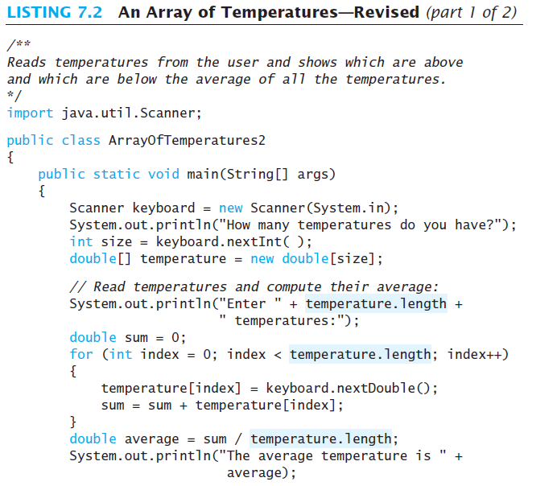

Slide 19
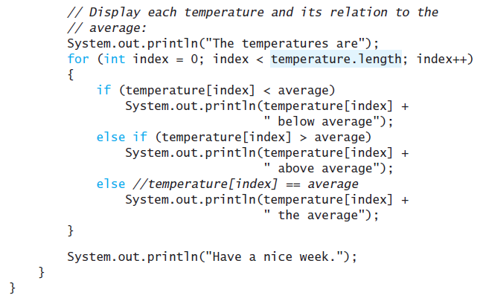

Slide 21
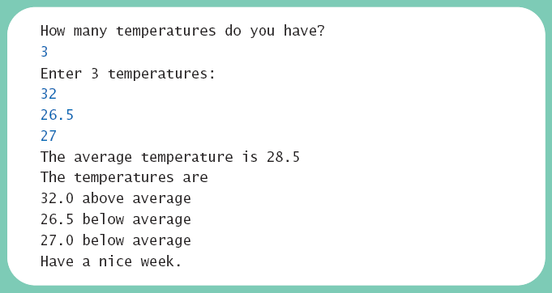
The Instance Variable length
Sample
screen output

Slide 22
More About Array Indices
Index of first array element is 0
Last valid Index is arrayName.length – 1
Array indices must be within bounds to be valid
  When program tries to access outside bounds, run time error occurs
OK to "waste" element 0
  Program easier to manage and understand
  Yet, get used to using index 0

Slide 23
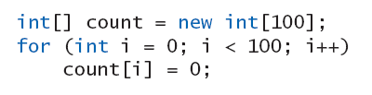
Initializing Arrays
Possible to initialize at declaration time
Also may use normal assignment statements
  One at a time
  In a loop

Slide 24
Initializing Arrays
It is a common practice for a program to keep track of the number of filled elements in an array
Simply store it in a variable, say numOfElements
Then numOfElements will tell you the actual number of elements in the array.
For example:
int numOfElements = 0;
numList[0] = 5;
numList[1] = 10;
numList[2] = 15;
numList[3] = 20;
numOfElements = 4;
System.out.print(numOfElements);
How about this instead?
int numOfElements = 0;
numList[numOfElements++] = 5;
numList[numOfElements++] = 10;
numList[numOfElements++] = 15;
numList[numOfElements++] = 20;
System.out.print(numOfElements);

Slide 25
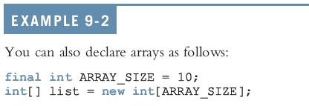
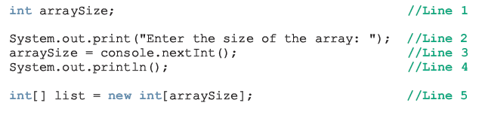
Recap: Specifying array size
Array size can be specified using a constant
Array size can be specified during program execution time

Slide 26
Recap: Specifying array size
Array size can be specified during array declaration with initialization:
The initializer list contains values, called initial values, that are placed between braces and separated by commas
The size of the array will be equal to the number of values.
In this example: sales.length will be equal to 5
sales would be initialized as follows:
sales[0]= 12.25, sales[1]= 32.50, sales[2]= 16.90,
sales[3]= 23.00, and sales[4]= 45.68
Note: If an array is declared and initialized simultaneously, we don’t use the operator new to instantiate the array object

Slide 27
Note on Array Declaration
What is the difference between the following declarations?
int alpha[], beta;
int[ ] gamma, delta;

Slide 28
Remember
The size of the array specified during instantiation cannot be changed.
Sometimes, the programmer does not know how many elements will be needed.
Therefore, it is common to specify a large size and use only the elements which were actually filled by the user.
Assume that numOfElements is a variable that represents the number of actually filled elements within the array (numOfElements <= length)
The value of numOfElements is used as a counter: it is initialized to zero, and then incremented with each new element filled in the array.

Slide 29
Printing an array
Consider an array list:
int list[ ] = new int[5];
list[0] = 50;
list[3] = 70;
What happens if we print the array name ?
  System.out.print(list + " ");
How do we print the whole array?
  for(int i = 0; i<list.length; i++)
  System.out.println(list[i]);

Slide 30
Common operations
int sales[]={12, 32, 4, 55, 1, 23, 17, 30};
Sum and average
int sum = 0; double average = 0.0;
for (int index = 0; index < sales.length; index++)
sum = sum + sales[index];
if (sales.length != 0)
average = sum / sales.length;
Finding index of largest number
maxIndex = 0;
for (int index = 1; index < sales.length; index++)
if (sales[maxIndex] < sales[index])
maxIndex = index;
int largestSale = sales[maxIndex];

Slide 31
Common operations
int sales[]={12, 32, 4, 55, 1, 23, 17, 30};
Searching for a specific value
int searchItem = 10; // what if searchItem = 4 ?
int loc = 0;
boolean found = false;
while (loc < sales.length && !found)
if (sales[loc] == searchItem)
found = true;
else
loc++;
if (found)
System.out.print(loc);
else
System.out.print(“not found”);

Slide 32
ARRAY OF Strings
1
2
3
4
5
6
7
String[] names = new String [5]; //declaration
//Fill in the array
names[0] = “Sarah Fahd”;
names[1] = “Rund Al-Otaibi”;
names[2] = “Asmaa Mubarak”;
names[3] = “Reem Al-Otaibi”;
names[4] = “Hind Al-Tamimi”;
The first statement declares an array names of size 5.
Each element of names is a String.
Remember that a String stores an address rather than a value.
Naturally, all String methods that we previously studied can be applied on EACH element of the String array.

Slide 33
ARRAY OF Strings
Therefore, after the execution of the previous code segment, each array element contains an address that points to (refers to) the corresponding String.
The memory layout will be as follows:
Adrs1
names
names[0] | names[1] | names[2] | names[3] | names[4]
Adrs of Str0 | Adrs of Str1 | Adrs of Str2 | Adrs of Str3 | Adrs of Str4
Sarah Fahd
Rund Al-Otaibi
Asmaa Mubarak
Reem Al-Otaibi
Shahd Al-Sheweiry

Slide 34
ARRAY OF Strings
String methods may be applied on each element of the String array.
The following code segment applies a few methods on each String of the array names:
1
…
7
8
9
10
11
12
13
14
15
16
17
18
String[] names = new String [5]; //declaration
//Fill in the array
names[4] = “Hind Al-Tamimi”;
for (index = 0; index < names.length; index++)
{
System.out.println (names[index]);
System.out.println (names[index].length());
System.out.println (names[index].substring(0, 5));
System.out.println (names[index].toUpperCase());
}

Slide 35
ARRAY OF Strings
String methods may be applied on each element of the String array.
The following code segment applies a few methods on each String of the array names:
1
…
7
8
9
10
11
12
13
14
15
16
17
18
String[] names = new String [5]; //declaration
//Fill in the array
names[4] = “Hind Al-Tamimi”;
for (index = 0; index < names.length; index++)
{
// print the stored names
System.out.println (names[index]);
// print the length of each name
System.out.println (names[index].length());
//extracts the first four letters
System.out.println (names[index].substring(0, 5));
// converts the string into upper case
System.out.println (names[index].toUpperCase());
}

Slide 36
Array Assignment and Equality
Arrays are objects
  Assignment and equality operators behave (misbehave) as specified in previous chapter
Variable for the array object contains memory address of the object
  Assignment operator = copies this address
  Equality operator == tests whether two arrays are stored in same place in memory

Slide 37
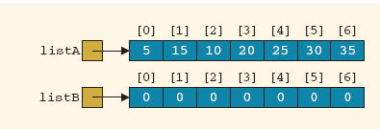
Assinging vs. Copying Arrays of same size
Consider two arrays: listA and listB as shown
Assume we want to make the content of listB a copy of listA
Therefore, we wrote the following:
listB = listA;
Will that work correctly?
No, because it only assigns the address of listA to listB

Slide 38
Copying Arrays of same size
This is the correct way to copy the contents:

Slide 39
COPYING ARRAYS Of DIFFERENT SIZES
1
2
3
4
5
6
7
8
9
10
11
12
13
14
15
16
//Instantiate arrays
int[ ] listA = {576, 753, 100, 422, 113, 312}
int[ ] listB = {1,2,3,4,5,6,7,8,9,10,11,12,13}
int sizeA = listA.length, sizeB = listB.length;
int arraySize, index;
// Identify the smaller array size
if (sizeA < sizeB)
arraySize = sizeA;
else
arraySize = sizeB;
// copy till the value of arraySize
for (index = 0; index < arraySize; index++)
listB[index] = listA[index];
What will be the content of listB?

Slide 40
COPYING ARRAYS Of DIFFERENT SIZES
Consider switching listB and listA
1
2
3
4
5
6
7
8
9
10
11
12
13
14
15
16
//Instantiate arrays
int[ ] listB = {576, 753, 100, 422, 113, 312}
int[ ] listA = {1,2,3,4,5,6,7,8,9,10,11,12,13}
int sizeA = listA.length, sizeB = listB.length;
int arraySize, index;
// Identify the smaller array size
if (sizeA < sizeB)
arraySize = sizeA;
else
arraySize = sizeB;
// copy till the value of arraySize
for (index = 0; index < arraySize; index++)
listB[index] = listA[index];
What will be the content of listB?

Slide 41
EQUALITY OF TWO ARRAYS
Two arrays are considered equal if:
  They have the same size, and
  All corresponding elements in both arrays are equal.
Adrs1
listA
listA[0] | listA[1] | listA[2] | listA[3] | listA[4] | listA[5] | listA[6]
5 | 10 | 15 | 20 | 25 | 30 | 35
Adrs2
listB
listB[0] | listB[1] | listB[2] | listB[3] | listB[4] | listB[5] | listB[6]
5 | 25 | 15 | 20 | 10 | 30 | 35
Adrs3
listC
listC[0] | listC[1] | listC[2] | listC[3] | listC[4] | listC[5] | listC[6]
5 | 10 | 15 | 20 | 0 | 0 | 0
Adrs4
listD
listD[0] | listD[1] | listD[2] | listD[3] | listD[4]
5 | 10 | 15 | 20 | 0

Slide 42

Array Assignment and Equality
Two kinds of equality
View example program, listing 7.6
class TestEquals
Sample
screen output

Slide 43
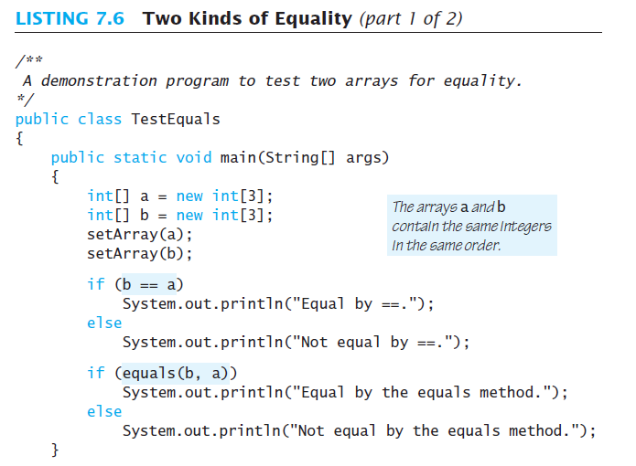
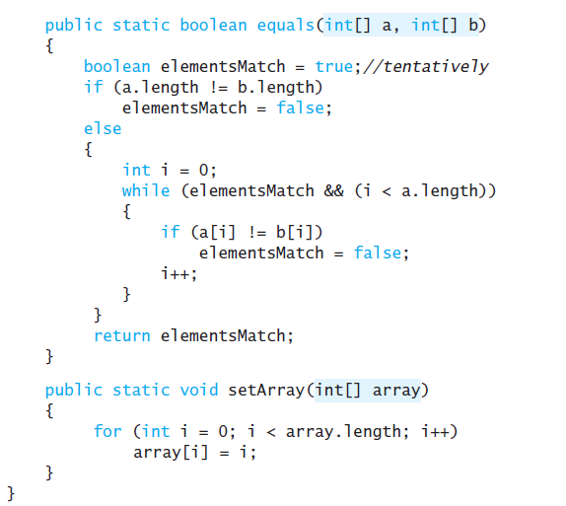


Slide 44
Array Assignment and Equality
Note results of ==
Note definition and use of method equals
  Receives two array parameters
  Checks length and each individual pair of array elements
Remember array types are reference types

