Slide 1
For Loop

Slide 2
The for Statement
A for statement executes the body of a loop a fixed number of times.
Examples
for (count = 1; count < 3; count++)
System.out.println(count);

Slide 3
The for Statement
SYNTAX
for (initial expression; logical expression; update expression)
statement; //loop body: the statement to be repeated
Example
for (counter = 1; counter<=N; counter++)
sum += counter; //loop body
Execution:
Initial statement(s) executes.
Loop condition is evaluated.
If loop condition is true,
execute for loop statement (loop body)
execute update statement(s).
Go back to step 2
If loop condition is false continue with remaining statements
Initial Expression
Update Expression
Logical Expression
True
Statement
False

Slide 4
Counter-controlled loops
The for loop is a specialized form of a while loop.
It’s primary purpose is to simplify the writing of counter-controlled loops.
The for loop is typically called a counted or indexed for loop.
If there’s more than one statement in the body, use a block {}
While loop
N = …
counter = 1
Loop while (counter<=N)
.
.
counter = counter + 1
End loop
N = …
For(counter = 1; counter <= N; counter=counter+ 1)
.
.
End For
Initialization
Condition
Increment \ Decrement

Slide 5
while vs for
while
for
int x = 0, i = 1;
while (i < 4)
{ x = x + i;
i++;
}
System.out.println(x);
System.out.println(i);
int x = 0, i;
for (i = 1; i < 4; i++)
{ x = x + i;
}
System.out.println(x);
System.out.println(i);
Notes:
i= 1 x=0
i=2 x=1
i= 3 x= 1 +2 =3
X= 3 + 3 = 6

Slide 6
while vs for
while
for
int x = 0, i = 1;
while (i < 4)
{ x = x + i;
i++;
}
System.out.println(x);
System.out.println(i);
int x = 0, i;
for (i = 1; i < 4; i++)
{ x = x + i;
i++;
}
System.out.println(x);
System.out.println(i);
What would happen if we left this in here?
And what if we changed it to i--;?

Slide 7
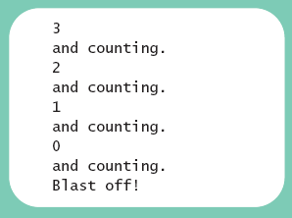
public class ForDemo
{
public static void main (String [] args)
{
int countDown;
for (countDown = 3 ; countDown >= 0 ; countDown--)
{
System.out.println (countDown);
System.out.println ("and counting.");
}
System.out.println ("Blast off!");
}
}
sample program, listing 4.5
Sample screen output

Slide 8
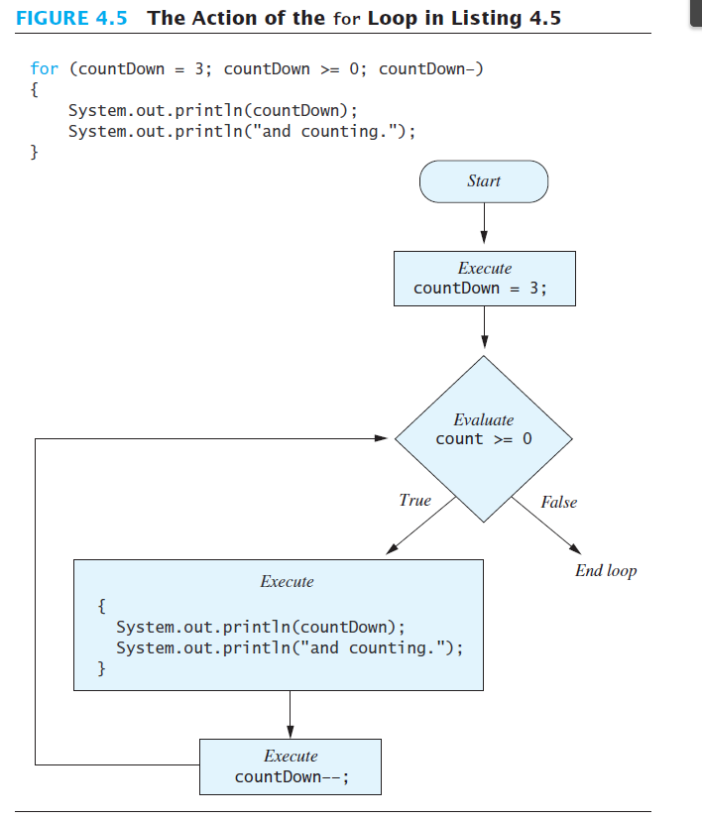

Slide 9
Example of while and equivalent for loop
Rewrite
The following while loop as a for loop
i = 0; //initialize
while (i <= 20) //condition
{
System.out.println(i + " ");
i = i + 5; //update
}
System.out.println();
Solution
// initialize condition update
for (i = 0; i <= 20; i = i + 5)
System.out.println(i + " ");
System.out.println();

Slide 10
The for Statement
Simple Example
Print the first 10 nonnegative integers:
for (i = 0; i < 10; i++)
System.out.print(i + " ");

Slide 11
The for Statement
What is the difference between these two for loops?
for (i = 1; i <= 5; i++)
{ System.out.println("Hello");
System.out.println("*");
}
This for loop outputs the word Hello and a star (on separate lines) five times
for (i = 1; i <= 5; i++)
System.out.println("Hello");
This for loop outputs the word Hello five times and the star only once
System.out.println("*");

Slide 12
Programming Example: Square
Write a program that reads a set of 1000 integers and prints the square of each integer.
INPUT
A set of int numbers (variable: number, type: int)
N = 1000 (type: int)
OUTPUT
The square of each read number (variable: square, type: int)
PROCESS
Repeat N times:
read number
square = number * number
print square

Slide 13
Programming Example: Square
1
2
3
4
5
6
7
8
9
10
11
12
13
14
15
16
17
18
19
20
21
22
23
// import necessary libraries
import java.util.*;
public class forLoop
{
static final int N = 1000; //constant declaration
// instantiate the object read from the class Scanner
static Scanner read = new Scanner (System.in);
public static void main (String[] args)
{
// Declaration section: to declare needed variables
int number, square, counter;
for (counter = 0; counter < N; counter++)
{
// Input section: to enter values of used variables
System.out.println (“Enter an integer number”);
number = read.nextInt();
// Processing section: processing statements
square = number * number;
// Output section: display program output
System.out.println (“Square = “ + square);
} //end for loop
} // end main
} // end class
Modify the program to read from the user the number of integers
counter is int
Increasing step ➔ final value (N=1000) > initial value (0)

Slide 14
Programming Example: Classify Numbers
Input:
N integers (positive, negative, and zeros).
int N = 20; //N easily modified
Output:
Number of 0s,
number of even integers,
number of odd integers.
Processing ??

Slide 15
Programming Example: Classify Numbers
int N = 20, number, evens = 0, odds=0, zeros = 0; System.out.println("Enter " + N + " integers:"); for (int counter = 1; counter <= N; counter++) { number = console.nextInt(); switch (number % 2) { case 0: evens++; if (number == 0) zeros++;
break; case 1: case -1: odds++;
} //end switch } //end for loop
System.out.printf("%d evens and %d odds and %d zeros\n",
evens, odds, zeros);
If we want to say what kind each number is. What do we need to add?

Slide 16
Programming Example: Classify Numbers
int N = 20, number, evens = 0, odds=0, zeros = 0; System.out.println("Enter " + N + " integers:"); for (int counter = 1; counter <= N; counter++) { number = console.nextInt(); System.out.print(number); switch (number % 2) { case 0: evens++; System.out.print(" is even"); if (number == 0) { zeros++;
System.out.print(" and a zero"); } break; case 1: case -1: odds++; System.out.print(" is odd"); } //end switch System.out.println(); } //end for loop
System.out.printf("%d evens and %d odds and %d zeros\n",
evens, odds, zeros);

Slide 17
Nested for - Syntax
SYNTAX
for (initial expression 1; logical expression 1; update expression 1)
{
statement i;
statement i+1;
for (initial expression 2; logical expression 2; update expression 2)
{
statement j;
statement j+1;
…
statement m;
}
statement i+k;
…
statement n;
}
// the inner loop.
NESTING
// the outer loop.
Each loop (inner and outer) has its own counter.

Slide 18
Initialize outCount
False
outCount < outFinal?
True
Statement(s) i
Initialize inCount
inCount < inFinal?
False
True
In statement(s) j
inCount++
Statement(s) i+k
outCount++

Slide 19
Nested for – Example 1
Example 1
1
2
3
4
5
6
7
8
9
10
11
int outCount, inCount = 0;
System.out.println (“Start the loops”);
for (outCount = 0; outCount < 2; outCount++)
{
System.out.printf (“Outer = %3d%n”, outCount);
for (inCount = 0; inCount < 3; inCount++)
System.out.printf (“\tInner = %3d ”, inCount);
System.out.println(“\n”);
} //end for outCount
System.out.printf (“After the outer loop ends, outCount = %d, inCount = %d”, outCount, inCount);
Output
1
2
3
4
5
6
7
8
Start the loops
Outer = ~~0
Inner = ~~0 Inner = ~~1 Inner = ~~2
Outer = ~~1
Inner = ~~0 Inner = ~~1 Inner = ~~2
After the outer loop ends, outCount = 2, inCount = 3

Slide 20
Nested for – Example 2 – analysis
Write a program that produces the following output:
*
**
***
****
*****
Line number Number of stars
1 1
2
3
4
5
If the line number (line) is the outer counter
➔ Initial value =1, final value: line <=5, step: line++
If the number of the stars (stars) is the inner counter
➔ Initial value = 1, final value: stars <= line, step: star++

Slide 21
Nested for – Example 2 – code
1
2
3
4
5
6
7
8
9
10
11
12
13
14
15
16
17
public class nestedFor
{
static final char ASTERISK = ‘*’;
public static void main (String[] args)
{
// Declaration section: to declare needed variables
int line, stars; //loop counters
// Processing section: processing statements
// Output section: display program output
for (line = 1; line <= 5; line++)
{
for (stars = 1; stars <= line; stars++)
System.out.print (ASTERISK);
System.out.print (“\n”);
} //end for (line =…
} // end main
} // end class

Slide 22
Nested for – Example 3
//What does this code do?
for (i = 1; i <= 5; i++)
{
for (j = 1; j <= 10; j++)
System.out.printf("%3d", i*j); System.out.println();
}
Output
1 2 3 4 5 6 7 8 9 10 2 4 6 8 10 12 14 16 18 20 3 6 9 12 15 18 21 24 27 30 4 8 12 16 20 24 28 32 36 40 5 10 15 20 25 30 35 40 45 50

