Slide 1
Flow of Control: Loops
Chapter 4

Slide 2
Java Loop Statements: Outline
The while statement
The do-while statement
The for Statement

Slide 3
Java Loop Statements
A portion of a program that repeats a statement or a group of statements is called a loop.
The statement or group of statements to be repeated is called the body of the loop.
Each repetition of the body is called an iteration.
There must be a means of exiting the loop.

Slide 4
Why do we need loops ?
There are many situations in which the same statements need to be executed several times.
Example:
  The sum of numbers from 1 to 100
    compute 1 + 2 + 3 + 4 …… + 100
  Reading grades for 50 students
    Read grade of a student
    repeat the operation 50 times
  Entering the prices of some items until I am done
    Read the price of an item
    Check if the user is done, otherwise repeat the operation

Slide 5
The while Statement
Also called a while loop
A while statement repeats while a controlling boolean expression remains true
The loop body typically contains an action that ultimately causes the controlling boolean expression to become false.
Why do we need that?
A loop that continues to execute endlessly is called an infinite loop, i.e., when the controlling expression remains always true.

Slide 6
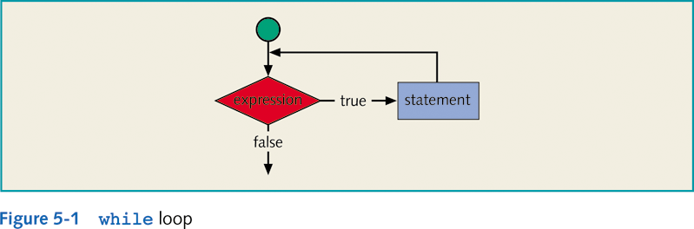
The while Statement – Syntax
SYNTAX 1
while (logical expression)
statement 1;
SYNTAX 2
while (logical expression)
{
statement 1;
statement 2;
---
statement n;
}

Slide 7
import java.util.Scanner;
public class WhileDemo
{
public static void main (String [] args)
{
int count, number;
System.out.println ("Enter a number");
Scanner keyboard = new Scanner (System.in);
number = keyboard.nextInt ();
count = 1;
while (count <= number)
{
System.out.print (count + ", ");
count++;
}
System.out.println ();
System.out.println ("Buckle my shoe.");
}
}
sample program, Listing 4.1

Slide 8
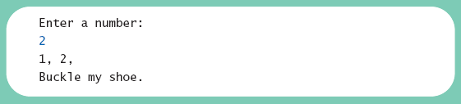
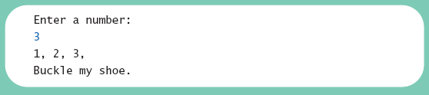
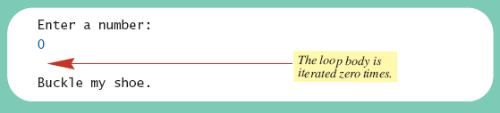
Sample run – class WhileDemo
count = 1;
while (count <= number)
{ System.out.print (count + ", ");
count++;
}
System.out.println ();
System.out.println ("Buckle my shoe.");
Sample
screen output

Slide 9
The while Statement – Tracing example
i = 0; //initialize
while (i <= 20) //condition
{
System.out.println(i + " ");
i = i + 5; //update
}
System.out.println();
i
0
Output
5
0
5
10
15
20
10
Can you trace this?
15
20
25

Slide 10
The do-while Statement – Syntax
SYNTAX 1
do
statement;
while (logical expression);
Don’t forget the semicolon ;
SYNTAX 2
do
{
statement 1;
statement 2;
---
statement n;
}
while (logical expression);
Also called a do-while loop
Similar to a while statement, except that the loop body is executed at least once

Slide 11
The do-while vs the while Statement
Initialize Variable(s)
Initialize Variable(s)
Do…
Update Variable
While(…)
Statement(s)
Logical Expression
True
Update Variable
Statement(s)
While(…)
False
Logical Expression
False
True
The main difference between while and do…while is that:
  while first tests the logical expression, then executes the statements accordingly
  do…while first executes the statements then tests the logical expression. If the condition is true, another iteration takes place.

Slide 12
import java.util.Scanner;
public class DoWhileDemo
{
public static void main (String [] args)
{
int count, number;
System.out.println ("Enter a number");
Scanner keyboard = new Scanner (System.in);
number = keyboard.nextInt ();
count = 1;
do
{
System.out.print (count + ", ");
count++;
} while (count <= number);
System.out.println ();
System.out.println ("Buckle my shoe.");
}
}
sample program, Listing 4.1

Slide 13
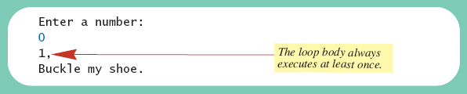
The do-while Statement
count = 1;
do
{ System.out.print (count + ", ");
count++;
} while (count <= number);
System.out.println ();
System.out.println ("Buckle my shoe.");
Sample
screen output

Slide 14
The do-while Statement – Example
Example 1 - do-while
Example 1 - while
1
2
3
4
5
6
7
8
int iteration = 0; //initialize the LCV
do
{
System.out.println (“Iteration = “ + iteration);
iteration = iteration + 5; //update the LCV
}
while (iteration <= 20); //test at the END of the loop
System.out.println (“After loop, iteration = “ + iteration);
int iteration = 0;
while (iteration <= 20)
{
System.out.println (…);
iteration = iteration + 5;
}
System.out.println(“After..”);
Output
Output
1
2
3
4
5
6
Iteration = 0
Iteration = 5
Iteration = 10
Iteration = 15
Iteration = 20
After the loop, iteration = 25
Iteration = 0
Iteration = 5
Iteration = 10
Iteration = 15
Iteration = 20
After the loop, iteration = 25

Slide 15
The do-while Statement – Example
Example 2 - do-while
Example 2 - while
1
2
3
4
5
6
7
8
int iteration = 0; //initialize the LCV
do
{
System.out.println (“Iteration = “ + iteration);
iteration = iteration + 5; //update the LCV
}
while (iteration <= -1); //test at the END of the loop
System.out.println (“After loop, iteration = “ + iteration);
int iteration = 0;
while (iteration <= -1)
{
System.out.println (…);
iteration = iteration + 5;
}
System.out.println(“After..”);
Output
Output
1
2
Iteration = 0
After the loop, iteration = 5
After the loop, iteration = 0
The statements in the loop body of a do-while are executed at least once.
Displaying a menu for the user and taking action according to the user’s input is better implemented using do-while. (see example at the end)

Slide 16
do-while for input validation
The do…while statement is convenient to use to validate the user input.
The following code segment forces the user to enter a number between 0 and 100.
1
2
3
4
5
6
int score;
do
{
System.out.println (“Enter the student’s score”);
score = read.nextInt();
} while ((score <0) || (score > 100));
The above loop ends only when the two conditions are false; i.e.,
  score is not less than zero ➔ when score >= 0
  and
  score is not greater than 100 ➔ when score <=100

Slide 17
Infinite Loops
A loop which repeats without ever ending is called an infinite loop.
If the controlling boolean expression never becomes false, a while loop or a do-while loop will repeat without ending.
Beware of that !!

Slide 18
import java.util.Scanner;
/**
Computes the average of a list of (nonnegative) exam scores.
Repeats computation for more exams until the user says to stop.
*/
public class ExamAverager
{
public static void main (String [] args)
{
System.out.println ("This program computes the average of");
System.out.println ("a list of (nonnegative) exam scores.");
double sum;
int numberOfStudents;
double next;
String answer;
Scanner keyboard = new Scanner (System.in);
sample program, listing 4.4

Slide 19
do
{ System.out.println ();
  System.out.println ("Enter all the scores to be averaged.");
  System.out.println ("Enter a negative number after");
  System.out.println ("you have entered all the scores.");
  sum = 0;
  numberOfStudents = 0;
  next = keyboard.nextDouble ();
  while (next >= 0)
  { sum = sum + next;
  numberOfStudents++;
  next = keyboard.nextDouble ();
  }
  if (numberOfStudents > 0)
  System.out.println("The average is “ + (sum/numberOfStudents));
  else
  System.out.println ("No scores to average.");
  System.out.println ("Want to average another exam?");
  System.out.println ("Enter yes or no.");
  answer = keyboard.next ();
  } while (answer.equalsIgnoreCase ("yes"));
  }}

Slide 20
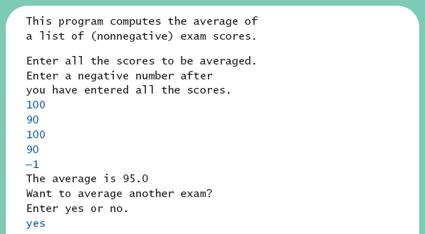
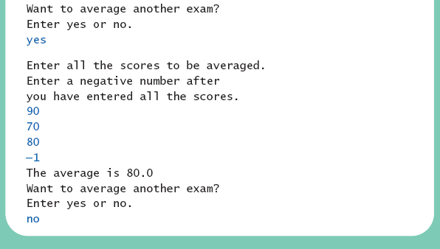
Nested Loops
class ExamAverager
Sample
screen output

Slide 21
Nested Loops
The body of a loop can contain any kind of statements, including another loop.
In the previous example
  The average score was computed using a while loop.
  This while loop was placed inside a do-while loop so the process could be repeated for other sets of exam scores.

Slide 22
do…while Programming Problem
Write a complete program that displays a menu to perform an arithmetic operation between two non-integer numbers. The user should select one of the following symbols: +, -, *, /, and %. The menu should contain an option to exit from the program.
INPUT
User’s selection (variable: selection, type: char)
Two numbers (variable: num1, num2, type: double)
OUTPUT
Result of the operation (variable: result, type: double)

Slide 23
1
2
3
4
5
6
7
8
9
10
11
12
13
14
15
16
17
18
19
20
21
22
23
// import necessary libraries
import java.util.*;
public class doWhile
{
static Scanner read = new Scanner (System.in);
public static void main (String[] args)
{
// Declaration section
double num1, num2, result;
char selection;
do
{
//Display Menu
System.out.println (“+: addition”);
System.out.println (“-: subtraction”);
System.out.println (“*: multiplication”);
System.out.println (“/: division”);
System.out.println (“%: modulus”);
System.out.println (“x: exit”);
//Get user’s selection
System.out.print (“Enter selection ”); //prompt
selection = read.next().charAt(0);
The menu is displayed at least once

Slide 24
22
23
24
25
26
27
28
29
30
31
32
33
34
35
36
37
38
39
40
41
42
43
44
45
if ((selection != ‘x’) && (selection !=‘X’))
{
System.out.println (“Enter two double numbers”);
num1 = read.nextDouble();
num2 = read.nextDouble();
switch (selection)
{
case ‘+’: result = num1 + num2; break;
case ‘-’: result = num1 – num2; break;
case ‘*’: result = num1 * num2; break;
case ‘/’: if (num2 != 0) result = num1 / num2;
else System.out.println (“Invalid divisor”);
break;
case ‘%’: if (num2 !=0) result = (num1) % (num2);
else System.out.println (“Invalid divisor”);
break;
default: System.out.println (“Invalid Input”);
} //end switch
System.out.printf (“Result = %.2f”, result);
} //end if
} while ((selection != ‘x’) && (selection != ‘X’));
System.out.println (“End of program”);
} // end main
} // end class
No need to proceed if the user wants to exit
The condition is tested at the end of the loop

