Slide 1
Variables, Types and Expressions
CSC215
Lecture

Slide 2
Outline
Variables
Data Types
Basic data types
Derived data types
Expressions
Operators: arithmetic, relational, logical, assignment, inc-/dec- rement, bitwise
Evaluation
Formatted input/output

Slide 3
Variables
Named values
Naming rules:
Made up of letters, digits and the underscore character ‘_’
Can not begin with a digit
Can not be a special keyword
Variable declaration:
Must declare variables before use
Variable declaration: int n; float phi;
int - integer data type
float - floating-point data type
Many other types
Variable initialization:
Do uninitialized variable assume a default value? To be discussed soon.
Variables initialized via assignment operator: n = 3;
Can also be initialized at declaration: float phi = 1.6180339887;
Can declare/initialize multiple variables at once: int a, b, c = 0, d = 4;
auto break case char const continue
default do double else enum extern
float for goto if int long
register return short signed sizeof static
struct switch typedef union unsigned void
volatile while

Slide 4
Data Types
Data type determines the variable’s domain and applicable operations
Basic data types
Four types:
char
int
float
double
What about boolean?
Derived data types
are aggregates of one or more types of basic data types
Most common:
Pointers
Arrays
Structures
and unions
What about strings?

Slide 5
Basic Data Types
Only four basic data types: char, int, float, double
Modifiers: signed unsigned short long
Combinations: Type Bits Range Char [signed] char 8 -128 .. 127 unsigned char 8 0 .. 255 int [signed] int 16 (at least) -2¹⁵ .. 2¹⁵-1 unsigned int 16 (at least) 0 .. 2¹⁶-1 [signed] short [int] 16 -2¹⁵ .. 2¹⁵-1 unsigned short [int] 16 0 .. 2¹⁶-1 [signed] long [int] 32 (at least) -2³¹ .. 2³¹-1 unsigned long [int] 32 (at least) 0 .. 2³²-1 float float 32 1.2E-38 .. 3.4E+38 (6 dig-prec) double double 64 2.3E-308 .. 1.7E+308 (15 dig-prec) long double 80 (at least) 3.4E-4932 .. 1.1E+4932 (19 dig-prec)
What about boolean? strings?

Slide 6
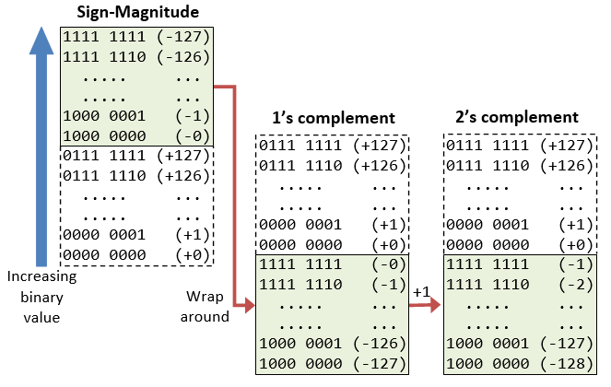
Basic Data Types
Representation
Integer
Floating Point
Examples: https://www.geeksforgeeks.org/ieee-standard-754-floating-point-numbers/

Slide 7
Boolean?
No special boolean type
Evaluating boolean and logical expressions:
results in integer 1 if the logic is true
results in 0 if the logic is false
Interpretation of integer as boolean:
0 is perceived as false
any non-zero value is perceived as true

Slide 8
Strings ?
Strings are stored as character array
Null-terminated (last character in array is ’\0’: null character) char course[7] = {'C', 'S', 'C', '2', '1', '5', '\0'}; char course[] = {'C', 'S', 'C', '2', '1', '5', '\0'};
Not written explicitly in string literals char course[7] = "CSC215"; char course[] = "CSC215";
Special characters specified using \ (escape character):
\\ – backslash
\' – apostrophe
\" – quotation mark
\b, \t, \r, \n – backspace, tab, carriage return, linefeed
\0oo, \xhh – octal and hexadecimal ASCII character codes, e.g. \x41 – 'A', \060 – '0'

Slide 9
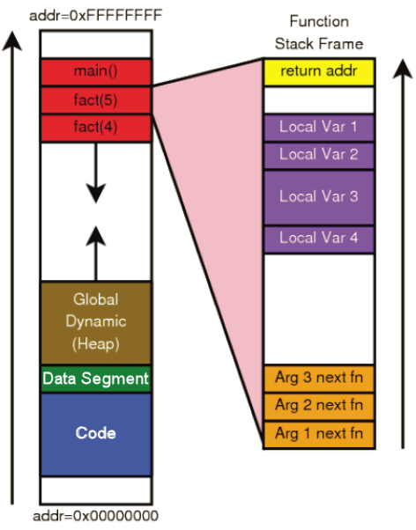
Memory Model and Initialization of Variables
Function parameters
stored in the stack frame of the function
initialized to the passed arguments
Local variables:
declared inside a function
stored in the stack frame of the function
are not initialized by default
Global variables:
declared outside of functions: on top of the program
stored in the data segment
if not explicitly initialized, are initialized by default:
Type | int | char | float | double | pointer | derived
Default | 0 | ‘\0’ | 0.0 | 0.0 | 0 (NULL) | recursive

Slide 10
Constants
The hello.c program examples can be rewritten as: int main(void) /∗ entry point ∗/ { const char msg [ ] = "Hello World!"; /∗ write message to console ∗/ puts(msg); }
const keyword: qualifies a variable as constant
char: data type representing a single character; written in quotes: ’a’, ’3’, ’n’
const char msg[]: a constant array of characters

Slide 11
Expressions
Expression:
a sequence of characters and symbols that can be evaluated to a single data item.
consists of: literals, variables, subexpressions, interconnected by one or more operators
Operator:
Can be unary, binary, and ternary
Categories:
Arithmetic: +x, -x, x+y, x-y, x*y, x/y, x%y
Relational x==y, x!=y, x<y, x<=y, x>y, x>=y
Logical x&&y, x||y, !x
Bitwise x&y, x|y, x^y, x<<y, x>>y, ~x
Assignment x=y, x+=y, x-=y, x*=y, x/=y, x%=y x<<=y, x>>=y, x&=y, x|=y, x^=y
inc-/dec- rement ++x, x++, --x, x--
Conditional x?y:z
More: *x, &x, (type)x, sizeof(x), sizeof(<type>)

Slide 12
Arithmetic Operators
2 Unary operators: + -
5 Binary operators: + - * / %
If both operands are of type int, the result is of type int
Example: int main() { int a = 9, b = 4, c; c = a+b; printf("a+b = %d \n",c); c = a-b; printf("a-b = %d \n",c); c = a*b; printf("a*b = %d \n",c); c=a/b; printf("a/b = %d \n",c); c=a%b; printf("Remainder when a divided by b = %d \n",c); return 0; }

Slide 13
Relational Operators
6 Binary operators: == != > >= < <=
Checks the relationship between two operands:
if the relation is true, it yieldss 1
if the relation is false, it yields value 0
Example:
int main(){ int a = 5, b = 5, c = 10; printf("%d == %d = %d \n", a, b, a == b); /* true */ printf("%d == %d = %d \n", a, c, a == c); /* false */ printf("%d > %d = %d \n", a, b, a > b); /*false */ printf("%d > %d = %d \n", a, c, a > c); /*false */ printf("%d < %d = %d \n", a, b, a < b); /*false */ printf("%d < %d = %d \n", a, c, a < c); /*true */ printf("%d != %d = %d \n", a, b, a != b); /*false */ printf("%d != %d = %d \n", a, c, a != c); /*true */ printf("%d >= %d = %d \n", a, b, a >= b); /*true */ printf("%d >= %d = %d \n", a, c, a >= c); /*false */ printf("%d <= %d = %d \n", a, b, a <= b); /*true */ printf("%d <= %d = %d \n", a, c, a <= c); /*true */ return 0; }

Slide 14
Logical Operators
1 Unary operator: ! and 2 binary operators: && ||
Example: int main(){ int a = 5, b = 5, c = 10, result; result = (a = b) && (c > b); printf("(a = b) && (c > b) equals to %d \n", result); result = (a = b) && (c < b); printf("(a = b) && (c < b) equals to %d \n", result); result = (a = b) || (c < b); printf("(a = b) || (c < b) equals to %d \n", result); result = (a != b) || (c < b); printf("(a != b) || (c < b) equals to %d \n", result); result = !(a != b); printf("!(a == b) equals to %d \n", result); result = !(a == b); printf("!(a == b) equals to %d \n", result); return 0; }

Slide 15
Bitwise Operators
1 Unary operator ~ and 5 binary operators & | ^ << >>
Examples: int main(){ int a = 12; int b = 25; printf("complement=%d\n",~35); printf("complement=%d\n",~-12); printf("Output = %d", a&b); printf("Output = %d", a^b); printf("Output = %d", a|b); int num=212; printf("Right shift by 3: %d\n", num>>3); printf("Left shift by 5: %d\n", num<<5); return 0; }
35 00000000 00100011 ~ -36 11111111 11011100
-12 11111111 11110100 ~ 11 00000000 00001011
12 00000000 00001100 25 00000000 00011001 ----------------- & 8 00000000 00001000
12 00000000 00001100 25 00000000 00011001 ----------------- | 29 00000000 00011101
12 00000000 00001100 25 00000000 00011001 ----------------- ^ 21 00000000 00010101
212 00000000 11010100 26 00000000 00011010 ↠
212 00000000 11010100 6784 00011010 10000000 ↞

Slide 16
Assignment Operators
11 Binary operators: = += -= *= /= %= &= |= ^= <<= >>=
Example: int main(){ int a = 5, c; c = a; printf("c = %d \n", c); c += a; /* c = c+a */ printf("c = %d \n", c); c -= a; /* c = c-a */ printf("c = %d \n", c); c *= a; /* c = c*a */ printf("c = %d \n", c); c /= a; /* c = c/a */ printf("c = %d \n", c); c %= a; /* c = c%a */ printf("c = %d \n", c); return 0; }

Slide 17
Increment/Decrement operators
2 Unary operators: ++ --
If used as a standalone statement: postfix x++ and prefix ++x have the same effect
If used as part of an expression:
Prefix ++x/--x: the expression will use the value of x after the increment/decrement
Postfix x++/x--: the expression will use the value of x before the increment/decrement
Example: int main(){ int a = 10, b = 100; float c = 10.5, d = 100.5; printf("++a = %d \n", ++a); /* 11 */ printf("b++ = %d \n", b++); /* 100 */ printf("c-- = %f \n", c--); /* 10,500000 */ printf("--d = %f \n", --d); /* 99.500000 */ return 0; }

Slide 18
Ternary Conditional Operator
Syntax: <conditionalExpression> ? <expression1> : <expression2>
The conditional operator works as follows:
<conditionalExpression> is evaluated first to non-zero (1) or false (0).
if <conditionalExpression> is true, <expression1> is evaluated
if <conditionalExpression> is false, <expression2> is evaluated.
Example: int main(){ char February; int days; printf("If this year is leap year, enter 1. If not enter any other integer: "); scanf("%c",&February); /* If test condition (February == 'l') is true, days equal to 29. */ /* If test condition (February =='l') is false, days equal to 28. */ days = (February == '1') ? 29 : 28; printf("Number of days in February = %d",days); return 0; }

Slide 19
More Operators
sizeof: unary operator returns the size needed to store data
(constant, variable, array, structure...)
returns a value of type size_t which is unsigned int in bytes
Example: int main(){ int a, e[10]; float b; double c; char d; printf("Size of int=%lu bytes\n",sizeof(a)); printf("Size of float=%lu bytes\n",sizeof(b)); printf("Size of double=%lu bytes\n",sizeof(c)); printf("Size of char=%lu byte\n",sizeof(d)); printf("Size of integer type array having 10 elements = %lu bytes\n", sizeof(e)); return 0; }

Slide 20
Evaluating Expressions
Expression: A sequence of characters and symbols that can be evaluated to a single data item.
Expression evaluation:
Order of operations: Use parentheses to override order of evaluation
Example: Assume x = 2.0 and y = 6.0. Evaluate the statement: float z = x+3∗x/(y−4); 1. Evaluate expression in parentheses → float z = x+3∗x/2.0; 2. Evaluate multiplies and divides, from left-to-right → float z = x+6.0/2.0; → float z = x+3.0; 3. Evaluate addition float: → float z = 5.0; 4. Perform initialization with assignment Now, z = 5.0.
How do I insert parentheses to get z = 4.0?
Operators by precedence Associativity
<function>(), [ ], ->, . left to right
!, ~, ++, --, +, -, *, (<type>), sizeof right to left
*, /, % left to right
+, - (binary) left to right
<<, >> left to right
<, <=, >, >= left to right
==, != left to right
& left to right
^ left to right
| left to right
&& left to right
|| left to right
? : left to right
= += -= *= /= %= &= ^= |= <<= >>= right to left
, lrft to right

Slide 21
Evaluating Expressions
Considerations:
When dealing with floating point values, remember that computer’s precision is finite
Ex. float a = 1.0/3; float b = 2.0/6; b==a is not guaranteed to be 1
Instead of comparing two FP values using ==, check if the difference is less than some threshold
Ex. float epsilon = 1e-10; check a-b < epsilon && a-b > -epsilon
The C standard does not define the result of division by zero
int x = 0 , y = 1/x; float xx = 0 , yy = 1/x; This code may or may not cause the program to crash or to yield a nonsense
There are 3 special floating point values: nan , inf , -inf
Integer Overflow/Underflow: result from a shortage of space
Overflow/Underflow not raise any errors: program continues to execute
Incorrect values (logical errors)
To avoid: check first !
int x = 0x7fffffff;
printf("%d", ++x);
-2147483648
int x = 0x80000000;
printf("%d", --x);
2147483647

Slide 22
Formatted Input and Output
Function printf printf(control_string, arg1, arg2, …);
control_string is the control string or conversion specification consists of % followed by a specifier %[flags][length][.precision|width]specifier
Specifiers (place holders):
%d - int (same as %i)
%ld - long int (same as %li)
%f - decimal floating point
%lf - double or long double
%e - scientific notation (similar to %E)
%c - char
%s - string
%o - signed octal
%x - hexadecimal (similar to %X)
%p - pointer
%%- %
Optional width, length precision and flags
Flags : - + # 0
Width : * number
Length : h l L Precision : .* .number

Slide 23
Formatted Input and Output
Numeric: %[[<FLAG>][<LENGTH>][.<PRECISION>]]<SPECIFIER>
String: %[<FLAG>][<LENGTH>][.<WIDTH>]<SPECIFIER>
%d int (same as %i)
%ld long int (same as %li)
%f decimal floating point
%lf double or long double
%e scientific notation (similar to %E)
%g shorter of f and e
%c char
%o signed octal
%x hexadecimal (similar to %X)
<Number> Decimal digits
* Passing it as an arg
Default: 6
- Left align
+ Prefix sign to the number
# Prefix 0 to octal, 0x/0X to hexadecimal Force decimal point with e E f G g
0 Pad with leading zeros
Replace positive sign with space
<Number> Minimum length
* Passing it as an arg
Default: All
- Left align
%s string
<Number> Minimum length
* Passing it as an arg
Default: All
<Number> Max number of characters to print
* Passing it as an arg
Default: 0 with ., all if . is omitted

Slide 24
Formatted Input and Output
Function scanf scanf(control_string, arg1, arg2, …);
Control_string governs the conversion, formatting, and printing of the arguments
Each of the arguments must be a pointer to the variable in which the result is stored
So: scanf(“%d”, &var); is a correct one, while scanf(“%d”, var); is not correct
Place holders:
%d - int (same as %i)
%ld - long int (same as %li)
%f - float
%lf - double
%c - char
%s - string
%x - hexadecimal

Slide 25
Macros
Preprocessor macros begin with # character
#define msg "Hello World" defines msg as “Hello World” throughout source file
#define can take arguments and be treated like a function #define add3(x,y,z) ((x)+(y)+(z))
parentheses ensure order of operations
compiler performs inline replacement; not suitable for recursion
#if, #ifdef, #ifndef, #else, #elif , #endif conditional preprocessor macros
can control which lines are compiled
evaluated before code itself is compiled, so conditions must be preprocessor defines or literals
the gcc option -Dname=value sets a preprocessor define that can be used
Used in header files to ensure declarations happen only once
Conditional preprocessor macros:
#pragma preprocessor directive
#error, #warning trigger a custom compiler error/warning
#undef msg remove the definition of msg at compile time

